Slide 1
2-1 Integrated Circuits
Integrated Circuits(IC)
  Digital circuits are constructed with Integrated Circuits
  An Integrated Circuits is a small silicon semiconductor crystal, called chip
  The various gates are interconnected inside the chip to form the required circuit
  The chip is mounted in a ceramic or plastic container, and connections are welded by thin gold wires to external pins to form the integrated circuits
  The number of pins may range from 14 in a small IC package to 100 or more in a larger package
  Each IC has a numeric designation printed on the surface of the package for identification
Logic Family
  MOSFET
  BJT
MOS Family(N or P Channel) : High Component Density
CMOS Family(N or P Channel) : Low Power
TTL Family
ECL Family

Slide 2
  TTL Family
    54 Series : -55 ° C ∼ 125 °C, Military
    74 Series : 0 ° C ∼ 70 ° C, Commercial
      54/74 : Standard
      54L/74L : Low-power
      54S/74S : Schottky
      54LS/74LS : Low-power, Schottky
      54H/74H : High-speed
  CMOS Family
    4000 Series(RCA), MC14500(Motorola), 5000(Toshiba), 54C/74C Series, 54HC/74HC Series
i
Pt
Si
0.2 0.4 0.6
V
Schottky Diode
Schottky Transistor
Forward Bias

Slide 3

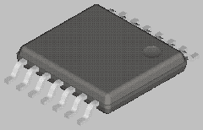
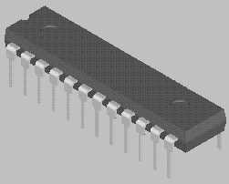
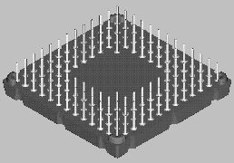
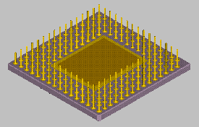
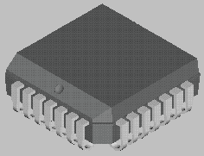
Package Types
Small Outline Transistor (SOT)
Small Outline Package (SOP)
Dual-In-Line Package (DIP)
Plastic/Ceramic Pin Grid Array (PPGA/CPGA)
Plastic Leaded Chip Carrier (PLCC)

Slide 4
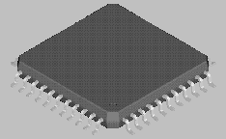
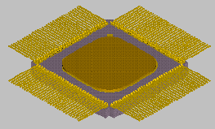
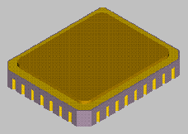
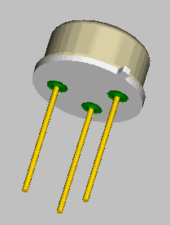
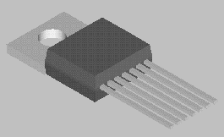
Plastic Quad Flat Package (PQFP)
Ceramic Leadless Chip Carrier (LCC)
TO Packages (Transistor single Outline)

Slide 5
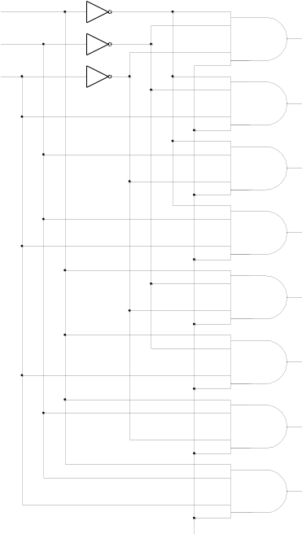
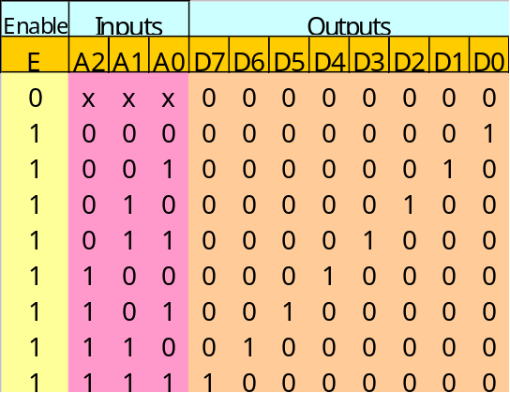
2-2 Decoder/Encoder
Decoder
  A combinational circuit that converts binary information from the n coded inputs to a maximum of 2^{n} unique outputs
  n-to-m line decoder = n x m decoder
    n inputs, m outputs
  If the n-bit coded information has unused bit combinations, the decoder may have less than 2^{n} outputs
    m ≤ 2^{n}
3-to-8 Decoder
  Logic Diagram : Fig. 2-1
  Truth Table : Tab. 2-1
  Commercial decoders
  include one or more
  Enable Input(E)
Fig. 2-1 3-to-8 Decoder
A2
A1
A0
D0
D1
D2
D3
D4
D5
D6
D7
Tab. 2-1 Truth table for 3-to-8 Decoder
Enable(E)

Slide 6
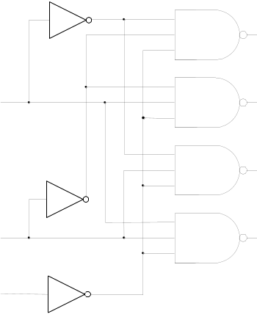
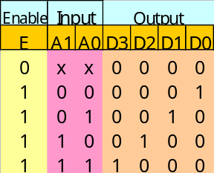
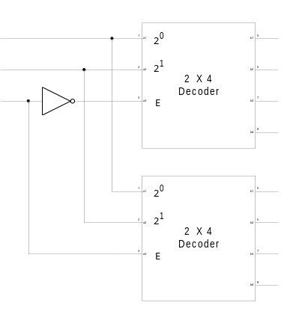
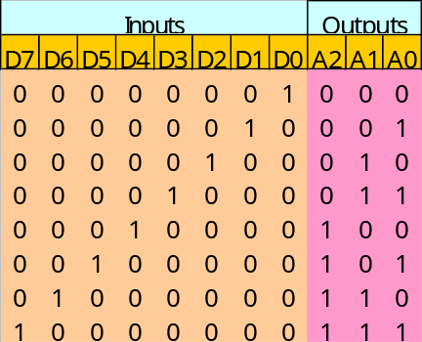
* Active Low Output
* Fig. 2-1 3-to-8 Decoder 는 Active High Output
NAND Gate Decoder
  Constructed with NAND instead of AND gates
  Logic Diagram/Truth Table : Fig. 2-2
Decoder Expansion
  3 X 8 Decoder constructed with two 2 X 4 Decoder
  Constructed decoder : Fig. 2-3
Encoder
  Inverse Operation of a decoder
  2^{n} input, n output
  Truth Table : Tab. 2-2
    3 OR Gates Implementation
      A0 = D1 + D3 + D5 + D7
      A1 = D2 + D3 + D6 + D7
      A2 = D4 + D5 + D6 + D7
D0
D1
D2
D3
A0
A1
Fig. 2-2 2-to-4 Decoder with NAND gates
(a) Truth Table
Enable(E)
(b) Logic Diagram
A2
A1
A0
Tab. 2-2 Truth Table for
Encoder
D0
D1
D2
D3
D4
D5
D6
D7
Fig. 2-3 A 3-to-8 Decoder
constructed with two
with 2-to-4 Decoder

Slide 7
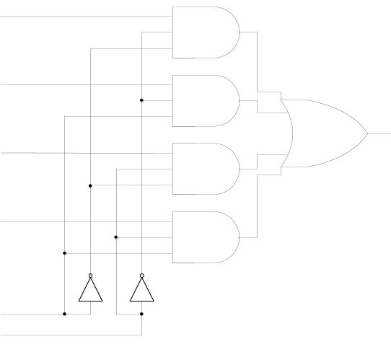
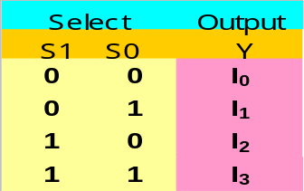
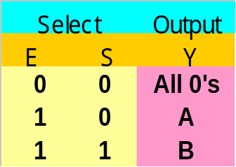
2-3 Multiplexers
Multiplexer(Mux)
  A combinational circuit that receives binary information from one of 2^{n} input data lines and directs it to a single output line
  A 2^{n} -to 1 multiplexer has 2^{n} input data lines and
  n input selection lines(Data Selector)
  4-to-1 multiplexer Diagram : Fig. 2-4
  4-to-1 multiplexer Function Table : Tab. 2-3
Quadruple 2-to-1 Multiplexer
  Quadruple 2-to-1 Multiplexer : Fig. 2-5
I₀
I₁
I₂
I₃
Y
Tab. 2-3 Function Table for
4-to-1 line Multiplexter
S0
S1
Fig. 2-4 4-to-1 Line Multiplexer
Enable
Select
A₀
A₁
A₂
A₃
Quadruple
2 x 1
Mux
Y₀
Y₁
Y₂
Y₃
Fig. 2-5 Quadruple 2-to-1
line Multiplexter
B₀
B₁
B₂
B₃
(a) Function Table
(b) Block Diagram

Slide 8
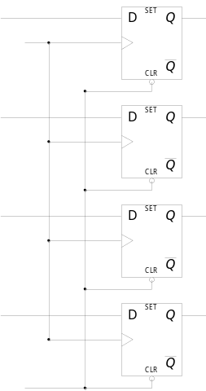
2-4 Registers
Register
  A group of flip-flops with each flip-flop capable of storing one bit of information
  An n-bit register has a group of n flip-flops and is capable of storing any binary information of n bits
  The simplest register consists only of flip-flops, with no external gate : Fig. 2-6
  A clock input C will load all four inputs in parallel
    The clock must be inhibited if the content of the register must be left unchanged
Register with Parallel Load
  A 4-bit register with a load control input : Fig. 2-7
  The clock inputs receive clock pulses at all times
  The buffer gate in the clock input will increase “fan-out”
  Load Input
    1 : Four input transfer
    0 : Input inhibited, Feedback from output to input(no change)
I₀
I₁
I₂
I₃
A₀
A₁
A₂
A₃
Clock
Clear
Fig. 2-6 4-bit register

Slide 9
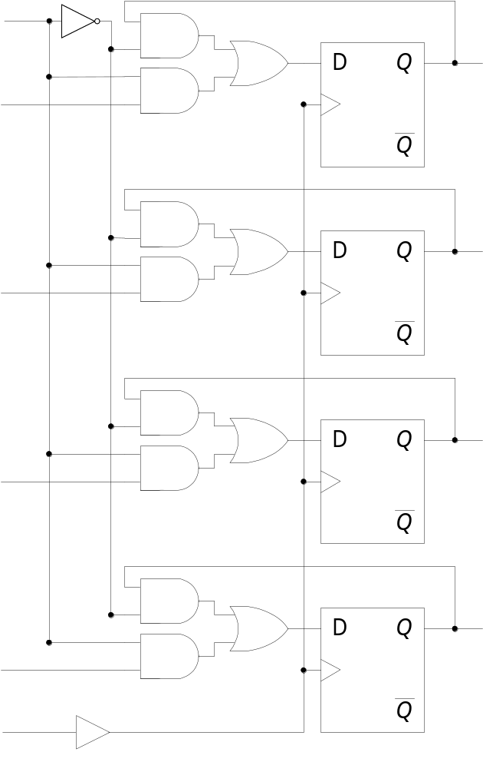
2-5 Shift Registers
Shift Register
  A register capable of shifting its binary information in one or both directions
  The logical configuration of a shift register consists of a chain of flip-flops in cascade
  The simplest possible shift register uses only flip-flops : Fig. 2-8
  The serial input determines what goes into the leftmost position during the shift
  The serial output is taken from the output of the rightmost flip-flop
Fig. 2-8 4-bit shift register
Fig. 2-7 4-bit register with parallel load

Slide 10
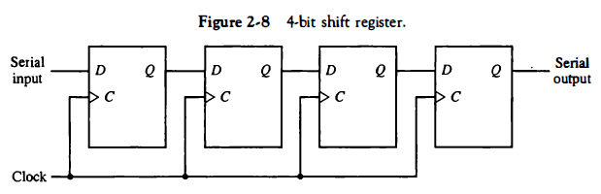

Slide 11
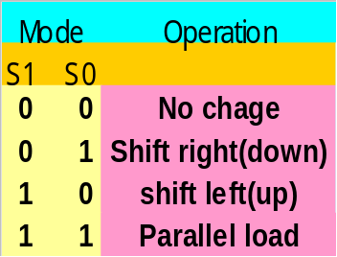
Bidirectional Shift Register with Parallel Load
  A register capable of shifting in one direction only is called a unidirectional shift register
  A register that can shift in both directions is called a bidirectional shift register
  The most general shift register has all the capabilities listed below:
    An input clock pulse to synchronize all operations
    A shift-right /left (serial output/input)
    A parallel load, n parallel output lines
    The register unchanged even though clock pulses are applied continuously
  4-bit bidirectional shift register with parallel load : Fig. 2-9
    4 X 1 Mux = 4 , D F/F = 4
Tab. 2-4 Function Table for Register
of Fig. 2-9
Fig. 2-9 Bidirectional shift register

Slide 12
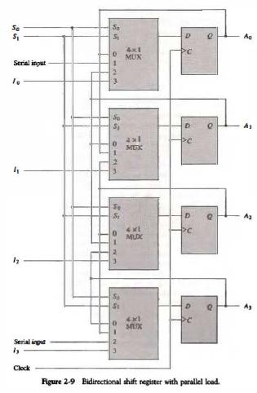

Slide 13

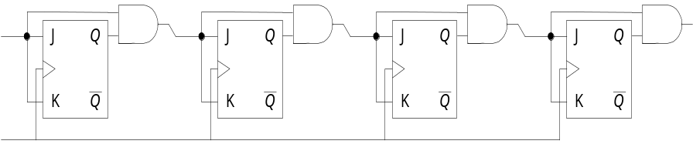
2-6 Binary Counter
Counter
  A register goes through a predetermined sequence of state(Upon the application of input pulses)
  Used for counting the number of occurrences of an event and useful for generating timing signals to control the sequence of operations in digital computers
  An n-bit binary counter is a register of n flip-flop(count from 0 to 2^{n} -1)
4 bit Synchronous Binary Counter
  A counter circuit will usually employ F/F with complementing capabilities(T and J-K F/F)
  4 bit Synchronous Binary Counter :
  Fig. 2-10
Count
Enable
Carry = Q3• Q2’
Q0 Q0’ Q1 Q1’ Q2 Q2’ Q3
Clock
Fig. 2-10 4-bit Synchronous binary counter

Slide 14
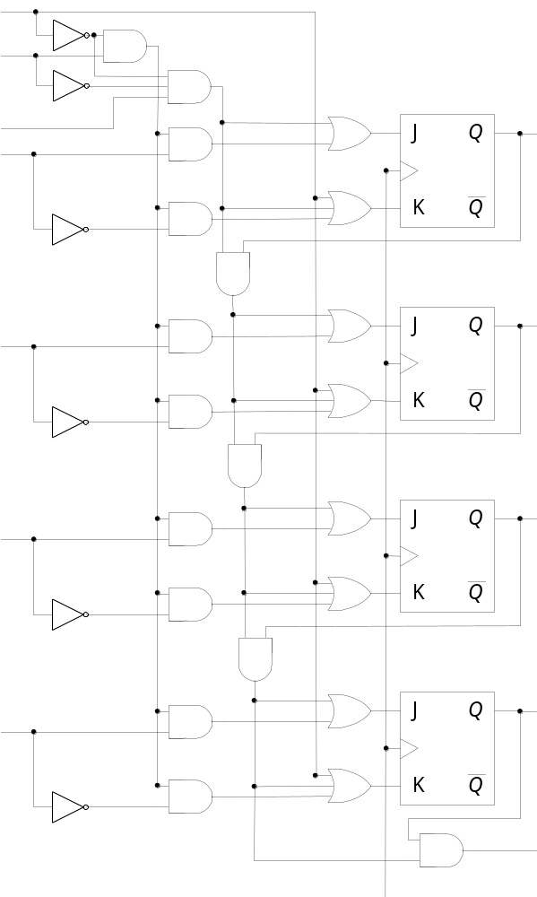
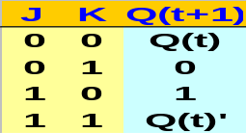
Binary Counter with Parallel Load
  Counters employed in digital systems(CPU Register) require a parallel load capability for transferring an initial binary number prior to the count operation
  4-bit binary counter with Clear, Parallel Load, and Increment(Counter) :
  Fig. 2-11
  Function Table : Tab. 2-5
    Clear : 1 K=X, J=0 Clear(Q=0)
    (Clear, Load=X)
    Load : 1 I=1 J=1, K=0
    (Clear=0) I=0 J=0, K=1
    Increment : 1 J=K=1(Toggle)
    (Clear, Load=0)
Fig. 2-11 4-bit binary counter with parallel load

Slide 15
2-7 Memory Unit
Memory Unit
  A collection of storage cells together with associated circuits needed to transfer information in and out of storage
  The memory stores binary information in groups of bits called words
  Word
    A group of binary information that is processed in one simultaneous operation
  Byte
    A group of eight bits (nibble : four bits)
  The number of address line = k
    Address(Identification number) : 0, 1, 2, 3, … up to 2^{k} -1
    The selection of specific word inside memory : k bit binary address
    1 Kilo= 2¹⁰, 1 Mega= 2²⁰, 1 Giga= 2³⁰
    16 bit address line : 2¹⁶= 64 K
  Solid State Memory(IC Memory)
    RAM(Volatile Memory)
    ROM(Non-volatile Memory)
Dec Hex
0 0000
1 0001
2 0010
3 0011
. .
. .
. .
65535 FFFF
Memory
Word

Slide 16
Random Access Memory
  The memory cells can be accessed for information transfer from any desired random location
  Communication between a memory and its environment is achieved through data input and output lines, address selection lines, and control lines : Fig. 2-12
  The two operations that a random-access memory can perform are the write and read operations
  Memory Write
    1) Apply the binary address
    2) Apply the data bits
    3) Activate the write input
  Memory Read
    1) Apply the binary address
    2) Activate the read input
      The content of the selected word does not change after reading
  NV-RAM : battery back-up CMOS RAM
data input lines n
Memory Unit
2^{k} words
n bits per word
address lines k
Read
Write
data output lines n
Fig. 2-12 Block diagram of RAM

Slide 17
Read-Only Memory
  A memory unit that performs the read operation only; it does not have a write capability
  ROM comes with special internal electronic fuses that can be “programmed” for a specific configuration
  m x n ROM : Fig. 2-13
    k address input lines to select one of 2^{k} = m words of memory, and n output lines(n bits word)
  ROM is classified as a combinational circuit, because the outputs are a function of only the present inputs(address lines)
    There is no need for providing storage capabilities as in a RAM
  ROM is also employed in the design of control units for digital computers
    A Control Unit that utilizes a ROM to store binary control information is called a micro-programmed control
  Types of ROMs
    UVEPROM(Chip level erase), EEPROM(Byte level erase), Flash ROM(Page or block level erase), OTPROM, Mask ROM
address input lines k
m x n ROM
(m = 2^{k})
data input lines n

