Slide 1
Chap. 3 Data Representation
3-1 Data Types
  Binary information is stored in memory or processor registers
  Registers contain either data or control information
    Data are numbers and other binary-coded information
    Control information is a bit or a group of bits used to specify the sequence of command signals
  Data types found in the registers of digital computers
    Numbers used in arithmetic computations
    Letters of the alphabet used in data processing
    Other discrete symbols used for specific purpose
      Number, Letter, gray code, error detection code, …
  Number Systems
    Base or Radix r system : uses distinct symbols for r digits
    Most common number system :Decimal, Binary, Octal, Hexadecimal
    Positional-value(weight) System : r² r ¹r⁰.r⁻¹ r⁻² r⁻³
      Multiply each digit by an integer power of r and then form he sum of all weighted digits

Slide 2
  Decimal System/Base-10 System
    Composed of 10 symbols or numerals(0, 1, 2, 3, 4, 5, 6, 7, 8, 9)
  Binary System/Base-2 System
    Composed of 10 symbols or numerals(0, 1)
    Bit = Binary digit
  Hexadecimal System/Base-16 System : Tab. 3-2
    Composed of 16 symbols or numerals(0, 1, 2, 3, 4, 5, 6, 7, 8, 9, A, B, C, D, E, F)
  Binary-to-Decimal Conversions
1011.101₂ = (1 x 2³) + (0 x 2²)+ (1 x 2¹) + (1 x 2º) + (1 x 2⁻¹) + (0 x 2⁻²) + (1 x 2⁻³)
= 8₁₀+ 0 + 2₁₀ + 1₁₀ + 0.5₁₀ + 0 + 0.125₁₀
= 11.625₁₀
  Decimal-to-Binary Conversions
    Repeated division(See p. 69, Fig. 3-1)
    37 / 2 = 18 remainder 1 (binary number will end with 1) : LSB
18 / 2 = 9 remainder 0
9 / 2 = 4 remainder 1
4 / 2 = 2 remainder 0
2 / 2 = 1 remainder 0
1 / 2 = 0 remainder 1 (binary number will start with 1) : MSB
  Read the result upward to give an answer of 37₁₀ = 100101₂
    0.375 x 2 = 0.750 integer 0 MSB
    0.750 x 2 = 1.500 integer 1 .
    0.500 x 2 = 1.000 integer 1 LSB
  Read the result downward .375₁₀ = .011₂

Slide 3
  Hex-to-Decimal Conversion
2AF₁₆ = (2 x 16²) + (10 x 16¹) + (15 x 16º)
= 512₁₀ + 160₁₀ + 15₁₀
= 687₁₀
  Decimal-to-Hex Conversion
423₁₀ / 16 = 26 remainder 7 (Hex number will end with 7) : LSB
26₁₀ / 16 = 1 remainder 10
1₁₀ / 16 = 0 remainder 1 (Hex number will start with 1) : MSB
  Read the result upward to give an answer of 423₁₀ = 1A7₁₆
  Hex-to-Binary Conversion
9F2₁₆ = 9 F 2
= 1001 1111 0010
= 100111110010₂
Table 3-2
Hex Binary Decimal
0 0000 0
1 0001 1
2 0010 2
3 0011 3
4 0100 4
5 0101 5
6 0110 6
7 0111 7
8 1000 8
9 1001 9
A 1010 10
B 1011 11
C 1100 12
D 1101 13
E 1110 14
F 1111 15
  Binary-to-Hex Conversion
1 1 1 0 1 0 0 1 1 0₂ = 0 0 1 1 1 0 1 0 0 1 1 0
3 A 6
= 3A6₁₆

Slide 4
  Binary-Coded-Decimal Code
    Each digit of a decimal number is represented by its binary equivalent
8 7 4 (Decimal)
1000 0111 0100 (BCD)
    Only the four bit binary numbers from 0000 through 1001 are used
    Comparison of BCD and Binary
137₁₀ = 10001001₂ (Binary) - require only 8 bits
137₁₀ = 0001 0011 0111_{BCD} (BCD) - require 12 bits
  Alphanumeric Representation
    Alphanumeric character set(Tab. 3-4)
      10 decimal digits, 26 letters, special character($, +, =,….)
      A complete list of ASCII : p. 386, Tab. 11-1
    ASCII(American Standard Code for Information Interchange)
      Standard alphanumeric binary code uses seven bits to code 128 characters

Slide 5
3-2 Complements
  Complements are used in digital computers for simplifying the subtraction operation and for logical manipulation
  There are two types of complements for base r system
    1) r’s complement 2) (r-1)’s complement
      Binary number : 2’s or 1’s complement
      Decimal number : 10’s or 9’s complement
  (r-1)’s Complement
    (r-1)’s Complement of N = (r^{n}-1)-N
      9’s complement of N=546700
      (10⁶-1)-546700= (1000000-1)-546700= 999999-546700
      = 453299
      1’s complement of N=101101
      (2⁶-1)-101101= (1000000-1)-101101= 111111-101101
      = 010010
  r’s Complement
    r’s Complement of N = r^{n}-N
      10’s complement of 2389= 7610+1= 7611
      2’s complement of 1101100= 0010011+1= 0010100
N : given number
r : base
n : digit number
546700(N) + 453299(9’s com)
=999999
101101(N) + 010010(1’s com)
=111111
* r’s Complement
(r-1)’s Complement +1 =(r^{n}-1)-N+1= r^{n}-N

Slide 6
  Subtraction of Unsigned Numbers
    1) M + (r^{n}-N)
    2) M ≥ N : Discard end carry, Result = M-N
    3) M < N : No end carry, Result = - r’s complement of (N-M)
      Decimal Example)
      72532(M) - 13250(N) = 59282
      72532
      + 86750 (10’s complement of 13250)
      1 59282
      Result = 59282
      Binary Example)
      1010100(X) - 1000011(Y) = 0010001
      1010100
      + 0111101 (2’s complement of 1000011)
      1 0010001
      Result = 0010001
(M-N), N≠0
M ≥ N
      13250(M) - 72532(N) = -59282
      13250
      + 27468 (10’s complement of 72532)
      0 40718
      Result = -(10’s complement of 40718)
      = -(59281+1) = -59282
M < N
Discard End Carry
No End Carry
X ≥ Y
      1000011(X) - 1010100(Y) = -0010001
      1000011
      + 0101100 (2’s complement of 1010100)
      0 1101111
      Result = -(2’s complement of 1101111)
      = -(0010000+1) = -0010001
X < Y

Slide 7
*Numeric Data
1) Fixed Point
2) Floating Point
3-3 Fixed-Point Representation
  Computers must represent everything with 1’s and 0’s, including the sign of a number and fixed/floating point number
  Binary/Decimal Point
    The position of the binary/decimal point is needed to represent fractions, integers, or mixed integer-fraction number
  Two ways of specifying the position of the binary point in a register
    1) Fixed Point : the binary point is always fixed in one position
      A binary point in the extreme left of the register(Fraction : 0.xxxxx)
      A binary point in the extreme right of the register(Integer : xxxxx.0)
        The binary point is not actually present, but the number stored in the register is treated as a fraction or as an integer
    2) Floating Point : the second register is used to designate the position of the
    binary point in the first register(refer to 3-4)
  Integer Representation
    Signed-magnitude representation
    Signed-1’s complement representation
    Signed-2’s complement representation
* 32.25
1) 0.25, 2) 32.0, 3) 32.25
* MSB for Sign
“0” is plus +
“1” is minus -
+14 -14
0 0001110 1 0001110
0 0001110 1 1110001
0 0001110 1 1110010
Most Common

Slide 8
  Arithmetic Addition
    Addition Rules of Ordinary Arithmetic
      The signs are same : sign= common sign, result= add
      The signs are different : sign= larger sign, result= larger-smaller
    Addition Rules of the signed 2’s complement
      Add the two numbers including their sign bits
      Discard any carry out of the sign bit position
  Arithmetic Subtraction
    Subtraction is changed to an Addition
      (± A) - (+ B) = (± A) + (- B)
      (± A) - ( - B) = (± A) + (+ B)
  Overflow
    Two numbers of n digits each are added and the sum occupies n+1 digits
    n + 1 bit cannot be accommodated in a register with a standard length of n bits(many computer detect the occurrence of an overflow, and a corresponding F/F is set)
(-12) + (-13) = -25
(+12) + (+13) = +25
(+25) + (-37)
= 37 - 25 = -12
*Addition Exam)
+ 6 00000110 - 6 11111010
+ 13 00001101 + 13 00001101
+ 19 00010011 + 7 00000111
+ 6 00000110 - 6 11111010
- 13 11110011 - 13 11110011
- 7 11111001 - 19 11101101
* Subtraction Exam) (- 6) - ( - 13) = +7
11111010 - 11110011 = 11111010 + 2’s comp of 11110011
= 11111010 + 00001101
= 1 00000111 = +7
Discard End Carry

Slide 9
  Overflow
    An overflow may occur if the two numbers added are both positive or both negative
      When two unsigned numbers are added
        an overflow is detected from the end carry out of the MSB position
      When two signed numbers are added
        the MSB always represents the sign
        - the sign bit is treated as part of the number
        - the end carry does not indicate an overflow
* Overflow Exam)
out in out in
carries 0 1 carries 1 0
+ 70 0 1000110 - 70 1 0111010
+ 80 0 1010000 - 80 1 0110000
+ 150 1 0010110 - 150 0 1101010
  Overflow Detection
    Detected by observing the carry into the sign bit position and the carry out of the sign bit position
    If these two carries are not equal, an overflow
    condition is produced(Exclusive-OR gate = 1)
  Decimal Fixed-Point Representation
    A 4 bit decimal code requires four F/Fs
    for each decimal digit
    The representation of 4385 in BCD requires 16 F/Fs (0100 0011 1000 0101)
    The representation in decimal is wasting a considerable amount of storage space and the circuits required to perform decimal arithmetic are more complex
*Decimal Exam) (+375) + (-240)
375 + (10’s comp of 240)= 375 + 760
0 375 (0000 0011 0111 0101)
+9 760 (1001 0111 0110 0000)
0 135 (0000 0001 0011 0101)
* Advantage *
Computer I/O data are generated by people who use the decimal system

Slide 10
3-4 Floating-Point Representation
  The floating-point representation of a number has two parts
    1) Mantissa : signed, fixed-point number
    2) Exponent : position of binary(decimal) point
  Scientific notation : m x r^{e} (+0.6132789 x 10⁺⁴)
    m : mantissa, r : radix, e : exponent
  Example : m x 2e = +(.1001110)₂ x 2⁺⁴
  Normalization
    Most significant digit of mantissa is nonzero
3-5 Other Binary Codes
  Gray Code
    Gray code changes by only one bit (Tab. 3-5 4-bit Gray Code )
    Application :
      The data must be converted into digital form before they can be used by a digital computer(Analog to Digital Converter)
      The analog data are represented by the continuous change of a shaft position(Rotary Encoder of Motor)
* Decimal + 6132.789
Fraction Exponent
+0.6132789 +4
Fraction Exponent
01001110 000100

Slide 11
  Other Decimal Codes
    Binary codes for decimal digits require four bits. A few possibilities are shown in Tab. 3-6
    Excess-3 Gray Code
      Is a decimal code that has been used in older computers. It is unweighted code. Its binary code assignment is obtained from the corresponding BCD equivalent binary number after the addition of binary 3 (0011).
    Self-Complementing : excess-3 code
      9’s complement of a decimal number is easily obtained by 1’s complement(=changing 1’s to 0’s and 0’s to 1’s)
    Weighted Code : 2421 code
      The bits are multiplied by the weights, and the sum
      of the weighted bits gives the decimal digit
  Other Alphanumeric Codes
    ASCII Code
      Format effector : Functional characters for controlling the layout of printing or display devices(carriage return-CR, line feed-LF, horizontal tab-HT,…)
      Data communication flow control(acknowledge-ACK, escape-ESC, synchronous-SYN,…)
    EBCDIC(Extended BCD Interchange Code)
      Used in IBM equipment
* Self-Complement Exam)
4₁₀ = 0111 (3-excess)
= 1000 ( 1’s comp)
= 5₁₀ (3-excess in Tab. 3-6)
= 5₁₀( 9’s comp of 4)

Slide 12
3-6 Error Detection Codes
  Binary information transmitted through some form of communication medium is subject to external noise
  Parity Bit
    An extra bit included with a binary message to make the total number of 1’s either odd or even(Tab. 3-7)
  Even-parity method
    The value of the parity bit is chosen so that the total number of 1s (including the parity bit) is an even number
    1 1 0 0 0 0 1 1
  Odd-parity method
    Exactly the same way except that the total number of 1s is an odd number
    1 1 0 0 0 0 0 1
Transmitter
×
Receiver
~
~
Added parity bit
Added parity bit

Slide 13
  Parity Generator/Checker
    At the sending end, the message is applied to a parity generator
    At the receiving end, all the incoming bits are applied to a parity checker
    Can not tell which bit in error
    Can detect only single bit error(odd number of errors)
    3 bit data line example : Fig. 3-3
  4 bit data line example :
1 1 0 0 0 0 1 1 “C” 1 1 0 0 0 0 1 0 ”B”
(Even-parity Generator) (Even-parity Checker)
Next Page

Slide 14
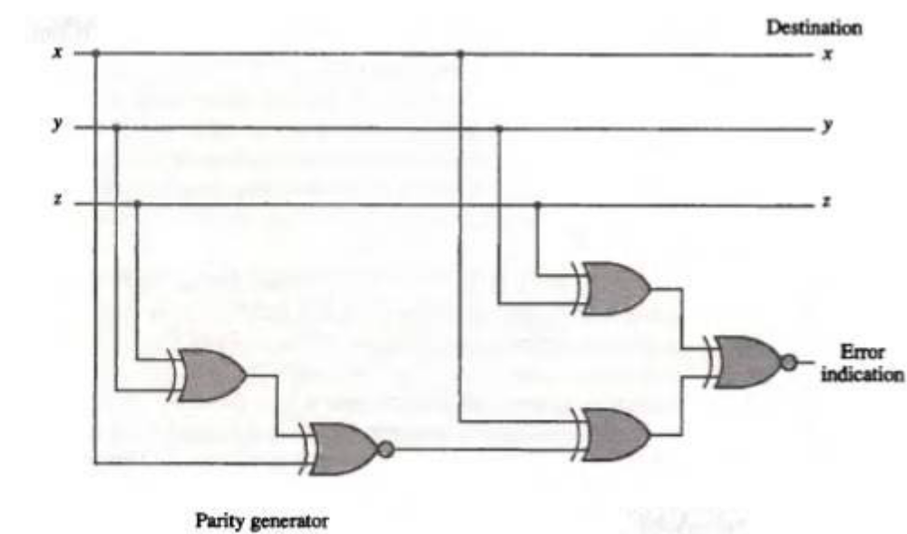

Slide 15
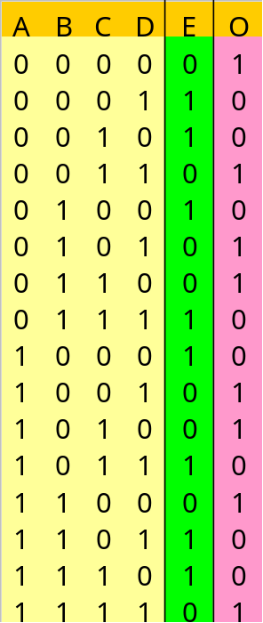
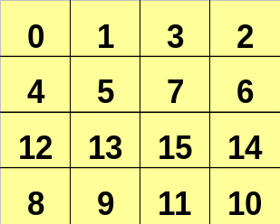
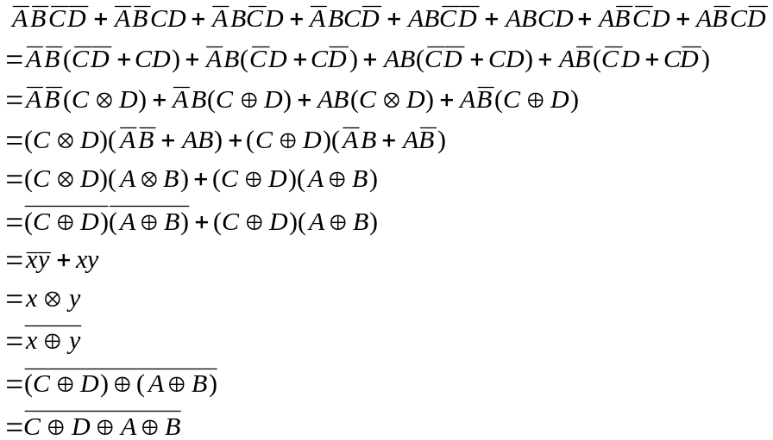


Odd Parity Generator/Checker
  Truth Table
  K-Map(Odd Parity)
C
B
A
D
  Expression

