Slide 1
Chap. 4 Register Transfer and Microoperations
4-1 Register Transfer Language
  Microoperation
    The operations executed on data stored in registers(shift, clear, load, count)
  Internal H/W Organization(best defined by specifying)
    1. The set of registers
    2. The sequence of microoperations
    3. The sequence control of microoperations
  Register Transfer Language
    The symbolic notation used to describe the microoperation transfer among registers
      The use of symbols instead of a narrative explanation provides an organized and concise manner
    A convenient tool for describing the internal organization of digital computers in concise and precise manner
4-2 Register Transfer
  Registers :
    Designated by Capital Letter(sometimes followed by numerals) : MAR(Memory Address Register), PC(Program Counter), IR(Instruction Register), R1(Processor Register)

Slide 2

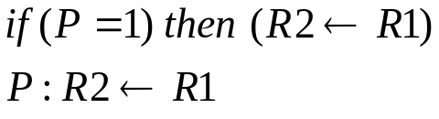

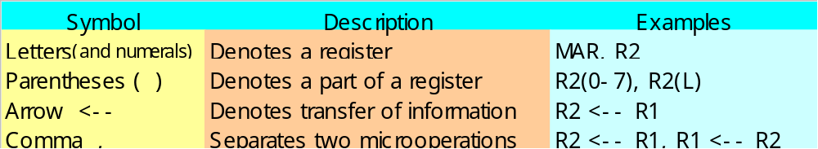
    The individual F/Fs in an n-bit register : numbered in sequence from 0(rightmost position) through n-1
    The numbering of bits in a 16-bit register : marked on top of the box
    A 16-bit register partitioned into two parts : bit 0-7(symbol “L” Low byte), bit 8-15(symbol “H” High byte)
  Register Transfer : Information transfer from one register to another
    (transfer of the content of register R1 into register R2)
      The content of the source register R1 does not change after the transfer
  Control Function : The transfer occurs only under a predetermined control condition
    The transfer operation is executed by the hardware only if P=1 :
    A comma is used to separate two or more operations(Executed at the same time)
  Basic Symbols for Register Transfer : Tab. 4-1
=

Slide 3
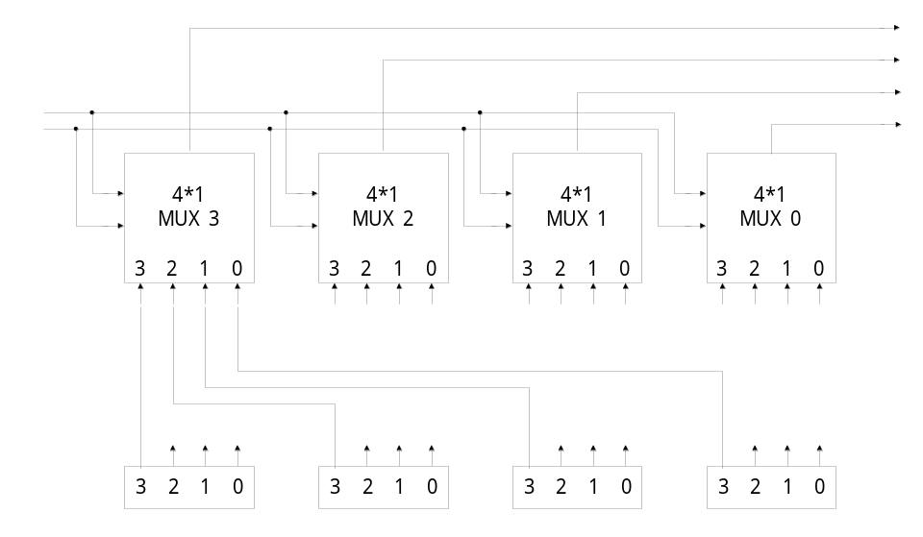
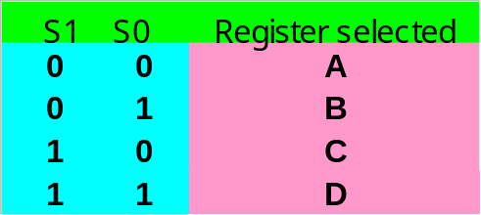
4-3 Bus and Memory Transfers
  Common Bus
    A more efficient scheme for transferring information between registers in a multiple-register configuration
    A bus structure = a set of common lines
    Control signals determine which register is selected
      One way of constructing a common bus system is with multiplexers
      The multiplexers select the source register whose binary information is place on the bus
    The construction of a bus system for four registers : Fig. 4-3
      4 bit register X 4
      Four 4 X 1 Multiplexers
      Bus Selection : S0, S1
    8 Registers with 16 bit
      16 X 1 mux 8
4-line
common
bus
S1
S0
Register D
Register C
Register B
Register A

Slide 4
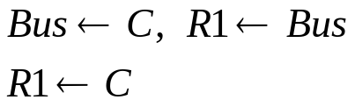
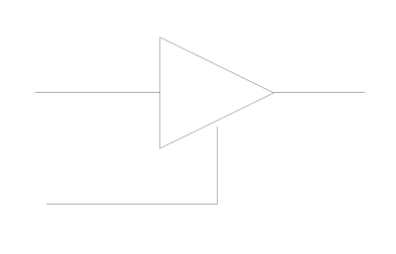
  Bus Transfer
    The content of register C is placed on the bus, and the content of the bus is loaded into register R1 by activating its load control input
  Three-State Bus Buffers
    A bus system can be constructed with three-state gates instead of multiplexers
    Tri-State : 0, 1, High-impedance(Open circuit)
    Buffer
      A device designed to be inserted between other devices to match impedance, to prevent mixed interactions, and to supply additional drive or relay capability
      Buffer types are classified as inverting or noninverting
    Tri-state buffer gate : Fig. 4-4
      When control input =1 : The output is enabled(output Y = input A)
      When control input =0 : The output is disabled(output Y = high-impedance)
Bus
=
R1 Register
C Register
n
Normal input A
If C=1, Output Y = A
If C=0, Output = High-impedance
Control input C

Slide 5
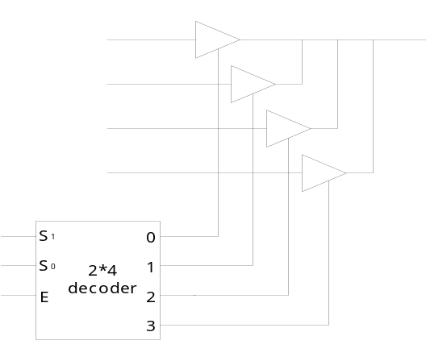

  The construction of a bus system with tri-state buffer : Fig. 4-5
    The outputs of four buffer are connected together to form a single bus line(Tri-state buffer)
    No more than one buffer may be in the active state at any given time(2 X 4 Decoder)
    To construct a common bus for 4 register with 4 bit :
  Memory Transfer
    Memory read : A transfer information into DR from the memory word M selected by the address in AR
    Memory Write : A transfer information from R1 into the memory word M selected by the address in AR
A0
B0
C0
D0
Bus line for bit 0
AR: Address Reg.
DR: Data Reg.
M : Memory Word(Data)
Select input
Enable input

Slide 6


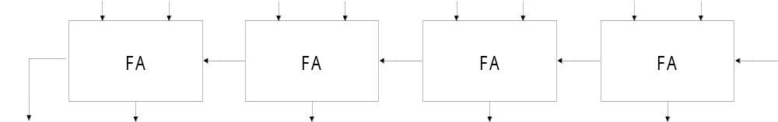
The 4 types of microoperation in digital computers
  Register transfer microoperation :
  Arithmetic microoperation
  Logic microoperation
  Shift microoperation
4-4 Arithmetic Microoperation
  Arithmetic Microoperation :
    Negate : 2’s complement
    Subtraction : R1 + 2’s complement of R2
    Multiplication(shift left), Division(shift right)
  4-bit Binary Adder : Fig. 4-6
    Full adder = 2-bits sum + previous carry
    c₀(input carry), c₄(output carry)
Sec 4-4, 4-5,
4-6
Sec 4-7
B3 A3 B2 A2 B1 A1 B0 A0
C0
C4
S3 S2 S1 S0

Slide 7
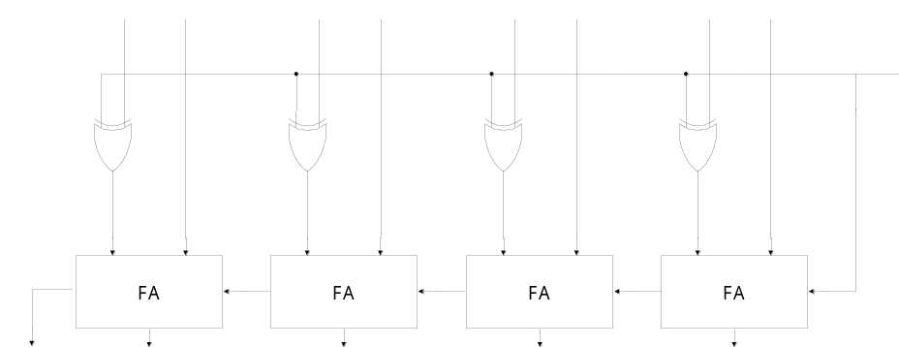
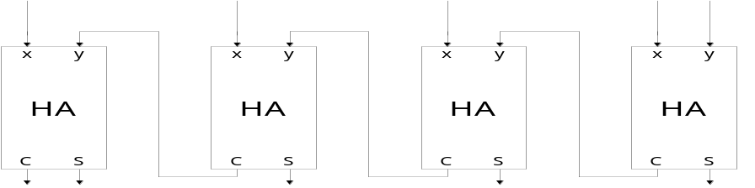
  4-bit Binary Adder-Subtractor : Fig. 4-7
    M =0 : Adder B ⊕ M + C = B ⊕ 0 + 0 = B, ∴ A + B
    M =1 : Subtractor B ⊕ M + C = B ⊕ 1 + 1 = B’ + 1= -B(2’s comp), ∴A - B
  4-bit Binary Incrementer
    Sequential circuit implementation by using binary counter : Fig. 2-10
    Combinational circuit implementation by using Half Adder : Fig. 4-8
B3 A3 B2 A2 B1 A1 B0 A0
M
C4
C0
S3 S2 S1 S0
B3 B2 B1 B0 1
Always added to 1
C4
S3 S2 S1 S0

Slide 8
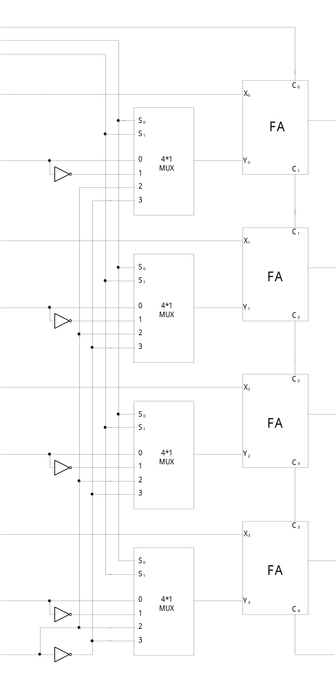
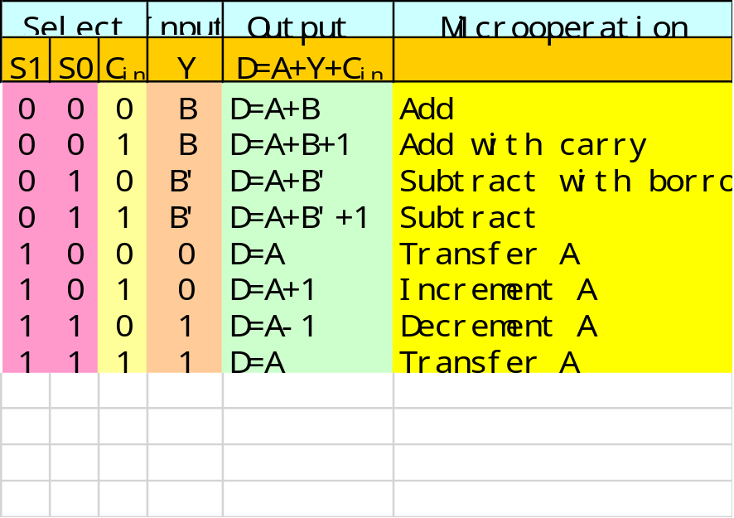
  Arithmetic Circuit
    One composite arithmetic circuit in Tab. 4-3 : Fig. 4-9
    D= A₀(X₀) + B₀(Y₀) + C_{in}
      B₀ : S₀, S₁ B, B, 0, 1
      Tab. 4-4: Input Y = B
Cin
S0
S1
A0
B0
A1
B1
A2
B2
A3
B3
0
D0
D1
D2
D3
A+B’=A+B’+1-1
= A-B-1
A+1111=A-1
A-1+1=A
Cout

Slide 9

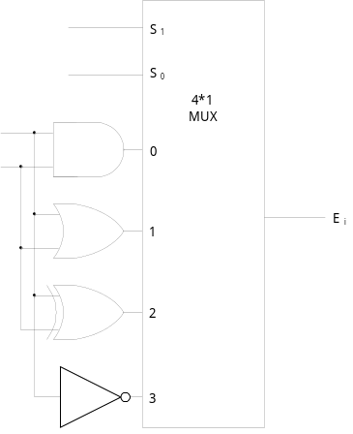
4-5 Logic Microoperation
  Logic microoperation
    Logic microoperations consider each bit of the register separately and treat them as binary variables
      exam)
    Special Symbols
      Special symbols will be adopted for the logic microoperations OR(∨/), AND(∧), and complement(a bar on top), to distinguish them from the corresponding symbols used to express Boolean functions
      exam)
  List of Logic Microoperation
    Truth Table for 16 functions for 2 variables : Tab. 4-5
    16 Logic Microoperation : Tab. 4-6
  Hardware Implementation
    16 microoperation Use only 4(AND, OR, XOR, Complement)
    One stage of logic circuit : Fig. 4-10
      1010 Content of R1
      + 1100 Content of R2
      0110 Content of R1 after P=1
Arithmetic : 1’s Complement
Logic OR
Arithmetic ADD
S0
S1
Ai
Bi
All other Operation can be derived

Slide 10




  Some Applications
    Logic microoperations are very useful for manipulating individual bits or a portion of a word stored in a register
    Used to change bit values, delete a group of bits, or insert new bit values
    Selective-set
      The selective-set operation sets to 1 the bits in register A where there are corresponding 1’s in register B. It does not effect bit positions that have 0’s in B
    Selective-complement
      The selective-complement operation complements bits in A where there are corresponding 1’s in B. It does not effect bit positions that have 0’s in B
    Selective-clear
      The selective-clear operation clears to 0 the bits in A only where there are corresponding 1’s in B
    Selective-mask
      The mask operation is similar to the selective-clear operation except that the bits of A are cleared only where there are corresponding 0’s in B
1 0
0 0
      1010 A before
      1100 B(Logic Operand)
      1110 A After
      1010 A before
      1100 B(Logic Operand)
      0110 A After
      1010 A before
      1100 B(Logic Operand)
      0010 A After
      1010 A before
      1100 B(Logic Operand)
      1010 A After
Selective-set
Selective-complement
Selective-clear
Selective-mask

Slide 11

    Insert
      The insert operation inserts a new value into a group of bits
      This is done by first masking the bits and then ORing them with the required value
    Clear
      The clear operation compares the words in A and B and produces an all 0’s result if the two numbers are equal
4-6 Shift Microoperations
  Shift Microoperations : Tab. 4-7
    Shift microoperations are used for serial transfer of data
    Three types of shift microoperation : Logical, Circular, and Arithmetic
  Logical Shift
    A logical shift transfers 0 through the serial input
    The bit transferred to the end position through the serial input is assumed to be 0 during a logical shift(Zero inserted)
1) Mask 2) OR
0110 1010 A before 0000 1010 A before
0000 1111 B mask 1001 0000 B insert
0000 1010 A after mask 1001 1010 A after insert
Clear
0110 A
0110 B
0000 A after clear
=
0
0

Slide 12




  Circular Shift(Rotate)
    The circular shift circulates the bits of the register around the two ends without loss of information
  Arithmetic Shift
    An arithmetic shift shifts a signed binary number to the left or right
    An arithmetic shift-left multiplies a signed binary number by 2
    An arithmetic shift-right divides the number by 2
    Arithmetic shifts must leave the sign bit unchanged because the sign of the number remains the same
    Shift right :
    Sign reversal occur : Overflow F/F V_{s}=1
    Shift left :
LSB lost
0 insert
Carry out
Sign bit
MSB
LSB
R_{n-1} Rn-2 . . . . . R₁ R₀
MSB
LSB

Slide 13
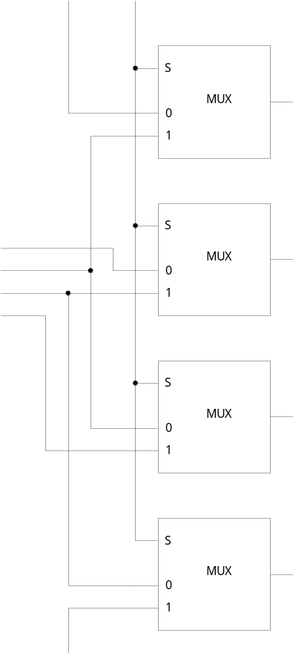
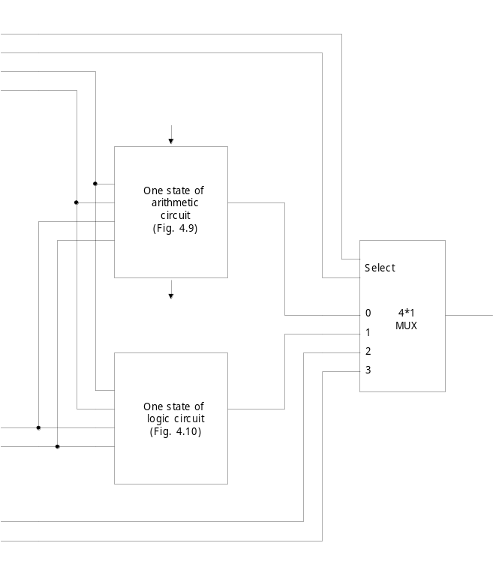
4-7 Arithmetic Logic Shift Unit
  One stage of arithmetic logic shift unit : Fig. 4-13
Select(S)
Serial
input(IR)
H0
H1
H2
H3
S3
S2
S1
S0
A0
A1
A2
A3
Ci
Ci+1
Fi
Bi
Ai
Ai-1
Ai+1
Serial
input(IL)

