Slide 1
Chap. 5 Basic Computer Org. and Design
5-1 Instruction Codes
  The user of a computer can control the process by means of a program
  A program is a set of instructions that specify the operations, operand, the sequence(control)
  A instruction is a binary code that specifies a sequence of microoperations
  Instruction codes together with data are stored in memory(=Stored Program Concept)
  The computer reads each instruction from memory and places it in a control register. The control then interprets the binary code of the instruction and proceeds to execute it by issuing a sequence of microoperations.
  Instruction Code :
    A group of bits that instruct the computer to perform a specific operation
    It is usually divided into parts(refer to Fig. 5-1 instruction format)
  Operation Code :
    The most basic part of an instruction code
    A group of bits that define such operations as add, subtract, multiply, shift, and complement(bit 12-15 : 2⁴ = 16 distinct operations)
Instruction
Cycle
Instruction Format
15 12 11 0
Op. Code Address

Slide 2
  Stored Program Organization :
    The simplest way to organize a computer
      One processor register : AC(Accumulator)
        The operation is performed with the memory operand and the content of AC
      Instruction code format with two parts : Op. Code + Address
        Op. Code : specify 16 possible operations(4 bit)
        Address : specify the address of an operand(12 bit)
        If an operation in an instruction code does not need an operand from memory, the rest of the bits in the instruction(address field) can be used for other purpose
      Memory : 12 bit = 4096 word(Instruction and Data are stored)
        Store each instruction code(program) and operand (data) in 16-bit memory word
  Addressing Mode
    Immediate operand address :
      the second part of an instruction code(address field) specifies an operand
    Direct operand address : Fig. 5-2(b)
      the second part of an instruction code specifies the address of an operand
    Indirect operand address : Fig. 5-2(c)
      the bits in the second part of the instruction designate an address of a memory word in which the address of the operand is found
    One bit of the instruction code is used to distinguish between a direct and an indirect address : Fig. 5-2(a)
Exam)
Clear AC, Increment AC,
Complement AC, ...
I=0 : Direct,
I=1 : Indirect

Slide 3
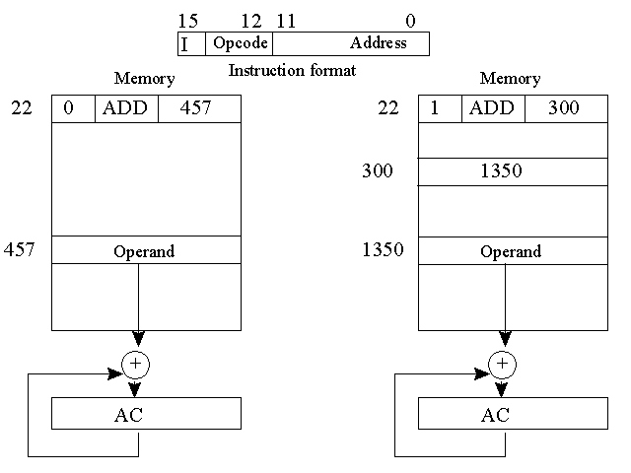

Slide 4
  Effective Address
    The operand address in computation-type instruction or the target address in a branch-type instruction
5-2 Computer Registers
  Basic computer registers and memory :
    Data Register(DR) : hold the operand(Data) read from memory
    Accumulator Register(AC) : general purpose processing register
    Instruction Register(IR) : hold the instruction read from memory
    Temporary Register(TR) : hold a temporary data during processing
    Address Register(AR) : hold a memory address, 12 bit width
    Program Counter(PC) :
      hold the address of the next instruction to be read from memory after the current instruction is executed
      Instruction words are read and executed in sequence unless a branch instruction is encountered
      A branch instruction calls for a transfer to a nonconsecutive instruction in the program
      The address part of a branch instruction is transferred to PC to become the address of the next instruction
      To read instruction, memory read cycle is initiated, and PC is incremented by one(next instruction fetch)

Slide 5
    Input Register(INPR) : receive an 8-bit character from an input device
    Output Register(OUTR) : hold an 8-bit character for an output device
  Common Bus System
    The basic computer has eight registers, a memory unit, and a control
    Paths must be provided to transfer information from one register to another and between memory and registers
    A more efficient scheme for transferring information in a system with many registers is to use a common bus
    The connection of the registers and memory of the basic computer to a common bus system : Fig. 5-4
      The outputs of seven registers and memory are connected to the common bus
      The specific output is selected by mux(S0, S1, S2) :
        Memory(7), AR(1), PC(2), DR(3), AC(4), IR(5), TR(6)
        When LD(Load Input) is enable, the particular register receives the data from the bus
      Control Input : LD, INC, CLR, Write, Read
      Address Register :

Slide 6
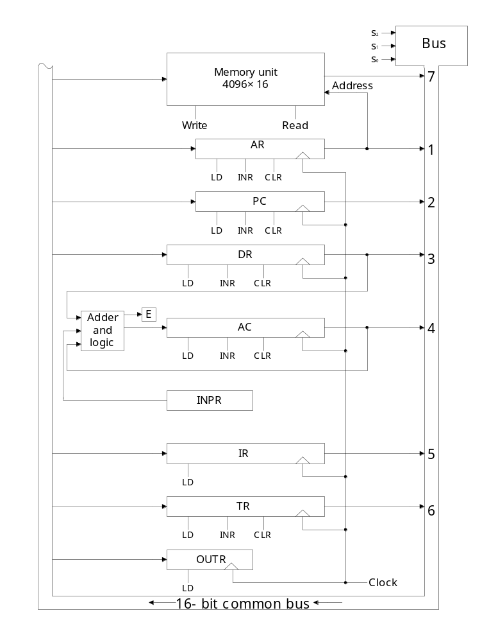
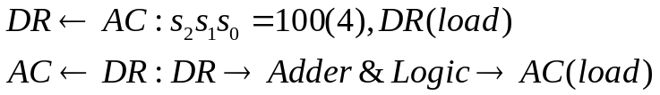
      Accumulator(AC) :
        1) Register Microoperation : clear AC, shfift AC,…
        2) Data Register : add DR to AC, and DR to AC
        3) INPR
      Note) Two microoperations can be executed at the same time

Slide 7
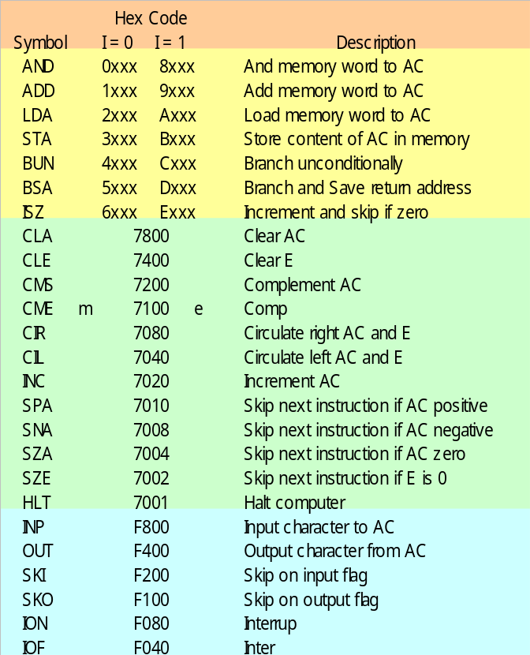
5-3 Computer Instruction
  3 Instruction Code Formats :
    Memory-reference instruction
      Opcode = 000 ∼ 110
        I=0 : 0xxx ~ 6xxx, I=1: 8xxx ~Exxx
    Register-reference instruction
      7xxx (7800 ~ 7001) : CLA, CMA, ….
    Input-Output instruction
      Fxxx(F800 ~ F040) : INP, OUT, ION, SKI, ….
I=0 : Direct,
I=1 : Indirect
15 14 12 11 0
I Opcode Address
15 14 12 11 0
0 1 1 1 Register Operation
15 14 12 11 0
1 1 1 1 I/O Operation

Slide 8
  Instruction Set Completeness
    Arithmetic, Logical, and shift : CMA, INC, ..
    Moving information to and from memory and AC : STA, LDA
    Program control : BUN, BSA, ISZ
    Input/Output : INP, OUT
5-4 Timing and Control
  Clock pulses
    A master clock generator controls the timing for all registers in the basic computer
    The clock pulses are applied to all F/Fs and registers in system
    The clock pulses do not change the state of a register unless the register is enabled by a control signal
    The control signals are generated in the control unit : Fig. 5-6
      The control signals provide control inputs for the multiplexers in the common bus, control inputs in processor registers, and microoperations for the accumulator
  Two major types of control organization
    Hardwired Control :
      The control logic is implemented with gates, F/Fs, decoders, and other digital circuits
      + Fast operation, - Wiring change(if the design has to be modified)
If the computer includes a sufficient number of instructions in each of the following categories

Slide 9
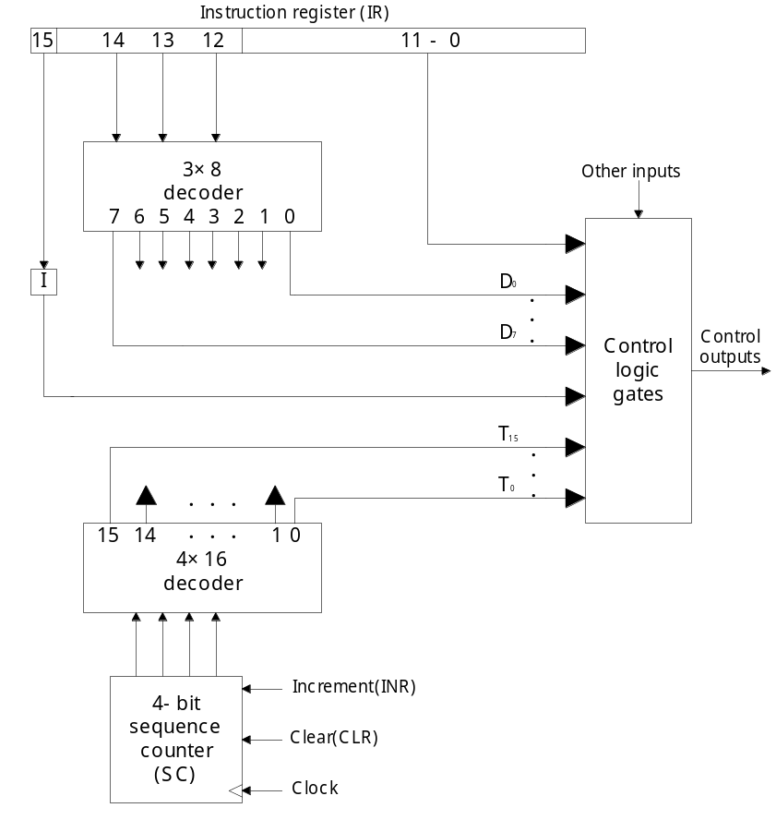

    Microprogrammed Control : Chap. 6
      The control information is stored in a control memory, and the control memory is programmed to initiate the required sequence of microoperations
      + Any required change can be done by updating the microprogram in control memory,
      - Slow operation
  Control Unit : Fig. 5-6
    Control Unit = Control Logic Gate + 3 X 8 Decoder + Instruction Register + Timing Signal
    Timing Signal = 4 X 16 Decoder + 4-bit Sequence Counter
    Exam) Control timing : Fig. 5-7
      Sequence Counter is cleared when D₃T₄ =1 :
    Memory R/W cycle time > Clock cycle time

Slide 10
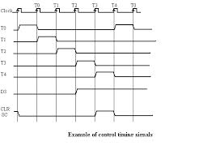

Slide 11




  Exam) Register transfer statement :
    A transfer of the content of PC into AR if timing signal T₀ is active
      1) During T₀ active, the content of PC is placed onto the bus
      2) LD(load) input of AR is enabled, the actual transfer occurs at the next positive transition of the clock(T₀ rising edge clock)
      3) SC(sequence counter) is incremented :
5-5 Instruction Cycle
  Instruction Cycle
    1) Instruction Fetch from Memory
    2) Instruction Decode
    3) Read Effective Address(if indirect addressing mode)
    4) Instruction Execution
    5) Go to step 1) : Next Instruction[PC + 1]
  Instruction Fetch : T0, T1
    T0 = 1
      1) Place the content of PC onto the bus by making the bus selection inputs S₂S₁S₀=010
      2) Transfer the content of the bus to AR by enabling the LD input of AR
T₀ : Inactive
T₁ : Active
Continue indefinitely unless HALT instruction is encountered

Slide 12

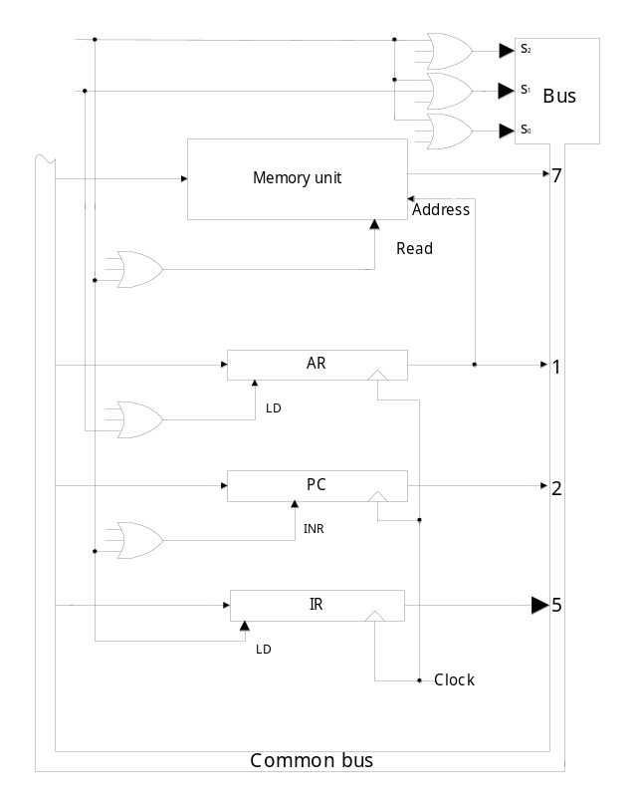


    T1 = 1
      1) Enable the read input memory
      2) Place the content of memory onto the bus by making S₂S₁S₀= 111
      3) Transfer the content of the bus to IR by enable the LD input of IR
      4) Increment PC by enabling the INR input of PC
  Instruction Decode : T2
    IR(12-14) Fig. 5-6 D0 - D7
  Instruction Execution : T3, T4, T5, T6
    D₇=1 Register(I=0) D₇I’T₃(Execute)
    I/O (I=1) D₇IT₃ (Execute)
    D₇=0 : Memory Ref. Indirect(I=1) D₇’IT₃( )
    Direct (I=0) nothing in T₃
  Flowchart for instruction cycle(Initial Configuration) : Fig. 5-9
T₁=1
T₀=1
0
1
0
1
1
1
Op.code
Address
Di/Indirect
Read effective
Address

Slide 13
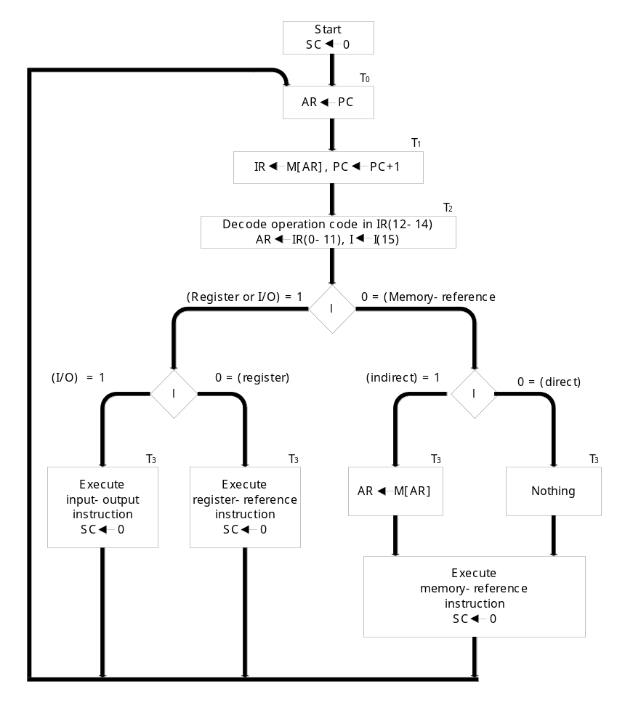
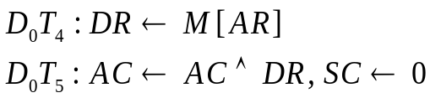
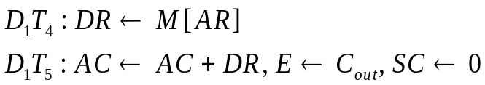
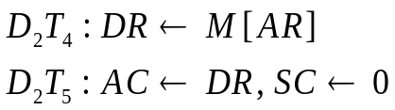
  Register Ref. Instruction
    r = D₇I’T₃ :
    IR(i) = B_{i} IR(0 -11)
    B₀ - B₁₁ : 12 Register Ref. Instruction
5-6 Memory Ref. Instruction
    D₇ : Register or I/O = 1
    D₆ - D₀ : 7 Memory Ref.
    Instruction
  AND to AC
  ADD to AC
  LDA : memory read
Fig. 5-9 Flowchart for instruction cycle(initial)
Address
IR(12,13,14)
= 111
3 X 8 Decoder

Slide 14


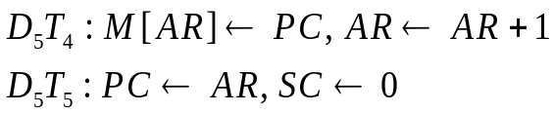
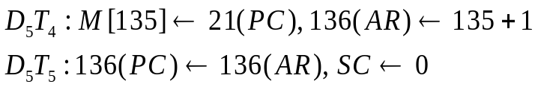
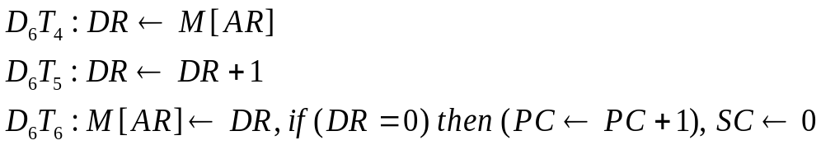
  STA : memory write
  BUN : branch unconditionally
  BSA : branch and save return address
    Return Address : save return address ( 135 21 )
    Subroutine Call : Fig. 5-10
  ISZ : increment and skip if zero
Fig. 5-10 Example of BSA
PC = 10
PC = 21
135
PC = 136
0 BSA 135
next instruction
21(return address)
Subroutine
1 BUN 135

Slide 15
5-7 Input-Output and Interrupt
  Input-Output Configuration :
    Input Register(INPR), Output Register(OUTR)
      These two registers communicate with a communication interface serially and with the AC in parallel
      Each quantity of information has eight bits of an alphanumeric code
    Input Flag(FGI), Output Flag(FGO)
      FGI : set when INPR is ready, clear when INPR is empty
      FGO : set when operation is completed, clear when output device is in the process of printing
  Input-Output Instruction : Tab. 5-5
    p = D₇IT₃ : Common to all I/O instructions
    IR(i) = B_{i} IR(6 -11) : B (bit in IR(6-11) that specifies the instruction)
    B₆ - B₁₁ : 6 I/O Instruction
  Program Interrupt
    I/O Transfer Modes
      1) Programmed I/O, 2) Interrupt-initiated I/O, 3) DMA, 4) IOP
1 : Ready
0 : Not ready

Slide 16
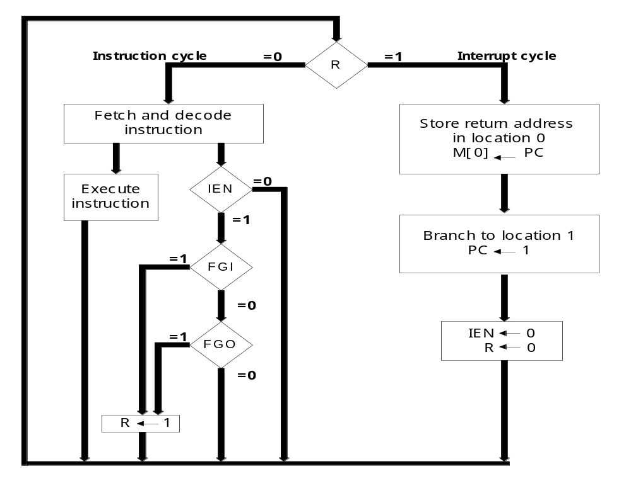
    Interrupt Cycle : Fig. 5-13
      During the execute phase, IEN is checked by the control
        IEN = 0 : the programmer does not want to use the interrupt, so control continues with the next instruction cycle
        IEN = 1 : the control circuit checks the flag bit, If either flag set to 1, R F/F is set to 1

Slide 17
5-9 Design of Basic Computer
  The basic computer consists of the following hardware components
    1. A memory unit with 4096 words of 16bits
    2. Nine registers : AR, PC, DR, AC, IR, TR, OUTR, INPR, and SC
    3. Seven F/Fs : I, S, E, R, IEN, FGI, and FGO
    4. Two decoder in control unit : 3 x 8 operation decoder, 4 x 16 timing
    decoder
    5. A 16-bit common bus
    6. Control Logic Gates
    7. Adder and Logic circuit connected to the AC input
  Control Logic Gates
    1. Signals to control the inputs of the nine registers
    2. Signals to control the read and write inputs of memory
    3. Signals to set, clear, or complement the F/Fs
    4. Signals for S₂ S₁ S₀ to select a register for the bus
    5. Signals to control the AC adder and logic circuit

Slide 18
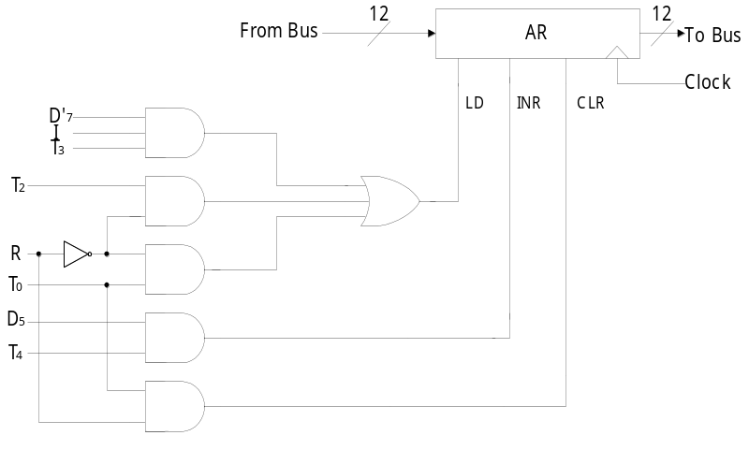

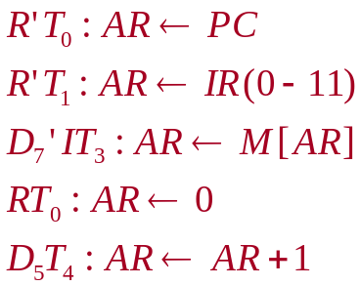
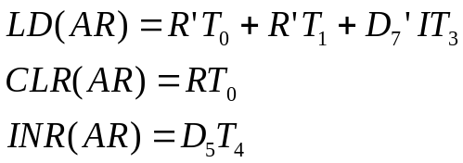




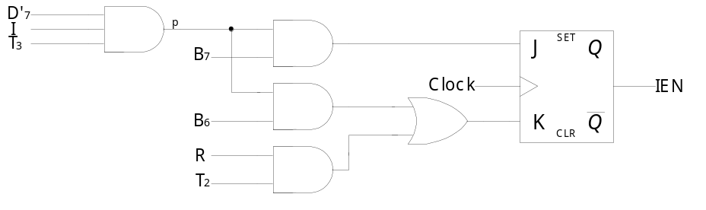
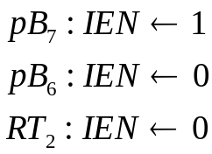
  Register Control : AR
    Control inputs of AR : LD, INR, CLR
    Find all the statements that change the AR
    in Tab. 5-6
    Control functions
  Memory Control : READ
    Control inputs of Memory : READ, WRITE
    Find all the statements that specify a read operation in Tab. 5-6
    Control function
  F/F Control : IEN
    Control functions

Slide 19
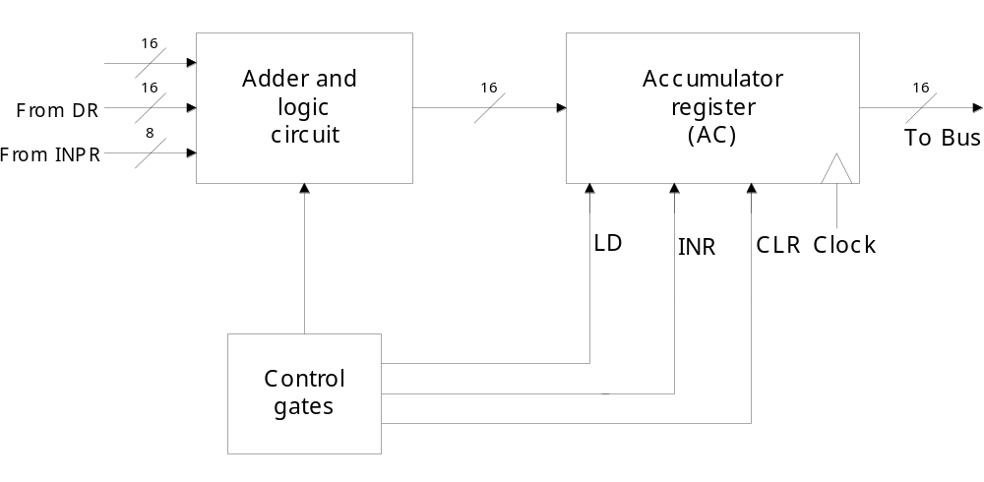
5-10 Design of Accumulator Logic
  Circuits associated with AC :
Fig. 5-21
Fig. 2-11
Fig. 5-20

Slide 20

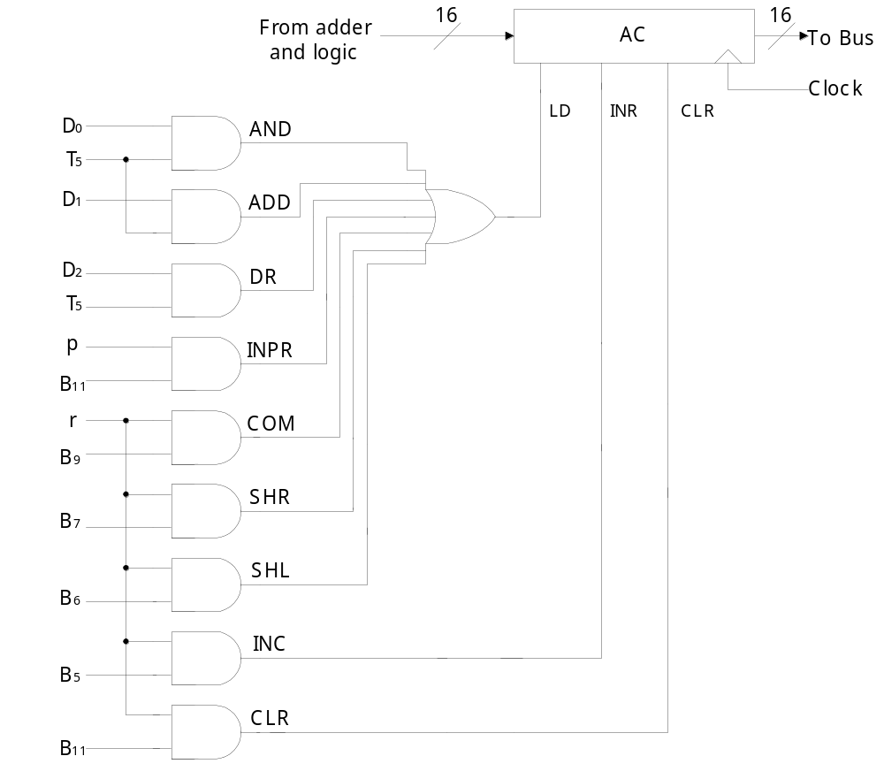
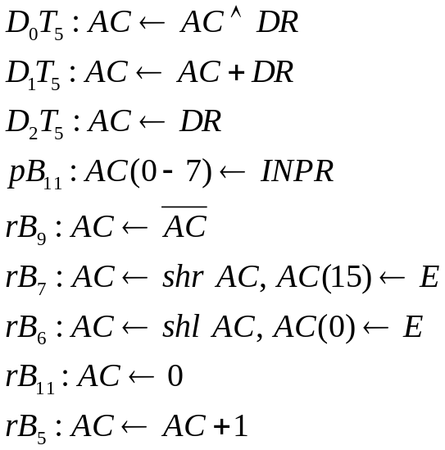
  Control of AC : Fig. 5-20
    Find the statement that change the AC :
LD
CLR
INR

Slide 21
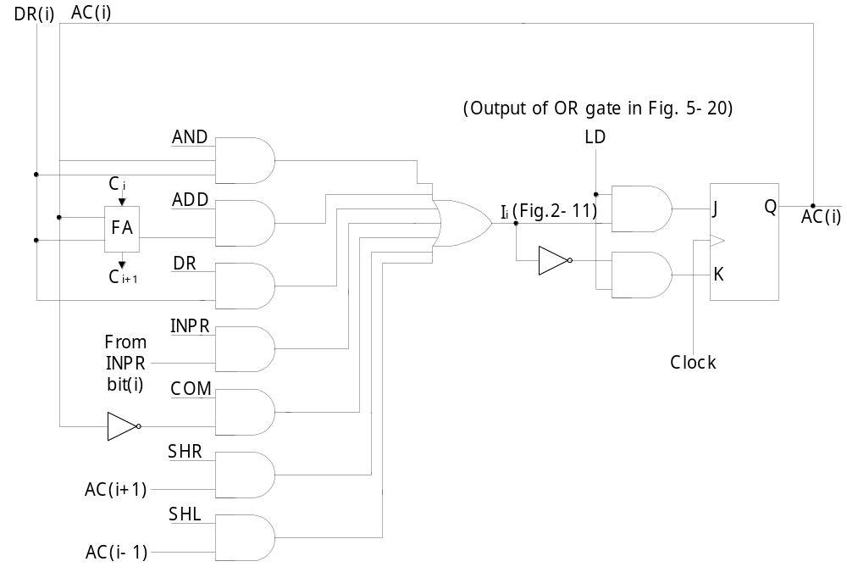
  Adder and Logic Circuit : Fig. 5-21

