Slide 1
Chap. 6 Central Processing Unit
6-1 Introduction
  3 major parts of CPU : Fig. 8-1
    1) Register Set
    2) ALU
    3) Control
  Design Examples of simple CPU
    Hardwired Control : Chap. 5
  In this chapter :
    Describe the organization and architecture of the CPU with an emphasis on the user’s view of the computer
    User who programs the computer in machine/assembly language must be aware of
      1) Instruction Formats
      2) Addressing Modes
      3) Register Sets
    The last section presents the concept of Reduced Instruction Set Computer (RISC)
Computer Architecture as seen by the programmer

Slide 2
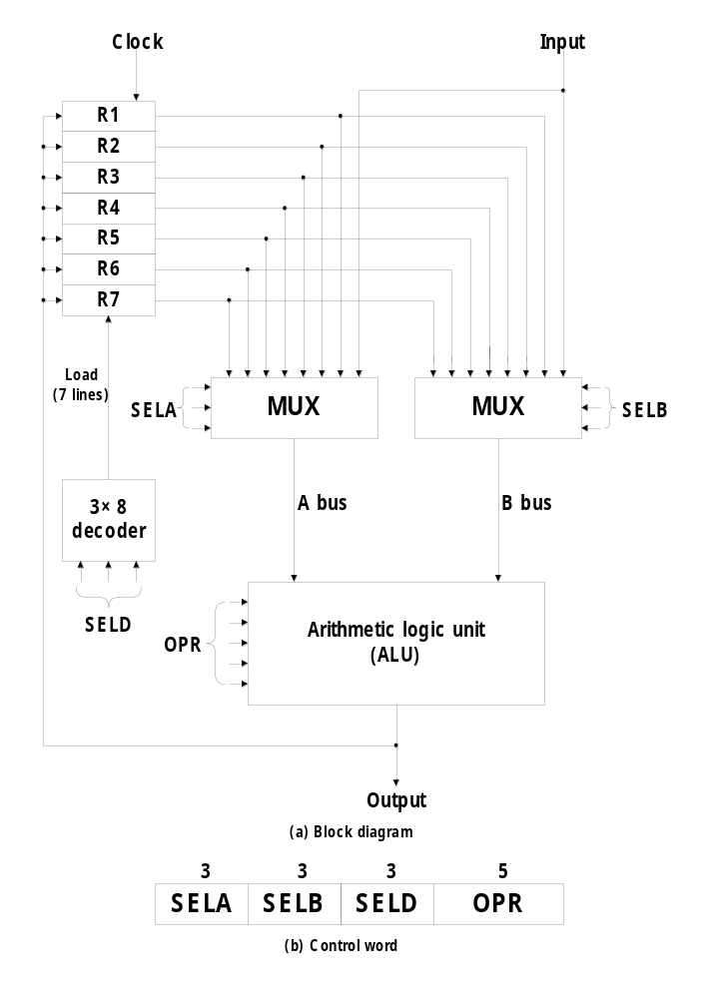
6-2 General Register Organization
  Register
    Memory locations are needed for storing pointers, counters, return address, temporary results, and partial products during multiplication
    Memory access is the most time-consuming operation in a computer
    More convenient and efficient way is to store intermediate values in processor registers
  Bus organization for 7 CPU registers : Fig. 8-2
    2 MUX : select one of 7 register or external data input by SELA and SELB
    BUS A and BUS B : form the inputs to a common ALU
    ALU : OPR determine the arithmetic or logic microoperation
      The result of the microoperation is available for external data output and also goes into the inputs of all the registers
    3 X 8 Decoder : select the register (by SELD) that receives the information from ALU
External Input
External Output

Slide 3


  Binary selector input :
    1) MUX A selector (SELA) : to place the content of R2 into BUS A
    2) MUX B selector (SELB) : to place the content of R3 into BUS B
    3) ALU operation selector (OPR) : to provide the arithmetic addition R2 + R3
    4) Decoder selector (SELD) : to transfer the content of the output bus into R1
  Control Word
    14 bit control word (4 fields) : Fig. 8-2(b)
      SELA (3 bits) : select a source register for the A input of the ALU
      SELB (3 bits) : select a source register for the B input of the ALU
      SELD (3 bits) : select a destination register using the 3 X 8 decoder
      OPR (5 bits) : select one of the operations in the ALU
    Encoding of Register Selection Fields : Tab. 8-1
      SELA or SELB = 000 (Input) : MUX selects the external input data
      SELD = 000 (None) : no destination register is selected but the contents of the output bus are available in the external output
    Encoding of ALU Operation (OPR) : Tab. 8-2
  Examples of Microoperations : Tab. 8-3
    TSFA (Transfer A) :
    XOR :
Tab. 8-1
Tab. 8-2

Slide 4
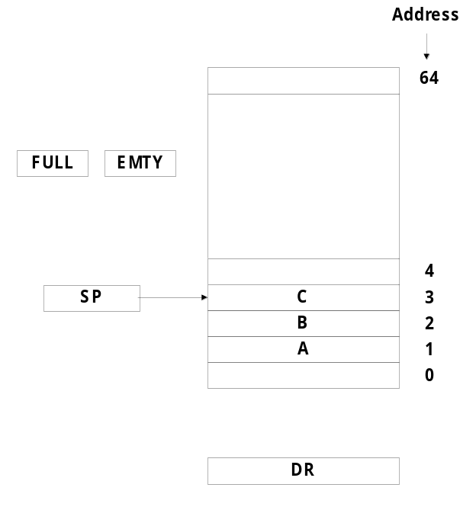
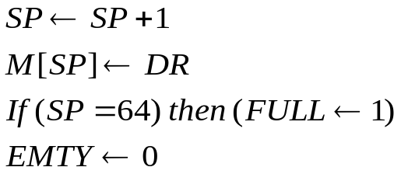
6-3 Stack Organization
  Stack or LIFO(Last-In, First-Out)
    A storage device that stores information
      The item stored last is the first item retrieved = a stack of tray
    Stack Pointer (SP)
      The register that holds the address for the stack
      SP always points at the top item in the stack
    Two Operations of a stack : Insertion and Deletion of Items
      PUSH : Push-Down = Insertion
      POP : Pop-Up = Deletion
    Stack
      1) Register Stack (Stack Depth )
        a finite number of memory words or register(stand alone)
      2) Memory Stack (Stack Depth )
        a portion of a large memory
  Register Stack : Fig. 8-3
    PUSH :
: Increment SP
: Write to the stack
: Check if stack is full
: Mark not empty
Last Item
SP = 0,
EMTY = 1,
FULL = 0

Slide 5
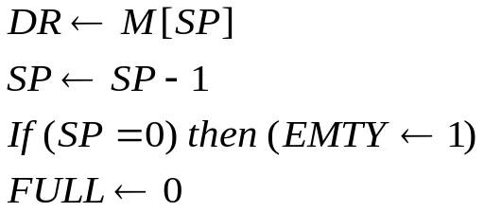
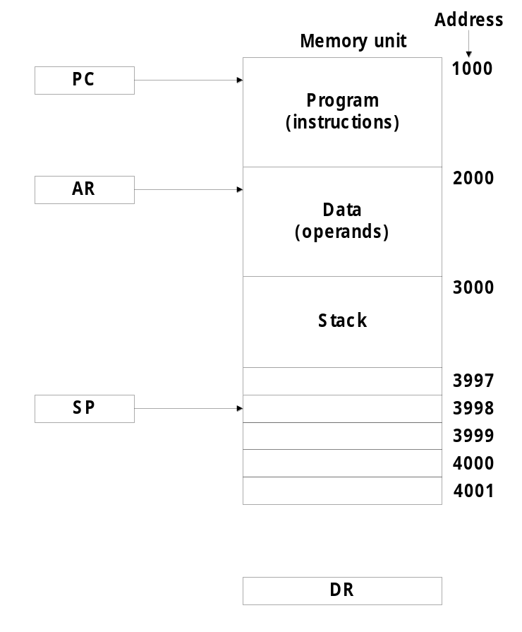
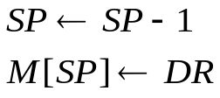
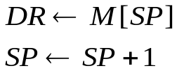
      The first item is stored at address 1, and the last item is stored at address 0
    POP :
  Memory Stack : Fig. 8-4
    PUSH :
      The first item is stored at address 4000
    POP :
  Stack Limits
    Check for stack overflow(full)/underflow(empty)
      Checked by using two register
        Upper Limit and Lower Limit Register
      After PUSH Operation
        SP compared with the upper limit register
      After POP Operation
        SP compared with the lower limit register
: Read item from the top of stack
: Decrement Stack Pointer
: Check if stack is empty
: Mark not full
* Memory Stack
PUSH = Address
* Register Stack
PUSH = Address
SP = 4001
* Error Condition
PUSH when FULL = 1
POP when EMTY = 1
Start Here

Slide 6
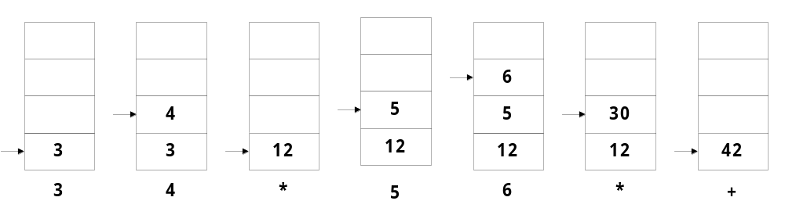
  RPN (Reverse Polish Notation)
    The common mathematical method of writing arithmetic expressions imposes difficulties when evaluated by a computer
    A stack organization is very effective for evaluating arithmetic expressions
    A * B + C * D → AB * CD * + : Fig. 8-5
      ( 3 * 4 ) + ( 5 * 6 ) → 34 * 56 * +
6-4 Instruction Formats
  Fields in Instruction Formats
    1) Operation Code Field : specify the operation to be performed
    2) Address Field : designate a memory address or a processor register
    3) Mode Field : specify the operand or the effective address (Addressing Mode)
Stack Arithmetic

Slide 7



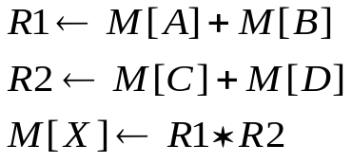
  3 types of CPU organizations
    1) Single AC Org. : ADD X
    2) General Register Org. : ADD R1, R2, R3
    3) Stack Org. : PUSH X
  The influence of the number of addresses on computer instruction
  X = (A + B)*(C + D)
  - 4 arithmetic operations : ADD, SUB, MUL, DIV
  - 1 transfer operation to and from memory and general register : MOV
  - 2 transfer operation to and from memory and AC register : STORE, LOAD
  - Operand memory addresses : A, B, C, D
  - Result memory address : X
    1) Three-Address Instruction
      Each address fields specify either a processor register or a memory operand
       Short program
      Require too many bit to specify 3 address
X = Operand Address
ADD R1, A, B
ADD R2, C, D
MUL X, R1, R2


Slide 8
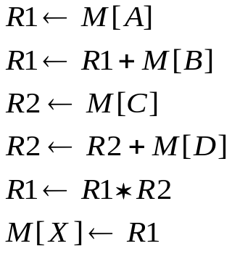
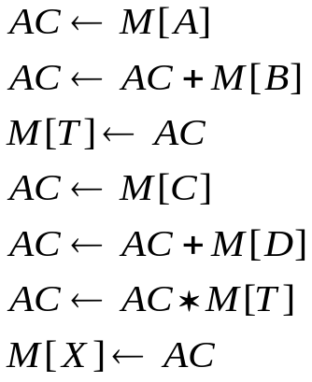
    2) Two-Address Instruction
      The most common in commercial computers
      Each address fields specify either a processor register or a memory operand
    3) One-Address Instruction
      All operations are done between the AC register and memory operand
MOV R1, A
ADD R1, B
MOV R2, C
ADD R2, D
MUL R1, R2
MOV X, R1
LOAD A
ADD B
STORE T
LOAD C
ADD D
MUL T
STORE X

Slide 9
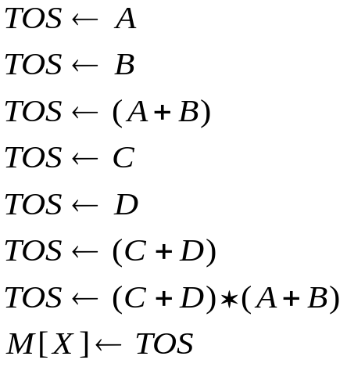
    4) Zero-Address Instruction
      Stack-organized computer does not use an address field for the instructions ADD, and MUL
      PUSH, and POP instructions need an address field to specify the operand
      Zero-Address : absence of address ( ADD, MUL )
  RISC Instruction
    Only use LOAD and STORE instruction when communicating between memory and CPU
    All other instructions are executed within the registers of the CPU without referring to memory
    RISC architecture will be explained in Sec. 6-8
PUSH A
PUSH B
ADD
PUSH C
PUSH D
ADD
MUL
POP X

Slide 10
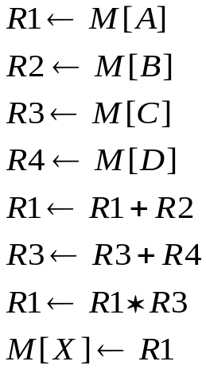
    Program to evaluate X = ( A + B ) * ( C + D )
6-5 Addressing Modes
  Addressing Mode
    1) To give programming versatility to the user
      pointers to memory, counters for loop control, indexing of data, ….
    2) To reduce the number of bits in the addressing field of the instruction
  Instruction Cycle
    1) Fetch the instruction from memory and PC + 1
    2) Decode the instruction
    3) Execute the instruction
LOAD R1, A
LOAD R2, B
LOAD R3, C
LOAD R4, D
ADD R1, R1, R2
ADD R3, R3, R4
MUL R1, R1, R3
STORE X, R1

Slide 11
  Program Counter (PC)
    PC keeps track of the instructions in the program stored in memory
    PC holds the address of the instruction to be executed next
    PC is incremented each time an instruction is fetched from memory
  Addressing Mode of the Instruction
    1) Distinct Binary Code
      Instruction Format , Opcode ,Addressing Mode Field
    2) Single Binary Code
      Instruction Format: Opcode + Addressing Mode Field
  Instruction Format with mode field : Fig. 8-6
  Implied Mode
    Operands are specified implicitly in definition of the instruction
    Examples
      COM : Complement Accumulator
        Operand in AC is implied in the definition of the instruction
      PUSH : Stack push
        Operand is implied to be on top of the stack

Slide 12


  Immediate Mode
    Operand field contains the actual operand
    Useful for initializing registers to a constant value
    Example : LD #NBR
  Register Mode
    Operands are in registers
    Register is selected from a register field in the instruction
      k-bit register field can specify any one of 2^{k} registers
    Example : LD R1
  Register Indirect Mode
    Selected register contains the address of the operand rather than the operand itself
     Address field of the instruction uses fewer bits to select a memory address
    Example : LD (R1)
  Autoincrement or Autodecrement Mode
    Similar to the register indirect mode except that
      the register is incremented after its value is used to access memory
      the register is decrement before its value is used to access memory
Implied Mode

Slide 13





    Example (Autoincrement) : LD (R1)+
  Direct Addressing Mode
    Effective address is equal to the address field of the instruction (Operand)
    Address field specifies the actual branch address in a branch-type instruction
    Example : LD ADR
  Indirect Addressing Mode
    Address field of instruction gives the address where the effective address is stored in memory
    Example : LD @ADR
  Relative Addressing Mode
    PC is added to the address part of the instruction to obtain the effective address
    Example : LD $ADR
  Indexed Addressing Mode
    XR (Index register) is added to the address part of the instruction to obtain the effective address
    Example : LD ADR(XR)
  Base Register Addressing Mode
    the content of a base register is added to the address part of the instruction to obtain the effective address
ADR = Address part of Instruction
Not Here

Slide 14

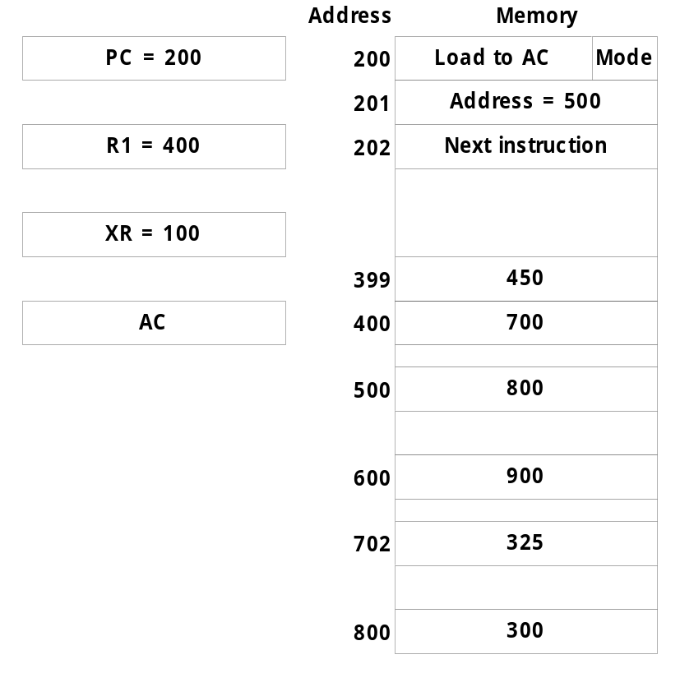
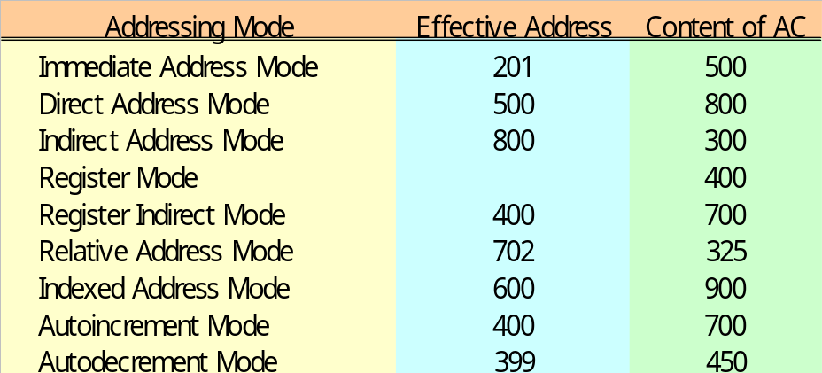
    Similar to the indexed addressing mode except that the register is now called a base register instead of an index register
      index register (XR) : LD ADR(XR)
        index register hold an index number that is relative to the address part of the instruction
      base register (BR) : LD ADR(BR)
        base register hold a base address
        the address field of the instruction gives a displacement relative to this base address
  Numerical Example
ADR
BR
R1 = 400
500 + 202 (PC)
R1 = 400 (after)
R1 = 400 -1 (prior)
500 + 100 (XR)

Slide 15
6-6 Data Transfer and Manipulation
  Most computer instructions can be classified into three categories:
    1) Data transfer, 2) Data manipulation, 3) Program control instructions
  Data Transfer Instruction
    Typical Data Transfer Instruction : Tab. 8-5
      Load : transfer from memory to a processor register, usually an AC (memory read)
      Store : transfer from a processor register into memory (memory write)
      Move : transfer from one register to another register
      Exchange : swap information between two registers or a register and a memory word
      Input/Output : transfer data among processor registers and input/output device
      Push/Pop : transfer data between processor registers and a memory stack
    8 Addressing Mode for the LOAD Instruction : Tab. 8-6
      @ : Indirect Address
      $ : Address relative to PC
      # : Immediate Mode
      ( ) : Index Mode, Register Indirect, Autoincrement
  Data Manipulation Instruction
    1) Arithmetic, 2) Logical and bit manipulation, 3) Shift Instruction

Slide 16
    Arithmetic Instructions : Tab. 8-7
    Logical and Bit Manipulation Instructions : Tab. 8-8
    Shift Instructions : Tab. 8-9
6-7 Program Control
  Program Control Instruction : Tab. 8-10
    Branch and Jump instructions are used interchangeably to mean the same thing
  Status Bit Conditions : Fig. 8-8
    Condition Code Bit or Flag Bit
      The bits are set or cleared as a result of an operation performed in the ALU
  4-bit status register
    Bit C (carry) : set to 1 if the end carry C₈ is 1
    Bit S (sign) : set to 1 if F₇ is 1
    Bit Z (zero) : set to 1 if the output of the ALU contains all 0’s
    Bit V (overflow) : set to 1 if the exclusive-OR of the last two carries (C₈ and C₇) is equal to 1
    Flag Example : A - B = A + ( 2’s Comp. Of B ) : A =11110000, B = 00010100
      11110000
      + 11101100 (2’s comp. of B)
      1 11011100
C = 1, S = 1, V = 0, Z = 0

Slide 17
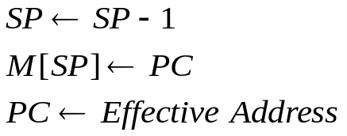
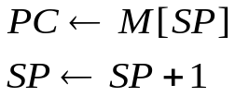
  Conditional Branch : Tab. 8-11
  Subroutine Call and Return
    CALL :
    RETURN :
  Program Interrupt
    Program Interrupt
      Transfer program control from a currently running program to another service program as a result of an external or internal generated request
      Control returns to the original program after the service program is executed
    Interrupt Service Program , Subroutine Call
      1) An interrupt is initiated by an internal or external signal (except for software interrupt)
        A subroutine call is initiated from the execution of an instruction (CALL)
      2) The address of the interrupt service program is determined by the hardware
        The address of the subroutine call is determined from the address field of an instruction
      3) An interrupt procedure stores all the information necessary to define the state of the CPU
        A subroutine call stores only the program counter (Return address)
: Decrement stack point
: Push content of PC onto the stack
: Transfer control to the subroutine
: Pop stack and transfer to PC
: Increment stack pointer

Slide 18
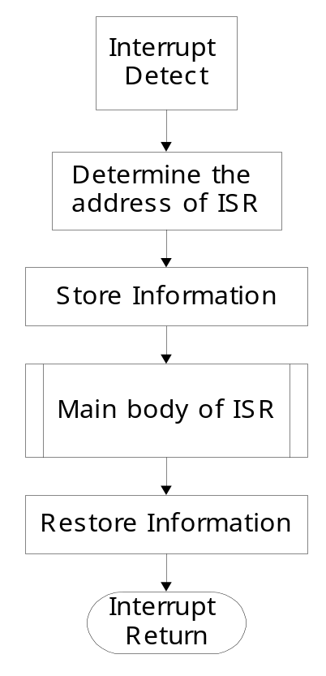
    Program Status Word (PSW)
      The collection of all status bit conditions in the CPU
    Two CPU Operating Modes
      Supervisor (System) Mode : Privileged Instruction
        When the CPU is executing a program that is part of the operating system
      User Mode : User program
        When the CPU is executing an user program
  Types of Interrupts
    1) External Interrupts
      come from I/O device, from a timing device, from a circuit monitoring the power supply, or from any other external source
    2) Internal Interrupts or TRAP
      caused by register overflow, attempt to divide by zero, an invalid operation code, stack overflow, and protection violation
    3) Software Interrupts
      initiated by executing an instruction (INT or RST)
      used by the programmer to initiate an interrupt procedure at any desired point in the program
External Int.
Internal Int.
Software Int.
PC, CPU Register, Status Condition
ISR
CPU operating mode is determined from special bits in the PSW

Slide 19
6-8 Reduced Instruction Set Computer (RISC)
  Complex Instruction Set Computer (CISC)
    Major characteristics of a CISC architecture
      1) A large number of instructions - typically from 100 to 250 instruction
      2) Some instructions that perform specialized tasks and are used infrequently
      3) A large variety of addressing modes - typically from 5 to 20 different modes
      4) Variable-length instruction formats
      5) Instructions that manipulate operands in memory (RISC in register)
  Reduced Instruction Set Computer (RISC)
    Major characteristics of a RISC architecture
      1) Relatively few instructions
      2) Relatively few addressing modes
      3) Memory access limited to load and store instruction
      4) All operations done within the registers of the CPU
      5) Fixed-length, easily decoded instruction format
      6) Single-cycle instruction execution
      7) Hardwired rather than microprogrammed control

Slide 20
    Other characteristics of a RISC architecture
      1) A relatively large number of registers in the processor unit
      2) Use of overlapped register windows to speed-up procedure call and return
      3) Efficient instruction pipeline
      4) Compiler support for efficient translation of high-level language programs into machine language programs

