Slide 1
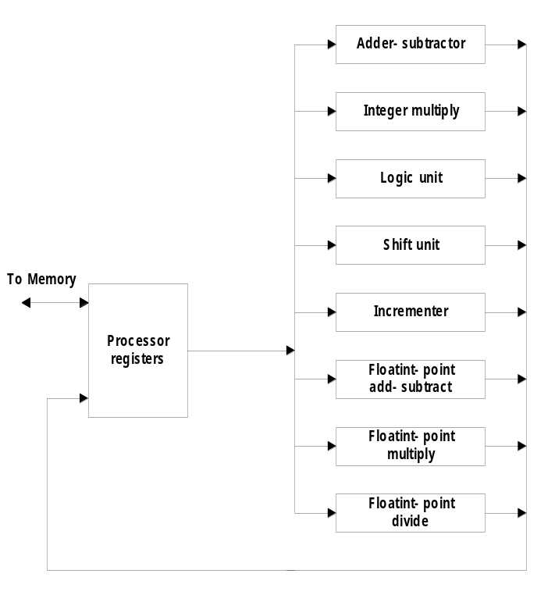
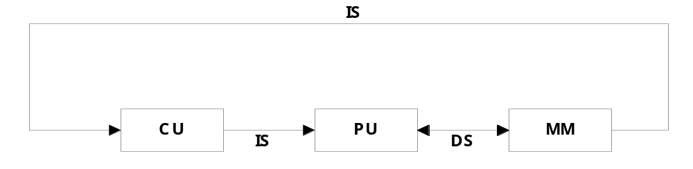
Chap. 7 Pipeline and Vector Processing
7-1 Parallel Processing
  Simultaneous data processing tasks for the purpose of increasing the computational speed
  Perform concurrent data processing to achieve faster execution time
  Multiple Functional Unit : Fig. 9-1
    Separate the execution unit into eight functional units operating in parallel
  Computer Architectural Classification
    Data-Instruction Stream : Flynn
    Serial versus Parallel Processing : Feng
    Parallelism and Pipelining : Händler
  Flynn’s Classification
    1) SISD (Single Instruction - Single Data stream)
      for practical purpose: only one processor is useful
      Example systems : Amdahl 470V/6, IBM 360/91
=
Parallel Processing Example

Slide 2
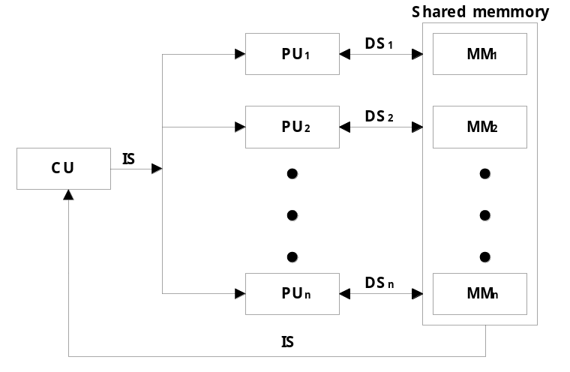
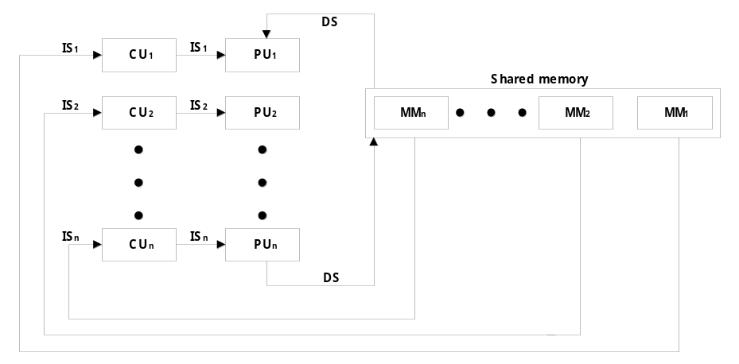
    2) SIMD
    (Single Instruction - Multiple Data stream)
      vector or array operations
        one vector operation includes many operations on a data stream
      Example systems : CRAY -1, ILLIAC-IV
    3) MISD
    (Multiple Instruction - Single Data stream)
      Data Stream Bottle neck

Slide 3
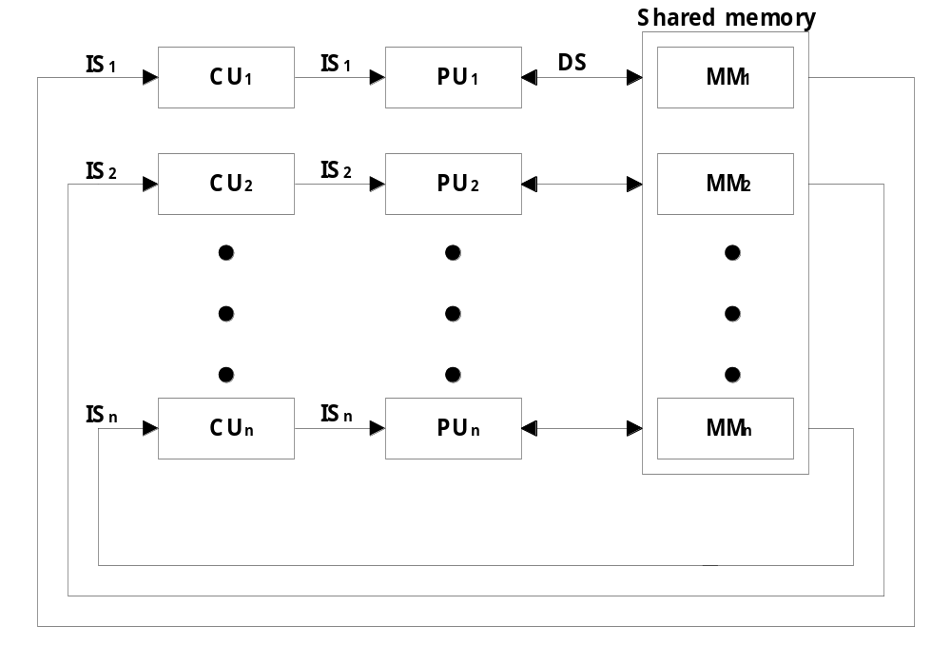
    4) MIMD
    (Multiple Instruction - Multiple Data stream)
      Multiprocessor System
  Main topics in this Chapter
    Pipeline processing : Sec. 7-2
      Arithmetic pipeline : Sec. 7-3
      Instruction pipeline : Sec. 7-4
    Vector processing :adder/multiplier pipeline , Sec. 7-6
    Array processing : array processor , Sec. 7-7
      Attached array processor : Fig. 7-14
      SIMD array processor : Fig. 7-15

Slide 4

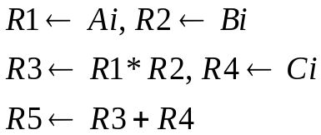
7-2 Pipelining
  Pipelining
    Decomposing a sequential process into suboperations
    Each subprocess is executed in a special dedicated segment concurrently
  Pipelining: Fig. 9-2
    Multiply and add operation : ( for i = 1, 2, …, 7 )
    3 Suboperation Segment
      1) : Input Ai and Bi
      2) : Multiply and input Ci
      3) : Add Ci
    Content of registers in pipeline example : Tab. 9-1
  General considerations
    4 segment pipeline : Fig. 9-3
      S : Combinational circuit for Suboperation
      R : Register(intermediate results between the segments)
    Space-time diagram : Fig. 9-4
      Show segment utilization as a function of time
    Task : T1, T2, T3,…, T6
      Total operation performed going through all the segment
Segment
versus
clock-cycle

Slide 5
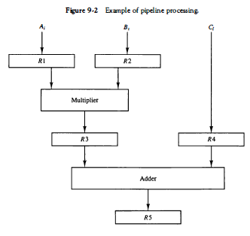
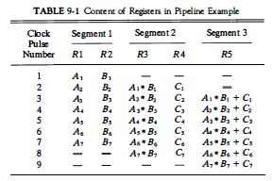

Slide 6
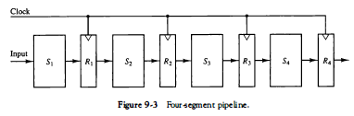
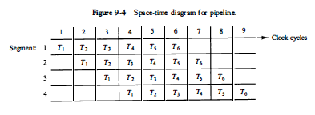

Slide 7
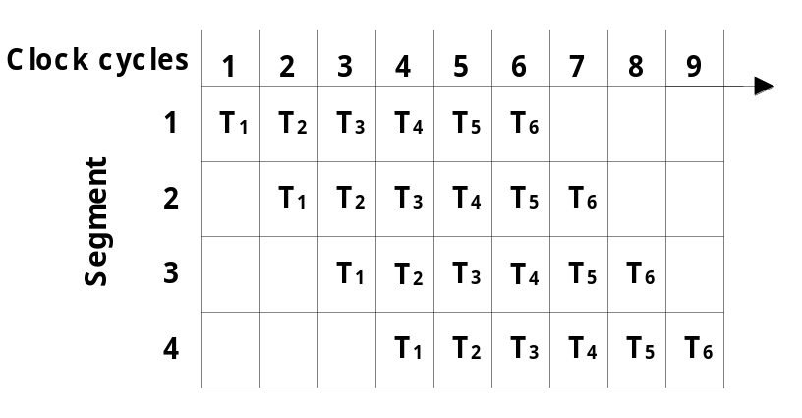
  Speedup S : Nonpipeline / Pipeline
    S = n • t_{n} / ( k + n - 1 ) • t_{p} = 6 • 6 t_{n} / ( 4 + 6 - 1 ) • t_{p} = 36 t_{n} / 9 t_{n} = 4
      n : task number ( 6 )
      t_{n} : time to complete each task in nonpipeline ( 6 cycle times = 6 t_{p})
      t_{p} : clock cycle time ( 1 clock cycle )
      k : segment number ( 4 )
    If n→ ∞,the speedup S = t_{n} / t_{p}
If we assume that the time it takes to process a
task is the same in the pipeline and non pipeline
circuits, we will have t, = kt,.
Including this assumption, the speedup reduces to
    S = t_{n} / t_{p} = k • t_{p} / t_{p} = k
This shows that the theoretical maximum speedup
that a pipeline can provide is k, where k is the number of segments in the pipeline
Sec. 7-3 Arithmetic Pipeline
  Floating-point Adder Pipeline Example : Fig. 9-6
    Add / Subtract two normalized floating-point binary number
      X = A x 2ª = 0.9504 x 10³
      Y = B x 2^{b} = 0.8200 x 10²
Pipeline= 9 clock cycles
k + n - 1 ≈ n

Slide 8
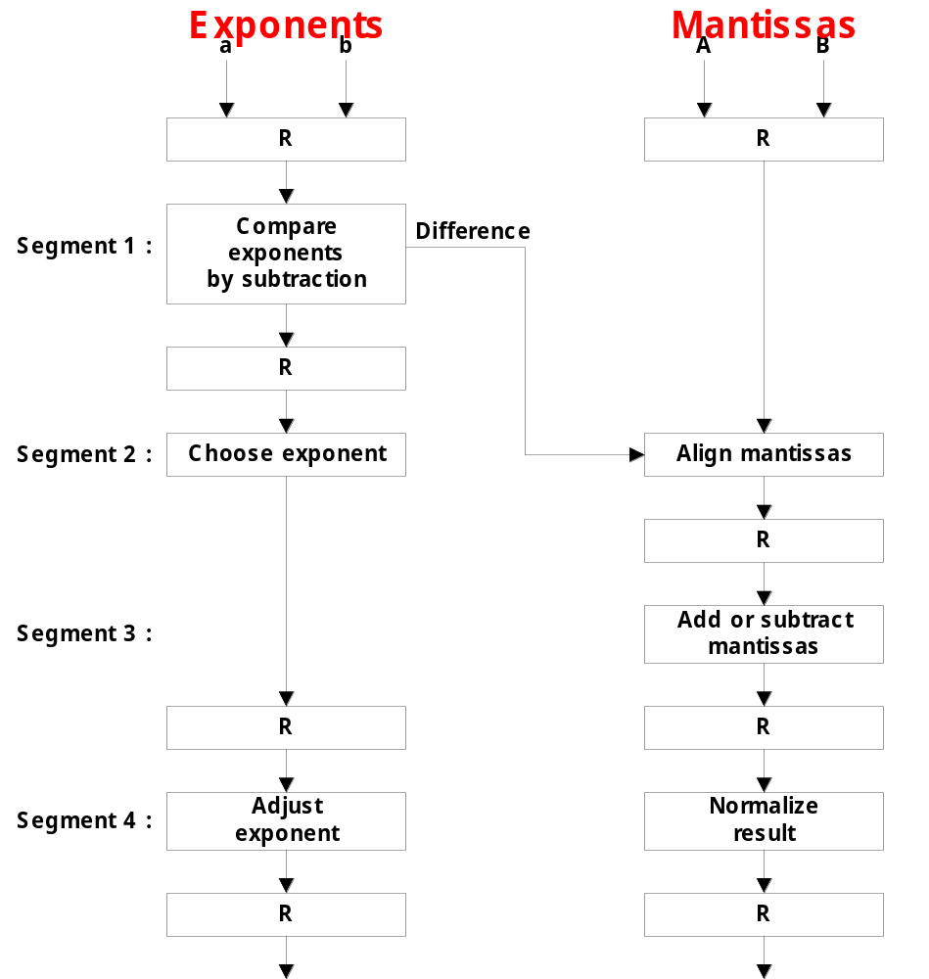
    4 segments suboperations
      1) Compare exponents by subtraction :
      3 - 2 = 1
        X = 0.9504 x 10³
        Y = 0.8200 x 10²
      2) Align mantissas
        X = 0.9504 x 10³
        Y = 0.08200 x 10³
      3) Add mantissas
        Z = 1.0324 x 10³
      4) Normalize result
        Z = 0.1324 x 10⁴

Slide 9
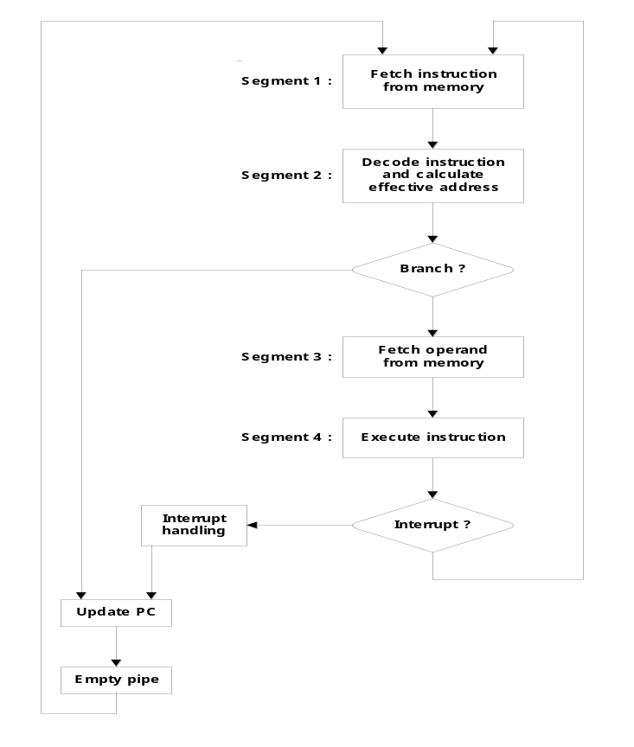
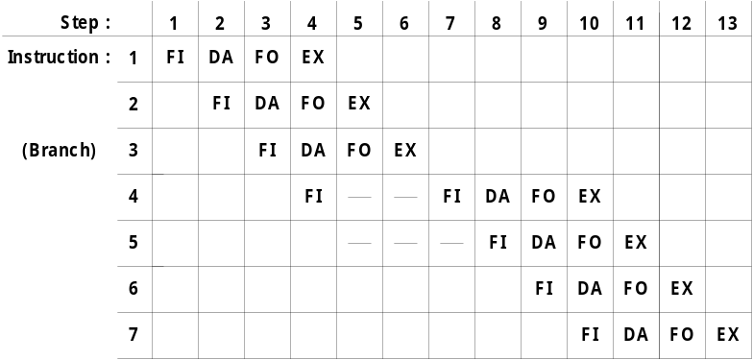
7-4 Instruction Pipeline
  Instruction Cycle
    1) Fetch the instruction from memory
    2) Decode the instruction
    3) Calculate the effective address
    4) Fetch the operands from memory
    5) Execute the instruction
    6) Store the result in the proper place
  Example : Four-segment Instruction Pipeline
    Four-segment CPU pipeline : Fig. 9-7
      1) FI : Instruction Fetch
      2) DA : Decode Instruction & calculate EA
      3) FO : Operand Fetch
      4) EX : Execution
    Timing of Instruction Pipeline : Fig. 9-8
      Instruction 3 is a Branch instruction
No Branch
Branch

Slide 10
  Pipeline Conflicts : 3 major difficulties
    1) Resource conflicts
      memory access by two segments at the same time
    2) Data dependency
      when an instruction depend on the result of a previous instruction, but this result is not yet available
    3) Branch difficulties
      branch and other instruction (interrupt, ret, ..) that change the value of PC
  Data Dependency
    Hardware
      Hardware Interlock
        previous instruction Hardware Delay
      Operand Forwarding
        previous instruction ALU ( , register )
    Software
      Delayed Load
        previous instruction No-operation instruction
  Handling of Branch Instructions
    Prefetch target instruction
      Conditional branch branch target instruction ( ) instruction ( ) fetch

Slide 11
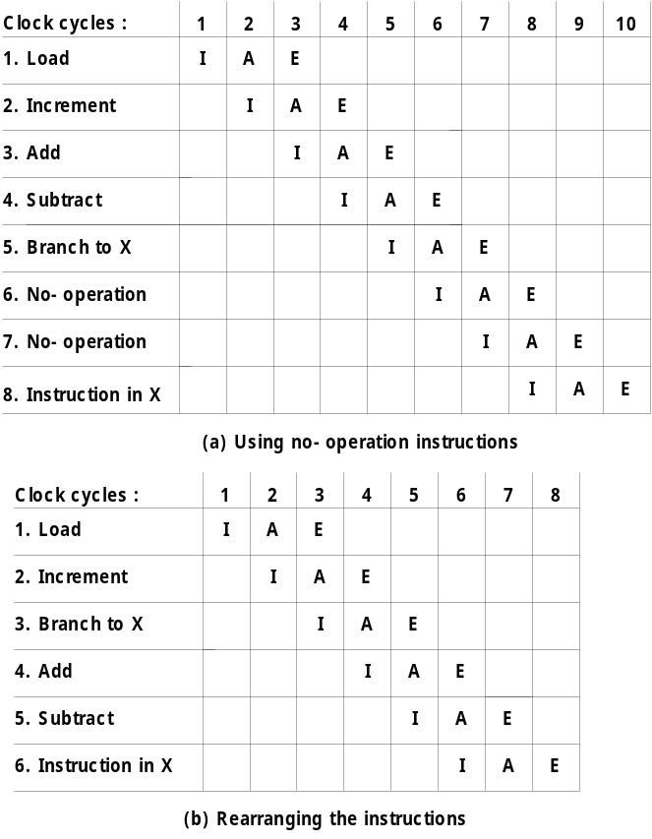
    Branch Target Buffer : BTB
      1) Associative memory branch target address instruction .
      2) branch instruction BTB BTB (Cache )
    Loop Buffer
      1) small very high speed register file (RAM) loop
      detect .
      2) loop loop
      Loop Buffer load
      access .
    Branch Prediction
      Branch predict additional hardware logic
  Delayed Branch
    Fig. 9-8 branch instruction
    pipeline operation
    : Fig. 9-10, p. 318, Sec. 7-5
      1) No-operation instruction
      2) Instruction Rearranging : Compiler

Slide 12
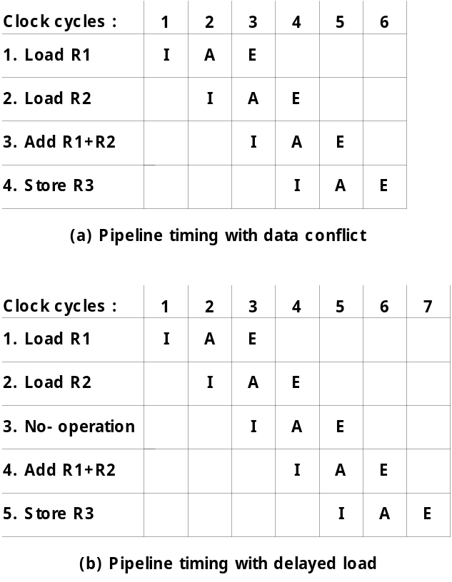
7-5 RISC Pipeline
  RISC CPU
    Instruction Pipeline
    Single-cycle instruction execution
    Compiler support
  Example : Three-segment Instruction Pipeline
    3 Suboperations Instruction Cycle
      1) I : Instruction fetch
      2) A : Instruction decoded and ALU operation
      3) E : Transfer the output of ALU to a register,
      memory, or PC
    Delayed Load : Fig. 9-9(a)
      3 Instruction(ADD R1 + R3) Conflict
        4 clock cycle 2 Instruction (LOAD R2)
        3 instruction R2
      Delayed Load : Fig. 9-9(b)
        No-operation
    Delayed Branch : Sec. 7-4
Conflict

Slide 13
7-6 Vector Processing
  Science and Engineering Applications
    Long-range weather forecasting, Petroleum explorations, Seismic data analysis, Medical diagnosis, Aerodynamics and space flight simulations, Artificial intelligence and expert systems, Mapping the human genome, Image processing
  Vector Operations
    Arithmetic operations on large arrays of numbers
    Conventional scalar processor
      Machine language
    Vector processor
      Single vector instruction
      Fortran language
Initialize I = 0
20 Read A(I)
Read B(I)
Store C(I) = A(I) + B(I)
Increment I = I + 1
If I ≤ 100 go to 20
Continue
DO 20 I = 1, 100
20 C(I) = A(I) + B(I)
C(1:100) = A(1:100) + B(1:100)

Slide 14
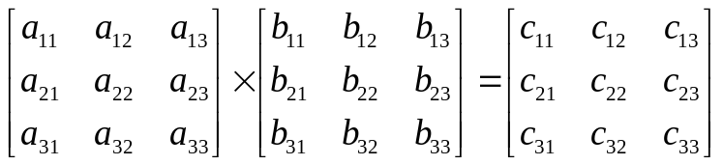



  Vector Instruction Format : Fig. 9-11
  ADD A B C 100
  Matrix Multiplication
    3 x 3 matrices multiplication : n² = 9 inner product
      : inner product 9
    Cumulative multiply-add operation : n³ = 27 multiply-add
      : multiply-add 3
      9 X 3 multiply-add = 27
① ② ③
① ② ③
C₁₁ = 0

Slide 15

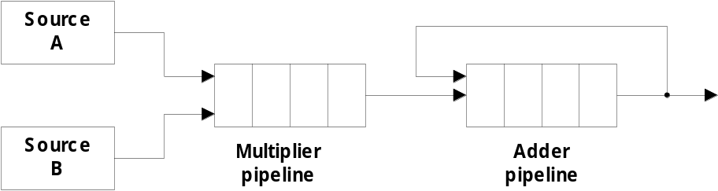
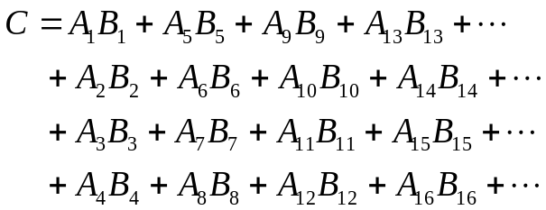


  Pipeline for calculating an inner product : Fig. 9-12
    Floating point multiplier pipeline : 4 segment
    Floating point adder pipeline : 4 segment
      after 1st clock input
      after 8th clock input
      Four section summation
      after 4th clock input
A₁B₁
A₄B₄ A₃B₃ A₂B₂ A₁B₁
      after 9th, 10th, 11th ,...
A₈B₈ A₇B₇ A₆B₆ A₅B₅ A₄B₄ A₃B₃ A₂B₂ A₁B₁
A₈B₈ A₇B₇ A₆B₆ A₅B₅ A₄B₄ A₃B₃ A₂B₂ A₁B₁
, , , ⑩ ⑨

Slide 16
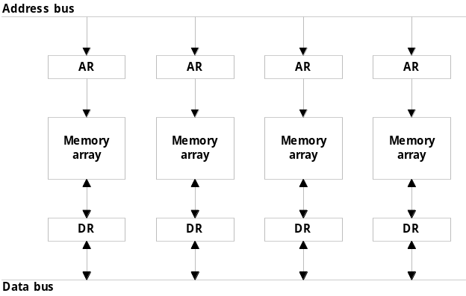
  Memory Interleaving : Fig. 9-13
    Simultaneous access to memory from two or more source using one memory bus system
    AR 2 bit 4 memory module
    Even / Odd Address Memory Access
  Supercomputer
    Supercomputer = Vector Instruction + Pipelined floating-point arithmetic
    Performance Evaluation Index
      MIPS : Million Instruction Per Second
      FLOPS : Floating-point Operation Per Second
        megaflops : 10⁶, gigaflops : 10⁹
    Cray supercomputer : Cray Research
      Cray-1 : 80 megaflops, 4 million 64 bit words memory
      Cray-2 : 12 times more powerful than the clay-1
    VP supercomputer : Fujitsu
      VP-200 : 300 megaflops, 32 million memory, 83 vector instruction, 195 scalar instruction
      VP-2600 : 5 gigaflops

Slide 17
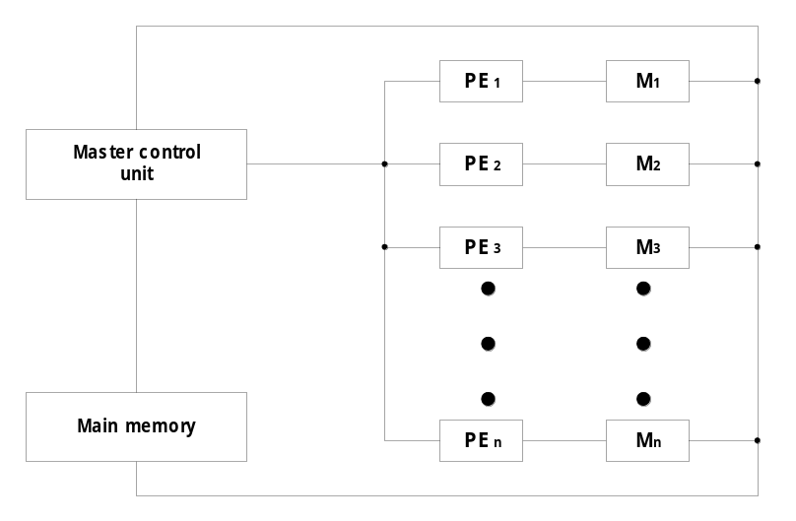
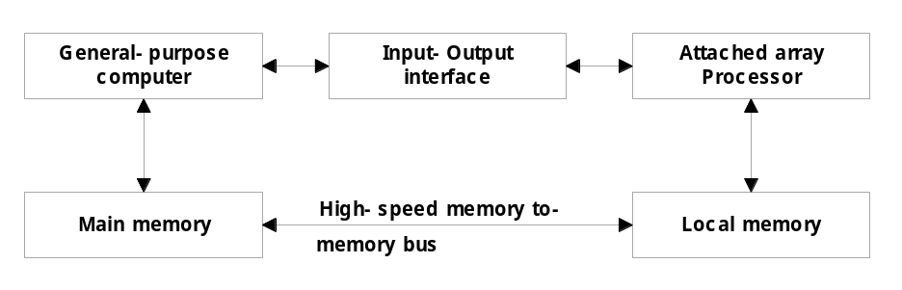
7-7 Array Processors
  Performs computations on large arrays of data
  Array Processing
    Attached array processor : Fig. 9-14
      Auxiliary processor attached to a general purpose computer
    SIMD array processor : Fig. 9-15
      Computer with multiple processing units operating in parallel
        Vector C = A + B c_{i} = a_{i} + b_{i}
        Pe_{i}
    Vector processing : Adder/Multiplier pipeline
    Array processing : array processor

