Slide 1
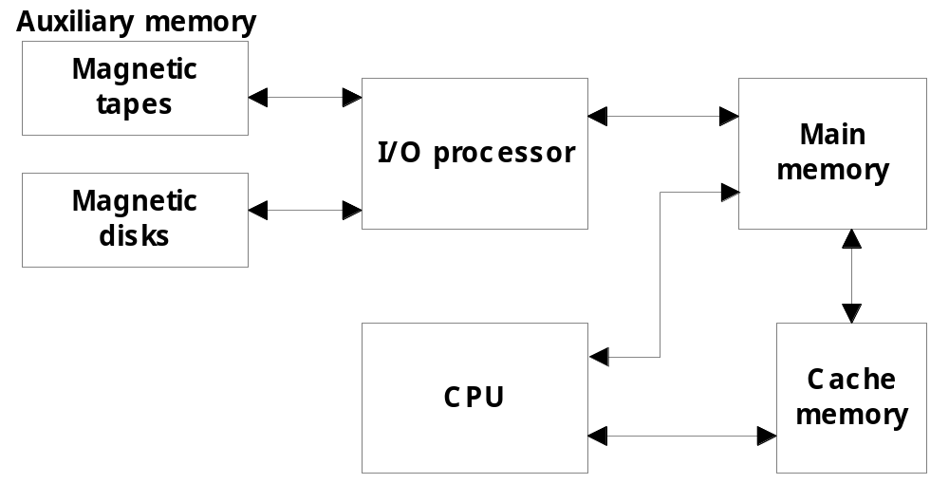
Chap. 12 Memory Organization
12-1 Memory Hierarchy
  Memory hierarchy in a computer system : Fig. 12-1
    Main Memory : memory unit that communicates directly with the CPU (RAM)
    Auxiliary Memory : device that provide backup storage (Disk Drives)
    Cache Memory : special very-high-speed memory to increase the processing speed (Cache RAM)
  Multiprogramming
    enable the CPU to process a number of independent program concurrently
  Memory Management System : sec. 12-7
    supervise the flow of information between auxiliary memory and main memory

Slide 2
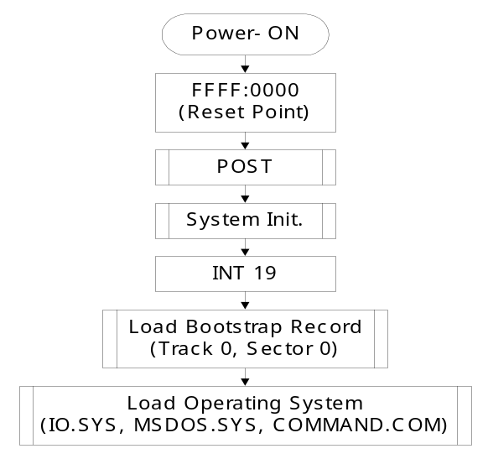
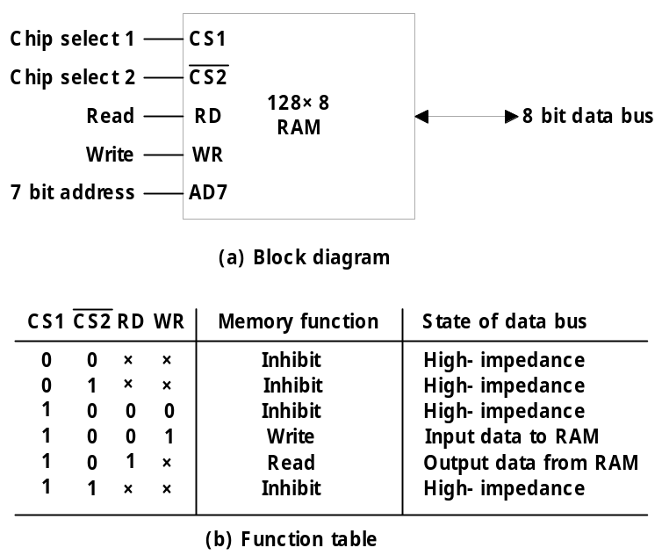
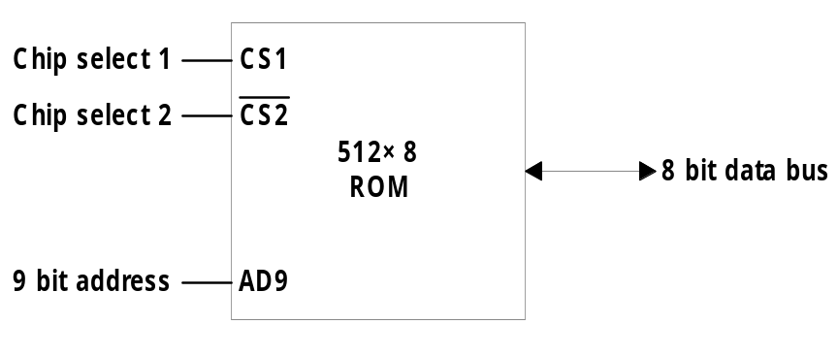
12-2 Main Memory
  Bootstrap Loader
    A program whose function is to start the computer software operating when power is turned on
  RAM and ROM Chips
    Typical RAM chip : Fig. 12-2
      128 X 8 RAM : 2⁷ = 128 (7 bit address lines)
    Typical ROM chip : Fig. 12-3
      512 X 8 ROM : 2⁹ = 512 (9 bit address lines)
Bootstrap Loader
Bootstrap ROM
Boot ROM

Slide 3
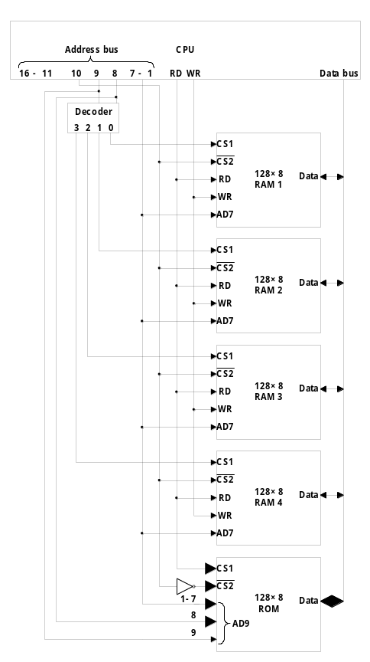
  Memory Address Map
    Memory Configuration : 512 bytes RAM + 512 bytes ROM
      1 x 512 byte ROM + 4 x 128 bytes RAM
    Memory Address Map : Tab. 12-1
      Address line 9 8
        RAM 1 0 0 : 0000 - 007F
        RAM 1 0 1 : 0080 - 00FF
        RAM 1 1 0 : 0100 - 017F
        RAM 1 1 1 : 0180 - 01FF
      Address line 10
        ROM 1 : 0200 - 03FF
    Memory Connection to CPU : Fig. 12-4
      2 x 4 Decoder : RAM select (CS1)
      Address line 10
        RAM select : CS2
        ROM select : CS2 의 Invert
      참고
        RD : ROM 의 CS1은 보통
        OE(Output Enable)로 사용

Slide 4
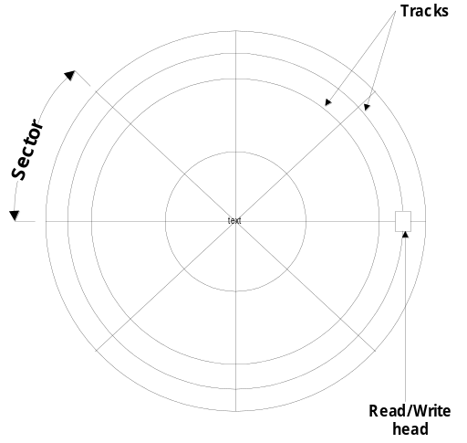
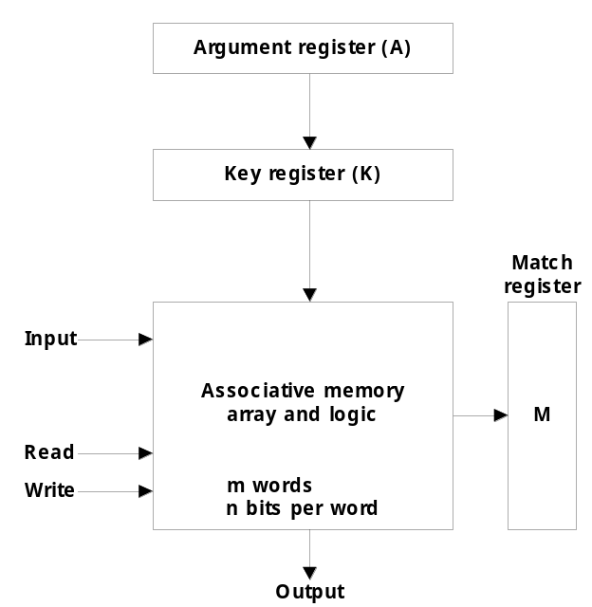
12-3 Auxiliary Memory
  Magnetic Disk : Fig. 12-5, FDD, HDD
  Magnetic Tape : Backup or Program 저장
  Optical Disk : CDR, ODD, DVD
12-4 Associative Memory
  Content Addressable Memory (CAM)
    A memory unit accessed by content
    Block Diagram : Fig. 12-6
이름
주소
A Register 101 111100
K Register 111 000000
Word 1 100 111100 M = 0
Word 2 101 000011 M = 1
Argument
Key (Mask)
Memory 내용
Match Logic
M = 1 일때 출력

Slide 5
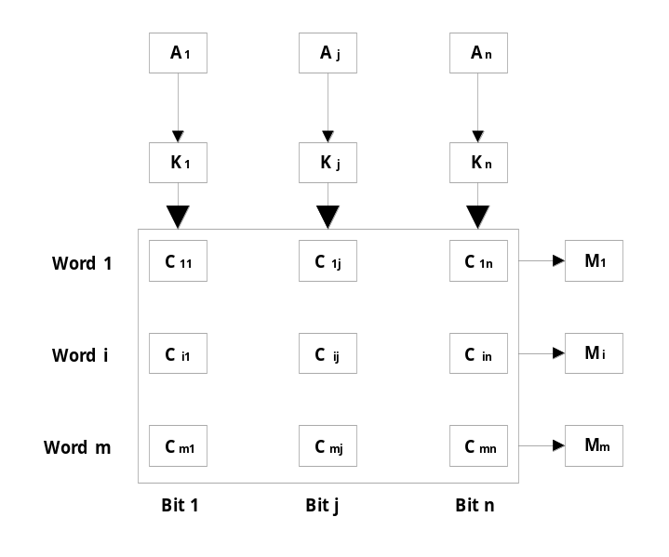
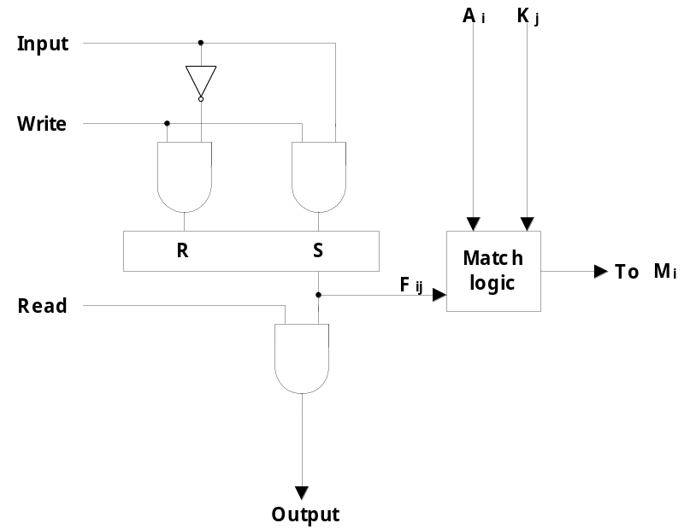
  m word x n cells per word : Fig. 12-7
  Match Logic
    One cell of associative memory : Fig. 12-8
      Input = 1 or 0 에 따라 Write 신호와 동시에 F/F에 저장
      A 와 K 에 의해 Match Logic 에서 M=1 이면 (M을 READ에 직접 연결 가능함)
      Read 신호에 따라 F/F에서 데이터를 읽는다

Slide 6
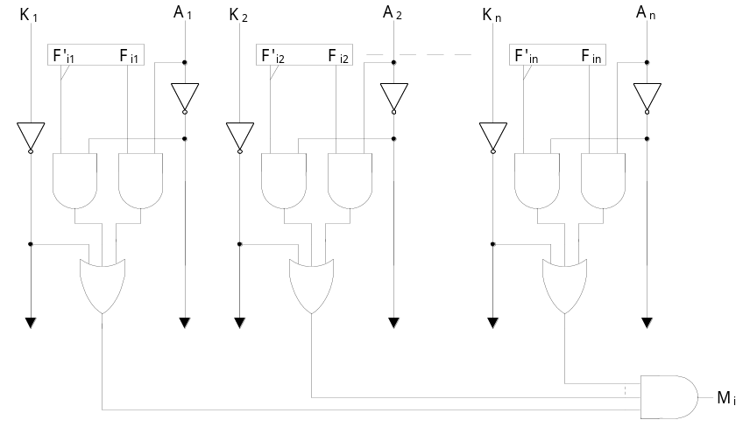

    Match Logic : Fig. 12-9
      A_{j} = Argument, F_{ij} = Cell ij 번째 bit
      j 번째 1 bit match 조건
      x_{j} = A_{j} F_{ij} (1 AND 1)+ A_{j}’ F_{ij}’ (0 AND 0)
      1 - n 까지 n bits match 조건 M_{i} = x₁x₂…..x_{n}
      Key bit K_{j} : x_{j} + K_{j}’
        K_{j} = 0 : A_{j} 와 F_{ij} 는 no comparison ( K_{j} : x_{j} + 1 = 1 )
        K_{j} = 1 : A_{j} 와 F_{ij} 는 comparison ( K_{j} : x_{j} + 0 = x_{j} )
      Match Logic for word I :
      M_{i} = (x₁ + K₁’) (x₂ + K₂’)…. (x_{n} + K_{n}’)
      = (x_{j} + K_{j}’)
      = (A_{j} F_{ij} + A_{j}’ F_{ij}’ + K_{j}’)

Slide 7
12-5 Cache Memory
  Locality of Reference
    the references to memory tend to be confined within a few localized areas in memory
  Cache Memory : a fast small memory
    keeping the most frequently accessed instructions and data in the fast cache memory
  Cache 의 설계 요소
    cache size : 보통 256 K byte (최대 512 K byte)
    mapping method : 1) associative, 2) direct, 3) set-associative
    replace algorithm : 1) LRU, 2) LFU, 3) FIFO
    write policy : 1) write-through, 2) write-back
  Hit Ratio
    the ratio of the number of hits divided by the total CPU references (hits + misses) to memory
      hit : the CPU finds the word in the cache (보통 0.9 이상)
      miss : the word is not found in cache (CPU must read main memory)
    예제 : cache memory access time = 100 ns, main memory access time = 1000 ns, hit ratio = 0.9
      1 회 miss : 1 x 1000 ns
      9 회 hit : 9 x 100 ns
총 10 회
Memory 참조
1900 ns / 10 회 = 190 ns
Cache가 없으면 1000 ns,
따라서 약 5 배 성능 향상

Slide 8
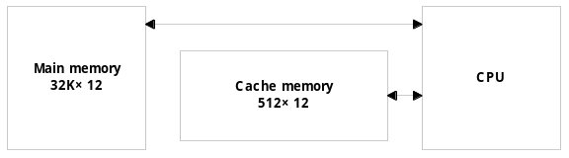
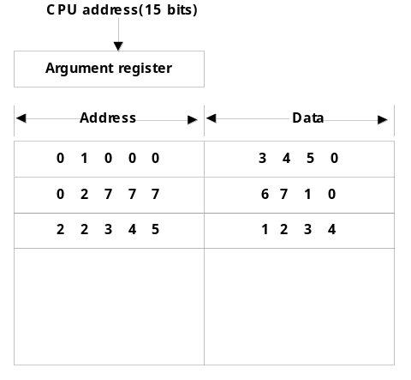
  Mapping
    The transformation of data from main memory to cache memory
      1) Associative mapping
      2) Direct mapping
      3) Set-associative mapping
  Example of cache memory : Fig. 12-10
    main memory : 32 K x 12 bit word (15 bit address lines)
    cache memory : 512 x 12 bit word
      CPU sends a 15-bit address to cache
        Hit : CPU accepts the 12-bit data from cache
        Miss : CPU reads the data from main memory (then data is written to cache)
  Associative mapping : Fig. 12-11
    Cache memory로 고가의 associative memory 사용
    Address 와 Data 가 직접 Cache memory에 사용됨
  Direct mapping : Fig. 12-12
    Cache memory로 저가의 일반 memory 사용
    Tag field (n - k) 와 Index field (k)를 사용
      2^{k} words cache memory + 2^{n} words main memory
        Tag = 6 bit (15 - 9), Index = 9 bit
Cache Coherence (Sec. 13-5)

Slide 9
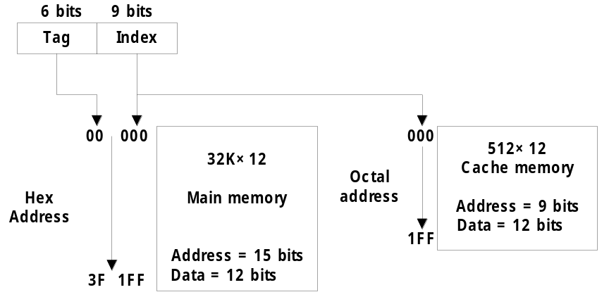
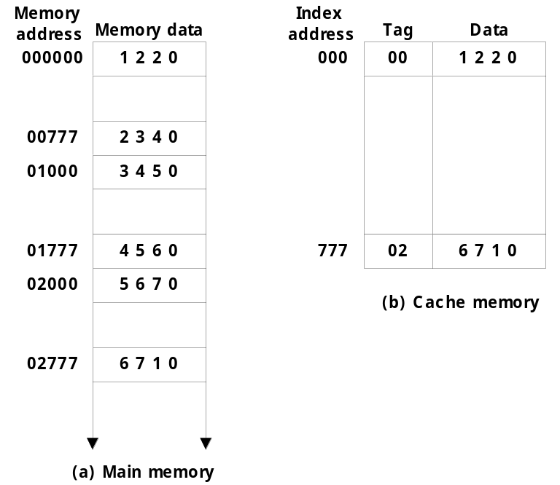
    Direct mapping cache organization : Fig. 12-13
      예제 : 02000 번지를 읽는 경우
        1) 우선 Index 000을 cache 에서 찾는다
        2) 다음은 Tag를 cache에서 비교한다
        3) 000 Index에 있는 cache tag는 00 이다
        (02가 아니다)
        4) 따라서 miss
        5) 그러므로 main memory에서 data read
        (address 02000 = 5670 read)
Tag (6 bit)
00 - 63
Index (9 bit)
000 - 511

Slide 10
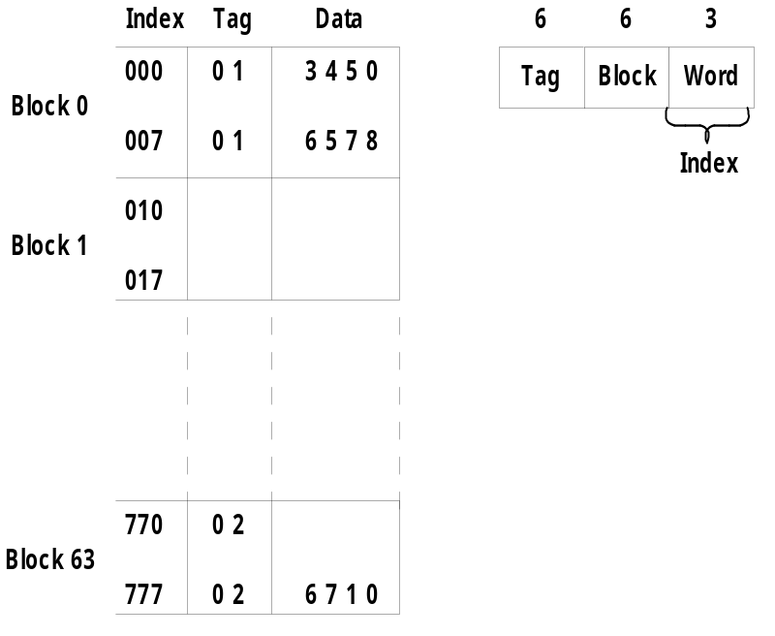
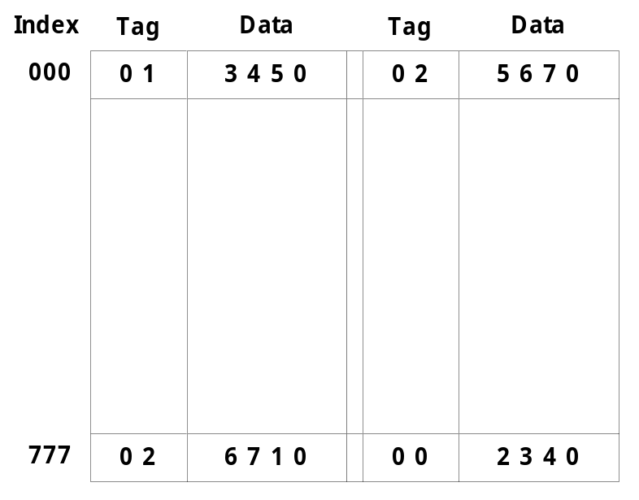
    Direct mapping cache with block size of 8 words : Fig. 12-14
      64 block x 8 word = 512 cache words size
        8 word 를 1개의 block 단위로 update
  Set-associative mapping : Fig. 12-15 (two-way)
    Direct mapping ( Fig. 12-13(b))에서 같은 Index에 다른 tag를 자주 읽으면 속도가 저하됨 ( 예제 02777, 01777 )
    따라서 set의 개수를 증가시키면 속도가 향상된다.

Slide 11
  Replacement Algorithm : cache miss or full 일때
    1) LRU (Least Recently Used) : 최근에 가장 적게 사용된 block 교체
    2) LFU (Least Frequently Used) : 사용 빈도가 가장 적은 block 교체
    3) FIFO (First-In First-Out) : 가장 오래된 block 교체
  Writing to Cache : Cache Coherence(Sec. 13-5)
    Cache에 있는 내용이 변경된(WRITE) 경우, Cache의 block이 교체되기 전에 main memory에 내용도 update 해야 함
      1) Write-through : Cache write 와 동시에 main memory도 항상 동시에 write 한다.
      2) Write-back : Cache write 시에 내용이 변경되었다는 flag 만 set해 놓고 나중에 block이 교체되기 전에 flag를 검사하여 변경된 부분만 나중에 write 한다.
        따라서 Write-back 방식은 main memory가 무효한 상태에 빠져 있을 수 있다.
  Cache Initialization
    Cache is initialized : 이때 cache 는 empty 상태이고 invalid data를 갖을 수 있다.
      1) when power is applied to the computer
      2) when main memory is loaded with a complete set of programs from auxiliary memory
    valid bit
      indicate whether or not the word contains valid data
Cache READ는 문제 없음
Main memory 와 Cache memory의 내용이 동일해야 함 : 통일성(일관성) 유지

Slide 12
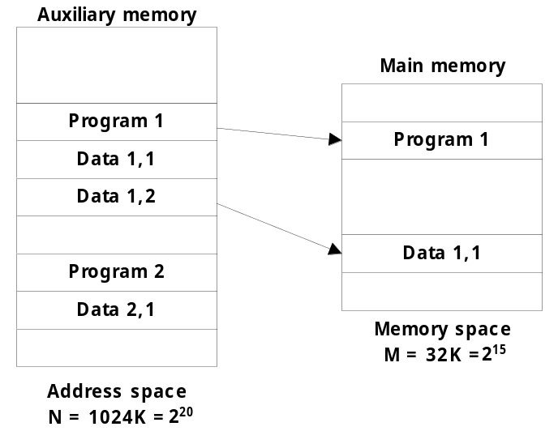
12-6 Virtual Memory
  Virtual Memory : Auxiliary memory Main memory
    Translate program-generated (Aux. Memory) address into main memory location
      Give programmers the illusion that they have a very large memory, even though the computer actually has a relatively small main memory
    예제 : Intel Pentium Processor
      Physical Address Lines = A₀ - A₃₁ : 2³² = 2³⁰ X 2² = 4 Giga
      Logical Address = 46 bits address : 2⁴⁶ = 2⁴⁰ X 2⁶ = 64 Tera
  Address Space & Memory Space
    Address Space : Virtual Address
      Address used by a programmer
    Memory Space : Physical Address(Location)
      Address in main memory
  예제 : Fig. 12-16
    address space (N) = 1024 K = 2²⁰
      Auxiliary Memory
    memory space (M) = 32 K = 2¹⁵
      main Memory

Slide 13
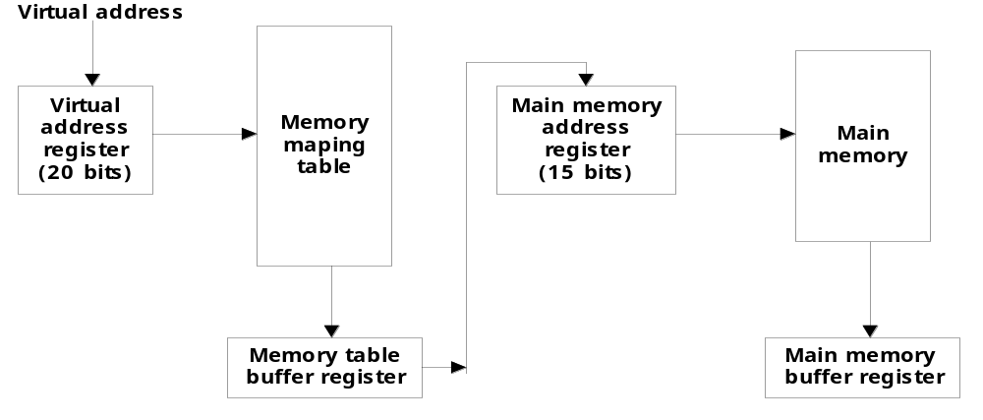
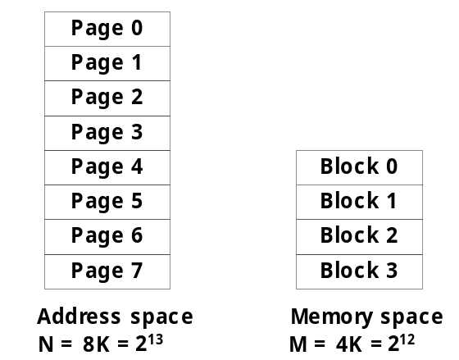
  Memory table for mapping a virtual address : Fig. 12-17
    Translate the 20 bits Virtual address into the 15 bits Physical address
  Address Mapping Using Pages : Fig. 12-18
    Address mapping 을 간단하게 하기 위하여 사용
      Address space와 memory space를 fixed size로
      분할하여 사용함
        Address space : 1 K page 로 분할
        Memory space : 1 k block으로 분할
      Address space의 4 개 page가 memory space에
      block에 들어 갈수 있다.

Slide 14
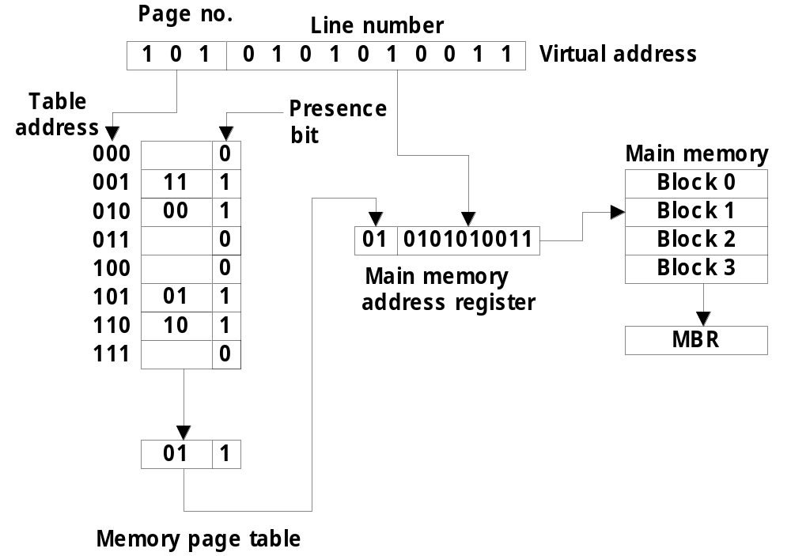
  Memory table in a paged system : Fig. 12-19

Slide 15
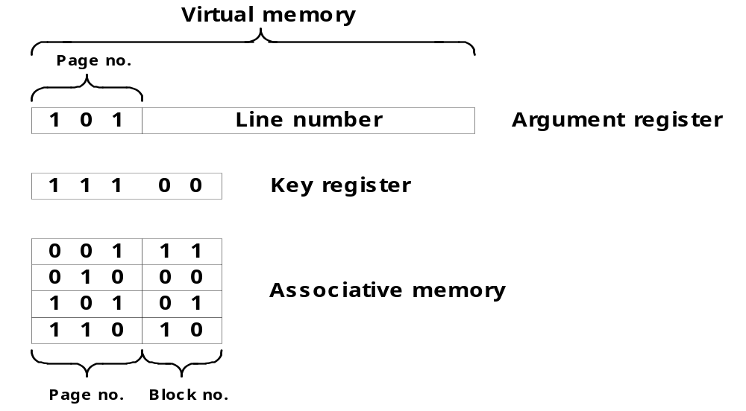
  Associative memory page table : Fig. 12-20
    Associative memory를 이용하여 block number(01)를 곧바로 찾는다
  Page(Block) Replacement
    Page Fault : the page referenced by the CPU is not in main memory
      a new page should be transferred from auxiliary memory to main memory
    Replacement algorithm : FIFO 와 LRU 주로 사용

Slide 16
12-7 Memory Management Hardware
  Basic components of a Memory Management Unit
    1) Address mapping
    2) Common program sharing
    3) Program protection
  MMU : OS 에서 지원 해야 함
    1) CPU에 내장된 형태
    2) 별도의 memory controller 형태
  Segment
    A set of logically related instruction or data elements associated with a given name
    예제 : a subroutine, an array of data, a table of symbol, user’s program
  Logical Address
    the address generated by a segmented program
    similar to virtual address
      Virtual Address : fixed-length page
      Logical Address : variable-length segment

Slide 17
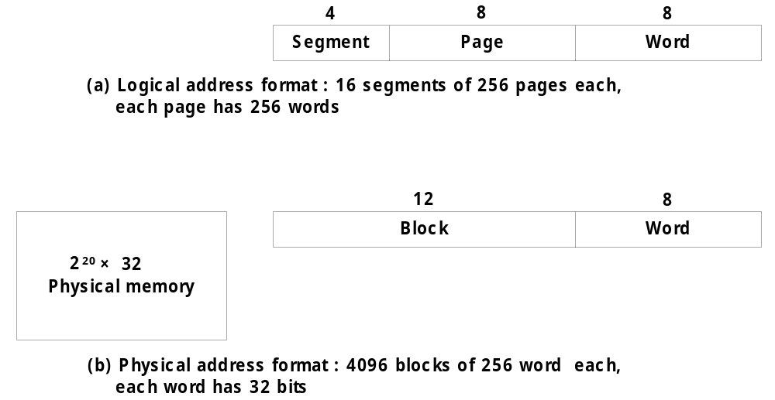
  Segmented-page MMU
    Fig. 12-21(a) : 2 개의 table(segment, page)을 사용함
      따라서 2 개의 table을 읽는데 많은 시간이 소모됨
    Fig. 12-21(b) : Associative memory를 이용한 1 개의 table을 사용함
      따라서 속도가 빠르다
      TLB (Translation Look-a-side Buffer)
        associative memory를 이용한 most recently reference table
  Numerical Example
    예제 : Logical address & Physical address (Fig. 12-22)
      Logical Address :
        4 bit segment : 16 segments
        8 bit page : 256 pages
        8 bit word : 256 address field
      Physical Address :
        12 bit block : 4096 blocks
        8 bit word : 256 address field
Address
or Index

Slide 18
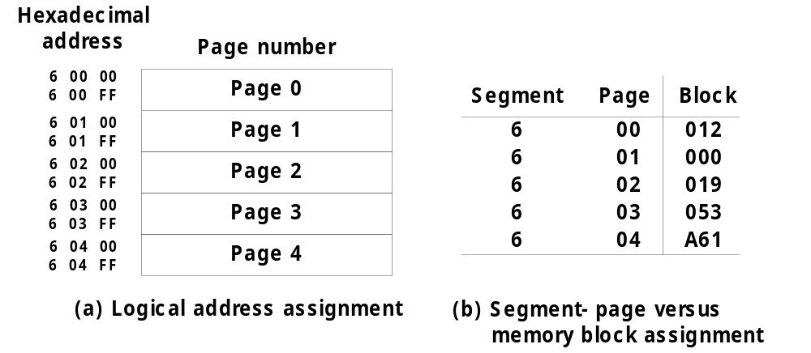
    예제 : Logical & Physical address assignment (Fig. 12-23)
Logical Address
Page Table
Segment
Page
Word
Block number 019 를 찾는다

Slide 19
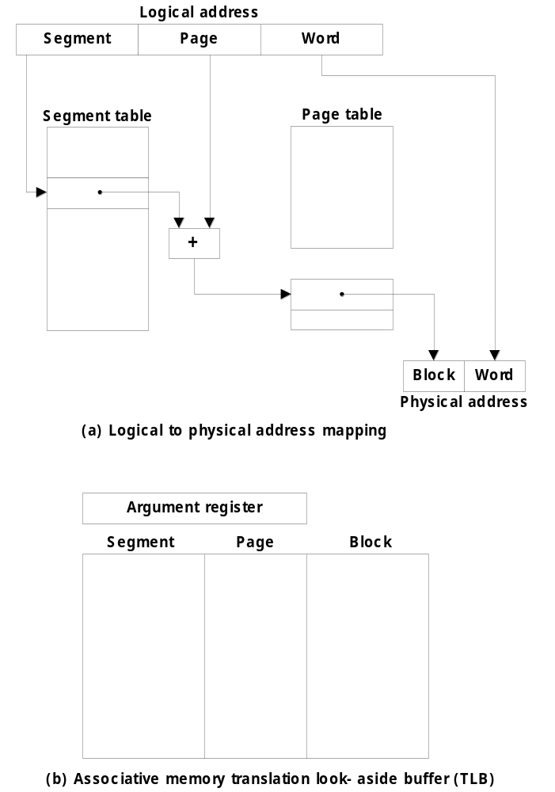
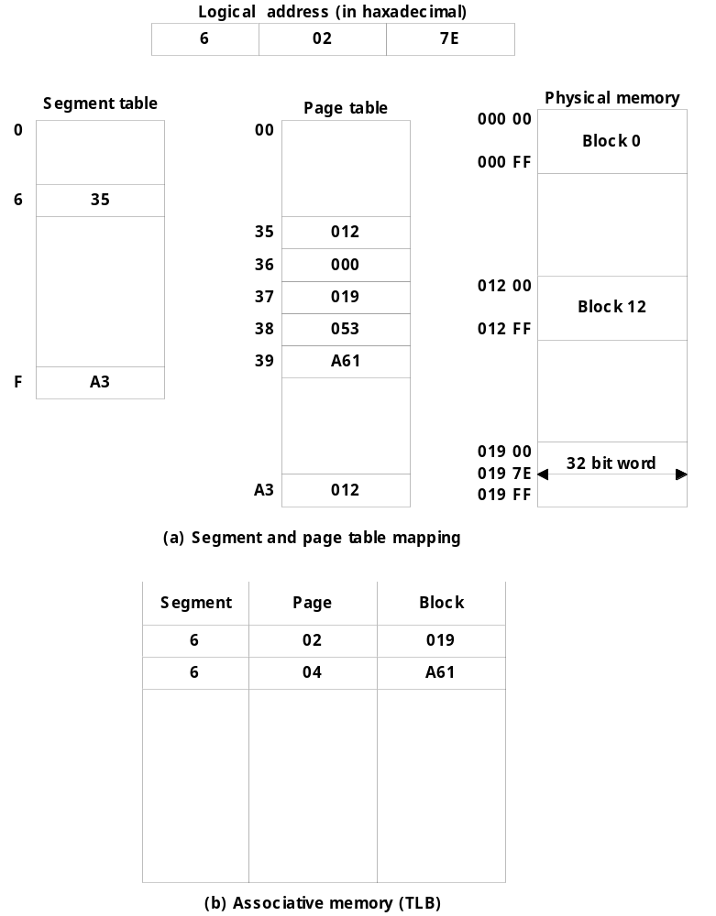
+

Slide 20
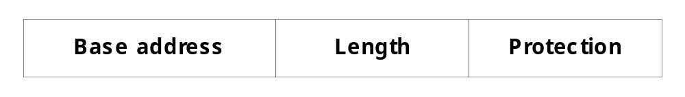
  Memory Protection
    Typical segment descriptor : Fig. 12-25
    Access Rights : protecting the programs residing in memory
      1) Full read and write privileges : no protection
      2) Read only : write protection
      3) Execute only : program protection
      4) System only : operating system protection
segment
Length
Base address

