Slide 1
Chapter 5:
Project Quality Management
Information Technology Project Management, Sixth Edition
Note: See the text itself for full citations.

Slide 2
Learning Objectives
Understand the importance of project quality management for information technology (IT) products and services
Define project quality management and understand how quality relates to various aspects of IT projects
Describe quality management planning and how quality and scope management are related
Discuss the importance of quality assurance
Explain the main outputs of the quality control process

Slide 3
Learning Objectives
Understand the tools and techniques for quality control, such as the Seven Basic Tools of Quality, statistical sampling, Six Sigma, and testing
Summarize the contributions of noteworthy quality experts to modern quality management
Describe how leadership, the cost of quality, organizational influences, expectations, cultural differences, and maturity models relate to improving quality in IT projects
Discuss how software can assist in project quality management

Slide 4
The Importance of Project Quality Management
Many people joke about the poor quality of IT products (see cars and computers joke on pages 292-294)
People seem to accept systems being down occasionally or needing to reboot their PCs
But quality is very important in many IT projects

Slide 5
What Went Wrong?
In 1986, two hospital patients died after receiving fatal doses of radiation from a Therac 25 machine after a software problem caused the machine to ignore calibration data
In one of the biggest software errors in banking history, Chemical Bank mistakenly deducted about $15 million from more than 100,000 customer accounts
In August 2008, the Privacy Rights Clearinghouse stated that more than 236 million data records of U.S. residents have been exposed due to security breaches since January 2005
In March 2012, Consumer Reports listed several recalls on its Web site in less than 10 days, including LED lights overheating, five different models of cars having problems

Slide 6
What Is Project Quality?
The International Organization for Standardization (ISO) defines quality as “the degree to which a set of inherent characteristics fulfils requirements” (ISO9000:2000)
Other experts define quality based on:
  Conformance to requirements: The project’s processes and products meet written specifications
  Fitness for use: A product can be used as it was intended

Slide 7
What Is Project Quality Management?
Project quality management ensures that the project will satisfy the needs for which it was undertaken
Project quality management involves three main processes:
  Plan quality management: Identifying which quality standards are relevant to the project and how to satisfy them; a metric is a standard of measurement
  Perform quality assurance: Periodically evaluating overall project performance to ensure the project will satisfy the relevant quality standards
  Control quality: Monitoring specific project results to ensure that they comply with the relevant quality standards
Notes:
The main outputs of quality planning are a quality management plan, quality metrics,
quality checklists, a process improvement plan, and project document updates. A
metric is a standard of measurement. Examples of common metrics include failure rates of products produced, availability of goods and services, and customer
satisfaction ratings

Slide 8
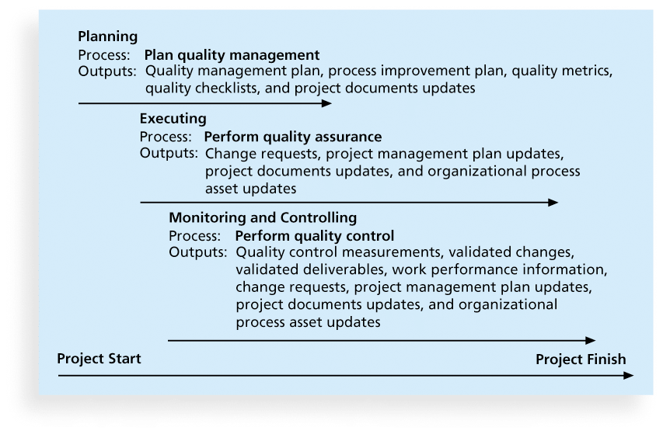
Figure 8-1. Project Quality Management Summary

Slide 9
Planning Quality
Implies the ability to anticipate situations and prepare actions to bring about the desired outcome
Important to prevent defects by:
  Selecting proper materials
  Training and indoctrinating people in quality
  Planning a process that ensures the appropriate outcome

Slide 10
Scope Aspects of IT Projects
Important scope aspects of information technology projects that affect quality include functionality and features, system outputs, performance, and reliability and maintainability.
Functionality is the degree to which a system performs its intended function
Features are the system’s special characteristics that appeal to users
System outputs are the screens and reports the system generates
Performance addresses how well a product or service performs the customer’s intended use
Reliability is the ability of a product or service to perform as expected under normal conditions
Maintainability addresses the ease of performing maintenance on a product

Slide 11
Who’s Responsible for the Quality of Projects?
Project managers are ultimately responsible for quality management on their projects
Several organizations and references can help project managers and their teams understand quality
  International Organization for Standardization (www.iso.org)
  IEEE (www.ieee.org)

Slide 12
Performing Quality Assurance
Quality assurance includes all the activities related to satisfying the relevant quality standards for a project
Another goal of quality assurance is continuous quality improvement
Benchmarking generates ideas for quality improvements by comparing specific project practices or product characteristics to those of other projects or products within or outside the performing organization
A quality audit is a structured review of specific quality management activities that help identify lessons learned that could improve performance on current or future projects
Notes:
For example, if a competitor has an EIS with an
average down time of only one hour a week, that might be a benchmark for which to strive.
Fishbone or Ishikawa diagrams, as described later in this chapter, can assist in ensuring and
improving quality by finding the root causes of quality problems

Slide 13
Controlling Quality
The main outputs of quality control are:
  Acceptance decisions
  Rework
  Process adjustments
There are Seven Basic Tools and Techniques that help in performing quality control

Slide 14
1. Cause-and-Effect Diagrams
Cause-and-effect diagrams trace complaints about quality problems back to the responsible production operations
They help you find the root cause of a problem
Also known as fishbone or Ishikawa diagrams
Can also use the 5 whys technique where you repeated ask the question “Why” (five is a good rule of thumb) to peel away the layers of symptoms that can lead to the root cause

Slide 15
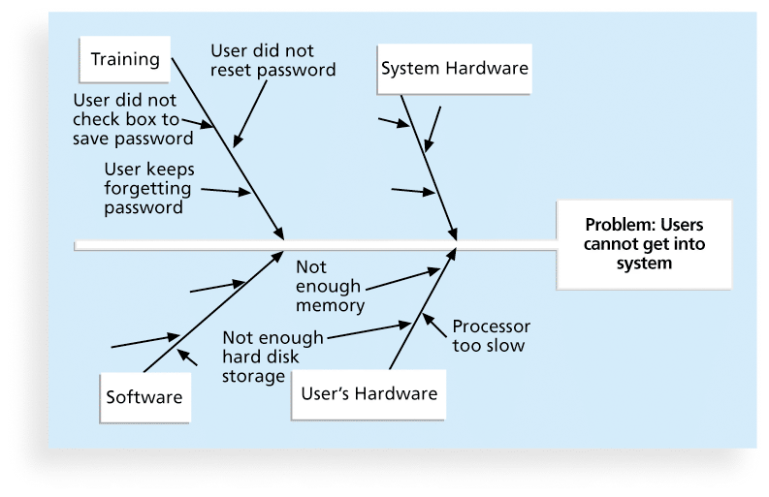
Figure 8-2. Sample Cause-and-Effect Diagram

Slide 16
2. Quality Control Charts
A control chart is a graphic display of data that illustrates the results of a process over time
The main use of control charts is to prevent defects, rather than to detect or reject them
Quality control charts allow you to determine whether a process is in control or out of control
  When a process is in control, any variations in the results of the process are created by random events; processes that are in control do not need to be adjusted
  When a process is out of control, variations in the results of the process are caused by non-random events; you need to identify the causes of those non-random events and adjust the process to correct or eliminate them

Slide 17
The Seven Run Rule
You can use quality control charts and the seven run rule to look for patterns in data
The seven run rule states that if seven data points in a row are all below the mean, above the mean, or are all increasing or decreasing, then the process needs to be examined for non-random problems
Notes:
The "seven run rule" is a commonly used rule of thumb in statistical process control (SPC) that states that if seven consecutive data points in a control chart fall on the same side of the centerline (either above or below), or exhibit a consistent increasing or decreasing trend, then the process may be out of control and should be examined for non-random problems.

Slide 18
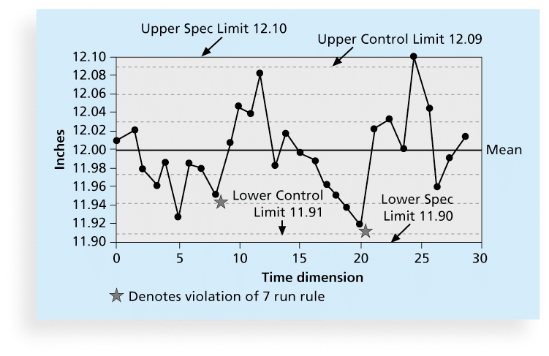
Figure 8-3. Sample Quality
Control Chart

Slide 19
3. Scatter diagram
A scatter diagram helps to show if there is a relationship between two variables
The closer data points are to a diagonal line, the more closely the two variables are related
Notes:
Scatter diagrams are commonly used in data analysis to explore the relationship between two variables. They can help identify patterns or trends in the data, as well as any outliers or anomalies. They are particularly useful for identifying correlations between variables, where a change in one variable may be related to a change in the other variable.

Slide 20
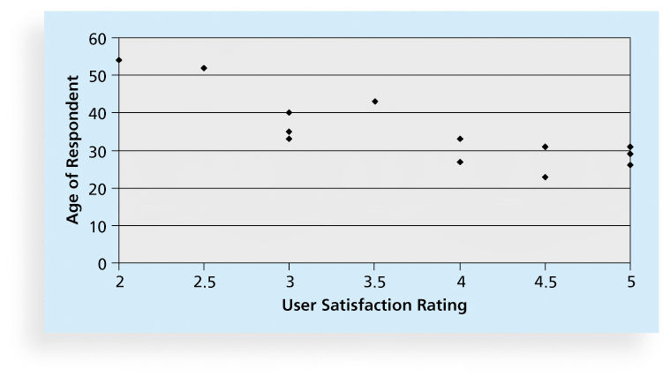
Figure 8-5. Sample Scatter Diagram

Slide 21
4. Histograms
A histogram is a bar graph of a distribution of variables
Each bar represents an attribute or characteristic of a problem or situation, and the height of the bar represents its frequency
For example, Scott Daniels might ask the Help Desk to create a histogram to show how many total complaints they received each week related to the EIS system. Figure 8-6 shows a sample histogram.

Slide 22
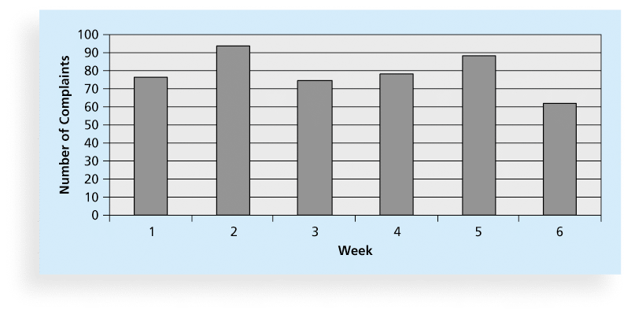
Figure 8-6. Sample Histogram

Slide 23
5. Pareto Charts
A Pareto chart is a histogram that can help you identify and prioritize problem areas
Pareto analysis is also called the 80-20 rule, meaning that 80 percent of problems are often due to 20 percent of the causes

Slide 24
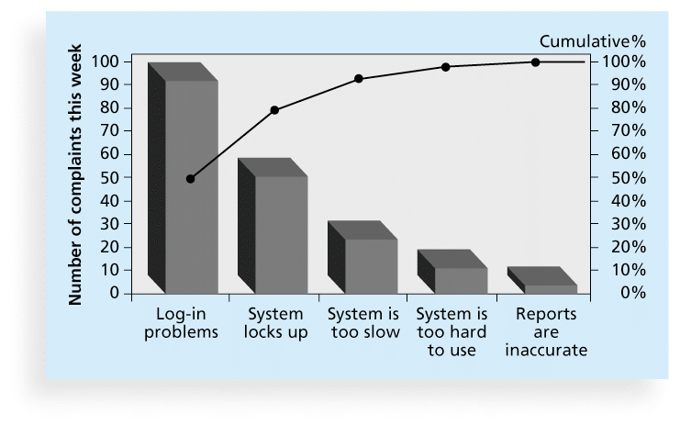
Figure 8-7. Sample Pareto Chart

Slide 25
6. Flowcharts
Flowcharts are graphic displays of the logic and flow of processes that help you analyze how problems occur and how processes can be improved
They show activities, decision points, and the order of how information is processed
Figure 8-8 provides a simple example of a flowchart that shows the process a project team might use for accepting or rejecting deliverables.

Slide 26
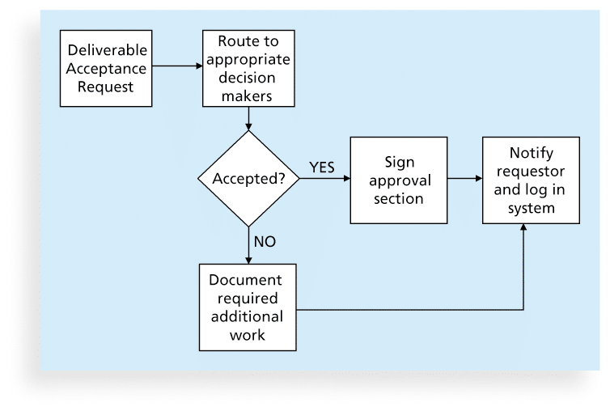
Figure 8-8. Sample Flowchart

Slide 27
7. Run Charts
In addition to flowcharts, run charts are also used for stratification, a technique that shows data from a variety of sources to see if a pattern emerges
A run chart displays the history and pattern of variation of a process over time.
You can use run charts to perform trend analysis and forecast future outcomes based on historical results

Slide 28
Cont’d
Figure 8-4 shows a sample run chart, charting the number of defects each month for three different types of defects. Notice that you can easily see the patterns of Defect 1 continuing to increase over time, Defect 2 decreasing the first several months and then holding steady, and Defect 3 fluctuating each month.

Slide 29
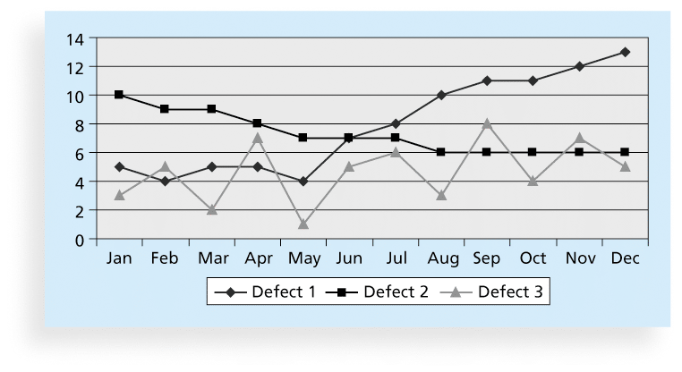
Figure 8-9. Sample Run Chart

Slide 30
Statistical Sampling
Statistical sampling involves choosing part of a population of interest for inspection
The size of a sample depends on how representative you want the sample to be
Sample size formula:
  Sample size = .25 X (certainty factor/acceptable error)²
Be sure to consult with an expert when using statistical analysis

Slide 31
Example
Here, the certainty factor represents the desired level of confidence (usually expressed as a percentage, e.g., 95% or 99%), while the acceptable error refers to the margin of error (also expressed as a percentage).
Please note that you should convert the percentages to decimals when using the formula. For example, if you want a 95% certainty level (0.95) with a 5% acceptable error (0.05), the formula would be:
n = 0.25 * (0.95 / 0.05)²
n ≈ 90.25
In this case, you would need a sample size of approximately 91 participants to achieve a 95% certainty level with a 5% acceptable error.

Slide 32
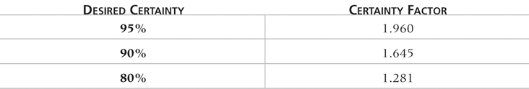
Table 8-1. Commonly Used Certainty Factors

Slide 33
Six Sigma
Six Sigma is “a comprehensive and flexible system for achieving, sustaining, and maximizing business success. Six Sigma is uniquely driven by close understanding of customer needs, disciplined use of facts, data, and statistical analysis, and diligent attention to managing, improving, and reinventing business processes”*
*Pande, Peter S., Robert P. Neuman, and Roland R. Cavanagh, The
Six Sigma Way, New York: McGraw-Hill, 2000, p. xi.
Notes:
Six Sigma is a data-driven methodology for process improvement, which originated in the manufacturing industry but has since been applied across various sectors, including in Ethiopia. It focuses on reducing defects and errors in business processes, leading to improved quality, efficiency, and customer satisfaction.
The Six Sigma approach uses a set of quality management techniques, statistical analysis, and a structured framework called DMAIC (Define, Measure, Analyze, Improve, and Control). By implementing Six Sigma in Ethiopian businesses and organizations, they can benefit from increased efficiency, reduced waste, and enhanced competitiveness in the global market.

Slide 34
Basic Information on Six Sigma
The target for perfection is the achievement of no more than 3.4 defects per million opportunities
The principles can apply to a wide variety of processes
Six Sigma projects normally follow a five-phase improvement process called DMAIC

Slide 35
DMAIC
DMAIC is a systematic, closed-loop process for continued improvement that is scientific and fact based
DMAIC stands for:
  Define: Define the problem/opportunity, process, and customer requirements
  Measure: Define measures, then collect, compile, and display data
  Analyze: Scrutinize process details to find improvement opportunities
  Improve: Generate solutions and ideas for improving the problem
  Control: Track and verify the stability of the improvements and the predictability of the solution

Slide 36
How is Six Sigma Quality
Control Unique?
It requires an organization-wide commitment.
Training follows the “Belt” system
Six Sigma organizations have the ability and willingness to adopt contrary objectives, such as reducing errors and getting things done faster
It is an operating philosophy that is customer focused and strives to drive out waste, raise levels of quality, and improve financial performance at breakthrough levels

Slide 37
Testing
Many IT professionals think of testing as a stage that comes near the end of IT product development – Wrong!!
Testing should be done during almost every phase of the IT product development life cycle

Slide 38
One type of Testing--Walkthroughs
A WALKTHROUGH after every level of design
  Architectural Design
    Walkthrough
  Database Design
    Walkthrough
  Medium-level Design
    Walkthrough
  Detailed Design
    Walkthrough
What is a Walkthrough???

Slide 39
What’s new in Testing?
TDD – Test-Driven Development
  To clarify requirements, have users/developers write the Acceptance Test Plan immediately after defining requirements (Requirements Document)
  Helps developers better understand what the user requires…
DB&T –Daily Build and Test Practice
  Promoted by Microsoft
  The Heartbeat of the development process

Slide 40
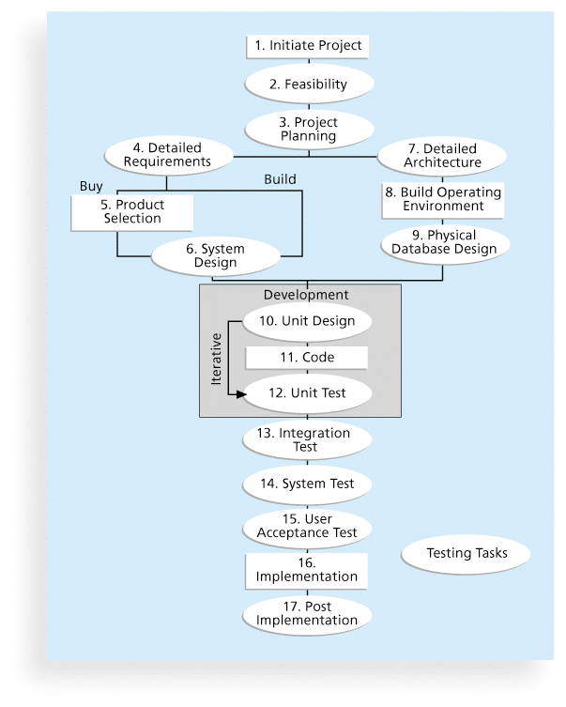
Figure 8-11. Testing Tasks in the Software Development Life Cycle

Slide 41
Types of Tests
Unit testing tests each individual component (often a program) to ensure it is as defect-free as possible
Integration testing occurs between unit and system testing to test functionally grouped components
System testing tests the entire system as one entity
User acceptance testing is an independent test performed by end users prior to accepting the delivered system

Slide 42
Modern Quality Management
Modern quality management:
  Requires customer satisfaction
  Prefers prevention to inspection
  Recognizes management responsibility for quality
Noteworthy quality experts include Deming, Juran, Crosby, Ishikawa, Taguchi, and Feigenbaum

Slide 43
Quality Experts
Deming was famous for his work in rebuilding Japan and his 14 Points for Management
Juran wrote the Quality Control Handbook and ten steps to quality improvement
Crosby wrote Quality is Free and suggested that organizations strive for zero defects
Ishikawa developed the concepts of quality circles and fishbone diagrams
Taguchi developed methods for optimizing the process of engineering experimentation
Feigenbaum developed the concept of total quality control

Slide 44
Malcolm Baldrige Award
The Malcolm Baldrige National Quality Award originated in 1987 to recognize companies that have achieved a level of world-class competition through quality management
Given by the President of the United States to U.S. businesses
Three awards each year in different categories:
  Manufacturing
  Service
  Small business
  Education and health care

Slide 45
ISO Standards
ISO 9000 is a quality system standard that:
  Is a three-part, continuous cycle of planning, controlling, and documenting quality in an organization
  Provides minimum requirements needed for an organization to meet its quality certification standards
  Helps organizations around the world reduce costs and improve customer satisfaction
See www.iso.org for more information

Slide 46
Improving Information Technology Project Quality
Several suggestions for improving quality for IT projects include:
  Establish leadership that promotes quality
  Understand the cost of quality
  Focus on organizational influences and workplace factors that affect quality
  Follow maturity models

Slide 47
Leadership
As Joseph M. Juran said in 1945, “It is most important that top management be quality-minded. In the absence of sincere manifestation of interest at the top, little will happen below”*
A large percentage of quality problems are associated with management, not technical issues.
  *American Society for Quality (ASQ), (www.asqc.org/about/history/juran.html).

Slide 48
The Cost of Quality
The cost of quality is the cost of conformance plus the cost of nonconformance
  Conformance means delivering products that meet requirements and fitness for use
  Cost of nonconformance means taking responsibility for failures or not meeting quality expectations
A study reported that software bugs cost the U.S. economy $59.6 billion each year and that one third of the bugs could be eliminated by an improved testing infrastructure

Slide 49
Five Cost Categories Related to Quality
Prevention cost: Cost of planning and executing a project so it is error-free or within an acceptable error range
Appraisal cost: Cost of evaluating processes and their outputs to ensure quality
Internal failure cost: Cost incurred to correct an identified defect before the customer receives the product
External failure cost: Cost that relates to all errors not detected and corrected before delivery to the customer
Measurement and test equipment costs: Capital cost of equipment used to perform prevention and appraisal activities

Slide 50
Organizational Influences, Workplace Factors, and Quality
Study by DeMarco and Lister showed that organizational issues had a much greater influence on programmer productivity than the technical environment or programming languages
Programmer productivity varied by a factor of one to ten across organizations, but only by 21 percent within the same organization
Study found no correlation between productivity and programming language, years of experience, or salary.
A dedicated workspace and a quiet work environment were key factors to improving programmer productivity

Slide 51
Expectations and Cultural Differences in Quality
Project managers must understand and manage stakeholder expectations.
Expectations also vary by:
  Organization’s culture
  Geographic regions

Slide 52
Maturity Models
Maturity models are frameworks for helping organizations improve their processes and systems
  The Software Quality Function Deployment Model focuses on defining user requirements and planning software projects
  The Software Engineering Institute’s Capability Maturity Model Integration is a process improvement approach that provides organizations with the essential elements of effective processes

Slide 53
Capability Maturity Model Integration (CMMI)Levels
Capability Maturity Model Integration (CMMI) is a process improvement approach that provides organizations with the essential elements of effective processes.
CMMI levels, from lowest to highest, are:
  0. Incomplete: a process is either not performed or partially performed.
  1. Performed
  2. Managed
  3. Defined
  4. Quantitatively Managed
  5. Optimizing
Companies may not get to bid on government projects unless they have a CMMI Level 3 means Defined.
Notes:
CMMI Level 3, also known as the "Defined" level, focuses on the establishment of well-defined and documented processes, practices, and procedures within an organization. At this level, organizations have standardized their processes across the entire organization, and these processes are tailored from an organization's set of standard processes according to guidelines.
Some key characteristics of CMMI Level 3 include:
Process standardization: All projects within the organization follow a consistent set of processes, which are tailored from a standard process library.
Process documentation: Processes are documented in detail, providing clear guidance for project teams on how to execute tasks and activities.
Process measurement: Organizations collect and analyze data to measure the effectiveness of their processes, allowing for continuous improvement.
Process training: Team members are trained to ensure they have the necessary skills and knowledge to perform their roles effectively.

Slide 54
PMI’s Maturity Model
PMI released the Organizational Project Management Maturity Model (OPM3) in December 2003
Model is based on market research surveys sent to more than 30,000 project management professionals and incorporates 180 best practices and more than 2,400 capabilities, outcomes, and key performance indicators
Addresses standards for excellence in project, program, and portfolio management best practices and explains the capabilities necessary to achieve those best practices

Slide 55
Using Software to Assist in Project Quality Management
Spreadsheet and charting software helps create Pareto diagrams, fishbone diagrams, and so on
Statistical software packages help perform statistical analysis
Specialized software products help manage Six Sigma projects or create quality control charts
Project management software helps create Gantt charts and other tools to help plan and track work related to quality management. Examples include Trello, Asana, Microsoft Project, and Basecamp.

Slide 56
End of Chapter-5

