Slide 1
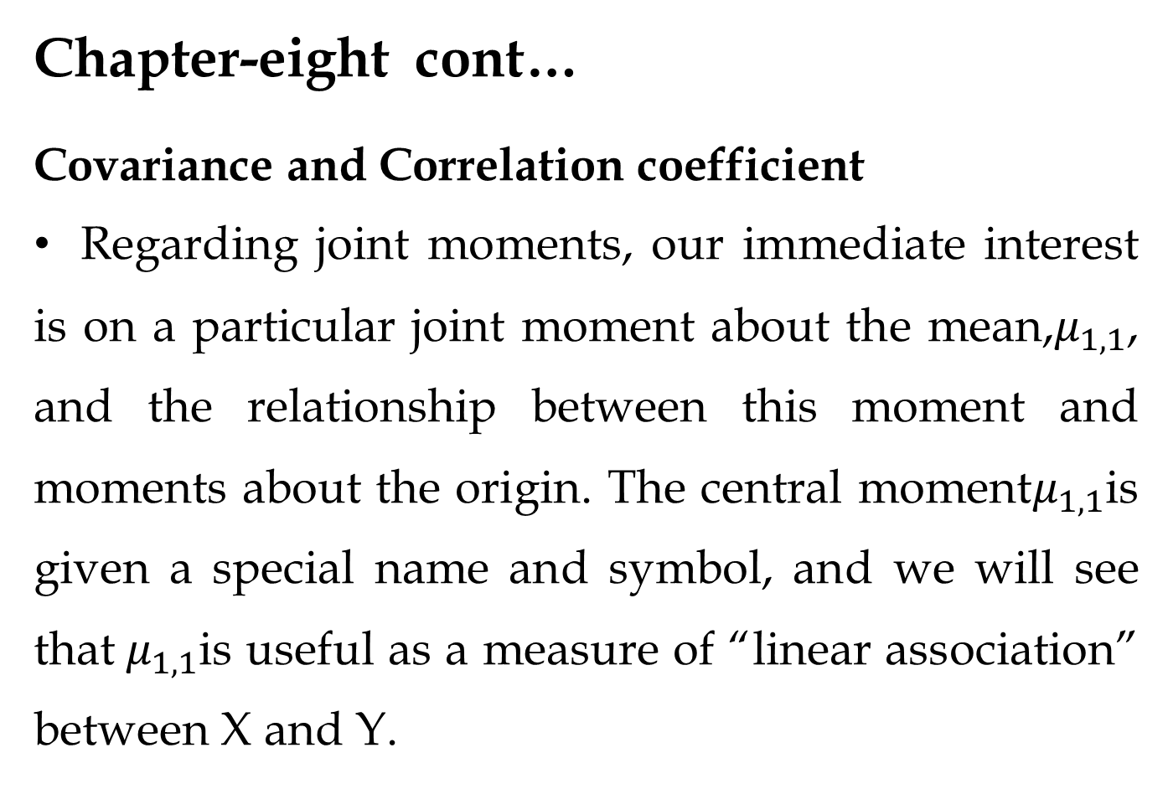
Chapter-eight cont…
Covariance and Correlation coefficient
Regarding joint moments, our immediate interest is on a particular joint moment about the mean,$μ_{1,1}$, and the relationship between this moment and moments about the origin. The central moment$μ_{1,1}$is given a special name and symbol, and we will see that${ μ}_{1,1}$is useful as a measure of “linear association” between X and Y.

Slide 2
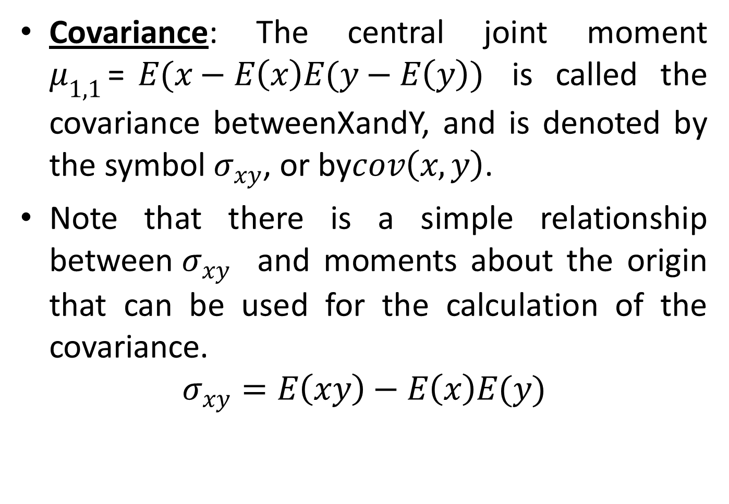
Covariance: The central joint moment $μ_{1,1}$=$E(x−E\left(x\right)E(y−E\left(y\right))$ is called the covariance betweenXandY, and is denoted by the symbol${ σ}_{xy}$, or by$cov\left(x,y\right)$.
Note that there is a simple relationship between${ σ}_{xy}$ and moments about the origin that can be used for the calculation of the covariance.
$$σ_{xy}=E\left(xy\right)−E\left(x\right)E(y)$$

Slide 3
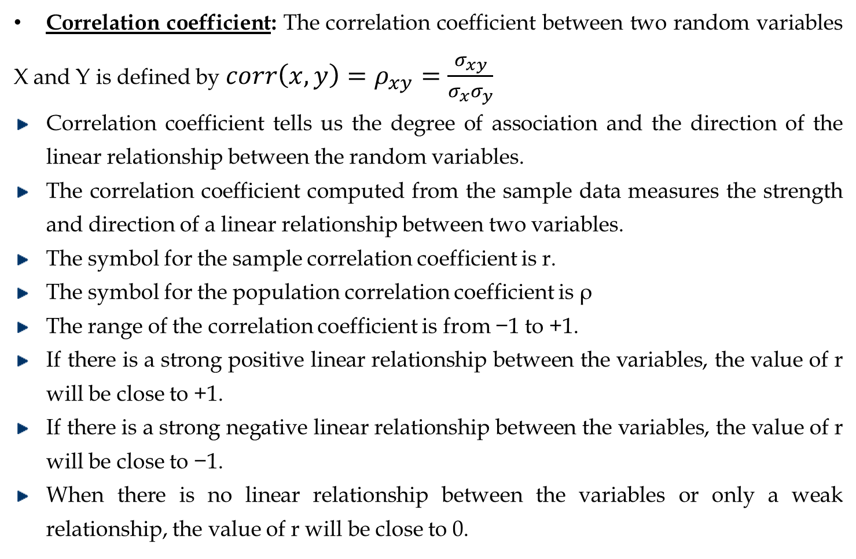
Correlation coefficient: The correlation coefficient between two random variables X and Y is defined by$corr\left(x,y\right)=ρ_{xy}=\frac{σ_{xy}}{σ_{x}σ_{y}}$
Correlation coefficient tells us the degree of association and the direction of the linear relationship between the random variables.
The correlation coefficient computed from the sample data measures the strength and direction of a linear relationship between two variables.
The symbol for the sample correlation coefficient is r.
The symbol for the population correlation coefficient is ρ
The range of the correlation coefficient is from −1 to +1.
If there is a strong positive linear relationship between the variables, the value of r will be close to +1.
If there is a strong negative linear relationship between the variables, the value of r will be close to −1.
When there is no linear relationship between the variables or only a weak relationship, the value of r will be close to 0.

Slide 4
CHAPTER-NINE
common Probability Distributions

Slide 5
Objectives
After studying this chapter, you should be able to:
Distinguish between Discrete random variables from continuous random variables.
Find the expected value and standard deviation of discrete probability distribution.
Calculate probability problems by applying definition of probability.
Apply expected value in decision making.

Slide 6
9.1 Common discrete distributions

Slide 7
9.1.1Binomial distribution
A binomial experiment is a probability experiment that satisfy the following four requirements
There must be a fixed number of trials called n
Each trial can have only two outcomes or outcomes that can be reduced to two outcomes. These outcomes can be considered ether success or failure
The outcome of each trial must be independent of each other.
The probability of success must remain the same for each trial.
The outcome of a binomial experiment and the corresponding probabilities of these outcomes are called a Binomial Distribution.
Pr (X=success) = Pr (X=1) = p
Pr (X=failure) = Pr (X=0) = 1-p

Slide 8
Binomial distribution, generally
If you have only two possible outcomes (call them 1/0 or yes/no or success/failure) in n independent trials, then the probability of exactly X “successes” is:
n = number of trials
1-p = probability of failure
X = # successes out of n trials
p = probability of success

Slide 9
Binomial distribution….
Example 1: Suppose that in a certain population, 52% of all recorded births are males. If we select randomly 10 birth records, what is the probability that exactly
5 will be males?
Given n=10, x=5 and p = 0.52
Pr (X= x) = n! p ^{x} (1- p) ^{n- x}
x ! (n -x )!
Therefore, Pr (X=5) = 10! X 0.52 ⁵ x (1- 0.52)¹⁰⁻⁵ =0.24
5!(10-5)!
3 or more will be females?
Pr(X≥3) = 1- Pr (X<3) = 1-[Pr(X=0)+Pr(X=1)+Pr(X=2)]
=1-[0.001+0.013+0.055]= 1-0.069=0.931

Slide 10
Binomial distribution….
Example 2: The exam has five questions and each question has four multiple choice in which one of the choice is the correct answer. If a student answers all the question by guess.
What is the probability that he will answer 3 out of 5 questions correctly?
What is the probability that he will answer more than 3 questions correctly?

Slide 11
9.2 Poisson Distribution
A kind of discrete probability distribution that applies to occurrence of some event over a specified interval.
Example
Number of telephone calls made to a switch board in a given minute.
Number of bacteria per slide
Number of road accidents on a particular motorway in one day
Number of natural hazards per year. etc. have a poison distribution

Slide 12

Poisson Distribution Con…
Suppose events happen randomly and independently in time at a constant rate. If events happen with rate λ events per unit time, the probability of x events happening in unit time is
P(x) = where e≈ 2.71828

Slide 13
Example
The daily number of new registrations of HIV is 2.2 on average
what is the probability of
Getting no new cases
Getting 1 case
c) Getting 2 cases
d) Getting 3 cases
e) Getting 4 cases

Slide 14

Solution
a) P(x= 0) = = 0.111
b) p(X=1) = 0.244
c) p(x=2) = 0.268
d) p(x=3) = 0.197
e) p(x=4) = 0.108

Slide 15
Characteristics of poison distribution
The Poisson distribution is very asymmetric when its mean is small
With large means it becomes nearly symmetric
It has no theoretical maximum value, but the probabilities tail off towards zero very quickly
λ is the parameter of the Poisson distribution
The mean is λ and the variance is also λ

Slide 16
A poison distribution differs from binomial
The binomial distribution is affected by the sample size n and the probability p, where as the Poison distribution is affected by the mean λ.
In a binomial distribution, the possible value of the random variable x are 0, 1, ………. n, but a Poison distribution has possible x values of 0,1,2,…. with no upper limit.
The poison distribution is sometimes used to approximate the binomial distribution when n is large and p is small. One rule of thump is to use such an approximation when the following two condition are both satisfied:
1. n > 50, P < o.1
2. np < 5

Slide 17
9.3 Geometric Distribution
The geometric random variable is used to describe the number of Bernoulli trials until the first success occurs. An experiment is said to be geometric experiment if it provides;
Each repetition is called trial.
For each trial there are two mutually exclusive out comes, success or failure.
The trials are independent.
The probability of success is the same for each trail of the experiment.
We repeat the trials until we get the success.

Slide 18
Let X be a random variable that denotes the number of Bernoulli trials until the first success. If the first success occurs on the x^{th} trial, then we know that the first x − 1 trials resulted in failures. Thus, the PMF of a geometric random variable, X, is given by
P(X=x)=P(1-P)^{x-1},x=1,2,3,4,5,…

Slide 19
The Differences between the Geometric and the Binomial Distributions is:
The most obvious difference is that the geometric distribution does not have a set number of observation, n
The 2nd most obvious difference is the question being asked:
Binomial distribution asks for the probability of a certain number of successes.
Geometric distribution asks for the probability of the first success.

Slide 20
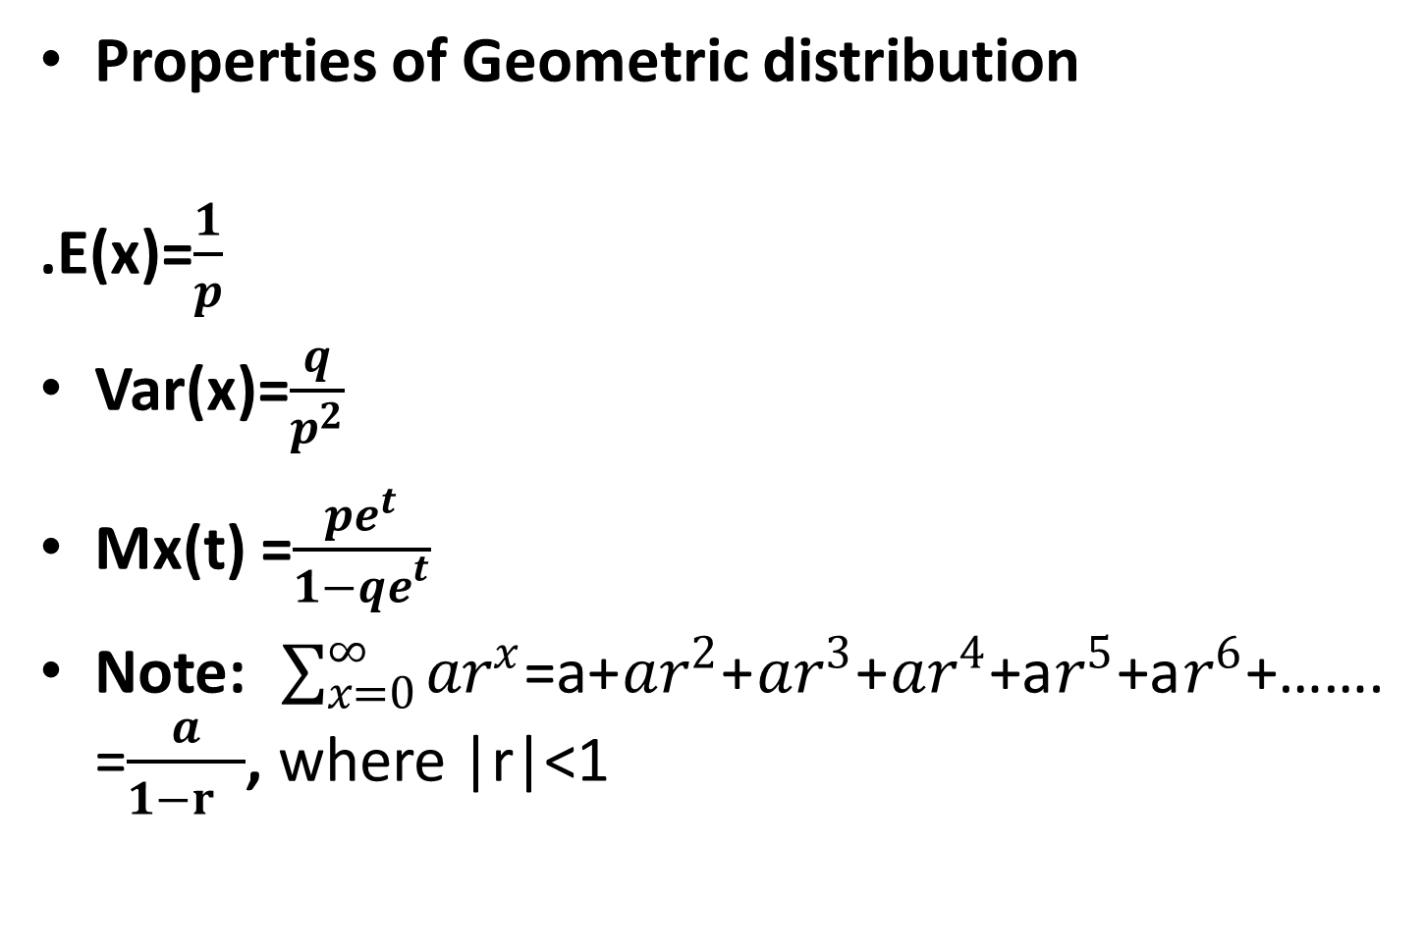
Properties of Geometric distribution
.E(x)=$\frac{1}{p}$
Var(x)=$\frac{q}{p^{2}}$
Mx(t) =$\frac{{pe}^{t}}{{1−qe}^{t}}$
Note: $\sum_{x=0}^{∞}{ar^{x}}$=a+$ar^{2}$+$ar^{3}$+$ar^{4}$+a$r^{5}$+a$r^{6}$+……. =$\frac{a}{1−r }$, where |r|<1

Slide 21
9.2 Continuous Probability Distributions

Slide 22
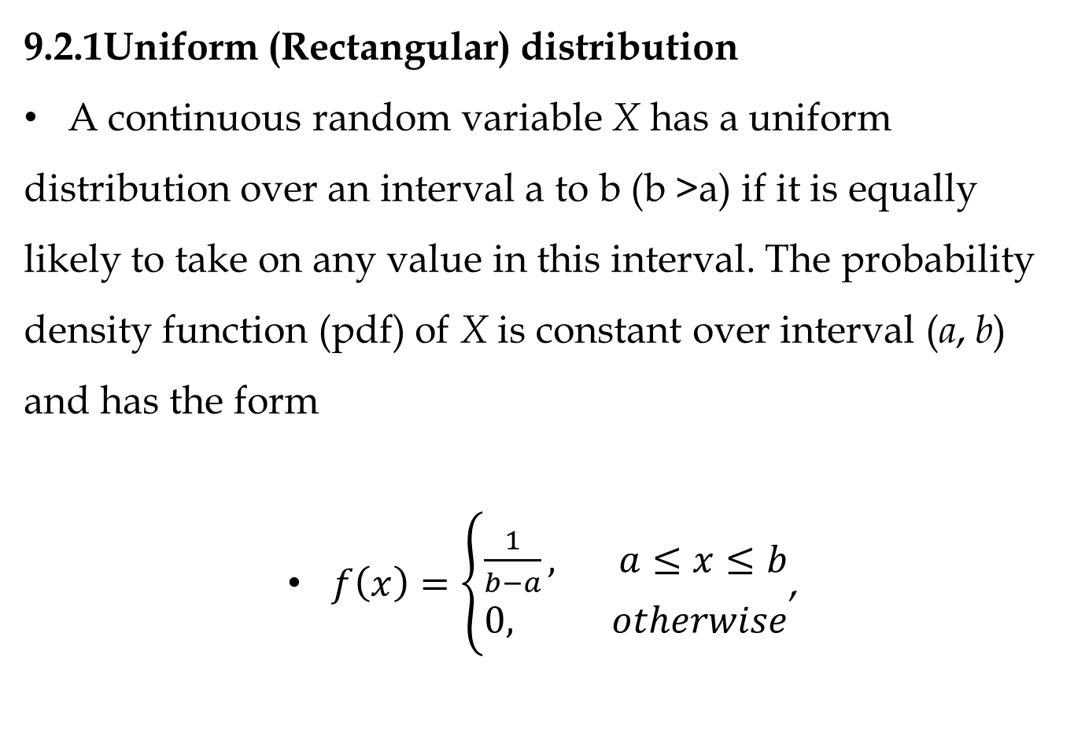
9.2.1Uniform (Rectangular) distribution
A continuous random variable X has a uniform distribution over an interval a to b (b >a) if it is equally likely to take on any value in this interval. The probability density function (pdf) of X is constant over interval (a, b) and has the form
$f\left(x\right)=\left\{\begin{aligned}\frac{1}{b−a}, a≤&x≤b \\ 0, otherwise\end{aligned}\right.$,

Slide 23

The probability that X lies in any subinterval of [a, b] is equal to the length of that subinterval divided by the length of the interval [ , b]. This follows since when [a, b] is a subinterval of [c, d]

Slide 25
Example:If X is uniformly distributed over the interval [0, 10], compute the probability that
2 <X <9,B. 1 <X <4,C.X <5 D.X >6.
Answer: The respective answers are
(a) 7/10, (b) 3/10, (c) 5/10, (d) 4/10.

Slide 26

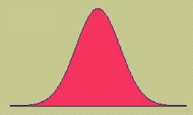
9.2.2 The Normal Distribution
The formula that generates the normal probability distribution is:
Where, σ = Population variance
µ = population mean
e =2.718…, π= 3.14…
This is a bell shaped curve with different centers and spreads depending on μ and σ

Slide 27


Properties of Normal Distributions
Properties of a Normal Distribution
The mean, median, and mode are equal.
The normal curve is bell-shaped and symmetric about the mean.
The total area under the curve is equal to one.
The normal curve approaches, but never touches the x-axis as it extends farther and farther away from the mean.
Between μ − σ and μ + σ (in the center of the curve), the graph curves downward. The graph curves upward to the left of μ − σ and to the right of μ + σ. The points at which the curve changes from curving upward to curving downward are called the inflection points.

Slide 28

Properties of Normal Distributions
Total area = 1
Inflection points
x
μ − 3σ
μ − 2σ
μ − σ
μ
μ + σ
μ + 2σ
μ + 3σ

Slide 29
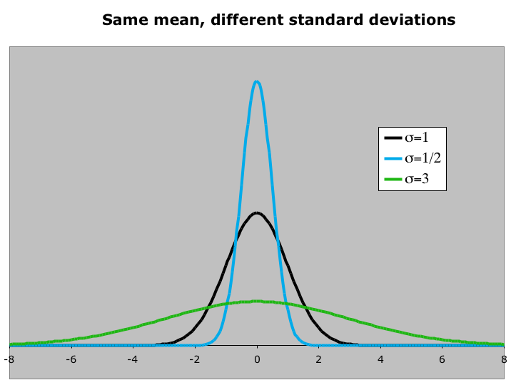
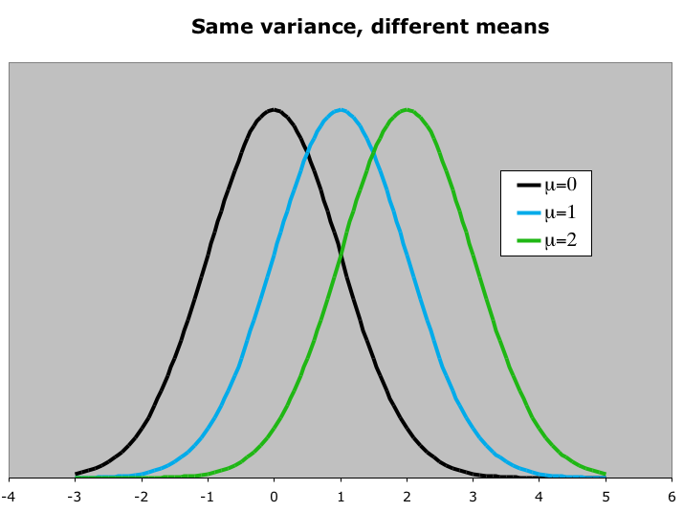
The Family of Normal Distribution
A normal distribution can have any mean and any positive standard deviation.
The Line of symmetry for the curve indicates the mean of the distribution, and the spread shows the magnitude of the standard deviation

Slide 30
The area under the curve
The area under a curve can be obtained:
a. By taking the integral of an interval, (a, b)
b. By preparing a tables containing areas for each curve
However, both of these are not good solutions because:
i. Either it requires us to have some knowledge of calculus or
ii. Preparing tables for the infinite family of normal curves is impossible
f
a b

Slide 31

The Standard Normal Distribution
Standardization solves the above two problems
Each data value of normally distributed random variable x can be transformed into a z-score by using the formula:
The resulting distribution will be the standard normal with a mean of 0 and a standard deviation of 1.
z-score = no. of σ-units above (positive z) or below (negative z) a distribution mean μ
The horizontal scale corresponds to z-scores.
z
−3
−2
−1
0
1
2
3

Slide 32


The Standard Normal Distribution
The area that falls in the interval under the unstandardized normal curve (the x-values) is the same as the area under the standard normal curve (within the corresponding z-boundaries)
That means standardization preserves area.
z
−3
−2
−1
0
1
2
3
X
-x₃, -x₂, -x₁
x₁, x₂, x₃
μ
After the formula is used to transform an x-value into a z-score, a Standard Normal Table can be used to find the area under the curve.

Slide 33
The Standard Normal Table
Properties of the Standard Normal Distribution
The cumulative area is close to 0 for z-scores close to z = −3.49.
The cumulative area increases as the z-scores increase.
The cumulative area for z = 0 is 0.5000.
The cumulative area is close to 1 for z-scores close to z = 3.49
Cum. Area is close to 0.
Cum. Area is close to 1.
z
z = −3.49
−3
−2
−1
0
1
2
3
z = 3.49
z = 0
Cum. Area is 0.5000.

Slide 34
The Standard Normal Table
Example:
Find the cumulative area that corresponds to a z-score of 2.71.
Standard Normal Table
z | .00 | .01 | .02 | .03 | .04 | .05 | .06 | .07 | .08 | .09
0.0 | .5000 | .5040 | .5080 | .5120 | .5160 | .5199 | .5239 | .5279 | .5319 | .5359
0.1 | .5398 | .5438 | .5478 | .5517 | .5557 | .5596 | .5636 | .5675 | .5714 | .5753
0.2 | .5793 | .5832 | .5871 | .5910 | .5948 | .5987 | .6026 | .6064 | .6103 | .6141
2.6 | .9953 | .9955 | .9956 | .9957 | .9959 | .9960 | .9961 | .9962 | .9963 | .9964
2.7 | .9965 | .9966 | .9967 | .9968 | .9969 | .9970 | .9971 | .9972 | .9973 | .9974
2.8 | .9974 | .9975 | .9976 | .9977 | .9977 | .9978 | .9979 | .9979 | .9980 | .9981
Find the area by finding 2.7 in the left hand column, and then moving across the row to the column under 0.01.
The area to the left of z = 2.71 is 0.9966.

Slide 35
The Standard Normal Table
Example:
Find the cumulative area that corresponds to a z-score of −0.25.
Standard Normal Table
z | .09 | .08 | .07 | .06 | .05 | .04 | .03 | .02 | .01 | .00
−3.4 | .0002 | .0003 | .0003 | .0003 | .0003 | .0003 | .0003 | .0003 | .0003 | .0003
−3.3 | .0003 | .0004 | .0004 | .0004 | .0004 | .0004 | .0004 | .0005 | .0005 | .0005
−0.3 | .3483 | .3520 | .3557 | .3594 | .3632 | .3669 | .3707 | .3745 | .3783 | .3821
−0.2 | .3859 | .3897 | .3936 | .3974 | .4013 | .4052 | .4090 | .4129 | .4168 | .4207
−0.1 | .4247 | .4286 | .4325 | .4364 | .4404 | .4443 | .4483 | .4522 | .4562 | .4602
−0.0 | .4641 | .4681 | .4724 | .4761 | .4801 | .4840 | .4880 | .4920 | .4960 | .5000
Find the area by finding −0.2 in the left hand column, and then moving across the row to the column under 0.05.
The area to the left of z = −0.25 is 0.4013

Slide 36
Guidelines for Finding Areas
Finding Areas Under the Standard Normal Curve
Sketch the standard normal curve and shade the appropriate area under the curve.
Find the area by following the directions for each case shown.
To find the area to the left of z, find the area that corresponds to z in the Standard Normal Table.
2. The area to the left of z = 1.23 is 0.8907.
z
0
1.23
1. Use the table to find the area for the z-score.

Slide 37
Guidelines for Finding Areas
Finding Areas Under the Standard Normal Curve
To find the area to the right of z, use the Standard Normal Table to find the area that corresponds to z. Then subtract the area from 1.
2. The area to the left of z = 1.23 is 0.8907.
3. Subtract to find the area to the right of z = 1.23:
1 − 0.8907 = 0.1093.
z
0
1.23
1. Use the table to find the area for the z-score.

Slide 38
Guidelines for Finding Areas
Finding Areas Under the Standard Normal Curve
To find the area between two z-scores, find the area corresponding to each z-score in the Standard Normal Table. Then subtract the smaller area from the larger area.
2. The area to the left of z = 1.23 is 0.8907.
4. Subtract to find the area of the region between the two z-scores: 0.8907 − 0.2266 = 0.6641.
3. The area to the left of z = −0.75 is 0.2266.
z
−0.75
0
1.23
1. Use the table to find the area for the z-score.

Slide 39
Normal Distributions and Probabilities

Slide 40
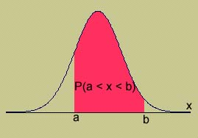
Probability and Normal Distributions
We know that the area under any normal curve is 1 unit
Therefore, we can link these areas with probability
i.e. if a random variable, x, is normally distributed, the probability that x will fall in a given interval is the area under the normal curve for that interval.
Or P(a ≤ x ≤ b) = area under the curve
between a and b.
There is no probability attached to any single value of x. That is, P(x = a) = 0.

Slide 41

Probability and Normal Distributions
Normal Distribution
Standard Normal Distribution
μ = 10
σ = 5
μ = 0
σ = 1
P(x < 15)
P(z < 1)
x
z
μ =10
15
μ =0
1
Same area
P(x < 15) = P(z < 1) = Shaded area under the curve
= 0.8413

Slide 42
Probability and Normal Distributions
Example: The average weight of pregnant women attending a prenatal care in a clinic was 78kg with a standard deviation of 8kg. If the weights are normally distributed:
a) Find the probability that a randomly selected pregnant woman weights less than 90kg.
μ = 78
σ = 8
P(x < 90)
The probability that a randomly selected pregnant woman weights less than 90kg. is 0.9332.
x
μ =78
90
1.5
z
Z =0
?
P(x < 90) = P(z < 1.5) = 0.9332

Slide 43
Probability and Normal Distributions
Example:
b) Based on the above example, find the probability that a pregnant woman weights greater than 85kg.
μ = 78
σ = 8
P(x > 85)
The probability that a randomly selected pregnant woman weights greater than 85kg. is 0.1894.
x
μ =78
85
z
μ =0
0.88
?
P(x > 85) = P(z > 0.88) = 1 − P(z < 0.88) = 1 − 0.8106 = 0.1894

Slide 44
Probability and Normal Distributions
Example:
From the above example, find the probability that a randomly selected pregnant woman weights between 60 and 80.
P(60 < x < 80)
μ = 78
σ = 8
The probability that a randomly selected pregnant women weights between 60 and 80 is 0.5865.
x
60
μ =78
80
z
−2.25
Z =0
0.25
?
?
P(60 < x < 80) = P(−2.25 < z < 0.25) = P(z < 0.25) − P(z < −2.25)
= 0.5987 − 0.0122 = 0.5865

Slide 45
Finding z-Scores
Example:
In a certain population, the proportion of individuals with uric acid level less than a certain limit is 36.7%.
Find the z-score that corresponds to this cut of point
z | .09 | .08 | .07 | .06 | .05 | .04 | .03 | .02 | .01 | .00
−0.3 | .3483 | .3520 | .3557 | .3594 | .3632 | .3669 | .3707 | .3745 | .3783 | .3821
−0.2 | .3859 | .3897 | .3936 | .3974 | .4013 | .4052 | .4090 | .4129 | .4168 | .4207
−0.1 | .4247 | .4286 | .4325 | .4364 | .4404 | .4443 | .4483 | .4522 | .4562 | .4602
−0.0 | .4641 | .4681 | .4724 | .4761 | .4801 | .4840 | .4880 | .4920 | .4960 | .5000
Find the z-score by locating 0.367 in the body of the Standard Normal Table. Use the value closest to 0.367.
The z-score is −0.34.

Slide 46
Finding a z-Score Given a Percentile
Example:
Find the z-score that corresponds to P75
Area = 0.75
z
μ =0
?
0.67
The z-score that corresponds to P 75 is the same as the z-score that corresponds to an area of 0.75.
The z-score is 0.67.

Slide 47
Class work
For a standard normal variable Z find
P(-2.2 <Z<1.2)
P(0<Z<0.96)
P(Z>1.05)
p(-1.45 <Z<0)
If X is normally distributed with μ = 12 and = 4.
Find the probability of
i. X>20
ii. X<20
iii. 0 <X < 12
iv. Find a when (X > a) = 0.24
V. Find b and c when P(b < X < c) = 0.5 and P(X > c) = 0.25

Slide 48

Table : Normal distribution
Area between 0 and z
 | 0.00 | 0.01 | 0.02 | 0.03 | 0.04 | 0.05 | 0.06 | 0.07 | 0.08 | 0.09
0.0 | 0.0000 | 0.0040 | 0.0080 | 0.0120 | 0.0160 | 0.0199 | 0.0239 | 0.0279 | 0.0319 | 0.0359
0.1 | 0.0398 | 0.0438 | 0.0478 | 0.0517 | 0.0557 | 0.0596 | 0.0636 | 0.0675 | 0.0714 | 0.0753
0.2 | 0.0793 | 0.0832 | 0.0871 | 0.0910 | 0.0948 | 0.0987 | 0.1026 | 0.1064 | 0.1103 | 0.1141
0.3 | 0.1179 | 0.1217 | 0.1255 | 0.1293 | 0.1331 | 0.1368 | 0.1406 | 0.1443 | 0.1480 | 0.1517
0.4 | 0.1554 | 0.1591 | 0.1628 | 0.1664 | 0.1700 | 0.1736 | 0.1772 | 0.1808 | 0.1844 | 0.1879
0.5 | 0.1915 | 0.1950 | 0.1985 | 0.2019 | 0.2054 | 0.2088 | 0.2123 | 0.2157 | 0.2190 | 0.2224
0.6 | 0.2257 | 0.2291 | 0.2324 | 0.2357 | 0.2389 | 0.2422 | 0.2454 | 0.2486 | 0.2517 | 0.2549
0.7 | 0.2580 | 0.2611 | 0.2642 | 0.2673 | 0.2704 | 0.2734 | 0.2764 | 0.2794 | 0.2823 | 0.2852
0.8 | 0.2881 | 0.2910 | 0.2939 | 0.2967 | 0.2995 | 0.3023 | 0.3051 | 0.3078 | 0.3106 | 0.3133
0.9 | 0.3159 | 0.3186 | 0.3212 | 0.3238 | 0.3264 | 0.3289 | 0.3315 | 0.3340 | 0.3365 | 0.3389
1.0 | 0.3413 | 0.3438 | 0.3461 | 0.3485 | 0.3508 | 0.3531 | 0.3554 | 0.3577 | 0.3599 | 0.3621
1.1 | 0.3643 | 0.3665 | 0.3686 | 0.3708 | 0.3729 | 0.3749 | 0.3770 | 0.3790 | 0.3810 | 0.3830
1.2 | 0.3849 | 0.3869 | 0.3888 | 0.3907 | 0.3925 | 0.3944 | 0.3962 | 0.3980 | 0.3997 | 0.4015
1.3 | 0.4032 | 0.4049 | 0.4066 | 0.4082 | 0.4099 | 0.4115 | 0.4131 | 0.4147 | 0.4162 | 0.4177
1.4 | 0.4192 | 0.4207 | 0.4222 | 0.4236 | 0.4251 | 0.4265 | 0.4279 | 0.4292 | 0.4306 | 0.4319
1.5 | 0.4332 | 0.4345 | 0.4357 | 0.4370 | 0.4382 | 0.4394 | 0.4406 | 0.4418 | 0.4429 | 0.4441
1.6 | 0.4452 | 0.4463 | 0.4474 | 0.4484 | 0.4495 | 0.4505 | 0.4515 | 0.4525 | 0.4535 | 0.4545
1.7 | 0.4554 | 0.4564 | 0.4573 | 0.4582 | 0.4591 | 0.4599 | 0.4608 | 0.4616 | 0.4625 | 0.4633
1.8 | 0.4641 | 0.4649 | 0.4656 | 0.4664 | 0.4671 | 0.4678 | 0.4686 | 0.4693 | 0.4699 | 0.4706
1.9 | 0.4713 | 0.4719 | 0.4726 | 0.4732 | 0.4738 | 0.4744 | 0.4750 | 0.4756 | 0.4761 | 0.4767
2.0 | 0.4772 | 0.4778 | 0.4783 | 0.4788 | 0.4793 | 0.4798 | 0.4803 | 0.4808 | 0.4812 | 0.4817
2.1 | 0.4821 | 0.4826 | 0.4830 | 0.4834 | 0.4838 | 0.4842 | 0.4846 | 0.4850 | 0.4854 | 0.4857
2.2 | 0.4861 | 0.4864 | 0.4868 | 0.4871 | 0.4875 | 0.4878 | 0.4881 | 0.4884 | 0.4887 | 0.4890
2.3 | 0.4893 | 0.4896 | 0.4898 | 0.4901 | 0.4904 | 0.4906 | 0.4909 | 0.4911 | 0.4913 | 0.4916

Slide 49
9.2.3Exponential distribution
A continuous random variable whose probability density function is given, for some λ > 0, by
, x ≥ 0
is said to be an exponential random variable (or, more simply, is said to be exponentially distributed) with parameter λ

Slide 50

The cumulative distribution function F (x) of an exponential random variable is given by
, x ≥ 0
The exponential distribution often arises, in practice, as being the distribution of the amount of time until some specific event occurs. For instance, the amount of time (starting from now) until an earthquake occurs, or until a new war breaks out, or until a telephone call you receive turns out to be a wrong number are all random variables that tend in practice to have exponential distributions.

Slide 52
Good uck!!!
All about Stat2071!!

