Slide 1
Chapter -5
One Dimensional Random Variable
Definitions of Random variable
A variable whose value is unknown or a function that assigns values to each of an experiment's outcomes.
Random variables are often designated by letters and can be classified as
discrete, which are variables that have specific values, or
continuous, which are variables that can have any values within a continuous range.

Slide 2
A probability distribution is a description of the chance a random variable has of taking on particular values. It is often displayed in a graph, table, or formula.
Random variable is a variable X whose value is determined by the outcomes of random experiment. It is classified as ;
Discrete random variable
Continuous random variable

Slide 3
Discrete random variable:
Possible values of isolated points along the number line. Random variables have their own sample space, or set of possible values. If this set is finite or countable, the random variable is said to be discrete.
If X is a discrete random variable taking a values X₁,X₂,….,Xn then P(x_{i})=P(X=x_{i}),where i=1,2,3,….,n is called probability mass function(pmf) of random variable X
The set of order pairs [x_{i} = P(x_{i})], i=1,2,3,….,n gives the probability distribution of random variable X

Slide 4
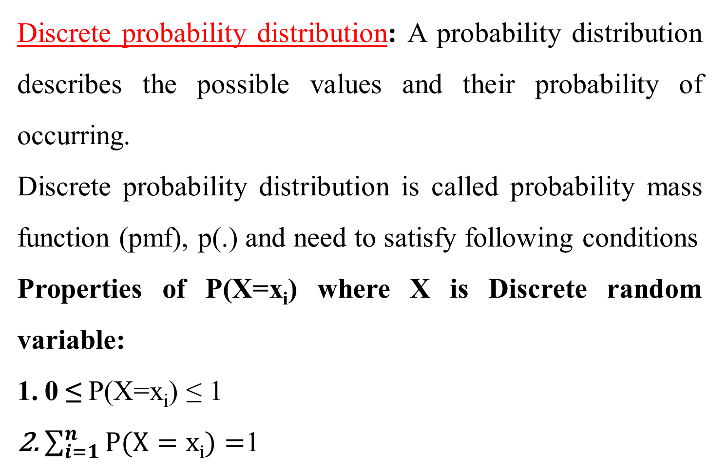
Discrete probability distribution: A probability distribution describes the possible values and their probability of occurring.
Discrete probability distribution is called probability mass function (pmf), p(.) and need to satisfy following conditions
Properties of P(X=x_{i}) where X is Discrete random variable:
0 ≤ P(X=x_{i}) ≤ 1
$\sum_{i=1}^{n}{P(X=xi)}=$1

Slide 5
Example: consider the experiment of tossing a coin three times let ‘x’ be the number of heads then write the probability distribution of the random variable x
Solution:
The variable ‘x’ takes the value 0,1,2,3 with probability distribution {HHH, HHT, HTH, TTH, THT, THH, HTT, TTT} then the probability distribution for ‘x’
X | 0 | 1 | 2 | 3
P(X) | 1/8 | 3/8 | 3/8 | 1/8

Slide 6
2. Continuous random variable:
A random variable X is said to be continuous if it can take all possible values (integral as well as fractional) between certain limits or intervals. Continuous random variables occur when we deal with quantities that are measured on a continuous scale.
For instance, the life length of an electric bulb, the speed of a car, weights, heights, and the like are continuous

Slide 7
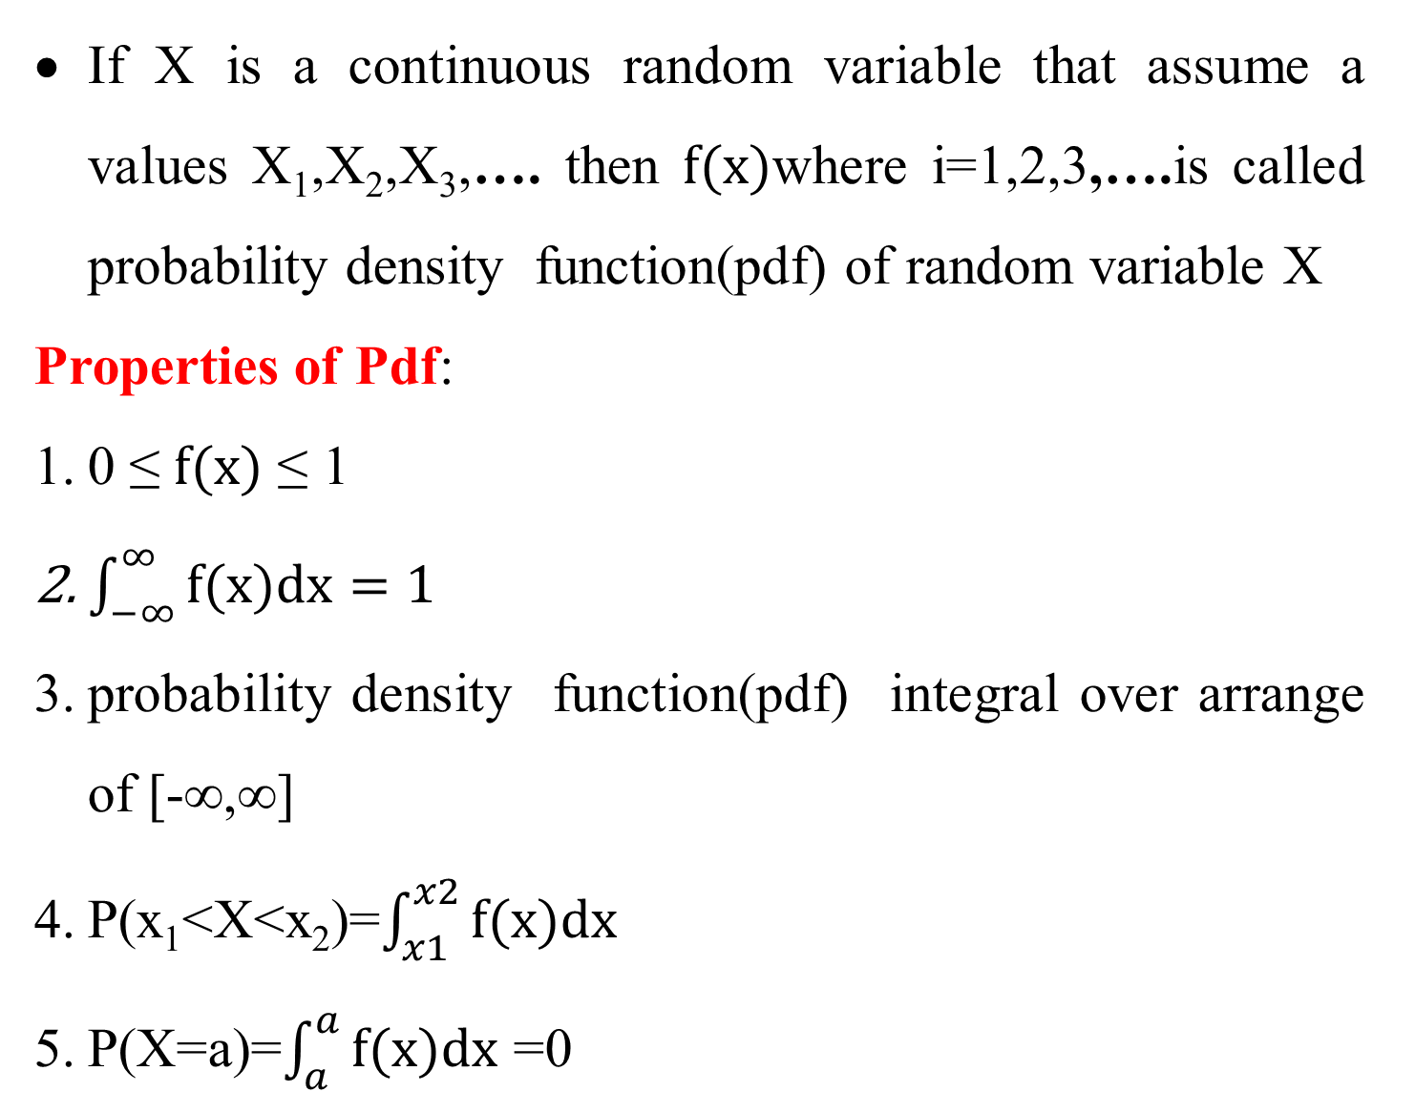
If X is a continuous random variable that assume a values X₁,X₂,X₃,…. then $f(x)$where i=1,2,3,….is called probability density function(pdf) of random variable X
Properties of Pdf:
0 ≤ $f(x)$ ≤ 1
$\int_{−∞}^{∞}{f(x)dx=1}$
probability density function(pdf) integral over arrange of [-∞,∞]
P(x₁<X<x₂)=$\int_{x1}^{x2}{f(x)dx}$
P(X=a)=$\int_{a}^{a}{f(x)dx}$ =0

Slide 8
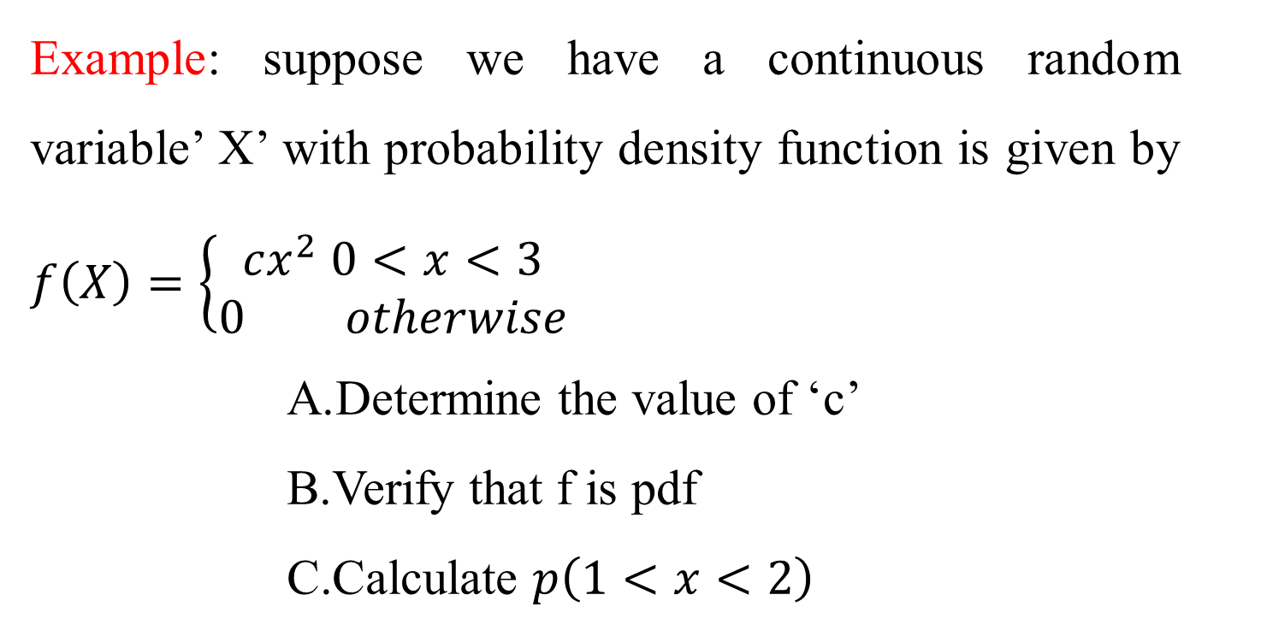
Example: suppose we have a continuous random variable’ X’ with probability density function is given by $f\left(X\right)=\left\{\begin{aligned}cx^{2} 0<x<3 \\ 0 otherwise\end{aligned}\right.$
Determine the value of ‘c’
Verify that f is pdf
Calculate $p\left(1<x<2\right)$

Slide 9
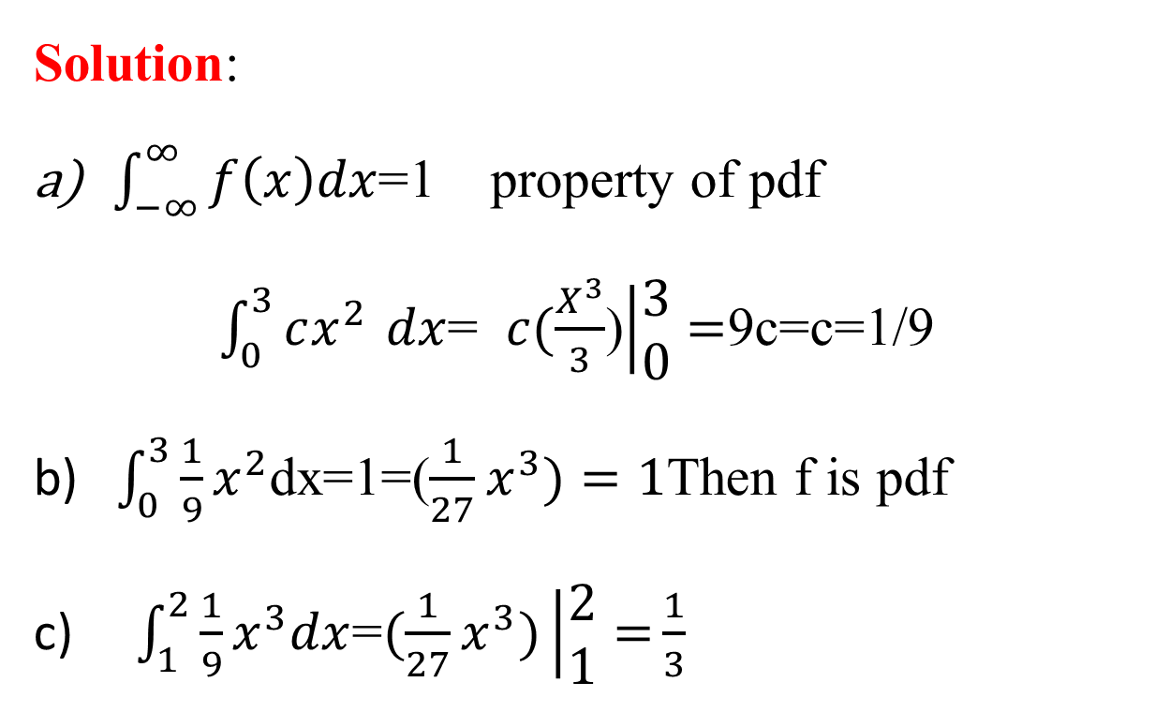
Solution:
$\int_{−∞}^{∞}{f\left(x\right)dx}$=1 property of pdf
$\int_{0}^{3}{cx^{2 }}dx$= $c(\frac{X^{3}}{3}$)$\left|\begin{aligned}3 \\ 0\end{aligned}\right.=$9c=c=1/9
b) $\int_{0}^{3}{\frac{1}{9}}x^{2}$dx=1=($\frac{1}{27}x^{3})=1$Then f is pdf
c) $\int_{1}^{2}{\frac{1}{9}}x^{3}dx$=$(\frac{1}{27}x^{3})\left|\begin{aligned}2 \\ 1\end{aligned}=\right.\frac{1}{3}$

Slide 10
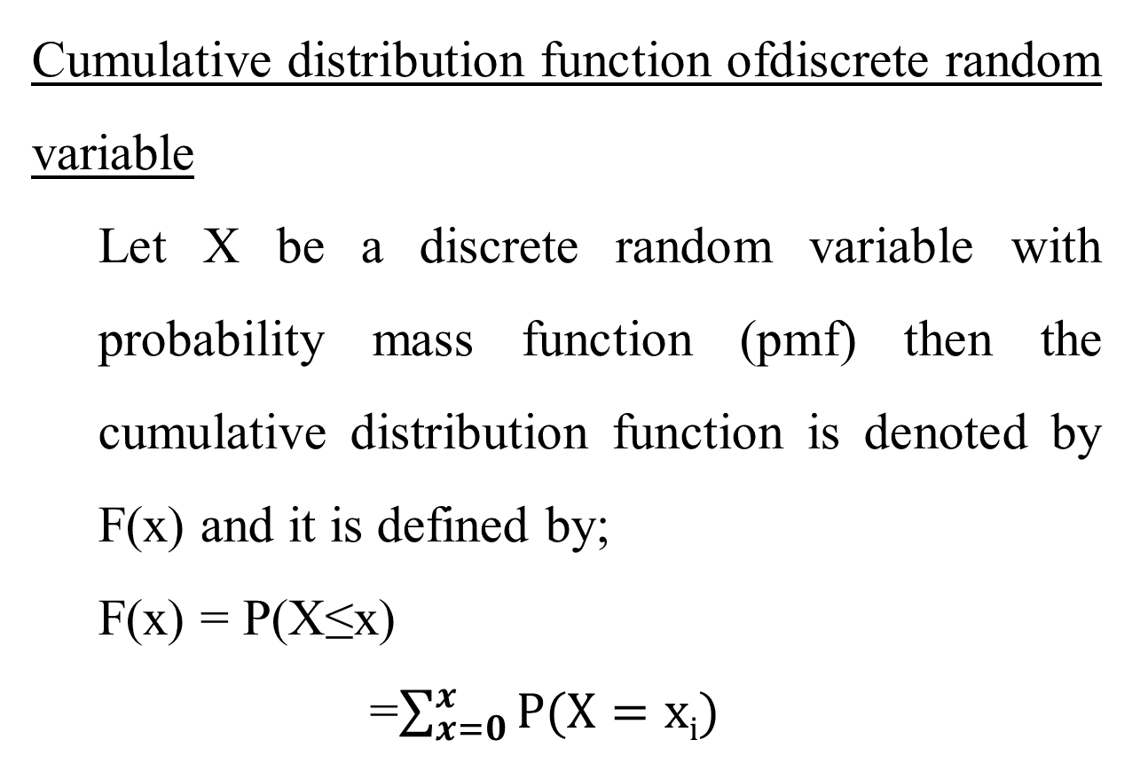
Cumulative distribution function ofdiscrete random variable
Let X be a discrete random variable with probability mass function (pmf) then the cumulative distribution function is denoted by F(x) and it is defined by;
F(x) = P(X≤x)
=$\sum_{x=0}^{x}{P(X=xi)}$

Slide 11
Example: Tossing a coin three time, let X be getting the numbers of head, then find the CDF of x
Solution: The variable ‘x’ takes the value 0,1,2,3 with probability distribution
(HHH, HHT, HTH, TTH, THT, THH, HTT, TTT)
x | P(x) | F(X)
0 | 1/8 | 1/8
1 | 3/8 | 4/8
2 | 3/8 | 7/8
3 | 1/8 | 1

Slide 12
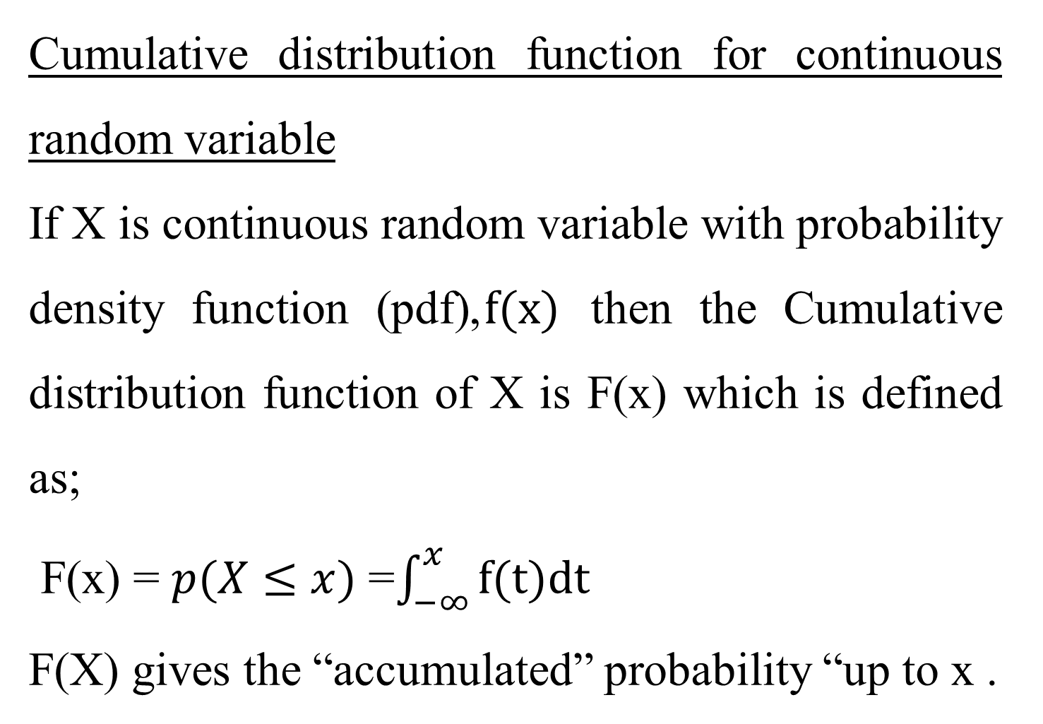
Cumulative distribution function for continuous random variable
If X is continuous random variable with probability density function (pdf),$f(x)$ then the Cumulative distribution function of X is F(x) which is defined as;
F(x) = $p(X≤x)$ =$\int_{−∞}^{x}{f(t)dt}$
F(X) gives the “accumulated” probability “up to x .

Slide 13
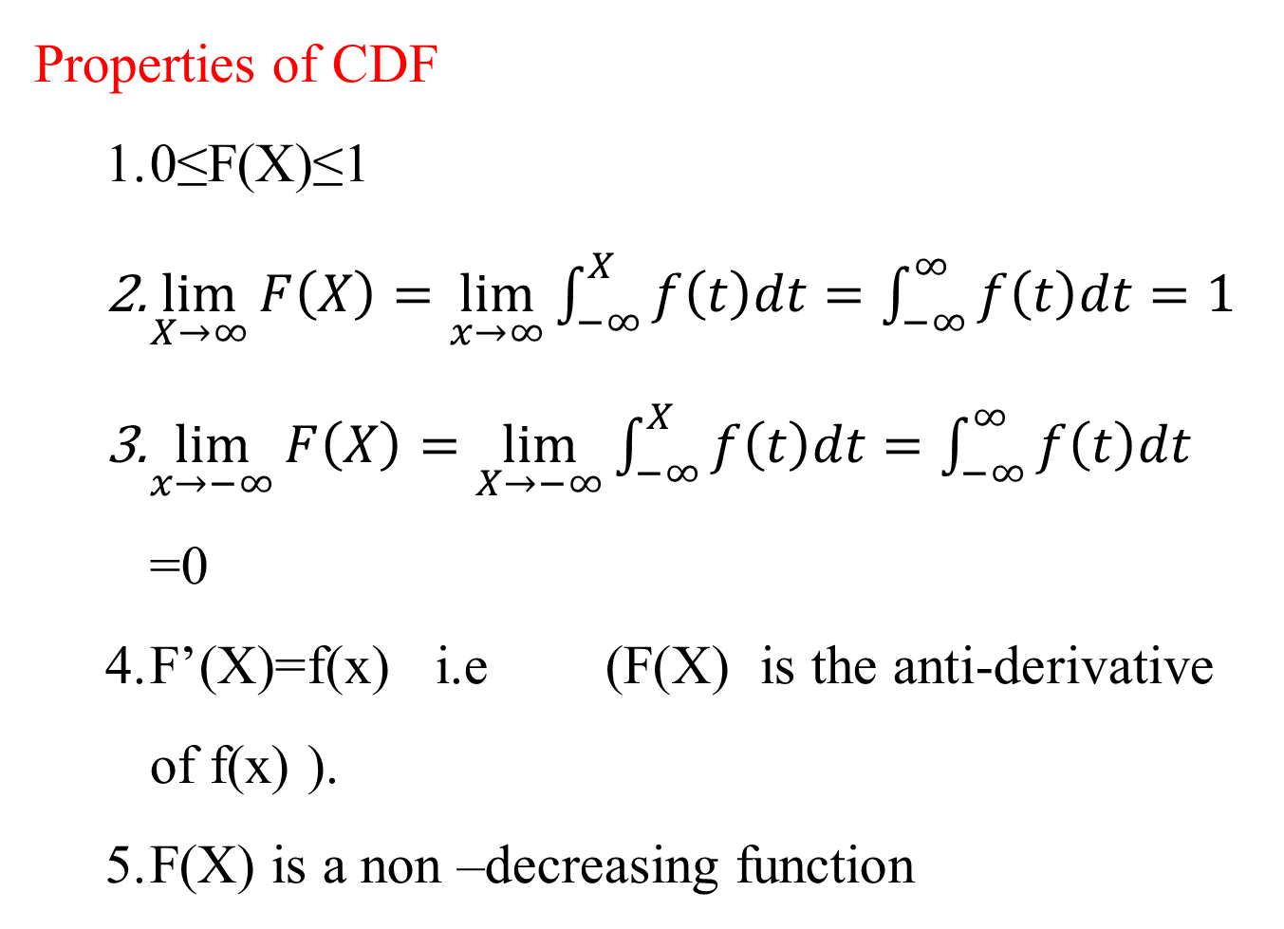
Properties of CDF
0≤F(X)≤1
$\lim_{X→∞}{F\left(X\right)=\lim_{x→∞}{\int_{−∞}^{X}{f\left(t\right)dt}}=\int_{−∞}^{∞}{f\left(t\right)dt=1}}$
$\lim_{x→−∞}{F\left(X\right)=\lim_{X→−∞}{\int_{−∞}^{X}{f\left(t\right)dt=\int_{−∞}^{∞}{f\left(t\right)dt}}}}$=0
F’(X)=f(x) i.e(F(X) is the anti-derivative of f(x) ).
F(X) is a non –decreasing function

Slide 14
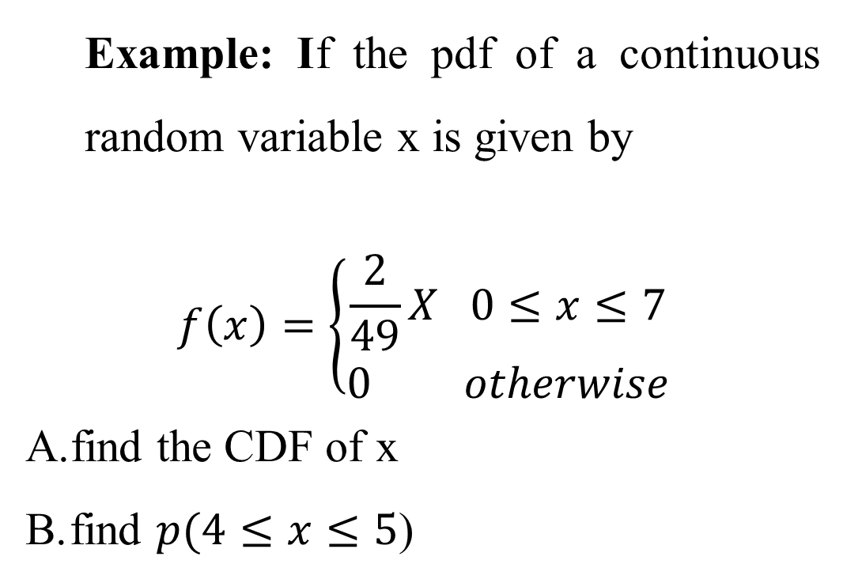
Example: If the pdf of a continuous random variable x is given by
$$f\left(x\right)=\left\{\begin{aligned}\frac{2}{49}X 0≤x≤7 \\ 0 otherwise\end{aligned}\right.$$
find the CDF of x
find $p(4≤x≤5$)

Slide 15
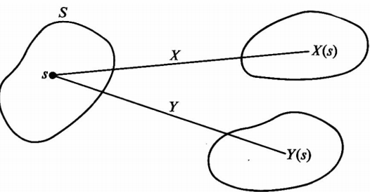
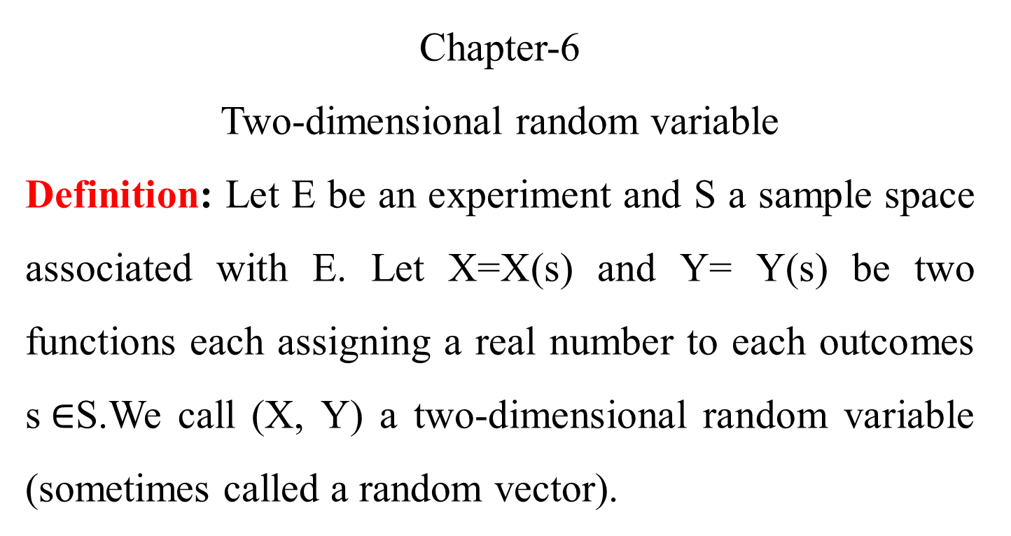
Chapter-6
Two-dimensional random variable
Definition: Let E be an experiment and S a sample space associated with E. Let X=X(s) and Y= Y(s) be two functions each assigning a real number to each outcomes s$∈$S.We call (X, Y) a two-dimensional random variable (sometimes called a random vector).

Slide 16
Example:
recording the amount of precipitate (p) and volume of gas (q) for a given locality, (p,q)
Observing the rainfall (R) and temperature (T) of certain town (R, T)
Note: If the possible values (x, y) are finite countable infinite, then (x, y) is called two-dimensional discrete random variable.
If (x, y) assumes all values in a specified region R in the xy-plane then (x,y) is called two-dimensional continuous random variable.

Slide 17
Joint probability distribution
If X and Y are two random variable the probability distribution for their simultaneous occurrences can be represented by a function f(x,y),for any pair values (X,Y) within the range ofthe random variable X and Y. This function is known as joint probability distribution (X, Y).

Slide 18
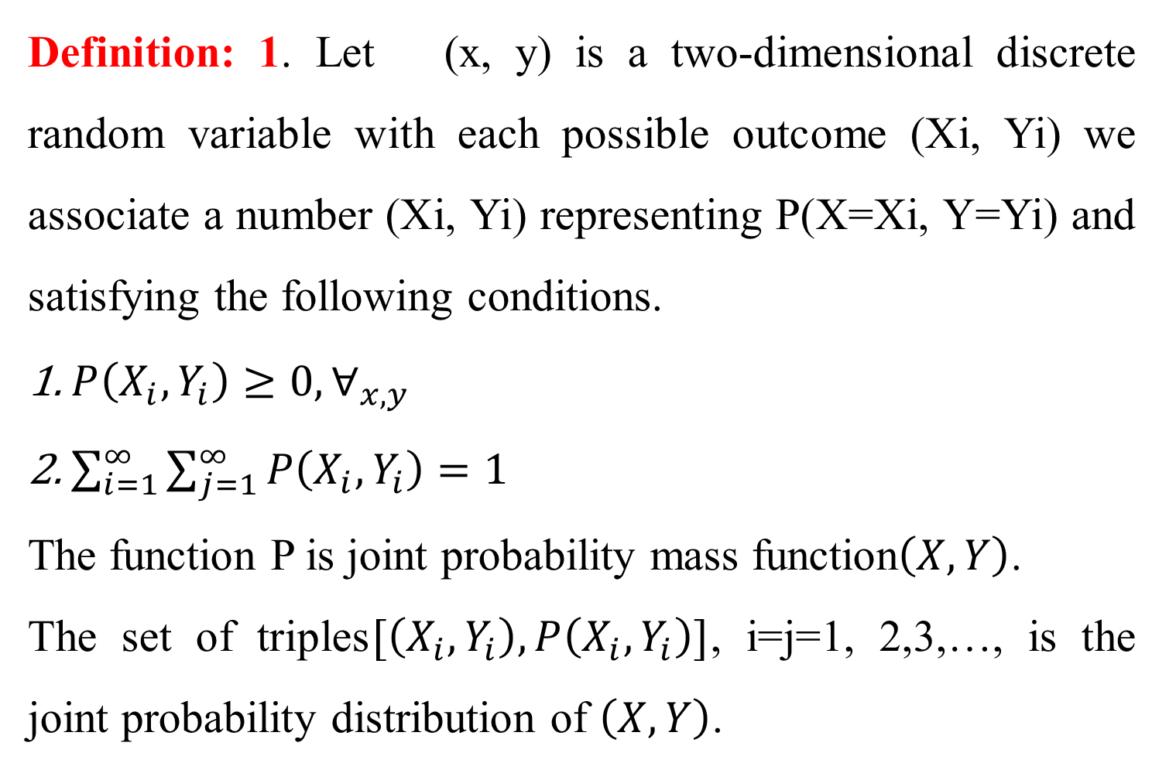
Definition: 1. Let (x, y) is a two-dimensional discrete random variable with each possible outcome (Xi, Yi) we associate a number (Xi, Yi) representing P(X=Xi, Y=Yi) and satisfying the following conditions.
$P\left(X_{i}, Y_{i}\right)≥0,∀_{x,y}$
$\sum_{i=1}^{∞}{\sum_{j=1}^{∞}{P\left(X_{i}, Y_{i}\right)=1}}$
The function P is joint probability mass function$\left(X, Y\right)$.
The set of triples$[\left(X_{i}, Y_{i}\right), P\left(X_{i}, Y_{i}\right)]$, i=j=1, 2,3,…, is the joint probability distribution of $\left(X, Y\right)$.

Slide 19
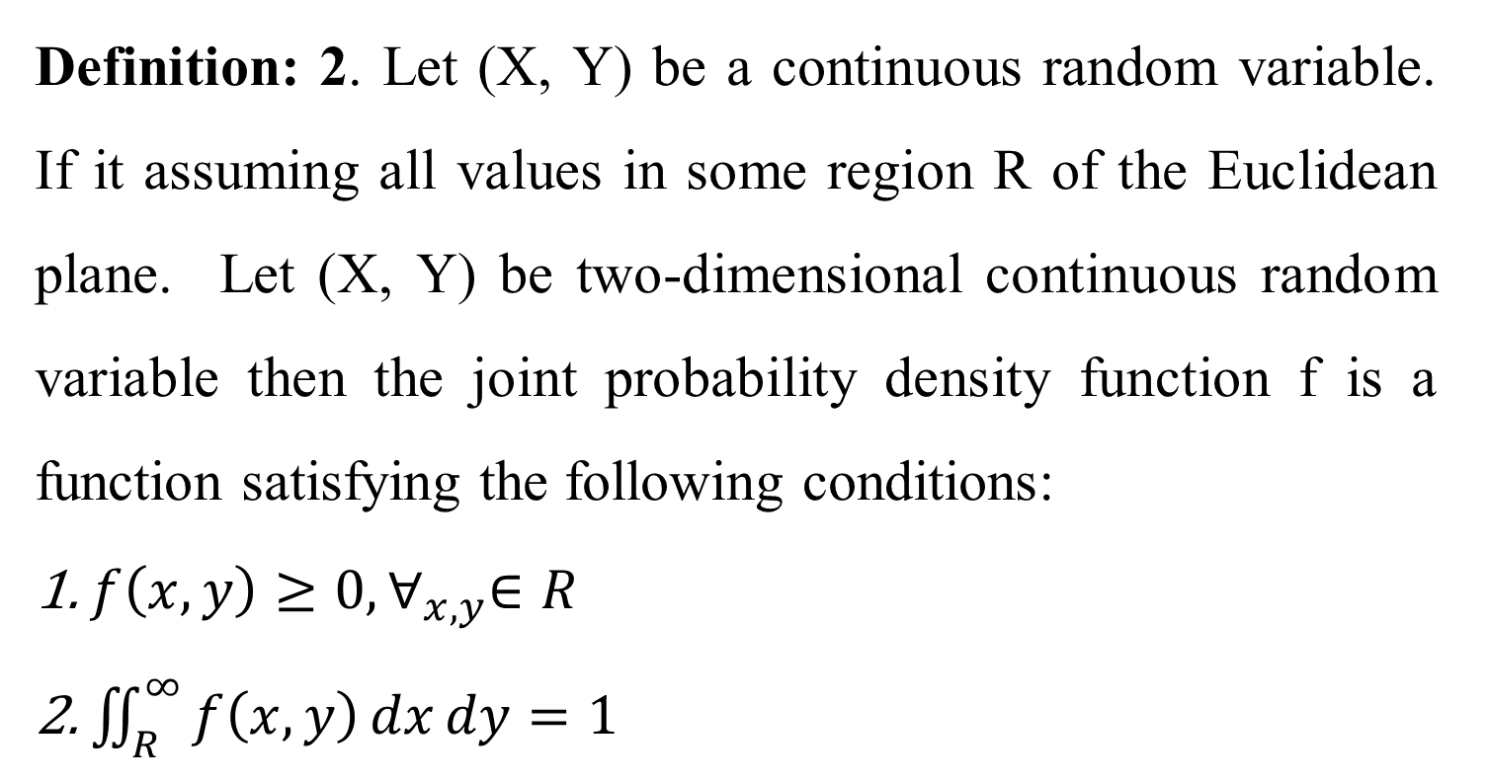
Definition: 2. Let (X, Y) be a continuous random variable. If it assuming all values in some region R of the Euclidean plane. Let (X, Y) be two-dimensional continuous random variable then the joint probability density function f is a function satisfying the following conditions:
$f\left(x, y\right)≥0,∀_{x,y}∈R$
$\iint_{R}^{∞}{f\left(x, y\right)dxdy}=1$

Slide 20
Example:
Two production lines 1 and 2 have a capacity of producing 5 and 3 items per day respectively, assume the numbers of items produced by each line is a random variable. Let x, y be a two-dimensional random variable yielding the number of items produced by line 1 and line 2 respectively.
Y|X | 0 | 1 | 2 | 3 | 4 | 5
0 | 0 | 0.01 | 0.03 | 0.05 | 0.07 | 0.09
1 | 0.01 | 0.02 | 0.04 | 0.05 | 0.06 | 0.08
2 | 0.01 | 0.03 | 0.05 | 0.05 | 0.05 | 0.06
3 | 0.01 | 0.02 | 0.04 | 0.06 | 0.06 | 0.05

Slide 21
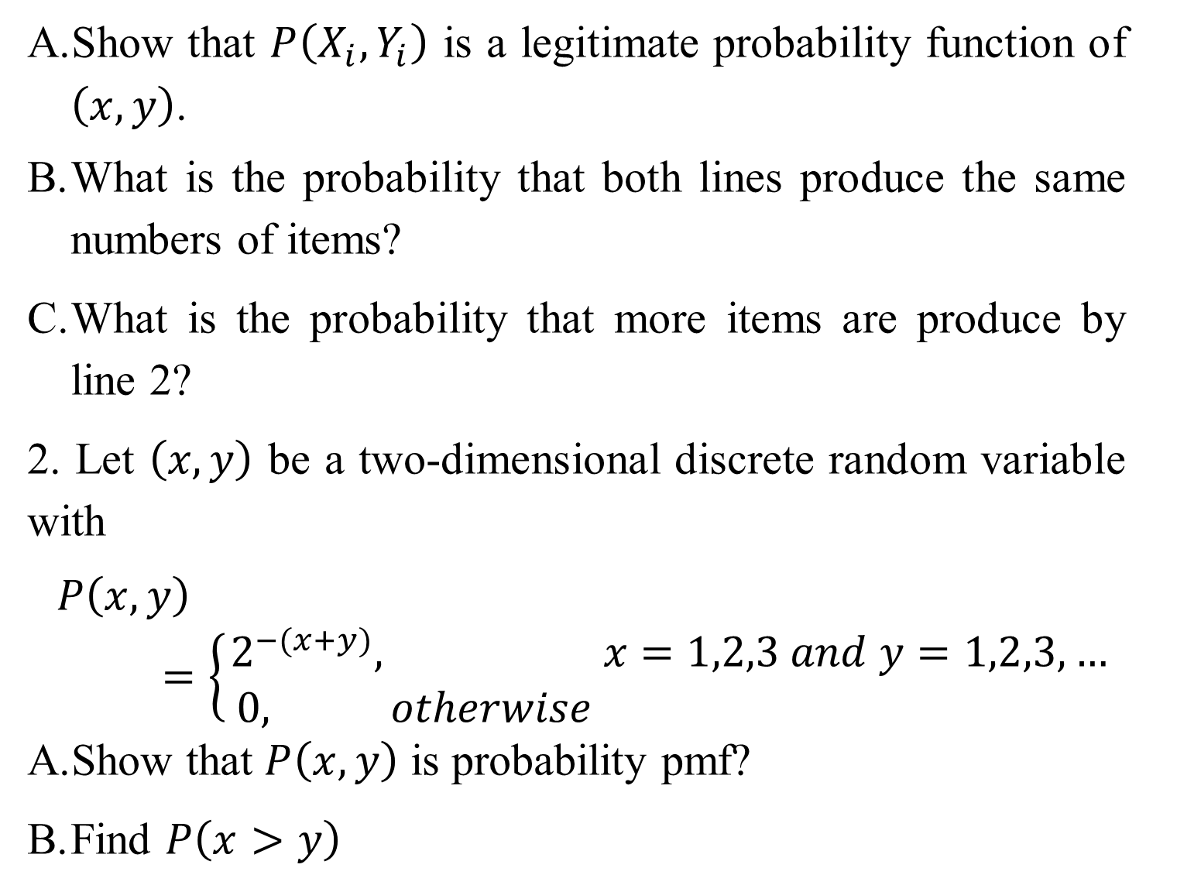
Show that $P\left(X_{i}, Y_{i}\right)$ is a legitimate probability function of $\left(x, y\right)$.
What is the probability that both lines produce the same numbers of items?
What is the probability that more items are produce by line 2?
2. Let $\left(x, y\right)$ be a two-dimensional discrete random variable with
$$P\left(x, y\right)=\left\{\begin{aligned}2^{−(x+y)}, &x=1,2,3 and y=1,2,3,… \\ 0, otherwise &\end{aligned}\right.$$
Show that $P\left(x, y\right)$ is probability pmf?
Find $P\left(x>y\right)$

Slide 22
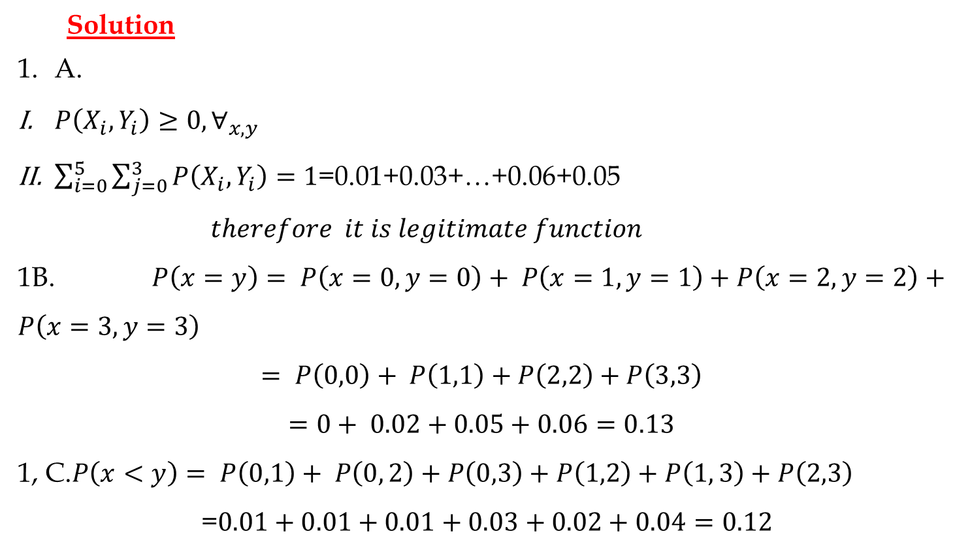
Solution
A.
$P\left(X_{i}, Y_{i}\right)≥0,∀_{x,y}$
$\sum_{i=0}^{5}{\sum_{j=0}^{3}{P\left(X_{i}, Y_{i}\right)=1}}$=0.01+0.03+…+0.06+0.05
$$therefore it is legitimate function$$
1B. $P\left(x=y\right)= P\left(x=0,y=0\right)+ P\left(x=1,y=1\right)+P\left(x=2,y=2\right)+P\left(x=3,y=3\right)$
$$= P\left(0,0\right)+ P\left(1,1\right)+P\left(2,2\right)+P\left(3,3\right)$$
$$=0+ 0.02+0.05+0.06=0.13$$
1, C.$P\left(x<y\right)= P\left(0,1\right)+ P\left(0, 2\right)+P\left(0,3\right)+P\left(1,2\right)+P\left(1, 3\right)+P\left(2,3\right)$
=$0.01+0.01+0.01+0.03+0.02+0.04=0.12$

Slide 23
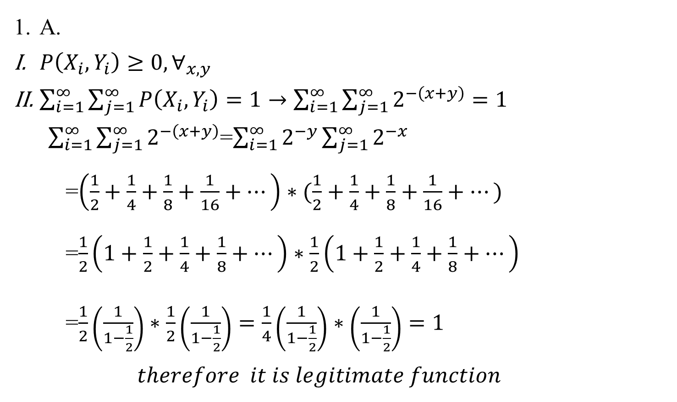
A.
$P\left(X_{i}, Y_{i}\right)≥0,∀_{x,y}$
$\sum_{i=1}^{∞}{\sum_{j=1}^{∞}{P\left(X_{i}, Y_{i}\right)=1}}→\sum_{i=1}^{∞}{\sum_{j=1}^{∞}{2^{−\left(x+y\right)}=1}}$
$\sum_{i=1}^{∞}{\sum_{j=1}^{∞}{2^{−\left(x+y\right)}}}$=$\sum_{i=1}^{∞}{2^{−y}\sum_{j=1}^{∞}{2^{−x}}}$
=$\left(\frac{1}{2}+\frac{1}{4}+\frac{1}{8}+\frac{1}{16}+…\right)∗(\frac{1}{2}+\frac{1}{4}+\frac{1}{8}+\frac{1}{16}+…)$
=$\frac{1}{2}\left(1+\frac{1}{2}+\frac{1}{4}+\frac{1}{8}+…\right)∗\frac{1}{2}\left(1+\frac{1}{2}+\frac{1}{4}+\frac{1}{8}+…\right)$
=$\frac{1}{2}\left(\frac{1}{1−\frac{1}{2}}\right)∗\frac{1}{2}\left(\frac{1}{1−\frac{1}{2}}\right)=\frac{1}{4}\left(\frac{1}{1−\frac{1}{2}}\right)∗\left(\frac{1}{1−\frac{1}{2}}\right)=1$
$$therefore it is legitimate function$$

Slide 24
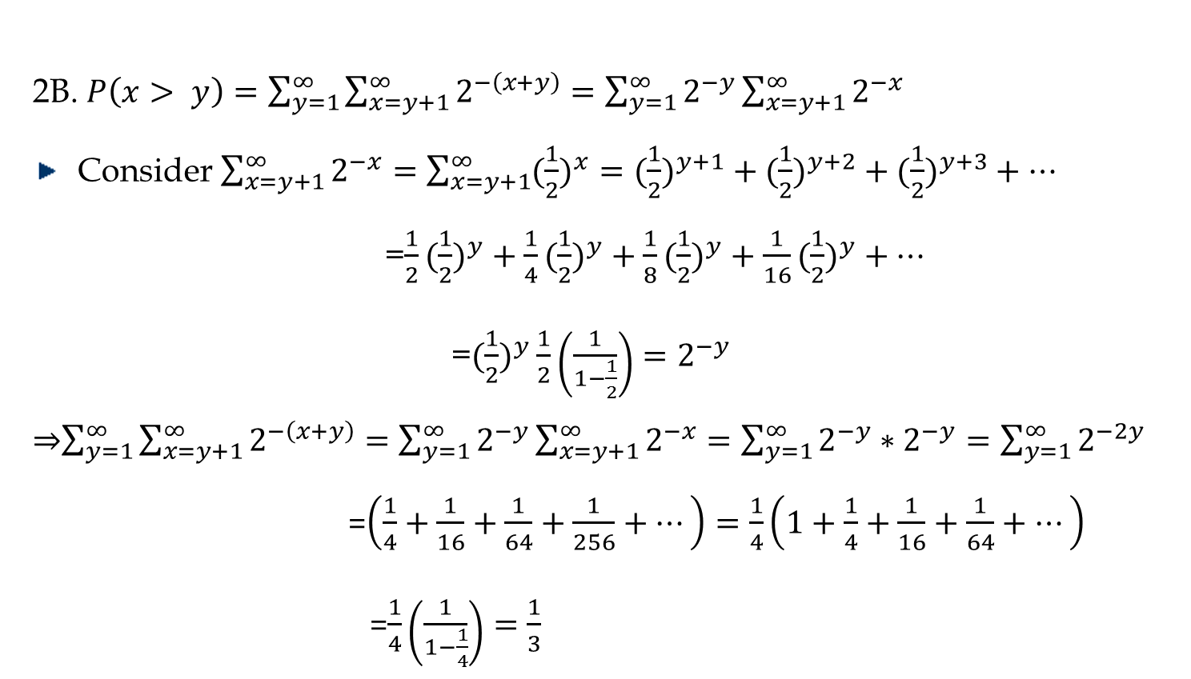
2B. $P\left(x> y\right)=\sum_{y=1}^{∞}{\sum_{x=y+1}^{∞}{2^{−\left(x+y\right)}}}=\sum_{y=1}^{∞}{2^{−y}\sum_{x=y+1}^{∞}{2^{−x}}}$
Consider $\sum_{x=y+1}^{∞}{2^{−x}}=\sum_{x=y+1}^{∞}{({\frac{1}{2})}^{x}=({\frac{1}{2})}^{y+1}+({\frac{1}{2})}^{y+2}+({\frac{1}{2})}^{y+3}+…}$
=$\frac{1}{2}({\frac{1}{2})}^{y}+\frac{1}{4}({\frac{1}{2})}^{y}+\frac{1}{8}({\frac{1}{2})}^{y}+\frac{1}{16}({\frac{1}{2})}^{y}+…$
=$({\frac{1}{2})}^{y}\frac{1}{2}\left(\frac{1}{1−\frac{1}{2}}\right)=2^{−y}$
⇒$\sum_{y=1}^{∞}{\sum_{x=y+1}^{∞}{2^{−\left(x+y\right)}}}=\sum_{y=1}^{∞}{2^{−y}\sum_{x=y+1}^{∞}{2^{−x}}}=\sum_{y=1}^{∞}{2^{−y}∗2^{−y}}=\sum_{y=1}^{∞}{2^{−2y}}$
=$\left(\frac{1}{4}+\frac{1}{16}+\frac{1}{64}+\frac{1}{256}+…\right)=\frac{1}{4}\left(1+\frac{1}{4}+\frac{1}{16}+\frac{1}{64}+…\right)$
=$\frac{1}{4}\left(\frac{1}{1−\frac{1}{4}}\right)=\frac{1}{3}$

Slide 25
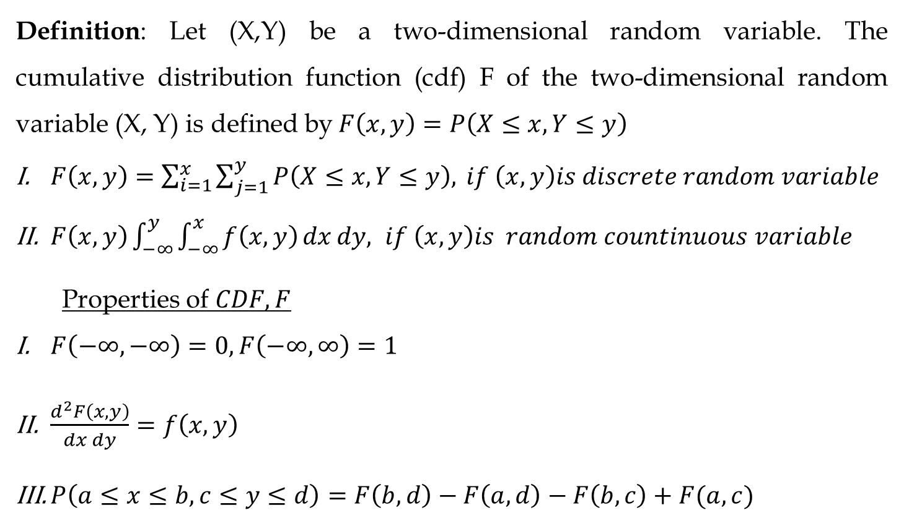
Definition: Let (X,Y) be a two-dimensional random variable. The cumulative distribution function (cdf) F of the two-dimensional random variable (X, Y) is defined by$F\left(x, y\right)=P\left(X≤x, Y≤y\right)$
$F\left(x, y\right)=\sum_{i=1}^{x}{\sum_{j=1}^{y}{P\left(X≤x, Y≤y\right),}} if \left(x,y\right)is discrete random variable$
$F\left(x, y\right)\int_{−∞}^{y}{\int_{−∞}^{x}{f\left(x, y\right)}}dxdy, if \left(x,y\right)is random countinuous variable$
Properties of $CDF,F$
$F\left(−∞, −∞\right)=0,F\left(−∞, ∞\right)=1$
$\frac{d^{2}F\left(x, y\right)}{dxdy}=f\left(x, y\right)$
$P\left(a≤x≤b, c≤y≤d\right)=F\left(b,d\right)−F\left(a,d\right)−F\left(b,c\right)+F(a,c)$

Slide 26
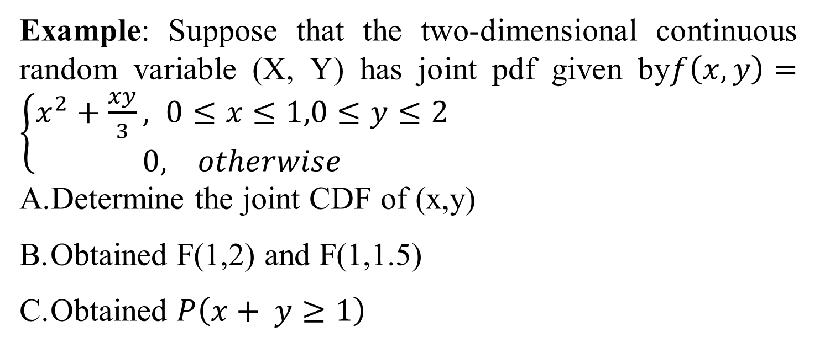
Example: Suppose that the two-dimensional continuous random variable (X, Y) has joint pdf given by$f\left(x, y\right)=\left\{\begin{aligned}x^{2}+\frac{xy}{3}, 0≤&x≤1,0≤y≤2 \\ 0, otherwise\end{aligned}\right.$
Determine the joint CDF of (x,y)
Obtained F(1,2) and F(1,1.5)
Obtained $P\left(x+ y≥1\right)$

Slide 27
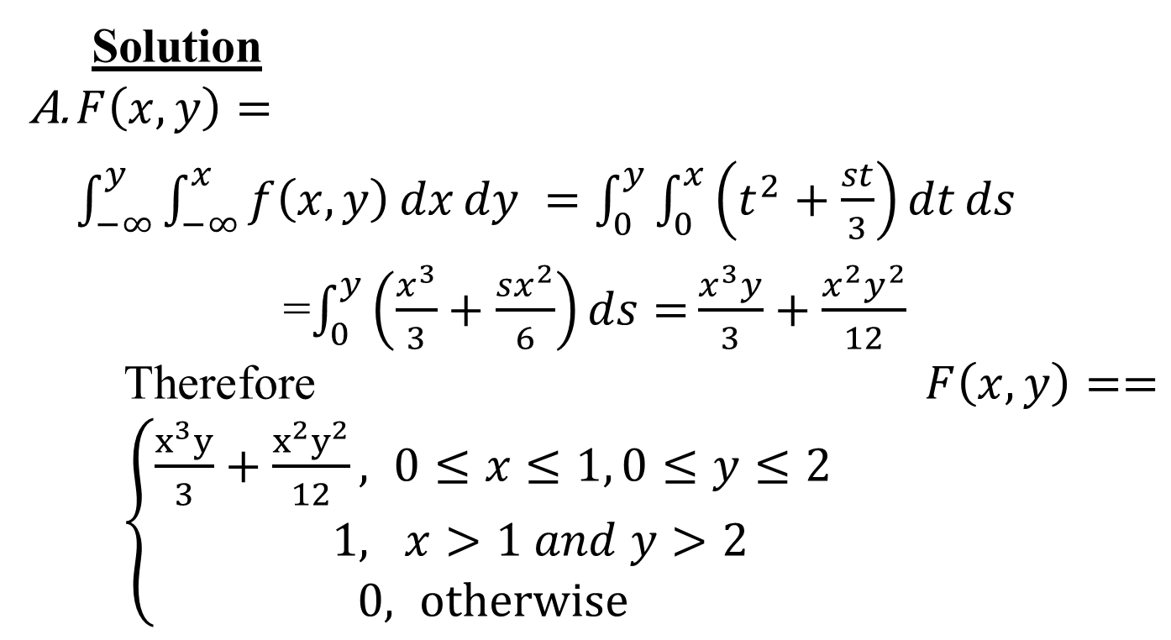
Solution
$F\left(x, y\right)=\int_{−∞}^{y}{\int_{−∞}^{x}{f\left(x, y\right)}}dxdy =\int_{0}^{y}{\int_{0}^{x}{\left(t^{2}+\frac{st}{3}\right)}}dtds$
=$\int_{0}^{y}{\left(\frac{x^{3}}{3}+\frac{sx^{2}}{6}\right)ds=}\frac{x^{3}y}{3}+\frac{x^{2}y^{2}}{12}$
Therefore$F\left(x, y\right)==\left\{\begin{aligned}\frac{x^{3}y}{3}+\frac{x^{2}y^{2}}{12}, &0≤x≤1, 0≤y≤2 \\ 1, & x>1 and y>2 \\ 0, otherwise\end{aligned}\right.$

Slide 28
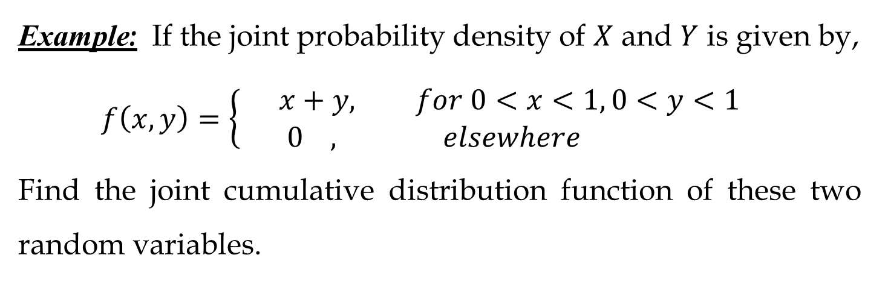
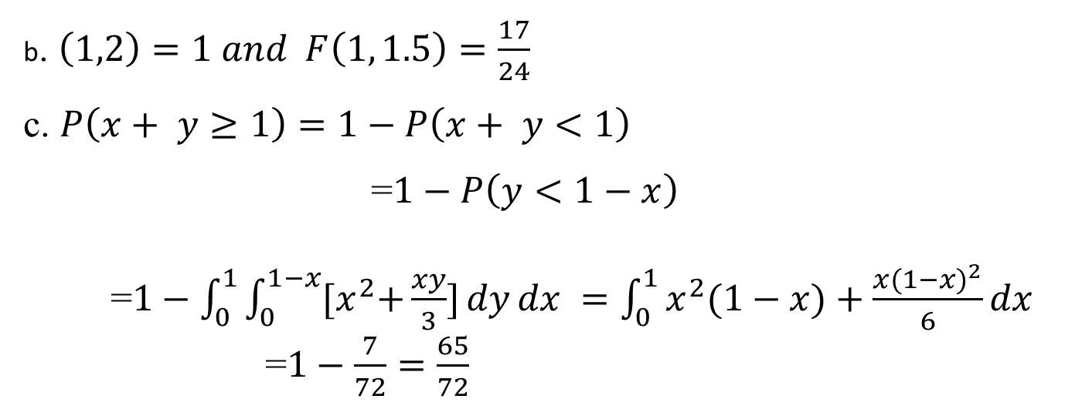
b. $\left(1,2\right)=1 and F\left(1, 1.5\right)=\frac{17}{24}$
c. $P\left(x+ y≥1\right)=1−P\left(x+ y<1\right)$
=$1−P\left(y<1−x\right)$
=$1−\int_{0}^{1}{\int_{0}^{1−x}{{[x}^{2}+\frac{xy}{3}]}}dydx =\int_{0}^{1}{x^{2}(1−x)+\frac{{x(1−x)}^{2}}{6}}dx$
=$1−\frac{7}{72}=\frac{65}{72}$
Example: If the joint probability density of $X$ and $Y$ is given by,
$$f\left(x,y\right)=\left\{\begin{aligned}x+y, for 0<x<1, 0<y<1 \\ 0 , elsewhere \end{aligned}\right.$$
Find the joint cumulative distribution function of these two random variables.

Slide 29
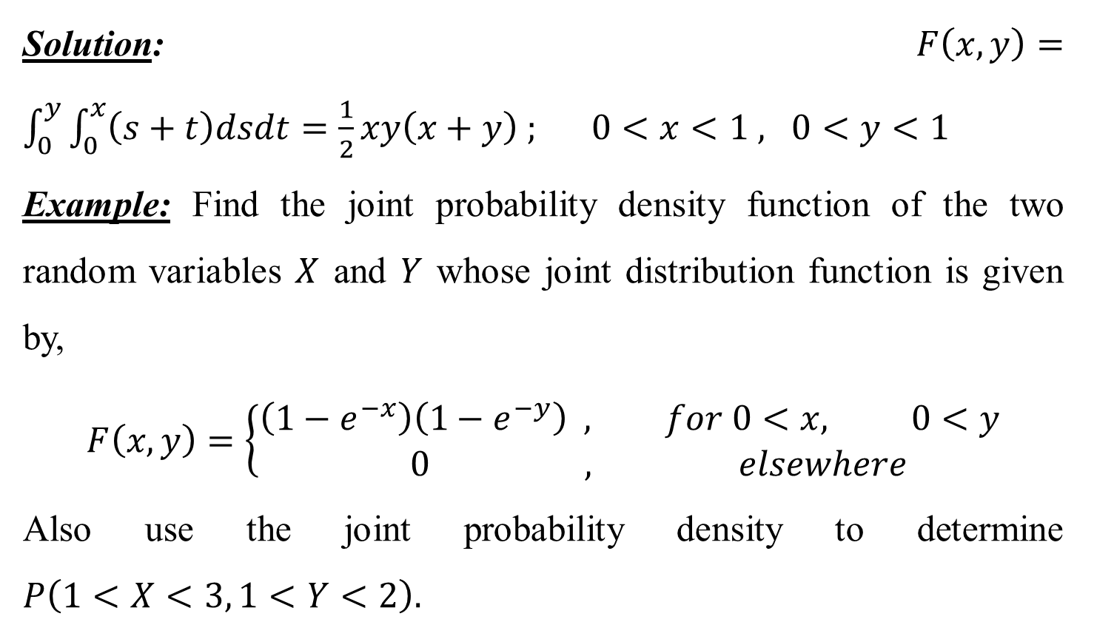
Solution:$F\left(x,y\right)=\int_{0}^{y}{\int_{0}^{x}{\left(s+t\right)dsdt=\frac{1}{2}xy\left(x+y\right) ; 0<x<1 , 0<y<1}}$
Example: Find the joint probability density function of the two random variables $X$ and $Y$ whose joint distribution function is given by,
$$F\left(x,y\right)=\left\{\begin{aligned}\left(1−e^{−x}\right)\left(1−e^{−y}\right) , for 0<x, 0<y \\ 0 , elsewhere \end{aligned}\right.$$
Also use the joint probability density to determine $P\left(1<X<3, 1<Y<2\right).$

Slide 30
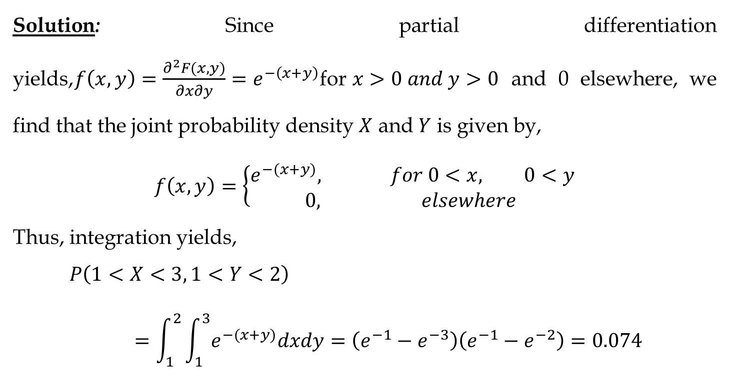
Solution: Since partial differentiation yields,$f\left(x,y\right)=\frac{∂^{2}F(x,y)}{∂x∂y}=e^{−\left(x+y\right)}$for$x>0 and y>0$ and 0 elsewhere, we find that the joint probability density $X$ and $Y$ is given by,
$$f\left(x,y\right)=\left\{\begin{aligned}e^{−(x+y)}, for 0<x, 0<y \\ 0, elsewhere \end{aligned}\right.$$
Thus, integration yields,
$$P\left(1<X<3, 1<Y<2\right)=\int_{1}^{2}{\int_{1}^{3}{e^{−(x+y)}dxdy=\left(e^{−1}−e^{−3}\right)\left(e^{−1}−e^{−2}\right)=0.074 }}$$

Slide 31
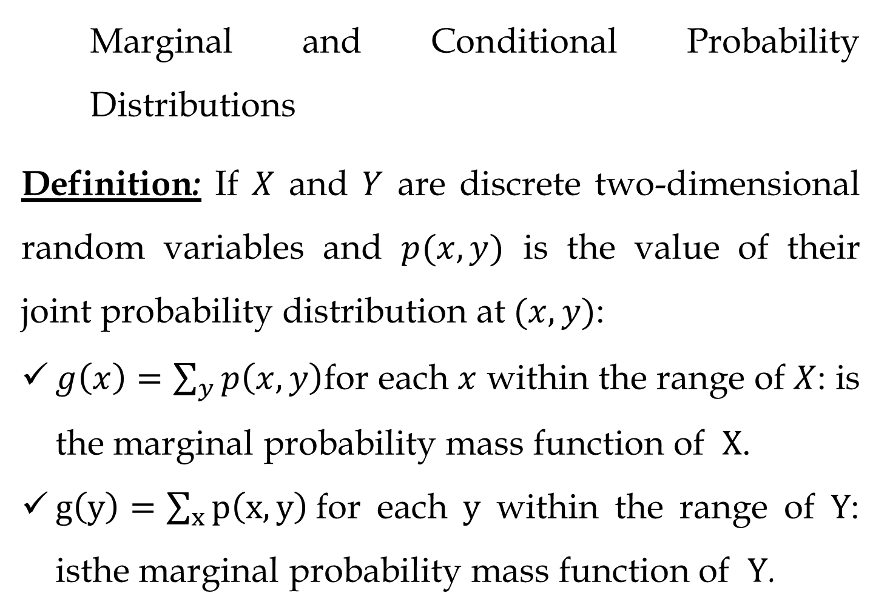
Marginal and Conditional Probability Distributions
Definition: If $X$ and $Y$ are discrete two-dimensional random variables and $p(x,y)$ is the value of their joint probability distribution at$(x,y)$:
$g\left(x\right)=\sum_{y}{p\left(x,y\right)}$for each $x$ within the range of $X$: is the marginal probability mass function of $X$.
$g\left(y\right)=\sum_{x}{p\left(x,y\right)}$for each $y$ within the range of $Y$: isthe marginal probability mass function of $Y$.

Slide 32
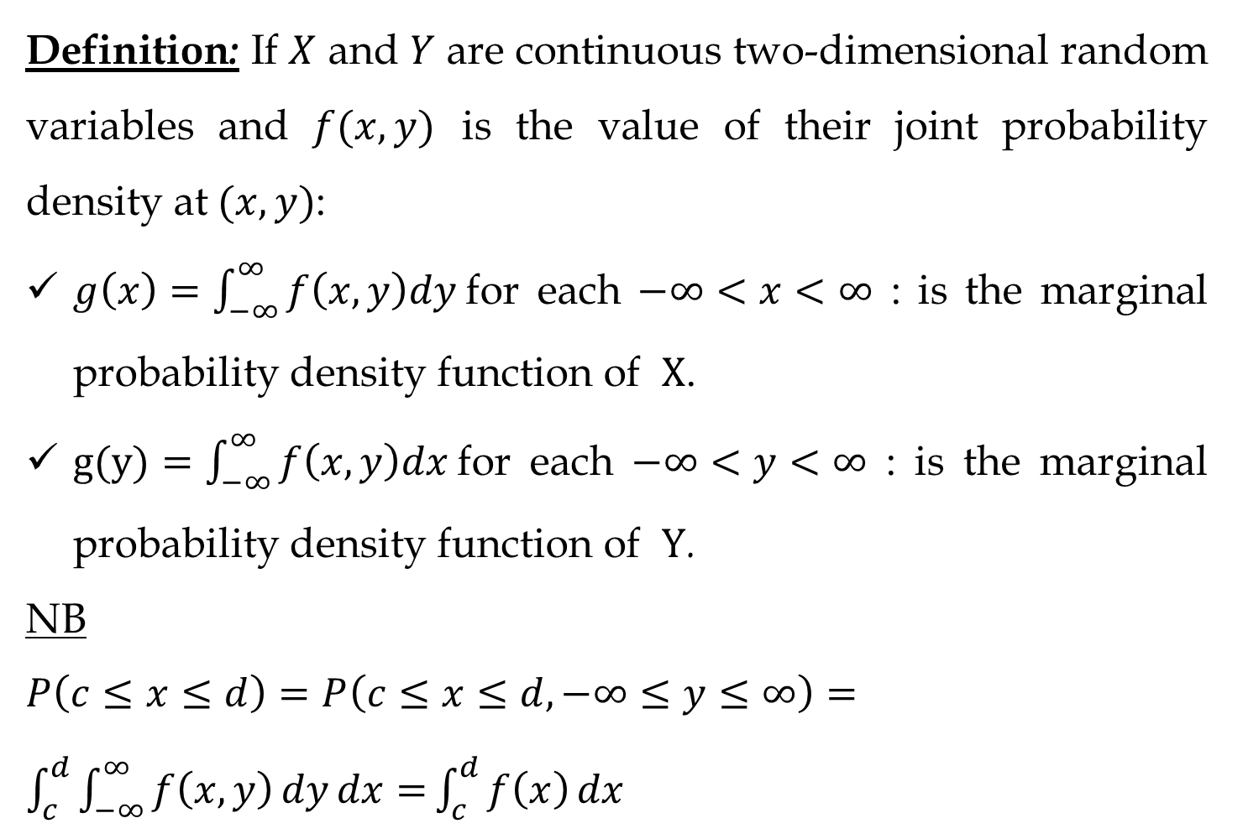
Definition: If $X$ and $Y$ are continuous two-dimensional random variables and $f(x,y)$ is the value of their joint probability density at$(x,y)$:
$g\left(x\right)=\int_{−∞}^{∞}{f\left(x,y\right)dy }$for each $−∞<x<∞$ : is the marginal probability density function of $X$.
$g(y)=\int_{−∞}^{∞}{f\left(x,y\right)dx }$for each $−∞<y<∞$ : is the marginal probability density function of $Y$.
NB $P\left(c≤x≤d\right)=P\left(c≤x≤d, −∞≤y≤∞\right)=\int_{c}^{d}{\int_{−∞}^{∞}{f\left(x, y\right)dydx=}}\int_{c}^{d}{f\left(x\right)}dx$

Slide 33
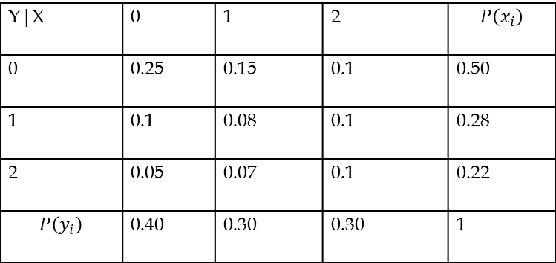
Example:
let (x,y) be the joint probability function given by
Find the marginal distribution function of X and Y
Y|X | 0 | 1 | 2 | $$P\left(x_{i}\right)$$
0 | 0.25 | 0.15 | 0.1 | 0.50
1 | 0.1 | 0.08 | 0.1 | 0.28
2 | 0.05 | 0.07 | 0.1 | 0.22
$$P\left(y_{i}\right)$$ | 0.40 | 0.30 | 0.30 | 1

Slide 34
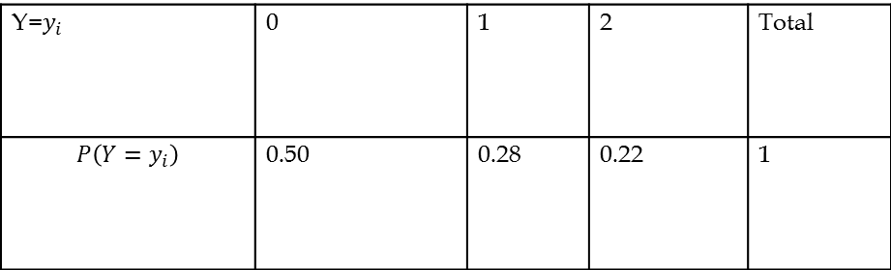
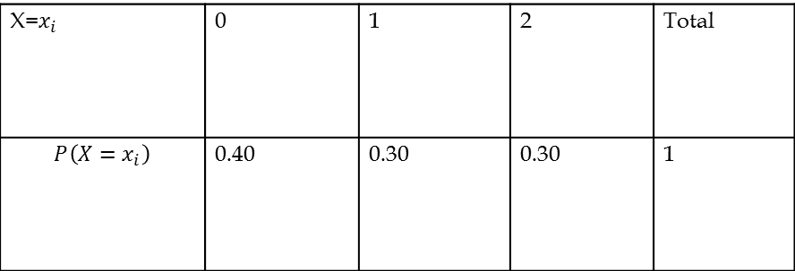
Solution:
The marginal distribution function of X is
The marginal distribution function of Y are
X=$x_{i}$ | 0 | 1 | 2 | Total
$$P\left(X=x_{i}\right)$$ | 0.40 | 0.30 | 0.30 | 1
Y=$y_{i}$ | 0 | 1 | 2 | Total
$$P\left(Y=y_{i}\right)$$ | 0.50 | 0.28 | 0.22 | 1

