Slide 1
Chapter / Module 2
Cryptography
Leykun Birhanu
AAU-CS
Notes:
1

Slide 2

Security Techniques: Cryptography
Terminologies
Cryptography: Schemes for encryption and decryption
Encryption: The process by which plaintext is converted into ciphertext.
Decryption: Recovering plaintext from the ciphertext
Secret key: Used to set some or all of the various parameters used by the encryption algorithm. In a classical (symmetric key) cryptography, the same secret key is used for encryption and decryption
Cryptanalysis: The study of “breaking the code”. Cryptanalysts!
Cryptology: Cryptography and cryptanalysis together constitute the area of cryptology.
Notes:
2

Slide 3
Cryptography
Cryptography has five ingredients:
Plaintext
Encryption algorithm
Secret Key
Ciphertext
Decryption algorithm
Security depends on the secrecy of the key, not the secrecy of the algorithm
Notes:
3

Slide 4
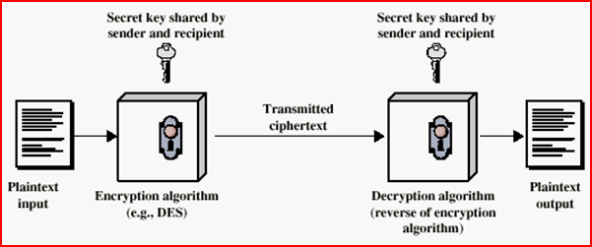
Cryptography
Simplified Encryption Model:
Notes:
4

Slide 5
Cryptography
Description:
A sender S wanting to transmit message M to a receiver R
To protect the message M, the sender first encrypts it into an unintelligible message M’
After receipt of M’, R decrypts the message to obtain M
M is called the plaintext
What we want to encrypt
M’ is called the ciphertext
The encrypted output
Notes:
5

Slide 6
Cryptography
Notation:
Given
P=Plaintext
C=CipherText
C = E_{K} (P) Encryption
P = D_{K} ( C) Decryption
➔P= D_{K}(E_{K}(P))
➔C= E_{K}(D_{K}(C))
Notes:
6

Slide 7
Cryptography
Caesar Cipher - early example:
Caesar Cipher: The earliest known example of a substitution cipher in which each character of a message is replaced by a character three position down in the alphabet.
Plain text: are you ready
Cipher text: duh brx uhdgb
Notes:
7

Slide 8
Cryptography
If we represent each letter of the alphabet by an integer that corresponds to its position in the alphabet:
The formula for replacing each character ‘p’ of the plaintext with a character ‘c’ of the ciphertext can be expressed as:
c = E₃(p ) = (p + 3) mod 26
Notes:
8

Slide 9
Cryptography
A more general version of this cipher that allows for any degree of shift:
c = E_{k}(p ) = (p + k) mod 26
The formula for decryption would be
p = D_{k}(c ) = (c - k) mod 26
In these formulas
‘k’ is the secret key. The symbols ’E’ and ’D’ stand for Encryption and Decryption respectively, and p and c are characters in the plain and cipher text respectively.
Notes:
9

Slide 10
Cryptography
Properties of encryption function
It is computationally infeasible to find the key K when given the plaintext P and associated ciphertext C= E_{K} (p)
It should also be computationally infeasible to find another key k’ such as E_{K}(p) = E_{K’}(p). Uniqueness.
Notes:
10

Slide 11
Cryptography
Types of attacks encryption
The attacker has only the ciphertext and his/her goal is to find the corresponding plaintext
The attacker has a ciphertext and the corresponding plaintext and his/her goal is to find the key
A good cryptosystem protects against all types of attacks
Attackers use both Mathematics and Statistics
Notes:
11

Slide 12
Cryptography
Intruders
Eavesdropping (listening/spying the message)
An intruder may try to read the message
If it is well encrypted the intruder will not know the content
However, just the fact the intruder knows that there is communication may be a threat (Traffic analysis)
Modification
Modifying a plaintext is easy, but modifying encrypted messages is more difficult
Insertion of messages
Inserting new message into a ciphertext is difficult
Notes:
12

Slide 13
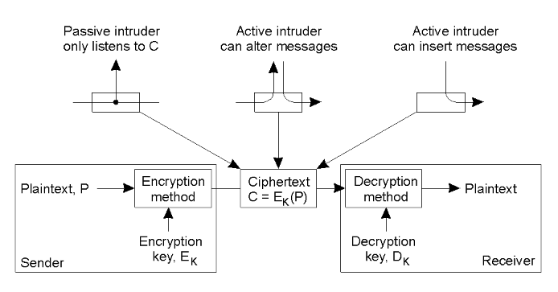
Cryptography
Intruders
Notes:
13

Slide 14
Cryptography
There are two fundamentally different cryptographic systems
Symmetric cryptosystem/ Private key encryption sys.
Asymmetric cryptosystem/ Public key encryption sys.
Notes:
14

Slide 15
Cryptography
Symmetric Cryptosystem
Also called secret-key/private-key cryptosystem
The same key is used to encrypt and decrypt a message
P = D_{K} [E_{K} (P) ]
Have been used for centuries in a variety of forms
The key has to be kept secret
The key has to be communicated using a secure channel
They are still in use in combination with public key cryptosystems due to some of their advantages
Notes:
15

Slide 16
Cryptography
Asymmetric Cryptosystem
Also called public-key cryptosystem
keys for encryption and decryption are different but form a unique pair
P = D_{KD} [E_{KE} (P) ]
Only one of the keys need to be private while the other can be public
Invented by Diffie and Hellman in 1976
Uses Mathematical functions whose inverse is not known by Mathematicians of the day
It is a revolutionary concept since it avoids the need of using a secure channel to communicate the key
It has made cryptography available for the general public and made many of today’s on-line application feasible
Notes:
16

Slide 17
Cryptography
Public-key Cryptosystem
Which one of the encryption or decryption key is made public depends on the use of the key
If Hana wants to send a confidential message to Ahmed
She encrypts the message using Ahmed’s public key
Send the message
Ahmed will then decode it using his own private key
On the other hand, if Ahmed needs to make sure that a message sent by Hana really comes from her, how can he make that?
Notes:
17

Slide 18
Cryptography
Public-key Cryptosystem
Digital signature
Hana has to first encrypt a digital signature using her private key
Then encrypt the message (signature included) with Ahmed’s public key
Sends the encrypted message to Ahmed
Ahmed decrypts the message using his private key
Ahmed then decrypts the signature using Hana’s public key
If successful, he insures that it comes from Hana
Notes:
18

Slide 19
Cryptography
Hash functions
One application of cryptography in distributed systems is the use of hash functions
A hash function H takes a message m of arbitrary length and produces a bit string h, h= H (m)
When the hash value h is sent with the message m, it enables to determine whether m has been modified or not
It is similar to cyclic-redundancy check (CRC) and Check sum
Notes:
19

Slide 20
Cryptography
Hash functions
Properties of hash functions
One-way function: It is computationally infeasible to find m that corresponds to a known output of h
Collision resistance
Weak-collision resistance: It is computationally infeasible, given m and H, to find m’ ≠ m such that H(m) = H(m’)
Strong-collision resistance: Given H, it is computationally infeasible to find any two different input values m and m’, such that H(m) = H(m’)
Notes:
20

Slide 21
Cryptography
Average time required for exhaustive key search
Key Size (bits) | Number of Alternative Keys | Time required at 10⁶ Decryption/µs
32 | 2³² = 4.3 x 10⁹ | 2.15 milliseconds
56 | 2⁵⁶ = 7.2 x 10¹⁶ | 10 hours
128 | 2¹²⁸ = 3.4 x 10³⁸ | 5.4 x 10¹⁸ years
168 | 2¹⁶⁸ = 3.7 x 10⁵⁰ | 5.9 x 10³⁰ years
Notes:
21

Slide 22
Cryptography
DES - Popular Example of Symmetric Cryptosystem
In 1973, the NBS (National Bureau of Standards, now called NIST - National Institute of Standards and Technology) published a request for an encryption algorithm that would meet the following criteria:
have a high security level
be easily understood
not depend on the algorithm's confidentiality
be adaptable and economical
be efficient and exportable
In late 1974, IBM proposed "Lucifer", which was then modified by NSA (National Security Agency) in 1976 to become the DES (Data Encryption Standard).
DES was then approved by the NBS in 1978. DES was standardized by the ANSI under the name of ANSI X3.92, also known as DEA (Data Encryption Algorithm).
Notes:
22

Slide 23
Cryptography
DES- Example of Symmetric Cryptosystem …
DES Utilizes block cipher, which means that during the encryption process, the plaintext is broken into fixed length blocks of 64 bits.
The key is 56 bits wide. 8-bit out of the total 64-bit block key is used for parity check (for example, if odd parity is used, each byte has an odd number of bits set to 1).
56-bit key gives 2⁵⁶ (≅ 7.2*10¹⁶) possible key variations
DES algorithm involves carrying out combinations, substitutions and permutations between the text to be encrypted and the key, while making sure the operations can be performed in both directions (for decryption).
The combination of substitutions and permutations is called a product cipher.
Notes:
23

Slide 24
Cryptography
DES- Example of Symmetric Cryptosystem …
DES was best suited for implementation in hardware, probably to discourage implementations in software, which tend to be slow by comparison during that time.
Modern computers are so fast that satisfactory software implementations for DES are possible.
DES is the most widely used symmetric algorithm despite claims whether 56 bits is long enough to guarantee security.
Using current technology, 56-bit key size is vulnerable to a brute force attack.
Notes:
24

Slide 25
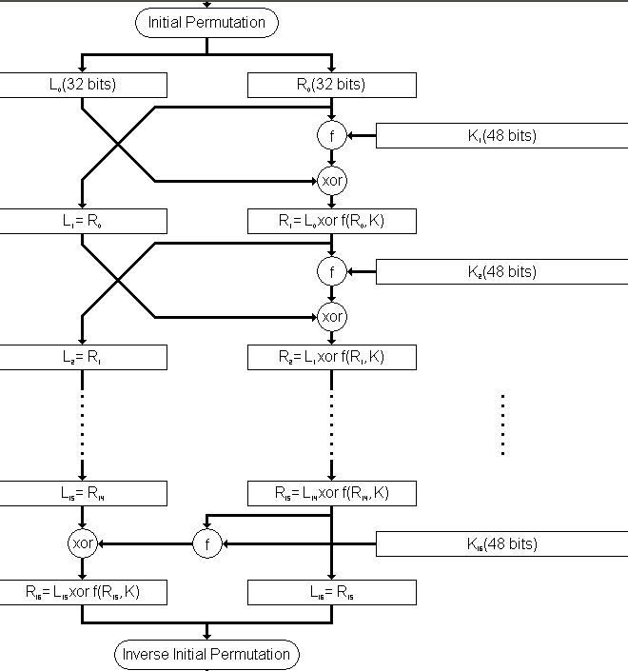
Cryptography
DES- Example of Symmetric Cryptosystem …
DES Encryption starts with an initial permutation (IP) of the 64 input bits. These bits are then divided into two 32-bit halves called L and R. The encryption then proceeds through 16 rounds, each using the L and R parts, and a subkey.
The R and subkeys are processed in the so called f-function, and exclusive-or of the output of the f-function with the existing L part to create the new R part. The new L part is simply a copy of the incoming R part.
In the final round, the L and R parts are swapped once more before the final permutation (FP) producing the 64 bits output block.
Decryption is identical to encryption, except that the subkeys are used in the opposite order. That is, subkey 16 is used in round 1, subkey 15 is used in round 2, etc., ending with subkey 1 being used in round 16.
Structure of DES Algorithm
Notes:
25

Slide 26
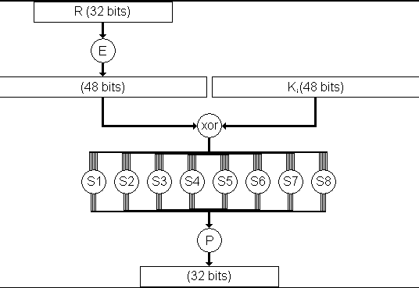
Cryptography
DES- Example of Symmetric Cryptosystem …
The f-function mixes the bits of the R portion using the Subkey for the current round. First the 32-bit R value is expanded to 48-bits using a permutation E. That value is then exclusive-or'ed with the subkey.
The 48-bits are then divided into eight 6-bit chunks, each of which is fed into an S-Box that mixes the bits and produces a 4-bit output. A little bit funny operation here!!
Those eight 4-bit outputs are combined into a 32-bit value, and permuted once again to give the output of the f-function.
DES- Algorithm, the f-function
Notes:
26

Slide 27
Cryptography
DES - Attacks
Cracking: The most basic method of attack for any cypher is brute force - trying every possible key in turn.
The length of the key determines the number of possible keys, and hence the feasibility of the approach.
DES is not adequate with this regard due to its key size
In academia, various proposals for a DES-cracking machine were advanced.
In 1977, Diffie and Hellman proposed a machine costing an estimated US$20 million which could find a DES key in a single day.
By 1993, Wiener had proposed a key-search machine costing US$1 million which would find a key within 7 hours.
However, none of these early proposals were ever implemented.
Notes:
27

Slide 28
Cryptography
DES – Attacks …
The vulnerability of DES was practically demonstrated in 1997, where RSA Security sponsored a series of contests, offering a $10,000 prize to the first team that broke a message encrypted with DES for the contest. That contest was won by the DESCHALL Project, led by Rocke Verser, Matt Curtin, and Justin Dolske, using idle cycles of thousands of computers across the Internet.
The feasibility of cracking DES quickly was demonstrated in 1998 when a custom DES-cracker was built by the Electronic Frontier Foundation (EFF), a cyberspace civil rights group, at the cost of approximately US$250,000. Their motivation was to show that DES was breakable in practice as well as in theory.
Notes:
28

Slide 29
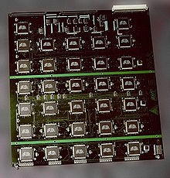
Cryptography
DES- – Attacks …
The EFF's US$250,000 DES cracking machine contained 1,856 custom chips and could brute force a DES key in a matter of days - the photo shows a DES Cracker circuit board fitted with several Deep Crack chips.
Notes:
29

Slide 30
Cryptography
DES - Variants
A variant of DES, Triple DES (3-DES), provides enhanced security by executing the core algorithm three times in a row.
With triple length key of three 56-bit keys K1, K2 & K3, encryption is:
Encrypt with K1
Decrypt with K2
Encrypt with K3
Decryption is the reverse process:
Decrypt with K3
Encrypt with K2
Decrypt with K1
Setting K3 equal to K1 in these processes gives us a double length key K1, K2.
Setting K1, K2 and K3 all equal to K has the same effect as using a single-length (56-bit key).
Thus it is possible for a system using triple-DES to be compatible with a system using single-DES.
Notes:
30

Slide 31
Group Presentation Topic
Present how DES works.

Slide 32
Cryptography
Public-key Cryptosystem
Properties of public key cryptosystem
A pair of keys (private, public)
If you have the private key, you can easily decrypt what is encrypted by the public key
Otherwise, it is computationally infeasible to decrypt what has been encrypted by the public key
Notes:
32

Slide 33
Cryptography
Public-key Cryptosystem: Example RSA
RSA is from R. Rivesh, A. Shamir and L. Aldermen
Principle: No mathematical method is yet known to efficiently find the prime factors of large numbers
In RSA, the private and public keys are constructed from very large prime numbers (consisting of hundred of decimal digits)
One of the keys can be made public
Breaking RSA is equivalent to finding the prime factors: this is known to be computationally infeasible
It is only the person who has produced the keys from the prime numbers who can easily decrypt the messages
Notes:
33

Slide 34
Cryptography
More on RSA
The RSA algorithm
Used for both public key encryption and digital signatures.
Security is based on the difficulty of factoring large integers.
Major Activities
Key Generation (Algorithm)
Encryption
Digital signing
Decryption
Signature verification
Notes:
34

Slide 35
Cryptography
RSA- Key Generating Algorithm
Generate two large random primes, p and q
Compute n = pq and (φ) phi = (p-1)(q-1)
Choose an integer e, 1 < e < φ, such that gcd(e, phi) = 1
Compute the secret exponent d, 1 < d < φ, such that
φ divides (ed-1)
The public key is (n, e) and the private key is (n, d).
Keep all the values d, p, q and φ secret
n is known as the modulus
e is known as the public exponent or encryption exponent
d is known as the secret exponent or decryption exponent.
Notes:
35

Slide 36
Cryptography
RSA- Encryption
Sender A does the following
Obtains the recipient B's public key (n, e)
Represents the plaintext message as a positive integer m
Computes the ciphertext c = m^{e} mod n
Sends the ciphertext c to B
RSA- Decryption
Recipient B does the following
Uses his private key (n, d) to compute m = c^{d} mod n
Extracts the plaintext from the message representative m
Notes:
36

Slide 37
Cryptography
RSA- Digital signing
Sender A does the following
Creates a message digest of the information to be sent
Represents this digest as an integer m between 0 and n-1
Uses private key (n, d) to compute the signature
s = m^{d} mod n.
Sends this signature s to the recipient B.
RSA- Signature verification
Recipient B does the following
Uses sender A's public key (n, e) to compute integer v = s^{e} mod n
Extracts the message digest from this integer
Independently computes the message digest of the information that has been signed
If both message digests are identical, the signature is valid
Notes:
37

Slide 38
Cryptography
RSA- Key Generation Simple Example
Select primes p=11, q=3.
n = pq = 11*3 = 33
phi = (p-1)(q-1) = 10*2 = 20
Choose e=3
Check gcd(e, p-1) = gcd(3, 10) = 1 (i.e. 3 and 10 are relatively prime - have no common factors except 1) and check gcd(e, q-1) = gcd(3, 2) = 1, therefore gcd(e, phi) = gcd(e, (p-1)(q-1)) = gcd(3, 20) = 1
Compute d (1<d<phi) such that phi divides ed-1 (20 divides 3d-1.)
Simple testing (d = 2, 3 ...) gives d = 7
Check: ed-1 = 3*7 - 1 = 20, which is divisible by phi (20).
Public key = (n, e) = (33, 3)
Private key = (n, d) = (33, 7).
Notes:
38

Slide 39
Cryptography
Given
Public key = (n, e) = (33, 3)
Private key = (n, d) = (33, 7)
RSA- Encryption Example
Now say we want to encrypt the message m = 7
c = m^{e} mod n = 7³ mod 33 = 343 mod 33 = 13
Hence the ciphertext c = 13
RSA- Decryption Example
To check decryption we compute
m = c^{d} mod n = 13⁷ mod 33 = 7
Notes:
39

Slide 40
Cryptography
RSA- More Meaningful Example
Message: ATTACKxATxSEVEN
Grouping the characters into blocks of three and computing a message representative integer for each block:
ATT ACK XAT XSE VEN
In the same way that a decimal number can be represented as the sum of powers of ten, e.g. 135 = 1 x 10² + 3 x 10¹ + 5, we could represent our blocks of three characters in base 26 using A=0, B=1, C=2, ..., Z=25
ATT = 0 x 26² + 19 x 26¹ + 19 = 513
ACK = 0 x 26² + 2 x 26¹ + 10 = 62
XAT = 23 x 26² + 0 x 26¹ + 19 = 15567
XSE = 23 x 26² + 18 x 26¹ + 4 = 16020
VEN = 21 x 26² + 4 x 26¹ + 13 = 14313
Notes:
40

Slide 41
Cryptography
Do public and private key form a unique pair?
e and d form no unique pair!
With RSA, we can make several private key for single public key and vice versa.
We have to avoid to make more than one public key for a single private key because combining two such keys help revealing the private key.
Notes:
41

Slide 42
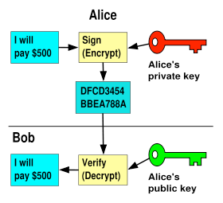
Cryptography
Digital Signature
Notes:
42

Slide 43
Cryptography
Digital Signature for Message Integrity and Confidentiality
Confidentiality insures that messages cannot be intercepted and read by eavesdroppers
Message integrity insures that messages are protected against modification
Principles of Digital Signature
User A signs digitally a message m using “cryptographic hash of the message m with the private key of A and attach it to the message m.
Anybody can then decrypt A’s digital signature using A’s public key and compare it with the cryptographic hash of the message m to verify that m was signed by A and m was not altered.
Notes:
43

Slide 44
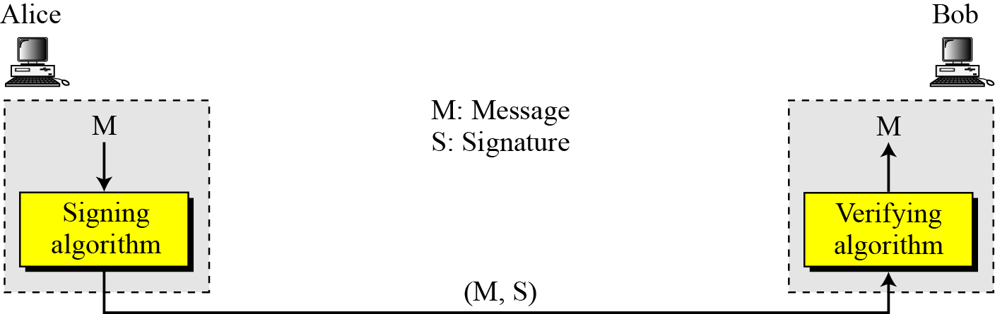
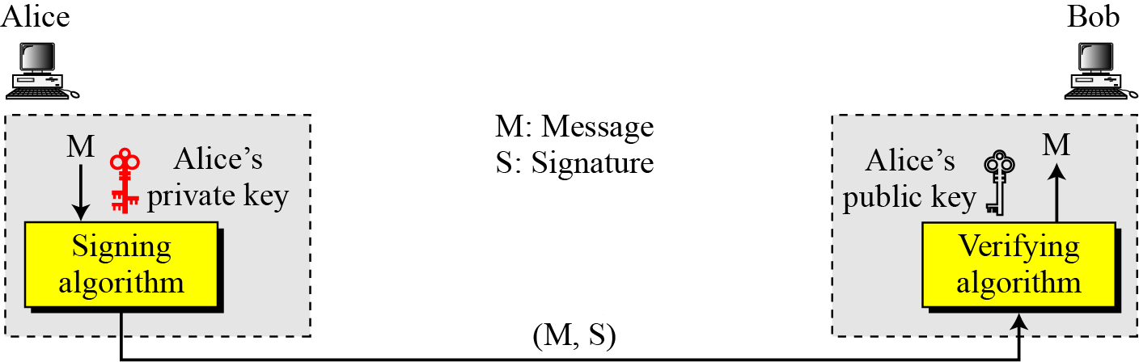
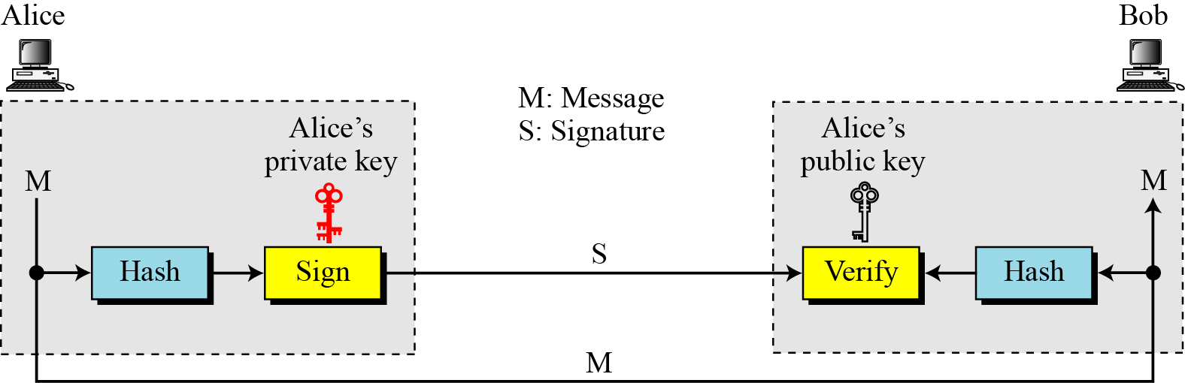
Cryptography
Digital Signature - Principles
Process
With Key
With Message Digest

Slide 45
Cryptography
Digital Signature for Assurance
Consider the situation where Bob has just sold Alice something for 500 Birr through a deal that is made by E-mail
Alice sends an E-mail accepting to pay 500 Birr
Two issues need to be taken care of in addition to authentication
Alice needs to be assured that Bob will not modify the amount and show that Alice promised to pay more than 500 Birr
Bob needs to be assured that Alice will not deny that she sends the message
If Alice signs the message digitally, the two issues will be solved
There are several ways to place digital signatures
One popular way is to use public-key cryptosystem such as RSA
Notes:
45

Slide 46
Cryptography
Digital Signature Using Public Key Cryptosystem
Notation: K_{X}^{- :} Private key of X
K_{X}^{+ :} Public key of X
When Alice sends her message m to Bob, she encrypts it with her private key K_{A}⁻(m)
If she wants to keep the message content a secret, she can use Bob’s public key and send K_{B}⁺(m, K_{A}⁻(m))
Alice is protected against modification by Bob since if Bob produces m’, he has to find K_{A}⁻(m’)
Notes:
46

Slide 47
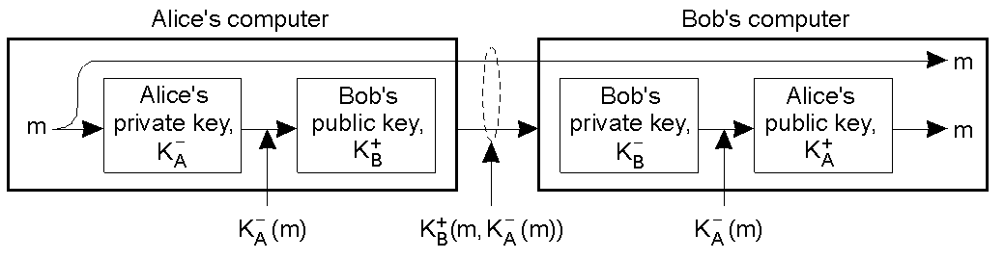
Cryptography
Digital Signature Using Public Key Cryptosystem …
Notes:
47

Slide 48
Cryptography
Digital Signature Using Message Digest
Hash/Message Digest: Short “signature” of the message, 128–512 bits, that depend on entire message
It is extremely improbable that unequal messages have same hash
Example: MD5 (Message Digest version 5)
H = H (m) is sent along m, where H is a cryptographic hash function
K_{A}⁻(H(m)) (or K_{B}⁺(m, K_{A}⁻(H(m)))) is sent so that Bob knows that it comes from Alice by decrypting it
Bob hashes the message m and compares it with H that he has received from Alice
Notes:
48

Slide 49
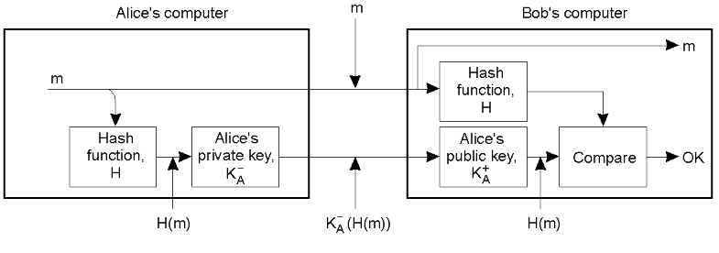
Cryptography
Digital Signature Using Message Digest …
Notes:
49

Slide 50
Cryptography
Key Distribution: Verifying Someone’s Public Key
Even with public-key cryptosystems and digital signatures, we still have the problem of authentication: binding users to keys.
Early days articles envisioned phonebook-like database with Name and Public Key entries.
Problem: How secure is that database itself?
Attacker can put in his own key for someone else, and start signing fake contracts (and even checks!).
Maybe we can secure the phonebook, but then it kills the idea of keys widely and easily available (publicly) .
Notes:
50

Slide 51
Cryptography
Key Distribution: Problems
Distribution of a key is a difficult matter!
For a symmetric cryptosystem, the initial key must be communicated along a secured channel(?)
For public key, we need a body that certifies the public key is that of the party we need to communicate with
Solution:Certification/Certificate Authority (CA) that signs (certifies) the public key
Notes:
51

Slide 52
Cryptography
Certification
The critical thing is that the name in the certificate must match the alleged name.
Common solution to public key distribution today is to have trusted third party to sign the user’s public encryption key.
A certificate is a public key and some naming “stuff”, digitally signed by someone you trust (third party) - Certification Authority (CA).
Remark: Just because they are CAs doesn’t mean you should trust them.
Resulting certificate will contain information like user’s name/ID, user’s public key, name of CA, start date of certificate, and length of time it is valid.
User publishes certificate with the X.509 standard (for formatting certificates).
Notes:
52

Slide 53
Cryptography
Certification - Associated Overheads
An important issue is the longevity of certificates
Lifelong certificates are not feasible
Therefore, we need a way to revoke certificates
Certificate Revocation List (CRL) published regularly
Problems
Vulnerability between the publishing and the request for revocation
Restricting the lifetime of a certificate
A client contacts the certification authority for each public key, checks whether it is valid or not
Notes:
53

Slide 54
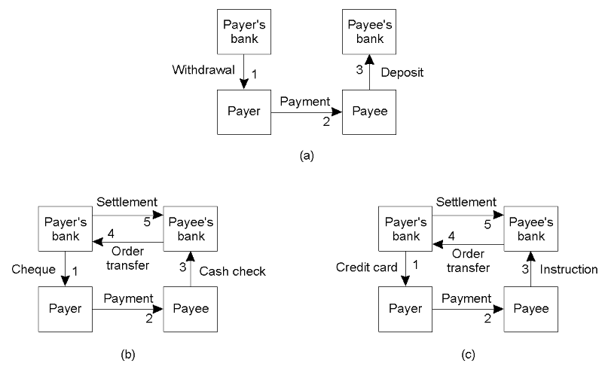
Cryptography
Applications – Electronic Payment
Payment systems - based on direct payment
Paying in cash.
Using a check.
Using a credit card.
Notes:
54

Slide 55
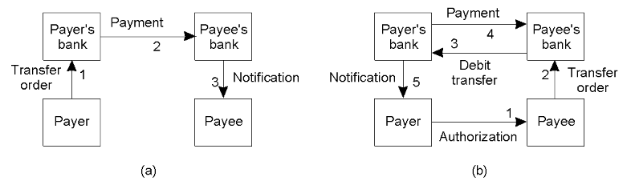
Cryptography
Applications – Electronic Payment …
Payment systems based on money transfer between banks.
Payment by money order.
Payment through debit order.
Notes:
55

Slide 56
Cryptography
Applications – Security in Electronic Payment
General requirements
In cash based systems (using ATM), the main issue is authentication
Use of magnetic card
PIN
Digital money
Protection against fraud
It should not be possible to use the money more than once
It should not be possible to use forged money
Credit card or check based system
No tampering/alteration
Protection against repudiation (the buyer denies having made the order)
Notes:
56

Slide 57
Cryptography
Use of Session keys
During the establishment of a secure channel, after the authentication phase, the communicating parties use session/temporary keys
Benefits
The session key is safely discarded when the channel is no longer used
When a key is used very often it becomes vulnerable. Thus by using the main key less often, we make them less vulnerable
Replay attacks can be avoided
Authentication keys are often expensive to replace
Such a combination of long-lasting and cheaper/more temporary/ session keys is a good choice
Notes:
57

Slide 58
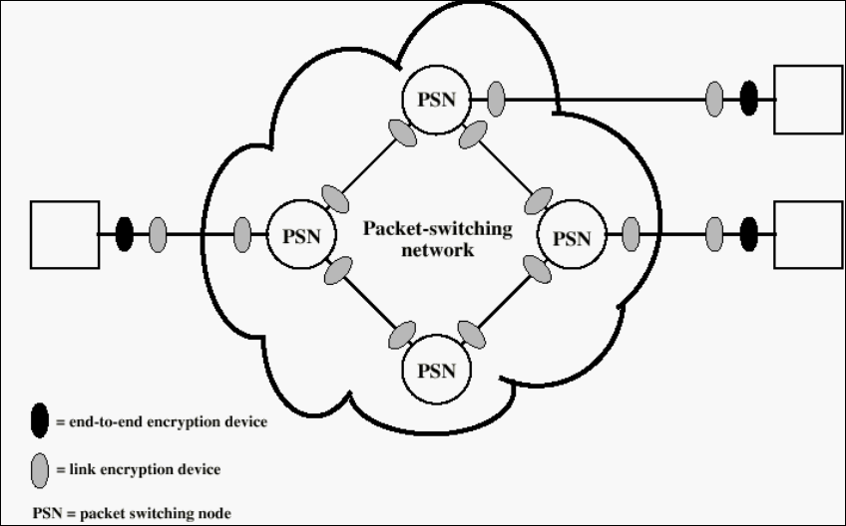
Cryptography
Summary: Location of Encryption/Decryption Devices

Slide 59
Cryptography
Summary
Advantage of private-key (symmetric/secret-key) cryptography is that it provides better secrecy but needs prearranged key exchange.
Advantage of public-key (asymmetric) cryptography is that it allows for secrecy between two parties who have not arranged in advance to have a shared key (or trusted some third party to give it to them) and the disadvantage is overhead and speed.
Therefore, in practice, hybrid systems use public-key to establish session key for private key !!
Notes:
59

Slide 60
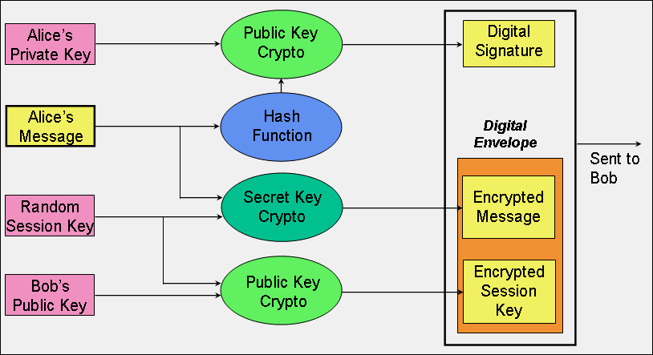
Security Techniques: Cryptography
Notes:
60

