Slide 1
Chapter 2
Data Models and DATABASE SYSTEM ARCHITECTURE

Slide 2
Objective
to briefly describe the evolution of database systems and to understand some of the main data models used and now in use.
To understand the database system Architecture

Slide 3
Outline
Basic Database Terminologies
Overview of data models
Schemas and Instances
DBMS Architecture
Data Independence

Slide 4
Basic Database Terminologies
Enterprise - an organization : A library, a bank, a university, etc.
Entity - person, place, thing, or event
An "object" in the real world that we are interested in like Student, Customer, Book, …
Attribute (Field) - a characteristics of an Entity, that has a specific meaning. Eg. Name, age, telephone, grade, sex, etc.
Record - a logically connected set of one or more Attributes that describe an Entity
File - a collection of related records. For example, a file might contain data about customers; or students of a certain department in a university
Database - collection of Files

Slide 5
Data Model
A set of primitives for defining the structure of a database.
Database Model is a collection of tools or concepts for describing:
Data
Data relationships
Data semantics
Data constraint
The main purpose of database model is to represent the data in an understandable way.

Slide 6
Data Model
Categories of database models include:
Object-based
Record-based
Physical

Slide 7
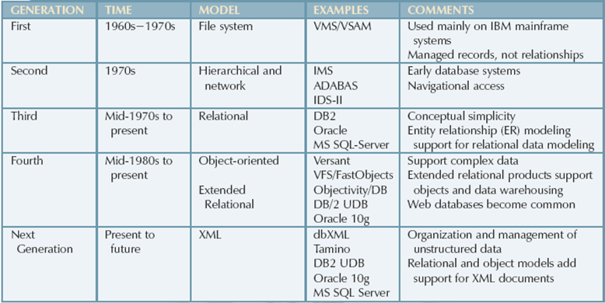
Evolution of Major Data Models

Slide 8
File-Processing Systems
The earliest database systems – during the 1960s
Data was stored in flat text files in the operating system.
Data was also grouped into records
e.g. a record of Customer data in a bank might look like this:
Number, Name, FathersName, PhoneNumber, Address, SavingsAccountNumber, SavingsAccountBalance, CurrentAccountNumber, CurrentAccountBalance
123,Tesfay, Kebede, 04 407600, Yeka kefle ketema Addis Ababa, 1234, 1000, 9876, 1000
A file contains data about one entity e.g. Customer is an entity. Each record in the file represents an instance of that entity.
Each row is a record; the file represents a record type.

Slide 9
Cont’d
Disadvantages
Programmers had to write specific programs to carry out each tasks - so a lot of work was involved.
e.g. to retrieve all customer records or to find the customer record for a given customer number.
It could also lead to data being duplicated in different files
e.g. think of a bank’s database. A customer’s name and phone number could appear in a file containing all savings accounts. If the same customer also has a current account, their name and phone number would also appear in the file containing all current accounts. Or if a customer has 2 savings accounts – need 2 rows in the file –name and phone number are repeated.
If the customer changes their phone number – it has to be changed in both files.
This system worked, but didn’t allow data to be related – e.g. to have the customer name and phone number in one place, and relate a savings account to it and a current account to it.

Slide 10
Record-based Data Models
Consist of a number of fixed format records.
Each record type defines a fixed number of fields
Each field is typically of a fixed length.
There are three types of Record-based data models:-
Hierarchical Database Model
Network Database Model
Relational Database Model

Slide 11
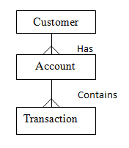
Hierarchical Model

Slide 12
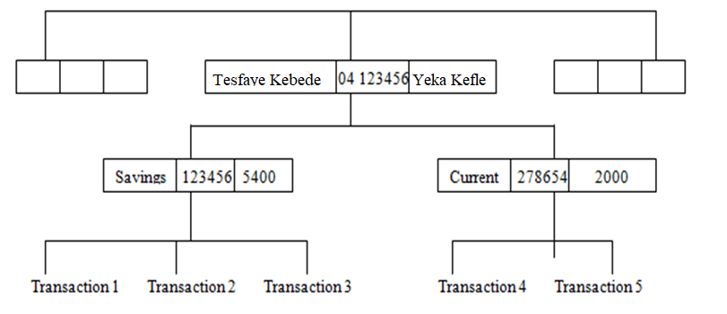

Slide 13
cont’d
The simplest database model
Records are represented as nodes or segments
Nodes are arranged in a hierarchical structure as sort of upside-down tree. The tree may be of arbitrary depth
Each record contain multiple fields, where each field may contain either data values like integer, real, text or a pointer to a record. The pointer is not allowed to form a cycle. Some hierarchical DBMS support null values or variable-length fields .

Slide 14
Cont’d
The top node is the root node
The relationship between parent and child is one-to-many and one-to-one
A parent node can have more than one child node
A child node can only have one parent node
Relation is established by creating physical link between stored records (each is stored with a predefined access path to other records)

Slide 15
Cont’d
The data is still stored in a flat file….like previously…but now the flat file has 3 different record types in it and the record types are related:
Customer: 123, Teffaye , Abebe, 04 407600, Yeka Kefle ketema,
Account: Savings, 123456, 5400
Transaction:…..
Transaction:….
Account: Current,278654, 2000
Customer: ……………

Slide 16
Advantages
Hierarchical Model is simple to construct and operate on
Conceptual simplicity – easy to understand the model layout
Data independence (a change in a data type will be automatically cascaded throughout the database by the DBMS, thereby eliminating the need to make changes in the program segments that reference the changes data type)
Database integrity – always a link between parent and child
Efficiency – very efficient when it contains a large volume of data in 1:M relationships and whose relationships are fixed over time

Slide 17
Cont’d
Searching of any record in a hierarchical tree is very fast since the hierarchical databases uses contiguous storage for hierarchical structures.
Language is simple; uses constructs like GET, GET UNIQUE, GET NEXT, GET NEXTWITHIN PARENT etc.

Slide 18
Disadvantage
Complex implementation – detailed knowledge of the physical data storage characteristics is required by the designers and programmers
Difficult to manage – relocation of segments requires application changes
Lacks structural independence
Complex applications programming and use – programmers and end users must know precisely how the data are physically distributed within the database
Lack of standards – no standard DDL and no DML

Slide 19
Cont’d
Navigational and procedural nature of processing.
A programmer still has to write the program to access the account information, but now the program navigates through the hierarchy e.g. to find the balance of the savings account for a given customer number.
does not support much consistency and security

Slide 20
Cont’d
Implementation limitations – difficult to support M:N relationships
a child node in the tree cannot have more than one parent. So if the same account is associated with 2 customers (e.g. a husband and wife have a joint account and also separate accounts), we cannot link the one account record to 2 different customer records. But we can have the account record appearing in two tree branches. This can lead to duplicated data – and inconsistent data, if the account is not updated in all the branches.

Slide 21
Cont’d
To add new record type or relationship, the database must be redefined and then stored in a new form.

Slide 22
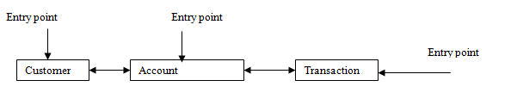
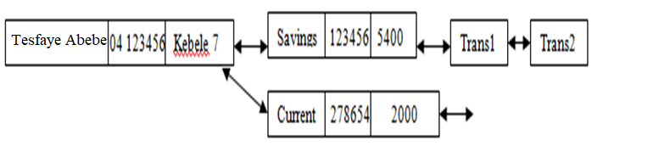
Network Model
also uses records and links but in a different way.
Instead of putting data in a hierarchy, it structures data in a network
Customer, Account and Transaction →record types.

Slide 23
Cont’d
Like hierarchical model network model is a collection of physically linked records.
Collection of records in 1:M relationships
Relationships are modelled using sets.
In a set, there is one owner-record type--Equivalent to the hierarchical model’s parent eg. (Customer) and 1 or more member record types Equivalent to the hierarchical model’s child eg.(Account).This is a set type, let us name it CustomerAccount. It models the relationship between Customer & Account – that a Customer can have 1 or more accounts. There will be many occurrences of the CustomerAccount set in the database – one for each Customer. A set occurrence relates one record from the owner record type (Customer) to the set of records from the member record type related to it (Account).For each CustomerAccount set, there is a network of links from the Customer record to the Account records.
A record can appear as a member in more than one set i.e., a member may have multiple owners
Can you identify another set type in this model?

Slide 24
Cont’d
The data is still stored in files but now we also have to define the set types.
The entry points are records that can be searched. An entry point is implemented as an index on a list of records – so the index must be created before such queries can be run against the database.
In terms of data structure can you think of how entry implemented ?

Slide 25
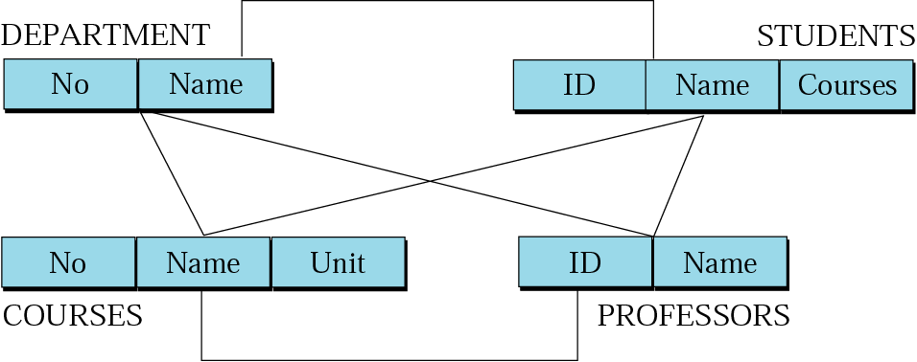
Registrar system

Slide 26
Advantages
Conceptual simplicity
Data access flexibility – no need for a preorder traversal
Promotes database integrity – must first define the owner and then the member record
Data independence
Network Model is able to model complex relationships and represents semantics of add or delete on the relationships.
Can handle most situations for modeling using record types and relationship types.
Conformance to standards

Slide 27
Disadvantages
System complexity
Lack of structural independence
Navigational and procedural nature of processing.
Language is navigational; uses constructs like FIND, FIND member, FIND owner, FIND NEXT within set, GET etc. Programmers can do optimal navigation through the database
Database contains a complex array of pointers that thread through a set of records.
Little scope for automated "query optimization”

Slide 28
Relational Model
Developed by Dr. Edgar Frank Codd in 1970 (famous paper, 'A Relational Model for Large Shared Data Banks').
Terminologies originates from the branch of mathematics called set theory and relational algebra.
Can define more flexible and complex relationship.
Viewed as a collection of tables called “Relations” equivalent to collection of record types.

Slide 29
Relation
Two dimensional table.
Stores information or data in the form of tables rows and columns.
A row of the table is called tuple equivalent to record.
A column of a table is called attribute equivalent to fields.

Slide 30
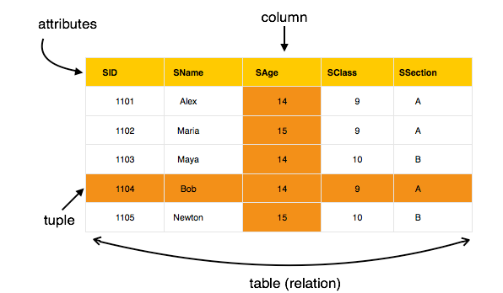

Slide 31
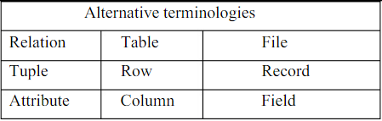

Slide 32
Cont’d
Data value is the value of the Attribute.
Records are related by the data stored jointly in the fields of records in two tables or files. The related tables contain information that creates the relation.
No physical consideration of the storage is required by the user.
Many tables are merged together to come up with a new virtual view of the relationship.
The relational data model is implemented through a very sophisticated relational database management system (RDBMS).

Slide 33
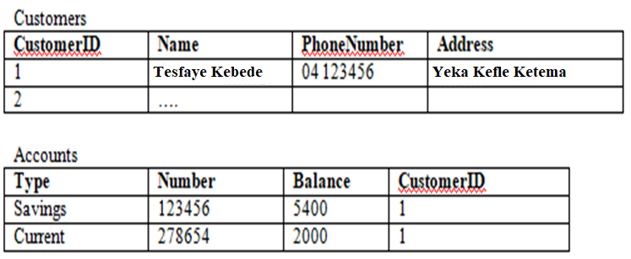
Cont’d

Slide 34
Cont’d
The RDBMS manages all of the physical details, while the user sees the relational database as a collection of tables in which data are stored.
The user can manipulate and query the data in a way that seems intuitive and logical.

Slide 35
Conducts searches by using data in specified columns of one table to find additional data in another table.
In conducting searches, a relational database model matches information from a field in one table with information in a corresponding field of another table to produce a third table that combines requested data from both tables.

Slide 36
Advantages
Structural independence – changes in the relational data structure do not affect the DBMS’s data access in any way.
Improved conceptual simplicity by concentrating on the logical view .
Easier database design, implementation, management, and use.
Ad hoc query capability – SQL.
Use of powerful database management system.

Slide 37
Disadvantages
Substantial hardware and system software overhead.
Can facilitate poor design and implementation.

Slide 38
Object relational
An Object relational model is a combination of a Object oriented database model and a Relational database model. So, it supports objects, classes, inheritance etc. just like Object Oriented models and has support for data types, tabular structures etc. like Relational data model.
One of the major goals of Object relational data model is to close the gap between relational databases and the object oriented practices frequently used in many programming languages such as C++, C#, Java etc.

Slide 39
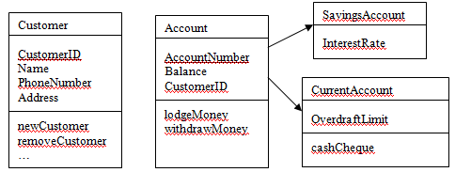

Slide 40
Advantages
Inheritance
The Object Relational data model allows its users to inherit objects, tables etc. so that they can extend their functionality. Inherited objects contains new attributes as well as the attributes that were inherited.
Complex Data Types
Complex data types can be formed using existing data types. This is useful in Object relational data model as complex data types allow better manipulation of the data.
Extensibility
The functionality of the system can be extended in Object relational data model. This can be achieved using complex data types as well as advanced concepts of object oriented model such as inheritance.

Slide 41
Disadvantages
The object relational data model can get quite complicated and difficult to handle at times as it is a combination of the Object oriented data model and Relational data model and utilizes the functionalities of both of them.

Slide 42
Object Oriented Approach
Object oriented data model is based upon real world situations. These situations are represented as objects, with different attributes. All these object have multiple relationships between them.
Elements of Object oriented data model
Objects
The real world entities and situations are represented as objects in the Object oriented database model.
Attributes and Method
Every object has certain characteristics. These are represented using Attributes. The behavior of the objects is represented using Methods.

Slide 43
Class
Similar attributes and methods are grouped together using a class. An object can be called as an instance of the class.
Inheritance
A new class can be derived from the original class. The derived class contains attributes and methods of the original class as well as its own.

Slide 44
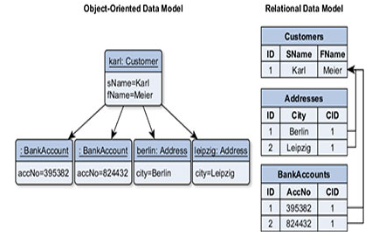

Slide 45
Deductive Model
In a deductive db system, rules can be defined – the rules deduce or infer additional information from the facts stored in the database.
Deductive databases are really a type of knowledge base, used in the area of AI (Artificial Intelligence).
A deductive db has facts and rules in it. Facts are stored similar to relations in a relational database, but attribute names are not necessary.
Rules are specifications that can be applied to the facts – to produce new information.

Slide 46
Cont’d
The rules are defined using a declarative language (what, rather than how…).
The system has an inference engine that deduces new facts from the db by interpreting the rules.
The deductive model is closely related to the relational model; it also has its basis in a branch of mathematics (domain relational calculus).
In a deductive database system, the emphasis is on deriving new knowledge from existing data by supplying rules based on knowledge of the real world.

Slide 47
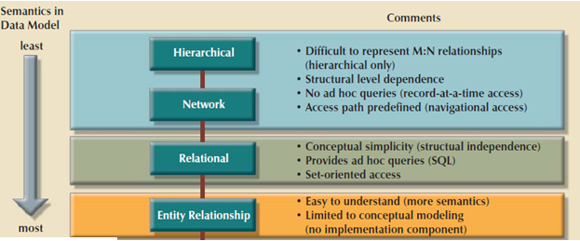
Summary of Data Model

Slide 48
Schema & Instance
There are two basic components of the database: the definition of the Relation (Schema) and the actual data stored in each table (Instance)

Slide 49
Database Schema
Describes how data is to be structured, defined at setup/design time (also called "metadata“)
it specifies name of relation, the name of each field and the type of each field
Example:
Students( sid: string, name: string, login: string, age: integer, gpa: real)
The preceding schema says that each record in the Students relation has five fields, with field names and types as indicated

Slide 50
Database Schema
The structure of a database that
Captures data types, relationships and constraints in data
Is independent of any application program
Changes infrequently

Slide 51
Database Instance or State:
is the collection of the actual data contained in the database at a particular point of time
Also called State or Snap Shot or Extension of the database
Since Instance is actual data of database at some point in time, it changes rapidly
To define a new database, we specify its database schema to the DBMS (database is empty), database is initialized when we first load it with data

Slide 52
Three levels ANSI_SPARC Architecture
The Systems Planning and Requirements Committee of the American National Standards Institute encapsulated the concept of schema in its three-level database architecture model, known as the ANSI/SPARC architecture, which is shown in the diagram below

Slide 53
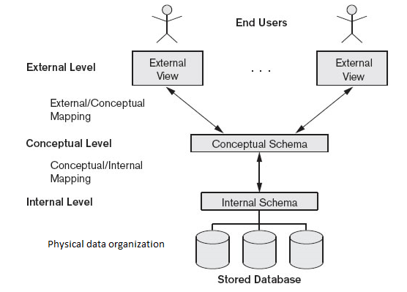
Three-level ANSI-SPARC Architecture of a Database System

Slide 54
ANSI/SPARC three-level architecture
ANSI = American National Standards Institute
ANSI/X3 = Committee on Computers and Information Processing
SPARC = Standards Planning and Requirements Committee
The ANSI/SPARC model is a three-level database architecture with a hierarchy of levels, from the users and their applications at the top, down to the physical storage of data at the bottom.

Slide 55
The Architecture of most of commercial DBMS are available today is mostly based on this ANSI-SPARC database architecture
Proposed to support DBMS characteristics of:
Program-data independence
Support of multiple views of the data

Slide 56
Objective of Three-level ANSI_SPARC architecture
It allows independent customized user views:
Each user should be able to access the same data, but have a different customized view of the data
These should be independent: changes to one view should not affect others
It hides the physical storage details from users:
Users should not have to deal with physical database storage details
Database Administrator should be able to change conceptual structure of database without affecting all users
Database Administrator should be able to change database storage structures without affecting the users’ views

Slide 57
External Level
Users’ view of the database
Conceptual Level
Community view of the database
Internal Level
Physical representation of the database on the computer

Slide 58
Cont’d
External Level
The external or view level includes a number of external schemas or user views.
Each external schema describes the part of the database that a particular user group is interested in and hides the rest of the database from that user group.
It excludes irrelevant data as well as data which the user is not authorized to access.
Implemented using a representational data mode

Slide 59
Cont’d
Conceptual Level
The conceptual level is a way of describing what data is stored within the whole database and how the data is inter-related
The conceptual level has a conceptual schema, which describes the structure of the whole database for a community of users.
concentrates on describing entities, data types, relationships, user operations, and constraints.
Usually, a representational data model is used to describe the conceptual schema when a database system is implemented.
This level does not specify how the data is physically stored

Slide 60
Cont’d
Internal Level
The internal level has an internal schema, which describes the physical storage structure of the database.
The internal level involves how the database is physically represented on the computer system
It describes how the data is actually stored in the database and on the computer hardware
The internal schema uses a physical data model

Slide 61
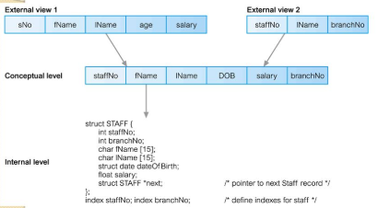
Three levels ANSI_SPARC Architecture Schema Example

Slide 62
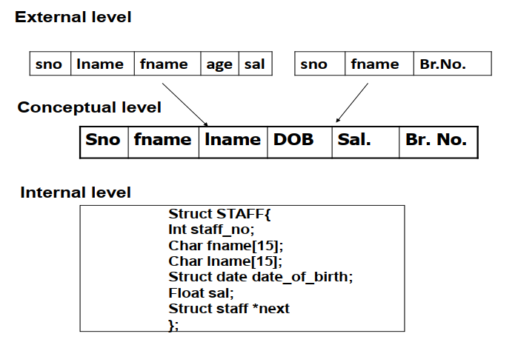

Slide 63
Three levels ANSI_SPARC Architecture Schema Example
External Schema (View):
Course_info(cid ,sid,name)
Conceptual (logical) schema:
Students(sid: string, name: string, login: string, age: integer, gpa:real)
Courses(cid: string, cname:string, credits:integer)
Enrolled(sid:string, cid:string, grade:string)
Internal(Physical) schema:
Relations stored as unordered files
Index on first column of Students

Slide 64
Database schemas
There are three different types of schema corresponding to the three levels in the ANSI-SPARC architecture
The external schemas
describe the different external views of the data and there may be many external schemas for a given database
The conceptual schema
describes all the data items and relationships between them of the whole database
There is only one conceptual schema per database
The Internal schema
describes physical storage structures and access paths
There is only one internal schema per database
The overall description of a database is called the database schema

Slide 65
Data Independence
A very important advantage of using a DBMS is that it offers Data Independence
That is, application programs are insulated from changes in the way the data is structured and stored
Data independence is achieved through use of the three levels of data abstraction (i.e., External level,Conceptual level & Internal level)

Slide 66
Logical Data Independence
The capacity to change the conceptual schema without having to change the external schemas and their application programs
Conceptual schema changes e.g. addition/removal of entities should not require changes to external schema or rewrites of application programs
Here are some examples of changes in the logical layer that can be safely made thanks to logical data independence:
Adding a new database object
Adding data items to an existing object

Slide 67
Physical Data Independence
The ability to modify the internal schema without changing the conceptual schema
The conceptual schema hides details such as how the data is actually laid out on disk, the file structure, and the choice of indexes
Physical schema changes e.g. using different file organizations, storage structures/devices should not require change to conceptual or external schemas

Slide 68
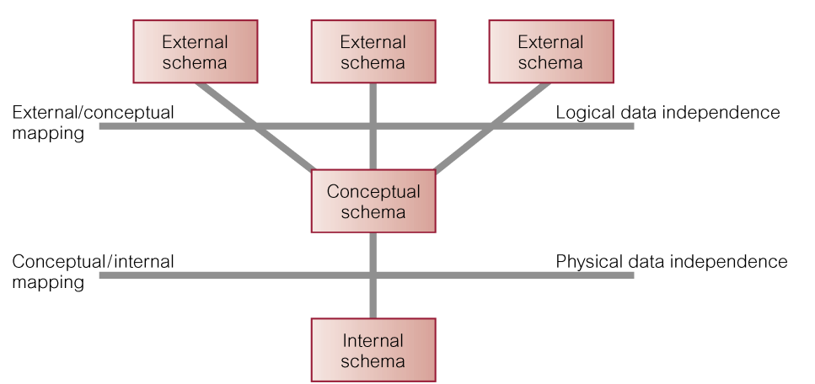
Data Independence and the ANSISPARC Three-Level Architecture

Slide 69
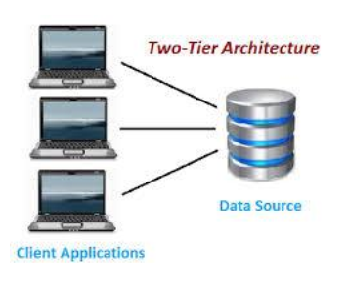
Two-Tier Client-Server Architecture
Client manages main business and data processing logic and user interface
Server manages and controls access to database
Disadvantages:
‘Fat’ client, requiring considerable resources on client’s computer to run effectively
Significant client side administration overhead

Slide 70
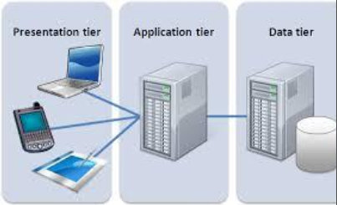
Three-Tier Client-Server Architecture
a type of multi-tier computing architecture in which an entire application is distributed across three different computing layers or tiers
User interface layer – runs on client
Business logic and data processing layer – middle tier runs on a server (application server)
DBMS – stores data required by the middle tier. This tier may be on a separate server (database server)
Advantages: ‘Thin’ client, requiring less expensive hardware Application maintenance centralized Easier to modify or replace one tier without affecting others

