Slide 1
Chapter One
Introduction to Database Systems

Slide 2
Outline
Introduction to database system
Basic terminologies
Data handling approaches
Database & DBMS
Components of Database System Environment
Users of Database System

Slide 3
Data VS. Information
Data
is a collection of raw( unorganized) facts.
by themselves are useless
Information
is a processed data in the form that is meaningful to the user.

Slide 4
Information System
Information System is a system that:
Receives data and instruction
Processes the data as per the instruction
Produces output
Stores data/information for future use

Slide 5
Data Handling Methods
There are three data handling methods
Manual Approach
Computerized Approaches
File Based Approach
Database Approach

Slide 6
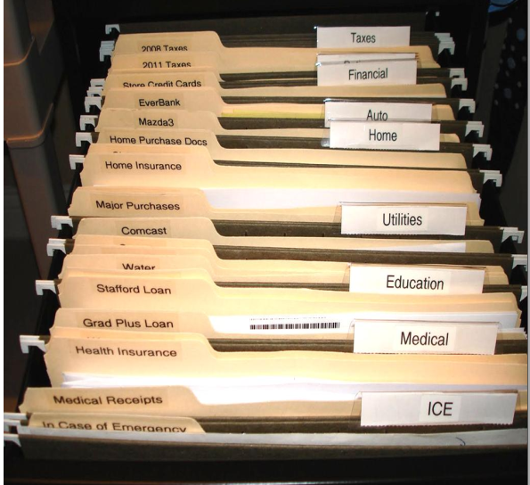
Data handling approaches
Manual Approach
data storage and retrieval follows the primitive and traditional way of data/information handling where cards and paper are used for the purpose of keeping records.
Typing the data on paper and put in a file cabinet
storage and retrieval will be performed using human labor.
Works well if the number of items to be stored is small

Slide 7
Limitations of the Manual approach
Prone to error
Data loss: due to damaged papers or unable to locate it.
Redundancy: multiple copies of the same data within the organization.
Inconsistency: Modifications are not reflected on all multiple copies.
Difficult to update, retrieve, integrate.
You have the data but it is difficult to compile the information
Cross referencing is difficult Cross referencing is difficult . You have the data but it is difficult to compile the information.
Limited to small size information.

Slide 8
Computerized Approach
A computerized way of dealing with information
File based approach→ Decentralized
Database approach →Centralized
Based on where the data resides in the system

Slide 9
File based Approach
an early attempt to computerize the manual filing system.
There were, and still are, several computer applications with file based processing for the purpose of data handling.
In such systems, every application program that provides service to end users define and manage its own data.
Such systems have number of programs for each of the different applications in the organization. And this approach is the decentralized computerized data handling method.
File, in file based approach, is a collection of records which contains logically related data .

Slide 10
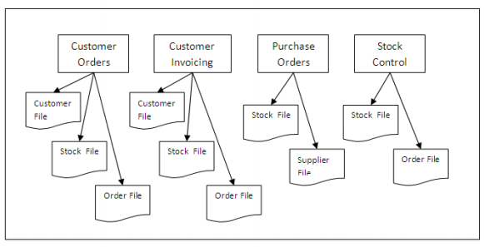

Slide 11
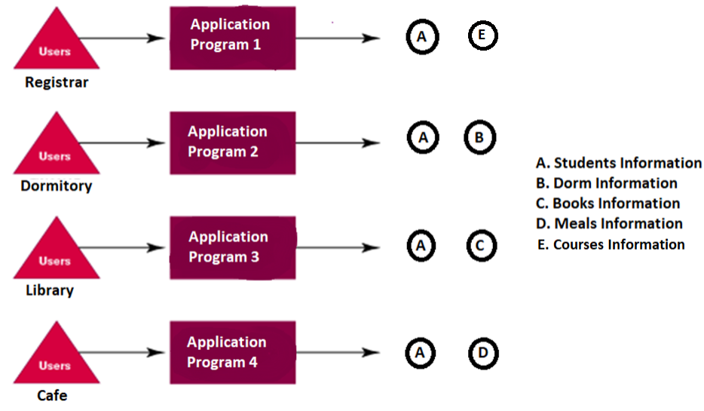

Slide 12
Limitations of the File Based approach
Limited data sharing
Duplication of data
Same data is held by different programs
Wasted space and potentially different values and/or different formats for the same item
Data dependence on the application
Definition of data was embedded in application programs, rather than being stored separately and independently
Poor Security and administration

Slide 13
Data Inconsistency and Confusion- Update Anomalies
Modification Anomalies: a problem experienced when one or more data value is modified on one application program but not on others containing the same data set
Deletion Anomalies: a problem encountered where one record set is deleted from one application but remain untouched in other application programs
Insertion Anomalies: a problem experienced when ever there is new data item to be recorded, and the recording is not made in all the applications

Slide 14
shared file approach
approach to solving the problem of each application having its own set of files is to share files between different applications.

Slide 15
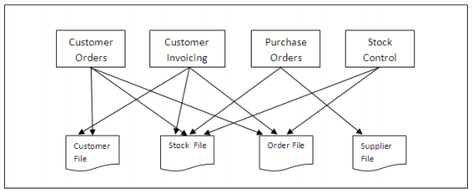

Slide 16
The introduction of shared files solves the problem of duplication and inconsistent data across different versions of the same file held by different departments, but other problems may emerge, including:
File incompatibility
Difficult to control access
Physical data dependence
Difficult to implement concurrency

Slide 17
Database Approach
Based on
The database and
Database Management System (DBMS)

Slide 18

Database Approach Cont’d
What is a Database?
A database is a collection of related data in an organized way.
of the time, organization is in tabular form. E.g. book database

Slide 19
Database Approach Cont’d
Database
is a single repository of data that is defined once and then is accessed by various users.
is a shared collection of logically related data and its metadata.
Shared collection (Centralized System) – can be used simultaneously by many departments and users.
Logically related data comprises entities, attributes, and relationships of an organization’s information.
In addition to containing data required by an organization, database also contains a description of the data which also called as “Metadata” or “Data Dictionary” or “Systems Catalogue” or “Data about Data”

Slide 20
Database Approach Cont’d
Database Management System
refers to a software system used to create and manage databases.
The term database system is usually an alternative term for database management system.
is a general-purpose software system that facilitates the processes of defining, constructing, manipulating, and sharing databases among various users and applications
Defining a database involves specifying the data types, structures, and constraints for the data to be stored in the database
Constructing the database is the process of storing the data itself on some storage medium
Manipulating a database includes such functions as querying the database to retrieve specific data, updating the database, and generating reports from the data
Sharing a database allows multiple users and programs to access the database concurrently

Slide 21
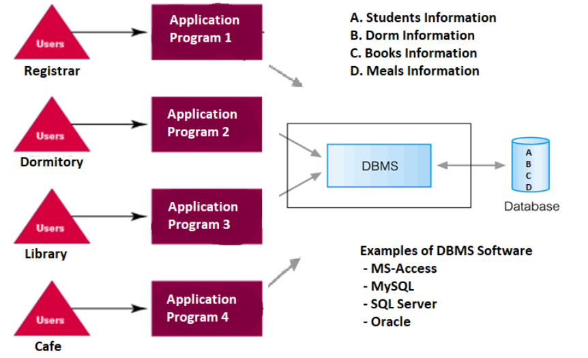
Database Approach Cont’d

Slide 22
Database Approach Cont’d
DBMS provides the following facilities:
Data Definition Language (DDL) - Language used to setup a database, create, delete and alter table with the facility of handling constraints
Data Manipulation Language (DML) - Is a core command used by end users and programmers to store, retrieve, and update the data in the database e.g. SQL
Data Control Language - are commands that will help the Database Administrator to control the database. The commands include grant or revoke privileges to access the database.
Data Dictionary - is used to store and organize information about the data stored in the database

Slide 23
Database Approach Cont’d
DBMS services
1. Data storage, retrieval and update in the database.
2. A user accessible catalogue
3. Transaction support service: ALL or NONE transaction, which minimize data inconsistency.
4. Concurrency Control Services: access and update on the database by different users simultaneously should be implemented correctly.
5. Recovery Services: a mechanism for recovering the database after a failure must be available.

Slide 24
Database Approach Cont’d
6. Authorization Services (Security): must support the implementation of access and authorization service to database administrator and users.
7. Support for Data Communication : should provide the facility to integrate with data transfer software or data communication managers.
8. Integrity Services: rules about data and the change that took place on the data, correctness and consistency of stored data, and quality of data based on business constraints.
9. Services to promote data independency between the data and the application

Slide 25
Database Approach Cont’d
Characteristics of the Database Approach
The main characteristics of the database approach are the following:
Self-describing nature of a database system
Insulation between programs and data, and data abstraction
Support of multiple views of the data
Sharing of data and multiuser transaction processing

Slide 26
Self-Describing Nature of a Database System
Database system contains not only the database itself but also a complete definition or description of the database structure and constraints.
The definition contains information like
the structure of each file, the type and storage
format of each data item, and
various constraints on the data.
These information are called meta-data and stored in the catalog.

Slide 27
Cont’d
The catalog is used by the DBMS software and also by database users who need information about the database structure.
A general-purpose DBMS software package is not written for a specific database application.
Therefore, it must refer to the catalog to know the structure of the files in a specific database, such as the type and format of data it will access.

Slide 28
The DBMS software must work equally well with any number of database applications—for example, a university database, a banking database, or a company database—as long as the database definition is stored in the catalog.

Slide 29
In traditional file processing, data definition is typically part of the application programs themselves. Hence, these programs are constrained to work with only one specific database, whose structure is declared in the application programs.

Slide 30
Insulation between Programs and Data, and Data Abstraction
In DBMS the structure of data files is stored in the DBMS catalog separately from the access programs.
We call this property program-data independency

Slide 31
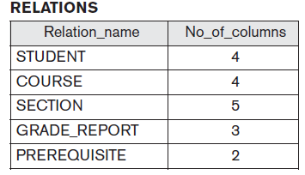
Example
Assume we have the following catalog for registrar database.
Notes:
Full example on Elmasri page 12

Slide 32
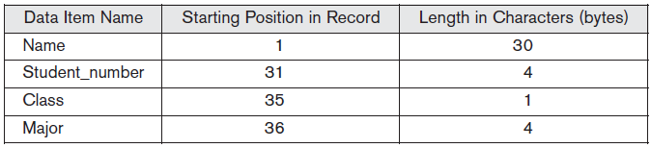
Internal storage format for a STUDENT record, based on the above database catalog

Slide 33
For example, a file access program may be written in such a way that it can access only STUDENT records of the structure shown in the figure above. If we want to add another piece of data to each STUDENT record, say the Birthdate, such a program will no longer work and must be changed. By contrast, in a DBMS environment, we just need to change the description of STUDENT records in the catalog to reflect the inclusion of the new data item Birthdate; no programs are changed. The next time a DBMS program refers to the catalog, the new structure of STUDENT records will be accessed and used.

Slide 34
In object-oriented and object-relational databases , users can define operations on data as part of the database definitions. An operation (also called a function) is specified in two parts.
The interface (or signature) of an operation includes the operation name and the data types of its arguments (or parameters).
The implementation (or method) of the operation is specified separately and can be changed without affecting the interface.
User application programs can operate on the data by invoking these operations through their names and arguments, regardless of how the operations are implemented. This may be termed program-operation independence.
The characteristic that allows program-data independence and program-operation independence is called data abstraction.

Slide 35
A DBMS provides users with a conceptual representation of data.
This does not include many of the details of how the data is stored or how the operations are implemented.

Slide 36
Database users and application programs refer to the conceptual representation of the files, and the DBMS extracts the details of file storage from the catalog when these are needed by the DBMS file access modules.

Slide 37
Support of Multiple Views of the Data
Each users of a database may require a different perspective or view
A view may be a subset of the database or it may contain virtual data that is derived from the database files but is not explicitly stored.
A multiuser DBMS whose users have a variety of distinct applications must provide facilities for defining multiple views.

Slide 38
Example
Assume we have data about
course
section
grade_report
prerequisite

Slide 39
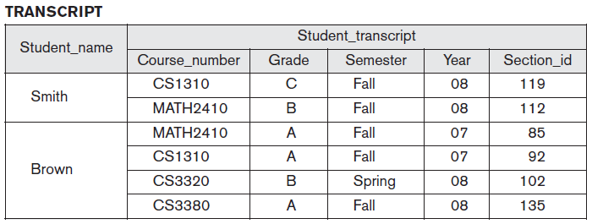
One user of the database may be interested only in accessing and printing the transcript of each student

Slide 40
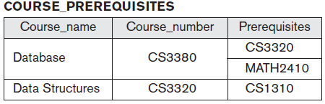
A second user, who is interested only in checking that students who have taken all the prerequisites of each course for which they register

Slide 41
Sharing of Data and Multiuser Transaction Processing
A transaction is an executing program or process that includes one or more database accesses, such as reading or updating of database records.
A multiuser DBMS must allow multiple users to access the database at the same time.

Slide 42
The DBMS must include concurrency control software to ensure that several users trying to update the same data do so in a controlled manner so that the result of the updates is correct.

Slide 43
Database Management System(DBMS)
A full scale DBMS should at least have the following services to provide to the user
Data storage, retrieval and update in the database
A user accessible catalogue
Transaction support service: ALL or NONE transaction, which minimize data inconsistency
Concurrency Control Services: access and update on the database by different users simultaneously should be implemented correctly
Recovery Services: a mechanism for recovering the database after a failure must be available
Authorization Services (Security): must support the implementation of access and authorization service to database administrator and users
Support for Data Communication: should provide the facility to integrate with data transfer software or data communication managers
Integrity Services: rules about data and the change that took place on the data, correctness and consistency of stored data, and quality of data based on business constraints

Slide 44
organization of the database becomes necessary when the data is voluminous. Otherwise, managing data will be very difficult.
E.g.
A Manufacturing Company with product data
A Bank with account data
A Hospital with patients
A University with Students
A government with planning data

Slide 45
Advantages of a database approach
Ease of application development
Minimal data redundancy
Physical data dependence is resolved
Compactness
Speed
Accuracy
Data can be shared
Inconsistency can (to some extent) avoided
Standards can be enforced
Security restrictions can be applied
Integrity can be maintained
Conflicting requirements can be balanced
Transaction support can be provided
Improved decision support
Less labor

Slide 46
Limitations and risk of Database Approach
Introduction of new professional and specialized personnel.
Complexity in designing and managing data
The cost and risk during conversion from the old to the new system
High cost to be incurred to develop and maintain the system
Complex backup and recovery services from the users perspective
Reduced performance due to centralization and data independency
High impact on the system when failure occurs to the central system.

Slide 47
Components of a Database System
four major components,
data
hardware
software
users and designers of database

Slide 48
Data:
Issues
stored as a single database or distributed
Is the system a single-user or multi-user one?
How are we going toachieve the utmost possible performance concerning the data storage and maintenance?
What other benefits or drawbacks do we expect as the result of placement or structure of the database?

Slide 49
Hardware:
secondary storage media (disks, tapes and optical media)
controllers (hard disk controller, etc.); and
the processor(s) and associated main memory

Slide 50
Software: Database Management System (DBMS)
Is responsible for the overall management of communications between the user and the database.
It is found between the data and the users, which, in other words, means the data is entirely covered or shielded by the DBMS software.
The DBMS provides facilities for operating on the database.

Slide 51
Actors on the Scene
People whose jobs involve the day-to-day use of a large database; we call them the actors on the scene.
Peoples whose work is to maintain the database system environment but who are not actively interested in the database contents---are called workers behind the scene

Slide 52
Cont’d
Actors On the Scene:
Database Administrator
Data Administrator
Database Designer
End Users

Slide 53
Database Administrator (DBA)
Responsible to oversee, control and manage the database resources (the database itself, the DBMS and other related software)
Authorizing access to the database
Coordinating and monitoring the use of the database
Responsible for determining and acquiring hardware and software resources
Accountable for problems like poor security, poor performance of the system
Involves in all steps of database development
We can have further classifications of this role in big organizations having huge amount of data and user requirement.

Slide 54
Data Administrator (DA): is responsible on management of data resources. Involves in database planning, development, maintenance of standards policies and procedures at the conceptual and logical design phases.

Slide 55
Database Designer (DBD)
Identifies the data to be stored and choose the appropriate structures to represent and store the data.
Should understand the user requirement and should choose how the user views the database.
Involve on the design phase before the implementation of the database system.

Slide 56
We have two distinctions of database designers, one involving in the logical and conceptual design and another involving in physical design.
Logical and Conceptual DBD
Identifies data (entity, attributes and relationship) relevant to the organization
Identifies constraints on each data
Understand data and business rules in the organization
Sees the database independent of any data model at conceptual level and consider one specific data model at logical design phase.
Physical DBD
Take logical design specification as input and decide how it should be physically realized.
Map the logical data model on the specified DBMS with respect to tables and integrity constraints. (DBMS dependent designing)
Select specific storage structure and access path to the database
Design security measures required on the database

Slide 57
Application Programmer and Systems Analyst
System analyst determines the user requirement and how the user wants to view the database.
The application programmer
who are responsible for writing application programs that use the database using some programming language such as COBOL, Pascal, or a programming language built-in to the DBMS.
implements these specifications as programs; code, test, debug, document and maintain the application program.
Determines the interface on how to retrieve, insert, update and delete data in the database.
The application could use any high level programming language according to the availability, the facility and the required service.

Slide 58
End-users
These are those people who are engaged on processing different types of operations on the database system. Users are workers, whose job requires accessing the database frequently for various purpose. There are different group of users in this category.
Naïve Users:
Sizable proportion of users
Unaware of the DBMS
Only access the database based on their access level and demand
Use standard and pre-specified types of queries.
Eg. Bank tellers ,reservation agents for airlines, hotels, and car rental companies
Sophisticated Users
Are users familiar with the structure of the Database and facilities of the DBMS.
Have complex requirements
Have higher level queries
Are most of the time engineers, scientists, business analysts, etc
Casual Users
Users who access the database occasionally.
Need different information from the database each time.
Use sophisticated database queries to satisfy their needs.
Are most of the time middle to high level managers.,

Slide 59
Workers behind the Scene
DBMS system designers and implementers
design and implement the DBMS modules and interfaces as a software package.
Tool developers
design and implement tools
software packages that facilitate database modeling and design, database system design, and improved performance.
Notes:
DBMS consists of many components, or modules, including modules for implementing the
catalog,
query language processing,
interface processing,
accessing and buffering data,
controlling concurrency,
handling data recovery and security.
DBMS must interface with other system software such as the operating system and compilers for various programming languages.

Slide 60
Operators and maintenance personnel
system administrator
are responsible for the actual running and maintenance of the hardware and software environment for the database system.

Slide 61
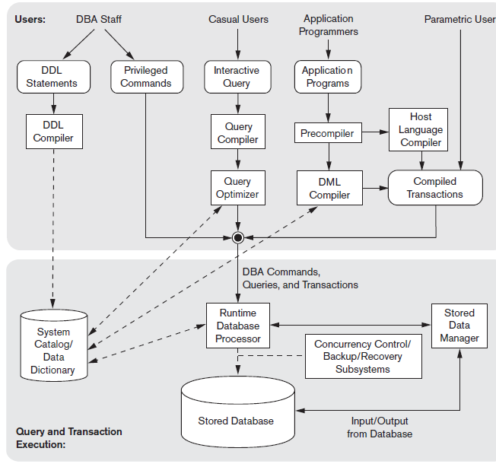
Database System environment

Slide 62
The database and the DBMS catalog are usually stored on disk.
Access is controlled by
Operating system (OS)
buffer management module
stored data manager module

Slide 63
The DDL compiler
processes schema definitions, specified in the DDL, and
Stores descriptions of the schemas (meta-data) in the DBMS catalog.
Notes:
DBA staff, casual users who work with interactive interfaces to formulate queries, application
programmers who create programs using some host programming languages, and
parametric users who do data entry work by supplying parameters to predefined transactions.
The catalog includes
information such as the names and sizes of files, names and data types of data items,
storage details of each file, mapping information among schemas, and constraints.

Slide 64
Casual users interact with the database with the interactive query interface
then the query compiler
parse and validate the correctness of
the query syntax
the names of files and data elements
then compiles them into an internal form.
This internal query is subjected to query optimization

Slide 65
query optimizer is concerned with the
rearrangement and possible reordering of operations,
elimination of redundancies, and
use of correct algorithms and indexes during execution.
consults the system catalog
Generates executable code that performs the necessary operations for the query and makes calls on the runtime processor.

Slide 66
The precompiler extracts DML commands from an application program written in a host programming language.
It sends the commands to DML compiler
The rest of the program is sent to the host language compiler.
Notes:
Application programmers write programs in host languages such as Java, C, or C++
that are submitted to a precompiler.
Canned transactions are executed repeatedly by parametric users, who
simply supply the parameters to the transactions. Each execution is considered to be
a separate transaction. An example is a bank withdrawal transaction where the
account number and the amount may be supplied as parameters.

Slide 67
The runtime database processor executes
the privileged commands,
the executable query plans, and
the canned transactions with runtime parameters.
It works with the
system catalog
stored data manager
concurrency control and backup and recovery systems are integrated into the working of the runtime database processor for purposes of transaction management.

Slide 68
Database System Utilities
help the DBA manage the database system.
Loading: A loading utility is used to load existing data files—such as text files or sequential files—into the database.
Backup: A backup utility creates a backup copy of the database, usually by dumping the entire database onto tape or other mass storage medium.

Slide 69
Database storage reorganization: used to reorganize a set of database files into different file organizations, and create new access paths to improve performance.
Performance monitoring: Such a utility monitors database usage and provides statistics to the DBA.

Slide 70
Database Development Life Cycle
The major steps in database system development are;
1. Planning
2. Analysis
3. Design
Conceptual Design
Logical Design
Physical Design
4.Implementation
5.Operation and Support

Slide 71
