Slide 1
Chapter 1
Introduction to Networking

Slide 2
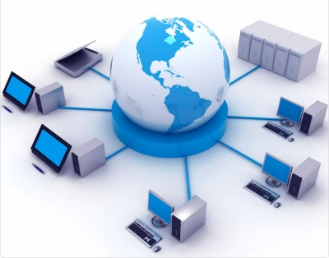
What is Computer Network?
  Computer network is an interconnection of two or more computers and peripherals such as printers and faxes.
  Computer network allows the user to share and transfer information using cables or modems within a network.

Slide 3
Communication
Exchange of information through the use of speech, signs or symbols is called communication.
When early humans started speaking, some 5,00,000 years ago, that was the first mode of communication.
Before we dive into modern technologies that drive communication in contemporary world, we need to know how humans developed better communication techniques to share knowledge with each other.

Slide 4
History of Communication
Communicating with people over a distance is known as telecommunication. The first forms of telecommunication were smoke signals, drums or fire torches.
The major disadvantage with these communication systems was that only a set of pre-determined messages could be transmitted. This was overcome in the 18th and 19th century through development of telegraphy and Morse code.

Slide 5
Invention of telephone and establishment of commercial telephony in 1878 marked a turnaround in communication systems and real telecommunication was born.
International Telecommunication Union (ITU) defines telecommunication as transmission, emission and
reception of any signs, signals or messages by electromagnetic systems. Now we had the

Slide 6
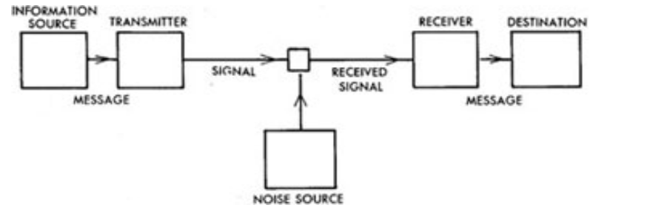
Communication components
Message /data
Source
Medium
Destination
Protocol

Slide 7
Physical components of a network
Pc
Interconnections –components that provide means for data to travel from one point to another point over the local network.
  Network interface card(NIC)
  Network Media
    Cables
    Wireless media
  Connector –provide connection point for media
Switches –device that provide network attachment to the end systems and intelligent switching for data with in local network
Routers –for internetworking and path selection

Slide 8
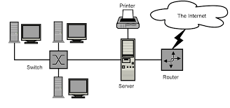

Slide 9
Why Networking ?
Allows File Sharing
Provides Convenient Resource Sharing(camera, printer, network storage, backup devices)
Inexpensive System
Flexible to be Used
Increase in Storage Capacity of the Software

Slide 10
Introduction to Computer Network
Disadvantages
  Security Difficulties
  Presence of Computer Viruses and Other Malwares
  Lack of Independence

Slide 11
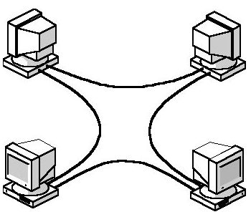
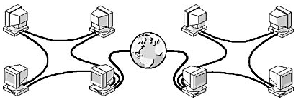
Network Categories:
based on size, ownership, the distance it covers
  Local Area Network (LAN): usually privately owned and links devices in a single office, building or campus
  Wide Area Network (WAN): covering large geographic area; may utilize public, leased, or private communications equipment

Slide 12
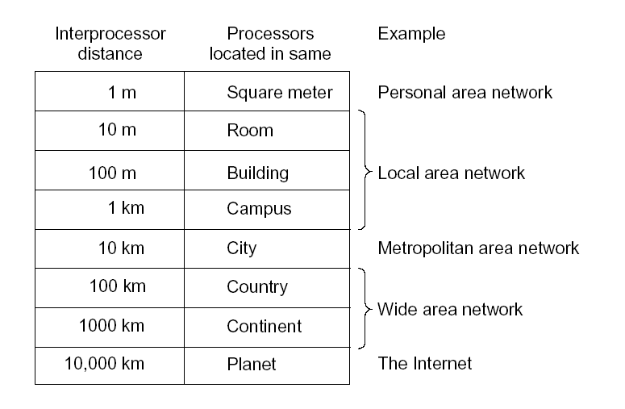
  Metropolitan Area Network (MAN): designed to extend over an entire city; it may be a single network or interconnected LANs
  Personal Area Network (PAN): meant for one person; e.g. a wireless network connecting a computer with its mouse, keyboard and printer

Slide 13
Network Architecture : includes the type of computers on the network and determines how network resources are handled
Two common types
  Peer-to-peer
  Client/Server
Peer-to-peer
  Each node considered as equal in terms of resource sharing and responsibilities
  pros
    Easy to set up
    Less expensive
    Demands moderate level of skill to administer
    User is able to control their own resources
  Cons
    Only < 10 nodes
    Very low level o security
    Performance suffers when a computer is accessed

Slide 14
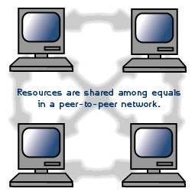
  Peer-to-peer networks are good choices for environments where:
    There are 10 users or fewer
    Users share resources, such as printers, but no specialised servers exist
    Security is not an issue
    The organization and the network will experience only limited growth within the foreseeable future

Slide 15
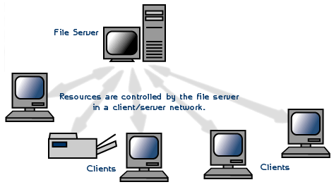
Client Server Model
  Consists of a group clients connected to a server
  Server – with more RAM, larger hard disk, more processing power…

Slide 16
servers in networking
File and Print Servers
File and print servers manage user access and use of file and printer resources.
Application Servers
Application servers make the server side of client/server applications, as well as the data, available to clients.
  an application server differs from a file and print server. With a file and print server, the data or file is downloaded to the computer making the request. With an application server, the database stays on the server and only the results of a request are downloaded to the computer making the request.
Mail Servers
Mail servers operate like application servers in that there are separate server and client applications, with data selectively downloaded from the server to the client.

Slide 17
Fax Servers
Fax servers manage fax traffic into and out of the network by sharing one or more fax modem boards.
Directory Services Servers
Directory services servers enable users to locate, store, and secure information on the network.
Advantages of client/server architecture
  Sharing Resources
  Security
  Number of Users - A server-based network can support thousands of users
Cons
  more complex to install, configure, and manage
  Expensive

Slide 18
Transmission media
Is a physical media that carries a signal from the transmitter to the receiver
The information or signal transmitted from one device to another is through electromagnetic signals.
Electromagnetic signals include power, voice, radio, waves, infrared light, visible light, ultraviolet light, X-rays, and gamma rays.
These signals can travel trough vacuum, air or any other transmission medium
The measurement of the quantity of data that can be passed down (transmitted) a communication link in a given time is done in terms of bandwidth
In digital circuits, bandwidth is measured in bits per second (bps)

Slide 19
Two basic categories
  Guided
  Unguided
  Guided – uses a cabling system that guides the signals along a specific path
    E.g. Fiber Optics, Twisted Pair, Coaxial Cable etc…
  Unguided – consists of a means for the data signals to travel but nothing to guide them along a specific path - wireless
    Example: Radio wave, Satellite, etc.

Slide 20
Twisted Pair
  Consists of two insulated copper wires twisted around each other
  Twisting cancels out electrical noise from adjacent pairs (crosstalk) and external sources
  Uses RJ-45 telephone-type connectors (larger than telephone and consists of eight wires Vs. Telephone’s 4 wires)
  Generally inexpensive
  Easy to install
  Up to 100 meters without a repeater
  Can be either Shielded or Unshielded
    STP (Shielded Twisted Pair)
    UTP (Unshielded Twisted Pair)

Slide 21
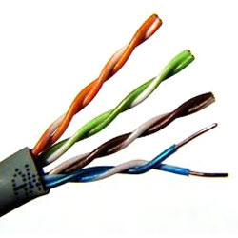
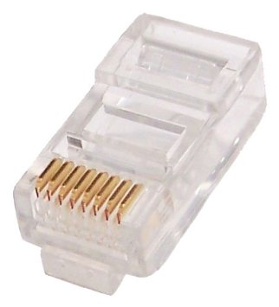
Cable
RJ-45 Connector

Slide 22
Coaxial Cable
  Consists of a solid or stranded copper core surrounded by insulation, a braided shield and an insulating jacket
  Braided shield prevents noise and crosstalk
  More resistant to interference and attenuation than twisted pair cabling
  Can use
    BNC cable connector
    BNC Barrel connectors
    BNC T connectors
    BNC Terminators
  Can transmit data, voice and video
  Up to 200/500 meters without a repeater depending on the type of cable

Slide 23
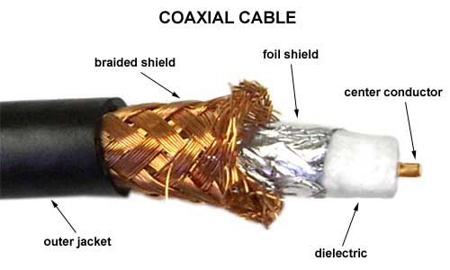
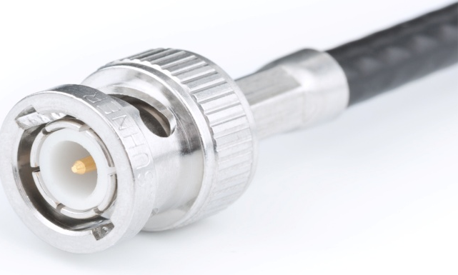
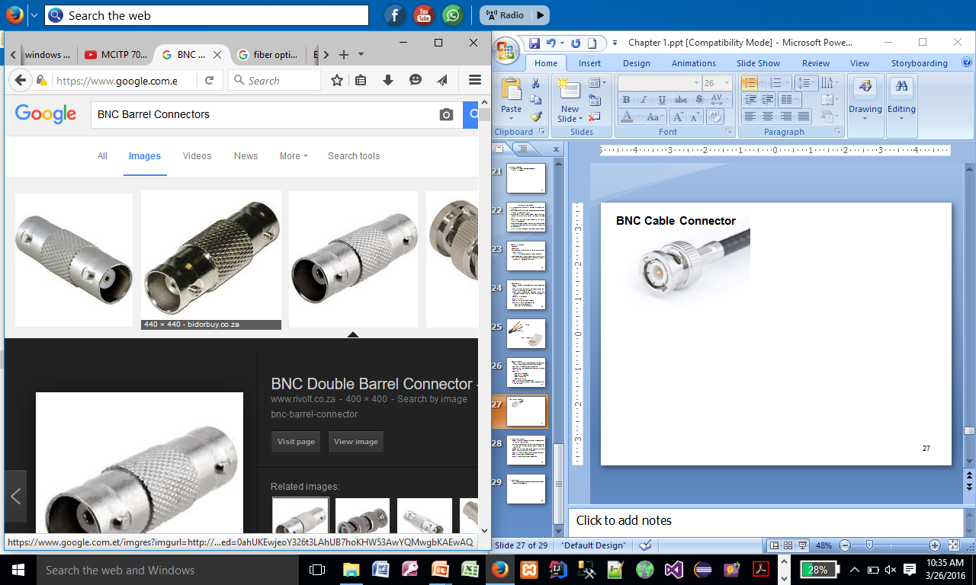
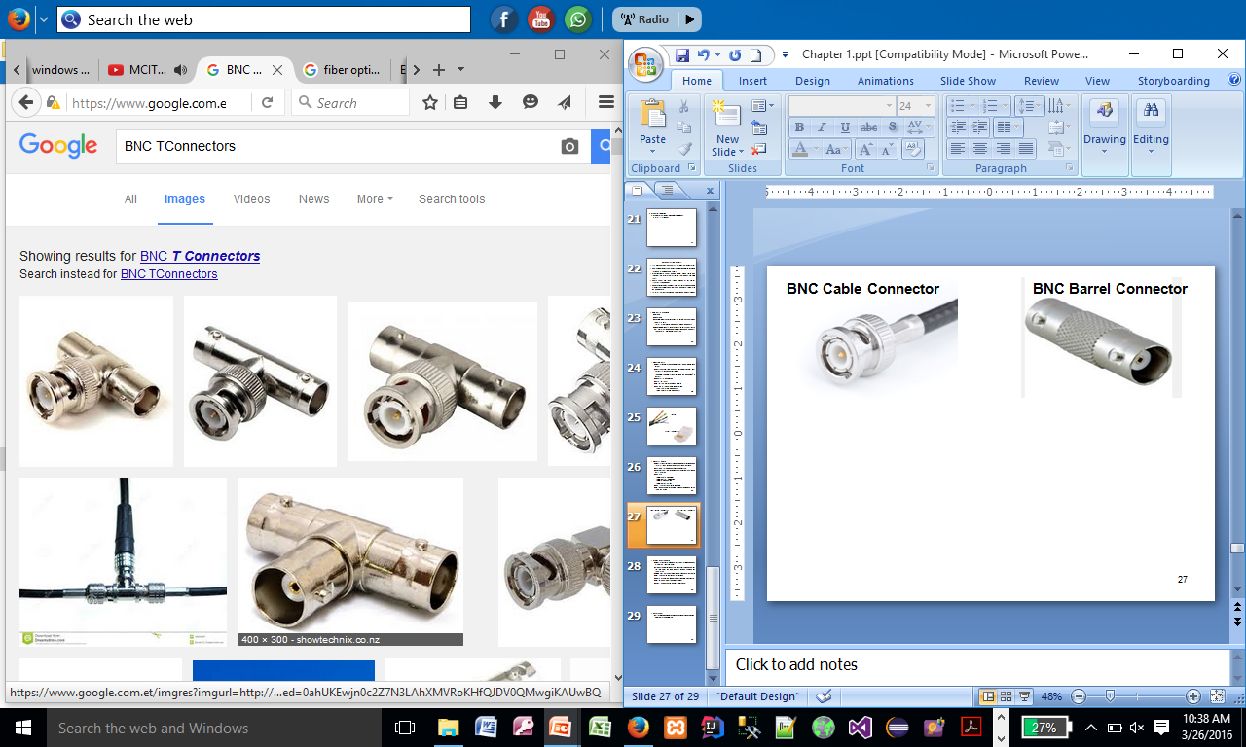
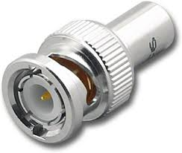
BNC Cable Connector
BNC Barrel Connector
BNC T-Connector
BNC Terminator

Slide 24
Fiber Optic Cable
  Consists of a small core of glass or plastic surrounded by a cladding layer and jacket
  Fibers are unidirectional (light only travels in one direction) so two fibers are used, one for sending and one for receiving
  Good for very high speed, long distance data transmission
  Not subjected to electrical interference
  Cable cannot be tapped and data stolen => high security
  Up to 2000 meters without a repeater
  Most expensive and difficult to work with.

Slide 25
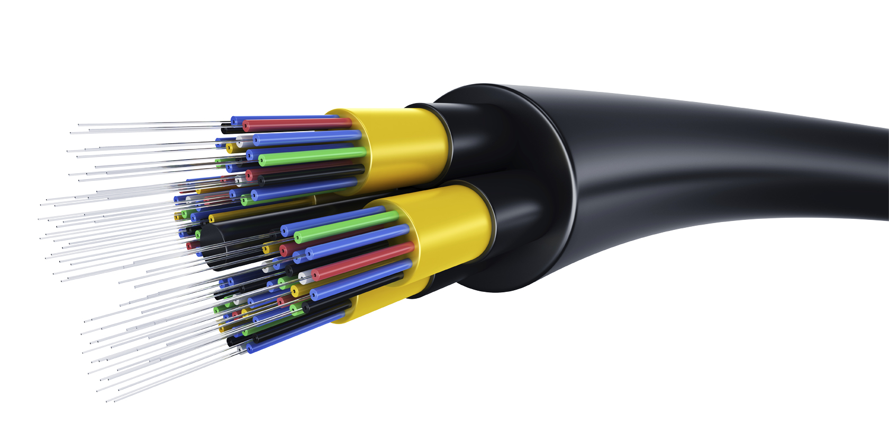
Fiber Optics Cable

Slide 26
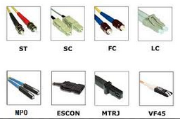
Fiber Optics Cable Connectors

