Slide 1
Chapter 3-4
Multiplexing

Slide 2
Objectives
Describe frequency division multiplexing and list its applications, advantages, and disadvantages ·
Describe synchronous time division multiplexing and list its applications, advantages, and disadvantages
Outline the basic multiplexing characteristics of both T1 and ISDN telephone systems
Describe statistical time division multiplexing and list its applications, advantages, and disadvantages
Cite the main characteristics of dense wavelength division multiplexing and its advantages and disadvantages
Cite the main characteristics of code division multiplexing and its advantages and
disadvantages

Slide 3
Multiplexing
Whenever the bandwidth of a medium linking two devices is greater than the bandwidth needs of the devices, the link can be shared.
Multiplexing is the set of techniques that allows the simultaneous transmission of multiple signals across a single data link.
Multiplexing is a technique performed at the physical layer of the OSI model or the interface layer of the Internet model.

Slide 4
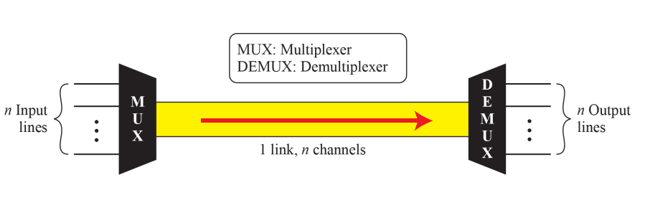
Dividing the link in to channels
In a multiplexed system, n lines share the bandwidth of one link.
Notes:
To make efficient use of high-speed telecommunications lines, some form of multiplexing is used.
Multiplexing allows several transmission sources to share a larger transmission capacity.
A common application of multiplexing is in long-haul communications.
Trunks on long-haul networks are high-capacity fiber, coaxial, or microwave links. These links can carry large numbers of voice and data transmissions simultaneously using multiplexing.
Common forms of multiplexing are frequency division multiplexing (FDM), time division multiplexing (TDM), and statistical TDM (STDM).
depicts the multiplexing function in its simplest form. There are n inputs to a multiplexer.
The multiplexer is connected by a single data link to a demultiplexer. The link is able to carry n separate channels of data. The multiplexer combines (multiplexes) data from the n input lines and transmits over a higher-capacity data link. The demultiplexer accepts the multiplexed data stream, separates (demultiplexes) the data according to channel, and delivers data to the appropriate output lines.

Slide 5
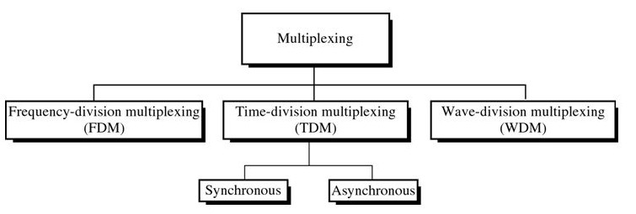
Categories of Multiplexing
The first two techniques are designed for analog signals, the third, for digital signals

Slide 6
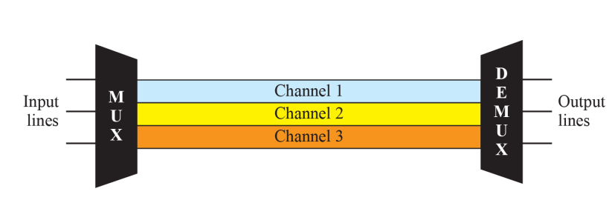
Frequency Division Multiplexing(FDM)
is an analog technique where each communications channel is assigned a carrier frequency.
Notes:
Frequency division multiplexing can be used with analog signals.
A number of signals are carried simultaneously on the same medium by allocating to each signal a different frequency band.
FDM is possible when the useful bandwidth of the transmission medium exceeds the required bandwidth of signals to be transmitted. A number of signals can be carried simultaneously if each signal is modulated onto a different carrier frequency and the carrier frequencies are sufficiently separated that the bandwidths of the signals do not significantly overlap.

Slide 7
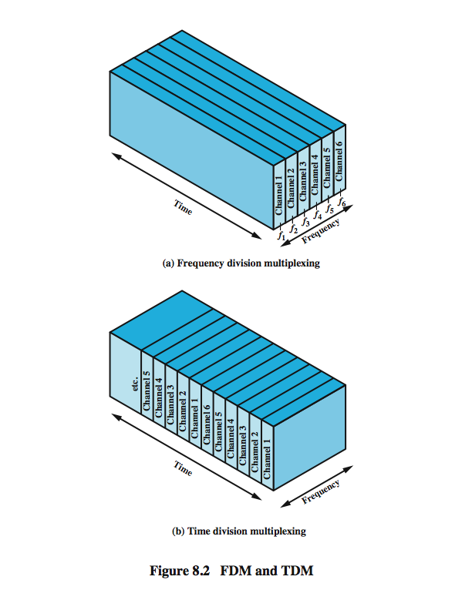
Notes:
A general case of FDM is shown in Stallings DCC8e Figure 8.2a. Six signal sources are fed into a multiplexer, which modulates each signal onto a different frequency (f₁, …, f₆). Each modulated signal requires a certain bandwidth centered on its carrier frequency, referred to as a channel. To prevent interference, the channels are separated by guard bands, which are unused portions of the spectrum.
The composite signal transmitted across the medium is analog. Note, however, that the input signals may be either digital or analog. In the case of digital input, the input signals must be passed through modems to be converted to analog. In either case, each input analog signal must then be modulated to move it to the appropriate frequency band.

Slide 8
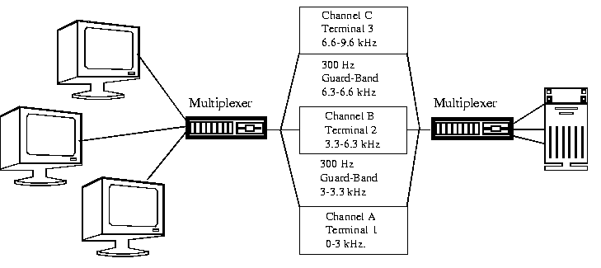
can be applied when the bandwidth of a link (in hertz) is greater than the combined bandwidths of the signals to be transmitted .
To separate the channels, a guard-band would be used. This is to ensure that the channels do not interfere with each other
Used in radio transmission.

Slide 9
Example
Assume that a voice channel occupies a bandwidth of 4 kHz. We need to combine three voice channels into a link with a bandwidth of 12 kHz, from 20 to 32 kHz. Show the configuration, using the frequency domain. Assume there are no guard bands.

Slide 10
Solution
We shift (modulate) each of the three voice channels to a different bandwidth as shown in Figure different bandwidth, as shown in Figure . We use the We use the 20- to 24-kHz bandwidth for the first channel, the 24- to 28-kHz bandwidth for the second channel and the kHz bandwidth for the second channel, and the 28- to 32-kHz bandwidth for the third one. Then we combine them as shown in Figure 6 6 6.10 them as shown in Figure .

Slide 11
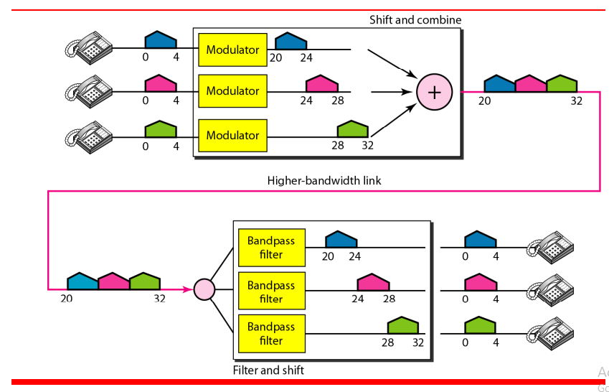

Slide 12
Example
Five channels channels, each with a 100-kHz bandwidth bandwidth, are to be multiplexed together. What is the minimum bandwidth of the link if there is a need for a guard band of 10 kHz between the channels to prevent interference?
Solution
For five channels, we need at least four guard bands. This means that the required bandwidth is at least 5 × 100 + 4 × 10 = 540 kHz.

Slide 13
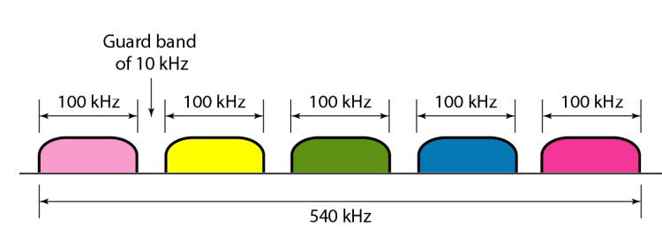

Slide 14
Time division Multiplexing(TDM)
allows several connections to share the high bandwidth of a link.
instead of sharing a portion of the bandwidth as in FDM, time is shared.
is a technique where a short time sample of each channel is inserted into the multiplexed data stream. Each channel is sampled in turn and then the sequence is repeated.
each connection occupies a portion of time in the link.
in the figure, portions of signals 1, 2, 3, and 4 occupy the link sequentially.

Slide 15
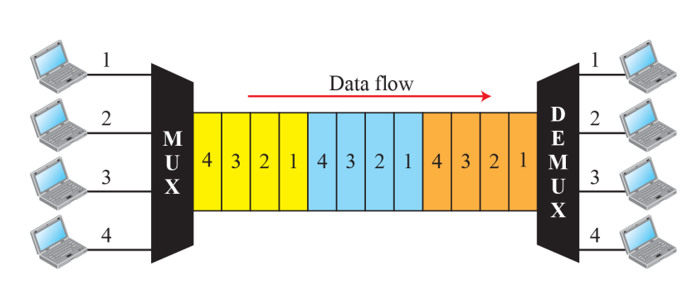
TDM is more efficient, easier to operate, less complex and less expensive compare to FDM.
TDM which is better suited for digital data

Slide 16
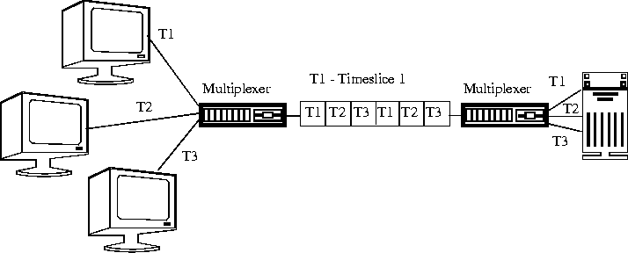

Slide 17
TDM is a digital multiplexing technique for combining several low-rate channels into one high-rate one.

Slide 18
Synchronous TDM
• Is simple time division multiplexing, each conversation is given one slot per frame
  Guaranteed the slot
  Slot is wasted if the connection does not use it
  Wasteful but still brings economies of scale
  Slot not Used In expensive to implement
In synchronous TDM, the data rate of the link is n times faster, and the unit duration is n times shorter.

Slide 19
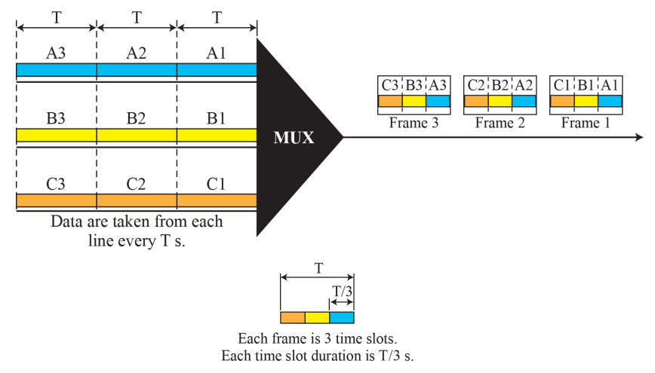
Synchronous time-division multiplexing

Slide 20
In the previous picture, the data rate for each input connection is 1 kbps. If 1 bit at a time is multiplexed (a unit is 1 bit), what is the duration of
  each input slot,
  each output slot, and
  each frame?

Slide 21
Solution
  1. The data rate of each input connection is 1 kbps. This means that the bit duration is 1/1000 s or 1 ms. The duration of the input time slot is 1 ms (same as bit duration).
  2. The duration of each output time slot is one-third of the input time slot. This means that the duration of the output time slot is 1/3 ms.
  3. Each frame carries three output time slots. So the duration of a frame is 3 × (1/3) ms, or 1 ms. The duration of a frame is the same as the duration of an input unit.

Slide 22
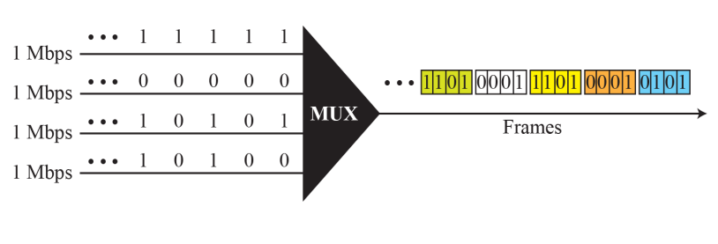

Slide 23
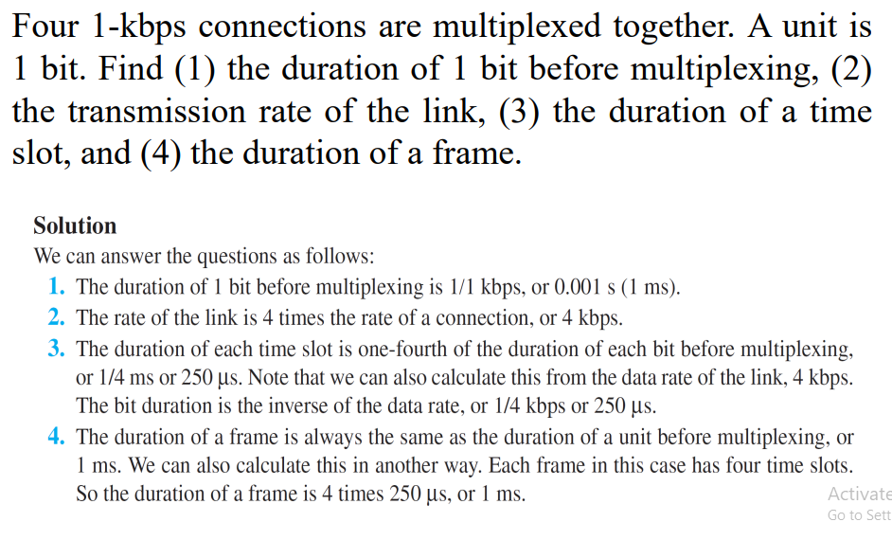

Slide 24
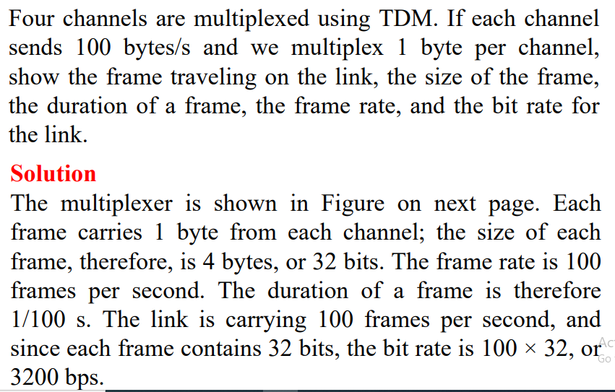

Slide 25
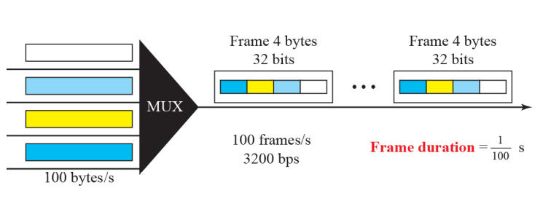

Slide 26
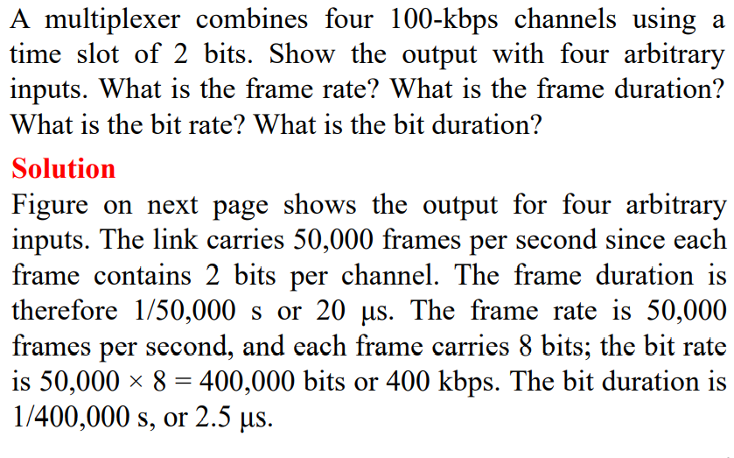

Slide 27
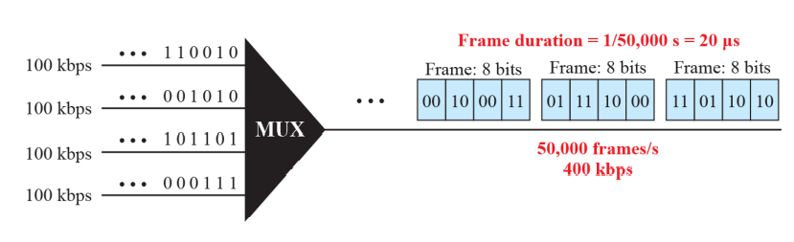

Slide 28
Asynchronous TDM
Still Frames and Slots
but statistical TDM assigns slots as needed
  Connections that need more slots get them
  More efficient use of line than simple TDM
  More expensive to implement Frame

Slide 29
Wavelength Division Multiplexing
Dense wavelength division multiplexing is a fairly new technology that multiplexes multiple data streams onto a single fiber optic line.
It is useful to increase the information carried by single optical fiber.
WDM can be view as an optical domain version of FDM in which multiple information signal modulate optical signals at different optical wavelength (colors). The resulting signals are combine and transmitted simultaneously over the same optical fiber.

Slide 30
Unlike frequency division multiplexing, which assigns input sources to separate sets of frequencies, and time division multiplexing, which divides input sources by time, wave division multiplexing uses different wavelength lasers to transmit multiple signals.

Slide 31
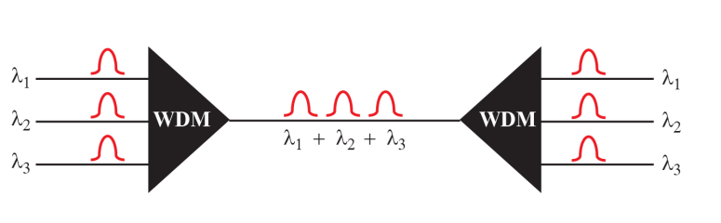

Slide 32
Code Division Multiplexing
This multiplexing technique assigns a multiple-bit sequence to each transmitter’s binary 1
and binary 0.
When all transmitters transmit at the same time, the receiver sums all received values and performs a mathematical computation on the sums to separate one code from another.

Slide 33
Comparison of Multiplexing Techniques
Frequency division multiplexing relies on analog signaling and is the simplest and most noisy of all the multiplexing techniques.
Synchronous time division multiplexing is also relatively straight forward, and like frequency division multiplexing, input devices that
have nothing to transmit can waste transmission space. The big advantage of synchronous TDM is the lower noise during transmission.
Statistical TDM is one step above synchronous TDM because it transmits data only from those input devices that have data to transmit. Thus, statistical TDM wastes less bandwidth on the transmission link.
Dense wavelength division multiplexing is a very good, albeit expensive, technique for transmitting multiple concurrent signals over a fiber optic line.

