Slide 1
Chapter 2
Network Models

Slide 2
Objectives
To discuss the OSI models and its architecture and to show the interface between the layers
Briefly discuss the function of each layers
Introduce TCP/IP protocol
Similarities and comparison between OSI and TCP/IP model
encapsulation

Slide 3
Layered tasks
We use the concept of layers in our daily life
As an example, let us consider 2 friends who communicate through postal mail.
The process of sending a letter to a friend would be complex if there were no services available from the post office.
Process of sending a letter
Sender, Receiver, and Carrier
Hierarchy
Tasks must be done in order given in hierarchy
Services
each layer at the sending site uses the services of the layer below it.

Slide 4
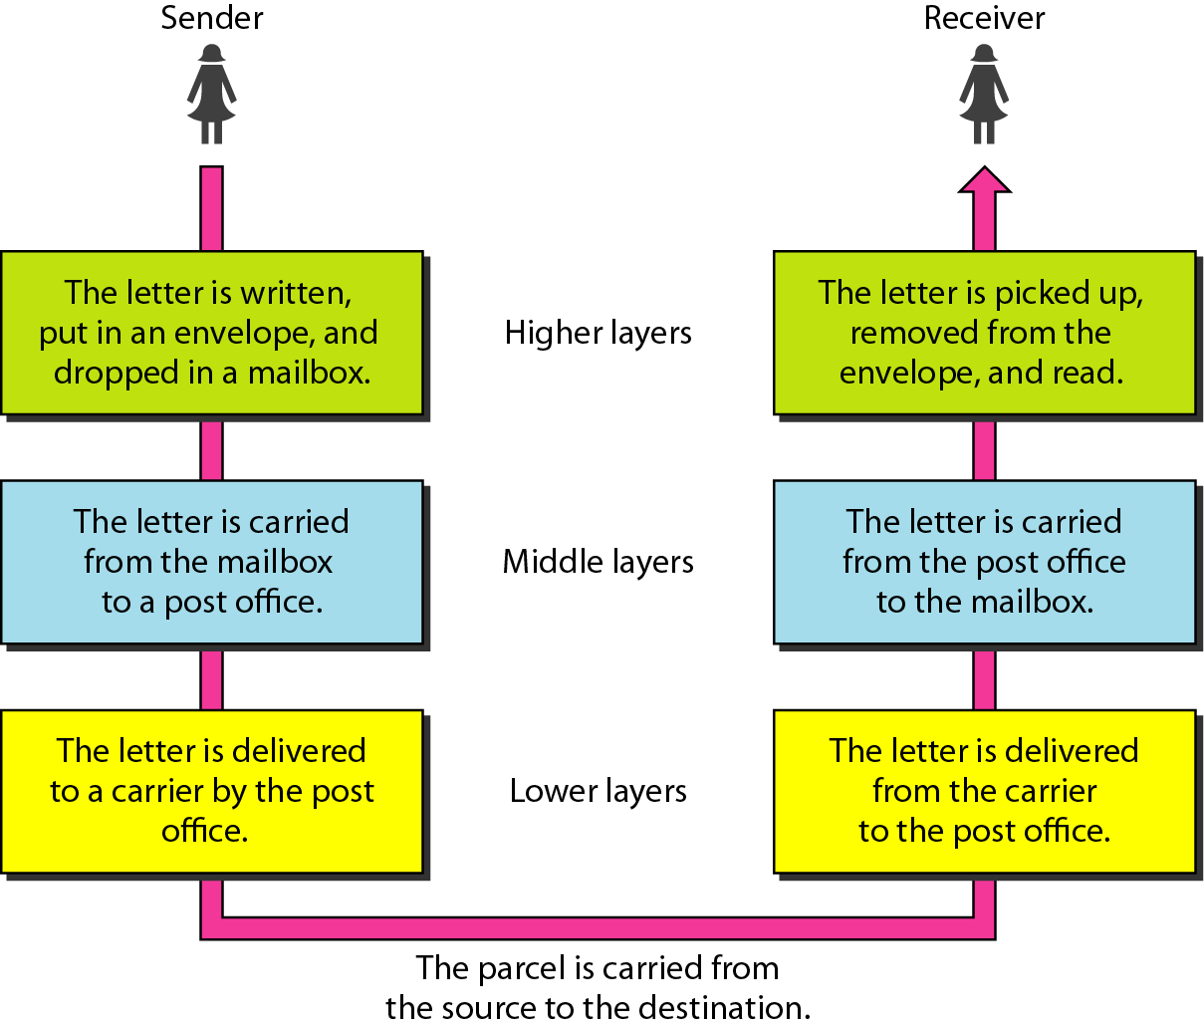
Tasks involved in sending a letter
A network model is a layered architecture
Task broken into subtasks
Implemented separately in layers in stack
Functions need in both systems
Peer layers communicate
Protocol
A set of rules that governs data communication
It represents an agreement between the communicating devices

Slide 5
Network Model
Network model is a method of describing and analyzing data communication networks by breaking the entire set of communication process into a number of layers
Each layer has a specific function

Slide 6
The OSI model
The OSI model is based on a proposal developed by the International Standards Organization (ISO) as a first step toward international standardization of the protocols used in the various layers (Day and Zimmermann, 1983). It was revised in 1995(Day, 1995).
The model is called the ISO-OSI (Open Systems Interconnection) Reference Model because it deals with connecting open systems—that is, systems that are open for communication with other systems.

Slide 7
Cont’ d
It is not a protocol: it is a model for understanding and designing a network architecture that is flexible and robust
The OSI model is a layered framework for the design of network systems that allows communication between all types of computer systems.
It consists of seven separate but related layers, each of which defines a part of the process of moving information across a network.

Slide 8
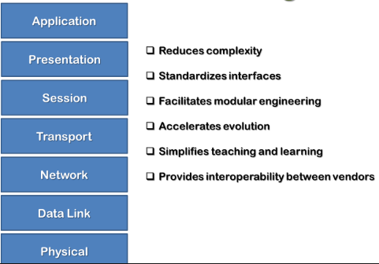
Why a layered Network Model

Slide 9
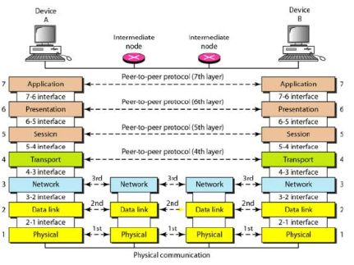
At the physical layer, communication is direct. At higher layers, communication must move down through the layers on Device A, then back up the layers on Device B. Each later adds its own information to the layer above it, and passes the whole thing along.

Slide 10
Cont’d
Layer organization
Network support layers :layer 1,2,3
Deals with physical aspect of moving data from one device to the other.
Ex: electrical specifications, physical connections, physical addressing,
User support layers :
Allow interoperability among unrelated software systems.
Layer 4: the transport layer
Links the two subgroups and ensures that what the lower layers have transmitted is in a form that upper layers can use.

Slide 11
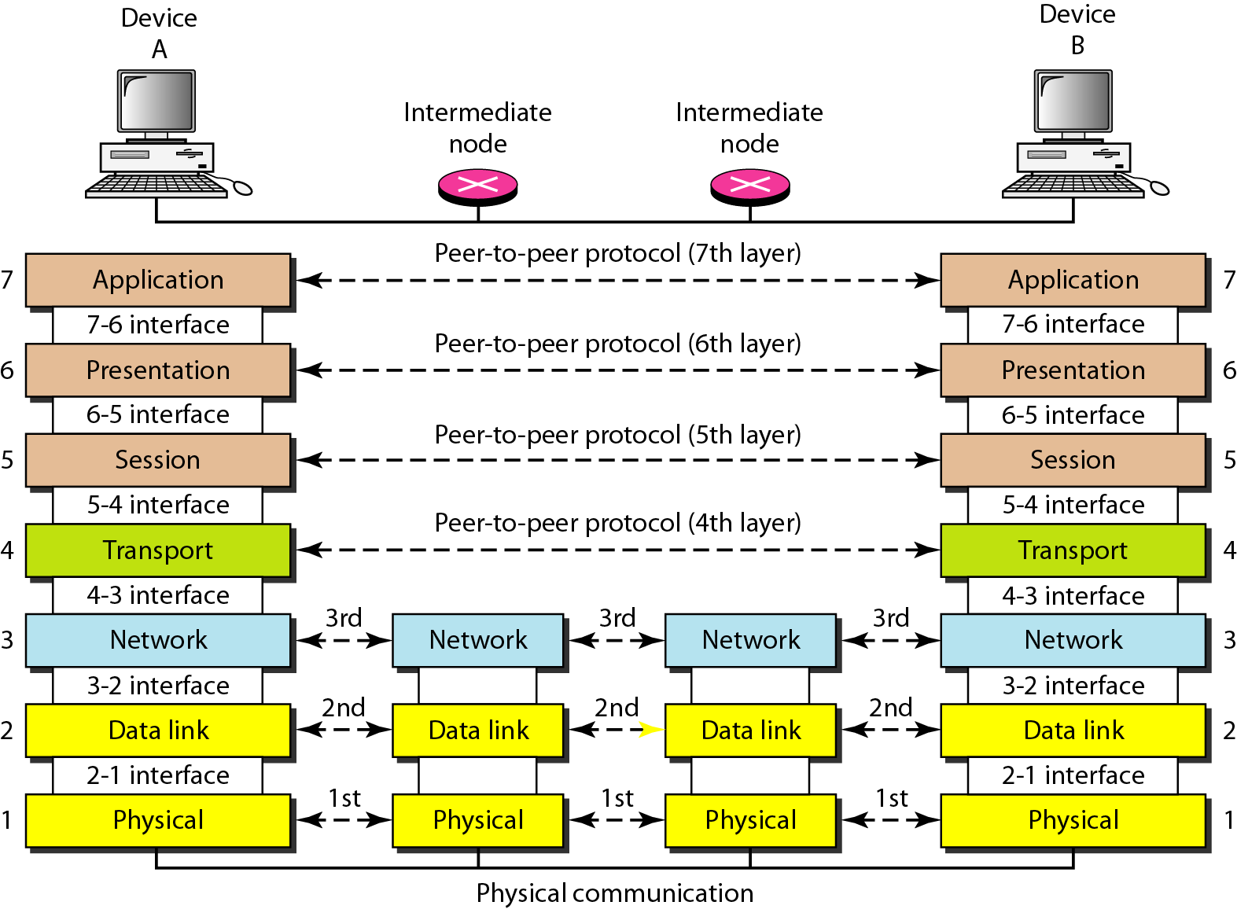
The interaction between layers in the OSI model
Communication between peer layers is “virtual”
In reality, communications pass up and down the protocol stacks on both machines
As data gets passed from layer to layer, it’s divided into data units appropriate for the layer
Protocol data units (PDUs) are passed as a self-contained data structure from layer to layer
Encapsulation process adds “headers” to allow successful delivery of each layer’s payload
Decapsulation strips header information on way up
No layer can pass information directly to its peer counterpart except for the Physical layer

Slide 12
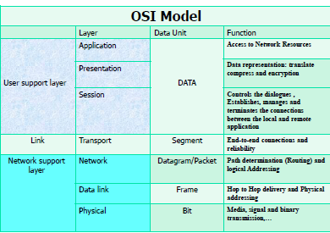
Encapsulation Process

Slide 13
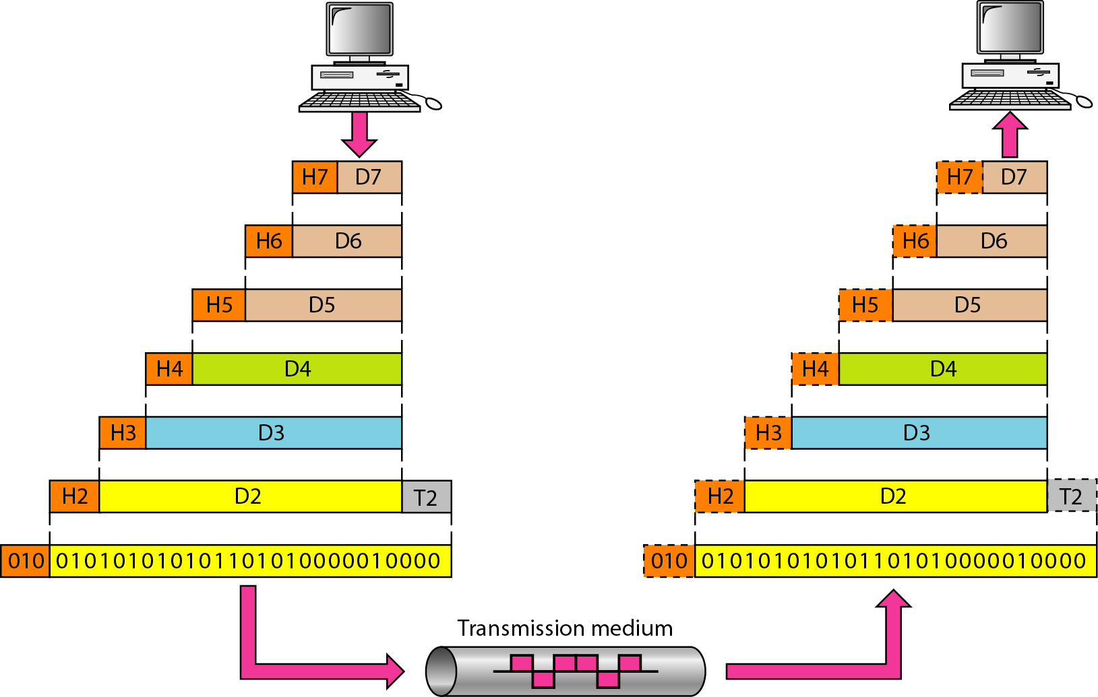

Slide 14
Physical Layer
The physical layer coordinates the functions required to carry a bit stream over a physical medium.
It deals with the mechanical and electrical specifications of the interface and transmission medium.
It also defines the procedures and functions that physical devices and interfaces have to perform for transmission to occur.
Moves individual bits from one node to the next.

Slide 15
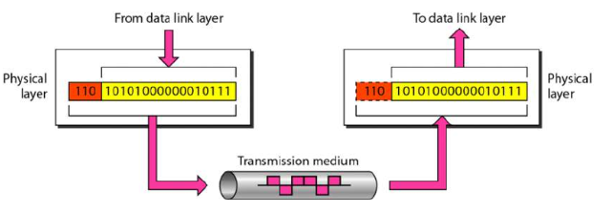
Cont’d

Slide 16
Cont’d
Other concerns
Physical characteristics of interfaces and medium.
Representation of bits
Physical Layer Data consists of a stream of bits (0's or 1's) with no interpretation.
Physical defines type of encoding (how 0's/1's are changed to signals) -- electrical or optical.
To be transmitted, buts must be encoded into signals. The physical layer defines the type of encoding
Data rate.
Transmission rate: Number of bits sent per second.
Implies PHY defines the duration of a bit. which is how long it lasts.
Synchronization of bits.
The sender and receiver clocks must be synchronized.

Slide 17
Cont’d
Line Configuration.
The Physical Layer is concerned with the connection of devices to the media. (Point-to-point vs multipoint.)
Physical topology
Transmission mode
Simplex, Half-duplex, full-duplex
Multiplexing
Switching

Slide 18
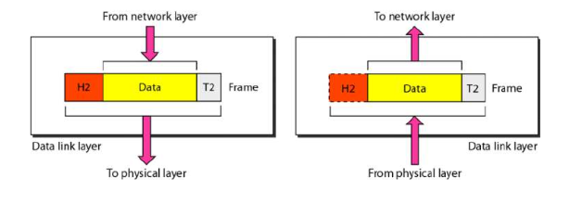
Data link Layer
Transforms the Physical layer into a reliable link. Makes Physical layer appear error-free to the upper layer.
Moves frames from one node to the next

Slide 19
Cont’d
Framing
Divides the stream of bits received from network layer into manageable data units called frames.
Physical addressing.
If frame going to somewhere in same network:
Adds a header to the frame to define sender/receiver of the frame.
If frame intended for outside the current network,
Receiver address is the one that connects this network to the next one.
Flow control.
Try to avoid overwhelming the receiver
If rate(receiver data absorption) < rate(sender data produced)

Slide 20
Cont’d
Error Control.
Add mechanisms to detect and retransmit damaged or lost frames
Typically achieved through trailer added to end of frame.
Recognizes duplicate frames.
Access Control
When two or more devices connected to the same link, data link layer determines which device has control over the link at any time.
Feedback

Slide 21
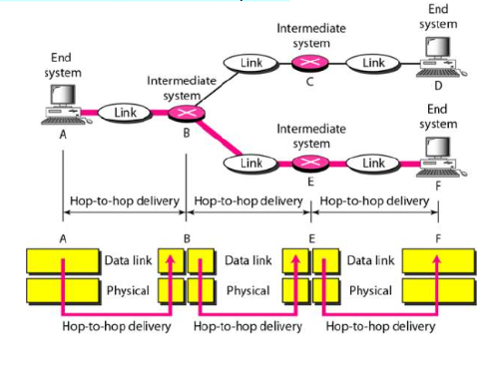

Slide 22
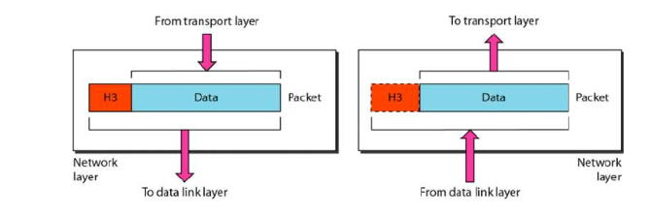
Network Layer
Responsible for source-to-destination delivery of packets, across multiple networks.
Data Link can only deliver the packet within a network.

Slide 23
Cont’d
Logical Addressing
If a packet passes the network boundary, need another addressing system to help distinguish the source and destination systems.
Network layer adds a header to the packet coming from the upper layer that contains the logical address of the sender and receiver.
Routing
When independent networks are connected to create internetworks, the routers/switches send packets to their final destination. The network layer does this.

Slide 24
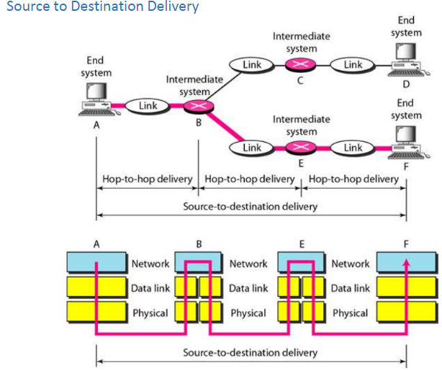

Slide 25
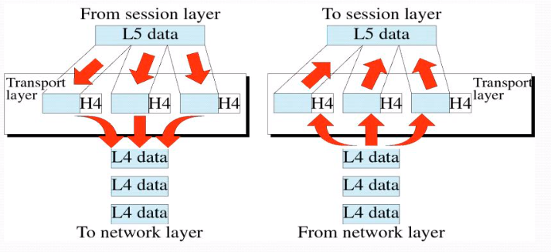
Transport Layer
The network layer does not recognize any relationship between packets.
The Transport layer ensures the whole message (group of packets) arrives in tact and in order.
The transport layer also is responsible for delivery of a message from one process to another.

Slide 26
Cont’d
Service-point addressing.
"Computer addresses" have ports (22, 80, etc.).
The Transport Layer Header defines a service-point address (port address).
The transport layer make sure that the message is delivered to the correct process on the destination machine
Segmentation and re-assembly.
message is divided into transmittable segments, each containing a sequence number. On receipt, assemble message in order, replace lost packets.

Slide 27
Cont’d
Connection control.
Can be connectionless or connection-oriented.
Connectionless: Treats each segment as an independent packet. the receiver doesn’t acknowledges the receipt of a packet.
Connection-oriented: Makes a connection with the transport layer at the destination machine first before delivering packets. After all data transferred, connection is terminated. the receiver acknowledges the receipt of a packet.
Flow control.
Like the Data Link Layer, Transport is also responsible for flow control.
Flow control at this layer is performed end-to-end rather than link-to-link.

Slide 28
Cont’d
Error Control
Performed process-to-process rather than across a single link.
Sending transport layer makes sure entire message arrives at receiving transport layer
without error.
Error Correction typically achieved through retransmission.

Slide 29
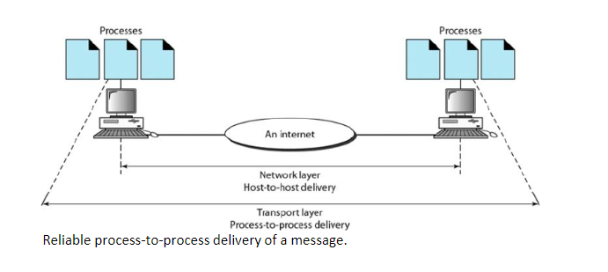

Slide 30
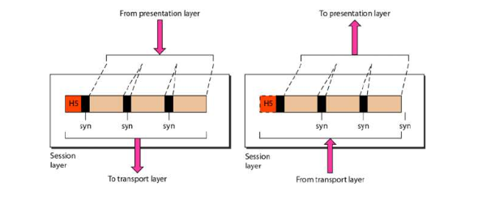
Session Layer
he session layer is the network dialog controller. It establishes, maintains, and synchronizes the interaction among communicating systems which is called a session.

Slide 31
Cont’d
Establishment, maintaining and ending a secession:
Send SYN packet– establishment request
Receive ACK and SYN--established
To end –sender sends ACK

Slide 32
Cont’d
Dialog Control:
Allow two systems to enter into a dialog. Allows communication between two processes to be half-duplex or full-duplex.
Synchronization:
Session layer allows a process to add checkpoints, or synchronization points to a stream of data.
Example: If sending a 2000 page file, add checkpoints every 100 pages to make sure that each 100-page unit is received and acknowledged independently. If a single 100-page section transmission fails, no need to resend the whole file, just that section.

Slide 33
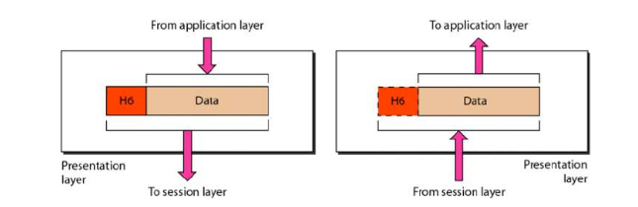
Presentation Layer

Slide 34
Cont’d
Translation
Changes sender-dependent format into common format. /vise-versa.
Example: Character encodings.
Encryption--for security and privacy purpose
Compression—reduce the number of bits contained in the information

Slide 35
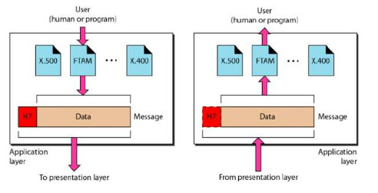
The application layer

Slide 36
The application layer
The application layer enables the user, whether human or software, to access the network.
It provides user interfaces and support for services such as electronic mail, remote file access and transfer, shared database management, and other types of distributed information services.

Slide 37
Cont’d
Specific services provided by the application layer include the following:
Network virtual terminal: this application allows a user to access files on a remote host.
File transfer, access, and management
Mail services: this application provides various e-mail services
Directory services: this application provides the distributed database sources and access for global information about various objects and services

Slide 38
TCP/IP Model
The TCPIIP protocol suite was developed prior to the OSI model.
TCP/IP forms the base of preset day internet
TCP and IP are two protocols of this model.
This model was initialy used by ARPNET
The original TCP/IP protocol suite was defined as having four layers: host-to-network, internet, transport, and application.

Slide 39
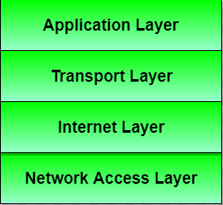
TCP/IP protocol Suite

Slide 40
Cont’d
TCP/IP is compared to OSI, we can say that the
host-to-network layer is equivalent to the combination of the physical and data link layers.
internet layer is equivalent to the network layer, and the
transport layer in TCP/IP taking care of part of the duties of the session layer.
application layer is roughly doing the job of the session, presentation, and application layers

Slide 41
Cont’d
TCP/IP is a hierarchical protocol made up of interactive modules, each of which provides a specific functionality; however, the modules are not necessarily interdependent.
Whereas the OSI model specifies which functions belong to each of its layers,
the layers of the TCP/IP protocol suite contain relatively independent protocols that can be mixed and matched depending on the needs of the system.
The term hierarchical means that each upper-level protocol is supported by one or more lower-level protocols.

Slide 42
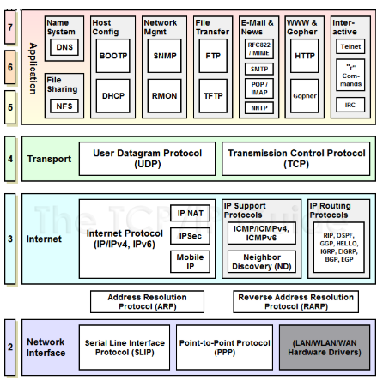
TCP/IP Protocols

Slide 43
Application Layer
This layer is comparable to the application, presentation, and session layers of the OSI model all combined into one.
It provides a way for applications to have access to networked services.
This layer also contains the high level protocols. The main issue with this layer is the ability to use both TCP and UDP protocols.

Slide 44
Transport Layer
It is similar in functionality with the OSI model transport layer.
Provides connectionless and connection oriented services
Connection oriented-- TCP
Connection less --UDP

Slide 45
Internet Layer
Similar to the Network layer of the OSI model.
The main purpose of this layer deliver IP packet to their destination.
The main protocol used at this layer is IP. While ICMP(used by popular ‘ping’ command) and IGMP are also used at this layer.

Slide 46
Host to Network Layer
This layer is also known as network interface layer
The purpose of this layer is to connect the host to the network.

Slide 47
Similarities of OSI and TCP/IP
Both are based on the concept of stack of independent protocols
Functionality of layers id roughly similar
Up to transport –network oriented
Above--- user oriented

Slide 48
Difference between OSI and TCP/IP
OSI model has seven layers and TCP/IP has four layers.
OSI model provides clear distinction between Services, Interfaces, and Protocols.
TCP/IP doesn’t provides clear distinction between Services, Interfaces, and Protocols.
The OSI model transport layer is connection oriented.
The TCP/IP transport layer is both connection oriented and connectionless.

Slide 49
Cont’d
The protocols do not fit well into the OSI model
Protocols fit well in the TCP/IP model
The minimum size of the OSI header is 5 byte in TCP/IP it is 20 bytes

Slide 50
Communication Protocols
Definition
Protocol is a set of rules that govern all aspect of data communication between computers on a network.
These rules include guidelines that regulate the following characteristics of a network: access method, allowed physical topologies, types of cabling, and speed of data transfer.
A protocol defines what, how, when it communicated.
The key elements of a protocol are syntax, semantics and timing.
Protocols are to computers what language is to humans. Since this article is in English, to understand it you must be able to read English. Similarly, for two devices on a network to successfully communicate, they must both understand the same protocols.

Slide 51
Elements of protocol
Syntax
The structure or format of the data.
Eg. A simple protocol;
Sender address
Receiver address
data
8 bits
8 bits
64 bits

Slide 52
ii) Semantics
- Refers to the meaning of each section of bits.
- how is a particular pattern to be interpreted, and what action is to be taken based on that interpretation.
Eg. Does an address identify the route to be taken or the final of the message?

Slide 53
iii) Timing
Refers to two characteristics:
When data to be sent
How fast it can be sent
Eg. If a sender produces data at 100 Mbps but the receiver can process data at only 1 Mbps, the transmission will overload the receiver and data will be largely lost.

Slide 54
Characteristics of a protocol
Direct/indirect
Monolithic or structure
Symmetric or Asymmetric
Standard Propriety and De fecto

Slide 55
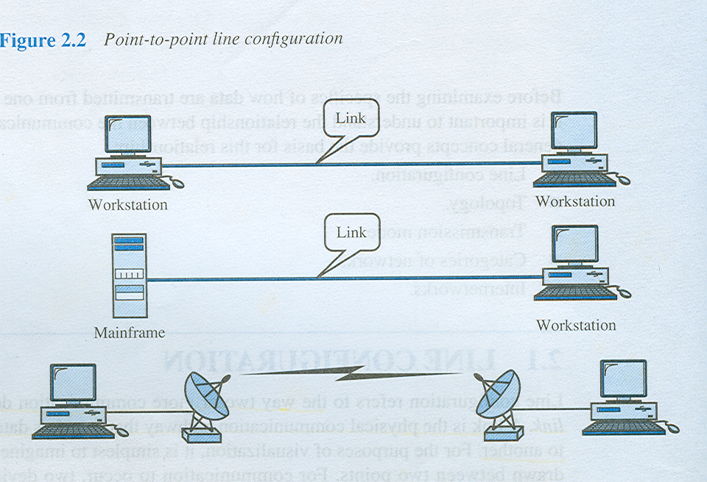
Direct / indirect
communication between two entities maybe direct or indirect.
i) point-to-point link
- connection provides a dedicated link between two devices
- the entities in these systems may communicate directly that is data and control information pass directly between entities with no intervening
active agent.

Slide 56
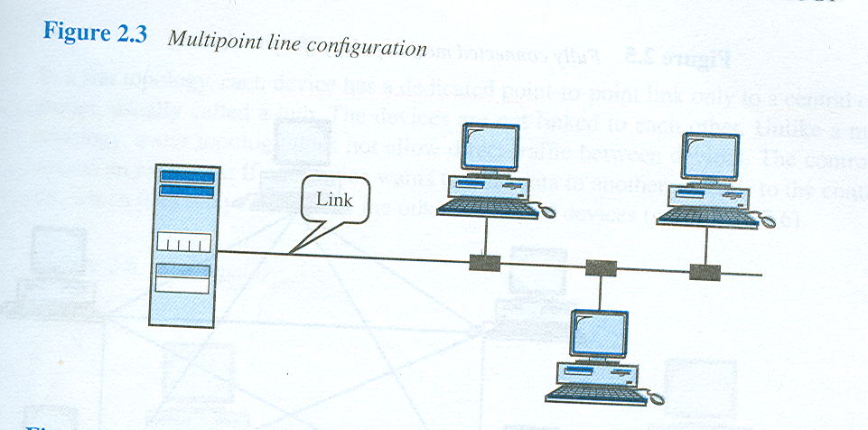
ii) multipoint link/
more than two devices can share a single link
Entities depend on other entities for data exchange ·
Entities may be connected over local network (Ethernet) or may belong to different networks (internet) , Switched networks
The entities must be concerned with the issue of access control and making the protocol more complex.

Slide 57
Monolithic/structured protocol
Monolithic protocol
All protocol logic (for every layer) is combined into one unit ·
Problem in changing any aspect of the protocol (such as virtual circuit request)
Structured protocol
Set of protocols with hierarchical/layered structure · Clearly shows the distinction between different layers of logic
Communications architecture
Hardware/software used to implement communications with structured protocol

Slide 58
c) Symmetric / asymmetric
- Symmetric is the most use in protocol and involve communication between peer entities.
- Asymmetry may be dictated by the logic of an exchange (eg; client and a server process) the desire to keep one of the entities or systems as simple as possible.

Slide 59
d) Standard / nonstandard
Standard protocol : Commonly accepted protocols that have been agreed on by a standards body
Nonstandard protocol :Built for specific communications situation
Notes:
If K different kinds of information sources have to communicate with L types of information receivers, as many as K x L different protocols are needed without standards and a total of 2 x K x L implementations are required
If all systems shared a common protocol, only K+L implementations would be needed.

Slide 60
Common protocol used
Protocol | Acronym | Remarks
Point To Point | PPP | Used to manage network communication over a modem
Transfer/Transmission Control Protocol | TCP / IP | Backbone protocol. The most widely used protocol.
Internetwork package exchange | IPX | Standard protocol for Novell NOS
NetBIOS extended user interface | NetBEUI | Microsoft protocol that doesn’t support routing to other network. Running only Windows-based clients.
File transfer Protocol | FTP | used to send and received file from a remote host
Simple mail Transfer protocol | SMTP | Used to send Email over a network
Hyper text transfer protocol | HTTP | Used for Internet to send document that encoded in HTML
Apple Talk | Apple Talk | Protocol suite to network Macintosh computer and a peer-to-peer network protocol
OSI Model | OSI Layers | A way of illustrating how information functions travels through network of its 7 layers.

Slide 61
Encapsulation
Data as well as control information in each pdu Protocols and Architecture
Control information is divided into the following categories:
Address of the sender and receiver
Error detection code or frame check sequence
Protocol control for other protocol functions

Slide 62
Segmentation and reassembly
Segment the data stream into small bounded size blocks or pdus
Reasons for segmentation
Communications network may accept data blocks only up to a certain size (53 octets for atm, 1526 octets for Ethernet)
Efficient error control with smaller pdu size; fewer bits retransmitted in the event of failure
Better access to shared transmission facilities, with shorter delay; nobody can monopolize the network ·
Smaller buffers at receiver stations
Can pause transfer for checkpoint and recovery

Slide 63
Disadvantages with segmentation
Larger overhead with smaller pdu size ·
More interrupts as pdus announce their arrival
More time spent to process smaller pdus
∗ Segmented data is reassembled into messages appropriate for application level

Slide 64
Connection control
Connectionless data transfer ·
Each pdu is independent of other pdus
Connection-oriented data transfer ·
Used if stations are to be connected for long time or protocol details are to be worked out dynamically ·
Also known as logical association, or virtual circuit, with three phases
Establish connection
Transfer data
Terminate connection

Slide 65
Establish connection
One station issues a connection request to the other, with or without involving a central authority
Receiver may accept or reject the connection ·
Request may include negotiating syntax, semantics, and timing of protocol
Protocol may have some options to be negotiated at connection time, such as pdu size

Slide 66
Transfer data
Exchange data and control information (flow control, error control) ·
Data flows in one direction while acknowledgements flow in the other
Terminate connection
Either side may terminate connection by sending a request ·
Connection may be terminated by a central authority

Slide 67
Sequencing
pdus are sequentially numbered as they are sent ·
Each side keeps track of outgoing numbers (generated locally), and incoming numbers (generated by other host)

Slide 68
Ordered delivery
pdus may not arrive in order in which they are sent
Connection-oriented protocols require the pdu order to be maintained Protocols and Architecture 12
Number the pdus sequentially as they are generated
Problem if sequence numbers repeat after overflow
Preferable to have the maximum number pdu to be twice the maximum number of outstanding pdus

Slide 69
Flow control
Function of receiving entity to limit the amount of data sent by transmitter
Stop-and-wait · Each pdu must be acknowledged before next one can be sent
Efficiency requires the transmission of a fixed number of pdus without acknowledgement
Implemented in several protocols

Slide 70
Error control
Guard against loss or damage of data and control information
Implemented as error detection and retransmission
Detection of error by receiver makes him discard the pdu
No acknowledgement makes the sender retransmit the pdu
With error correction code, the receiver may be able to correct the error at destination
Implemented in several protocols

Slide 71
Addressing
Addressing level · Level in the communications architecture at which an entity is named · Network-level address or ip address used to route a pdu through network (also called Network Service Access Point or nsap in osi terminology) · Upon arrival at destination, the pdu must be routed to port or Service Access Point (sap) for the application
Addressing scope · Global address Global nonambiguity One system to one address but possible to have more then one address for the system Global applicability Any system can be identified from anywhere · A port may not be unique in the network unless attached to a system (think of smtp port on every system in a network)

Slide 72
Connection identifiers
Useful for connection-oriented data transfer (virtual circuit) but meaningless for connectionless data transfer (datagram) ·
Identified by a connection name during the data transfer phase ·
Advantages
Reduced overhead Data packets can contain just the circuit number after a virtual circuit is established
Routing Allows the setting up of a fixed route
Multiplexing More than one connection between entities; incoming pdu can be identified by connection identifier
Use of state information State information related to the connection; enables flow control and error control using sequence numbers
Addressing mode
Individual or unicast address – reference to a single system or port ·
Multicast or broadcast address

Slide 73
Multiplexing
Combining several signals for transmission on some shared medium Protocols and Architecture
Possible to have multiple virtual circuits terminating into a single end system
Can also be accomplished via port names
Upward multiplexing · Multiple higher-level connections are multiplexed on a single lower-level connection · Connecting your pc to isp for multiple applications, including web, email, telnet, ftp, ...
Downward multiplexing · Split a single higher-level connection over a number of lower-level connections · Useful for reliability, performance, or efficiency

Slide 74
Transmission services
Additional services, such as priority, quality of service, and security

