Slide 1
Chapter 3-5
Transmission Media
Notes:
Lecture slides prepared by Dr Lawrie Brown (UNSW@ADFA) for “Data and Computer Communications”, 8/e, by William Stallings, Chapter 4 “Transmission Media”.

Slide 2
Learning Objectives
· Outline the differences between Category 1, 2, 3, 4, 5, 5e, 6, and 7 twisted pair wire.
· Outline the characteristics of coaxial cable including the advantages and disadvantages.
· Outline the characteristics of fiber optic cable including the advantages and disadvantages.
· Outline the characteristics of terrestrial microwave systems including the advantages and disadvantages.
· Outline the characteristics of satellite microwave systems including the advantages and disadvantages as well as the differences between low earth orbit, middle earth orbit, geosynchronous earth orbit, and highly elliptical earth orbit satellites.
· Describe the basics of wireless radio, including AMPS, D-AMPS, PCS systems, and
third generation wireless systems.
· Outline the characteristics of pager systems including the advantages and disadvantages.
· Outline the characteristics of short-range transmissions, including Bluetooth
· Describe the characteristics, advantages, and disadvantages of wireless application protocol
· Outline the characteristics of broadband wireless systems including the advantages and disadvantages.
· Apply the media selection criteria of cost, speed, distance and expandability, environment, and security to various media in a particular application.

Slide 3
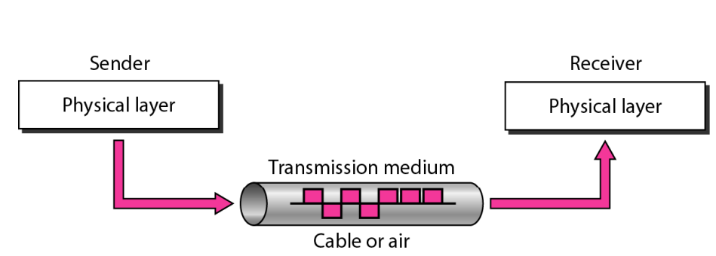
Transmission media
Is a pathway that carries the information from sender to receiver.
Are located below the physical layer
Are directly controlled by the physical layer.
We use different types of cables or waves to transmit data.

Slide 4
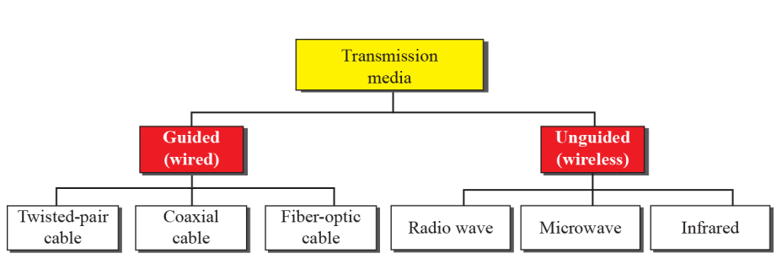

Slide 5
Guided/Wired/Bound Transmission Media
Are the cables that are tangible or have physical existence and are limited by the physical geography.
provide a conduit from one device to another, include twisted-pair cable, coaxial cable, and fiber-optic cable
A signal traveling along any of these media is directed and contained by the physical limits of the medium.

Slide 6
Transmission Characteristics of Guided Media
Frequency Range
Typical Attenuation
Typical Delay
Repeater Spacing
Twisted pair (with loading)
0 to 3.5 kHz
0.2 dB/km @ 1 kHz
50 µs/km
2 km
Twisted pairs (multi-pair cables)
0 to 1 MHz
0.7 dB/km @ 1 kHz
5 µs/km
2 km
Coaxial cable
0 to 500 MHz
7 dB/km @ 10 MHz
4 µs/km
1 to 9 km
Optical fiber
186 to 370 THz
0.2 to 0.5 dB/km
5 µs/km
40 km
Notes:
For guided transmission media, the transmission capacity, in terms of either data rate or bandwidth, depends critically on the distance and on whether the medium is point-to-point or multipoint. Stallings DCC8e Table 4.1(shown above) indicates the characteristics typical for the common guided media for long-distance point-to-point applications; we defer a discussion of the use of these media for LANs to Part Four. The three guided media commonly used for data transmission are twisted pair, coaxial cable, and optical fiber. We examine each of these in turn.

Slide 7
Twisted-pair cable(TP)
Consists of two conductors (normally copper), each with its own plastic insulation, twisted together
One of the wires is used to carry signals to the receiver, and the other is used only as a ground reference.
The receiver uses the difference between the two.
In addition to the signal sent by the sender on one of the wires, interference (noise) and crosstalk may affect both wires and create unwanted signals.
The two lines are twisted to minimize interference (noise) and crosstalk.

Slide 8

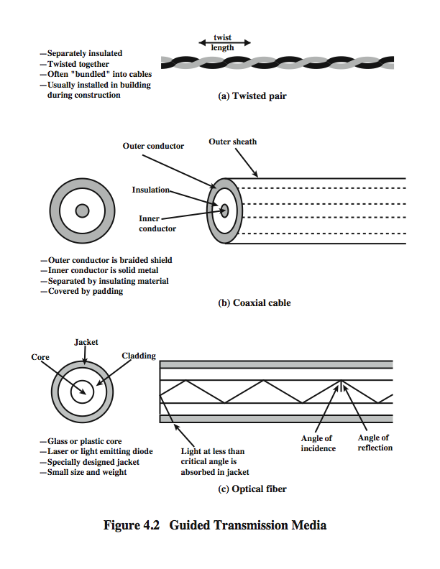
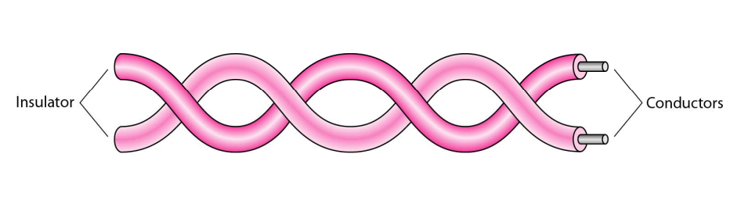

Slide 9
TP - Transmission Characteristics
Analog
  needs amplifiers every 5km to 6km
Digital
  can use either analog or digital signals
  needs a repeater every 2-3km
limited distance
limited bandwidth (1MHz)
limited data rate (100MHz)
susceptible to interference and noise
Notes:
Twisted pair may be used to transmit both analog and digital transmission. For analog signals, amplifiers are required about every 5 to 6 km. For digital transmission (using either analog or digital signals), repeaters are required every 2 or 3 km.
Compared to other commonly used guided transmission media (coaxial cable, optical fiber), twisted pair is limited in distance, bandwidth, and data rate. The attenuation for twisted pair is a very strong function of frequency. Other impairments are also severe for twisted pair. The medium is quite susceptible to interference and noise because of its easy coupling with electromagnetic fields. Several measures are taken to reduce impairments. Shielding the wire with metallic braid or sheathing reduces interference. The twisting of the wire reduces low-frequency interference, and the use of different twist lengths in adjacent pairs reduces crosstalk.
For point-to-point analog signaling, a bandwidth of up to about 1 MHz is possible. For long-distance digital point-to-point signaling, data rates of up to a few Mbps are possible; for very short distances, data rates of up to 10 Gbps have been achieved in commercially available products.

Slide 10
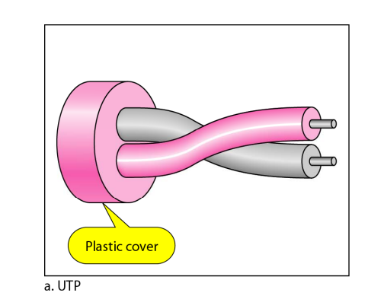
Unshielded Twisted Pair (UTP)
  ordinary telephone wire
  cheapest
  easiest to install
  suffers from external EM interference
Notes:
Twisted pair comes in two varieties: unshielded and shielded.
Unshielded twisted pair (UTP) is ordinary telephone wire. Office buildings, by universal practice, are prewired with excess unshielded twisted pair, more than is needed for simple telephone support. This is the least expensive of all the transmission media commonly used for local area networks and is easy to work with and easy to install. However UTP is subject to external electromagnetic interference, including interference from nearby twisted pair and from noise generated in the environment.
A way to improve the characteristics of this medium is to shield the twisted pair with a metallic braid or sheathing that reduces interference. This shielded twisted pair (STP) provides better performance at higher data rates. However, it is more expensive and more difficult to work with than unshielded twisted pair.
Twisted Pair cables come in a variety of categories. Originally most office buildings were prewired with a type of 100-ohm twisted pair cable commonly referred to as voice grade. Because voice-grade twisted pair was already installed, it was an attractive alternative for use as a LAN medium, and this use was recognised by the Electronic Industries Association standard EIA-568, Commercial Building Telecommunications Cabling Standard, published in 1991. Unfortunately, the data rates and distances achievable with voice-grade twisted pair are limited. As users migrated to higher-performance workstations and applications, there was increasing interest in providing LANs that could operate up to 100 Mbps over inexpensive cable.

Slide 11
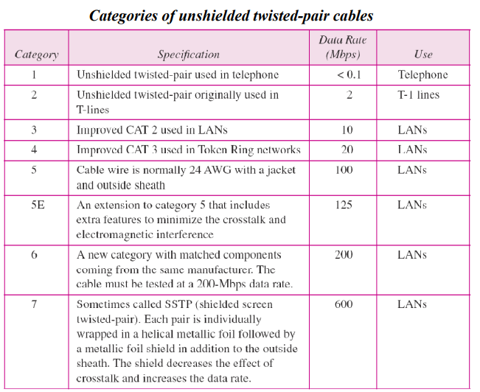

Slide 12
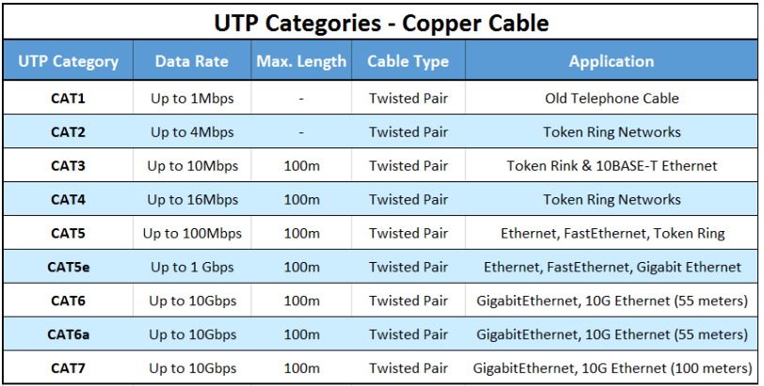

Slide 13
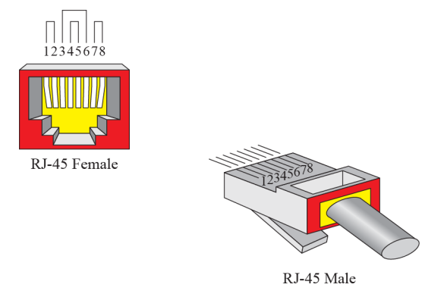
UTP connector

Slide 14
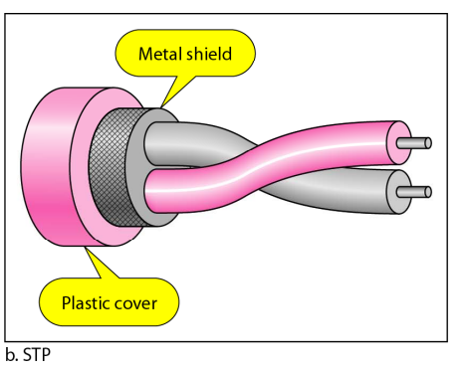
Shielded Twisted Pair (STP)
metal braid or sheathing that reduces interference
more expensive
harder to handle (thick, heavy)
in a variety of categories - see EIA-568

Slide 15
Applications
Twisted-pair cables are used in telephone lines to provide voice and data channels.
The local loop-the line that connects subscribers to the central telephone office-commonly consists of unshielded twisted-pair cables.
The DSL lines that are used by the telephone companies to provide high-data-rate connections also use the high-bandwidth capability of unshielded twisted pair cables.
Local-area networks, such as 100Base-T and 100Base-T, also use twisted-pair cables.

Slide 16
Coaxial Cable(coax)
carries signals of higher frequency ranges than those in twisted pair cable, in part because the two media are constructed quite differently.
Instead of having two wires, coax has a central core conductor of solid or stranded wire (usually copper) enclosed in an insulating sheath, which is, in turn, encased in an outer conductor of metal foil, braid, or a combination of the two.
The outer metallic wrapping serves both as a shield against noise and as the second conductor, which completes the circuit.
This outer conductor is also enclosed in an insulating sheath, and the whole cable is protected by a plastic cover

Slide 17
The outer shield protects the inner conductor from outside electrical signals. The distance between the outer conductor (shield) and inner conductor plus the type of material used for insulating the inner conductor determine the cable properties or impedance.

Slide 18
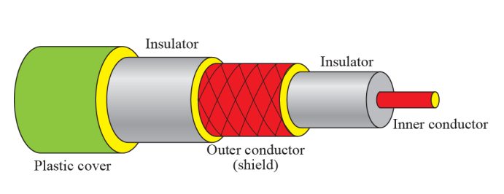

Slide 19
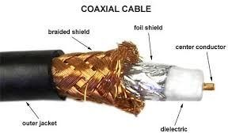
Notes:
Coaxial cable, like twisted pair, consists of two conductors, but is constructed differently to permit it to operate over a wider range of frequencies. It consists of a hollow outer cylindrical conductor that surrounds a single inner wire conductor (Stallings DCC8e Figure 4.2b). The inner conductor is held in place by either regularly spaced insulating rings or a solid dielectric material. The outer conductor is covered with a jacket or shield. A single coaxial cable has a diameter of from 1 to 2.5 cm. Coaxial cable can be used over longer distances and support more stations on a shared line than twisted pair.
Coaxial cable is a versatile transmission medium, used in a wide variety of applications, including:
• Television distribution - aerial to TV & CATV systems
• Long-distance telephone transmission - traditionally used for inter-exchange links, now being replaced by optical fiber/microwave/satellite
• Short-run computer system links
• Local area networks

Slide 20
Coaxial Cable - Transmission Characteristics
Superior frequency characteristics to TP
Performance limited by attenuation & noise
Analog signals
  amplifiers every few km
  closer if higher frequency
  up to 500MHz
Digital signals
  repeater every 1km
  closer for higher data rates
Notes:
Coaxial cable is used to transmit both analog and digital signals.
It has frequency characteristics that are superior to those of twisted pair and can hence be used effectively at higher frequencies and data rates.
Because of its shielded, concentric construction, coaxial cable is much less susceptible to interference and crosstalk than twisted pair.
The principal constraints on performance are attenuation, thermal noise, and intermodulation noise. The latter is present only when several channels (FDM) or frequency bands are in use on the cable.
For long-distance transmission of analog signals, amplifiers are needed every few kilometers, with closer spacing required if higher frequencies are used. The usable spectrum for analog signaling extends to about 500 MHz.
For digital signaling, repeaters are needed every kilometer or so, with closer spacing needed for higher data rates.

Slide 21
There are two major coaxial cable technologies, depending on the type of signal each carries: baseband or broadband.
Coaxial cable also comes in two primary physical types: thin coaxial cable and thick
coaxial cable.

Slide 22
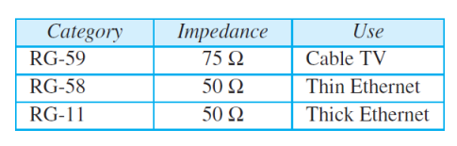
Categories of coaxial cables

Slide 23
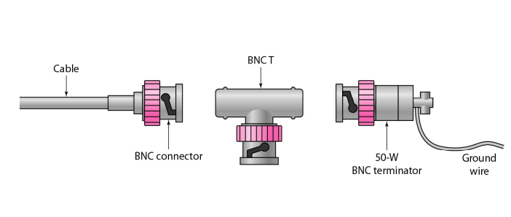
BNC connectors

Slide 24
Applications
Coaxial cable was widely used in analog telephone networks where a single coaxial network could carry 10,000 voice signals.
Later it was used in digital telephone networks where a single coaxial cable could carry digital data up to 600 Mbps. However, coaxial cable in telephone networks has largely been replaced today with fiber-optic cable.
Cable TV networks also use coaxial cables. In the traditional cable TV network, the entire network used coaxial cable. Later, however, cable TV providers replaced most of the media with fiber-optic cable; hybrid networks use coaxial cable only at the network boundaries, near the consumer premises.
Cable TV uses RG-59 coaxial cable.
Another common application of coaxial cable is in traditional Ethernet LANs. Because of its high bandwidth, and consequently high data rate, coaxial cable was chosen for digital transmission in early Ethernet LANs.

Slide 25
Optical fiber
Fiber optic cable (or optical fiber) is a thin glass fiber cable approximately a little thicker than a human hair surrounded by a plastic coating that can carry information at frequencies in the visible light spectrum.
Optical fiber is a cable that accepts and transports signals in the form of light.
A light source, called a photo diode, is placed at the transmitting end and quickly switched on and off. The light pulses travel down the glass cable and are detected by an optic sensor called a photo receptor on the receiving end.

Slide 26
Fiber optic cable is capable of transmitting data at over 100 Gbps (that’s 100 billion bits per second!) over several kilometers.
In addition to having almost error free high data transmission rates, fiber optic cable has a number of other advantages over twisted pair and coaxial cable.
Since fiber optic cable passes electrically non conducting photons through a glass medium, it is immune to electromagnetic interference and virtually impossible to wiretap.

Slide 27
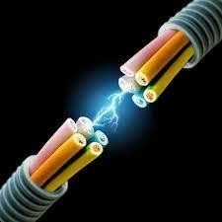

Slide 28
Optical Fiber
Notes:
An optical fiber is a thin (2 to 125 µm), flexible medium capable of guiding an optical ray. Various glasses and plastics can be used to make optical fibers. An optical fiber cable has a cylindrical shape and consists of three concentric sections: the core, the cladding, and the jacket (Stallings DCC8e Figure 4.2c). The core is the innermost section and consists of one or more very thin strands, or fibers, made of glass or plastic; the core has a diameter in the range of 8 to 50 µm. Each fiber is surrounded by its own cladding, a glass or plastic coating that has optical properties different from those of the core and a diameter of 125 µm. The interface between the core and cladding acts as a reflector to confine light that would otherwise escape the core. The outermost layer, surrounding one or a bundle of cladded fibers, is the jacket. The jacket is composed of plastic and other material layered to protect against moisture, abrasion, crushing, and other environmental dangers.
Optical fiber already enjoys considerable use in long-distance telecommunications, and its use in military applications is growing. The continuing improvements in performance and decline in prices, together with the inherent advantages of optical fiber, have made it increasingly attractive for local area networking. Five basic categories of application have become important for optical fiber: Long-haul trunks, Metropolitan trunks, Rural exchange trunks, Subscriber loops & Local area networks.

Slide 29
Optical Fiber - Benefits
greater capacity
  data rates of hundreds of Gbps
smaller size & weight
lower attenuation
electromagnetic isolation
greater repeater spacing
  10s of km at least
Notes:
The following characteristics distinguish optical fiber from twisted pair or coaxial cable:
• Greater capacity: The potential bandwidth, and hence data rate, of optical fiber is immense; data rates of hundreds of Gbps over tens of kilometers have been demonstrated. Compare this to the practical maximum of hundreds of Mbps over about 1 km for coaxial cable and just a few Mbps over 1 km or up to 100 Mbps to 10 Gbps over a few tens of meters for twisted pair.
• Smaller size and lighter weight: Optical fibers are considerably thinner than coaxial cable or bundled twisted-pair cable. For cramped conduits in buildings and underground along public rights-of-way, the advantage of small size is considerable. The corresponding reduction in weight reduces structural support requirements.
• Lower attenuation: Attenuation is significantly lower for optical fiber than for coaxial cable or twisted pair, and is constant over a wide range.
• Electromagnetic isolation: Optical fiber systems are not affected by external electromagnetic fields. Thus the system is not vulnerable to interference, impulse noise, or crosstalk. By the same token, fibers do not radiate energy, so there is little interference with other equipment and there is a high degree of security from eavesdropping. In addition, fiber is inherently difficult to tap.
• Greater repeater spacing: Fewer repeaters mean lower cost and fewer sources of error. The performance of optical fiber systems from this point of view has been steadily improving. Repeater spacing in the tens of kilometers for optical fiber is common, and repeater spacings of hundreds of kilometers have been demonstrated.

Slide 30
Optical Fiber - Transmission Characteristics
uses total internal reflection to transmit light
  effectively acts as wave guide for 10¹⁴ to 10¹⁵ Hz
can use several different light sources
  Light Emitting Diode (LED)
    cheaper, wider operating temp range, lasts longer
  Injection Laser Diode (ILD)
    more efficient, has greater data rate
relation of wavelength, type & data rate
Notes:
Optical fiber transmits a signal-encoded beam of light by means of total internal reflection. Total internal reflection can occur in any transparent medium that has a higher index of refraction than the surrounding medium. In effect, the optical fiber acts as a waveguide for frequencies in the range of about 10¹⁴ to 10¹⁵ Hertz; this covers portions of the infrared and visible spectra.
Two different types of light source are used in fiber optic systems: the light-emitting diode (LED) and the injection laser diode (ILD). Both are semiconductor devices that emit a beam of light when a voltage is applied. The LED is less costly, operates over a greater temperature range, and has a longer operational life. The ILD, which operates on the laser principle, is more efficient and can sustain greater data rates.
There is a relationship among the wavelength employed, the type of transmission, and the achievable data rate. Both single mode and multimode can support several different wavelengths of light and can employ laser or LED light sources.

Slide 31
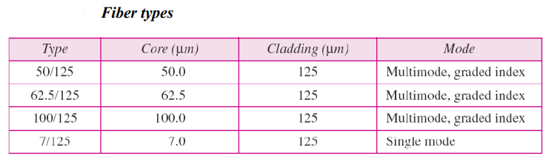

Slide 32
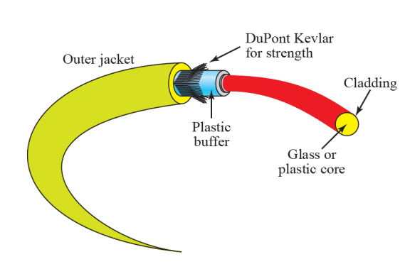
Fiber construction

Slide 33
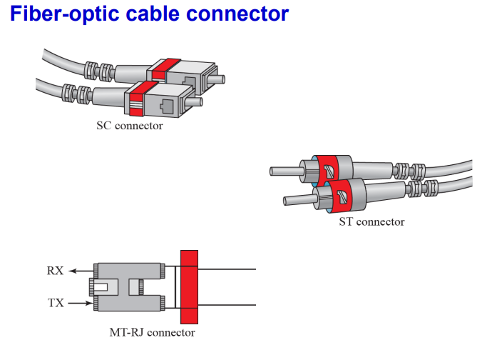

Slide 34
Unguided/Unbound Transmission Media
transport waves without using a physical conductor- data signals flows through the air.
are the ways of transmitting data without using any cables.
These media are not bounded by physical geography.
Signals are normally broadcast through free space and thus are available to anyone who has a device capable of receiving them.
This type of transmission is often referred to as Wireless communication.

Slide 35
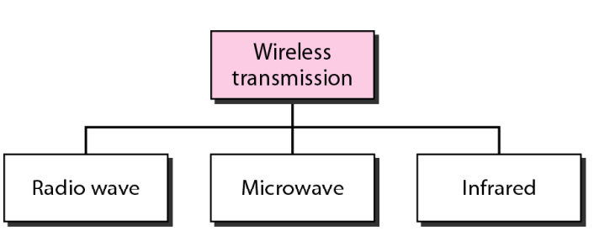

Slide 36
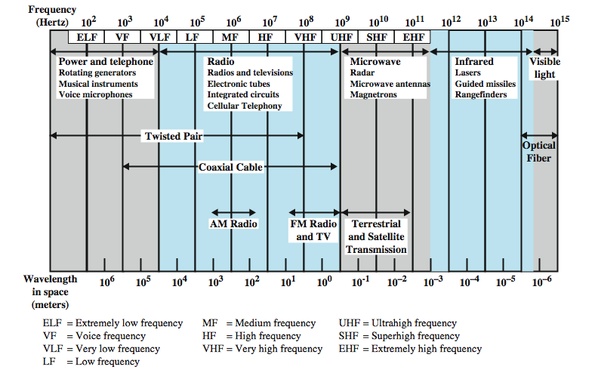
Electromagnetic Spectrum
Notes:
Figure 4.1 depicts the electromagnetic spectrum and indicates the frequencies at which various guided media and unguided transmission techniques operate. In this chapter we examine these guided and unguided alternatives. In all cases, we describe the systems physically, briefly discuss applications, and summarize key transmission characteristics.

Slide 37
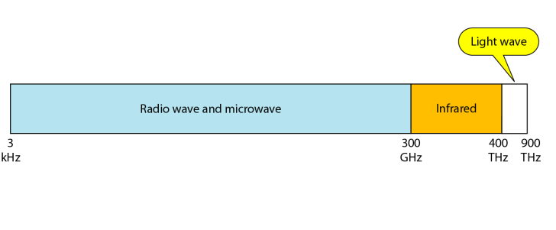

Slide 38
Radio Waves
Electromagnetic waves ranging in frequencies between 3 kHz and 1 GHz are normally called radio waves.
Radio waves, for the most part, are omnidirectional.
the sending and receiving antennas do not have to be aligned.
The radio waves transmitted by one antenna are susceptible to interference by another antenna that may send signals using the same frequency or band.
Radio waves are used for multicast communications, such as radio and television, and paging systems.
Notes:
The transmission media that are used to convey information can be classified as guided or unguided. Guided media provide a physical path along which the signals are propagated; these include twisted pair, coaxial cable, and optical fiber. Unguided media employ an antenna for transmitting through air, vacuum, or water.
The characteristics and quality of a data transmission are determined both by the characteristics of the medium and the characteristics of the signal. In the case of guided media, the medium itself is more important in determining the limitations of transmission.
For unguided media, the bandwidth of the signal produced by the transmitting antenna is more important than the medium in determining transmission characteristics. One key property of signals transmitted by antenna is directionality. In general, signals at lower frequencies are omnidirectional; that is, the signal propagates in all directions from the antenna. At higher frequencies, it is possible to focus the signal into a directional beam. In considering the design of data transmission systems, key concerns are data rate and distance: the greater the data rate and distance the better.

Slide 39
Radio waves can travel long distances.
  This makes radio waves a good candidate for long-distance broadcasting such as AM radio.
Radio waves, particularly those of low and medium frequencies, can penetrate walls.
  This characteristic can be both an advantage and a disadvantage.
  It is an advantage because, for example, an AM radio can receive signals inside a building.
  It is a disadvantage because we cannot isolate a communication to just inside or outside a building.

Slide 40
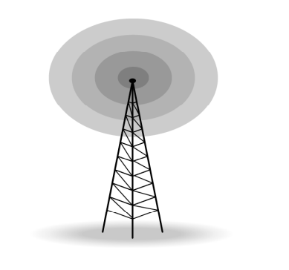
Omnidirectional antenna

Slide 41
Microwaves
Electromagnetic waves having frequencies between 1 and 300 GHz are called microwaves.
Microwaves are unidirectional--This means that the sending and receiving antennas need to be aligned.
Microwave propagation is line-of-sight.
Very high-frequency microwaves cannot penetrate walls.

Slide 42
Use of certain portions of the band requires permission from authorities.
Microwaves, due to their unidirectional properties, are very useful when unicast (one-to-one) communication is needed between the sender and the receiver.
Microwaves are used for unicast communication such as cellular telephones satellite networks telephones, satellite networks, and wireless LANs

Slide 43
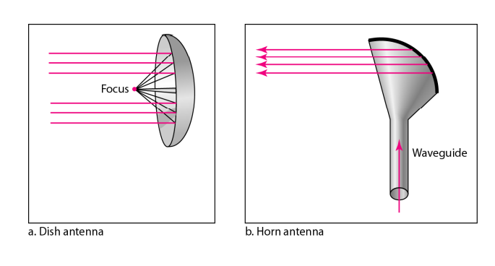
Unidirectional antennas

Slide 44
Infrared
Infrared waves, with frequencies from 300 GHz to 400 THz (wavelengths from 1 mm to 770 nm), can be used for short-range communication.
Infrared waves, having high frequencies, cannot penetrate walls.
This advantageous characteristic prevents interference between one system and another;
a short-range communication system in one room cannot be affected by another system in the next room.
  However, this same characteristic makes infrared signals useless for long-range communication.

Slide 45
we cannot use infrared waves outside a building because the sun’s rays contain infrared waves that can interfere with the communication.
Infrared signals can be used for short-range communication in a closed area using line-of-sight propagation.

Slide 46
Bluetooth
is a short-range radio hookup that resides on a microchip.
It was initially developed by Swedish mobile phone maker Ericsson in 1994 as a way to let laptop computers make calls over a mobile phone.
over 20,000 companies have signed on to make Bluetooth the low-power short-range wireless standard for a wide range of devices.
Originally published as IEEE 802.15.1 standards
Named after Danish king Harald Blatand (Bluetooth) who united dissonant Danish tribes into a single kingdom.

Slide 47
An industry consortium known as the Bluetooth SIG (Special Interest Group) publishes Bluetooth standards.
Bluetooth devices within 10 m of each other can share up to 2.1 Mbps or 24 Mbps of capacity.
uses short-wavelength UHF radio waves in the ISM (Industrial, Scientific and Medical) band from 2.4 to 2.485 GHz

Slide 48
Is globally unlicensed (but not unregulated) Industrial, Scientific and Medical (ISM) band.
Bluetooth is intended to support an open-ended list of applications, including data (e.g., schedules and telephone numbers), audio, graphics, and even video.
The following are some examples of the capabilities that Bluetooth can provide consumers:
  Make calls from a wireless headset connected remotely to a cell phone.
  Control communication between a smartphone and a car stereo system.

Slide 49
Control of peripherals such as a keyboard, mouse, or speaker from a computer or tablet.
Call home from a remote location to turn appliances on and off, set the alarm, and monitor activity.
Set up home networks so that a couch potato can remotely monitor air conditioning, the oven, and children’s Internet surfing.

Slide 50
Top uses in order of volume are for the following devices:
    Mobile handsets
    Voice handsets
    Stereo headsets and speakers
    Personal computers and tablets
    Human interface devices, such as mice and keyboards
    Wireless controllers for video game consoles
    Cars, Machine-to-machine applications: credit-card readers, industrial automation, and so on.

Slide 51
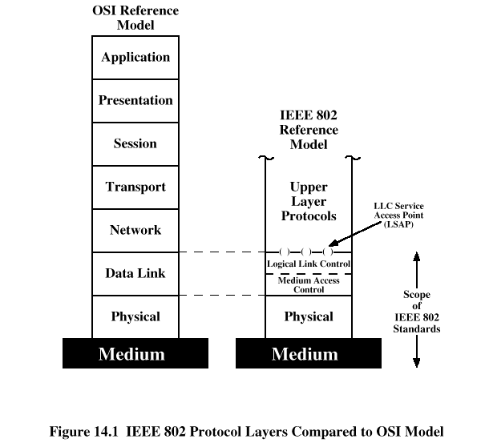
IEEE 802.11 (WiFi)
802.11 standard focuses on the bottom two layers of the OSI model, the physical layer (PHY) and data link layer (DLL).

Slide 52
802.11
Two network architectures are defined in the IEEE 802.11 standard
  Point-to-point (ad hoc) network
    Two wireless-capable devices
    is used to support Mutual communication between wireless clients
    is created spontaneously and does not support access to wired networks.
    Doesn’t require AP
    Simple to setup
    Interference with other networks and potential security risks
    Provides an Independent Basic Service Set (IBSS)

Slide 53
  Infrastructure network
    Communication between wireless clients and wired network resources
    Uses AP
    An AP and its associated wireless clients define the coverage area
    Single AP
      One Access Point (AP)
      Connected to wired infrastructure
      Wireless LAN Controller (WLC) – optional
        Lightweight AP (with WLC)
        Autonomous AP (Without WLC)
      Creates a Basic Service Area (BSA)
      Provides a Basic Service Set (BSS)

Slide 54
    Multiple Aps
      More than one Aps
      Connected to Wired infrastructure
      Wireless LAN Controller – Optional
        Lightweight AP (with WLC)
        Autonomous AP (without WLC)
      Creates an Extended Service Area (ESA)
      Provides an Extended Services Set (ESS)

Slide 55

Wi-Fi
Based on the 802.11 standard:
  802.11a
  802.11b
  802.11g
  802.11n (WiFi 4)
  802.11ac (WiFi 5)
  802.11ax (WiFi 6)

Slide 56
Standard | Year | Frequency (GHz) | Data Rate (Mbps) | Technology | Range (Indoor) | Range (Outdoor)
802.11b | 1999 | 2.4 | 11 |  | 35m | 120m
802.11a | 1999 | 5 | 54 | Uses OFDM (Orthogonal Frequency Division Multiplexing) | 35m | 120/5000m
802.11g | 2003 | 2.4 | 54 | Uses OFDM | 38m | 140m
802.11n | 2009 | 2.4/5 | 600 | Uses MIMO (Multiple Input Multiple Output | 70m | 250m
802.11ac | 2014 | 2.4/5 | 450 /1300 | MU-MIMO (Multi User MIMO) | 35m | -
802.11ax | 2019 | 2.4/5 | 10000 -15000 | Orthogonal Frequency Division Multiple Access (OFDMA) | 30m | 120m

Slide 57
Media Selection Criteria
When designing or updating a computer network, the selection of one type of media over another is an important issue.
The principal factors you should consider in your decision include cost, speed, expandability, distance, environment, and security.

