Slide 1

PCL Application Configuration for Xamarin.Forms in C#
99/4A
Ben Ishiyama-Levy
Xamarin Evangelist
ben@Tippstr.com

Slide 2
Configuration in the .net world
ASP.net
WPF, WinForm, Service
Silverlight
web.config
Api: System.Configuration
Configurations: Built in transforms
app.config, settings.settings
Api: System.Configuration
Configurations: Transforms with 3rd party (slow cheetah)
Xaml, web.config
Api: System.Configuration
Configurations: Built in transforms

Slide 3
Why System Configuration is not included in PCL?

Slide 4


Each mobile platform has its own file system management
Each mobile platform has its own configuration management
System.Configuration is a relatively heavy library
Notes:
A native app needs a lot of things, but three important ones stick out:
Each mobile platform has its own configuration management
Each mobile platform has its own file system management
System.Configuration is a relatively heavy library

Slide 5
What are the options available to configure our cross platform apps?

Slide 6
Native configuration
Constant configuration reader
Unified configuration

Slide 7
Native Platform Configuration PROS
plist
SharedPreferences
ApplicationsData
Built in

Slide 8
Native Platform Configuration CONS
plist
SharedPreferences
ApplicationsData
1 config per platform
No xamarin.forms support
different configuration api
pain to maintain
no support for configuration transforms
not familiar to .net devs

Slide 9
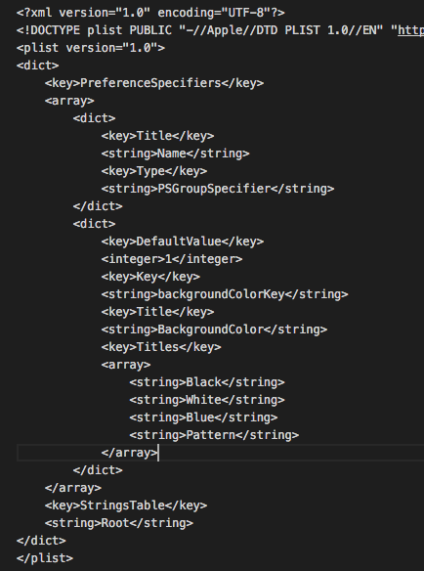
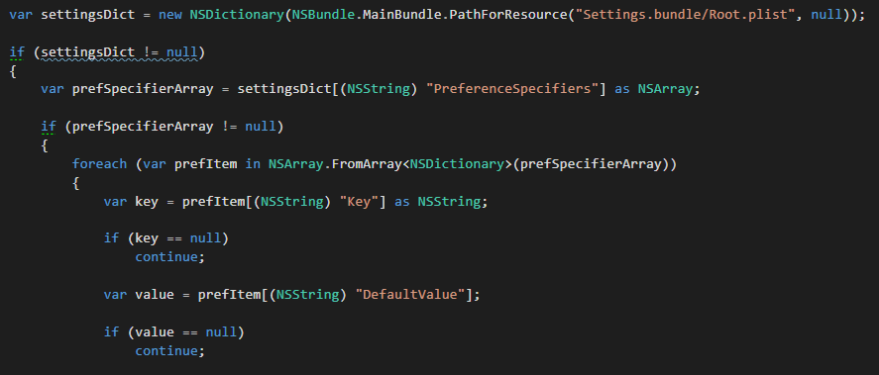
Native iOS Config
plist
Specific xml format
Must live in ios app ‘Settings.bundle’ directory
iOS specific api
Doc: documentation

Slide 10
Native Android Config
SharedPreferences
…

Slide 11


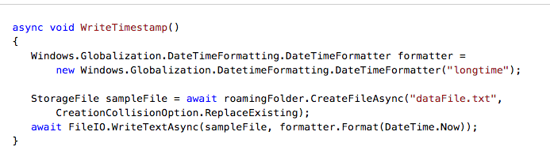
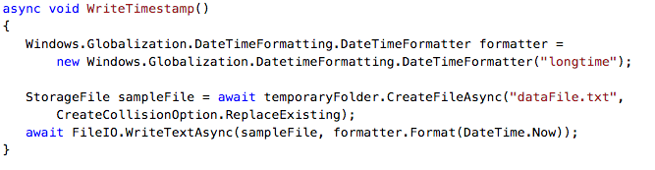
Native UWP Config
Local
ApplicationsData
Roaming
Local App Data: for between app sessions
Roaming Data: sync between devices
Temp Data: like cache
Doc https://msdn.microsoft.com/en-us/windows/uwp/app-settings/store-and-retrieve-app-data
Temp

Slide 12
Native Platform Configuration
plist
SharedPreferences
ApplicationsData
DEMO

Slide 13

Digression: Quick intro to CoreApp
Full control of the app lifecycle
Unlimited Dependency injection
View/ViewModel registration
Full navigation Control
Unified platform events
ViewModel Unit Testable

Slide 14
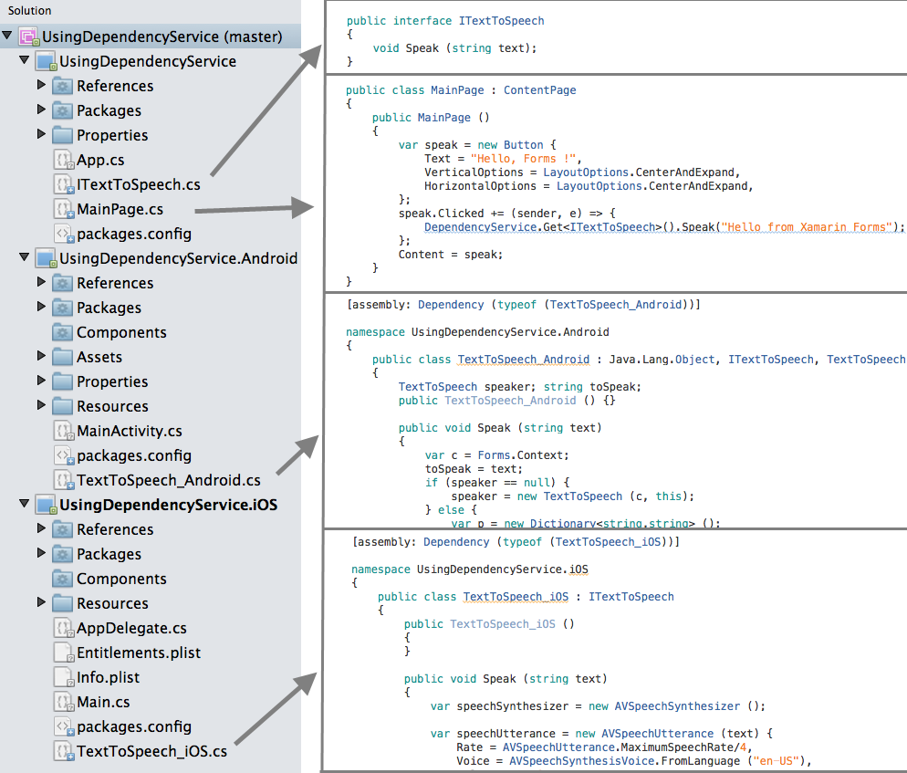
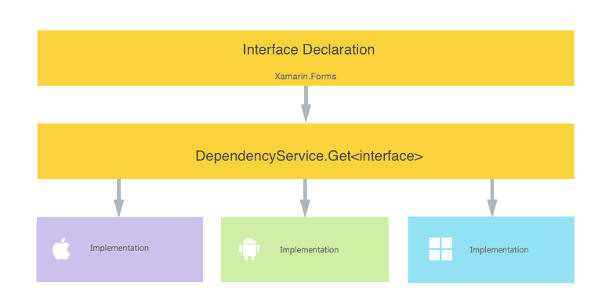
Unlimited Dependency injection
Xamarin.Forms ships with
a built in dependency service:

Slide 15




Unlimited Dependency injection
It will do just fine in many cases, but will not be suitable provided:
Your dependencies are only meant for Xamarin.Forms, ie. If you are like me and like sharing client and server code, that won’t do
You want to use the DI service of your choice
You want one registration method for all
You need advanced DI features, such as generic and multi-interface registration
You need full control of DI container lifecycle

Slide 16
Constant Reader Configuration PROS
Constant Reader
1 config source for all platforms (hard coded)
1 config api

Slide 17
Constant Reader Configuration CONS
Constant Reader
no support for configuration transforms
cannot alter after compilation

Slide 18
Native Platform Configuration
Constant Reader
DEMO

Slide 19
PCL App Configuration PROS
Unified App
1 config for all platforms
located in pcl app project
1 config api
familiar to .net devs
support for configuration transform
can alter after compilation
Notes:
support for deployment server like octopus - build once, deploy everywhere
ios needs ipa resigning (http://www.xgiovio.com/blog-photos-videos-other/blog/resign-your-ios-ipa-frameworks-and-plugins-included/)

Slide 20
PCL App Configuration
Unified App
DEMO

Slide 21
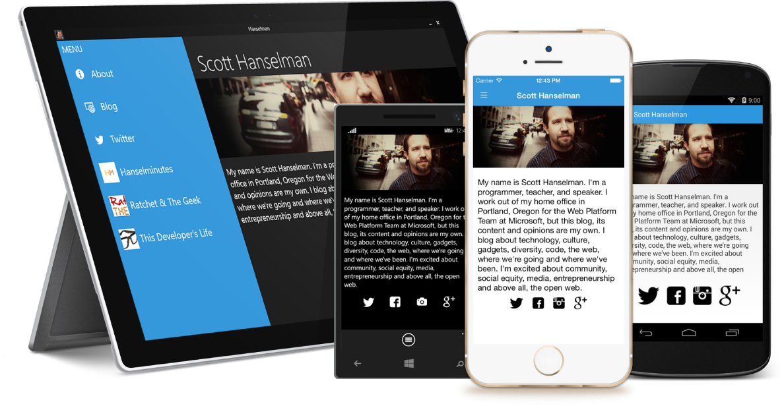
Finally, try Xamarin.Forms
Build native UIs for iOS, Android, and Windows Phone from a single, shared C# codebase.
Notes:
Xamarin Forms is a new set of APIs allowing you to quickly and easily write shared User Interface code that is still rendered natively on each platform, while still providing direct access to the underlying SDKs if you need it.

Slide 22
Thank You! Questions?
Ben Ishiyama-Levy
Xamarin Evangelist
ben@tippstr.com

