Slide 1
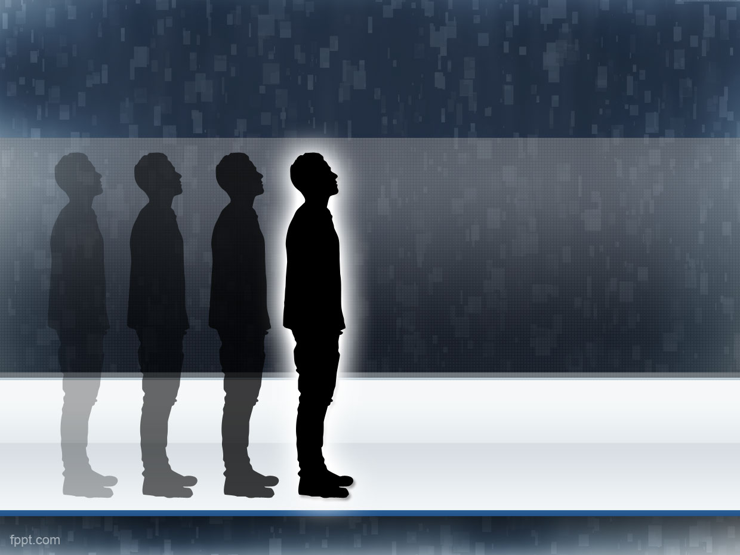
People detection
A Project by: Chiara Bizzotto,
Maurizio Ingrassia e Roberta Papa

Slide 2






Gantt
Project presentation
Project assignment
6/16/2015
7/14/2015
Day 1
5
9
13
17
21
25
29
2015
Today
6/14/2015
Problem analisys
6/23/2015
6/18/2015
Research
7/13/2015
6/24/2015
Software development
7/12/2015
7/6/2015
Labeling
7/12/2015
Parameters tuning
7/11/2015
7/14/2015

Slide 3
Scope & Target
Detect people in a scene
Each person must be found at least once in a set of frames
possible applications
in a videosurveillance system

Slide 4
Constraints
Limited to pedestrians
Good performances only in enviroments with few people
Fixed camera
(For now) works only at one scale

Slide 5
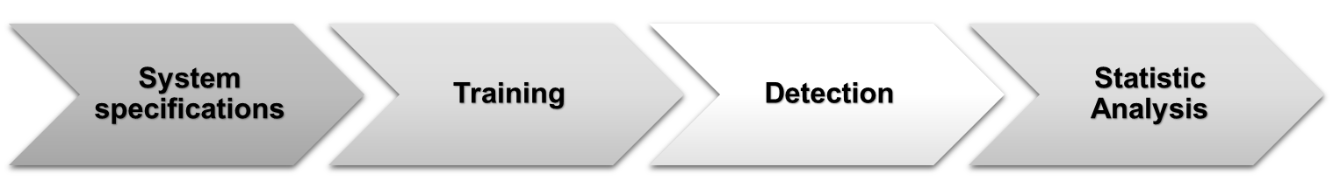
Software
THE PROJECT

Slide 6
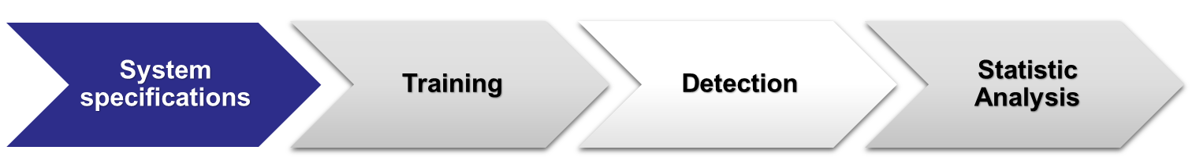
Software
Features vector: HOG
    8 orientations
    16x16 Pixel per cell
    1x1 Cells per block
Classifier: SVM
    Linear Kernel
    Faster Prediction on probability
Indipendence to features and classifier

Slide 7
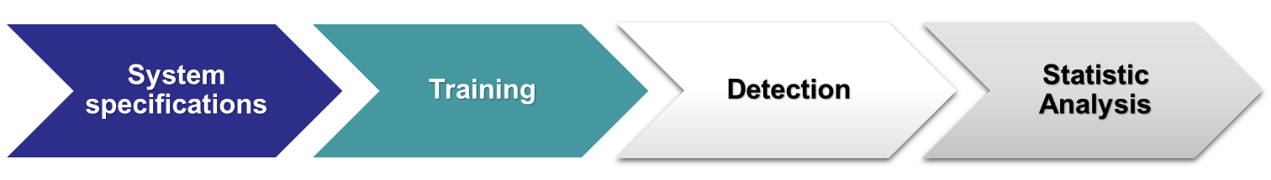
Software
Dataset :
    ViPeR for positive examples
    Custom set for negative examples
    Window pixels size 48x128
    Total set of ~6000 images

Slide 8
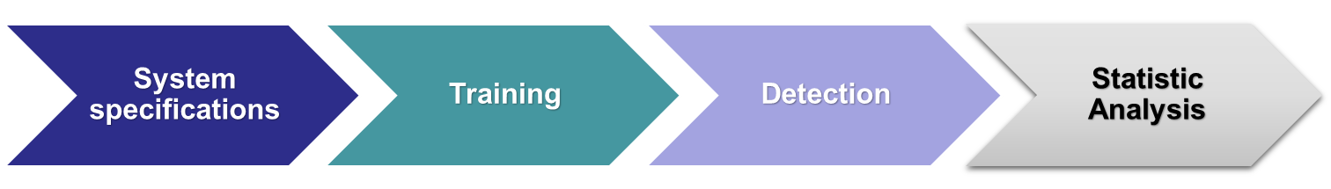






Software
Frame
Sliding window
Detection
NMS
Background subtraction
Mask
Number of persons found

Slide 9
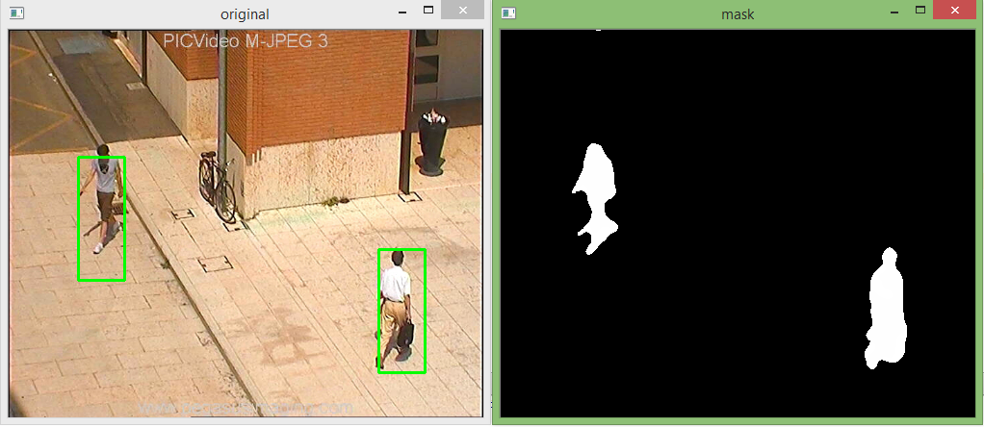
Software
Detection
Mask

Slide 10
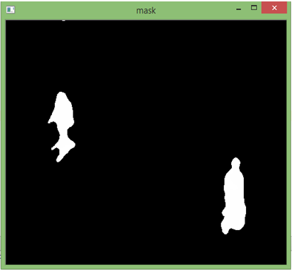
Software
We will try for detection only where the check on the mask is positive
It indicates movement in that part of the frame

Slide 11
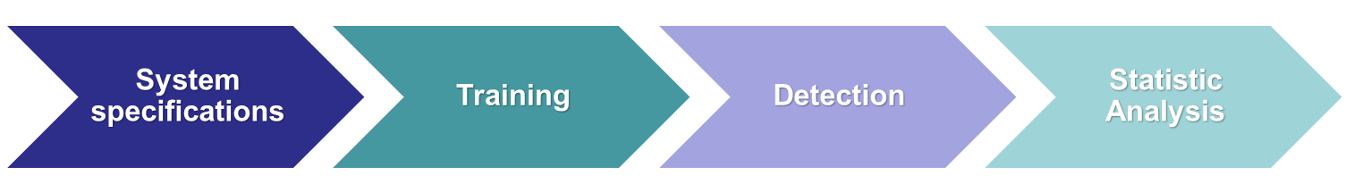
Software
Cross-comparison between groundtruth and people found by our system
      Accuracy
      Precision
      Recall
      F1-score
Mediated on a validation set
(~2500 frames)

Slide 12
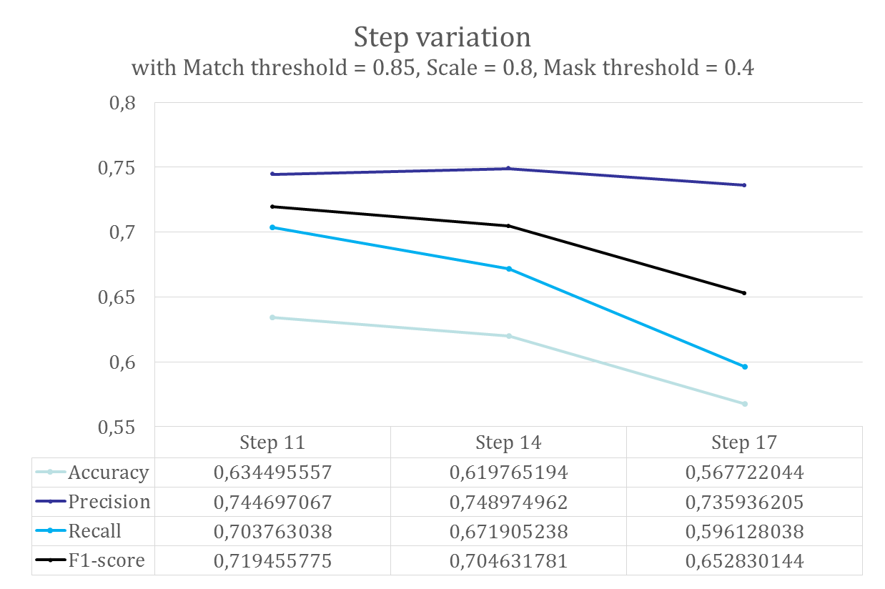
Results

Slide 13
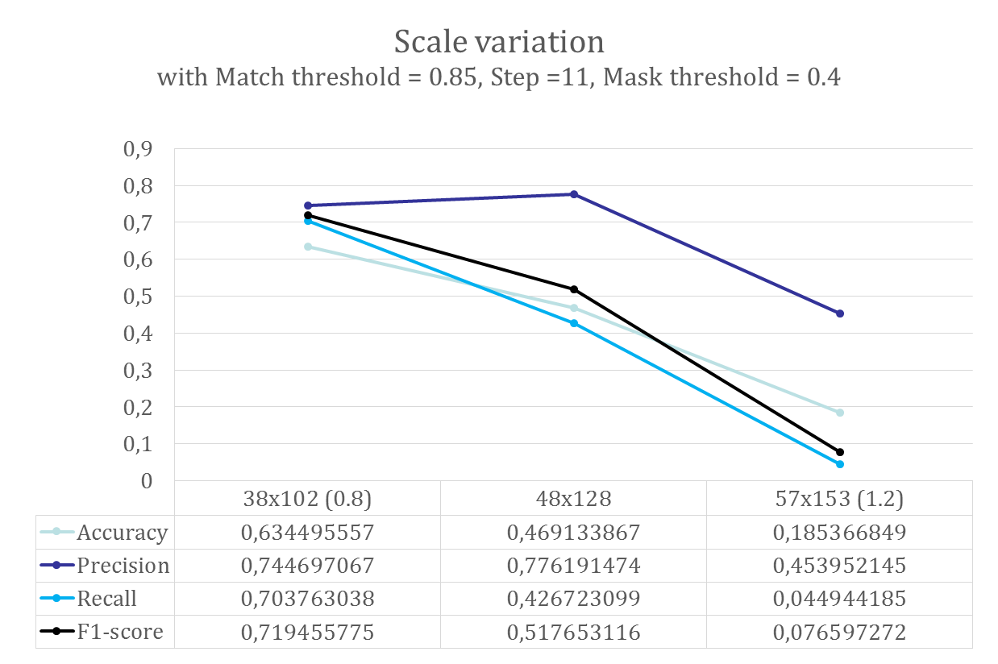
Results

Slide 14
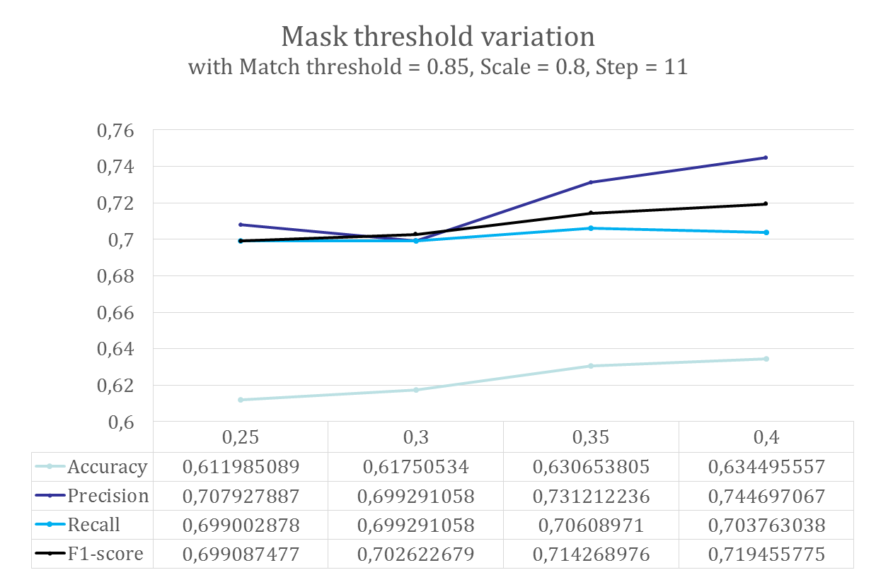
Results

Slide 15
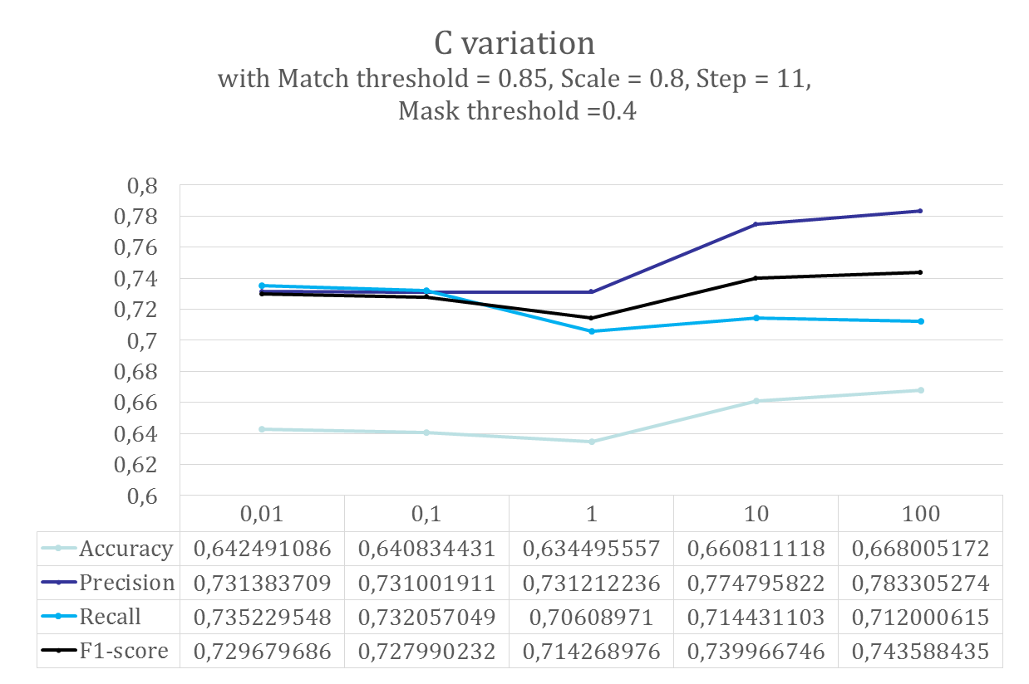
Results

Slide 16
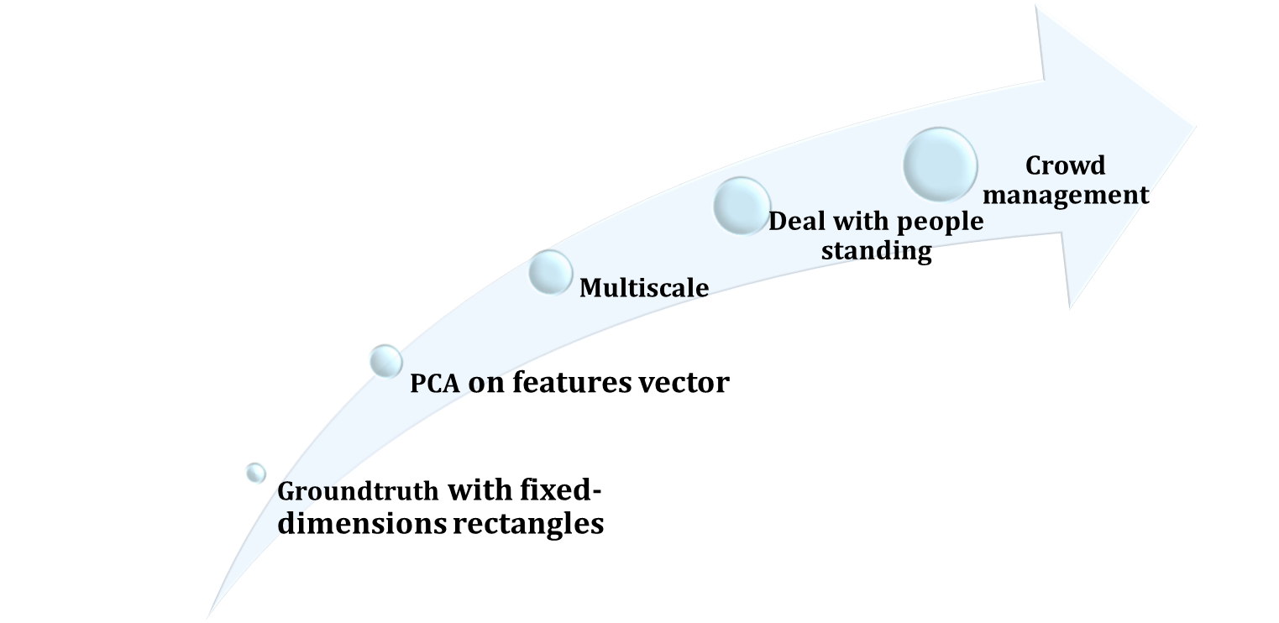
Future work

