Slide 1
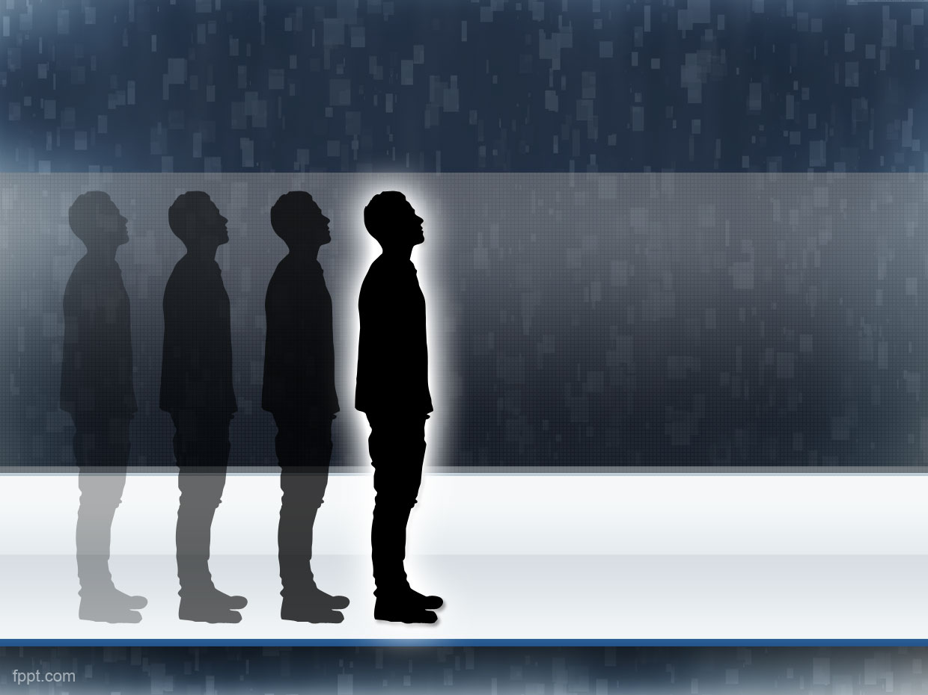
People detection
A Project by: Chiara Bizzotto,
Maurizio Ingrassia e Roberta Papa

Slide 2
Scope & Target
Detect people that are in the scene
The person must be found at least one time in a set of frames
possible implementation in a videosurveillance system

Slide 3
Constraints
Only pedestrians
Good performances only in enviroments with few people
Fixed camera
(For now) works only at one scale

Slide 4






Gantt
Project presentation
Project assignment
6/16/2015
7/14/2015
Day 1
5
9
13
17
21
25
29
2015
Today
6/14/2015
Problem analisys
6/23/2015
6/18/2015
Research
7/13/2015
6/24/2015
Software development
7/12/2015
7/6/2015
Labeling
7/12/2015
Parameters tuning
7/11/2015
7/14/2015

Slide 5
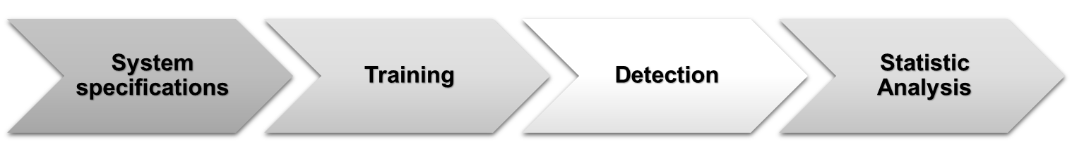
Software
THE PROJECT

Slide 6
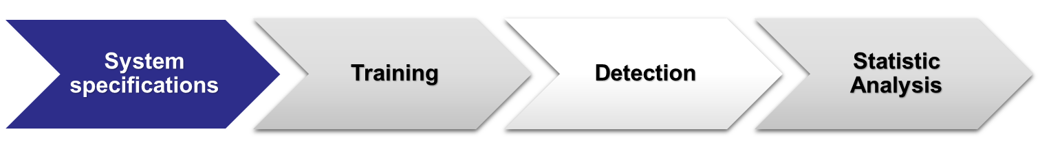
Software
Features vector: HOG
    8 orientations
    16x16 Pixel per cell
    1x1 Cells per block
Classifier: SVM with Linear Kernel → faster
    Prediction on probability

Slide 7
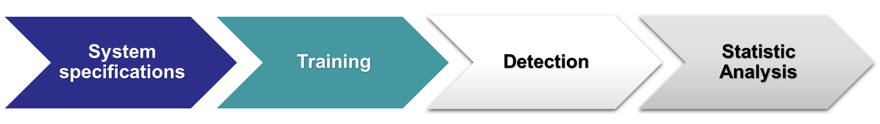
Software
Dataset :
    ViPeR for positive examples
    Custom set for negative examples
    For a total amount of ~6000 images
48x128 pixels images

Slide 8
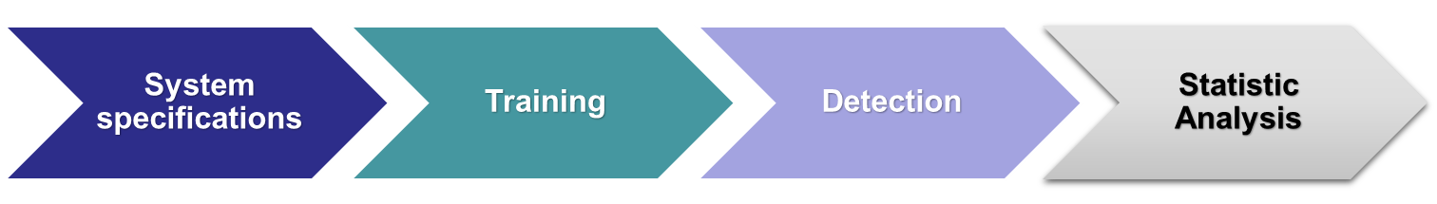
Software
Background subtraction: obtains a binary mask that highlights only the movement
Detection: sliding window over the frame (dimension = 48x128)
Non Maxima Suppression on the probability associated with each rectangle

Slide 9






Software
Frame
Sliding window
Detection
NMS
Number of persons found
Background subtraction
Mask

Slide 10
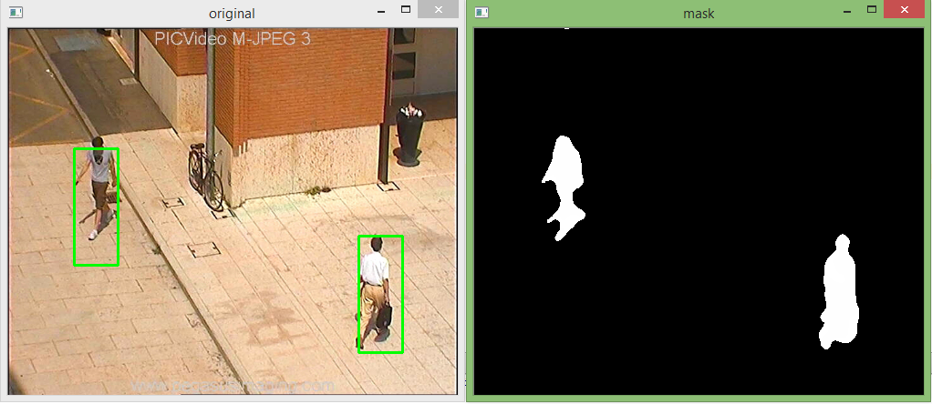
Software
Detection
Mask

Slide 11
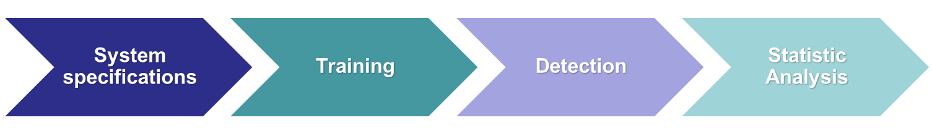
Software
Cross-comparison between groundtruth and people found by our system
      Accuracy
      Precision
      Recall
      F1-score
Mediated on a validation set

Slide 12
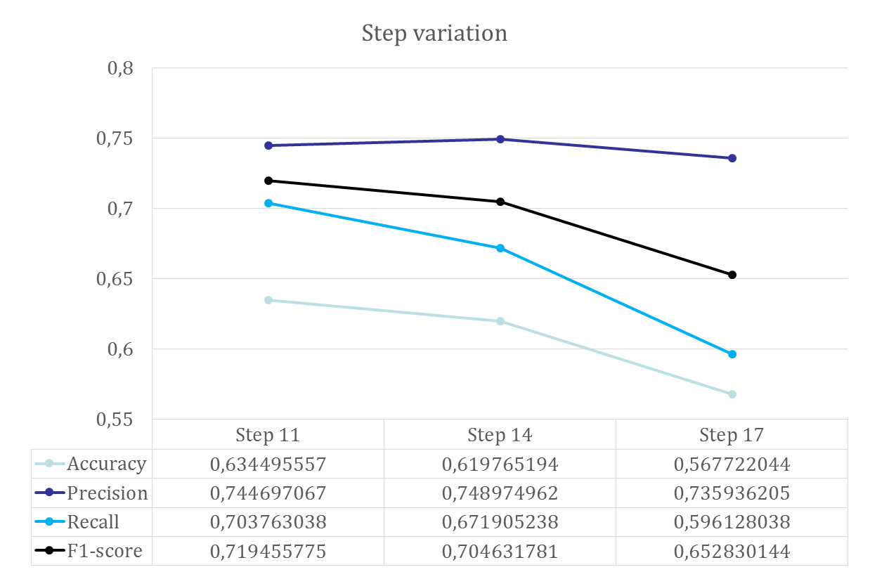
Results

Slide 13
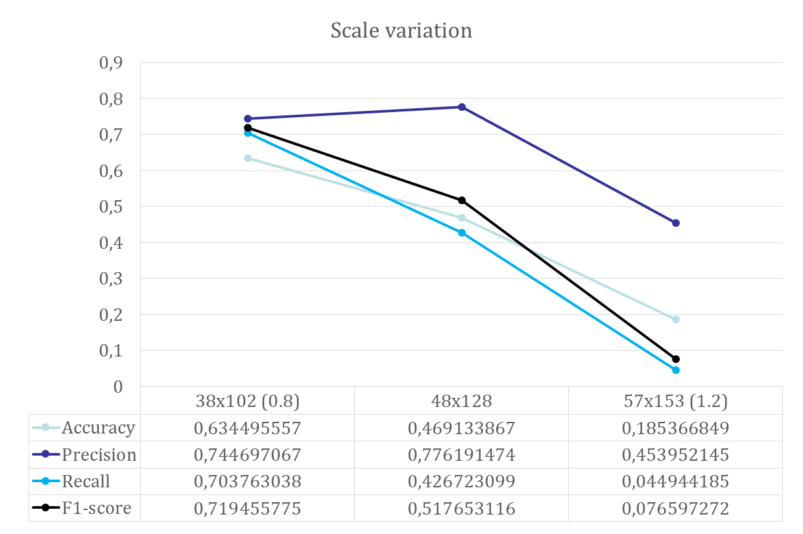
Results

Slide 14
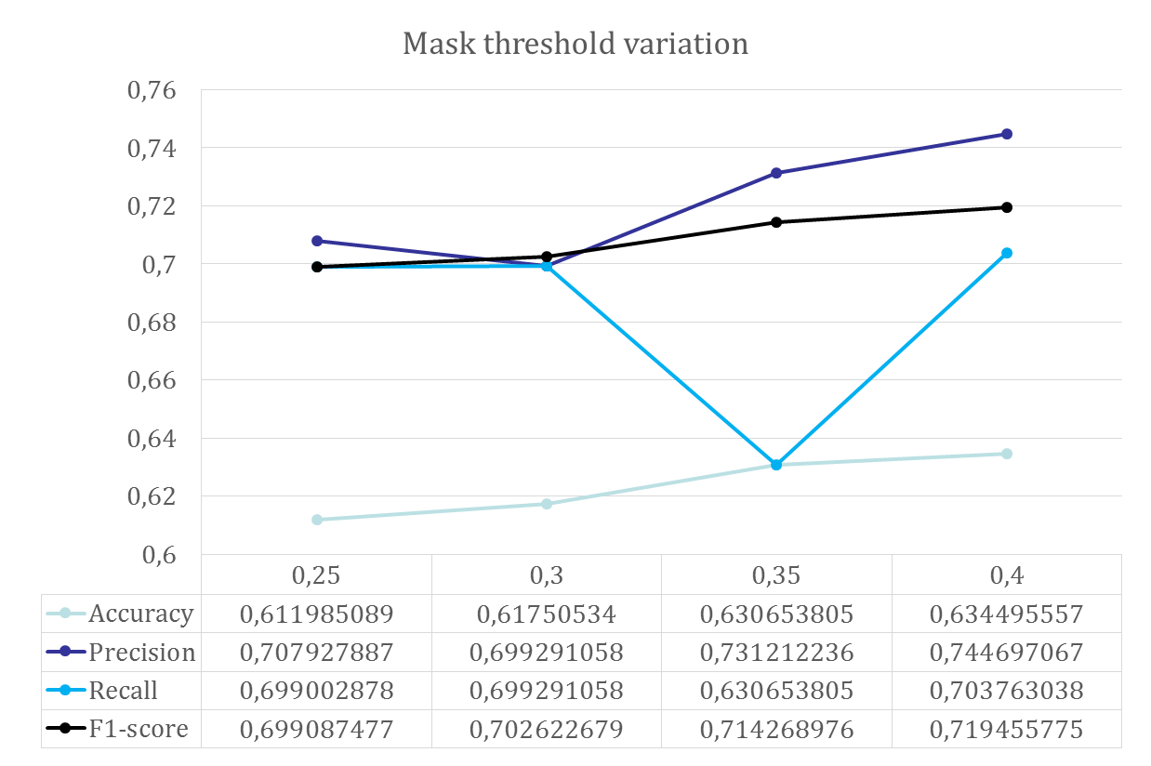
Results

Slide 15
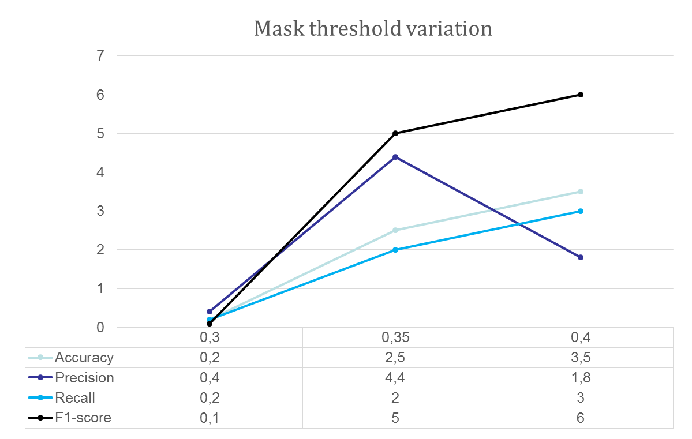
Results

Slide 16
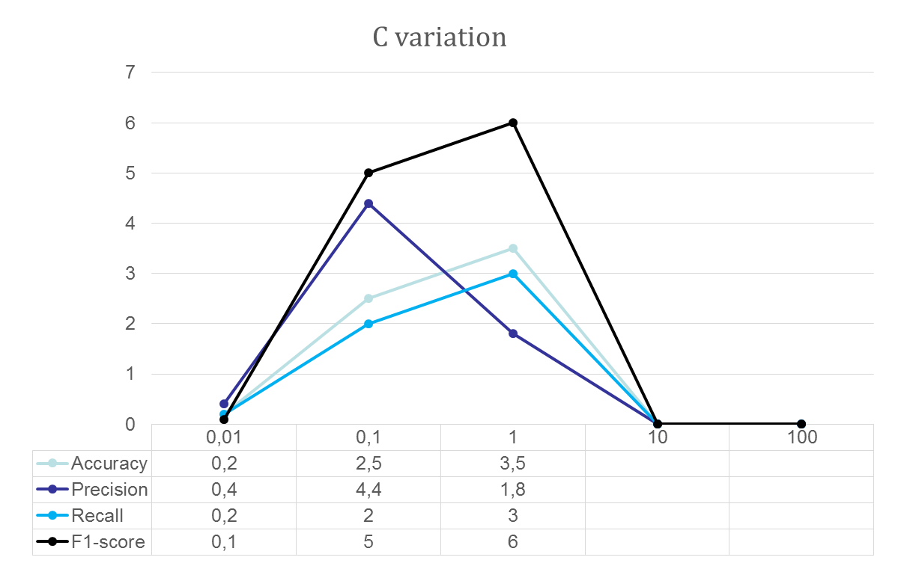
Results

Slide 17
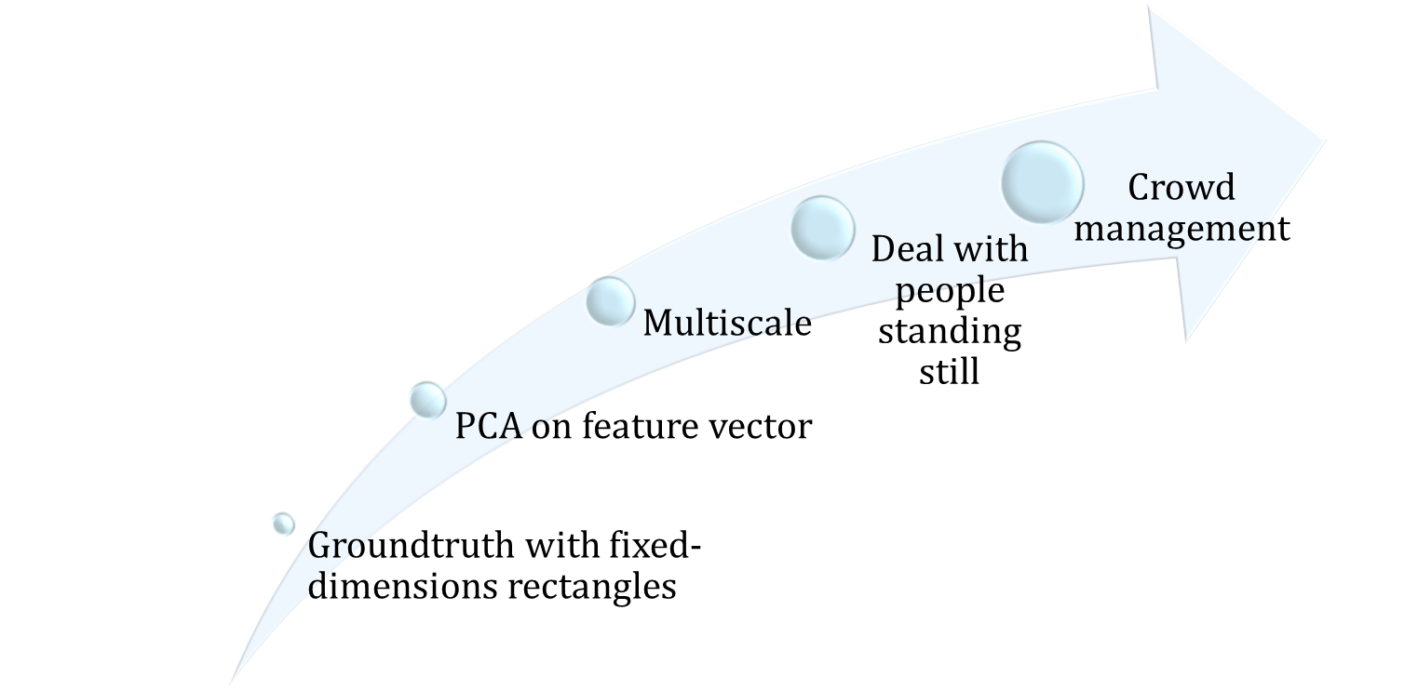
Future work

