Slide 1

导师：汤振宇 报告人：郭祥栋
组会报告
2019.4.3

Slide 2
上周学习内容：
Grading of Gliomas by Using Radiomic Features on Multiple Magnetic Resonance Imaging (MRI) Sequences（Qin J B , Liu Z , Zhang H , et al. Grading of Gliomas by Using Radiomic Features on Multiple Magnetic Resonance Imaging (MRI) Sequences[J]. Medical Science Monitor, 2017, 23:2168-2178.）
下周任务：
尝试复现论文中的特征选择方法

Slide 3
这篇文章主要讲述使用多种MRI序列中的影像特征对脑胶质瘤进行分级，分为2类(grade I–II, low-grade； grade III–IV, and high-grade)。选取66人的T2WI-FLAIR, T1WI-CE, 和 ADC maps 3种序列（模态）的图像，共提取114个影像组学特征（论文中图一），再选取8个有明显的意义（有显著差异的）的特征进行融合出一个新的特征，发现该组合特征可以提高hgg与lgg的分类精度。同时该文章也验证了具有显著差异的特征与胶质纤维酸性蛋白(GFAP)表达有很大关联性

Slide 4
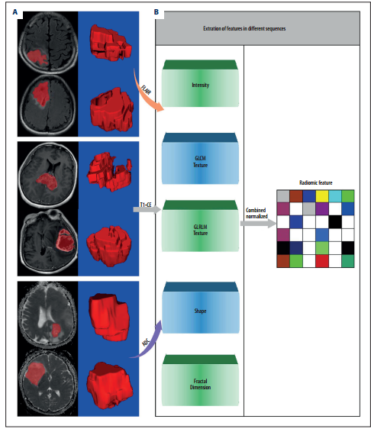
1、Feature Extraction
基于T2WI-FLAIR, T1WI-CE,ADC maps 3种模态提取特征---共提取114个影像组学特征。

Slide 5
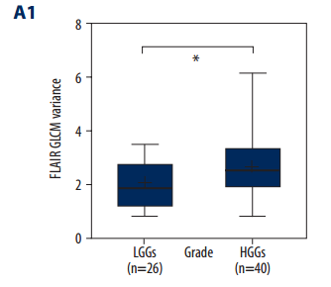
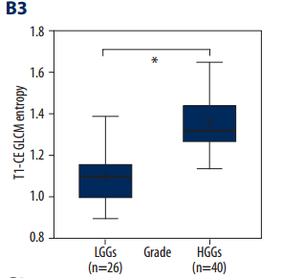
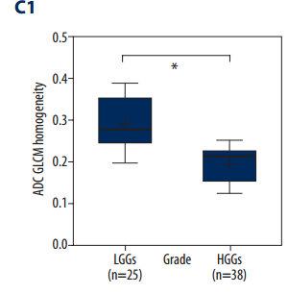
2、Feature Selection
① All the values of radiomic features for diﬀerent sequences in regions containing gliomas are compared with 2-samples t test. We found 2 statistical diﬀerential features on T2WI-FLAIR sequence, 3 features on T1WI-CE sequence, and 3 features on the ADC map between LGGs and HGGs (P<0.05).

Slide 6
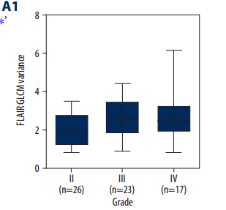
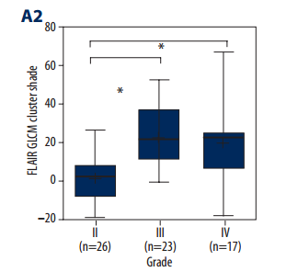
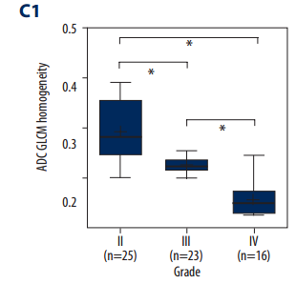
② 原肿瘤分为4 grades (low-grade：grade I–II; high-grade：grade III–IV)，在选择的8个特征的基础上进一步分析，使用单因素方差分析(ANOVA)和事后检验来检验II、III和IV级胶质瘤之间的差异。
发现T1WI-CE GLCM Entropy and和ADC GLCM Homogeneity能够鉴别II级至IV级胶质瘤。

Slide 7
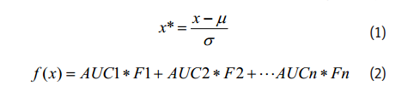
3、 Analysis
ROC分析放射学特征和联合特征的LGGs与HGGs鉴别的诊断效果
①分别作出每个特征（8个选择特征）ROC
②进行特征融合

Slide 8
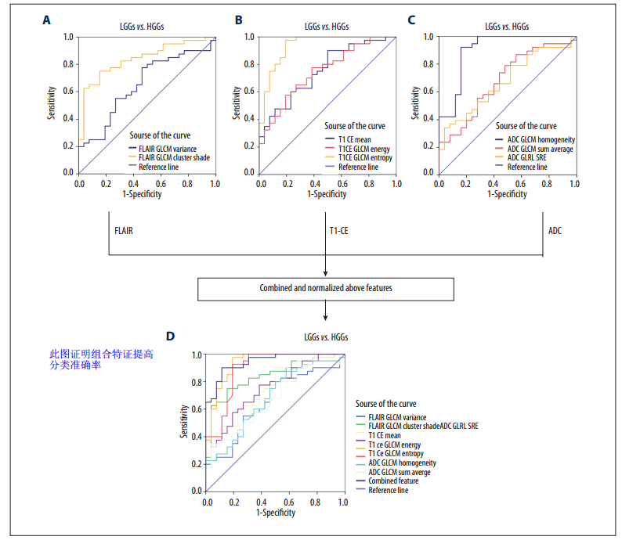

Slide 9
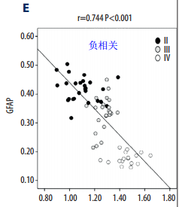
4、Correlation between GFAP and radiomic features
Relationships between the radiomic features on each MRI sequence and IHC index of glioma GFAP were analyzed using the Pearson correlation method.
A signifcant correlation was found between GFAP and T1-CE GLCM Entropy, as well as between GFAP and ADC GLCM Homogeneity.

Slide 10
谢谢！

