Slide 1

An edge-first IoT and multi-agent ecosystem for daycare safety
and child activity monitoring
IEEE COMPUTER SOCIETY R10 SUMMER SCHOOL 2026 · MINI IDEATHON · SDG 3

Slide 2

THE PROBLEM
SDG 3 · GOOD HEALTH & WELL-BEING
What daycares still do by hand
“
01
Attendance
A paper register or tablet form signed at drop-off. It has no idea if a child later leaves the premises.
No adult can watch every child, every second.
02
Supervision
One carer per group, by line of sight. A child out of view is, by definition, unmonitored.
Staffing ratios make continuous individual attention physically impossible. This isn’t a failure of carers, it’s a limit of the model.
03
Activity & incidents
No objective record exists. Parents get a verbal summary; detection depends on a carer noticing.
Why LetGo Band
LetGo Band

Slide 3

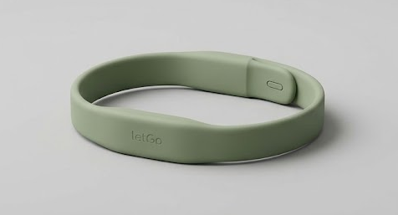



THE SOLUTION
LetGo Band
A tamper-evident activity band for daycare, paired with a facility gateway that runs the reasoning locally, so children stay safer without staff or parents watching a screen all day.
Worn continuously, tamper-evident
A resistive strap loop knows worn, removed and tampered, instantly and deterministically.
Talks only to the facility
Bands broadcast to on-site anchors, never to the open internet.
Parents see a real day
Active minutes and movement, not a rushed verbal handover at pickup.
The solution
LetGo Band

Slide 4




CAPABILITIES
What it does
Tamper-evident by design
Sub-second alerts
Zone-level presence
A strap loop distinguishes worn, removed and tampered in real time.
Safety events reach staff before they become incidents.
Anchors track which room a child is in, not just device presence.
Automated attendance
A real daily record
Privacy by design
Clip, motion and roster reconciled automatically, no register needed.
Parents see active minutes and movement, not a verbal summary.
Raw motion never leaves the building; only summaries reach the cloud.
Capabilities
LetGo Band

Slide 5




ARCHITECTURE
How it fits together
Band
Anchors
Edge Gateway
Cloud
Worn, broadcasts only
Hear every band, per zone
All agents run here
Encrypted summaries only
Every agent runs on the gateway. Only encrypted summaries ever leave the building.
Full specification and code: github.com/DahamDissanayake/mini-ideathon-smart-ecosystem-team-A
Architecture
LetGo Band

Slide 6
IOT LAYER
Sensing & connectivity
01
Sensing
An IMU and a tamper-evident strap on an ESP32-C3, broadcasting over BLE and never connecting to anything.
02
Zone anchors
One radio choice per tier, not one radio for everything.
Mains-powered listeners, one per room, turn broadcast signal strength into zone-level presence.
03
Simulated pipeline
SIMULATED TELEMETRY
A mock generator streams schema-validated telemetry, so the full pipeline runs before any hardware ships.
{ "strap": "CLIPPED",
"conf": 0.94 }
IoT layer
LetGo Band

Slide 7

AI AGENT ORCHESTRATION
Five agents, one guardrail
Sensor data
5 specialist agents
Safeguard
Staff & parents
01
Movement Classifier Model-backed. Turns IMU features into an activity type with a confidence score.
02
Anomaly Monitor Deterministic. Flags signal loss, early power-off, prolonged stillness and strap breach.
03
Zone Resolver Deterministic. Smooths anchor signal strength into room-level presence.
04
Trend Analyst Model-backed. Flags multi-day activity pattern changes for staff review only.
05
Attendance Manager Deterministic. Reconciles clip, motion and roster into one attendance state.
Safeguard Deterministic policy engine, not a model. Checks every proposal against a signed policy, with veto power and no override.
AI agent orchestration
LetGo Band

Slide 8
CYBERSECURITY & RISK (RAID)
Security & privacy
RAID LOG
R
Risk motion misread by an untrained classifier.
A
Assumption the facility has power and network for the gateway.
The threat model includes the institution, not only outside attackers.
I
Issue no labelled activity dataset exists yet.
D
Dependency a per-facility signal calibration walk at setup.
Guardrails: data minimised · four adversaries in scope · every decision signed and logged.
Cybersecurity
LetGo Band

Slide 9
MARKET
Global opportunity
$370B+
$4.8B → $11.6B
10–19%
Global childcare & early‑education services market, 2025
Kids GPS trackers & wearables market, 2025 to 2034 (10.3% CAGR)
Typical CAGR range across child-safety wearable categories
Daycare and after-school care sit inside the broader childcare market; child-safety wearables are the fastest-growing adjacent category. Almost none of it is built for facilities rather than individual families.
Sources: Fortune Business Insights, Market Reports World, DataIntelo (2026 estimates)
Global market
LetGo Band

Slide 10


REVENUE MODEL
One-time purchase, not a subscription
Every electronic component is a one-time capital purchase. A facility buys the hardware once and owns it outright, with no per-child licence and no annual hardware renewal.
One-time
One-time
One-time
LetGo Band
Zone Anchor
Edge Gateway
Priced per child
Priced per room
Priced per facility
Optional ongoing cost: cloud hosting for the parent portal, billed separately from the hardware.
Revenue model
LetGo Band

Slide 11

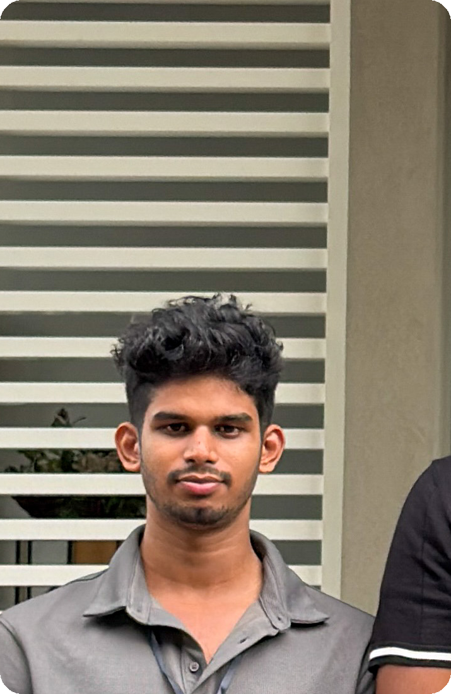
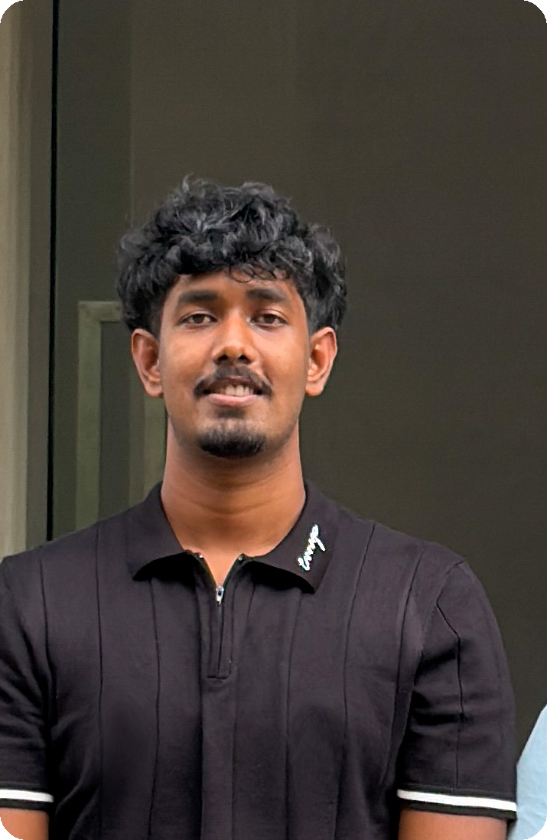
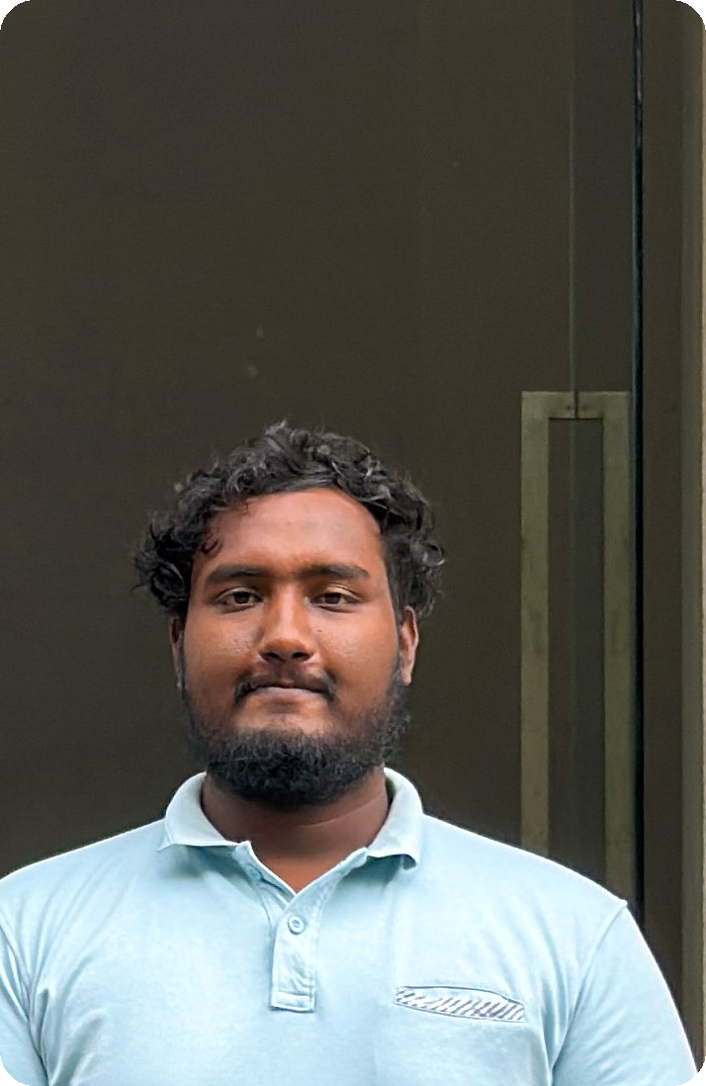


OUR TEAM
Who’s behind LetGo Band
[ Role ]
[ Role ]
[ Role ]
[ Role ]
[ Role ]
[ Role ]
[ Name ]
[ Name ]
[ Name ]
[ Name ]
[ Name ]
[ Name ]
[ University ]
[ University ]
[ University ]
[ University ]
[ University ]
[ University ]
Our team
LetGo Band

Slide 12
Thank you.
Questions, and the demo, whenever you’re ready.
IEEE COMPUTER SOCIETY R10 SUMMER SCHOOL 2026 · MINI IDEATHON · SDG 3

