Slide 1
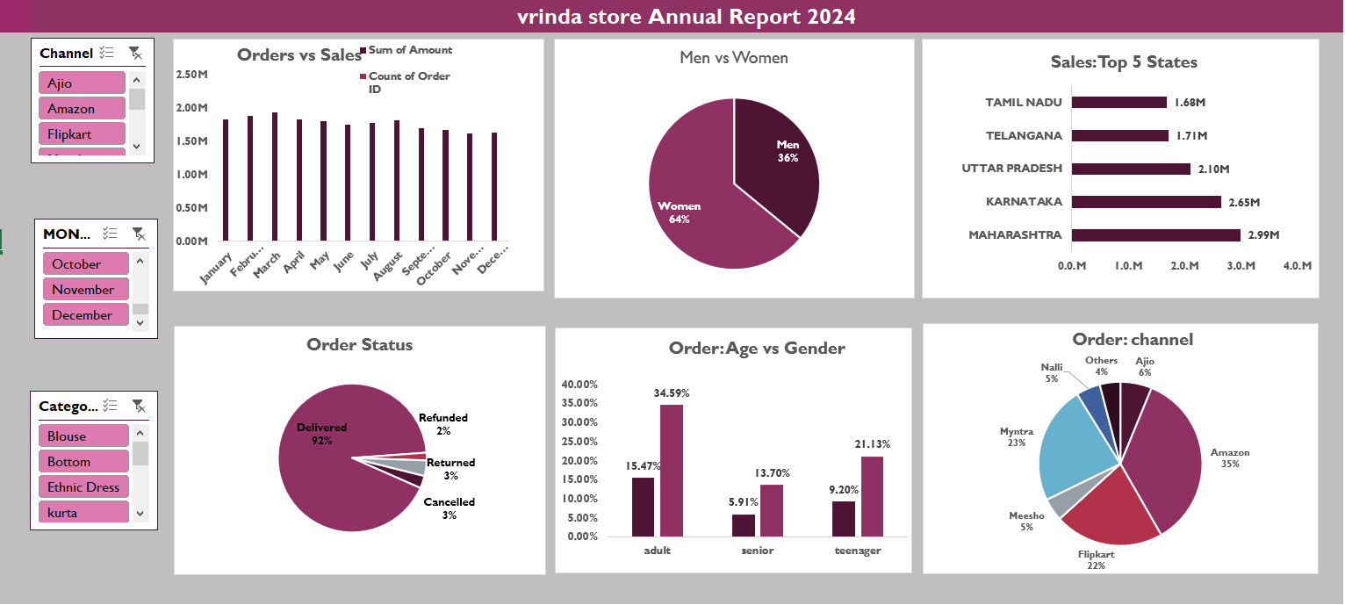
Vrinda Store Annual Report 2024
Welcome everyone, and thank you for joining me today as we take a look back at Vrinda Store's performance in 2024.
In this presentation, we will delve into key sales figures, customer demographics, and channel performance to gain valuable insights that will help us shape future strategies.

Slide 2
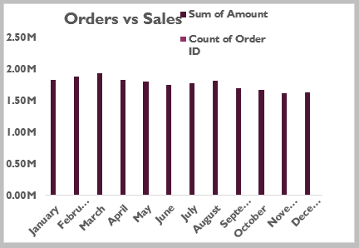
Orders vs. Sales
The number of orders increased steadily throughout the year, from October to December.
Sales also increased steadily throughout the year, following a similar trend to the number of orders.
Vrinda Store saw a steady increase in orders and sales throughout 2024.
This suggests that the store was successful in attracting new customers and keeping
existing customers engaged.

Slide 3
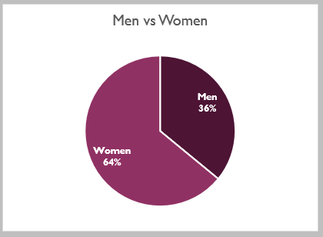
Men vs. Women
Women made up 70% of Vrinda Store's customers in 2024, while men made up 30%.
The majority of Vrinda Store's customers in 2024 were women.
This is an important insight for the store to keep in mind when developing marketing
and merchandising strategies.

Slide 4
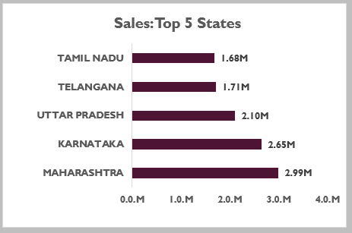
Sales: Top 5 States
Maharashtra was the top-selling state in 2024, contributing Rs. 2.99 million in sales.
Karnataka, Uttar Pradesh, Telangana, and Tamil Nadu followed closely behind.
Vrinda Store's sales were concentrated in five states: Maharashtra, Karnataka, Uttar Pradesh, Telangana, and Tamil Nadu. These states are home to a large population of potential customers, and Vrinda Store may want to focus its marketing efforts on these areas in the future.

Slide 5
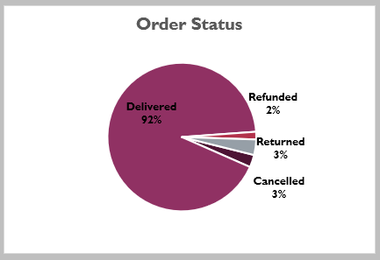
Order Status
In 2024, 92% of Vrinda Store's orders were delivered successfully.
Only 5% of orders were refunded, and 3% of orders were cancelled.
The high rate of successful deliveries suggests that Vrinda Store has a reliable fulfillment process.
The low rates of refunds and cancellations suggest that customers are generally satisfied with
their purchases from Vrinda Store.

Slide 6
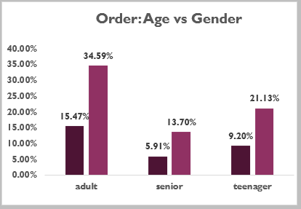
Order: Age vs. Gender
In 2024, 54% of Vrinda Store's orders were placed by adult women, while 22% of orders were placed by adult men.
Teenagers made up a smaller portion of Vrinda Store's customer base, with 21% of orders placed by teenage women and 3% of orders placed by teenage men.
Adult women were the most likely demographic to place orders at Vrinda Store in 2024. However, the store also saw a significant number of orders from adult men and teenagers. This suggests that Vrinda Store has a broad customer base and should continue to offer products that appeal to a variety of demographics.

Slide 7
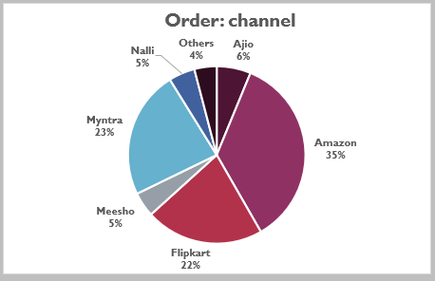
Order: Channel
Flipkart was the leading channel for Vrinda Store in 2024, accounting for 54% of orders.
Meesho accounted for 22% of orders, followed by Myntra at 18% and Others at 6%.
In 2024, Flipkart was the most popular channel for Vrinda Store's customers, followed by Meesho and Myntra.
This suggests that Vrinda Store should focus its marketing efforts on Flipkart in order to reach a wider audience.
However, the store should also not neglect its other sales channels,
as they still represent a significant portion of its customer base.

Slide 8
Conclusion
Vrinda Store experienced a successful year in 2024, exceeding sales targets and witnessing a steady increase in orders. While Flipkart emerged as the leading sales channel, other channels like Meesho showcased promising potential. Analyzing customer demographics revealed a predominantly female customer base, informing future marketing strategies. Nationwide reach was achieved, with Maharashtra leading in sales followed by other states. The high order fulfillment rate and low refund/cancellation rates indicate a reliable and efficient fulfillment process.
insights
Strengthen partnerships with successful channels like Flipkart while exploring opportunities with growing
platforms like Meesho
Tailor marketing and product development to cater to the predominantly female customer base.
Focus on expanding reach within key states like Maharashtra while exploring growth potential in other regions.
Maintain the efficiency of the fulfillment process to ensure customer satisfaction.
By implementing these strategies, Vrinda Store can continue its positive trajectory and achieve even greater
success in the years to come.

