Slide 1
Number of Employees by Company and Country
Analysis and Insights
June 2024
Prepared by Mohammad Daheem

Slide 2
Overview
Brief overview of the data
Key metrics:
- Total employees: 123M
- Total companies: 8399
- Total stock price: $595.27K
- Average stock price: $141.50

Slide 3
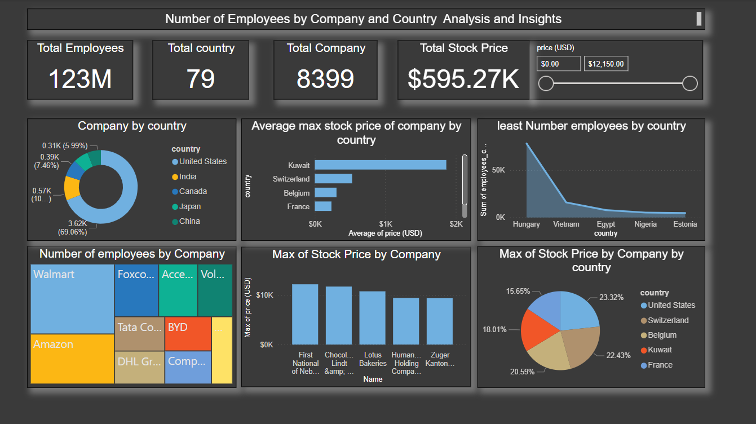

Slide 4
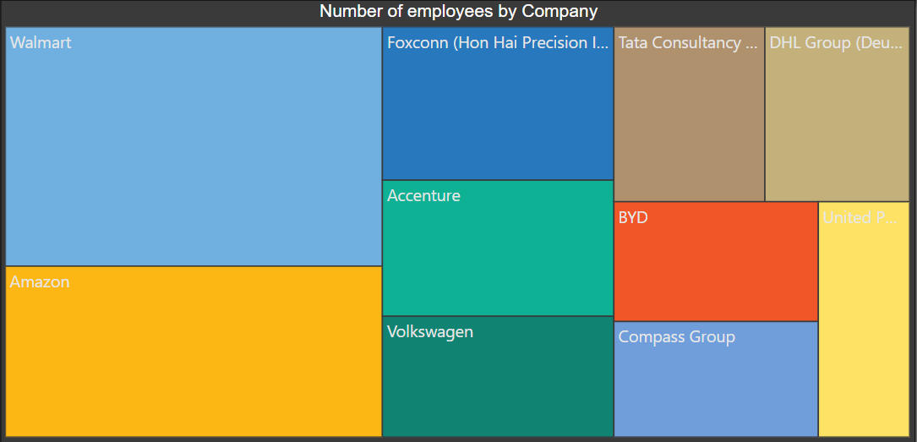
Number of Employees by Company
Walmart has the highest number of employees with approximately 2.3 million.
Amazon follows with 1.5 million employees.
Other notable companies include Foxconn, Accenture, and Volkswagen,
each having hundreds of thousands of employees.

Slide 5
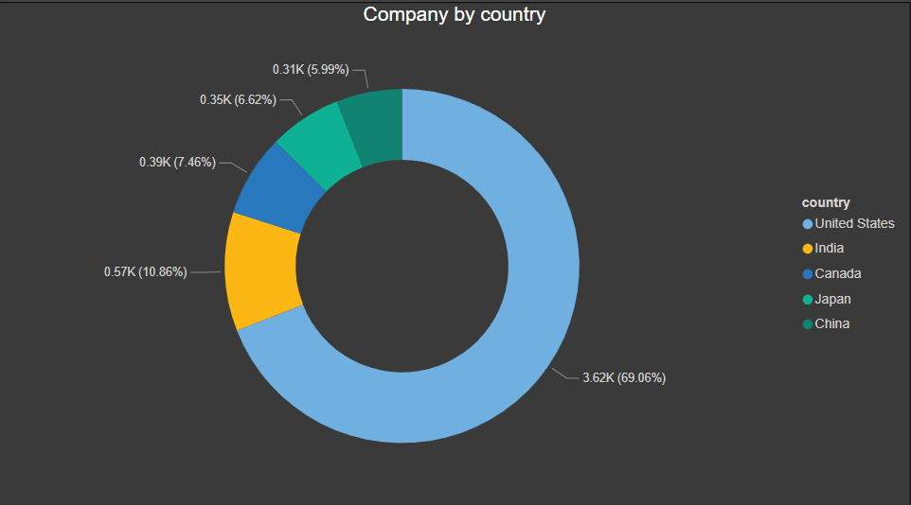
Companies by Country
The majority of the companies in the dataset are based in the United States,
accounting for the largest percentage.
Other significant countries include India, Germany, and China.

Slide 6
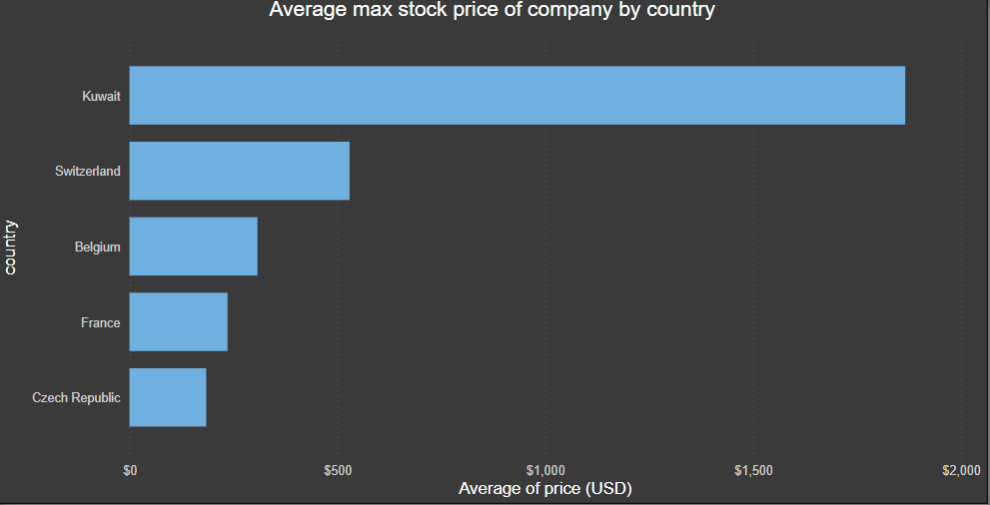
Average Max Stock Price by Country
Companies based in Switzerland and Belgium tend to have higher
average maximum stock prices compared to other countries.
France and Kuwait also show relatively high average stock prices.

Slide 7
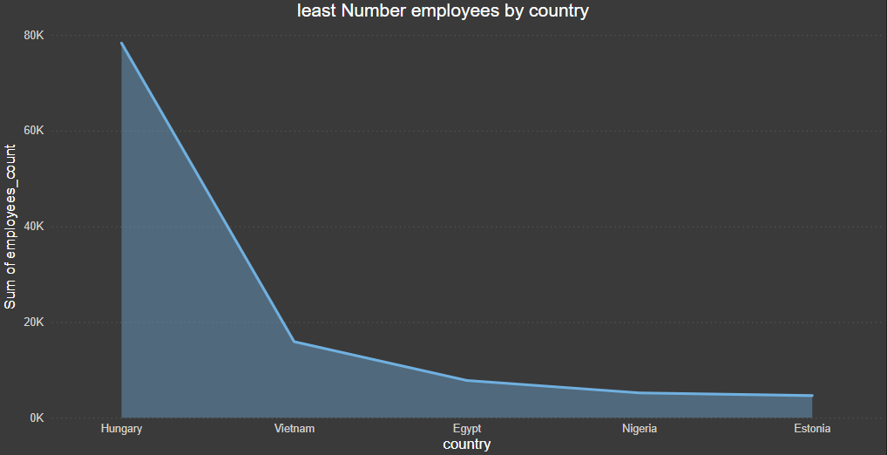
least Number employees by country
Countries like Hungary, Vietnam, and Estonia have the least number of
employees among the companies analyzed.
These countries have significantly fewer employees compared to major
countries like the United States and India.

Slide 8
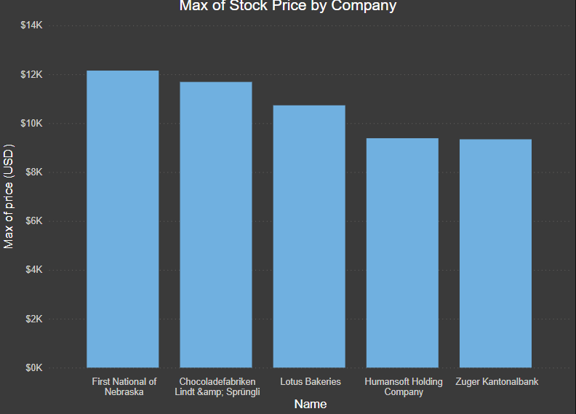
Max Stock Price by Company
Amazon has one of the highest stock prices among the companies analyzed,
with a maximum price exceeding $3,300.
Other companies with high stock prices include First National of Nebraska,
Lindt & Sprüngli, and Lotus Bakeries.

Slide 9
Implications and Recommendations: Workforce Management: .
Companies with a large number of employees, like Walmart and Amazon, may face unique challenges in workforce management and operational efficiency. Strategies to enhance employee productivity and satisfaction could be beneficial. Geographic Expansion: The distribution of companies by country highlights potential areas for geographic expansion. Companies looking to expand could consider countries with fewer large companies to reduce competition and capture new markets. Stock Price Insights: The analysis of stock prices provides insights into the financial health and market perception of companies. Companies with high stock prices are perceived as valuable investments, which can attract more investors. Investment Opportunities: Investors might consider focusing on companies in countries with higher average stock prices, as these regions may offer more stable and lucrative investment opportunities

