Slide 1
SQL Project: Jobs in Data Science Analysis of Job Titles, Salaries, and Employment Type
Welcome to my comprehensive SQL project presentation on Jobs in Data Science. In this analysis, we delve into the intricacies of job titles, salary distributions, employment types, and more within the data science industry. This project aims to provide valuable insights into the employment landscape, highlighting trends and patterns that can aid in understanding the current state and future directions of data science careers. Join me as we explore the data and uncover meaningful conclusions from our detailed SQL queries and analyses.

Slide 2

-- 1. Find the total number of employees in the dataset. SELECT COUNT(*) AS TOTAL_EMP FROM jobs_in_data;

Slide 3

- 2. List all unique job titles. SELECT distinct job_title FROM jobs_in_data;

Slide 4
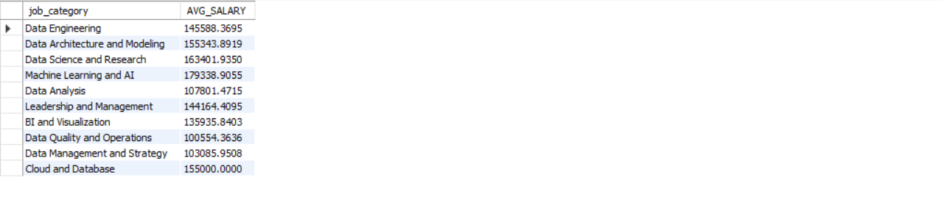
-- 3. Find the average salary for each job category. SELECT job_category, AVG(SALARY) AS AVG_SALARY FROM jobs_in_data group by job_category;

Slide 5
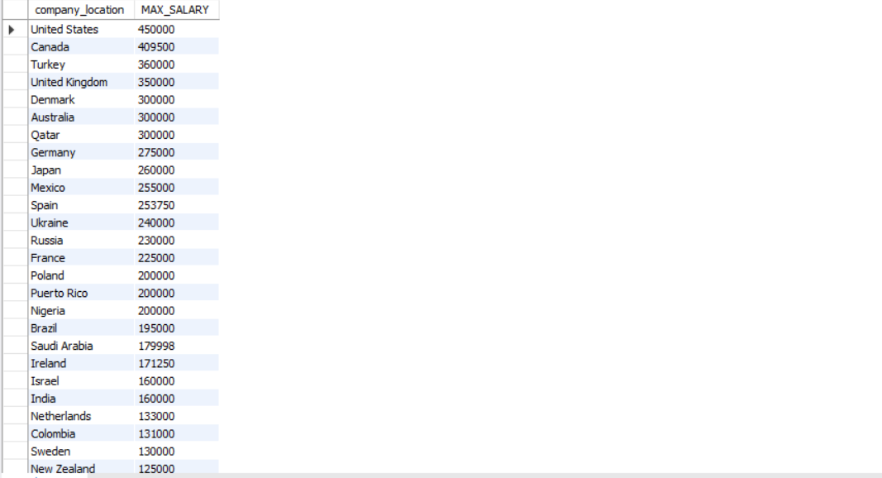
-- 4. Find the maximum salary in each company location. select company_location, MAX(SALARY) AS MAX_SALARY FROM jobs_in_data group by company_location ORDER BY MAX(SALARY) DESC;

Slide 6

-- 5. Count the number of employees with different employment types. SELECT employment_type , COUNT(employment_type) AS "employment types."FROM jobs_in_data group by employment_type;

Slide 7

-- 6. Calculate the average salary for employees working remotely. SELECT AVG(SALARY) AS AVG_SALARY FROM jobs_in_data WHERE work_setting = 'Remote';

Slide 8
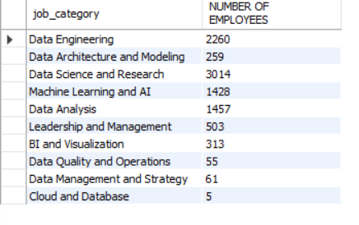
-- 7. Find the number of employees in each job category. SELECT job_category , COUNT(job_category) AS "NUMBER OF EMPLOYEES" FROM jobs_in_data group by job_category;

Slide 9
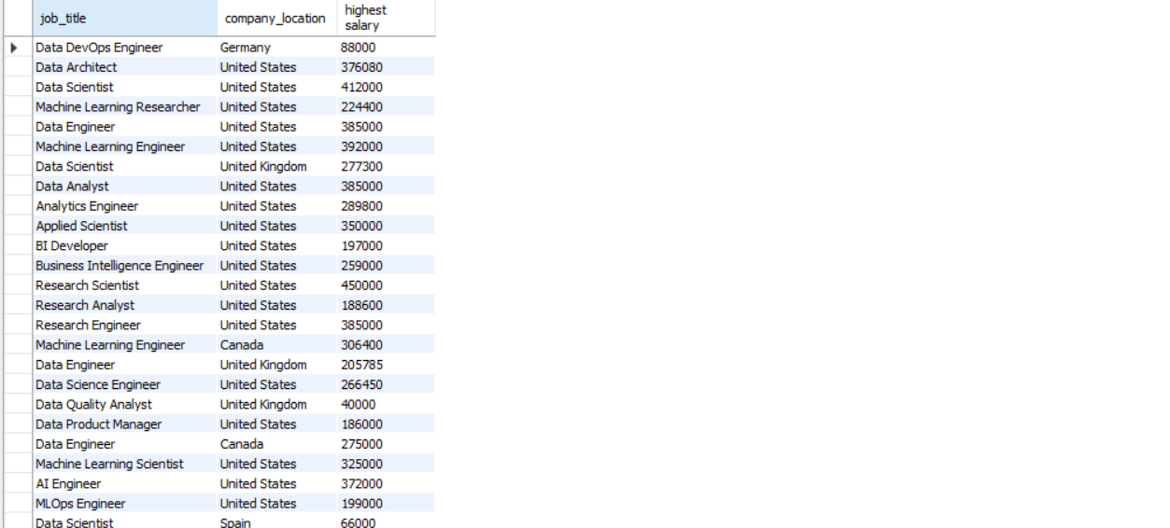
-- 8. Find the job title with the highest salary in each company location. SELECT job_title, company_location ,max(SALARY) AS "highest salary" FROM jobs_in_data group by job_title, company_location ;

Slide 10
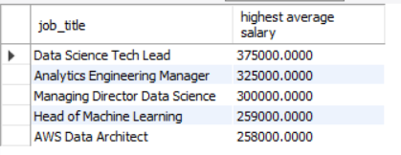
-- 9. List the top 5 job titles with the highest average salary. SELECT job_title , AVG(SALARY) AS "highest average salary" FROM jobs_in_data group by job_title ORDER BY AVG(salary) DESC LIMIT 5;

Slide 11
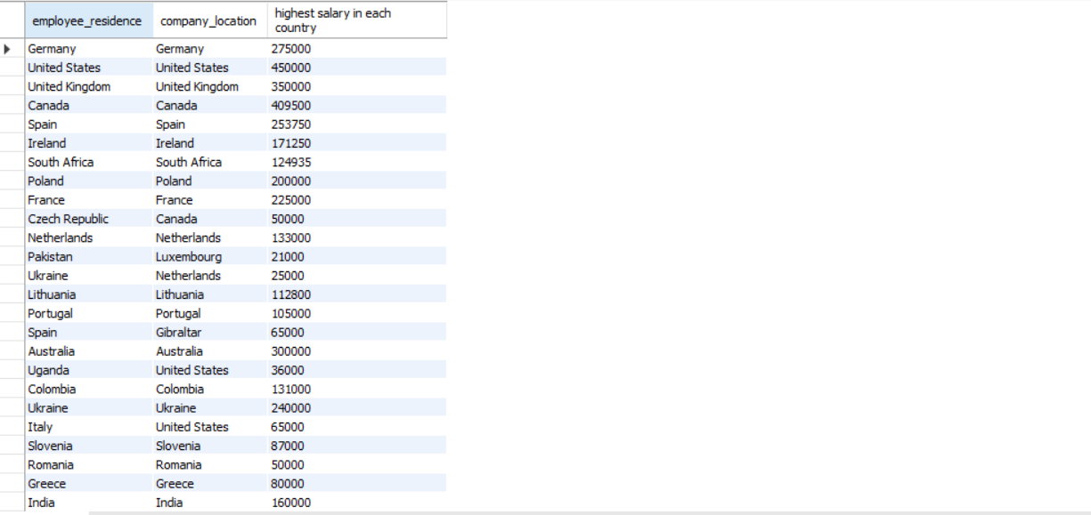
-- 10. Find the employee with the highest salary in each country. SELECT employee_residence, company_location, MAX(SALARY) AS "highest salary in each country" FROM jobs_in_data group BY company_location,employee_residence;

Slide 12
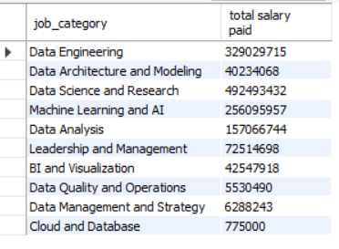
-- 11. Calculate the total salary paid for each job category. SELECT job_category , SUM(SALARY) AS "total salary paid " FROM jobs_in_data group by job_category;

Slide 13
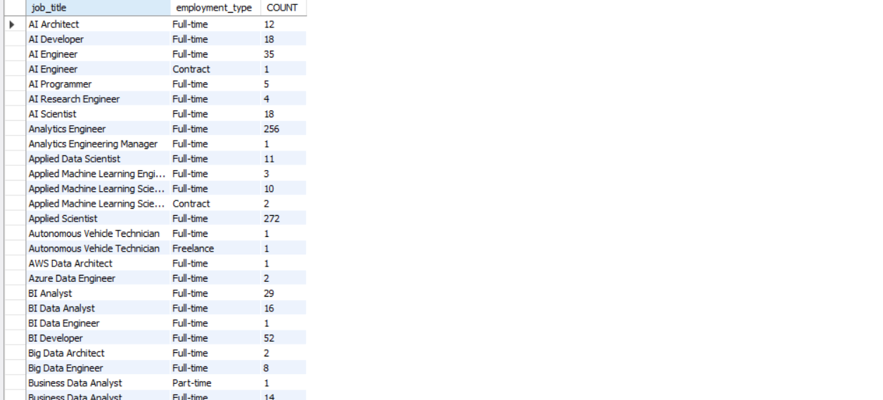
-- 12. Find the most common employment type for each job title. SELECT job_title, employment_type, COUNT(*) AS COUNT FROM jobs_in_data group by job_title,employment_type order by job_title, employment_type DESC;

Slide 14
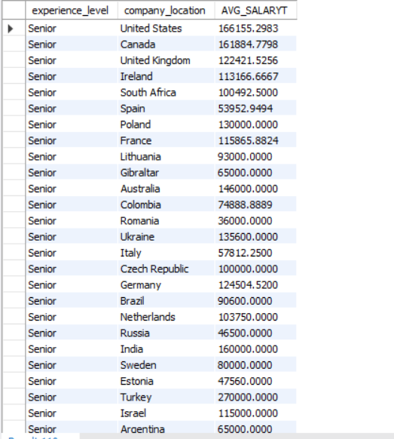
-- 13. Calculate the average salary for employees with a senior experience level in each country. SELECT experience_level, company_location ,AVG(SALARY) AS AVG_SALARYT FROM jobs_in_data WHERE experience_level = 'Senior' group by company_location;

Slide 15
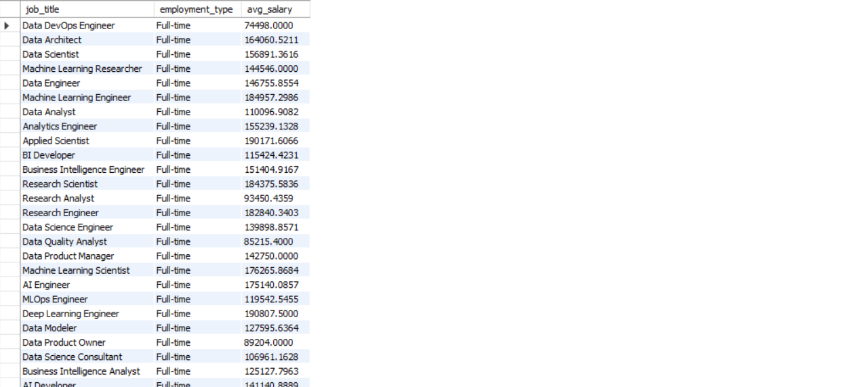
-- 14. Find the average salary for each combination of job title and employment type. SELECT job_title, employment_type, AVG(salary_in_usd) AS avg_salary FROM jobs_in_data GROUP BY job_title, employment_type;

Slide 16

-- 15. Calculate the number of employees in each experience level for each country. SELECT company_location, experience_level , COUNT(*) AS EMP_COUNT FROM jobs_in_data group by experience_level ,company_location ORDER BY company_location ;

Slide 17
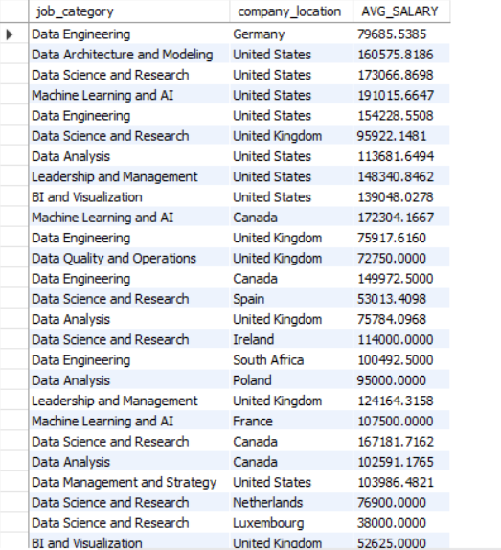
-- 16. Find the average salary for each job category in each company location. SELECT job_category , company_location , AVG(SALARY) AS AVG_SALARY FROM jobs_in_data group by company_location, job_category;

Slide 18
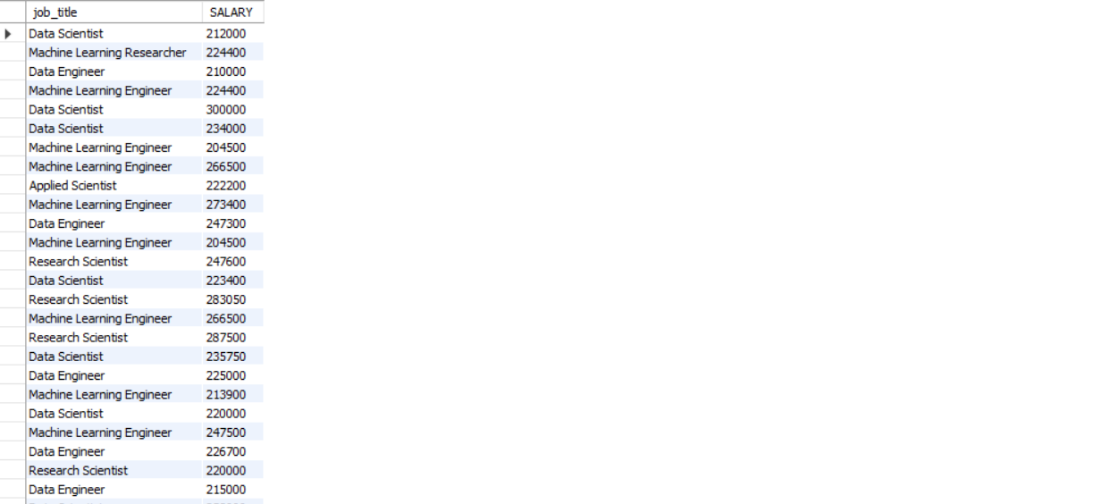
-- 17. List the job titles with a salary above a certain threshold (e.g., 200000 USD) . SELECT job_title , SALARY FROM jobs_in_data WHERE SALARY > 200000;

Slide 19

-- 18. Calculate the difference in average salary between full-time and part-time employees for each job title. SELECT job_title, AVG(CASE WHEN employment_type = 'Full-time' THEN salary ELSE NULL END) - AVG(CASE WHEN employment_type = 'Part-time' THEN salary ELSE NULL END) AS avg_salary_diff FROM jobs_in_data GROUP BY job_title;

Slide 20
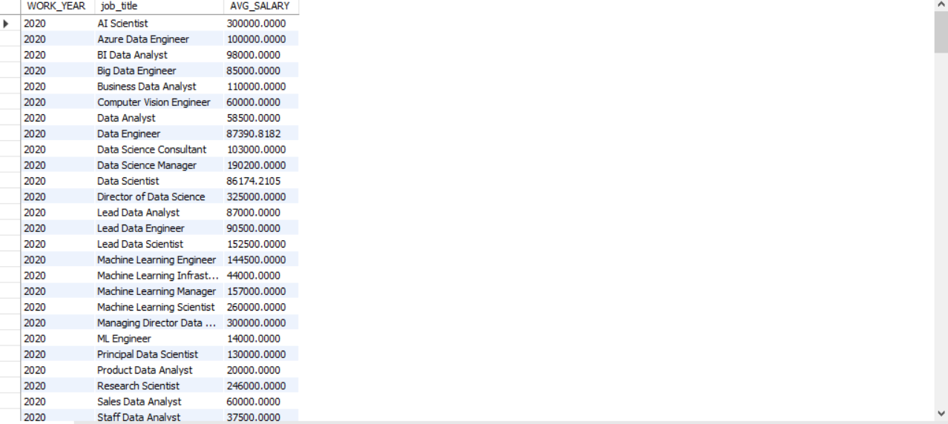
-- 20. Calculate the average salary for each job title in each year. SELECT WORK_YEAR , job_title , AVG(SALARY) AS AVG_SALARY FROM jobs_in_data group by work_year, job_title ORDER BY work_year;

Slide 21
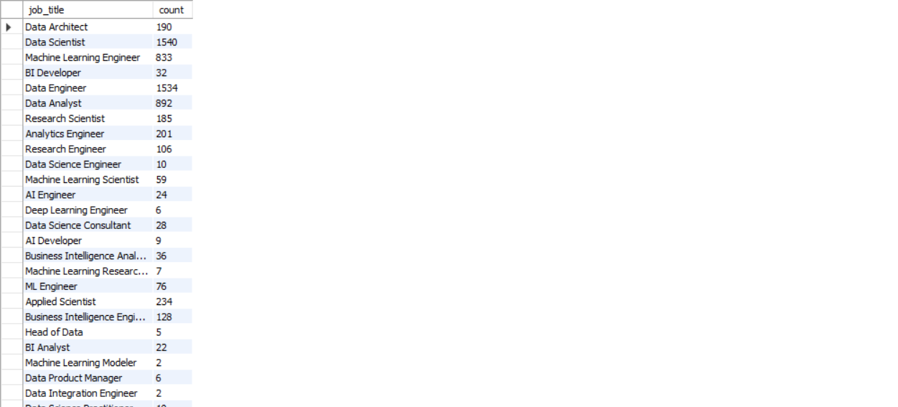
-- 19. Find the number of employees with more than 5 years of experience in each job title SELECT job_title, COUNT(*) AS count FROM jobs_in_data WHERE experience_level = 'Senior' GROUP BY job_title;

