Slide 1
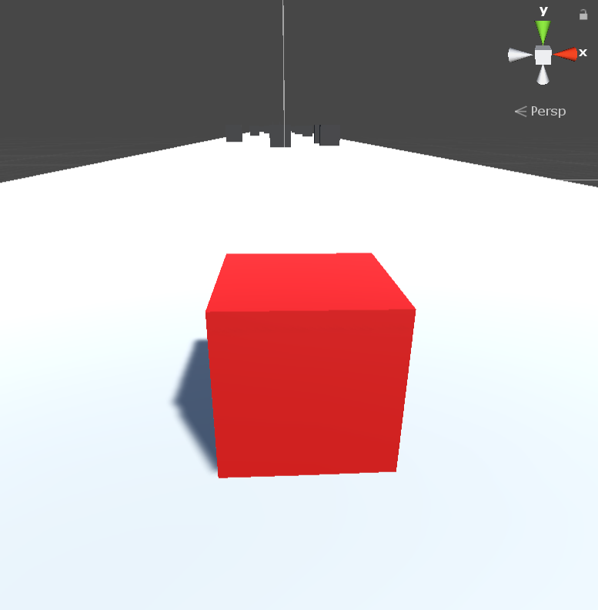
CUBERUN

Slide 2
WHAT IS CUBERUN?
Cuberun is a video game developed by Dahir Ibrahim from Deedax Inc. It’s a simple but modern and classic hyper-casual game that is fun to play. It entails a cube as a player that runs through a course but is disturbed by some obstacles on the way.

Slide 3
CUBERUN FUN FACTS
Cuberun has a total of three levels of increasing difficulty
It has been reported to be completed only by Dahir Ibrahim, the creator of the game. After him, there has been no other person that has beaten all three levels of the game
The game was designed using Unity Engine with the idea of simplicity in mind
Total time taken to fully develop the game was three days

Slide 4
THANKS FOR THE AUDIENCE
Also, special thanks to:
Satya Nadella (Microsoft C.E.O)
Tim Cook (Apple C.E.O)
Elon Musk (Tesla Owner & C.E.O)
Bill Gates (Microsoft Owner)
Sergey Brin & Larry Page (Google Inc. Owners)
Mark Zuckerberg (Facebook Owner)

