Slide 1
Black-Scholes Report

Slide 2
Openmp execution time where m= 1000000 note that the sequential time is 0.0717921seconds
# of Threads | 1 | 2 | 4 | 6 | 8 | 10 | 12 | 14 | 16
Execution Time (in seconds) | 0.039387 | 0.029241 | 0.022486 | 0.021853 | 0.018413 | 0.020591 | 0.022177 | 0.022443 | 0.198002

Slide 3
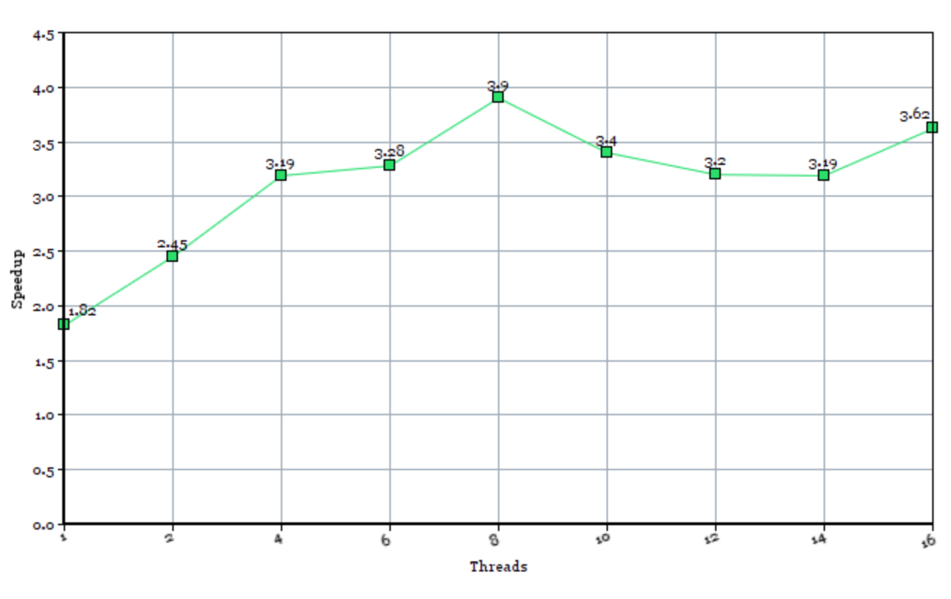
Speedup of openmp execution: Sequential/Parallel
Sequential time : 0.0717921

Slide 4
Machine used
Macbook pro 2016
Intel i7 4 cores
16 gb ram
500gb ssd
Compiler : icc (we put the -02 flag)

Slide 5
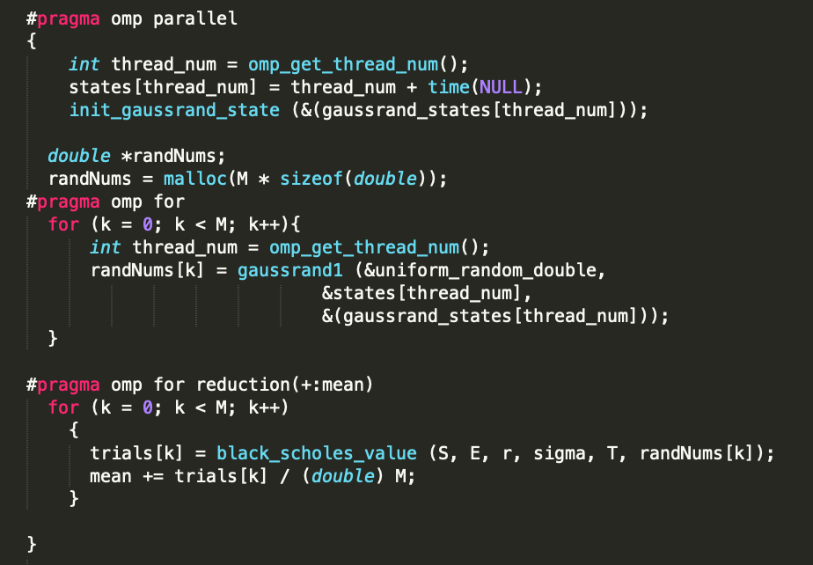
The most efficient part to parallelize was in black_scholes.c where we divided the work on randNums[] , trials[] and the mean.
We first generate random numbers and store them in randNums[] in one pragma
Then we store the black_scholes_value in the trials array and we add the mean of each value in the trials array using reduction

Slide 6
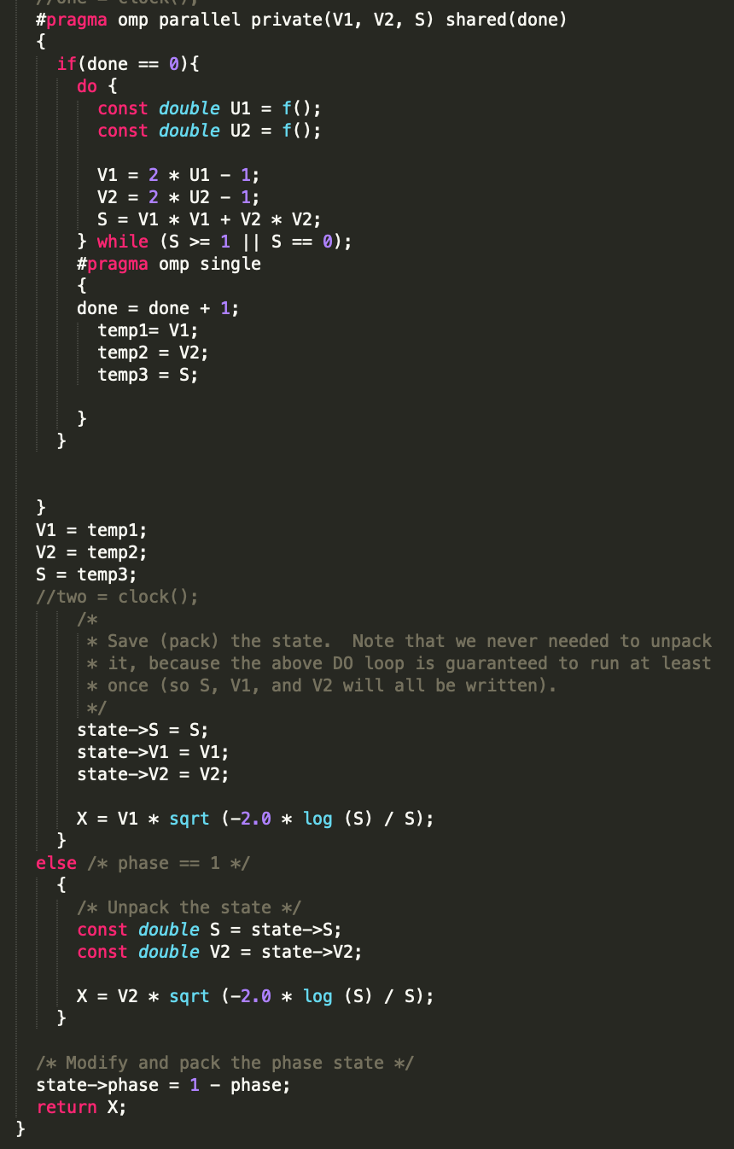
In the gaussian.c file we parallelized the while loop to ensure further efficiency and speedup

Slide 7
The same modifcations were applied to the OpenACC version of the code.
Another aspect we took care of is that we carefully choose which data we need to copy in the GPU and when to copy them out
We also used a larger number of iterations as well as more number of threads.

Slide 8
Execution Time using acc where M = 10,000,000
# of Threads | 1 | 2 | 4 | 8 | 16 | 32 | 64 | 128 | 256
Execution time in seconds | 1.20452 | 0.62356 | 0.48321 | 0.26248 | 0.19374 | 0.09892 | 0.07421 | 0.04892 | 0.4601
512 | 1024
0.03903 | 0.0388

Slide 9
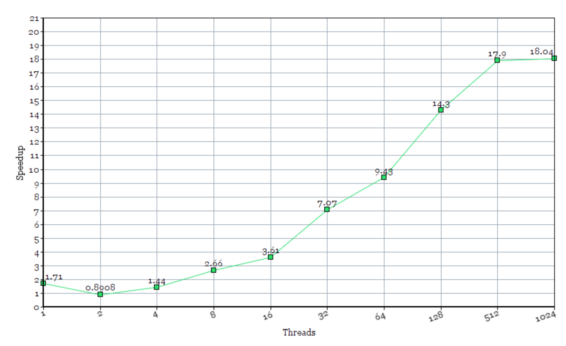
Speedup with acc
Sequential time = 0.708883

