Slide 1
Euclidean
& Similarity

Slide 2
01
Introduction

Slide 3
What is Similarity in Data Mining?
In data mining, similarity refers to the measure of how alike two data objects or patterns are. It is a crucial concept allowing for comparisons and pattern recognition.
Similarity measures quantify the likeness or resemblance between two objects. They provide a numerical value indicating how similar two objects are to each other. Often falls in the range [0,1], sometimes in [-1,1]
What is Euclidean Distance algorithm?
Euclidean Distance calculates the straight-line distance between two data points in a multidimensional space. The smaller the distance, the more similar the points are.

Slide 4
02
How it Works?

Slide 5
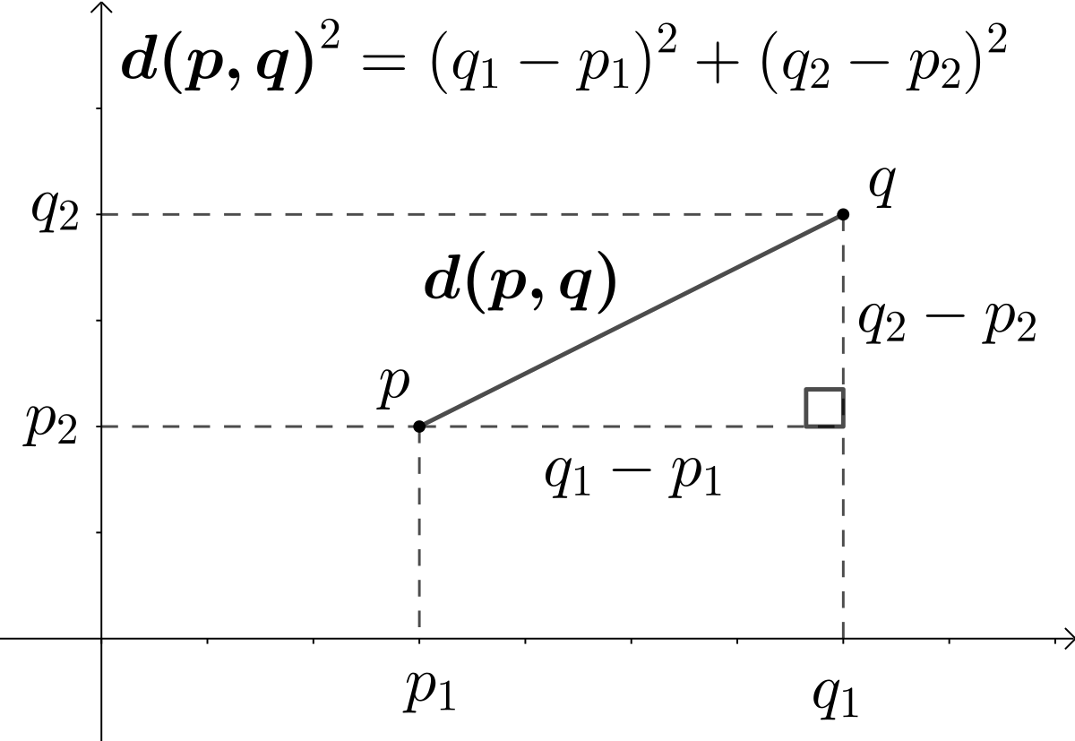
Step 1: Define Data Points Step 2: Calculate Differences Step 3: Compute Squared Differences Step 4: Sum of Squared Differences Step 5: Take Square Root
How it Works?

