Slide 1
DBSCAN
& Clustering

Slide 2
01
Introduction

Slide 3
What is Clustering in Data Mining?
Clustering in data mining is a technique used to group similar data objects or observations into sets known as clusters. The primary goal of clustering is to identify natural groupings within a dataset based on the inherent similarities between the data points.
What is DBSCAN algorithm?
DBSCAN is particularly effective at discovering clusters of arbitrary shapes in spatial datasets and can identify outliers as noise. The algorithm defines clusters based on the density of data points, rather than assuming a specific number of clusters or relying on the geometry of the clusters. This makes it robust in situations where clusters have varying shapes and densities.

Slide 4
02
How it Works?

Slide 5
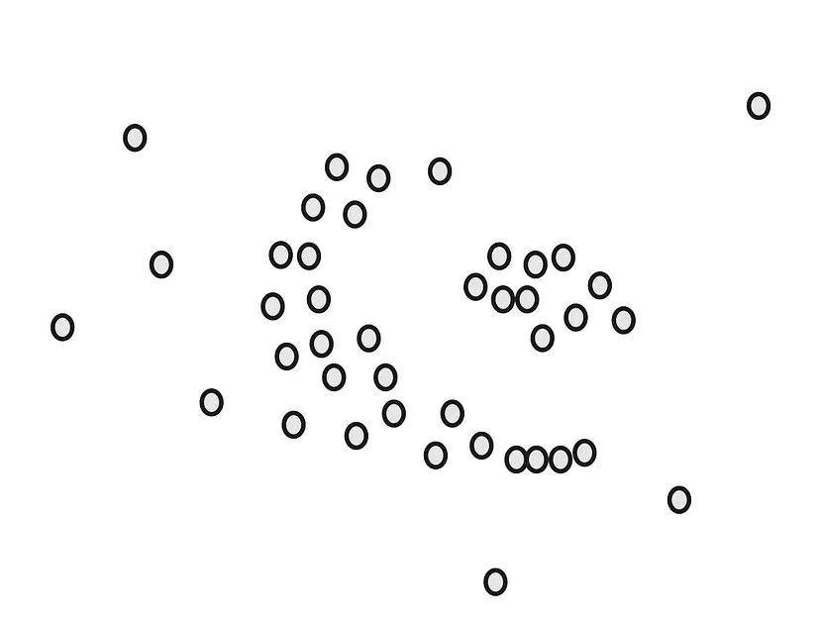
Let’s say we have a dataset of points like the following:

Slide 6
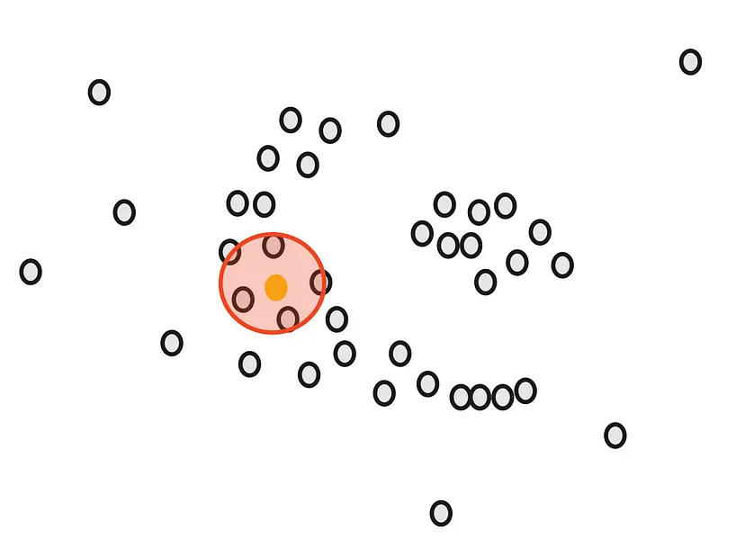
Our goal is to cluster these points into groups that are densely packed together. Firstly, we count the number of points close to each point. For example, if we start with the green point, we draw a circle around it.

Slide 7
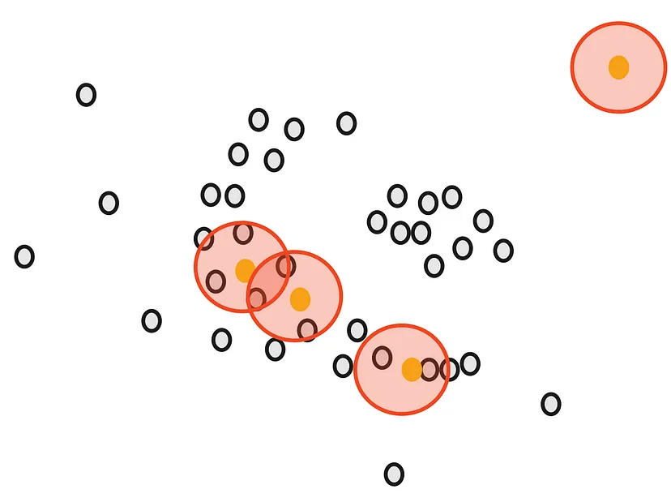
The radius ε (epsilon) of the circle is the first parameter that we have to determine when using DBSCAN.
After drawing the circle, we count the overlaps. For example, for our yellow point, there are 5 close points.
Likewise, we count the number of close points for all remaining points.

Slide 8
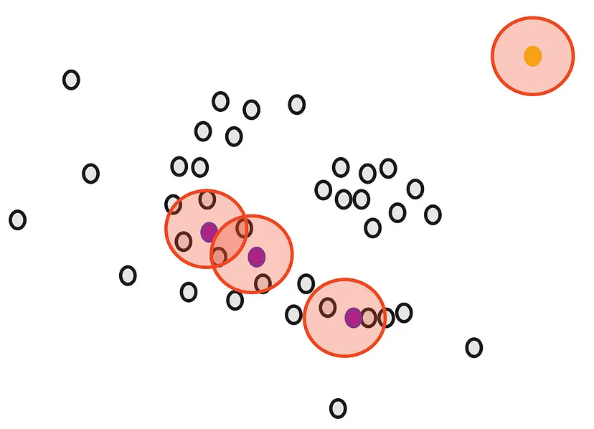
Next, we will determine another parameter, the minimum number of points m. Each point is considered Core Point if they are close to at least m other points. For example, if we take m as 3, then, purple points are considered as Core Points but the yellow one is not because it doesn’t have any close points around it.

Slide 9
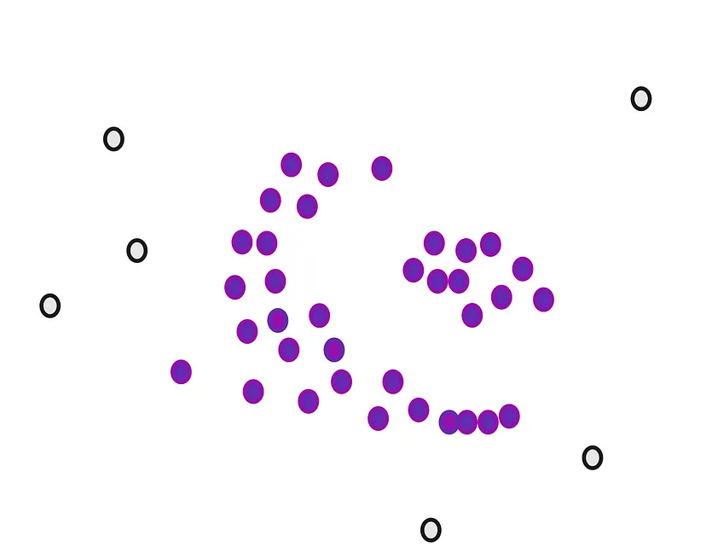
We do that for all points

Slide 10
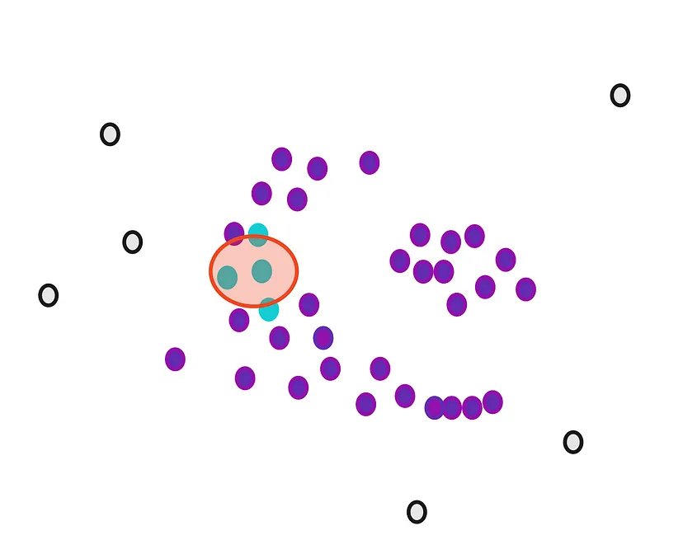
Then, we randomly select a Core Point and assign it as the first point in our first cluster. Other points that are close to this point are also assigned to the same cluster (i.e., within the circle of the selected point).

Slide 11
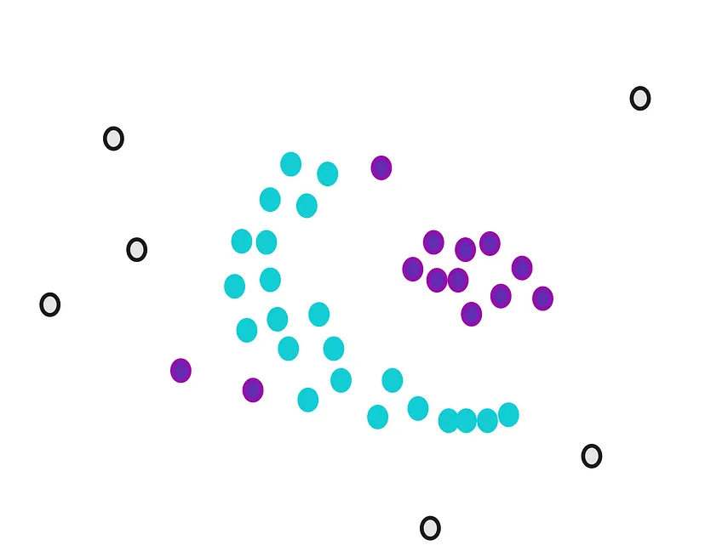
Then, we extend it to the other points that are close.

Slide 12
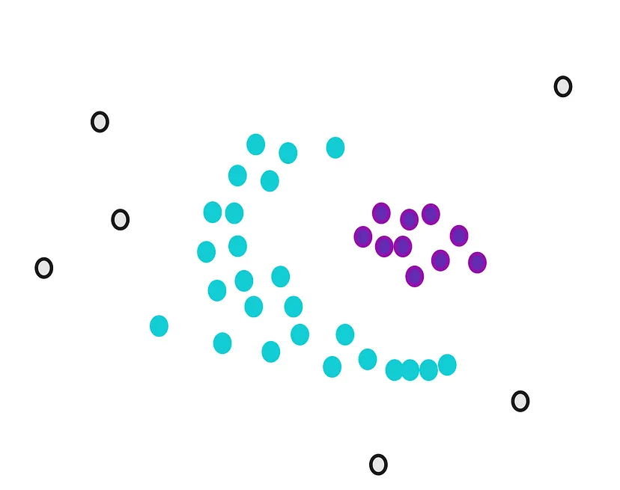
We stop when we cannot assign more core points to the first cluster. Some core points could not be appointed even though they were close to the first cluster. We draw the circles of these points and see if the first cluster is close to the core points. If there is an overlap, we put them in the first cluster.

Slide 13
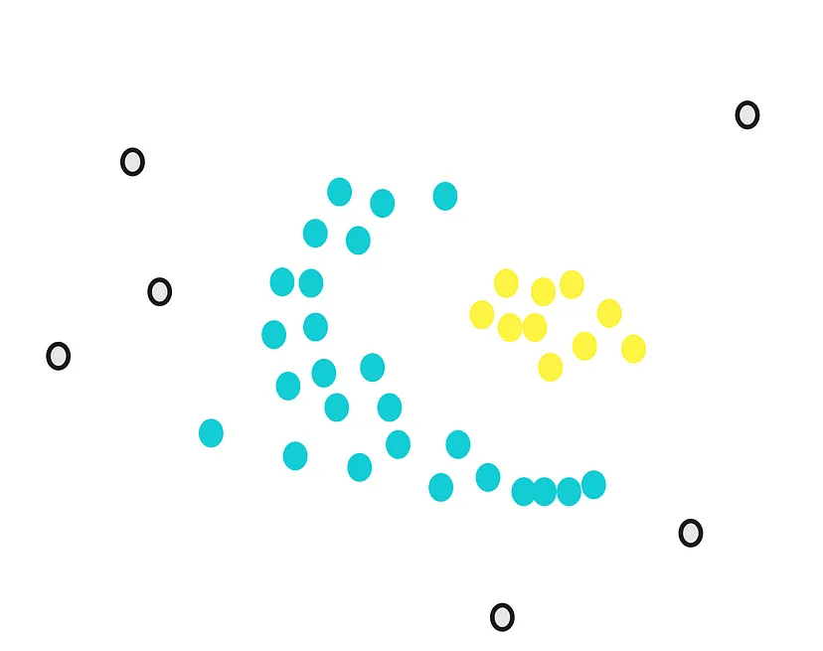
Now, we still have core points that are not assigned. We randomly select another point from them and start over.

Slide 14
