Slide 1
FP-Growth
& Association Rules

Slide 2
Table of contents
01
02
03
04
Introduction
Company
You can describe the topic of the section here
You can describe the topic of the section here
Analysis
Conclusion
You can describe the topic of the section here
You can describe the topic of the section here

Slide 3
01
Association Rules

Slide 4
What is Association Rules?
Association rule is a rule-based machine learning method, used to deploy pattern recognition in order to identify relationships between different, yet related items.
Say for example that coffee and sugar are frequently purchased together. With that information, you may increase sales by:
Placing coffee and sugar next to each other so that a customer who buys one product does not walk to buy the other one.
Advertising to those who buys either coffee or milk in order to increase that person’s propensity to buy the paired other product.
Offering discounts on both milk and and coffee if the customer buys both of them in one purchase.

Slide 5
Example
First of all, it is important to note that an association rule has two parts: an antecedent (if) and a consequent (then).
An antecedent is an item found within the data.
A consequent is an item found in combination with the antecedent.
By applying the association rule to our previous use case we can have the following expression with the example of coffee and milk.
“If items coffee are purchased, then possibility of buying sugar is ___” which can be represented by:
{coffee} → {sugar}
The three main ways of measuring association are: Support, Confidence and Lift. Let’s highlight these concepts with our coffee and sugar analogy. Image the following scenario in which:
The total number of transaction in the store is 3000
The number of purchase for Coffee (C) is 800 transactions
The number of purchase for Sugar (S) is 500 transactions
The number of Both Coffee and Sugar (C → S) purchased together is 400 transactions

Slide 6
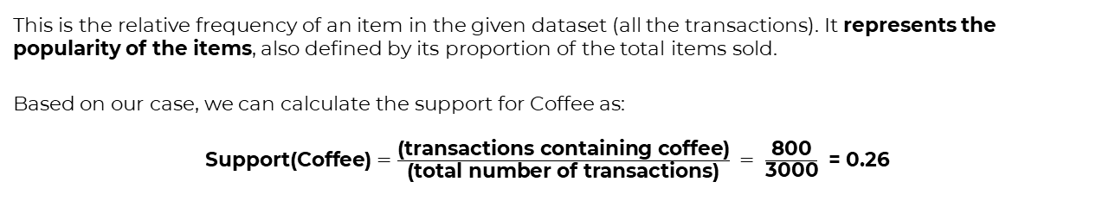
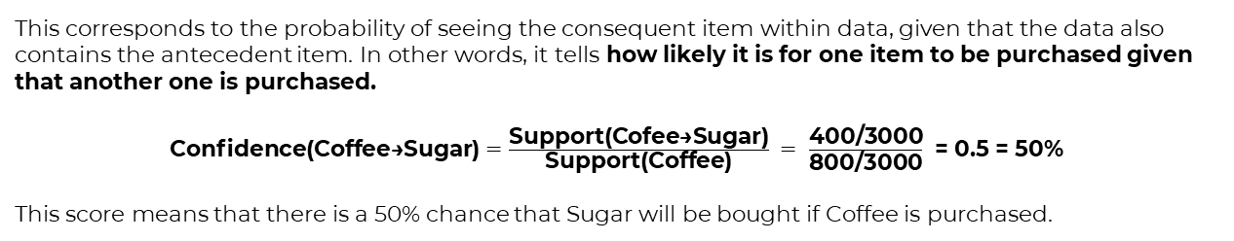
1) Support
This is the relative frequency of an item in the given dataset (all the transactions). It represents the popularity of the items, also defined by its proportion of the total items sold.
Based on our case, we can calculate the support for Coffee as:
$\text{Support}\text{(}\text{Coffee}\text{)}=\frac{\text{(}\text{transactions} \text{containing} \text{coffee}\text{)}}{\text{(}\text{total} \text{number} \text{of} \text{transactions}\text{)}} =$ $\frac{\text{800}}{\text{3000}}$ = 0.26
2) Confidence
This corresponds to the probability of seeing the consequent item within data, given that the data also contains the antecedent item. In other words, it tells how likely it is for one item to be purchased given that another one is purchased.
$\text{Confidence}\text{(}\text{Coffee}\text{→}\text{Sugar}\text{)}=\frac{\text{Support}\text{(}\text{Cofee}\text{→}\text{Sug}\text{ar}\text{)}}{\text{Support}\text{(}\text{Coffee}\text{)}} =$ $\frac{\text{400}\text{/}\text{3000}}{\text{800}\text{/}\text{3000}}$ = 0.5 = 50%
This score means that there is a 50% chance that Sugar will be bought if Coffee is purchased.

Slide 7
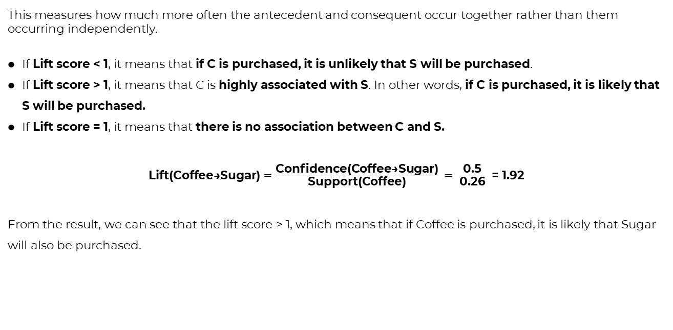
3) Lift
This measures how much more often the antecedent and consequent occur together rather than them occurring independently.
If Lift score < 1, it means that if C is purchased, it is unlikely that S will be purchased.
If Lift score > 1, it means that C is highly associated with S. In other words, if C is purchased, it is likely that S will be purchased.
If Lift score = 1, it means that there is no association between C and S.
$\text{Lift}\text{(}\text{Coffee}\text{→}\text{Sugar}\text{)}=\frac{\text{Confidence}\text{(}\text{Coffee}\text{→}\text{Sugar}\text{)}}{\text{Support}\text{(}\text{Coffee}\text{)}} =$ $\frac{\text{0.5}}{\text{0.26}}$ = 1.92
From the result, we can see that the lift score > 1, which means that if Coffee is purchased, it is likely that Sugar will also be purchased.

Slide 8
02
FP-Growth

Slide 9
Why FP-Growth algorithm?
The two primary drawbacks of the Apriori Algorithm are:
At each step, candidate sets have to be built.
To build the candidate sets, the algorithm has to repeatedly scan the database.
These two properties inevitably make the algorithm slower. To overcome these redundant steps, a new association-rule mining algorithm was developed named Frequent Pattern Growth Algorithm. It overcomes the disadvantages of the Apriori algorithm by storing all the transactions in a Trie Data Structure.

Slide 10
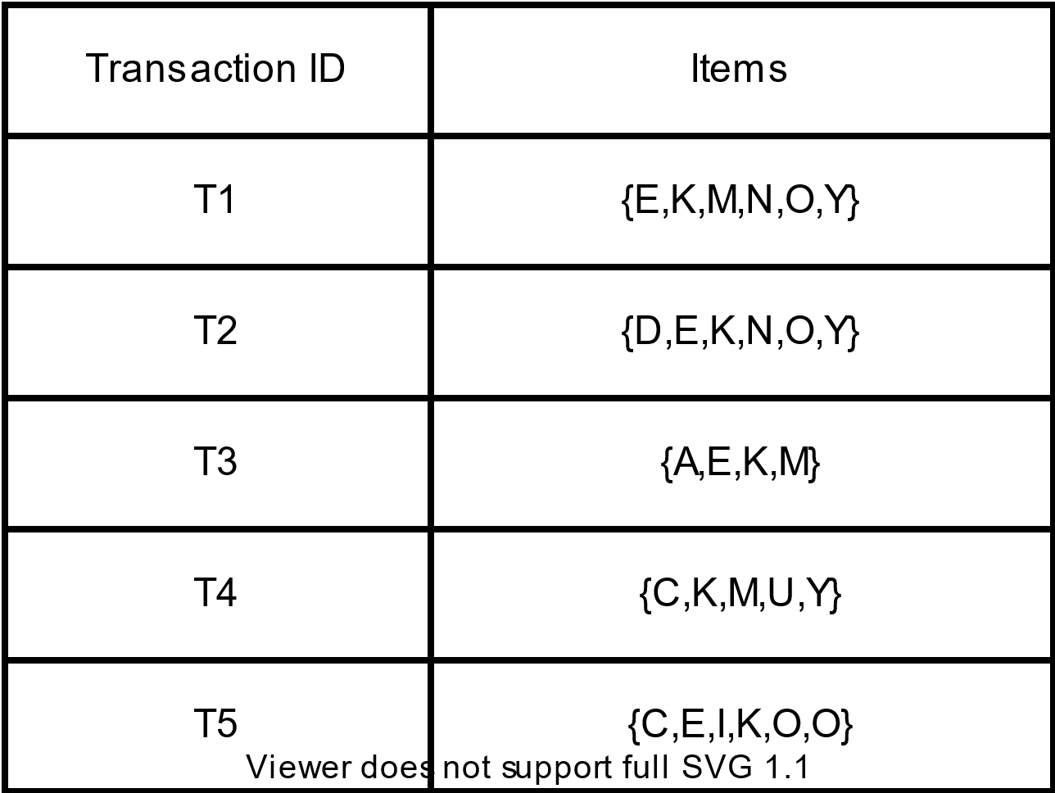
How It Works?
Consider the following data:

Slide 11
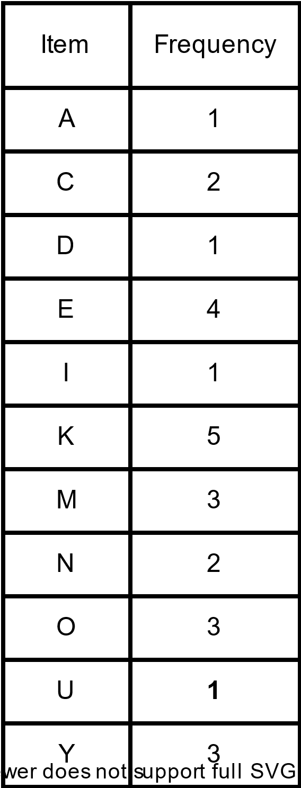
The above-given data is a hypothetical dataset of transactions with each letter representing an item. The frequency of each individual item is computed:
If the frequency of items is less than the specified minimum support, we simply delete them from the database.
The set of frequent items is sorted in the descending order of support.
MIN SUPPORT=3
Ordered Itemset={K:5,E:4,M:3,O:3,Y;3}

Slide 12
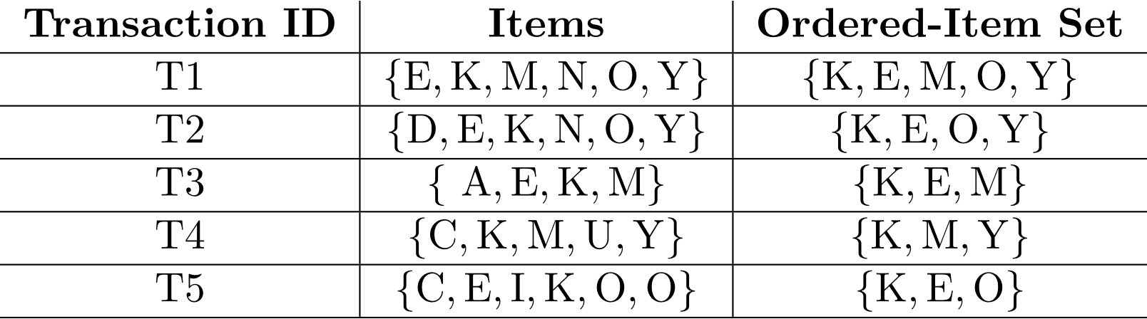
Now, for each transaction, the respective Ordered-Item set is built. It is done by iterating the Frequent Pattern set and checking if the current item is contained in the transaction in question. If the current item is contained, the item is inserted in the Ordered-Item set for the current transaction. The following table is built for all the transactions:

Slide 13
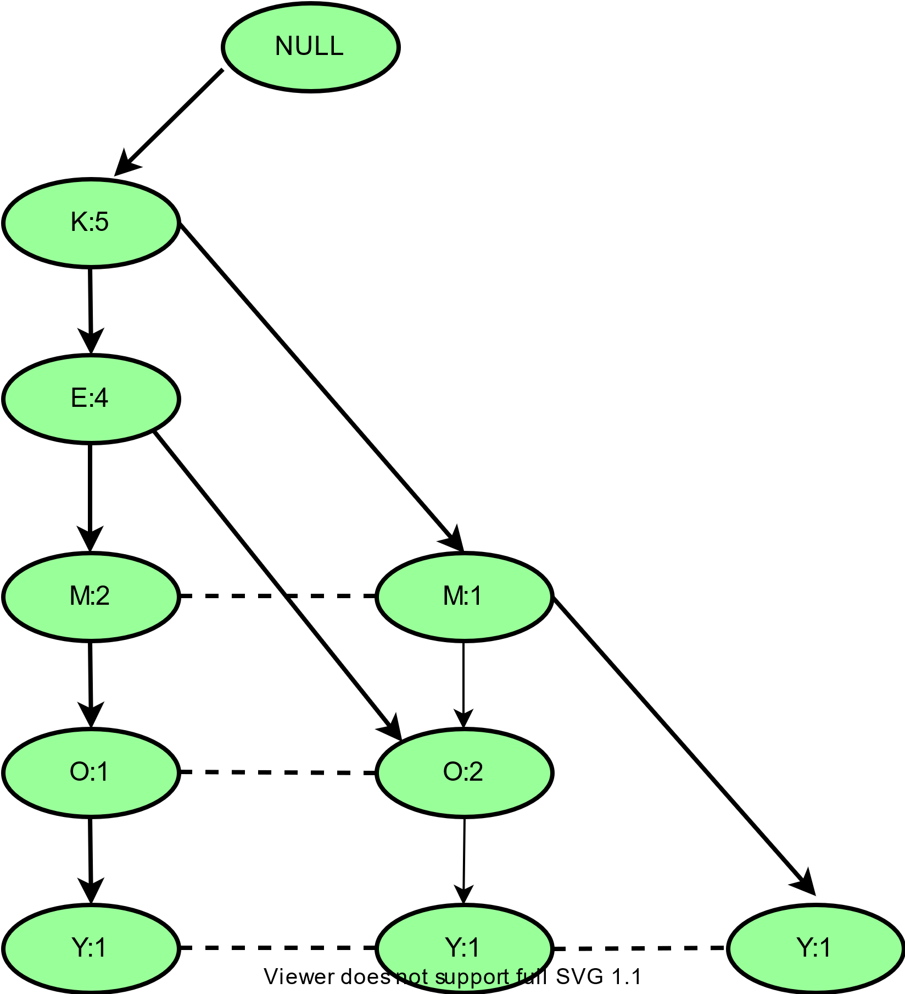
Now, all the Ordered-Item sets are inserted into a Trie Data Structure.

Slide 14
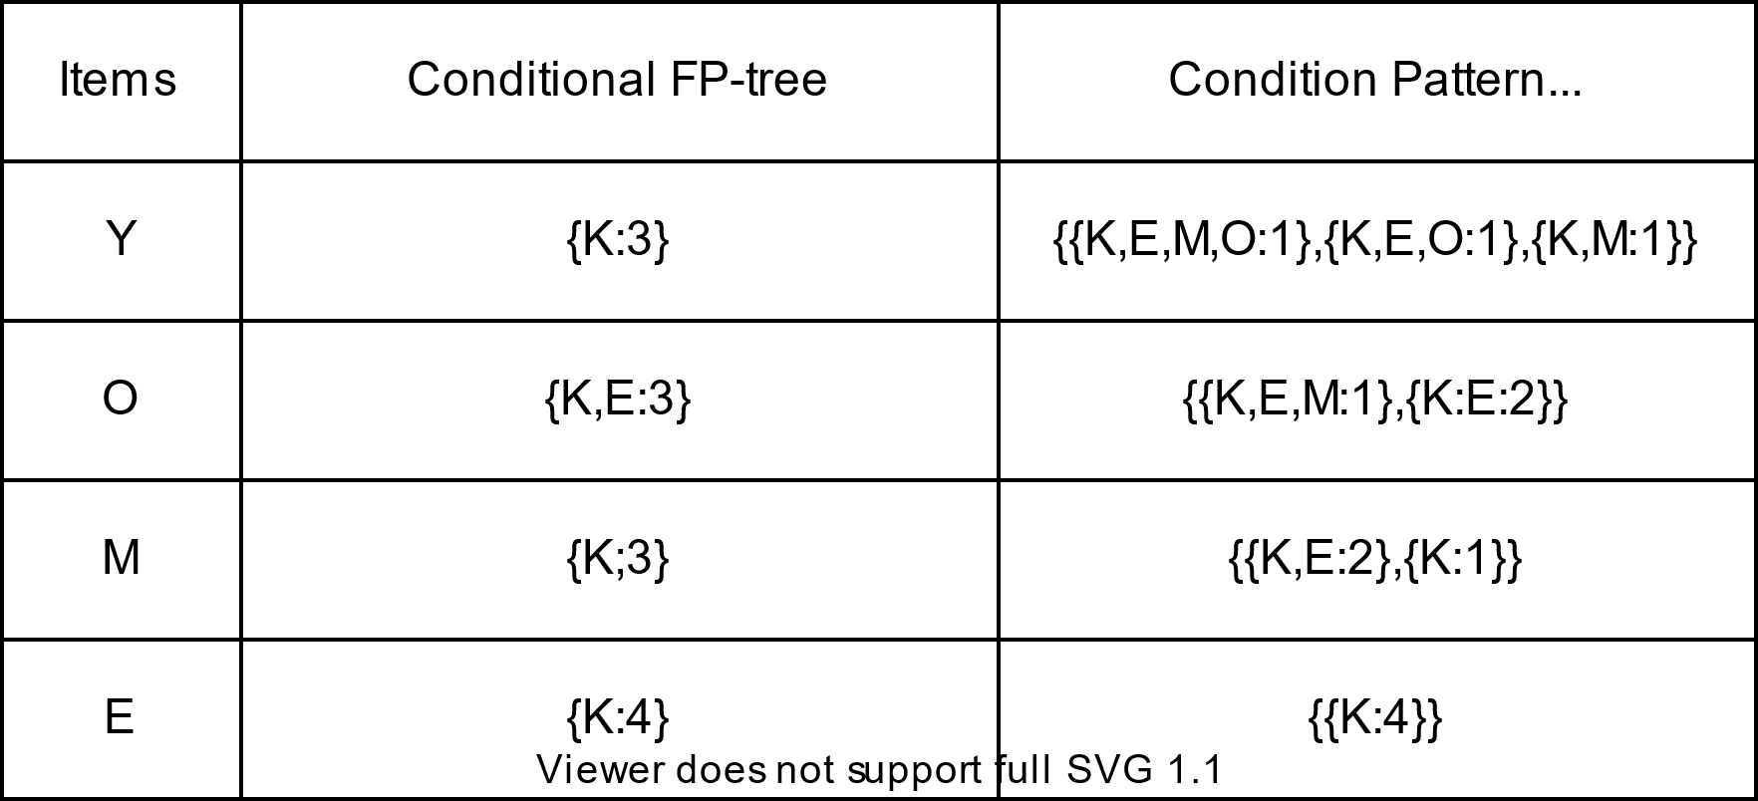
Now, for each item, the Conditional Pattern Base is computed which is path labels of all the paths which lead to any node of the given item in the frequent-pattern tree.
Now for each item, the Conditional Frequent Pattern Tree is built. It is done by taking the set of elements that is common in all the paths in the Conditional Pattern Base of that item and calculating its support count by summing the support counts of all the paths in the Conditional Pattern Base.

Slide 15
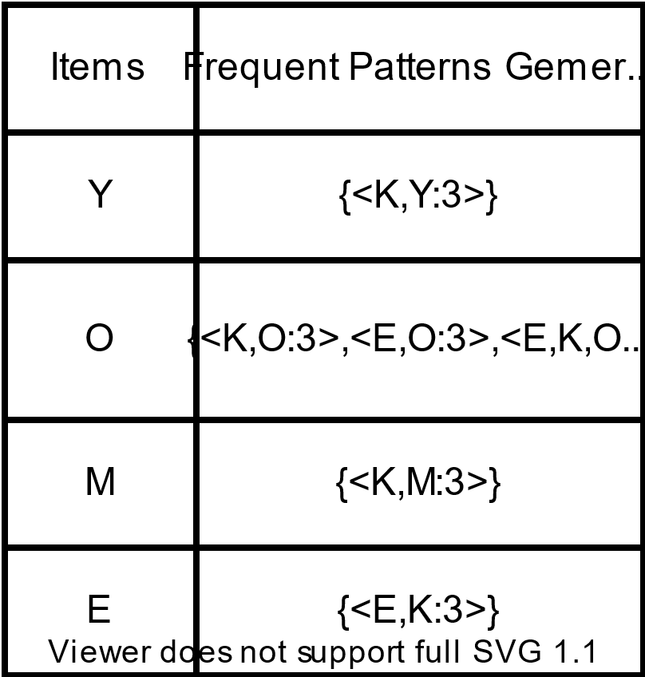
From the Conditional Frequent Pattern tree, the Frequent Pattern rules are generated by pairing the items of the Conditional Frequent Pattern Tree set to the corresponding to the item as given in the below table.

