Slide 1
Visual programming of ImageJ using Imageflow
Kai Uwe Barthel, Daniel Senff
HTW, University of Applied Sciences, Berlin Germany

Slide 2
Summary
Motivation
History of ImageFlow
Visual programming
Installation
Implementing a workflow
Defining new units / XML-Definition
Problems and outlook

Slide 3
ImageJ Fields of Application
Measurements & standard tasks
Teaching
Design of new image processing algorithms
…
All these use cases often consist of
a repeated sequence of single steps.

Slide 4
ImageJ Operation Modes
Interactive Mode:
Successive calls of different ImageJ functions:
  Open image(s)
  Apply functions, combine images, …
  Store the result
  Get rid of unwanted intermediate images

Slide 5
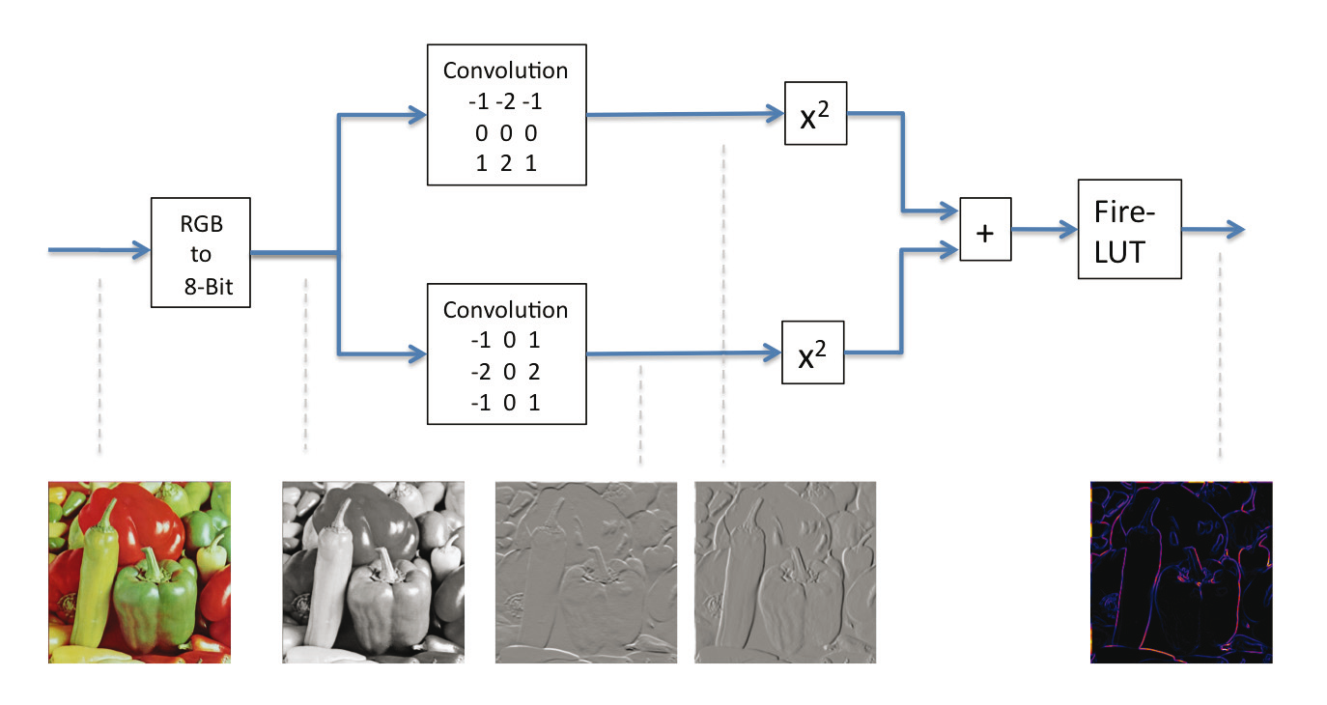
Very simple example (Edge detection)
32

Slide 6
ImageJ macro for this example
run("Clown (14K)");
run("32-bit");
run("Duplicate...", "title=clown-1.jpg");
run("Convolve...", "text1=[-1 -2 -1\n0 0 0\n1 2 1\n] normalize");
selectWindow("clown.jpg");
run("Convolve...", "text1=[-1 0 1\n-2 0 2\n-1 0 1\n] normalize");
run("Square");
selectWindow("clown-1.jpg");
run("Square");
imageCalculator("Add create 32-bit", "clown.jpg","clown-1.jpg");
selectWindow("Result of clown.jpg");
run("Fire");

Slide 7
Problems of automating image processing
Manual interactive approach is very
time consuming and sensitive to errors
Writing macros is not too easy, the user has to care about image IDs and image titles and data types
Writing ImageJ plugins is even harder for inexperienced users

Slide 8
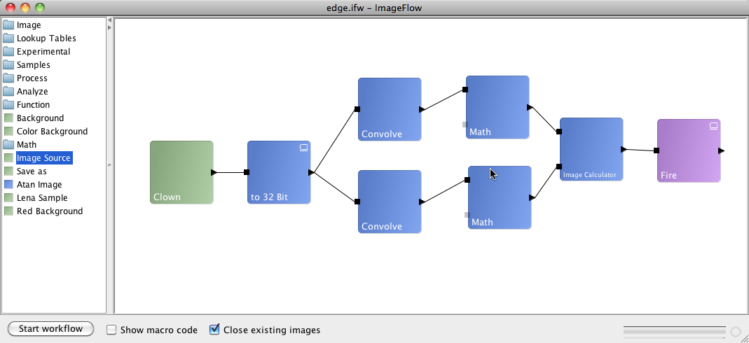
Goal: Visual programming!
Design your algorithm visually without having to assign image names or IDs
Demo

Slide 9
A visual programming framework
should take care about:
Image IDs and image titles
The correct processing order
Control for compatible data types and
Guided setting of parameters
This means:
The users should not have to care
about these things!

Slide 10
History of ImageFlow
Idea was announced at the
ImageJ conference 2008 (proof of concept)
May 2009, stable version (v1.0)
August 2009, Internship at CRP Tudor in Luxembourg, Improved Version (v1.1):
new data types, grouping, many more units
ImageJ Conference 2010, new updates (v1.2)
bugfixes, stand-alone-jar
Future plans …

Slide 11
Start working with ImageFlow today
The workshop materials contain a complete ImageFlow-Folder including everything.
http:/tinyurl.com/ifworkshop
Copy this folder to you ImageJ-Plugins directory.
Start ImageFlow by starting the ImageFlow_.jar
Or as Plugin in ImageJ from menu:
Plugins/Imageflow/ImageFlow
Notes:
10/28/10

Slide 12
Start as stand-alone application
Double-click the ImageFlow_.jar
On unix: Double-click the ImageFlow-script file
Everything you need in one file
ImageJ included as library
Notes:
10/28/10

Slide 13
Start as ImageJ plugin
Simple way:
Copy ImageFlow_.jar to Plugins-folder.
Extendible way:
Create ImageFlow/ subfolder in Plugins-folder
Move ImageFlow_.jar into this folder
Create ImageFlow/xml_units/ subfolder
Notes:
10/28/10

Slide 14
Example 1
Simple Gaussian Blur
Open a sample image
and
blur it with a Gaussian Blur Filter (radius = 3)

Slide 15
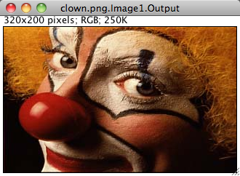
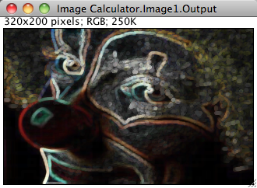
Example 2
Morphological edge detection
Process/Filters/Filter
Erosion
Max-Filter
+
_
Dilatation
Min-Filter
Radius

Slide 16
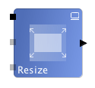
Description of ImageJ processing units
Unit
Inputs
(Data types)
Selections
etc.
Output(s)
(Data types)
Parameters

Slide 17
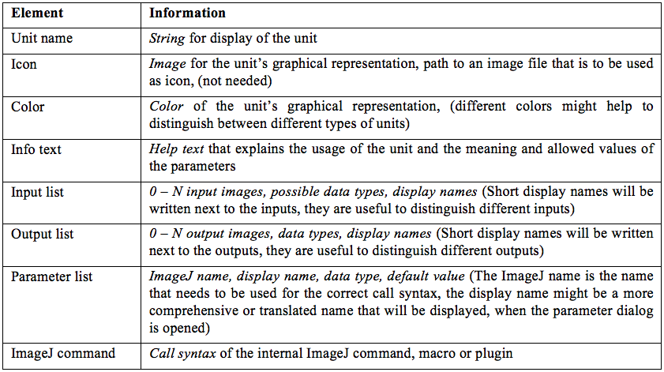
Unit description (Principle)

Slide 18
XML-Unit Description
<?xml version="1.0" encoding="UTF-8"?>
<UnitDescription>
<General>
<UnitName>Unique Unit Name</UnitName> …
</General>
<Inputs>
<Input><Name>Input Image</Name> … </Input>
</Inputs>
<Outputs>
<Output><Name>Result Image</Name> … </Output>
</Outputs>
<Parameters>
<Parameter><Name>Radius</Name> … </Parameter>
</Parameters>
</UnitDescription>
Notes:
10/28/10

Slide 19
XML-Unit General Description
…
<General>
<UnitName>Unique Unit Name</UnitName>
<PathToIcon>Unit_icon.png</PathToIcon>
<ImageJSyntax>
<![CDATA[
setMinAndMax(0, 255);
]]>
</ImageJSyntax>
<Color>0x6e91de</Color>
<HelpString>
Sets the Minimum and the Maximum of the image,
thereby changing brightness and contrast.
</HelpString>
</General>
…
Notes:
10/28/10

Slide 20
XML-Unit Parameter Description
…
<Parameters>
<Parameter>
<Name>Minimum</Name>
<DataType>integer</DataType>
<Value>0</Value> <!– default value -->
<HelpString>Specified Minimum value.</HelpString>
</Parameter>
…
</Parameters>
…
Notes:
10/28/10

Slide 21
ImageJ Syntax - Parameter Substitution
    <General>
    <UnitName>Gaussian Blur</UnitName>
    <ImageJSyntax>
    run("Gaussian Blur...", "sigma=PARA_DOUBLE_1 ");
    </ImageJSyntax>
    ...
    </General>
    <Parameters>
    <Parameter>
    <Name>Radius</Name>
    <DataType>double</DataType>
    <Value>4</Value>
    </Parameter>
    </Parameters>
run("Gaussian Blur...", "sigma=4");
Notes:
10/28/10

Slide 22
XML-Unit Input Description
…
<Inputs>
<Input>
<Name>My Input Name</Name>
<ShortName>I</ShortName>
<DataType>Image</DataType>
<ImageType>31</ImageType> <!-- DOES_ALL -->
<NeedToCopyInput>true</NeedToCopyInput>
<Required>true</Required>
</Input>
…
</Inputs>
…
Notes:
10/28/10

Slide 23
XML-Unit Output Description
…
<Outputs>
<Output>
<Name>Output Image</Name>
<ShortName>O</ShortName>
<DataType>Image</DataType>
<ImageType>-1</ImageType><!-- type given by Input -->
<DoDisplay>false</DoDisplay>
</Output>
…
</Outputs>
…
Notes:
10/28/10

Slide 24
  <?xml version="1.0" encoding="UTF-8"?>
  <UnitDescription>
  <General>
    <UnitName>Lena Sample</UnitName>
    <PathToIcon></PathToIcon>
    <ImageJSyntax>run("Lena (68K)");</ImageJSyntax>
    <Color>0x9cba92</Color>
    <HelpString>Opens one of ImageJ's RGB Image Examples</HelpString>
  </General>
  <Outputs>
    <Output>
      <Name>Output</Name>
      <ShortName>O</ShortName>
      <DataType>Image</DataType>
      <ImageType>16</ImageType>
      <DoDisplay>true</DoDisplay>
    </Output>
  </Outputs>
  </UnitDescription>
A complete
example
Notes:
10/28/10

Slide 25
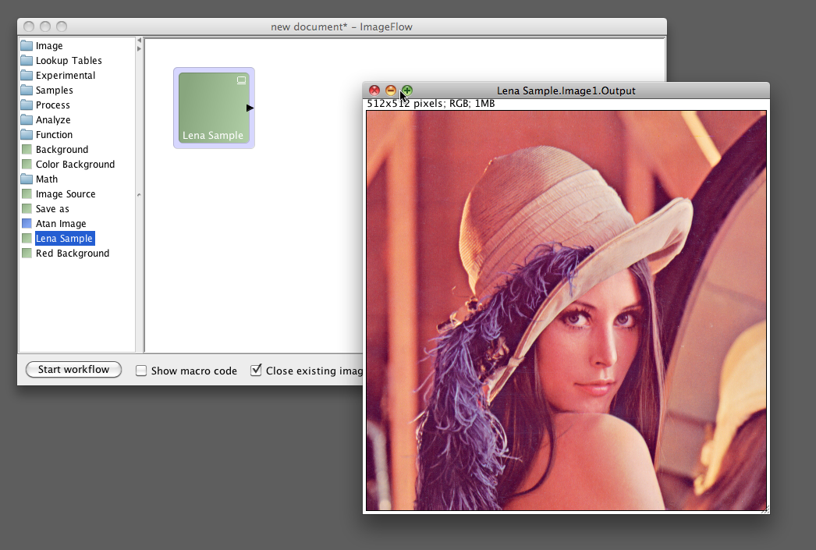

Slide 26
Data Types for Outputs and Inputs
Integer
Double
String
StringArray(Enum)
Boolean
Image
Image Type | Constant
8 bit greyscale | 1
8 bit Color | 2
16 bit greyscale | 4
32 bit greyscale | 8
RGB Color | 16
All | 31
Stacks | 32
Keep input type | -1
Notes:
10/28/10

Slide 27
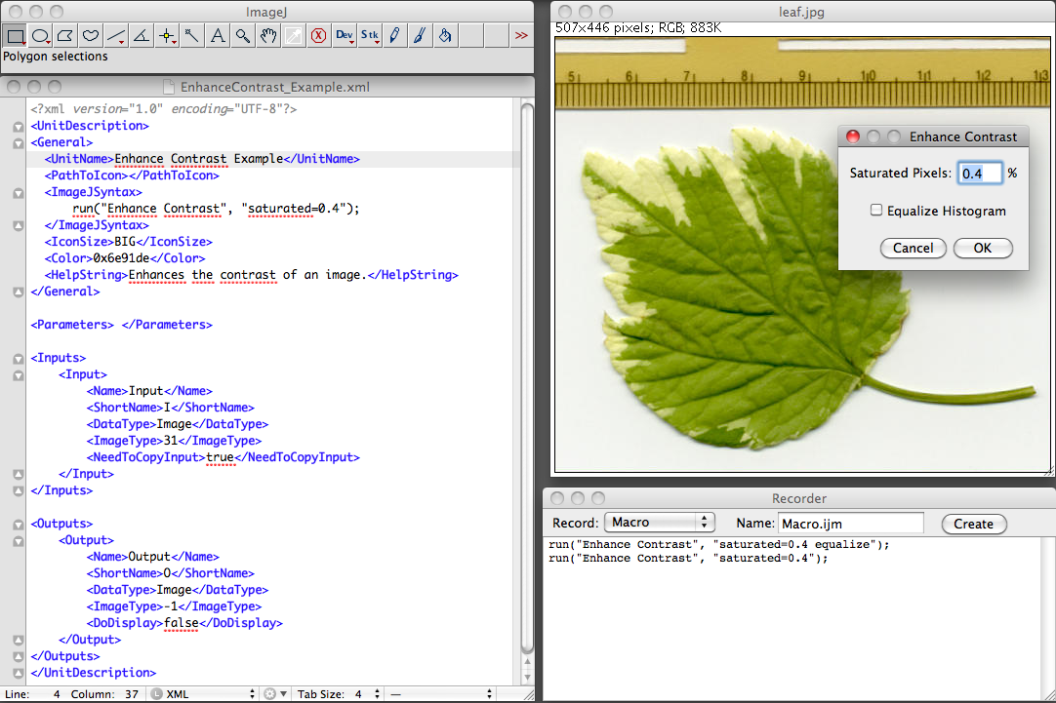
Modify the example EnhanceContrast_Example.xml

Slide 28
ImageJ Syntax - Parameter Substitution
    <General>
    <UnitName>Gaussian Blur</UnitName>
    <ImageJSyntax>
    run("Gaussian Blur...", "sigma=PARA_DOUBLE_1 ");
    </ImageJSyntax>
    ...
    </General>
    <Parameters>
    <Parameter>
    <Name>Radius</Name>
    <DataType>double</DataType>
    <Value>4</Value>
    <HelpString> The filter radius </HelpString>
    </Parameter>
    </Parameters>
Task 1:
Add the double parameter (saturated)
Task 2:
Add the boolean parameter
TrueString = “equalize”
Notes:
10/28/10

Slide 29
Customized Macro Example I
run("Tree Rings (48K)");
var idBig = getImageID();
makeRectangle(0, 0, 440, 162);
run("Duplicate...", "title=small");
run("32-bit");
var idOrig = getImageID();
selectImage (idBig);
close();
selectImage (idOrig);
setBatchMode(true);
...

Slide 30
Customized Macro Example II
run("Duplicate...", "title=vertical");
idVert = getImageID();
run("Convolve...", "text1=[-1 0 1 -2 0 2 -1 0 1 ]");
selectImage (idOrig);
run("Duplicate...", "title=horizontal");
idHor = getImageID();
run("Convolve...", "text1=[-1 -2 -1 0 0 0 1 2 1 ]");
w = getWidth();
h = getHeight();
newImage(“Angle", "8-bit Black", w, h, 1);
idAngle = getImageID();
...

Slide 31
Customized Macro Example III
for(y = 0; y < h; y++) {
for(x = 0; x < w; x++) {
selectImage(idVert);
dy = getPixel(x,y);
selectImage(idHor);
dx = getPixel(x,y);
selectImage(idAngle);
angle = atan2(dy, dx); // -PI to PI
angle = 255/(2*PI) * (angle + PI); // 0 to 255
putPixel(x, y, angle);
}
}
setBatchMode(false);
selectImage(idAngle);
run("Spectrum");
Demo

Slide 32
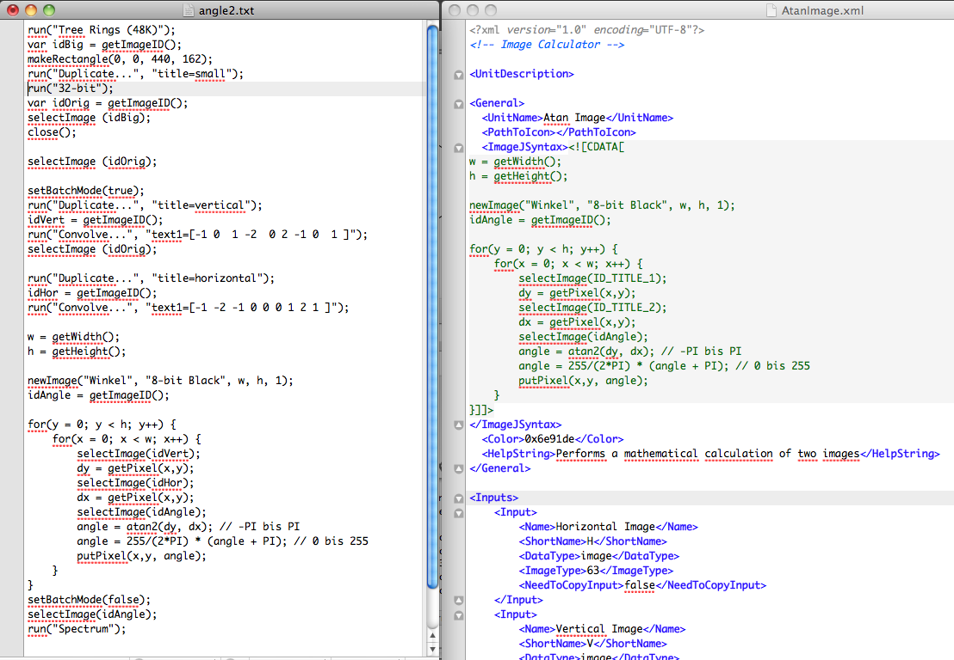

Slide 33
Contribution
At Github: http://www.github.com/dahie/imageflow
Source Code: stable, development
Issue/Idea tracker
Wiki and Documentation
Comment, build, fork, extent
Future ideas
Notes:
10/28/10

Slide 34

Thank you very much!

