Slide 1
Comparing New York City and Hamburg
Battle of the Neighborhoods

Slide 2
Why comparing both cities?
Financial Community → New York City
Oversea Markets Community → Hamburg
→ Similarities?

Slide 3
Data Acquisition
Hamburg Neighborhoods scraped from https://www.hamburg.com/residents/neighbourhoods/
Location Data from http://foursquare.com/

Slide 4
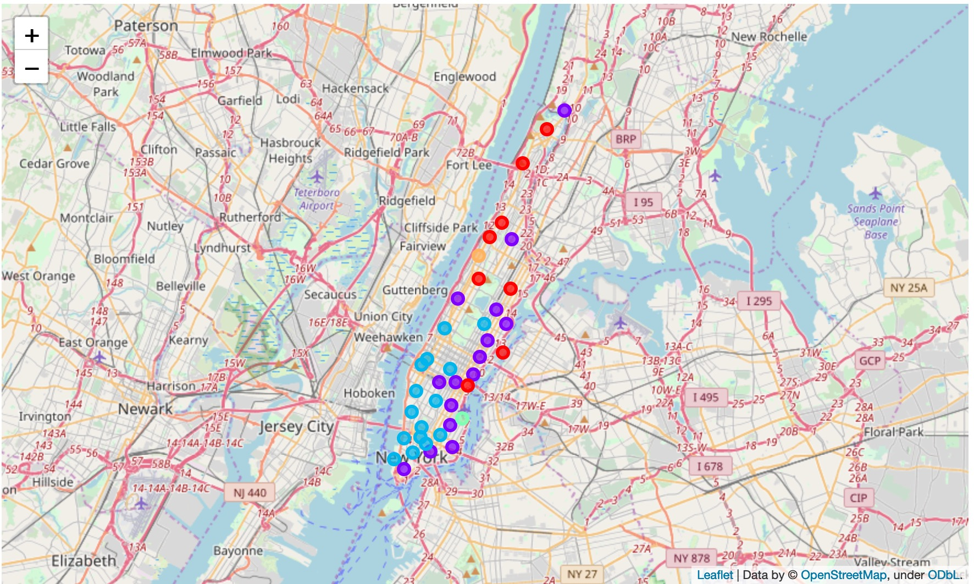
Clusters: New York City (Manhattan)

Slide 5
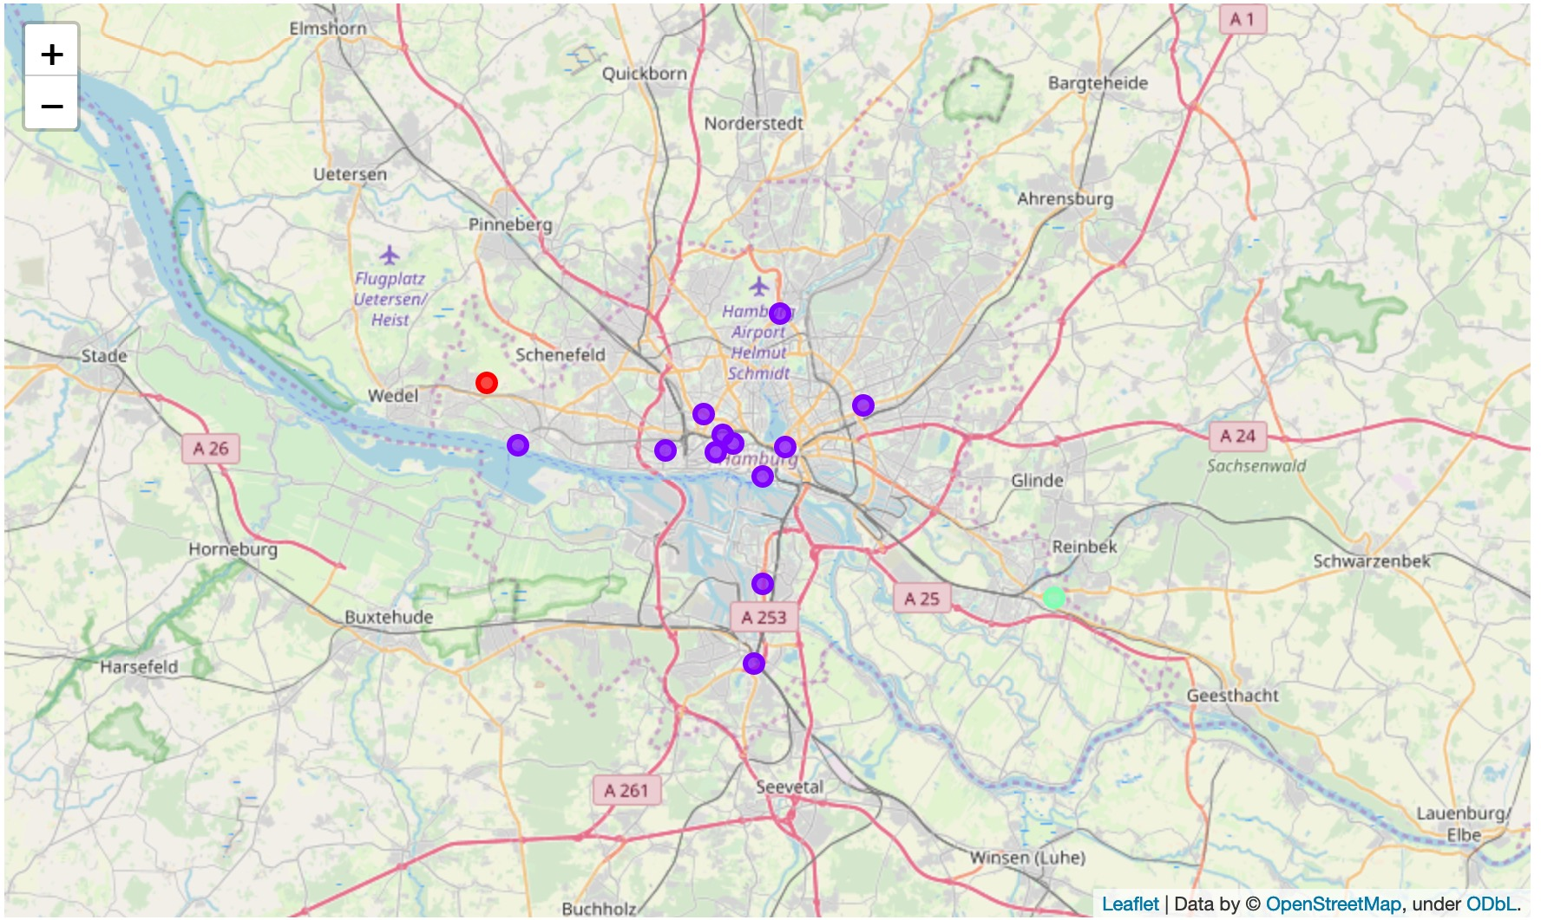
Clusters: Hamburg (3 Clusters)

Slide 6
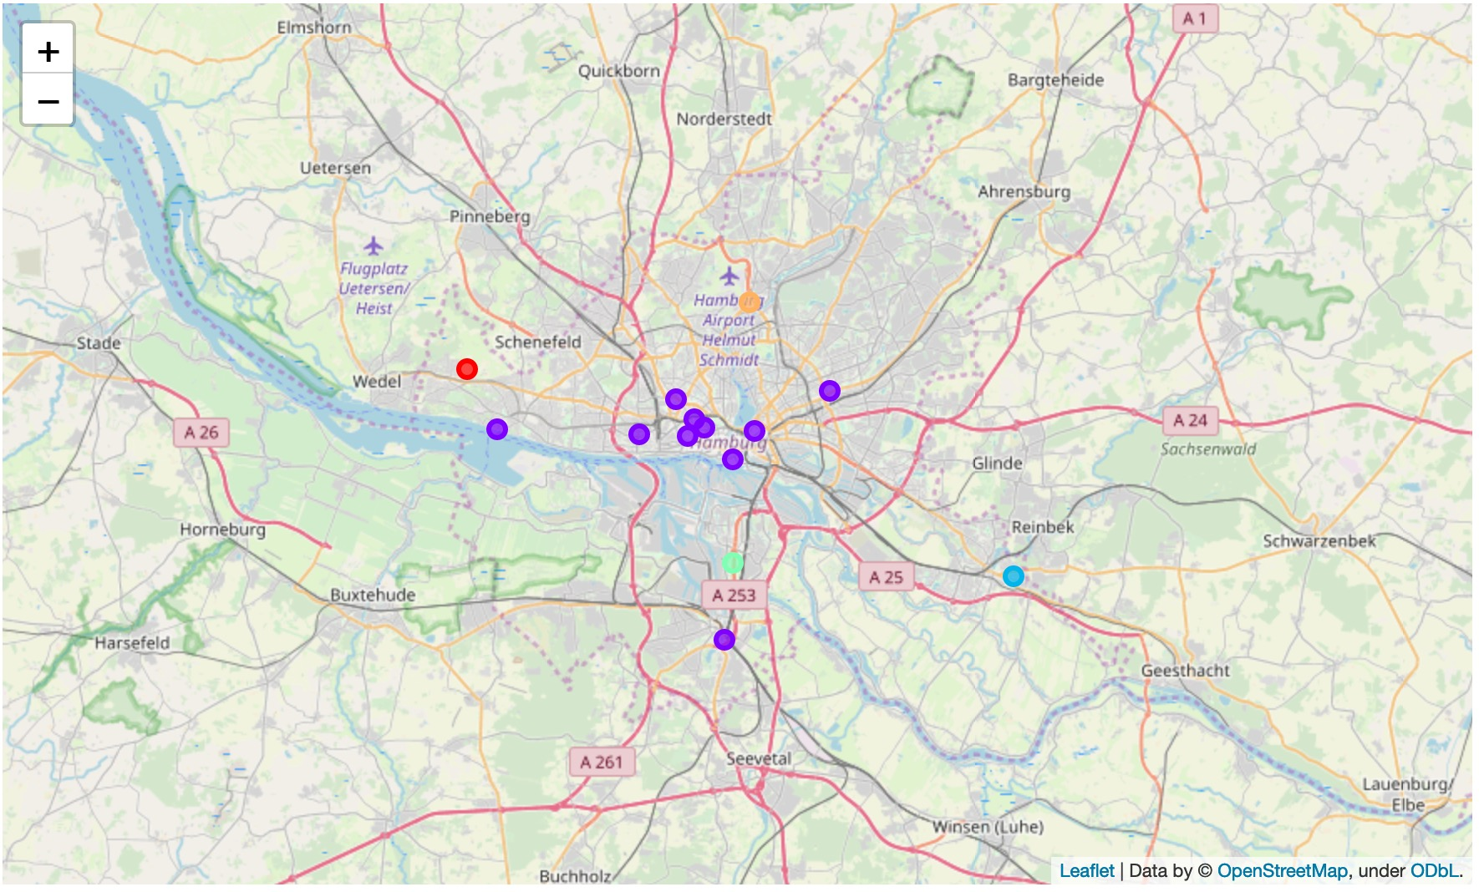
Clusters: Hamburg (5 Clusters)

Slide 7
Conclusions
New York City (Manhattan) is very heterogen
Hamburg is very homogen
Reasons: High difference in population, importance, location, history

