Slide 1

Corpus construction for Arabic anaphora resolution
Prepared by
Dahou Abdelhalim Hafedh and Abdelmoazz Mohamed
Supervised by
Mr. CHERAGUI Mohamed Amine

Slide 2
Overview
1. Introduction
2. General concepts
3. Conception
4. Evaluation
5. Conclusion

Slide 3
1. Introduction

Slide 4
Anaphora resolution is seen to be very challenging and complex in NLP (Natural Language Processing) specially for the Arabic language due to its complexity. Major NLP applications need a proper anaphora resolution and identification.
Our work resolve around creating a tool that would help us annotating and creating a corpus with pronominal and verbal anaphoric links which is our main objective.

Slide 5
2. General concepts

Slide 6
Natural language processing (NLP)
A natural language is any language human learn from their environment used to communicate with each other.
Natural language processing (NLP) is a corps of strategies applied to reveal and identify sentence boundaries, extract their grammatical structure, and detect the language.
NLP is based on a number of disciplines, and cover several fields of studies such as text processing and text classification.

Slide 7
Purpose of NLP
The objective of NLP is processing the language as a human does, means that a computer must understand the input of a text or speech and manipulate it easily and faster.
By automatically processing linguistic data, NLP would save us a huge amount of time and effort.

Slide 8
NLP applications
Information extraction.
Information retrieval.
Question-answering.
summarization.
Machine translation.
Sentiment analysis.

Slide 9
Arabic natural language processing (ANLP)
The Arabic language has more than 422 million speaker, due to that huge number and its strategical and political influence on the world, it gained huge interest in the NLP field.
By utilizing NLP, developers can organize and structure knowledge to perform linguistics tasks such as Arabic text translation, speech recognition, and topic segmentation… etc.

Slide 10
ANLP challenges
Absence of capitalization.
Letters changing shape according to their position in the word.
The lack of letters dedicated to vowels.
Free-word-order language.
Written from right to left and semi-cursively.

Slide 11
Objectives of anlp
The main focus of the ANLP developed in the western world is to enable non Arabic speakers get the meaning of Arabic texts. As for the Arabic world, the ANLP application developed there have different objectives.
the ANLP goes through different levels but also through the development of different modules that can contribute to understanding, one of the important modules is the anaphora resolution.

Slide 12
What is an anaphora?
Anaphora is a Greek expression that means “carrying back”.
Anaphora is a linguistic relation between two textual entities which is deﬁned when a textual entity (the anaphor) refers to another entity of the text which usually occurs before (the antecedent).
الشجرة لازلت صامدة فى مكانـــها وأوراقــــها جافة.
The tree is still in place and its leaves are dry.

Slide 13
Different anaphora types
a. Pronominal anaphora are characterized by anaphoric pronouns which are divided into 3 sub-types:
Relative pronouns: Relative pronouns are always anaphoric and generally indicating the previously existing noun phrase.
Personal pronouns: are pronouns that are associated primarily with a particular grammatical person we can find it isolated (هو) or with a suffix (كتابه).
Demonstrative pronouns: is a pronoun that is used to point to something specific within a sentence.
.البسط التي نسجتها يد طبيعة
The valleys that have been created by nature.

Slide 14
Different anaphora types (cont.)
B. Verbal anaphora another variety of anaphora which is characterized by the use of the verb (فعل did).
صرح عسكري على ان الانتصارات المسنودة من التحالف أرغمت الإنقلابيين على الانسحاب من المدينة.
A military statement that the victories assigned by the coalition forced the coup to withdraw from the city.

Slide 15
Different anaphora types (cont.)
C. Lexical anaphora: Lexical anaphora occurred when the referring statement give a description of proper names.
يُوسُفُ أَيُّهَا الصِّدِّيقُ أَفْتِنَا فِي سَبْعِ بَقَرَاتٍ سِمَانٍ يَأْكُلُهُنَّ سَبْعٌ عِجَافٌ
Joseph, O man of righteousness! tell me the meaning of the dream of seven fat cows whom seven lean cows are devouring

Slide 16
Different anaphora types (cont.)
D. Comparative anaphora: The indication of comparative anaphora is when the anaphoric statement introduced comparative adjectives (أكبر, افضل) (bigger, better). This definition proves the existing of comparison, similarity and complement between the anaphor and the antecedent.
كان لديه قطتين ، واحدة سوداء والاخرى رمادية.
he had two cats, one is black and the other grey.

Slide 17
Anaphoric resolution approaches
Rule-based approaches.
Statistical approaches.
Machine-learning approaches.

Slide 18
Arabic anaphora resolution challenges
The Arabic morphology.
The complexity of a sentence (Agglutination phenomenon).
The phenomenon of non-vowelized words.
The big lack of Arabic anaphora annotated corpus.

Slide 19
What is a corpus?
Corpus (in plural: corpora) is a large collection of linguistic data, compiled either as a transcription of recorded speech or as written texts, used to study all the aspects of language such as syntax, morphological, semantics, pragmatics, speech, and recently in lexicographic studies.

Slide 20
The utility of building a corpus
Evaluating and ameliorating approaches.
Used for training and testing.
Help for extraction new features and rules.
Retrieving information about words by applying frequency and repetition methods.

Slide 21
How to build a corpus?
Data gathering.
Primary check and conversion.
Linguistic annotation.
Text cataloguing and final checking.

Slide 22
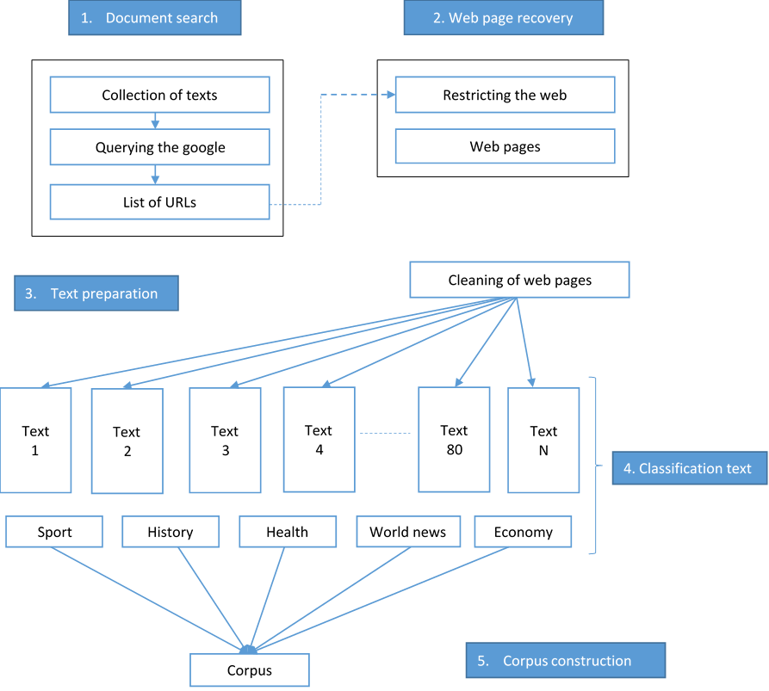
Steps of a corpus creation from the web

Slide 23
Anaphoric corpus annotation
The idea behind annotating resources is help the evaluation and the training systems or ameliorating approaches. But the annotation may be difficult due to the huge amount of texts and the anaphora diversity and its production may be challenging and very time-consuming which follows a specific annotation scheme.

Slide 24
Anaphoric annotation schemes
MUC scheme: uses SGML tags to annotate anaphoric expressions.
Extensible Markup Language (XML) scheme: simple and very flexible text format derived from SGML.
Meta scheme: which is divided into two schemes (Core scheme and extensible scheme)

Slide 25
Works on Anaphoric annotated corpora
Work on annotated corpora | Scheme | Word segments | Pronouns | Text categories
Arabic corpora annotation (AnAtAr) | XML-based | 77.124 word | 4.300 | Arabic newspapers Computer technical manuals
QurAna Corpus | AQA, MUC-7 | 128.000 word | 24.679 | Original Quranic text
Combining QAC and QurAna | MUC-7 | 128.240 word | 29.287 | Original Quranic text

Slide 26
3. Conception

Slide 27
General environment architecture
Preprocessing phase.
Processing phase.
Evaluation phase.

Slide 28
List of URLs
Classification clustering
Clear and eliminating web tags
Text crawling from the web
Automtic anaphora resolving phase
MADAMIRA POS tagger
convert file format
Preprocessing Phase
Text tagged with anaphoric relationships

Slide 29
2.apply annotation scheme
1.evaluaion by expert
3.Validate the text
Final Text tagged with anaphoric relationships
Processing Phase
Category of the corpus

Slide 30
Pre-Processing phase:
This phase is going through 4 sub-phases and uses several module through that.
1
crawling the web
categorie clustring
2
Tokenization
POS tagger
anaphora resolving
detect anaphora
detect candidates
4
3

Slide 31
Construction of a raw corpus
Crawling text from the web module.
Categories classification module.

Slide 32
Construction of a raw corpus (cont.)
Crawling from the web module: On this module, we developed a script that requires us to enter the URL of each category and specify the limited number of pages, then it store all links of articles exists in the current pages into a list.
Categories Classification module: The corpus composed of articles in different fields such as: culture, politics, economy and the last category one religions.

Slide 33
Text processing
Tokenization module.
Format conversion module.
Pos tagger module.

Slide 34
Text processing (cont.)
Tokenization module: Is the first step in text analytics the process of breaking down a text paragraph into smaller chunks such as words or sentence is called Tokenization.
Convert from TXT to XML module: The purpose of this phase is to simplify text and represented on MADAMIRA file to prepare it for the POS tag phase. We developed python script to do that.
POS tagger module: The primary target of Part-of-Speech (POS) tagging is to identify the grammatical group of a given word. For our purposes, The MADAMIDA tagger was utilized. It is mentioned that its precision is 95.9%. Provides high-quality word-level disambiguation of Arabic text

Slide 35
Element detection
Anaphora identification module.
candidates identification module.

Slide 36
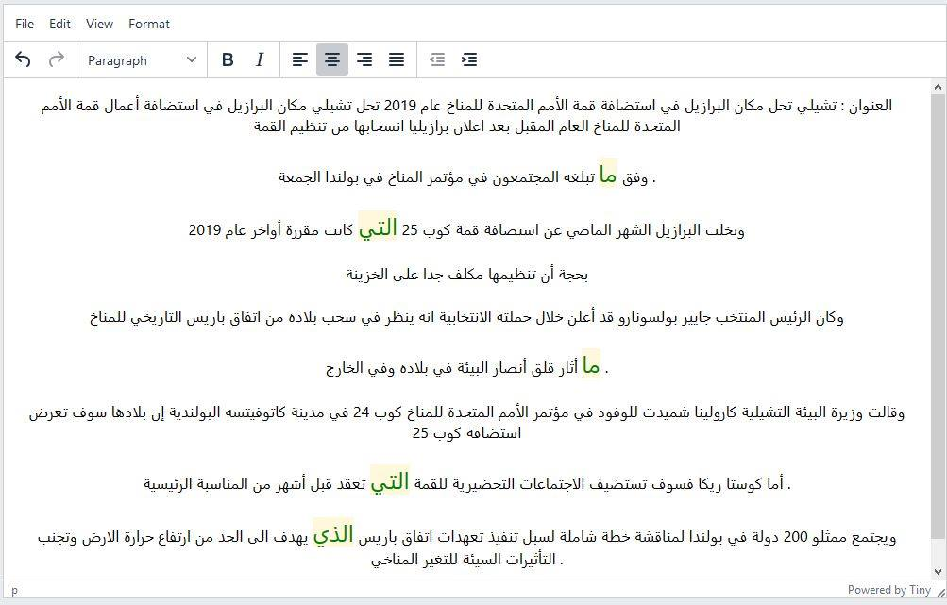

Slide 37
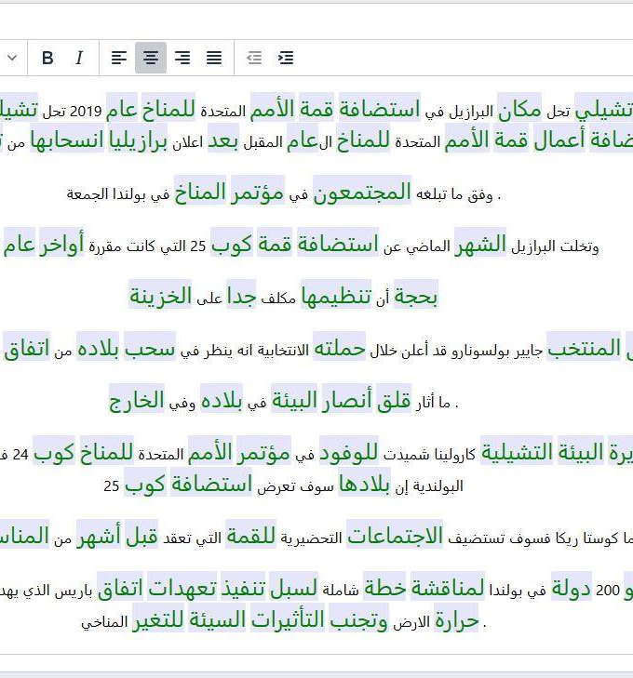
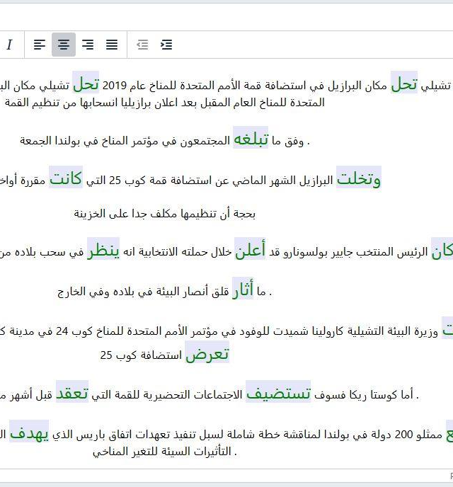

Slide 38
Anaphora resolution
Anaphora resolving module: Resolving module is the main part of the anaphora resolution process. This module focusses to resolve two types of anaphora, pronominal and verbal anaphora. After the identification of the anaphors and filtering the candidate list, we chose the most suitable antecedents for each anaphora from the listed most likely candidates.

Slide 39
The Linguistic Rules and their Respective Scores.
Linguistic rules | Description
Definiteness | A score of 1 is given if an NP is definite and of 0 if not.
Recency | A score of 1 is assigned to the recency NP to the anaphora and 0 if not.
Referential Distance | A score of 2 is assigned to NPs in the current sentence and further than those are given 0.
First Noun Phrases | A score of 1 is issued to the first NP of each sentence and 0 if not.
NPs in the title | A score of 1 is issued to the existing NP in title and 0 if not
Grammatical function. | Scores of 1 are given to an NP that has the same syntactic structure as the anaphora and 0 if not.
Frequency of NP in text | A score of 2 is assigned to the most frequent NP in text and 0 if not.

Slide 40
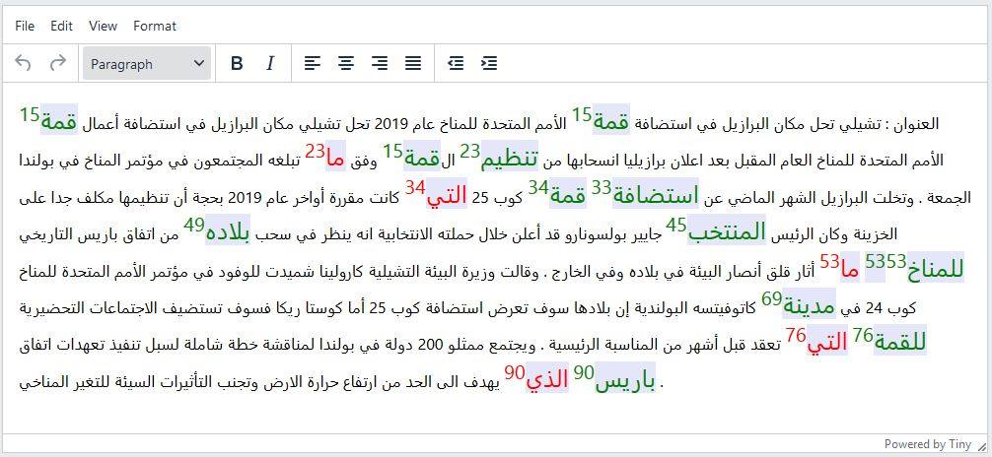

Slide 41
Processing phase
Automatic corpus annotation.
Expert processing.

Slide 42
4. Evaluation

Slide 43
Development environment
Development language: python.
IDE: PyCharm.
Machine features:
Processor: I5-4210H.
RAM: 12Gb.
Operating system: Windows 10/ Mint Linux.

Slide 44
Arabic anaphoric annotated corpus (A3C) in numbers
Category | Words count | Nouns count | Verbs count | Sentences count
Economy | 302696 | 153449 | 23149 | 24020
Education | 290044 | 134667 | 33189 | 29108
Politics | 205954 | 98040 | 18121 | 14669
Sport | 241374 | 170632 | 17685 | 12782
Miscellany | 311255 | 107958 | 25896 | 17871

Slide 45
A3C in numbers (cont.)
Category | Pronominal anaphora count | Possessive | Demonstrative | Relative
Economy | 18580 | 7455 | 6742 | 4383
Education | 13210 | 5696 | 3121 | 2163
Politics | 28540 | 13539 | 9276 | 5725
Sport | 10953 | 6437 | 3572 | 3201
Miscellany | 15069 | 6597 | 4853 | 3619

Slide 46
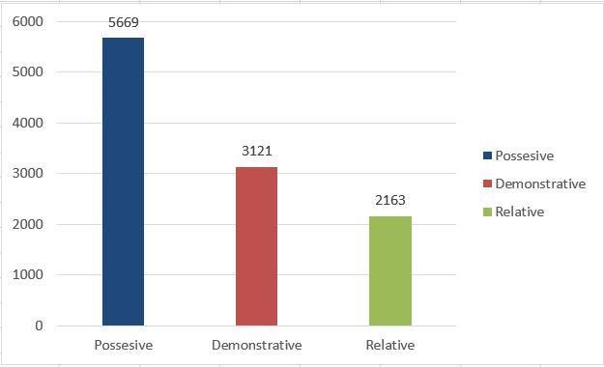
Education category pronominal anaphora statistics.

Slide 47
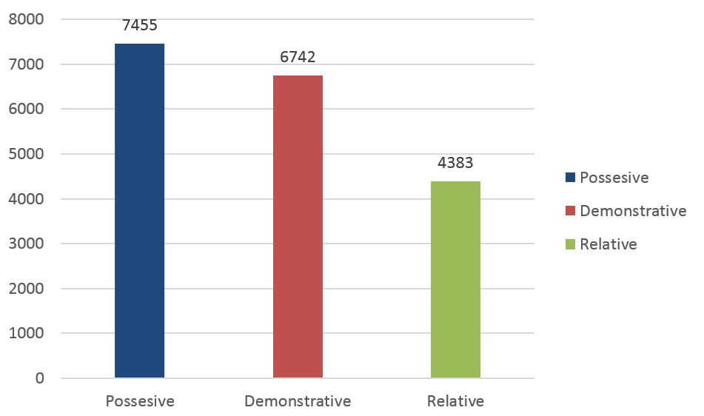
Economic category pronominal anaphora statistics.

Slide 48
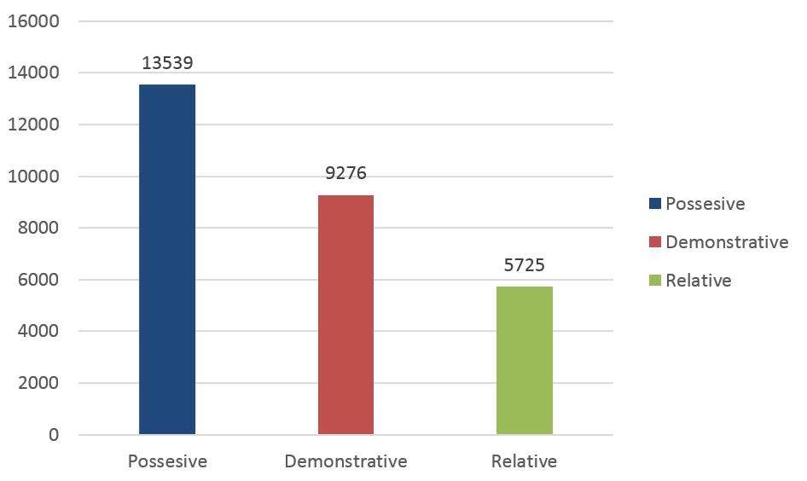
Politics category pronominal anaphora statistics.

Slide 49
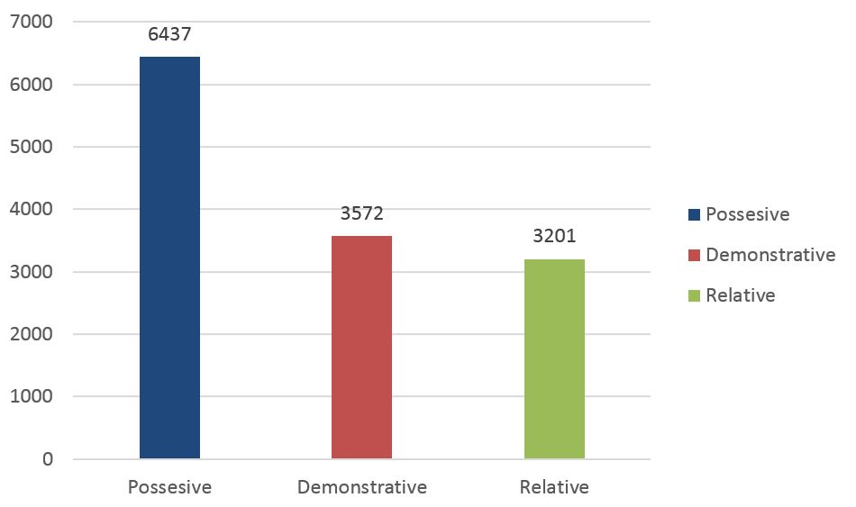
Sports category pronominal anaphora statistics.

Slide 50
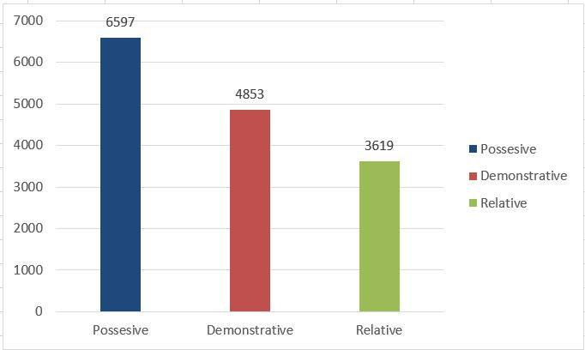
Miscellany category pronominal anaphora statistics.

Slide 51

Arabic anaphoric annotating tool (A3T) interface

Slide 52
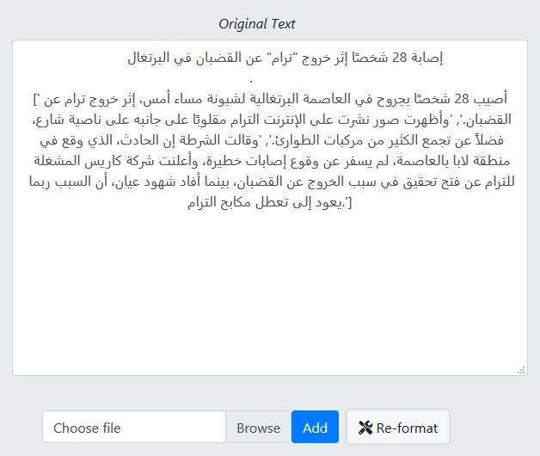
Original text input.

Slide 53
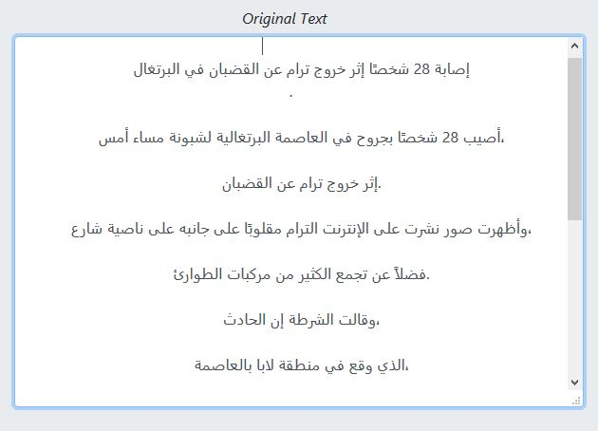
Original text sentence segmentation.

Slide 54
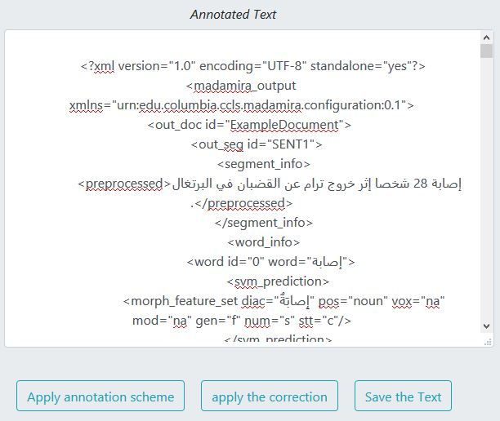
MADAMIRA part-of-speech tagging.

Slide 55
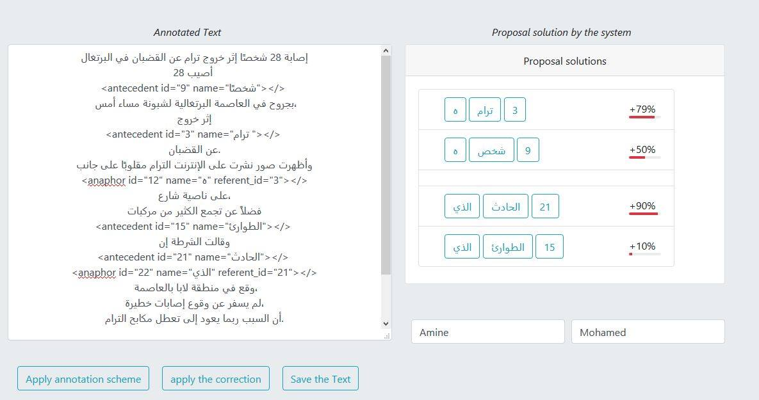
Expert verification and correction interface.

Slide 56
Pronominal evaluation
We used the corpora that was annotated using AnAtAr represent: a technical manual, newspaper articles, texts of Tunisian books used for basic education and a novel dataset, to evaluate the resolution system’s performance.
By doing the verification on the “AnAtAr” corpus, our tool achieved a success rate of 83.19%.

Slide 57

Verbal evaluation
Since we are not aware of any other works done on the verbal anaphora, we going to evaluate our work by seeking the help of an expert in linguistics, who will define if the link between the verbal anaphora and its antecedent is correct or not and give us the right antecedent to see if it was initially included on the list. Through that, the performance of our system was evaluated using the following accuracy metric:
$$Accuracy =\frac{Number of correctly resolve anaphora }{Number of all anaphoras}$$
Concerning the verbal anaphora, we arrive at a satisfactory result whose rate of recognition average is: 57.23%.

Slide 58
5. conclusion

Slide 59
outcome
It is obvious, that the automatic processing of the Arabic language is an area that requires a lot of effort and deep research to make it able to simulate the human processing of texts. In the automatic processing of the Arabic language, anaphora play an important role in understanding texts by determining links between the text entities.
we developed a tool for solving pronominal and verbal anaphora to select optimal referents among candidates based on linguistic concepts (MADAMIRA POS-Tag). In order to evaluate our application, several tests were carried out, the results obtained on the tests corpus showed a satisfactory average percentage in terms of success rate of 83.19% for pronominal anaphora and 57.23% on the verbal anaphora.

Slide 60
Perspectives
As a perspective, we can identify a few points that can improve the quality of our A³T, such as:
Include other knowledge in the resolution: semantic aspects
use a more effective Tagger.
Deepening constraints: defining other operating rules.
Exploit other anaphoric resolution approaches such as the machine learning approach.
Solve other types of anaphora (lexical and comparative)
As for our Arabic anaphoric annotated corpus (A³C), we may look forward for a better correction and increasing it’s size allowing more effectiveness in other researches.

Slide 61
THANKS
Questions?

