Slide 1
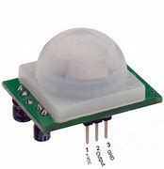
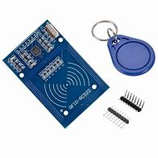
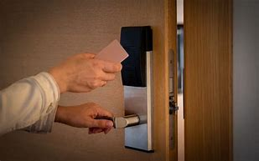
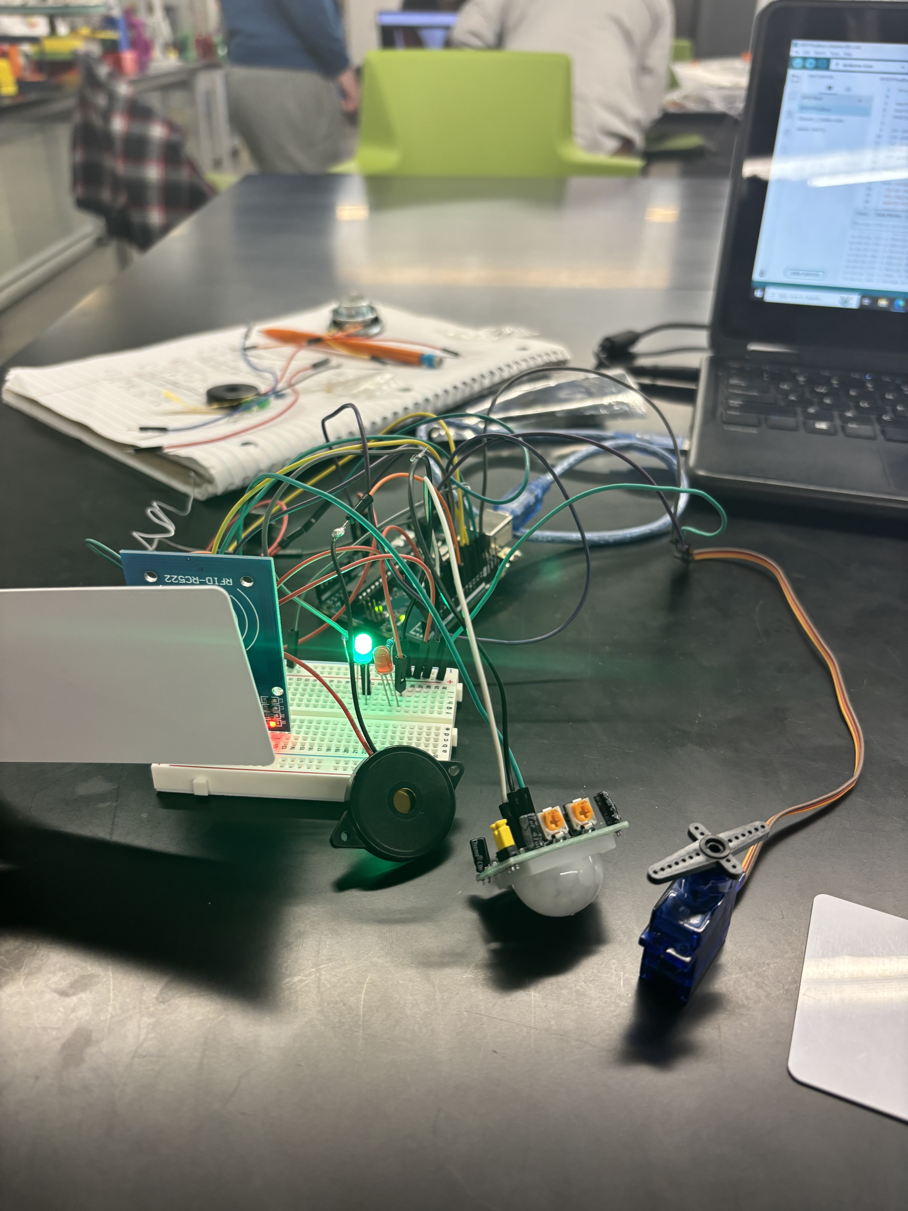

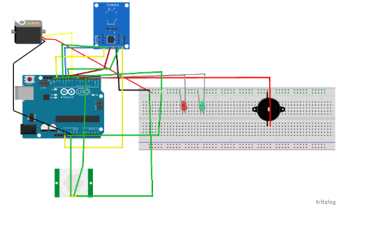
RFID DOOR LOCK
Professor Lubna Alazzawi
Department of Electrical and Computer Engineering
Daishon, Harshil, Deeksha, Jose
Opportunity and Significance
The significance is easily accessible security that you can trust , RFID is becoming a common form of security due to its convenience of being a hand-held form of a key, but with another layer of protection on the door.
Technical Objectives
To completely lock a door using the Arduino as an RFID sensor/reader that reacts to an RFID (card) tag to unlock your doors. This helps keeps your home safe, and is easier to keep around than a key,
Next Steps for Development and Test
Further research of more compact Arduino technology and PIR sensors are needed to make the design a bit more practical and secure. The goal is to fit it onto a box shape and easy to install onto a wall.
Commercialization Plan & Partners
Our Team Consisted of Deeksha Hadagali, Harshil Kunjadiya, Jose Arellano, and Daishon Nelson
Who will you work with to commercialize the product or process?
A home security business that partners with homeowners and businesses with the goal of protections. Such as ADT or Allstate, or any home security company.
What are the main steps or hurdles to commercialization?
Finding a trusted business that acknowledges the pitch of the project and serve as a third-party seller through their platform,.
Technical Approach, Accomplishments and Results
We approached this project with the idea of effectively implementing home security with arduino.
Related Work and State of Practice
The project is related to home security and protection with more personalized and modern forms of security similar products are ring doorbells, security alarms, and camera options.
References
"RFID Door Lock (Updated) "
https://projecthub.arduino.cc/mehmetefepekerr/rfid-door-lock-updated-e77ecb

