Slide 1


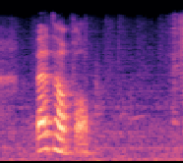
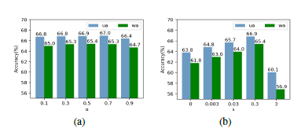
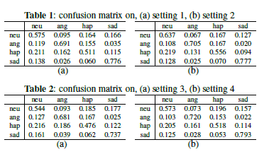
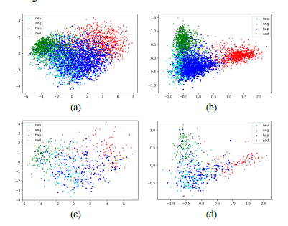
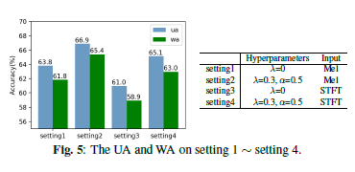

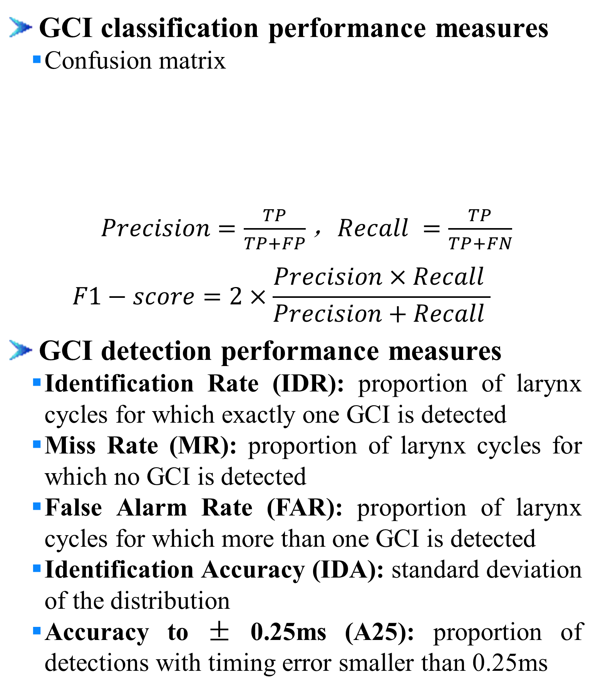
Learning Discriminative Features from Spectrograms using Center Loss for Speech Emotion Recognition
Dongyang Dai^{1,2}, Zhiyong Wu^{1,2,3}, Runnan Li^{1,2}, Xixin Wu³, Jia Jia^{1,2}, Helen Meng^{1,3}
¹Tsinghua-CUHK Joint Research Center for Media Sciences, Technologies and Systems, Graduate School at Shenzhen, Tsinghua University, Shenzhen, China ² Tsinghua National Laboratory for Information Science and Technology (TNList), Department of Computer Science and Technology, Tsinghua University, Beijing, China
³ Department of Systems Engineering and Engineering Management, The Chinese University of Hong Kong
1. Introduction
2. Proposed Method
Motivation
Speech emotion recognition (SER) is crucial for natural human-computer interaction
Challenge
Emotions are naturally ambiguous
Contribution
Introduce center loss in SER task to learn discriminative features
Extract discriminative features and predict emotion in an end-to-end manner
Model Achitecture
a
b
Center loss
a
b
Center Loss
+
Input
FC1
Softmax Cross-entropy Loss
CNN layers
Bi-RNN
FC2
Reshape output: ${L′}_{T} ×d_{cnn} { (d_{cnn}=96⋅d′}_{T}$)
Reshape(Keep time axis)
2D convolutions output: ${L′}_{T} × L_{F}^{′}×$96
Softmax cross-entropy loss
a
b
Max-pooling: 2 $×$ 2, strides [2, 2]
Concatenate
Convolution: 96 filters of 3 $×$ 3, strides [1, 1]
Max-pooling: 2 $×$ 2, strides [2, 2]
Convolution: 80 filters of 3 $×$ 3, strides[1, 1]
Max-pooling: 2 $×$ 2, strides [2, 2]
Convolution: 64 filters of 3 $×$ 3, strides [1, 1]
Convolution: 48 filters of 7 $×$ 7, strides [2, 2]
Input: spectrogram L_{T} $× L_{F}$
3. Experiments and Results
4. Conclusion
Speech material
CMU ARCTIC databases: BDL, SLT, KED and JMK
MIX2: 800 utterances of BDL, 400 utterances of JMK
MIX4: 800 utterances of BDL, 400 utterances of JMK, 400 utterances of SLT , 100 utterances of KED
Compared methods
ERT-P3 [11], DYPSA [9], SEDREAMS [10]
Experiments
Experiment-1
Trained on MIX2, tested on MIX2, SLT and KED
Training: 800 utterances from MIX2; Validation: 100 MIX2;
Test: 300 MIX2, 1131 SLT, 452 KED
Experiment-2
Trained on MIX4, tested on MIX4, SLT and KED
Training: 1000 MIX4; Validation: 200 MIX4;
Test: 500 MIX4, 732 SLT, 352 KED
GCI classification performance measures
Confusion matrix
$Precision=\frac{TP}{TP+FP}$，$Recall =\frac{TP}{TP+FN}$
$$F1−score=2×\frac{Precision×Recall }{Precision+Recall }$$
GCI detection performance measures
Identification Rate (IDR): proportion of larynx cycles for which exactly one GCI is detected
Miss Rate (MR): proportion of larynx cycles for which no GCI is detected
False Alarm Rate (FAR): proportion of larynx cycles for which more than one GCI is detected
Identification Accuracy (IDA): standard deviation of the distribution
Accuracy to ± 0.25ms (A25): proportion of detections with timing error smaller than 0.25ms
Conclusion
a
Database | Number of speakers | Number of utterances | Approximate duration
BDL | 1 | 1132 | 54 min
SLT | 1 | 1132 | 54 min
KED | 1 | 452 | 20 min
JMK | 1 | 1132 | 55 min
MIX2 | 2 | 1200 | 57 min
MIX4 | 4 | 1700 | 81 min
 | Positive Class | Negative Class
Predict Positive | True Positive (TP) | False Positive (FP)
Predict Negative | False Negative (FN) | True Negative (TN)
5. Acknowledgment
This work is supported by National Natural Science Foundation of China (NSFC) (61433018, 61375027), joint research fund of NSFC-RGC (Research Grant Council of Hong Kong) (61531166002, N CUHK404/15) and National Social Science Foundation of China (13&ZD189)

