Slide 1


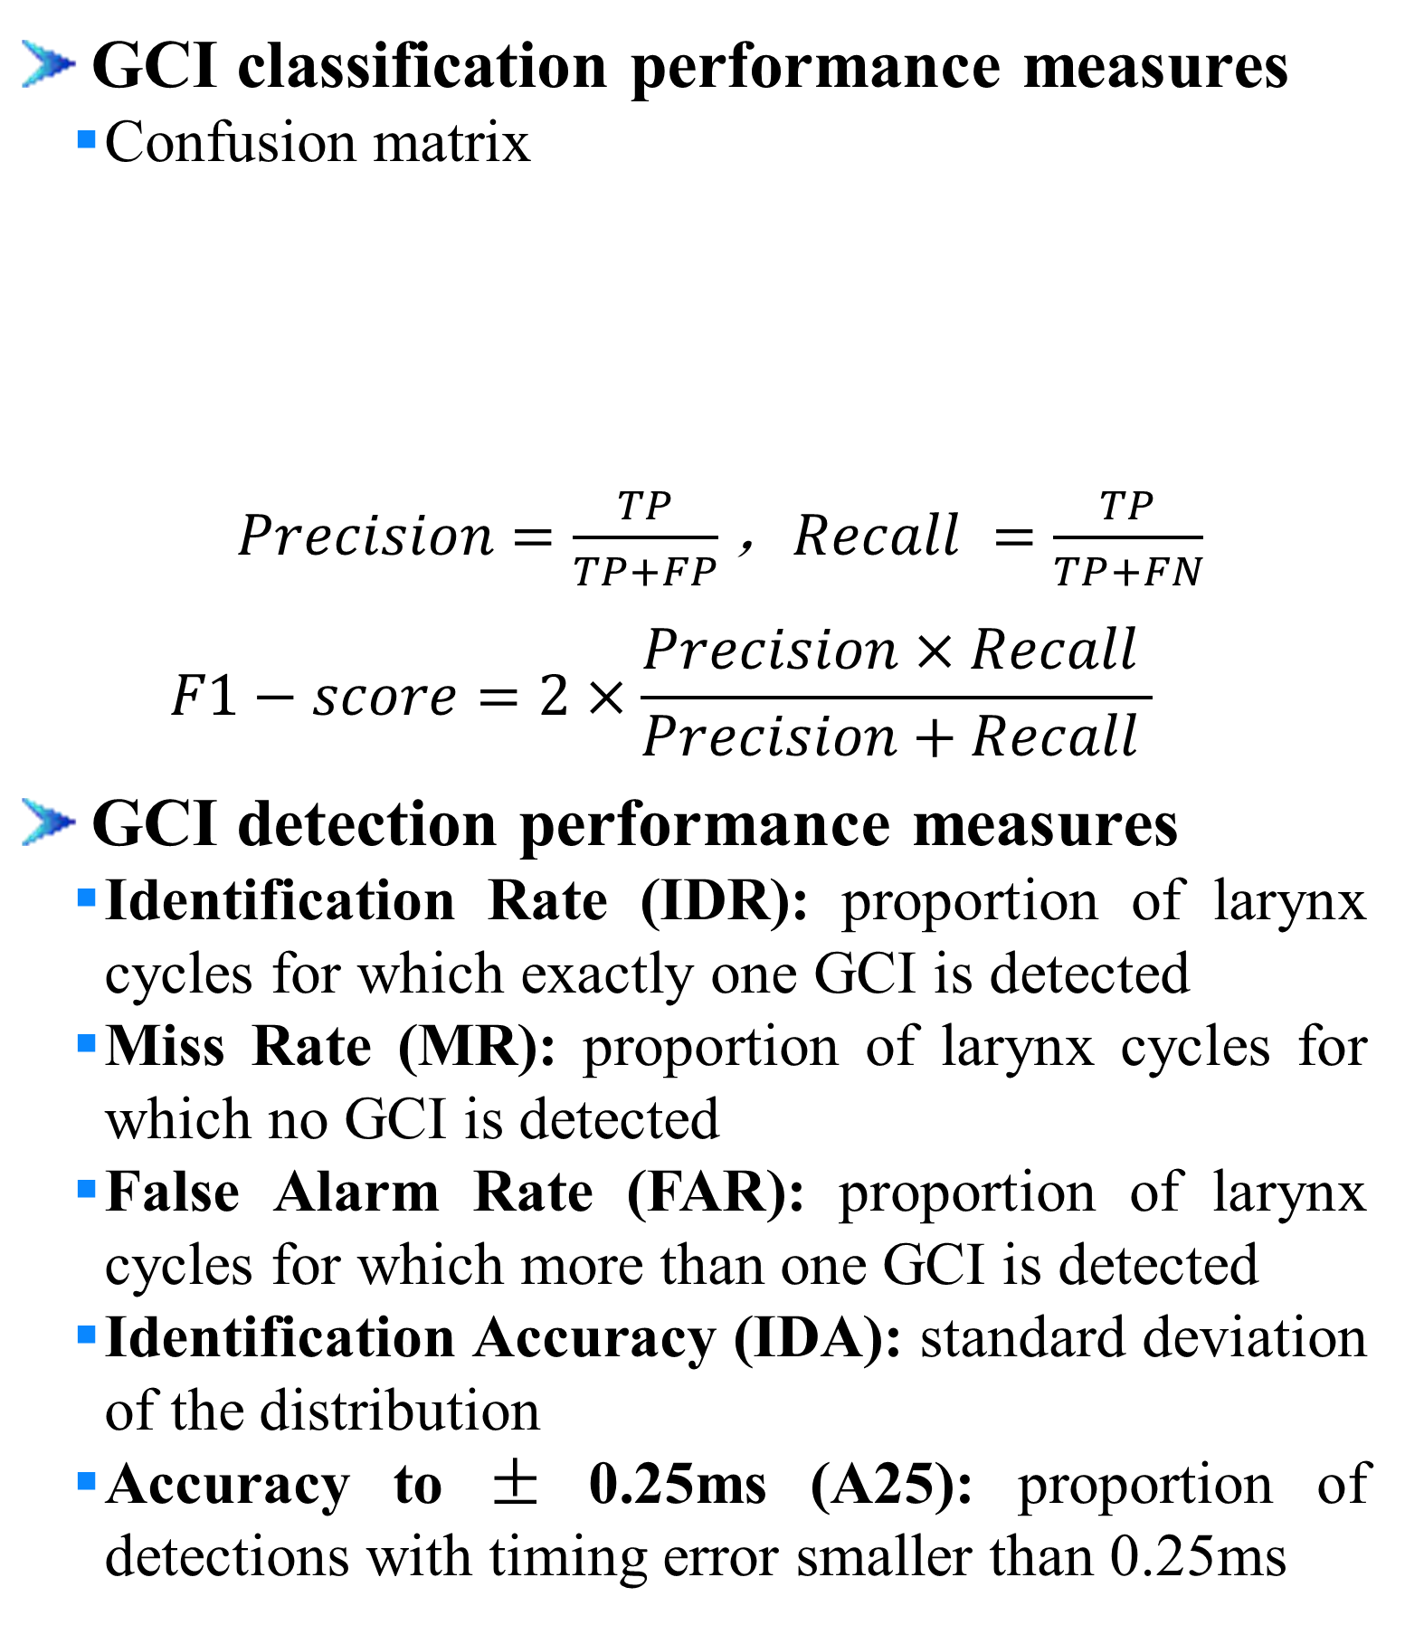
Learning Discriminative Features from Spectrograms using Center Loss for Speech Emotion Recognition
Dongyang Dai^{1,2}, Zhiyong Wu^{1,2,3}, Runnan Li^{1,2}, Xixin Wu³, Jia Jia^{1,2}, Helen Meng^{1,3}
¹Tsinghua-CUHK Joint Research Center for Media Sciences, Technologies and Systems, Graduate School at Shenzhen, Tsinghua University, Shenzhen, China ² Tsinghua National Laboratory for Information Science and Technology (TNList), Department of Computer Science and Technology, Tsinghua University, Beijing, China
³ Department of Systems Engineering and Engineering Management, The Chinese University of Hong Kong
1. Introduction
2. Proposed Method
Objective
Detect glottal closure instants (GCI) directly from speech signals
speech signal (a), lowpass filtered signal (b), EGG signal (c)
Challenge
Data imbalance problem as GCIs are very rare events in raw speech signal
Contribution
Divide the GCI detection procedure into two successive steps:
GCI candidates selection
GCI classification among GCI candidates
Propose using convolutional neural network (CNN) as classification model for GCI detection from raw speech waveform
GCI candidates selection
Low-pass filter speech waveforms using a 6th-order low-pass Butterworth filter with the cutoff frequency 700 Hz
Take the negative peaks in the low-pass filtered signal as the candidates for GCI placement
raw signal (dashed line), low-pass filtered signal (solid line), GCI candidates (circle), true GCIs (solid points)
GCI classification with CNN
Features
Raw waveform samples in the window surrounding the GCI candidates (negative peaks)
Example:
Sampling rate: 16kHz
Window length: 30ms (radius=15ms, 240 samples)
Feature vector: 481 (240+1+240)
Model specification
Input: 481-dimensional feature vector
Feature extraction: 9-layer CNN
Decision network: 3-layer fully connected (FC) network
Output: binary GCI classification result
Model training
Loss function: cross entropy with L2 norm
Optimizer: Adam
Layers | Output shape (channels * time dimension) | padding | Kernel Size / Strides
Output | 2*1
Fully Connected | 64*1
Max_Pool_9 | 512*1 | same | 1*3 / 2
Conv_9 | 512*2 | same | 1*3 / 1
Max_Pool_8 | 512*2 | same | 1*3 / 2
Conv_8 | 512*4 | same | 1*3 / 1
Max_Pool_7 | 512*4 | same | 1*3 / 2
Conv_7 | 512*8 | same | 1*3 / 1
Max_Pool_6 | 512*8 | same | 1*3 / 2
Conv_6 | 512*16 | same | 1*3 / 1
Max_Pool_5 | 256*16 | same | 1*3 / 2
Conv_5 | 256*31 | same | 1*3 / 1
Max_Pool_4 | 128*31 | same | 1*3 / 2
Conv_4 | 128*61 | same | 1*3 / 1
Max_Pool_3 | 64*61 | same | 1*3 / 2
Conv_3 | 64*121 | same | 1*3 / 1
Max_Pool_2 | 32*121 | same | 1*3 / 2
Conv_2 | 32*241 | same | 1*5 / 1
Max_Pool_1 | 16*241 | same | 1*3 / 2
Conv_1 | 16*481 | same | 1*7 / 1
Input | 1*481
3. Experiments and Results
4. Conclusion
Speech material
CMU ARCTIC databases: BDL, SLT, KED and JMK
MIX2: 800 utterances of BDL, 400 utterances of JMK
MIX4: 800 utterances of BDL, 400 utterances of JMK, 400 utterances of SLT , 100 utterances of KED
Compared methods
ERT-P3 [11], DYPSA [9], SEDREAMS [10]
Experiments
Experiment-1
Trained on MIX2, tested on MIX2, SLT and KED
Training: 800 utterances from MIX2; Validation: 100 MIX2;
Test: 300 MIX2, 1131 SLT, 452 KED
Experiment-2
Trained on MIX4, tested on MIX4, SLT and KED
Training: 1000 MIX4; Validation: 200 MIX4;
Test: 500 MIX4, 732 SLT, 352 KED
GCI classification performance measures
Confusion matrix
$Precision=\frac{TP}{TP+FP}$，$Recall =\frac{TP}{TP+FN}$
$$F1−score=2×\frac{Precision×Recall }{Precision+Recall }$$
GCI detection performance measures
Identification Rate (IDR): proportion of larynx cycles for which exactly one GCI is detected
Miss Rate (MR): proportion of larynx cycles for which no GCI is detected
False Alarm Rate (FAR): proportion of larynx cycles for which more than one GCI is detected
Identification Accuracy (IDA): standard deviation of the distribution
Accuracy to ± 0.25ms (A25): proportion of detections with timing error smaller than 0.25ms
Experiment-1
Experiment-2
Conclusion
A CNN based method is proposed to detect GCIs from raw speech waveform
The proposed method can achieve near or better performance compared to state-of-the-art methods
The model can get better results when the training set covers more speaker variations (i.e. more speakers in training set)
To detect GCIs of a specific speaker’s speech, adding a small portion of this speaker’s data into the training set would help boost the GCI detection performance
Future work
MR of the proposed method is relatively high as most GCIs on the border between voiced and silence sections are missed
The method to reduce MR needs further investigation
Database | Number of speakers | Number of utterances | Approximate duration
BDL | 1 | 1132 | 54 min
SLT | 1 | 1132 | 54 min
KED | 1 | 452 | 20 min
JMK | 1 | 1132 | 55 min
MIX2 | 2 | 1200 | 57 min
MIX4 | 4 | 1700 | 81 min
 | Positive Class | Negative Class
Predict Positive | True Positive (TP) | False Positive (FP)
Predict Negative | False Negative (FN) | True Negative (TN)
Database | Method | Precision (%) | Recall (%) | F1-score (%)
MIX2 | CNN | 97.26 | 99.22 | 98.23
SLT | CNN | 95.16 | 98.48 | 96.79
 | ERT-P3 | 95.07 | 99.69 | 97.33
KED | CNN | 93.07 | 96.15 | 94.21
 | ERT-P3 | 92.73 | 96.96 | 94.79
Database | Method | Precision (%) | Recall (%) | F1-score (%)
MIX4 | CNN | 97.26 | 98.44 | 97.85
SLT | CNN | 95.80 | 99.71 | 97.72
 | ERT-P3 | 95.07 | 99.69 | 97.33
KED | CNN | 93.40 | 97.12 | 95.23
 | ERT-P3 | 92.73 | 96.96 | 94.79
Data set | Method | IDR (%) | MR (%) | FAR (%) | IDA (ms) | A25 (%)
MIX2 | CNN | 92.33 | 7.01 | 0.67 | 0.04 | 95.65
SLT | CNN | 94.87 | 4.51 | 0.62 | 0.03 | 99.46
 | ERT-P3 | 95.18 | 1.35 | 3.47 | 0.15 | 95.08
 | DYPSA | 91.50 | 2.80 | 5.70 | 0.30 | 81.23
 | SEDREAMS | 92.96 | 1.15 | 5.89 | 0.19 | 89.09
KED | CNN | 91.51 | 6.87 | 1.62 | 0.02 | 96.98
 | ERT-P3 | 91.88 | 2.94 | 5.18 | 0.27 | 88.02
 | DYPSA | 89.01 | 4.62 | 6.37 | 0.48 | 83.70
 | SEDREAMS | 89.54 | 1.16 | 9.30 | 0.56 | 78.46
Data set | Method | IDR (%) | MR (%) | FAR (%) | IDA (ms) | A25 (%)
MIX4 | CNN | 94.67 | 4.86 | 0.47 | 0.03 | 97.38
SLT | CNN | 97.51 | 2.27 | 0.22 | 0.03 | 99.47
 | ERT-P3 | 95.18 | 1.35 | 3.47 | 0.15 | 95.08
 | DYPSA | 91.50 | 2.80 | 5.70 | 0.30 | 81.23
 | SEDREAMS | 92.96 | 1.15 | 5.89 | 0.19 | 89.09
KED | CNN | 94.61 | 5.12 | 0.26 | 0.02 | 98.31
 | ERT-P3 | 91.88 | 2.94 | 5.18 | 0.27 | 88.02
 | DYPSA | 89.01 | 4.62 | 6.37 | 0.48 | 83.70
 | SEDREAMS | 89.54 | 1.16 | 9.30 | 0.56 | 78.46
5. Acknowledgment
This work is supported by National Natural Science Foundation of China - Research Grant Council of Hong Kong (NSFC-RGC) joint research fund (61531166002, N_CUHK404/15), National Natural Science Foundation of China (61433018, 61375027) and National Social Science Foundation of China (13&ZD189)

