Slide 1
Diagrams

Slide 2

















$$x_{1}^{′}$$
$$x_{2}^{′}$$
$$x_{3}^{′}$$
$$x_{4}^{′}$$
$$x_{5}^{′}$$
$$x_{6}^{′}$$
$$x_{7}^{′}$$
$$w_{5}^{′}$$
$$w_{6}^{′}$$
$$w_{7}^{′}$$
$$x_{1}$$
$$x_{2}$$
$$x_{3}$$
$$x_{4}$$
$$x_{5}$$
$$x_{6}$$
$$x_{7}$$

Slide 3








$$x_{1}^{′}$$
$$x_{2}^{′}$$
$$x_{3}^{′}$$
$$x_{4}^{′}$$
$$x_{5}^{′}$$
$$w_{1}^{′}$$
$$w_{2}^{′}$$
$$x_{1}$$
$$x_{2}$$
$$x_{3}$$
$$x_{4}$$
$$x_{5}$$

Slide 4




















$$O_{1}$$
$$O_{2}$$
$$O_{3}$$
$$O_{4}$$
$$O_{5}$$
$$O_{6}$$
$$O_{7}$$
$$O_{8}$$
$$H_{1}$$
$$H_{2}$$
$$H_{3}$$
5
$$I_{1}$$
3
4
$$I_{7}$$
$$I_{8}$$
$$I_{1}$$
$$I_{2}$$
$$I_{3}$$
$$I_{4}$$
$$I_{5}$$
$$I_{6}$$
1
2

Slide 5
output
output
fc
fc
input
input

Slide 6









Output: 4 posterior probabilities
Timing Frequency Max-pooling: 2 $×$ 2
Dense Layer(Soft-max): length 4
Convolution: 16 filters of 3 $×$ 3
Dropout: 0.5(training)/0.0(infer)
Timing Frequency Max-pooling: 2 $×$ 2
Convolution: 16 filters of 3 $×$ 3
Dense Layer: length 64
Timing Frequency Max-pooling: 2 $×$ 2
Timing GRU: bi-directional, 128 $×$ 2
Convolution: 8 filters of 3 $×$ 3
Convolution Layers
Timing Frequency Max-pooling: 2 $×$ 2
Convolution: 8 filters of 3 $×$ 3
Input: spectrogram N $×$400 (T sec $×$ 400)

Slide 7
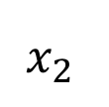
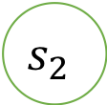
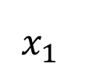

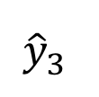
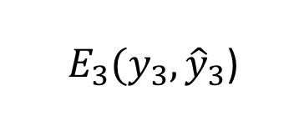
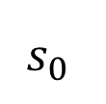
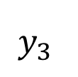
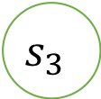
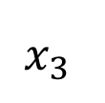
$$y_{3}$$
$E_{3}(y_{3},{\hat{y}}_{3}$)
$${\hat{y}}_{3}$$
$$s_{0}$$
$$s_{1}$$
$$s_{2}$$
$$s_{3}$$
$$x_{1}$$
$$x_{2}$$
$$x_{3}$$

Slide 8
output
fc
attention
Self attention (multihead)
Dilation Conv
xN
Dilation Conv
Dilation Conv
input

Slide 9
+
Self attention/CNN
$$x_{1}$$
$$x_{2}$$
$$x_{3}$$
$$x_{4}$$
$$x_{5}$$
$$x_{6}$$
$$x_{7}$$

Slide 10


Reshape output: ${L′}_{T} ×d_{cnn} { (d_{cnn}=96⋅d′}_{T}$)
Reshape(Keep time axis)
CNN layers output: ${L′}_{T} × L_{F}^{′}×$96
Max-pooling: 2 $×$ 2, strides [2, 2]
Convolution: 96 filters of 3 $×$ 3, strides [1, 1]
Max-pooling: 2 $×$ 2, strides [2, 2]
Convolution: 80 filters of 3 $×$ 3, strides[1, 1]
Max-pooling: 2 $×$ 2, strides [2, 2]
Convolution: 64 filters of 3 $×$ 3, strides [1, 1]
Convolution: 48 filters of 7 $×$ 7, strides [2, 2]
Input: spectrogram L_{T} $× L_{F}$

Slide 11
Reshape output: ${L′}_{T} ×d_{cnn} { (d_{cnn}=96⋅d′}_{T}$)
Reshape(Keep time axis)
2D convolutions output: ${L′}_{T} × L_{F}^{′}×$96
Max-pooling: 2 $×$ 2, strides [2, 2]
Convolution: 96 filters of 3 $×$ 3, strides [1, 1]
Max-pooling: 2 $×$ 2, strides [2, 2]
Convolution: 80 filters of 3 $×$ 3, strides[1, 1]
Max-pooling: 2 $×$ 2, strides [2, 2]
Convolution: 64 filters of 3 $×$ 3, strides [1, 1]
Convolution: 48 filters of 7 $×$ 7, strides [2, 2]
Input: spectrogram L_{T} $× L_{F}$

Slide 12
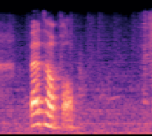
Center Loss
Center Loss
+
+
Softmax Cross-entropy Loss
Softmax Cross-entropy Loss
Input
FC1
FC1
CNN layers
Bi-RNN
FC2
FC2

Slide 13
Center Loss
+
Softmax Cross-entropy Loss
Input
FC1
CNN layers
Bi-RNN
FC2

Slide 14
Center Loss
Center Loss
+
+
Softmax Cross-entropy Loss
Softmax Cross-entropy Loss
Input
Dropout
FC1
FC1
CNN Layers
CNN Layers
BiRNN
FC2
FC2

Slide 15
Concatenate

Slide 16
Concatenate

Slide 17
Synthesized Audio
Decoder
Attention
Text Encoder
Input Text Sequence

Slide 18
Waveform
Acoustic features
Vocoder
Acoustic features
Decoder
Acoustic Parameter Model
Linguistic features
(frame)
Attention
Duration Model
Text Encoder
Linguistic features
(phoneme)
Frontend Text Processing
Input phoneme Sequence
Input Text

Slide 19
Center Loss
+
Softmax Cross-entropy Loss
Input
FC1
CNN layers
Bi-RNN
FC2

Slide 20
NN
classifier
Features
Emotion Category

Slide 21
NN
Classifier
Raw Data
Features
Emotion Category

Slide 22
Center Loss
+
Softmax Cross-entropy Loss
Input
FC1
CNN-layers
Bi-RNN
FC2

Slide 23

Center Loss
$$z$$
+
Softmax Cross-entropy Loss

Slide 24



Center Loss
+
Softmax Cross-entropy Loss
$$Input$$
FC1
$$CNN−layers$$
$$Bi−RNN$$
FC2

Slide 25

Reshape output: ${L′}_{T} ×d_{cnn} { (d_{cnn}=96⋅L′}_{F}$)
Reshape(Keep time axis)
2-D convolutions output: ${L′}_{T} × L_{F}^{′}×$96
Max-pooling: 2 $×$ 2, strides [2, 2]
Convolution: 96 filters of 3 $×$ 3, strides [1, 1], ReLU nonlinear
Max-pooling: 2 $×$ 2, strides [2, 2]
Convolution: 80 filters of 3 $×$ 3, strides[1, 1], ReLU nonlinear
Max-pooling: 2 $×$ 2, strides [2, 2]
Convolution: 64 filters of 3 $×$ 3, strides [1, 1], ReLU nonlinear
Convolution: 48 filters of 7 $×$ 7, strides [2, 2], ReLU nonlinear
Input: spectrogram L_{T} $× L_{F}$

Slide 26
Concatenate

Slide 27

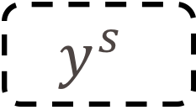
$$y^{s}$$
Source

Slide 28

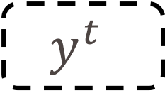
$$y^{t}$$
Target

Slide 29
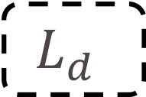
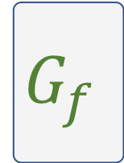
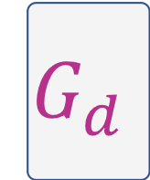

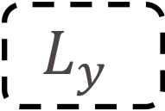
$$G_{y}$$
$$L_{y}$$
$$G_{f}$$
Input
$$G_{d}$$
$$L_{d}$$

Slide 30


$$G_{y}$$
$$L_{y}$$
$$G_{f}$$
Input
$$G_{d}$$
$$L_{d}$$

Slide 31
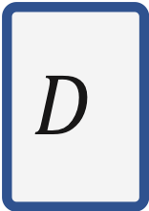




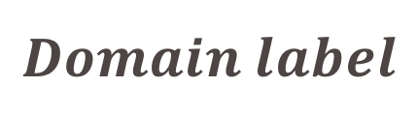
$$M_{s}$$
$$C$$
$$Class label$$
Source
$$M_{t}$$
$$D$$
$$Domain label$$
Target

Slide 32
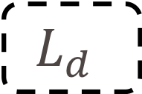
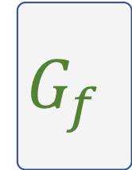
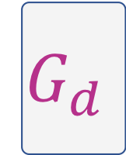


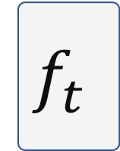

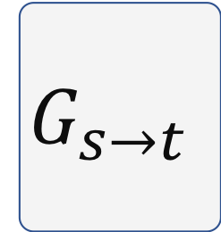
$$G_{s→t}$$
$$f_{t}$$
$$label$$
Source
Target
$$G_{y}$$
$$L_{y}$$
$$G_{f}$$
Input
$$G_{d}$$
$$L_{d}$$

Slide 33
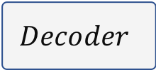
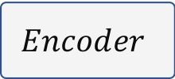
$$G_{s→t}$$
$$f_{t}$$
$$label$$
Source
Target
Input Sequence
$$Encoder$$
$$Decoder$$
Output Sequence

Slide 34








Original Emotion Embedding
$$Emotion \\ Label$$
$$Audio$$
Feature Extractor
Emotion Classifier
Emotion Embedding
Embedding Reconstructor
$$Text$$
Original Emotion Embedding
$$Emotion \\ Label$$
$$Audio$$
Feature Extractor
Emotion Classifier
Emotion Embedding
Embedding Reconstructor
$$Text$$
$$Text$$
Text Encoder
Conditioning
Attention
Decoder
$$Audio$$

Slide 35

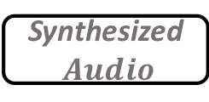




$$Emotion \\ Label$$
Emotion Classifier
Original Emotion Embedding
Feature Extractor
$$Audio$$
$$Text$$
Embedding Reconstructor
Reconstructed Emotion Embedding
$$Emotion \\ Label$$
Emotion Classifier
Original Emotion Embedding
Feature Extractor
$$Audio$$
Embedding Reconstructor
Reconstructed Emotion Embedding
$$Text$$
Text Encoder
Conditioning
Attention
Decoder
Synthesized$Audio$

Slide 36

$$Audio$$
Feature Extractor
Emotion Embedding
Emotion Classifier
Softmax Cross-entropy Loss
+
Discriminative Loss

Slide 37
Audio
Feature Extractor
Emotion Embedding
Emotion Classifier
Softmax Cross-entropy Loss
+
Discriminative Loss
Embedding
Text
TTS Network
Audio

Slide 38
Audio
Feature Extractor
Emotion Embedding
Classifier
Softmax Loss
+
Discriminative Loss
Feature Reconstructor
Emotion Embedding
Text
TTS Network
Audio

Slide 39
Audio
Feature Extractor
SER Emotion Embedding
TTS Network
Audio
Feature Extractor
SER Emotion Embedding
Classifier
Text
Feature Reconstructor
Emotion Label
Emotion Embedding
TTS Network

Slide 40
Text
Feature Reconstructor
Emotion Label
Emotion Embedding
TTS Network

Slide 41
Audio
Feature Extractor
SER Emotion Embedding
Classifier
Text
Feature Reconstructor
Emotion Label
Emotion Embedding
TTS Network

Slide 42
Text
Feature Reconstructor
Emotion Label
Emotion Embedding
TTS Network

Slide 43

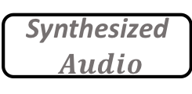

$$Audio$$
Feature Extractor
Emotion Embedding
$$Text$$
Text Encoder
Conditioning
Attention
Decoder
Synthesized$Audio$
$$Emotion \\ Label$$
Emotion Classifier
Original Emotion Embedding
Feature Extractor
$$Audio$$
Embedding Reconstructor
Reconstructed Emotion Embedding
$$Text$$
Text Encoder
Conditioning
Attention
Decoder
Synthesized$Audio$

Slide 44
SER Corpus
Adaptation
TTS Corpus

Slide 45
Adaptation
SER Corpus
TTS Corpus
Source Domain
Target Domain

Slide 46






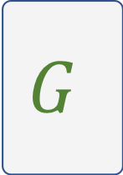

x
$$D$$
$$Real or Fake?$$
$$G$$
G(z)
z

Slide 47
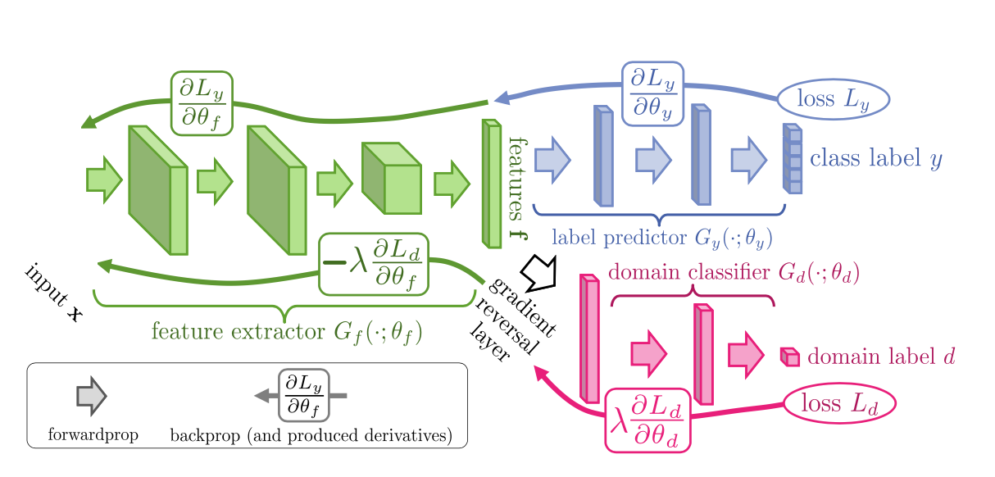

Slide 48
$$M_{s}$$
$$C$$
$$Class label$$
English Audio
$$M_{t}$$
$$D$$
$$Domain label$$
German Audio

Slide 49

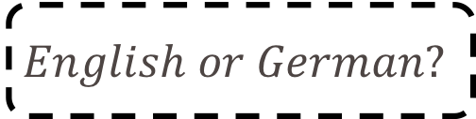
$$G_{y}$$
$$emotions of English audio$$
$$G_{f}$$
Input
$$G_{d}$$
$$English or German?$$

Slide 50
Spectrograms
Discriminative Features
Emotion

Slide 51
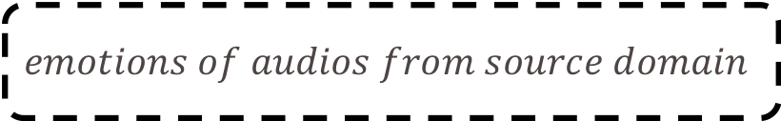
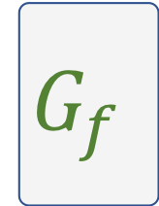
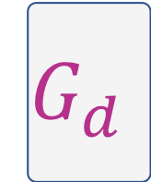
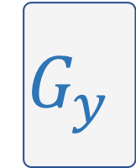
$$G_{y}$$
$$emotions of audios from source domain$$
$$G_{f}$$
Input: Audios from source domain + target domain
$$G_{d}$$
Audio from source domain or target domain?

Slide 52
$$G_{y}$$
$$L_{y}$$
$$G_{f}$$
Input
$$G_{d}$$
$$L_{d}$$

Slide 53











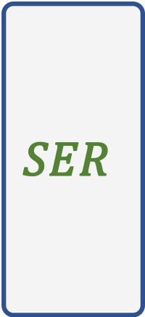
$$SER$$
$$Text$$
$$emo$$
$$Audio$$
SER Corpus
$$SER$$
$$Text$$
$$emo$$
$$TTS$$
$$emo$$
$$Audio$$
$$Audio$$
TTS Corpus2
$$Text$$
TTS Corpus2
TTS Corpus2

Slide 54







$$Text$$
$$TTS$$
TTS Corpus2
$$Audio$$
TTS Corpus2
$$emo$$
$$TTS$$
$$Text$$
$$Audio$$
TTS Corpus1
TTS Corpus1

Slide 55
adaption

Slide 56
adaptation

Slide 57
adaptation

