Slide 1

DAI JONES INVESTMENTS
-----------
Dai Jones
Investments
-----------
-----------
Dai Jones
Investments
-----------
Annual Financial Review
www.daijones.tk

Slide 2
-----------
Dai Jones
Investments
-----------
ACCOUNT DETAILS
-----------
Dai Jones
Investments
-----------
CHECKING ACCOUNT
TRADING ACCOUNT
Value at close of business Friday 04/04/04.
Account - £212.24
Ian Jones to receive £10 this months.
Tertiary - £255.78
Newmedia - £309.96
Antisoma - £174.25
Host Europe - £245.34
Tullow - £320.05
Spare cash - £56.23
TOTAL - £202.24
TOTAL - £1718.23
DAI JONES
www.daijones.tk

Slide 3
-----------
Dai Jones
Investments
-----------
TOTALS
-----------
Dai Jones
Investments
-----------
CURRENT FUND VALUE - £1663.85
(MONEY AVAILABLE FOR INVESTMENT - £358.47)
Member value:
Previous months:
£166.39
April – £192.05
March – £179.00
(£28.3v8 increase)
www.daijones.tk

Slide 4
-----------
Dai Jones
Investments
-----------
One Year On…
www.daijones.tk

Slide 5
-----------
Dai Jones
Investments
-----------
How much profit has the first year brought us??
Enough to buy –
National Health Nurse for 1 week
26 Lap dancing sessions in The Gentlemens Club
2 pairs of Beckham’s Adidas Predator boots
6.5 bottles of Veurve Cliquet
www.daijones.tk

Slide 6
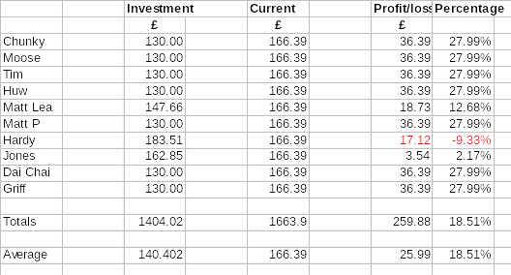
Portfolio Returns – year ending 05/05/04
Fund Statements will be received shortly

Slide 7
Financial Comparatives
International League Table:
USA - Dow Jones
20%
WALES - Dai Jones
18.51%
UK - FTSE
15.1%
FRANCE – Le CAC
14%
-----------
Dai Jones
Investments
-----------

Slide 8
