Slide 1
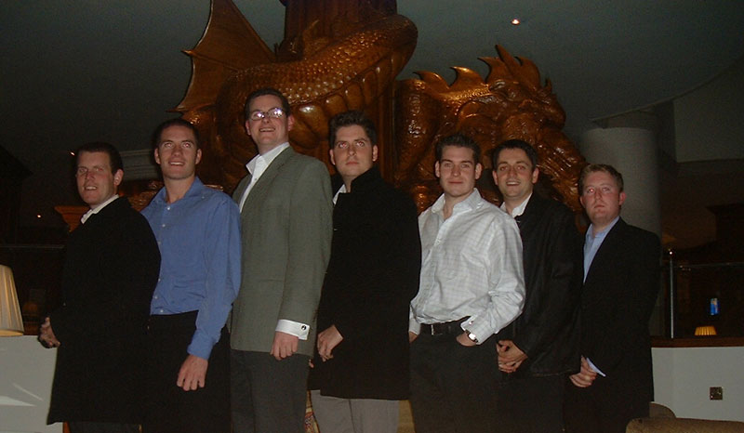
DAI JONES INVESTMENTS
-----------
Dai Jones
Investments
-----------
-----------
Dai Jones
Investments
-----------
Financial Review for the 5th AGM
May 4th 2008
www.daijones.tk

Slide 2
Volatile Markets
(Data as at start Feb 2007)
DAILY: 21st JAN the FIFTH worst daily decline (-5.3%) in the FTSE A/S in the period Jan ’86 through current (nearly 6000 days!).
    7 days in that span saw declines of more than 5%
WEEKLY: For the week 21st-25th JAN, the FTSE A/S’s decline was much more muted: “only” (-0.4%)
    That is the 410th worst week since 1986 (out of over 1100 weeks)
    In fact, the previous week was much worse (-4.3%), the 16th worse week in that span.
MONTHLY: If Jan 25th represents the end of the month (i.e. -9.0%), Jan 2008 would be the 8th worst month since 1986 (266 months).
    There have been 30 months which saw declines of more than 5%, with the average of those poor months = -7.9%
YEARLY: FOLLOWING POOR MONTHS if we look at those 30 poor months, and then track price index performance over the next year (including the down month):
    There were 22 positive periods and eight down periods, with average increase of over 10%!
    Of the 8 periods that saw equity markets finish lower a year later, they all occurred either during a recession (1989-90, 2002) or a mid cycle-slowdown (1994)

Slide 3
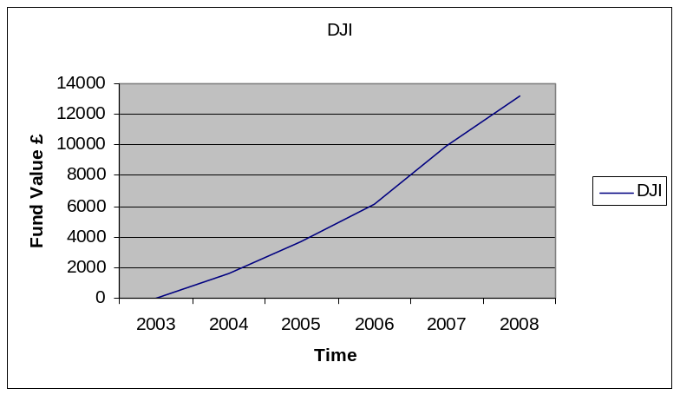
-----------
Dai Jones
Investments
-----------
TOTALS
-----------
Dai Jones
Investments
-----------
CURRENT FUND VALUE -
£13,185.75
2004
2005
2006
2007
£1663.85
£3747.90
£6116.35
£9894.16
(MONEY AVAILABLE FOR INVESTMENT - £614.14)
Member value:
£1098.91
First time >£1k
www.daijones.tk

Slide 4
-----------
Dai Jones
Investments
-----------
TOTALS
-----------
Dai Jones
Investments
-----------
£13,185.75
CURRENT FUND VALUE -
£12,012.24*
Investment -
Profit
£1,173.51
9.8%
(*exc. £95 debt)
www.daijones.tk

Slide 5
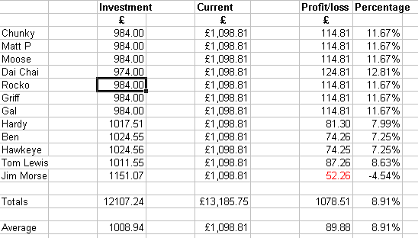
(Note: Does not include debts – ie. JM/DC)

Slide 6
Some analysis…

Slide 7



The Roller Coaster of Investor Emotions
great about this
“Temporary setback. I’m a long term investor.”
“Wow, I feel great about this investment.”
Euphoria
Point of maximum
financial opportunity
Thrill
Anxiety
“Maybe the markets just aren’t for me.”
Denial
Excitement
Fear
Optimism
Optimism
Depression
Relief
Panic
Hope
Point of maximum
financial risk
Capitulation
Desperation

Slide 8
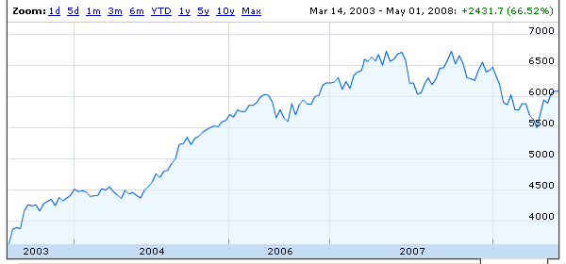
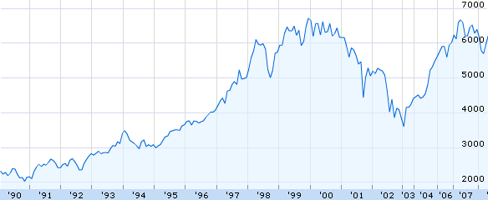
-----------
Dai Jones
Investments
-----------
FTSE – since inception
-----------
Dai Jones
Investments
-----------

Slide 9
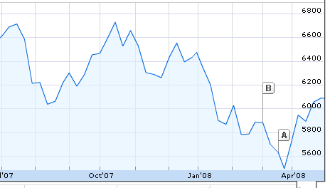
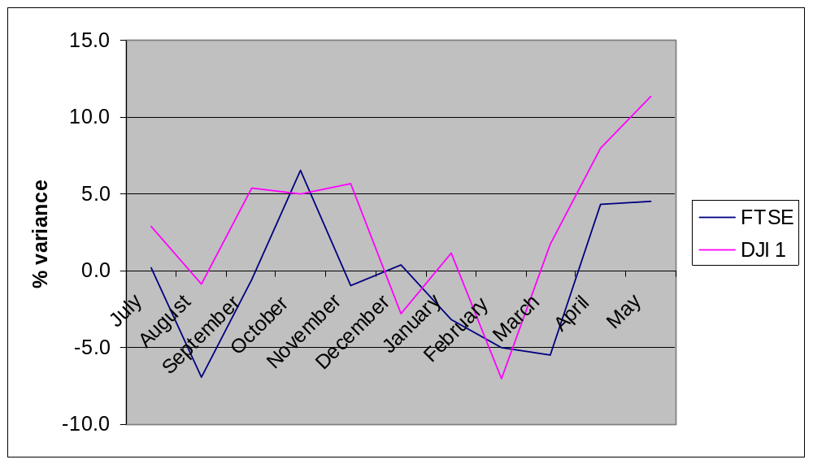

Slide 10
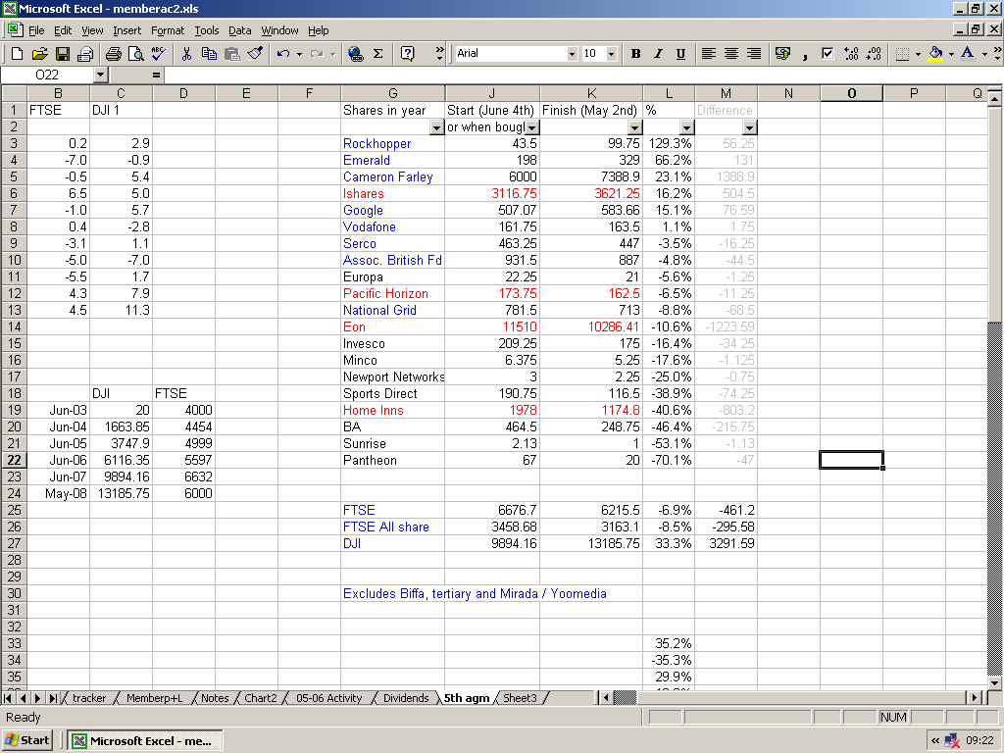
Av. Gain –41.8%
Blue – Shares sold
Red – price adjust
Average –4.8%
Av. Loss –24.9%

Slide 11
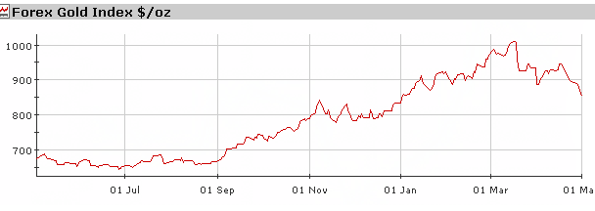
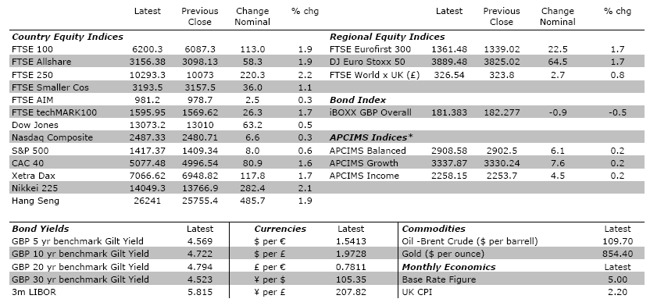
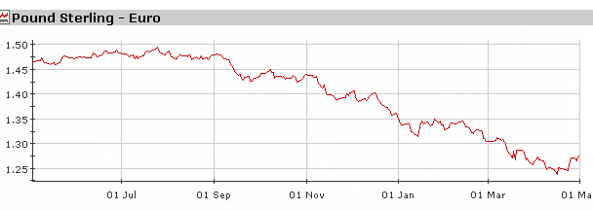

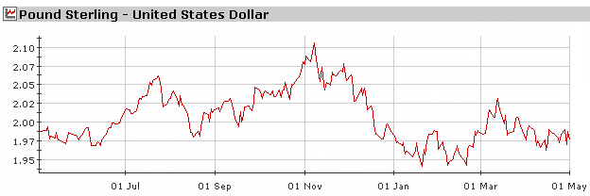
-----------
Dai Jones
Investments
-----------
Some Other Financials…
-----------
Dai Jones
Investments
-----------

Slide 12
The Importance of Remaining Invested
25,000
20,000
15,000
10,000
5,000
-
0 Days
10 Days
20 Days
30 Days
40 Days
Source: Russell Investments FTSE ALL Share, Data as at end Dec 2007

Slide 13
Markets go up more frequently and by a greater amount than they go down
UK Equity Returns Since Start of 20th Century
30
25
26
20
15
17
Frequency (Number of years result occurs)
16
10
12
12
10
5
6
3
4
2
0
<-20
-20 to -15
-15 to -10
-10 to -5
-5 to 0
0 to 5
5 to 10
10 to 15
15 to 20
> 20
Calendar Year Returns %
Source: Barclays Equity Gilt Study 2008 (108 calendar year data points to end 2007)

Slide 14
Where should I invest…
Lack of consistent asset class performance
Best performer
2nd best performer
Median performer
4th best performer
Worst performer
Asset class returns % 1991 – 2007
1991
1992
1993
1994
1995
1996
1997
1998
1999
2000
2001
2002
2003
2004
2005
2006
2007
2008
World Equity
23.8
16.9
25.3
0.9
20.1
1.4
19.3
22.3
31.3
-4.1
-14.0
-27.4
20.7
7.8
24.8
5.7
9.7
?
UK Equity
20.7
20.4
28.4
-5.8
23.9
16.7
23.6
13.8
24.2
-5.9
-13.3
-22.7
20.9
12.8
22.0
16.8
5.3
?
UK Property
-3.1
-1.6
20.2
11.9
3.6
10.0
16.8
11.8
14.5
10.5
6.8
9.6
10.9
18.3
19.1
18.1
-3.4
?
Bonds
16.1
18.6
20.9
-6.2
16.4
7.3
14.1
18.9
-0.9
8.7
3.0
9.2
2.1
6.6
7.9
0.7
5.3
?
Cash
8.0
7.0
5.5
6.3
6.5
6.0
7.3
6.3
5.3
6.0
4.0
4.0
3.8
4.8
4.5
5.0
5.5
?
Source: World Equity: FTSE World x UK; S&P UK Equity: FTSE All Share; Property: IPD All Property Index; Bonds: FTSE Government All stock, Cash: Year end base rate
Data as at December 2007.

Slide 15
-----------
Dai Jones
Investments
-----------
How long will the fund last?
-----------
Dai Jones
Investments
-----------
10 Years
Age 60-65
In its present format, until the year 2018
Until we reach 65 and then we collect our pension.
Even Longer
I think for tax reasons we will need to re-structure however we will still be investing for fun in 10 years
20 Years
Until we reach 60 and we cash it in to go on a cruise!
i cant see it folding
Until one of us gets investigated for tax evasion
Another 20 years
into perpetuity (eternal in lifetime) - the rest of our lives.
a long time - probably 20+years, but we will need to run it properly when it starts getting much bigger
I can foresee a long future if the monthly sum to be invested remains reasonable (i.e. not a grand a month or something as some/most members may stand down!). However, there may come a point when breakaway mobs decide that they want to put their dai jones money into something else! That will be de defining moment.

Slide 16
-----------
Dai Jones
Investments
-----------
Your objective for the fund?
-----------
Dai Jones
Investments
-----------
Old Age Social Accrual
To get an actual green jacket
Bit of fun/make me rich
'haven't really got one!'
World domination
To own a Derby Winner
Make a profit, learn about investing!
Make money and have fun
Jointly invest where alone would not
Outperform cash inflation and FTSE
To meet in a gentlemens club
To pay for my funeral party

Slide 17
-----------
Dai Jones
Investments
-----------
How much in 10 years?
-----------
Dai Jones
Investments
-----------
Response – in order:
10 years – growing the same as the last 5 years =
£15,888.09
(inc. Monthly fees)
£50,501
£60,000
£61,917.36
10 years – keeping with inflation c3% =
£17,720.54
(exc. Monthly fees)
£65,000
£100,000
£102,484.61
10 years – av. Pension growth of 7% = £25,938
(exc. Monthly fees)
£193,547
£350,000
10 years – growing the same as the last 11 months =
£228,346!
(inc. Monthly fees)
£500,000

Slide 18
-----------
Dai Jones
Investments
-----------
Good use of tax breaks…
-----------
Dai Jones
Investments
-----------
1. £20,000 into a VCT
Eg. Downing Protected
£6,000 – tax reducer!!!!
2. Hold for 5 years
3. Put proceeds in pension
Ex. £40k
Net payment - £51,282
4. 10 years average pension growth
Net payment - £100,879

Slide 19

And Finally…
-----------
Dai Jones
Investments
-----------
-----------
Dai Jones
Investments
-----------
Some advice…
"Investors should remember that excitement and expenses are their enemies. And if they insist on trying to time their participation in equities, they should try to be fearful when others are greedy and greedy when others are fearful."
"You only find out who is swimming naked when the tide goes out."
www.daijones.tk

Slide 20
-----------
Dai Jones
Investments
-----------
www.daijones.tk

