Slide 1
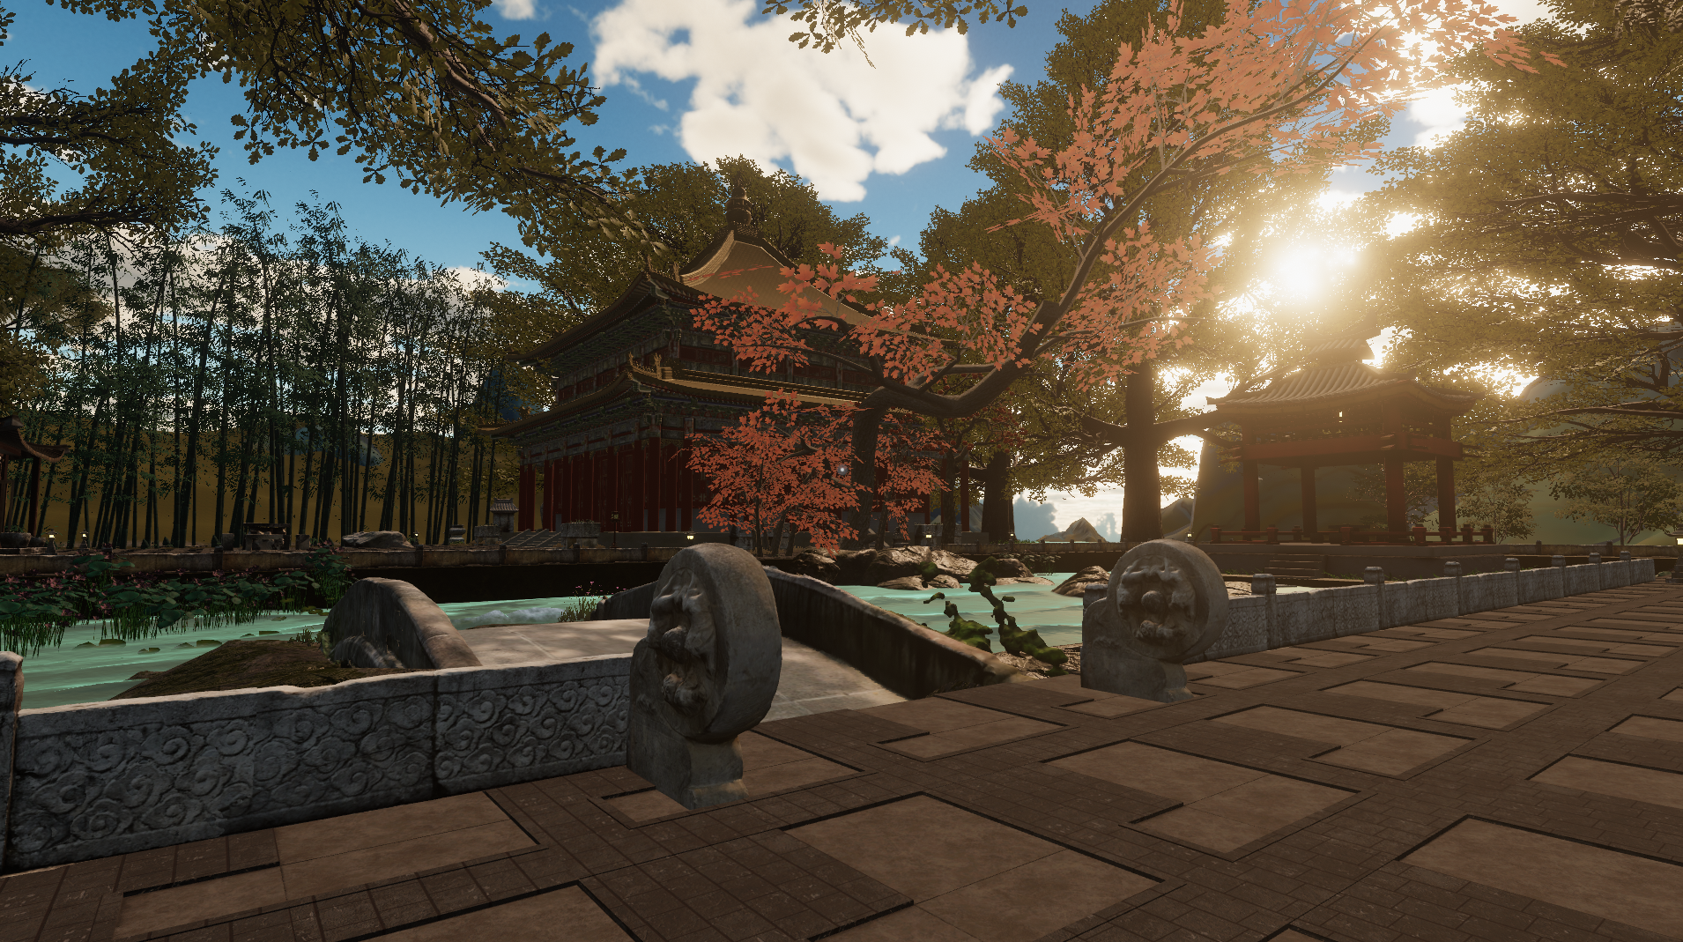
Root-Seeking · Xun Gen
A practice-based inquiry into XR environments for diasporic cultural reconnection
Root-Seeking · Xun Gen — the reconstructed Jichang Garden in VR
Daichen Wang — School of Creative Arts, Queensland University of Technology
Expanded 2026 · Linz
Notes:
Good morning. My name is Daichen Wang, and I am a doctoral candidate in the School of Creative Arts at Queensland University of Technology. The project is called Root-Seeking, or Xun Gen, and what you are looking at is a classical Chinese garden that no longer exists in this form, rebuilt as a virtual environment for people who cannot go back to it.

Slide 2
9 February 2026, Wuxi Railway Station
The crowd was returning home, but I was not.
Photograph to be added
The Lunar New Year rush at its peak; in a few days I would fly back to Brisbane. That tension — between those for whom return is a way of life and those for whom it has become a periodic exception
— is where this research starts.
Reserved — add your own photograph of the station, 9 February 2026.
Root-Seeking · Xun Gen — Expanded 2026, Linz
2
Notes:
I want to start with the moment this research actually began, because it explains the whole thing better than an abstract can. On the ninth of February this year I was standing in the waiting hall of Wuxi Railway Station. It was the peak of the Lunar New Year rush. Everyone around me was going home, and in a few days I would be flying back to Brisbane. That is the tension the project sits inside. For some people return is simply a rhythm of life. For others it has become a periodic exception, something you plan and save for and eventually stop planning. The Chinese diaspora numbers in the tens of millions, and for a great many of them the desire to reconnect with where they came from stays powerful and persistent long after returning stops being practical.

Slide 3
Roots of soil, routes of mobility
Fei Xiaotong — identity bound to the soil
Xiangtu society: identity, kinship and moral obligation are inseparable from the land of birth — Chaxu Geju, concentric circles.
Where that frame reaches its limit
For permanent transnational migrants the geographical centre has irreversibly shifted. Roots give way to routes.
Brah — homing desire, and a body that remembers
Home is “a mythic place of desire” — a feeling constructed, not a place reached. Connerton then puts it in the body.
Root-Seeking · Xun Gen — Expanded 2026, Linz
3
Notes:
So the first question is what kind of thing that desire actually is. Fei Xiaotong described traditional Chinese society as Xiangtu, soil-bound: identity, kinship and obligation inseparable from the land you were born on, organised in concentric circles he called Chaxu Geju. Chunyun, the migration I was standing in the middle of, is its most visible modern expression. But Fei's frame reaches a limit with permanent migrants, because their geographical centre has already moved and is not moving back. So the research shifts from roots to routes, and turns to Avtar Brah. Homing desire, she argues, is not the desire to return to a particular place. Home is a mythic place of desire in the diasporic imagination: a feeling you construct, not a location you reach. And Paul Connerton tells us where that construction happens. Cultural memory is not only in texts and monuments; it is inscribed in the body through habit. Familiar spaces, familiar sounds, familiar ways of moving are the mechanism.

Slide 4
What has not been built
No peer-reviewed, empirically validated social VR environment has been designed for the cultural and spatial needs of the Chinese diaspora.
Existing digital strategies
Existing VR-for-diaspora work
WeChat, video calls and social media sustain relationships at a distance
— but not the embodied spatial familiarity Fei identified as the bedrock of Xiangtu society.
Preliminary studies either lacked cultural specificity or focused narrowly on students. None centres the classical Chinese garden as a carrier for root-seeking.
Root-Seeking · Xun Gen — Expanded 2026, Linz
4
Notes:
Which brings me to what has not been built. Despite a lot of very good XR heritage research, there is no peer-reviewed, empirically validated social VR environment designed specifically for the cultural and spatial needs of the Chinese diaspora. The tools people already use — WeChat, video calls, social media — do sustain relationships across distance, and I want to be fair to them. What they cannot do is reproduce the embodied spatial familiarity Fei identified as the bedrock of that soil-bound world. You can see your mother's face on a screen; you cannot walk through the courtyard behind her. On the research side, the preliminary VR-for-diaspora studies either lacked cultural specificity or narrowed to student populations, and none of them centres the classical Chinese garden as a carrier for root-seeking.

Slide 5
The questions
The overarching question
When permanent physical return is no longer viable, how can the sensory, spatial and social conditions of cultural belonging be reconstituted elsewhere?
Operationalised through one designed case — the garden is an instrumental case, not the object of the thesis
Q1 Which cultural, spatial and sensory elements are essential?
Q2 How can co-design engage diaspora communities in shaping it?
Q3 How do participants experience belonging and reconnection?
Root-Seeking · Xun Gen — Expanded 2026, Linz
5
Notes:
The doctoral inquiry sits at two levels. The overarching question is bigger than any single platform: when permanent physical return is no longer viable, how can the sensory, spatial and social conditions of cultural belonging be reconstituted elsewhere? I operationalise that through one designed case, and I want to be precise about the word case. The garden is an instrumental case, not the object of the thesis. Underneath it sit three subsidiary questions. Which cultural, spatial and sensory elements do diaspora members themselves identify as essential. How participatory co-design can genuinely engage a diaspora community in shaping something culturally authentic. And how participants actually experience the environment in terms of belonging and emotional reconnection.

Slide 6
A three-phase participatory study
PHASE ONE
PHASE TWO
PHASE THREE
Requirements
Reflection
Measurement
172
12
26
retained diaspora responses of 206 returned 50 visitors and staff on site 27 written questionnaires 40 demonstration participants
Brisbane participants in two groups of six, 20 June 2026 recruited beyond student networks — social media, the CSSA, a table tennis club
item experience measure on interface, immersion, culture recognition, social presence plus pre- and post-state questionnaires, same sessions
All data collection approved by the QUT Human Research Ethics Committee — LR 2025-8766.
Root-Seeking · Xun Gen — Expanded 2026, Linz
6
Notes:
The study answers those in three phases. Phase One was survey work and building. A global online survey of the Chinese diaspora returned two hundred and six questionnaires across two rounds, of which a hundred and seventy-two were retained. On site at Jichang Garden I worked with fifty visitors and staff, twenty-seven of whom completed the questionnaire — fifteen visitors and twelve administrators — and demonstrations reached forty people. Phase Two took the prototype to Brisbane: twelve participants in two groups of six, in June. I recruited through Chinese-language social media, the Chinese Students and Scholars Association, and deliberately through a local table tennis club, because I did not want a room full of students. Phase Three was folded into those same sessions: pre- and post-experience state questionnaires plus a twenty-six item experience measure covering interface, immersion, cultural recognition and social presence. All of it under QUT ethics approval.

Slide 7
Design requirements came from the data
What the online survey required
Important in Chinese culture
4.47
4.32
Willing to visit one abroad
4.33
seasonal change and the passage of time; highest of 5 (SD 0.68)
Visiting relieves pressure
4.33
4.25
Gardens have social functions
4.07
I feel emotionally attached
3.80
centrality of cultural symbols (SD 0.75)
Holds special significance
3.53
130/172
0
1
2
3
4
5
named overly complex operation as the interaction style to avoid
On-site visitor questionnaire, Jichang Garden (N=15); 5-point scale.
Root-Seeking · Xun Gen — Expanded 2026, Linz
7
Notes:
This is where the design requirements came from, and I want to be clear that they came from the data rather than from my taste. On the left are the on-site visitor items, ranked. Gardens being important in Chinese culture sits highest at four point four seven, with ninety-three per cent agreement. Willingness to visit a garden abroad and gardens relieving pressure both sit at four point three three. But look at the bottom two bars, in the lighter blue. I feel emotionally attached drops to three point eight, and it holds special significance for me drops to three point five three, with fewer than half agreeing in each case. Recognition is running ahead of attachment, in the same people at the same sitting. On the right, the online survey set the requirements. Seasonal change and the passage of time rated highest of the five cultural authenticity items, cultural symbols second. And the clearest result was negative: a hundred and thirty of a hundred and seventy-two named overly complex operation as the thing to avoid. That pushed the prototype away from gamification and towards ritual.

Slide 8
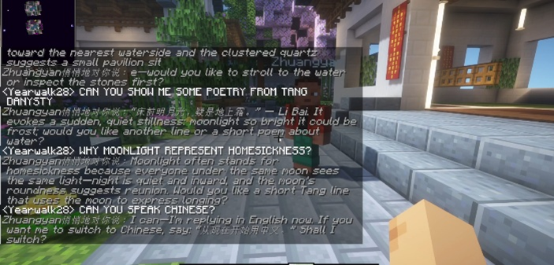
Two platforms, one designed environment
Minecraft is the methodological engine of Phase Two.
High-fidelity VR
Minecraft + MinePal
Unity 2022.3 → VRChat on Meta Quest 3 90fps, 3 × 3 m volume, desktop fallback
Java Edition, custom server, AI guide configured by a character brief
Root-Seeking · Xun Gen — Expanded 2026, Linz
8
Notes:
So two platforms were built, and they are one designed environment rather than two projects. On the left, the high-fidelity world: Unity 2022.3, deployed through VRChat for Meta Quest 3, running at ninety frames per second inside a three by three metre tracking volume, with a desktop fallback so nobody is excluded for lack of a headset. On the right, Minecraft Java Edition on a custom server with an AI cultural guide through MinePal — configured rather than engineered: I wrote it a character brief covering classical poetry, Daoist naturalism and garden design, rather than training anything. The line at the top is the important one. Minecraft is the methodological engine of Phase Two, not a demo. Its coarse blocks keep building visible and reversible for people with no 3D modelling skills, and its message boards and personal courtyards let them contribute when they are not in the room.

Slide 9
Current status
90
fps on Meta Quest 3; the VR environment is fully operational and publicly exhibited
90%
Photograph to be added
conversational accuracy for the MinePal guide across roughly 20 test rounds
102
scanned artifacts open on Sketchfab, via LiDAR, Gaussian Splatting, aerial capture
Reserved — add your own photo of the public exhibition, or of a participant in the headset.
IN PROGRESS
Thematic analysis of the June 2026 focus group data; an Unreal iteration underway
Root-Seeking · Xun Gen — Expanded 2026, Linz
9
Notes:
Where it stands today. Data collection is complete across all three phases. The VR environment is fully operational, holding ninety frames per second on Quest 3, and it has been publicly exhibited. The Minecraft platform with the MinePal guide is complete, with over ninety per cent conversational accuracy across roughly twenty test rounds. A hundred and two artifacts scanned from Jichang Garden — using handheld iPhone LiDAR, Gaussian Splatting and aerial photogrammetry — are openly available on Sketchfab. The one thing still in progress is the thematic analysis of the June focus-group data, and a third iteration in Unreal Engine.

Slide 10
Three contributions, three fields
Theory
Evidence
Method
diaspora and memory studies
digital heritage and HCI
community-centred design
A model of diasporic root- seeking as sensory and embodied memory activation, bringing Fei's Xiangtu into dialogue with Brah's homing desire.
To our knowledge the first peer-reviewed, empirically evaluated social VR environment tailored to Chinese diaspora cultural needs.
A validated co-design model for culturally specific XR, replicable with other displaced communities.
The empirical findings are situated in this case; the theory and the methodology are designed to travel.
Root-Seeking · Xun Gen — Expanded 2026, Linz
10
Notes:
The work makes three contributions, and they are addressed to three different rooms. To diaspora and memory studies, a theoretical one: a model of root-seeking as sensory and embodied memory activation, which is what happens when you put Fei's Xiangtu in dialogue with Brah's homing desire. To digital heritage and human-computer interaction, an empirical one: to my knowledge the first peer-reviewed, empirically evaluated social VR environment tailored to Chinese diaspora cultural needs. And to community-centred design practice, a methodological one: a co-design model for culturally specific XR that other people can run. The line underneath matters for how you should read all of this. The empirical findings are situated in this case. The theoretical model and the methodology are the parts designed to travel.

Slide 11
Next steps
01 Complete the thematic analysis
02 Compare the two modalities
It drives iterative updates to both platforms and answers the third question.
Triangulate questionnaire patterns with discussion themes: presence against building.
03 Finish the Unreal Engine version
04 Bring classical dance into the world
Higher visual fidelity, then comparison across all three platforms.
With the QUT XR Screen Futures Hub, captured at The Block as a periodic cultural event.
Supervisors: Dr Rewa Wright, Prof. Damian Candusso, Prof. Gavin Sade, QUT. Thanks to the staff and visitors of Jichang Garden.
If root-seeking operates through sensory memory rather than physical location, the question is not where it can happen, but how.
daichen.wang@hdr.qut.edu.au — QUT Ethics LR 2025-8766
11
Notes:
Four things next. Finish the thematic analysis, which drives every remaining update to both platforms. Compare the two modalities by triangulating the questionnaire patterns against the discussion themes, because embodied presence and social building may well shape root-seeking differently. Finish the Unreal Engine version and then compare across all three. And bring motion-captured classical dance into both worlds with the QUT XR Screen Futures Hub, so that root-seeking extends past exploring a space into performing in it. Let me leave you with the claim I would most like challenged. If root-seeking operates through sensory memory rather than physical location, then the question is not where it can happen. It is how. Thank you.

