Slide 1
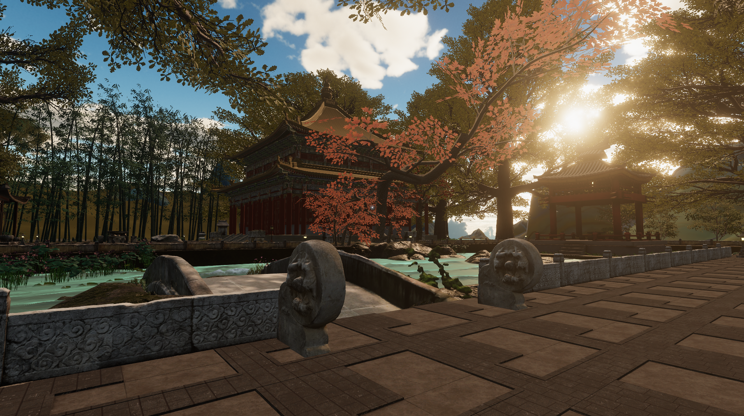
Root-Seeking · Xun Gen
Reimagining a historic Chinese garden in XR
Daichen Wang · Rewa Wright · Damian Candusso · Gavin Sade — QUT
Expanded 2026 · Linz
Notes:
This is Root-Seeking, Xun Gen. What you are looking at is Jichang Garden in Wuxi, one of the most celebrated classical literati gardens in China, rebuilt in extended reality. The name comes from xun gen, the search for cultural, historical and spiritual origins that runs through Chinese diaspora communities. I am Daichen Wang, and this is work with Rewa Wright, Damian Candusso and Gavin Sade at QUT.

Slide 2
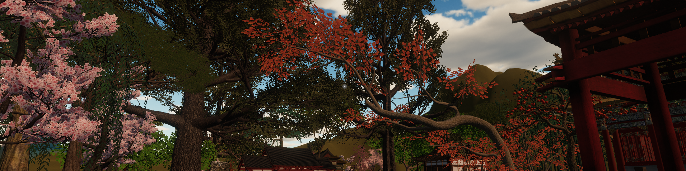
An experiential, multisensory world
Unity 2022.3, deployed on Meta Quest 3. It engages users through gesture, sound and poetic narrative, drawing on the spatial logics of Jichang Garden.
Root-Seeking · Xun Gen — Expanded 2026, Linz
2
Notes:
Let me tell you what it actually is before I tell you what it argues. It is built in Unity 2022.3 and deployed on Meta Quest 3. It is experiential and multisensory: you move through it with gesture, you hear it, and poetry surfaces as you go. It draws on the aesthetics and the spatial logics of Jichang Garden, and I want to be precise about the relationship there. The garden is not a subject we photographed. It is both a symbolic and a technical scaffold — the thing that gives the virtual site its grammar of framed views, borrowed scenery, and revelation withheld and then granted.

Slide 3
Addressed to a displaced community
The position
The limitation, stated
XR heritage research aims at accurate reconstruction, education and tourism. This work differs in audience and aim: the garden is not an object to document but a spatial language to speak again.
Participation does not dissolve power relations, and we do not claim that it does. What was scanned, whose dialects are heard and which garden stands in for home were decided by the research team.
Heritage is a process negotiated in the present, so interpretive authority shifts toward the diaspora itself.
One Jiangnan literati garden cannot represent the regional diversity of Chinese heritage.
Root-Seeking · Xun Gen — Expanded 2026, Linz
3
Notes:
Now the position, because it is not the usual one. Surveys of XR in cultural heritage describe a field pointed at accurate reconstruction, education and virtual tourism. We differ in audience and in aim. We are addressed to a displaced community rather than to tourists, and we treat the garden not as an object to be documented but as a spatial language to be spoken again. That follows critical heritage studies: heritage is a process through which belonging gets negotiated in the present, and Smith's critique of authorised heritage discourse asks whose voices are centred. So interpretive authority shifts toward the diaspora. And on the right is the part we are not going to smooth over. Participation does not dissolve power relations and we do not claim it does. What got scanned, whose dialects you hear, which garden stands in for home — the research team decided all of that. One Jiangnan literati garden cannot represent the regional diversity of Chinese heritage.

Slide 4
Co-creation, not distortion
Speculative layer
Community-authored ritual, narrative and atmosphere — legible as interpretation.
Image to be added
Factual layer
All 102 systematically scanned artifacts, open and publicly inspectable — the record.
Participants may imagine precisely because imagining does not overwrite the record.
Reserved — add a capture of one scanned artifact, or of the Sketchfab archive page.
Root-Seeking · Xun Gen — Expanded 2026, Linz
4
Notes:
Which raises the question you should be asking. If we are inviting people to speculate on a real heritage site, what separates that from distortion? Our answer is a layered model of provenance. Underneath, the factual layer: a hundred and two systematically scanned artifacts, published openly, permanently inspectable by anyone who wants to check us. On top of it, the speculative layer: ritual, narrative and atmosphere authored by the community, and deliberately legible as interpretation rather than as record. Keeping those two apart is what lets the work be an archive and an artwork at the same time. Participants are given licence to imagine precisely because imagining does not overwrite the record underneath.

Slide 5
Recognition runs ahead of attachment
What follows for the design
Both groups rated sensory experience the most important quality of a virtual garden — 4.20 and 4.25 — while reporting almost no prior VR use.
Visitors: importance
vs personal significance
3.53
4.47
Attachment: visitors
130/172
vs administrators
3.80
4.50
named overly complex operation as the style to avoid, ahead of gamification (86) and modernity
(56). 40.1% had never used VR.
3.0
3.5
4.0
4.5
5.0
On-site questionnaire, Jichang Garden. Visitors N=15, administrators N=12.
Root-Seeking · Xun Gen — Expanded 2026, Linz
5
Notes:
This is the result that has shaped the project most, and it is the least comfortable one. On the left, two pairs of values. The top pair is visitors on site: they rate the cultural importance of the Chinese garden at four point four seven, ninety-three per cent agreement, the highest of twelve items — but personal significance for them, individually, sits at three point five three. That gap is in the same people at the same sitting. The lower pair is the one item both questionnaires share, emotional attachment: visitors at three point eight, administrators at four point five with unanimous agreement. Sustained, professional involvement moves attachment; sharing a nationality, a language and a location does not. So recognition runs ahead of attachment, and that matters for how work like ours gets evaluated: a virtual heritage environment can secure recognition without securing attachment. On the right, what follows. Both groups rated sensory experience the most important quality of a virtual garden while reporting almost no prior VR use — insect sound, birdsong, the scent of flowering shrubs. And the clearest result in the online survey was negative: a hundred and thirty of a hundred and seventy-two named overly complex operation as the thing to avoid.

Slide 6
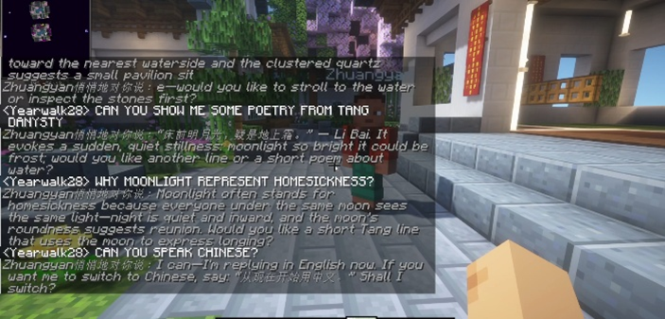
Presence, and authorship
Affords presence
Affords authorship
Continuous space, naturalistic scale, spatialised sound. Visual completeness signals a finished world.
Coarse blocks make building legible and reversible, and signal a world that is open to change.
Realism communicates that heritage is to be received; blocks communicate that heritage may be remade.
Root-Seeking · Xun Gen — Expanded 2026, Linz
6
Notes:
So we built two environments, and the pairing is an argument about affordances rather than a hedge. The VRChat world affords presence: continuous space, naturalistic scale and vegetation, spatialised sound. It positions you as an embodied visitor, and its visual completeness signals a finished world — something to be contemplated, not altered. The Minecraft world affords authorship: coarse blocks make construction legible and reversible, they lower the skill threshold for building, and they signal that the world is unfinished and open. I want to be honest that our on-site demonstrations evaluated the virtual version as one object, so this pairing rests on affordance analysis and on that survey requirement for a low operational threshold, not on measured preference. The line at the bottom is the compressed version. Realism communicates that heritage is to be received. Blocks communicate that heritage may be remade.

Slide 7
No score, no timer, no failure state
Up to three concurrent users on Meta Quest 3, free exploration in a 3 × 3 m volume, 90fps, with a non-VR desktop fallback.
Approaching an artifact triggers Classical poetry in Mandarin and local dialects; Suzhou Pingtan and a day-night cycle do the rest.
Root-Seeking · Xun Gen — Expanded 2026, Linz
7
Notes:
Here is what a session is actually like. Up to three concurrent users on Quest 3, free exploration inside a three by three metre volume at ninety frames per second, with a non-VR desktop mode so the work is not gated on owning a headset. Approach a heritage artifact and it triggers a reading of classical Chinese poetry, in Mandarin and in local dialects. Suzhou Pingtan and fragments of dialectal voice are distributed across the space, so the soundtrack is positional rather than ambient wallpaper. A day-night cycle shifts the light and the sound, which is how the passage of time gets into a space that is otherwise frozen. And then the three refusals in the title. There is no score, no timer, and no failure state. That was a decision taken directly against the clearest result in our survey data.

Slide 8
Depth through mist, not perspective
The optical problem
The cultural answer
Under uniform illumination the scene flattened: equal lighting across the depth scale reduced the legibility of distance.
Shanshui painting renders depth through mist and tonal recession, and Jichang borrows the Xishan hills through haze.
Distance-based volumetric fog and height fog now attenuate contrast toward the horizon.
8
Notes:
One technical decision that turned out to be more than technical. Under uniform illumination the environment flattened — equal lighting across the whole depth scale, and distance stopped being legible. The fix was distance-based volumetric fog and height fog, attenuating contrast and saturation toward the horizon, so dark saturated foreground elements recede into progressively hazier distance. But look at what that actually restores. Classical shanshui landscape painting renders depth through mist and tonal recession rather than through linear perspective. And Jichang Garden itself borrows the distant Xishan hills through atmospheric haze — that borrowed prospect is what the whole composition is built around. So restoring aerial perspective improves depth perception and recovers a culturally specific way of seeing at the same time.

Slide 9
Digitising the garden
102 objects across six functional categories
Architectural components
Garden furniture and objects
Sculpture and decoration
16
11
Inscriptions and calligraphy
Plants and natural landscape
47
Architecture and structures
11
9
8
Fieldwork photo to be added
Reserved — add your own capture shot: handheld LiDAR, or the aerial pass.
iPhone LiDAR, Gaussian Splatting, aerial photogrammetry — every tree is procedural.
Models decimated 50,000 → 5,000–8,000 polygons, UVs preserved for 4K atlases. Open on Sketchfab.
9
Notes:
The factual layer, in detail. A hundred and two heritage objects, digitised across six categories assigned by the function each object performs in the garden. The dominant block is architectural components, forty-seven of them, and I want to flag that the distribution reflects the conditions of capture as much as the composition of the site: architectural components are numerous, discrete and reachable, and the two smallest categories are the two hardest to record. Three capture methods. Handheld iPhone LiDAR for objects at ground level, stone guardian lions and bridges. Gaussian Splatting, processed in Scaniverse, for intricate surfaces and difficult light. Aerial video reconstructed as photogrammetry for the borrowed prospect. Vegetation resists photogrammetry entirely, so every tree here is procedural. And there is something beyond fidelity in the Gaussian Splatting: its point-based volumetric nature mirrors the fragmented, fluid quality of diasporic memory. Heritage as a reconstructing field of light and data, not a solid immutable object.

Slide 10
Configured, not engineered
The AI cultural guide
Minecraft Java Edition on a custom server, with an in-world NPC through MinePal that converses about garden aesthetics, classical poetry and Chinese philosophy, switching language on request.
The workshop instrument
The project supplies a written character brief; the service holds it as the agent's standing instruction.
Message boards for asynchronous dialogue, real-time voice, and personal courtyards participants customise themselves.
Co-creation workshops run through the second half of 2026.
10
Notes:
The Minecraft side runs on Java Edition with a custom server, and it carries an AI cultural guide through the MinePal service — an in-world character who will hold a conversation about garden aesthetics, classical poetry and Chinese philosophical traditions, and switch language on request. The phrase I want to insist on is configured, not engineered. We supply a written character brief covering classical poetry, Daoist naturalism and classical garden design principles, and the service holds that brief as the agent's standing instruction. It was written against curated cultural references, with attention to data governance and to how representative the generated content actually is. Around the agent sit message boards for asynchronous dialogue, real-time voice, and personal courtyard spaces participants customise themselves — which is what makes this a workshop instrument rather than a feature.

Slide 11
What this contributes
Empirically
As design
As practice
What this audience wants: contemplative, not gamified interaction; temporal rhythm sensory content; a low operational threshold.
A transferable dual-platform model: a contemplative world paired with a co-creative one, joined by a pipeline that moves content between.
A cultural XR privileging affect, ritual and the multisensory over photoreal
— heritage invention, not heritage documentation.
The boundary, stated: these findings establish need, design preferences and initial reception — not long-term effect. Identity formation awaits the post-workshop evaluation.
Postgeographic sanctuaries: living counter-archives co-created with the communities they serve.
daichen.wang@hdr.qut.edu.au · sketchfab.com/DaichenWang — QUT Ethics LR 2025-8766
11
Notes:
Three registers, and then a boundary. Empirically, we document what this audience wants from virtual heritage: contemplative rather than gamified interaction, temporal rhythm, cultural symbolism, sensory content beyond the visual, and a low operational threshold. As design research, the dual-platform model is the transferable part — a high-fidelity contemplative environment paired with a low-barrier co-creative one, joined by a pipeline that moves community-authored content into the crafted world. As arts practice, a cultural XR that privileges affect and ritual over photorealism, shifting from heritage documentation toward heritage invention. Now the boundary, and I would rather state it than have you find it. These findings establish need, design preferences and initial reception. They do not establish long-term effect. Claims about identity formation and durable cultural reconnection wait on the post-workshop evaluation. What we are proposing, in the end, is that heritage sites can be reimagined as postgeographic sanctuaries: living counter-archives, co-created with the communities they serve. Thank you.

