Slide 1
What are the contributing factors to the increase of U.S. domestic Airfare?
Presented by: Daijah Fletcher
Last Updated: July 28th, 2022

Slide 2
Table Of contents
Objective – What are the contributing factors?
Results – Visual illustrations of the data found
Conclusion
Appendix

Slide 3
Objective
Identify if the most notable variables are the contributing to the fluctuation of airfares:
Frequent cancellation of flights
Airline Employment
Increasing fuel cost

Slide 4
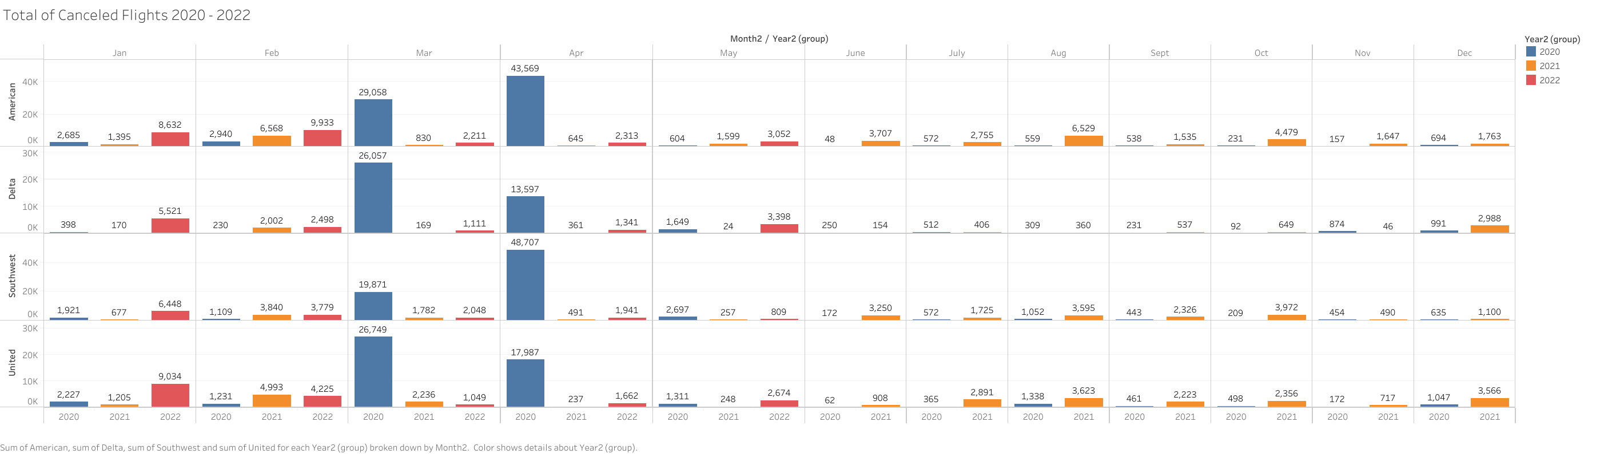
Flight Cancellations
As of March 2020 U.S. states began to shut down to prevent the spread of COVID-19
If comparing to this year, airlines are still cancelling flights which are contributing to delays and limited tickets
Major airlines cancelled most of their flights in Mar/Apr 2020
Although not significantly, and can be ruled out as a variable

Slide 5
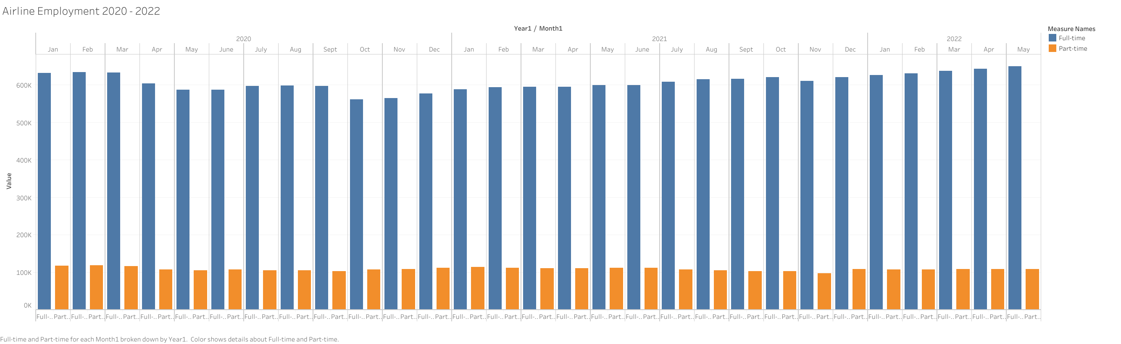
Airline employment
Noticeable dip in employment for full time workers in 2020
Since then employment has increased
Therefore the theory of if there are not enough workers can be ruled out
Factor in workers getting sick, caring for ill family members, etc

Slide 6
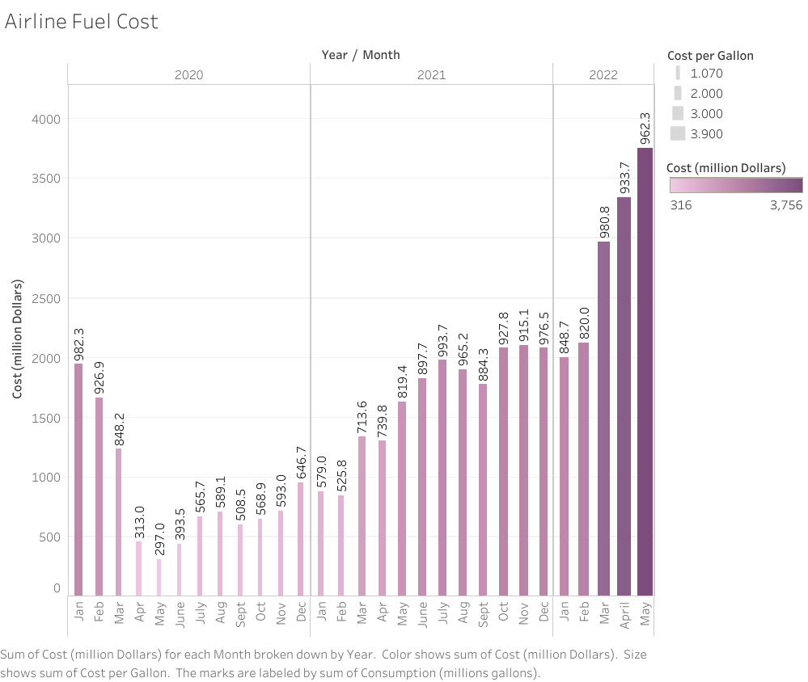
Increasing Fuel cost
Fuel is a contributing factor but not in the ways that we think
Because of these results, another variable needs to be added: Consumer Demand
The cost per gallon and gallons of fuel purchased by airlines is shown to increase
Consumption has dipped in 2020 and increased and remained constant in 2022
The rise in cost per gallon has effected many individuals and businesses nationally

Slide 7
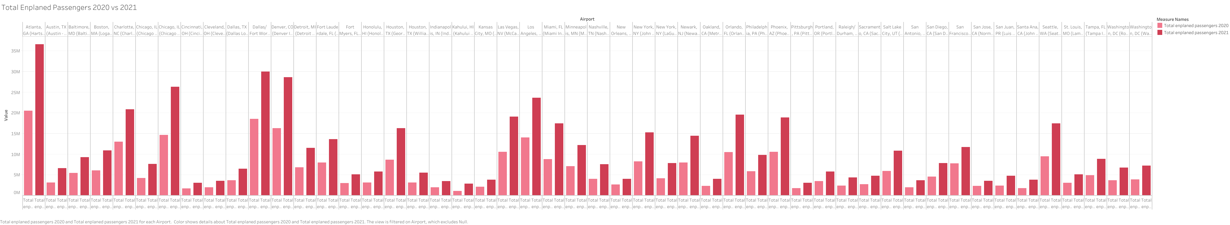
Consumer Demand
Listed are the top 50 airports and the total passengers they received in 2020 vs 2021
In 2022 these numbers will continue to trend upwards as gas prices increase, and will spike during holiday seasons
Comparing 2020 vs 2021 airlines received more passengers in 2021
Consumers will choose to fly instead of drive because of this increase

Slide 8
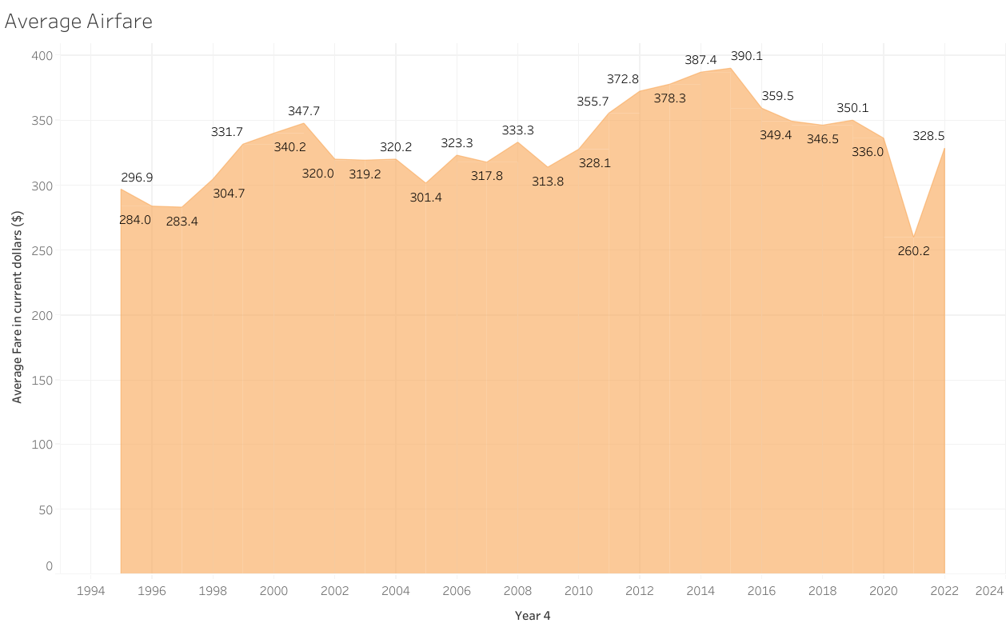
Average Airfare
Therefore, it is the availability of tickets itself contributing to the increase in price
As supply decreases, and demand increases, the price will increase as well
If airlines are unable to meet the demand, you can see these prices continue to rise
To compare today’s average of domestic airfare to previous years, airfare has been cheaper or remained constant

Slide 9
Conclusion
Fuel
Consumer Demand
As cost per gallon continues to increase, consumers will find alternate ways to travel over driving
There is a positive correlation between Fuel and Consumer Demand
Demand for flights will spike significantly when fuel continues to increase
Airlines may find themselves overextending their workers during the pandemic thus unable to meet demand

Slide 10
Appendix
Resources
Bureau of Transportation Statistics:
“First Quarter 2022 Average Air Fare Increases 16.9% from First Quarter 2021.” First Quarter 2022 Average Air Fare Increases 16.9% from First Quarter 2021 | Bureau of Transportation Statistics, https://www.bts.gov/newsroom/first-quarter-2022-average-air-fare-increases-169-first-quarter-2021.
“Passengers Boarded at the Top 50 U.S. Airports.” Passengers Boarded at the Top 50 U.S. Airports | Bureau of Transportation Statistics, https://www.bts.gov/content/passengers-boarded-top-50-us-airports.
Bureau of Transportation Statistics:
“General.” Employment, https://www.transtats.bts.gov/Employment/.
“A Decade of Change in Fuel Prices and U.S. Domestic Passenger Aviation Operations.” Bureau of Transportation Statistics, https://www.bts.gov/archive/publications/special_reports_and_issue_briefs/special_report/2012_03_33/entire.
“Scheduled, Canceled, and Operated Flights by Month 2019-2022 (through May).” Scheduled, Canceled, and Operated Flights by Month 2019-2022 (through May) | Bureau of Transportation Statistics, https://www.bts.gov/topics/airlines-and-airports/scheduled-canceled-and-operated-flights-month-2019-2022-through-may.

Slide 11
Thank You

