Slide 1
Lambda Expression
Daiki Itoh Zhiquan Tang Lloyd Thomas

Slide 2
Programming Language Tools
Java Local Server:
Uses visitor for lambda expression in open-source projects
MySQL Database:
Stored relevant data about lambda expression in open-source projects
Python Clients (Analysis tools):
Parsed through revisions and lambda expression tables, counting uses

Slide 3
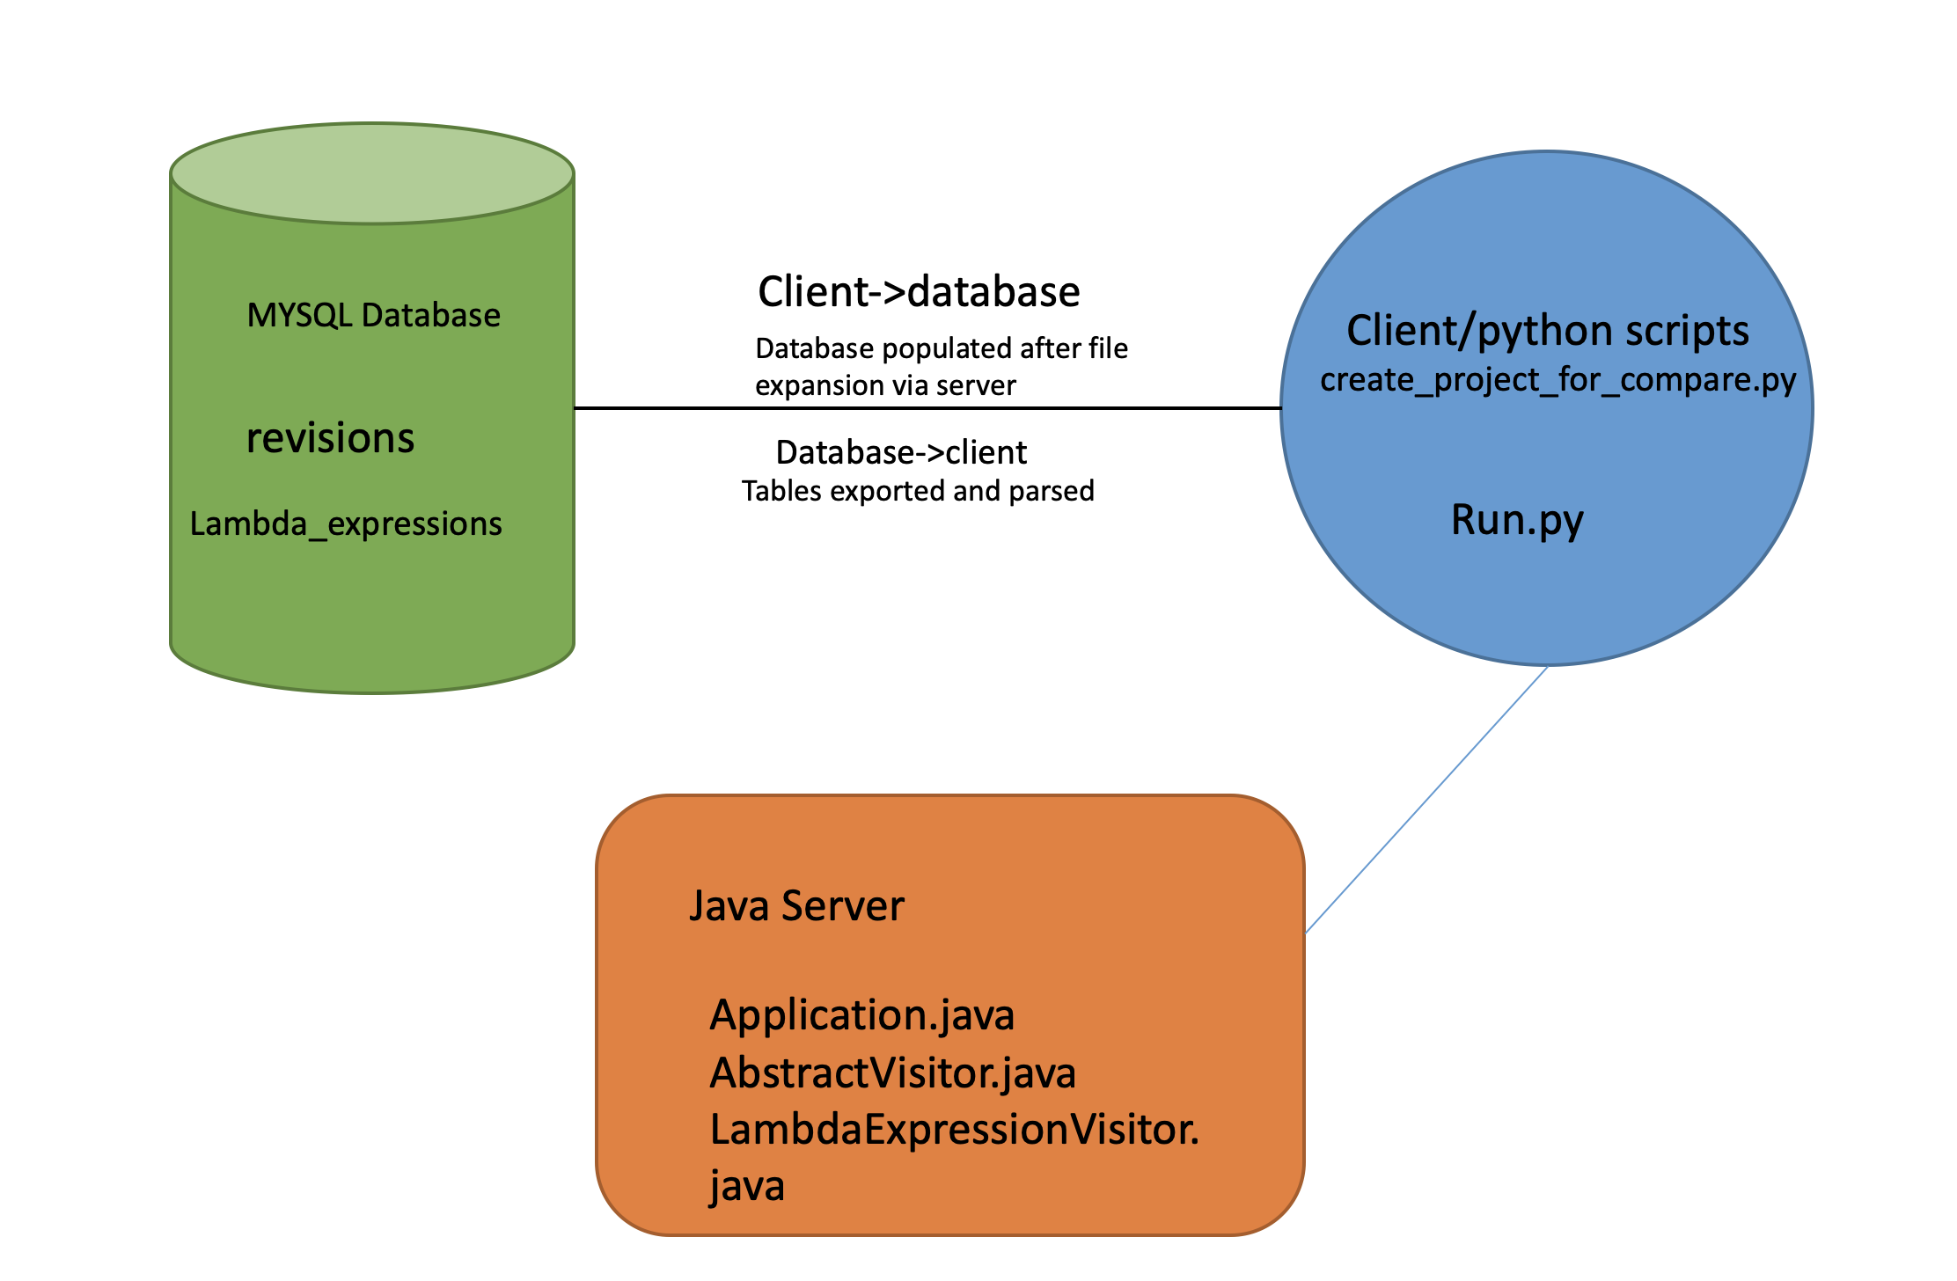
Architecture

Slide 4
Pros and Cons
Pros:
1. It shortens lines of code
2. It is more convenient for one-off functions
Cons:
1. It hurts readability of code
2. It iss possibly confusing to understand

Slide 5
Research Questions
How many times lambda expressions are used in projects?
-Daiki
In what case lambda expressions are used?
-Lloyd
Are Java lambda expressions different from those of other languages?
-zhiquan

Slide 6
Implementation
In order to detect lambda expression we added LambdaExpressionVisitor in AbstractVisitor.java and Application.java in the Java server.
We also added LambdaPattern class to send lambda to server.
All the data is exported from lambda_expressions and revisions to .csv and parsed.
Data time and lambda expressions are the output to produce a graph.

Slide 7
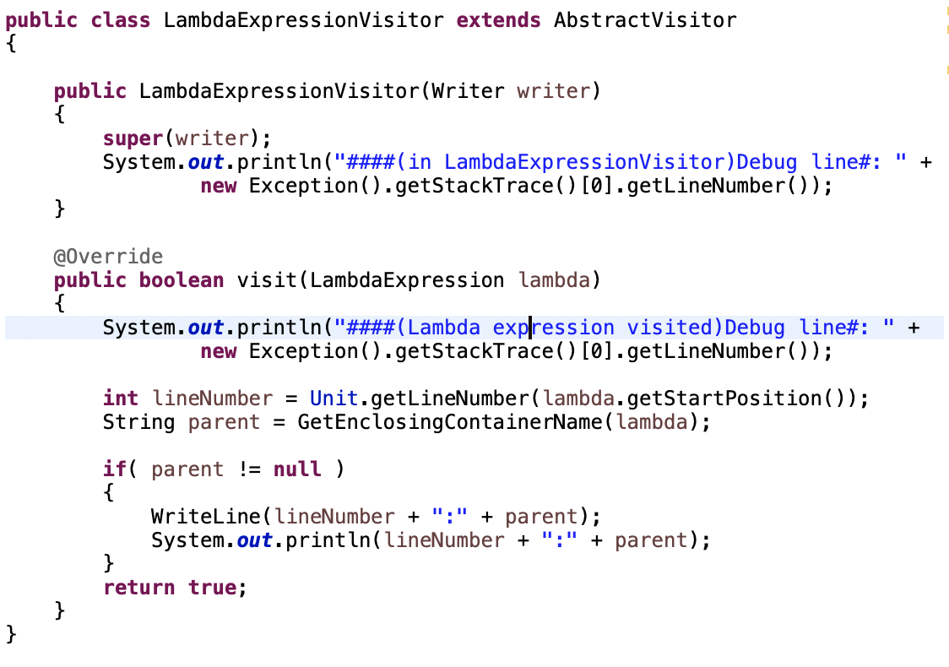
LambdaExpressionVisitor

Slide 8
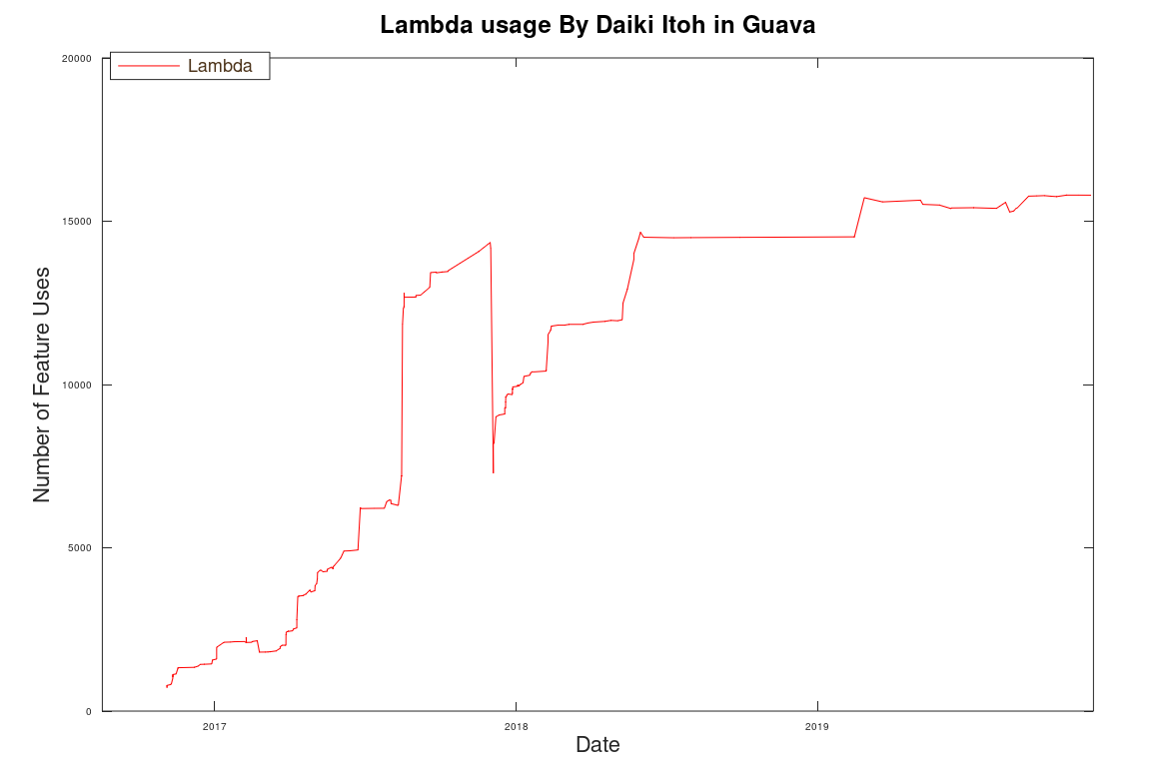
Guava

Slide 9
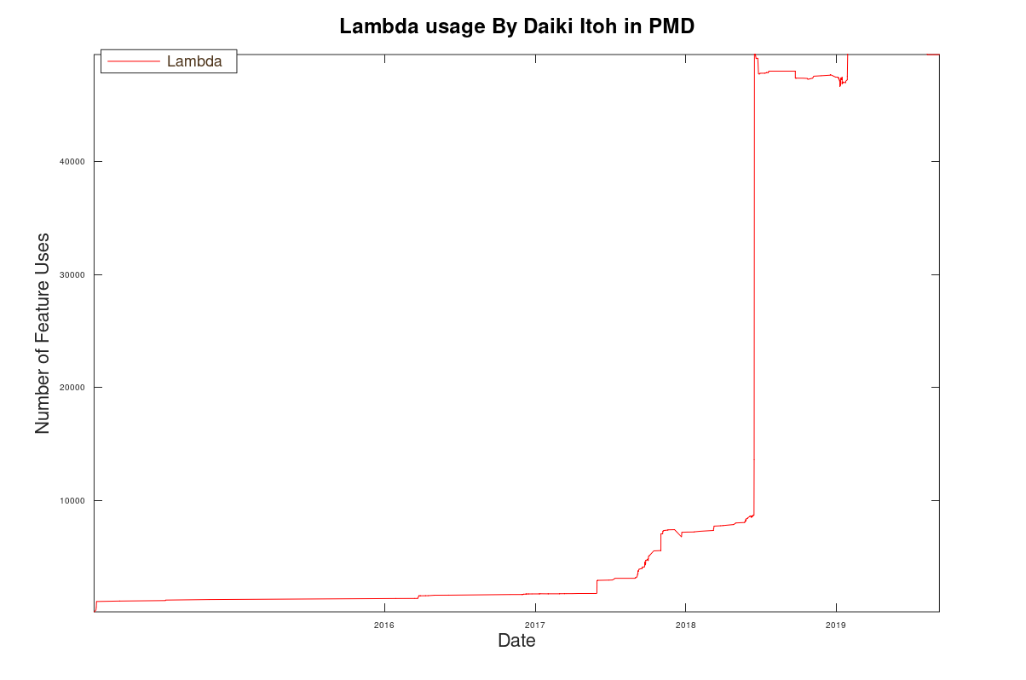
PMD

Slide 10
Implementation Lambda in C++
Basic syntax:[captures](params)->returnType{body}
Example:
Auto A=[](int x, int y)->int {return x+y;}
[captures]
[], [=], [&] ,[=a],[&a]
(params): basic parameters as you use in other function , there are no difference between lambda function and normal function.
Return type:[] (int x, int y) {return X+Y};

Slide 11
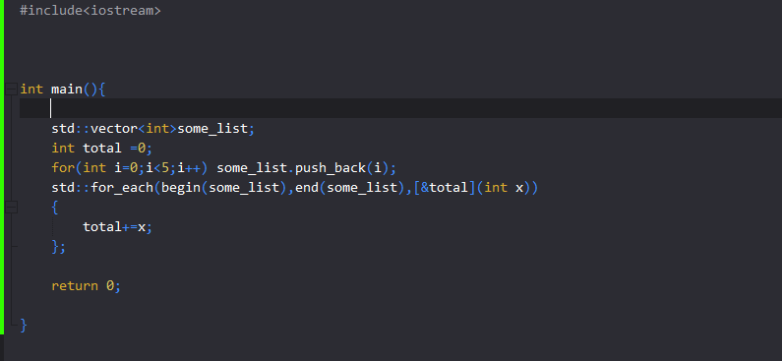
Lambda in C++

Slide 12
Lambda in python
Syntax : lambda parameter:body
Example:
  addition =lambda x,y :x+y
  addition(1,2)
  Output would be 3.
Another example:
List1 =[3,5,-4,1,0,-2,6]
Sorted(list1,key=lambda x:abs(x))
No capture , no return type not even has parenthesis .
Python try to make everything easy to learn

Slide 13
Lambda expression in Java
Baics syntax:
(parameters)->expression;
(parameters)->{statements};
No return type requirement
No capture requirement
Parameter can be nothing: ()->System.out.println(“Hello Lambda”);

Slide 14
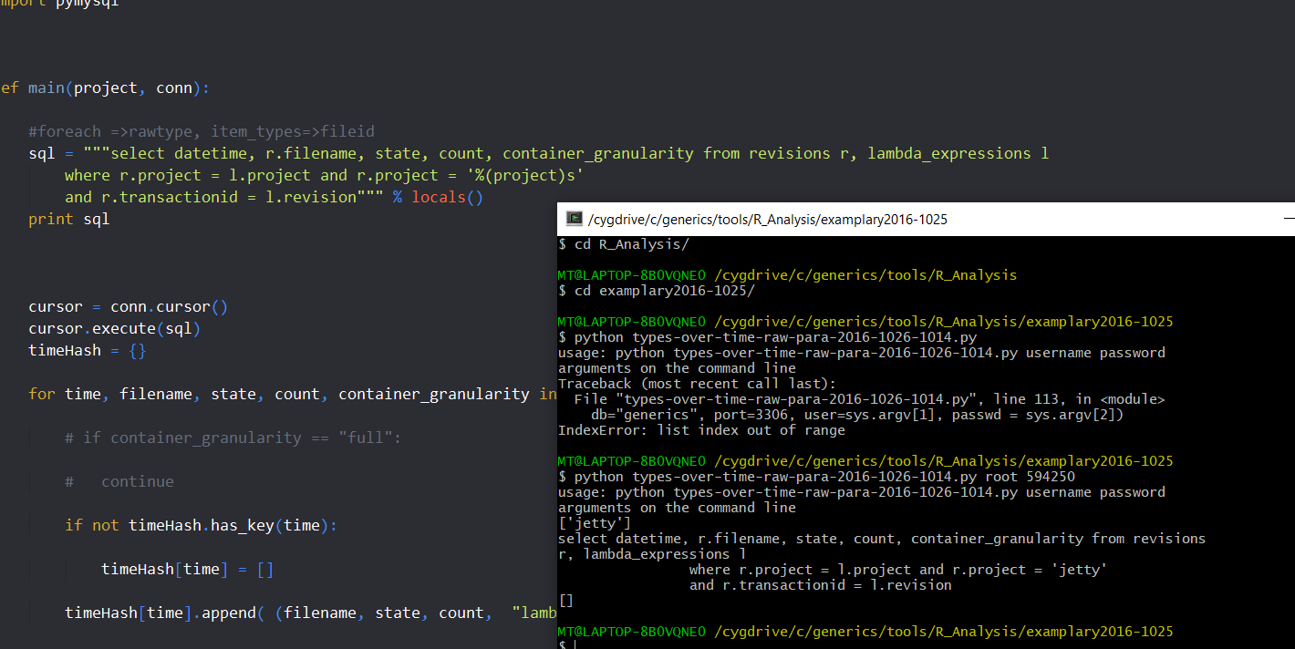
Error

Slide 15
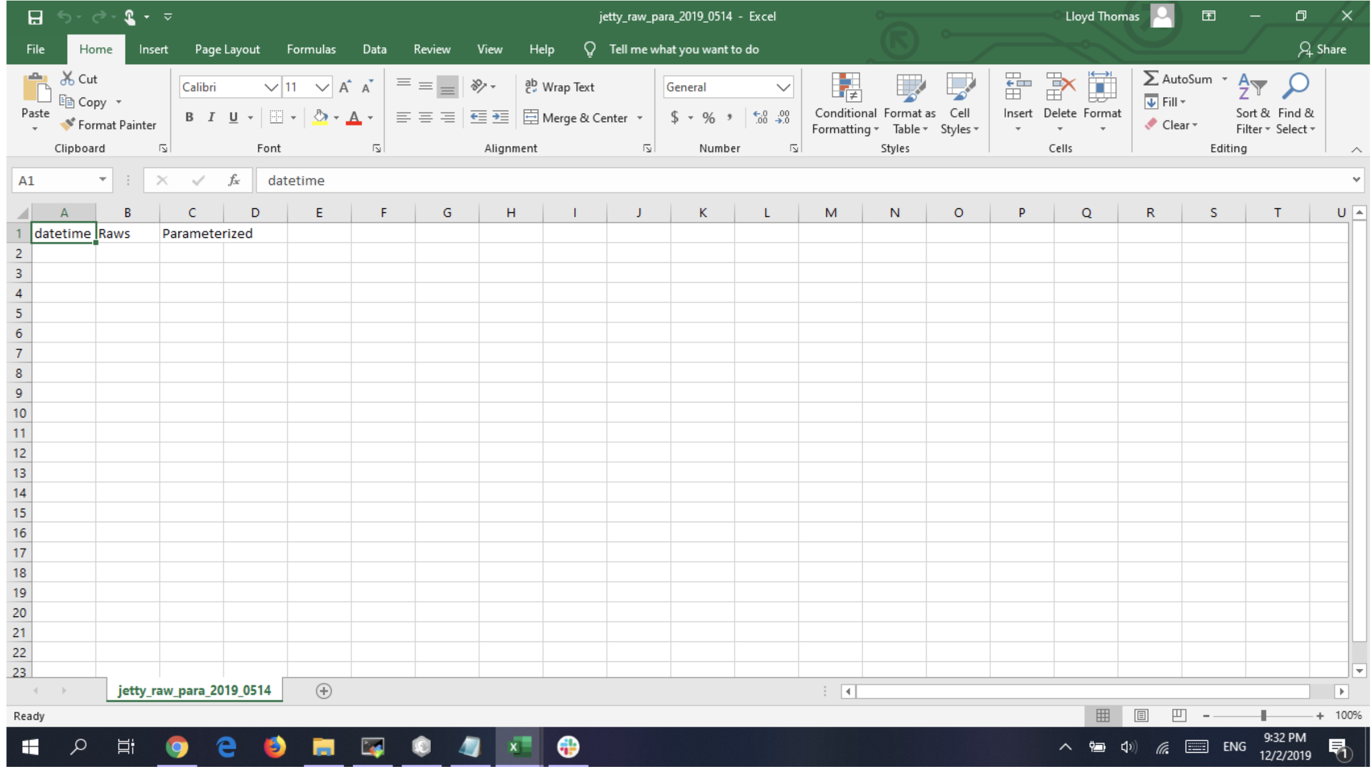
Error

Slide 16
Conclusion
How often are lambda expressions used?
Lambda expression usage has been on a steady increase since the feature’s introduction in LISP and is now a common feature in many programming languages.
When should lambda expressions be used?
Lambdas are most commonly used for one-off methods because they are shorter than writing out a full method that would only be used once.
How do lambda expressions in Java differ from lambda expressions in other languages?
They largely vary in syntax. For example, a lambda that returns a number squared would look like:
Java 8: square = (int x) -> x * x;
C#: Func<int, int> square = x => x * x;
C++: [](int x){return x * x;}
LISP: (lambda (x) (* x x))

