Slide 1

Project Violet
A High-Frequency Limit Order Book Simulation
Black Box Model of Consumer Behavior conceptualizes market decisions as inputs (stimuli) that lead to outputs (responses).
The user must analyze the data to expose human nature in the stock market, such as the Panic Seller or Greed, and exploit them for profit.

Slide 2
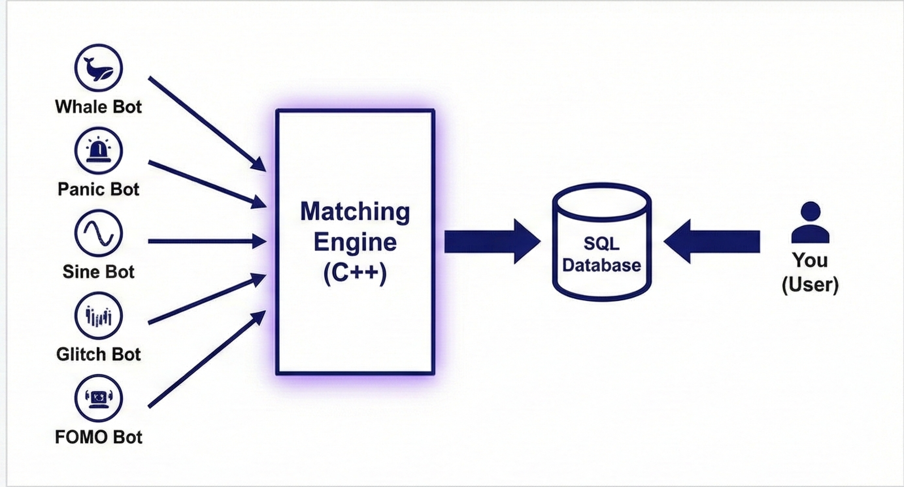
The Architecture
A C++ Limit Order Book that enforces strict financial rules.
The Database: A Relational Database that uses CRUD.
High-Frequency Simulation: The 5 bots with 5 Algorithms will run in parallel loops, generating hundreds of orders per minute to simulate a hysterical stock market.

Slide 3
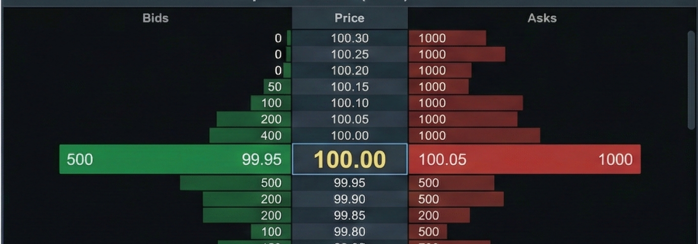
Ladder (Depth of Market)
The ladder of liquidity ensures higher foresight.
Allows strategic maneuver such as a Sacrifice Play – intentionally eating through liquidity walls to trigger panic.
Project Violet turns relational Database and Business Logic into a strategic battle between the lower-class and the elite class.

Slide 4
Core System Functions
Authentication & Security
Login Function User authentication via username, password, and PIN to load a personalized trading state.
Order Confirmation User approval required for all trades; PIN verification enforced for sell orders and high-value transactions.

Slide 5
Trading Operations (CRUD Model)
Place Limit Order (create) Submit buy or sell limit orders after verifying sufficient cash or shares.
View Market Data (Read) Display the order book with active orders grouped by price to visualize supply and demand.
Monitor Portfolio Show real-time cash balance, owned shares, and total net worth based on market prices.
Modify Active Orders (Update) Change the price of unfilled orders after revalidating available cash or shares.
Cancel Orders (Delete) Cancel unfilled orders and immediately release reserved cash or shares.

Slide 6
Market Simulation Engine
Matching Engine Background process that matches buy and sell orders and executes trades when prices align.
Market Maker Algorithms Five automated bot algorithms generate liquidity and drive price movement.
Pattern Generator Bot behaviors are randomized at startup to create a unique market puzzle each session.

