Slide 1
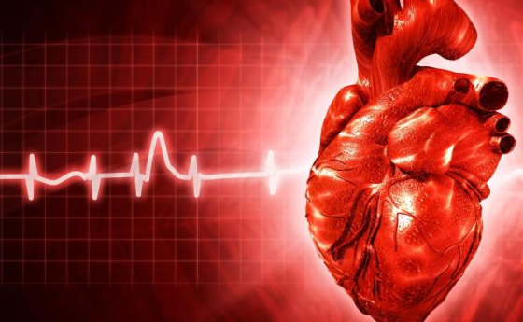

HEART STROKE PREDICTION
Under the Guidance of (Mentor)
Mrs. Aishwarya Saxena
Presented by:
Mr. Sushant Jadhav
Mr. Avinash. K
Mr. Sadiq Jaffer

Slide 2
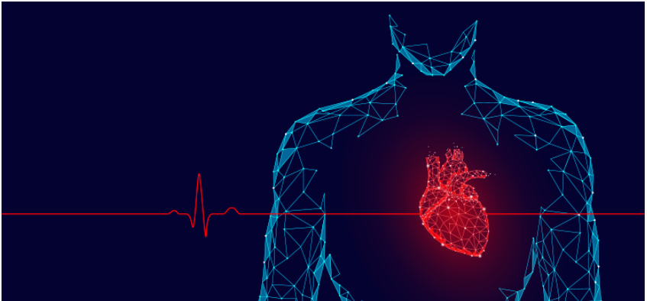
INTRODUCTION
The main topic is prediction using machine learning technics. Machine learning is widely used now a days in many business applications like e-commerce and many more. Prediction is one of area where this machine learning used, our topic is about prediction of heart stroke by processing patient’s dataset and a data of patients to whom we need to predict the chance of occurrence of a heart stroke disease. The aim is to achieve better accuracy and to make the system more efficient so that it can predict the chances of heart stroke.

Slide 3
OBJECTIVE
Heart stroke prediction by machine learning will reduce the time by predicting the value risk of heart stroke using dataset which include normal information of individual.
In this, we are predicting risk of heart stroke without novel calcium scan of human heart but by putting input and calculating the same.
3. Hence, overall analysing time will be reduced, cross validation of feature selection.
4. In the end, Patient who has high risk of heart stroke can be easily diagnosed and will be put under treatment procedure instantly.
5. Overall test cost will also get reduced as man power gets reduced.

Slide 4
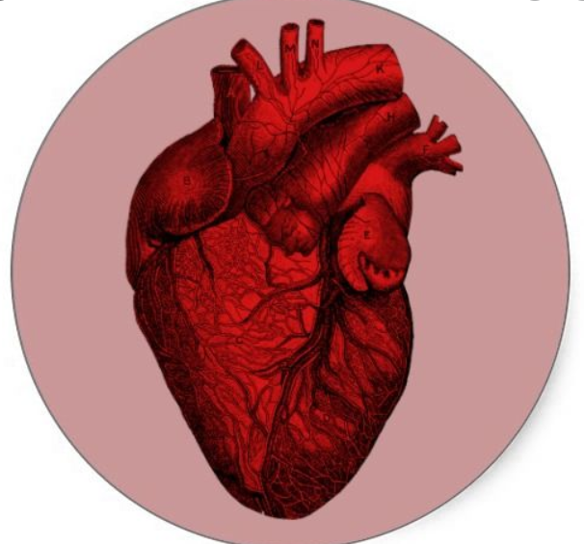
BACKGROUND
Data analysis proves to be crucial in the medical field. It provides a meaningful base to critical decisions. It helps to create a complete study proposal. One of the most important uses of data analysis is that it helps in keeping human bias away from medical conclusion with the help of proper statistical treatment. By use of data mining for exploratory analysis because of nontrivial information in large volumes of data.
Heart predictor system will use the data mining knowledge to give a user-oriented approach to new and hidden patterns in the data. The knowledge which is implemented can be used by the healthcare experts to get better quality of service and to reduce the extent of adverse medicine effect.

Slide 5
HARDWARE AND SOFTWARE REQUIREMENTS
Hardware Requirements:
Hardware Tools | Minimum Requirements
Processor | I5 or above
Hard Disk | 10 GB
RAM | 8 GB
Monitor | 17'' Coloured
Mouse | Optical
Keyboard | 122 Keys

Slide 6
Software Requirements:
Software Tools | Minimum Requirements
Platform | Windows, Linux and Mac OS
Operating System | Windows, Linux and Mac OS
Technology | Machine Learning - Python
Scripting Language | Python
IDE | Pycharm/ jupyter (notebook)

Slide 7
FUTURE SCOPE
The heart stroke prediction can be done using other machine learning algorithms. Advance Logistic regression can also perform well in case of binary classification problems such as heart stroke prediction. Random forests can perform well than decision trees. Also, the ensemble methods and artificial neural networks can be applied to the dataset. The results can be compared and improvised.
We will be able to easily recognise condition of individual with its risk percentage.
We can easily know exact accuracy and implement it in medical case papers.
With help of this prediction system we can lead to much healthier lifestyle.

Slide 8
CONCLUSION
Heart Stroke is one of the major concerns for society today. It is difficult to manually determine the odds of getting heart disease based on risk factors. However, machine learning techniques are useful to predict the output from existing data.

Slide 9
BIBLIOGRAPHY AND REFRENCES
[1] Datasets (https://www.kaggle.com/ronitf/heart-disease-uci/data#)
[2] Sklearn libraries (https://scikit-learn.org/)
[3] Algorithms Reference(https://towardsdatascience.com/)
[4] Matplotlib Reference(https://matplotlib.org/tutorials/index.html)

Slide 10
Thank You

