Slide 1
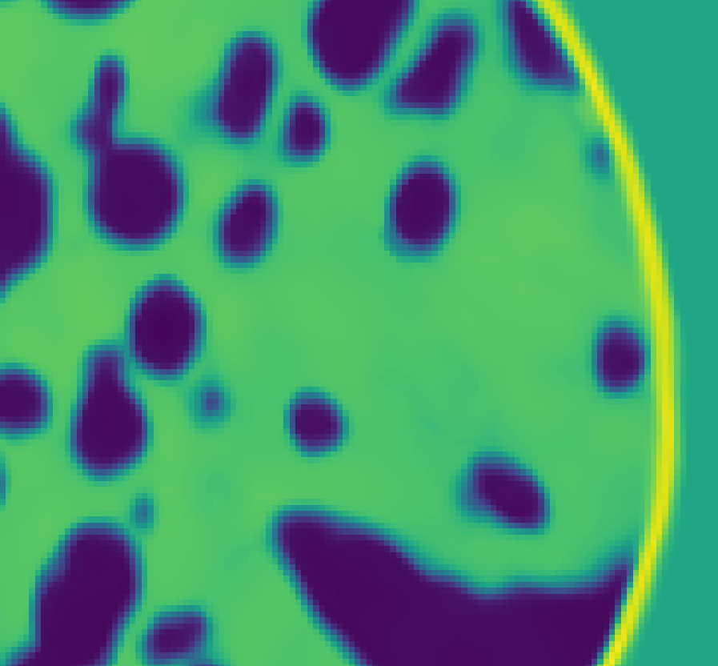

* This figure shows an enlargement of the dashed area in figure A
Clear and correct low frequencies, but missing high-frequency details

