Slide 1
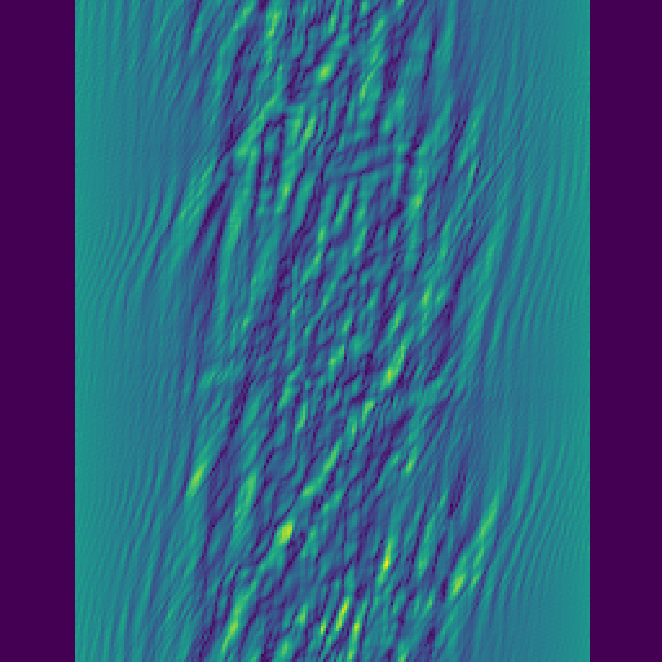
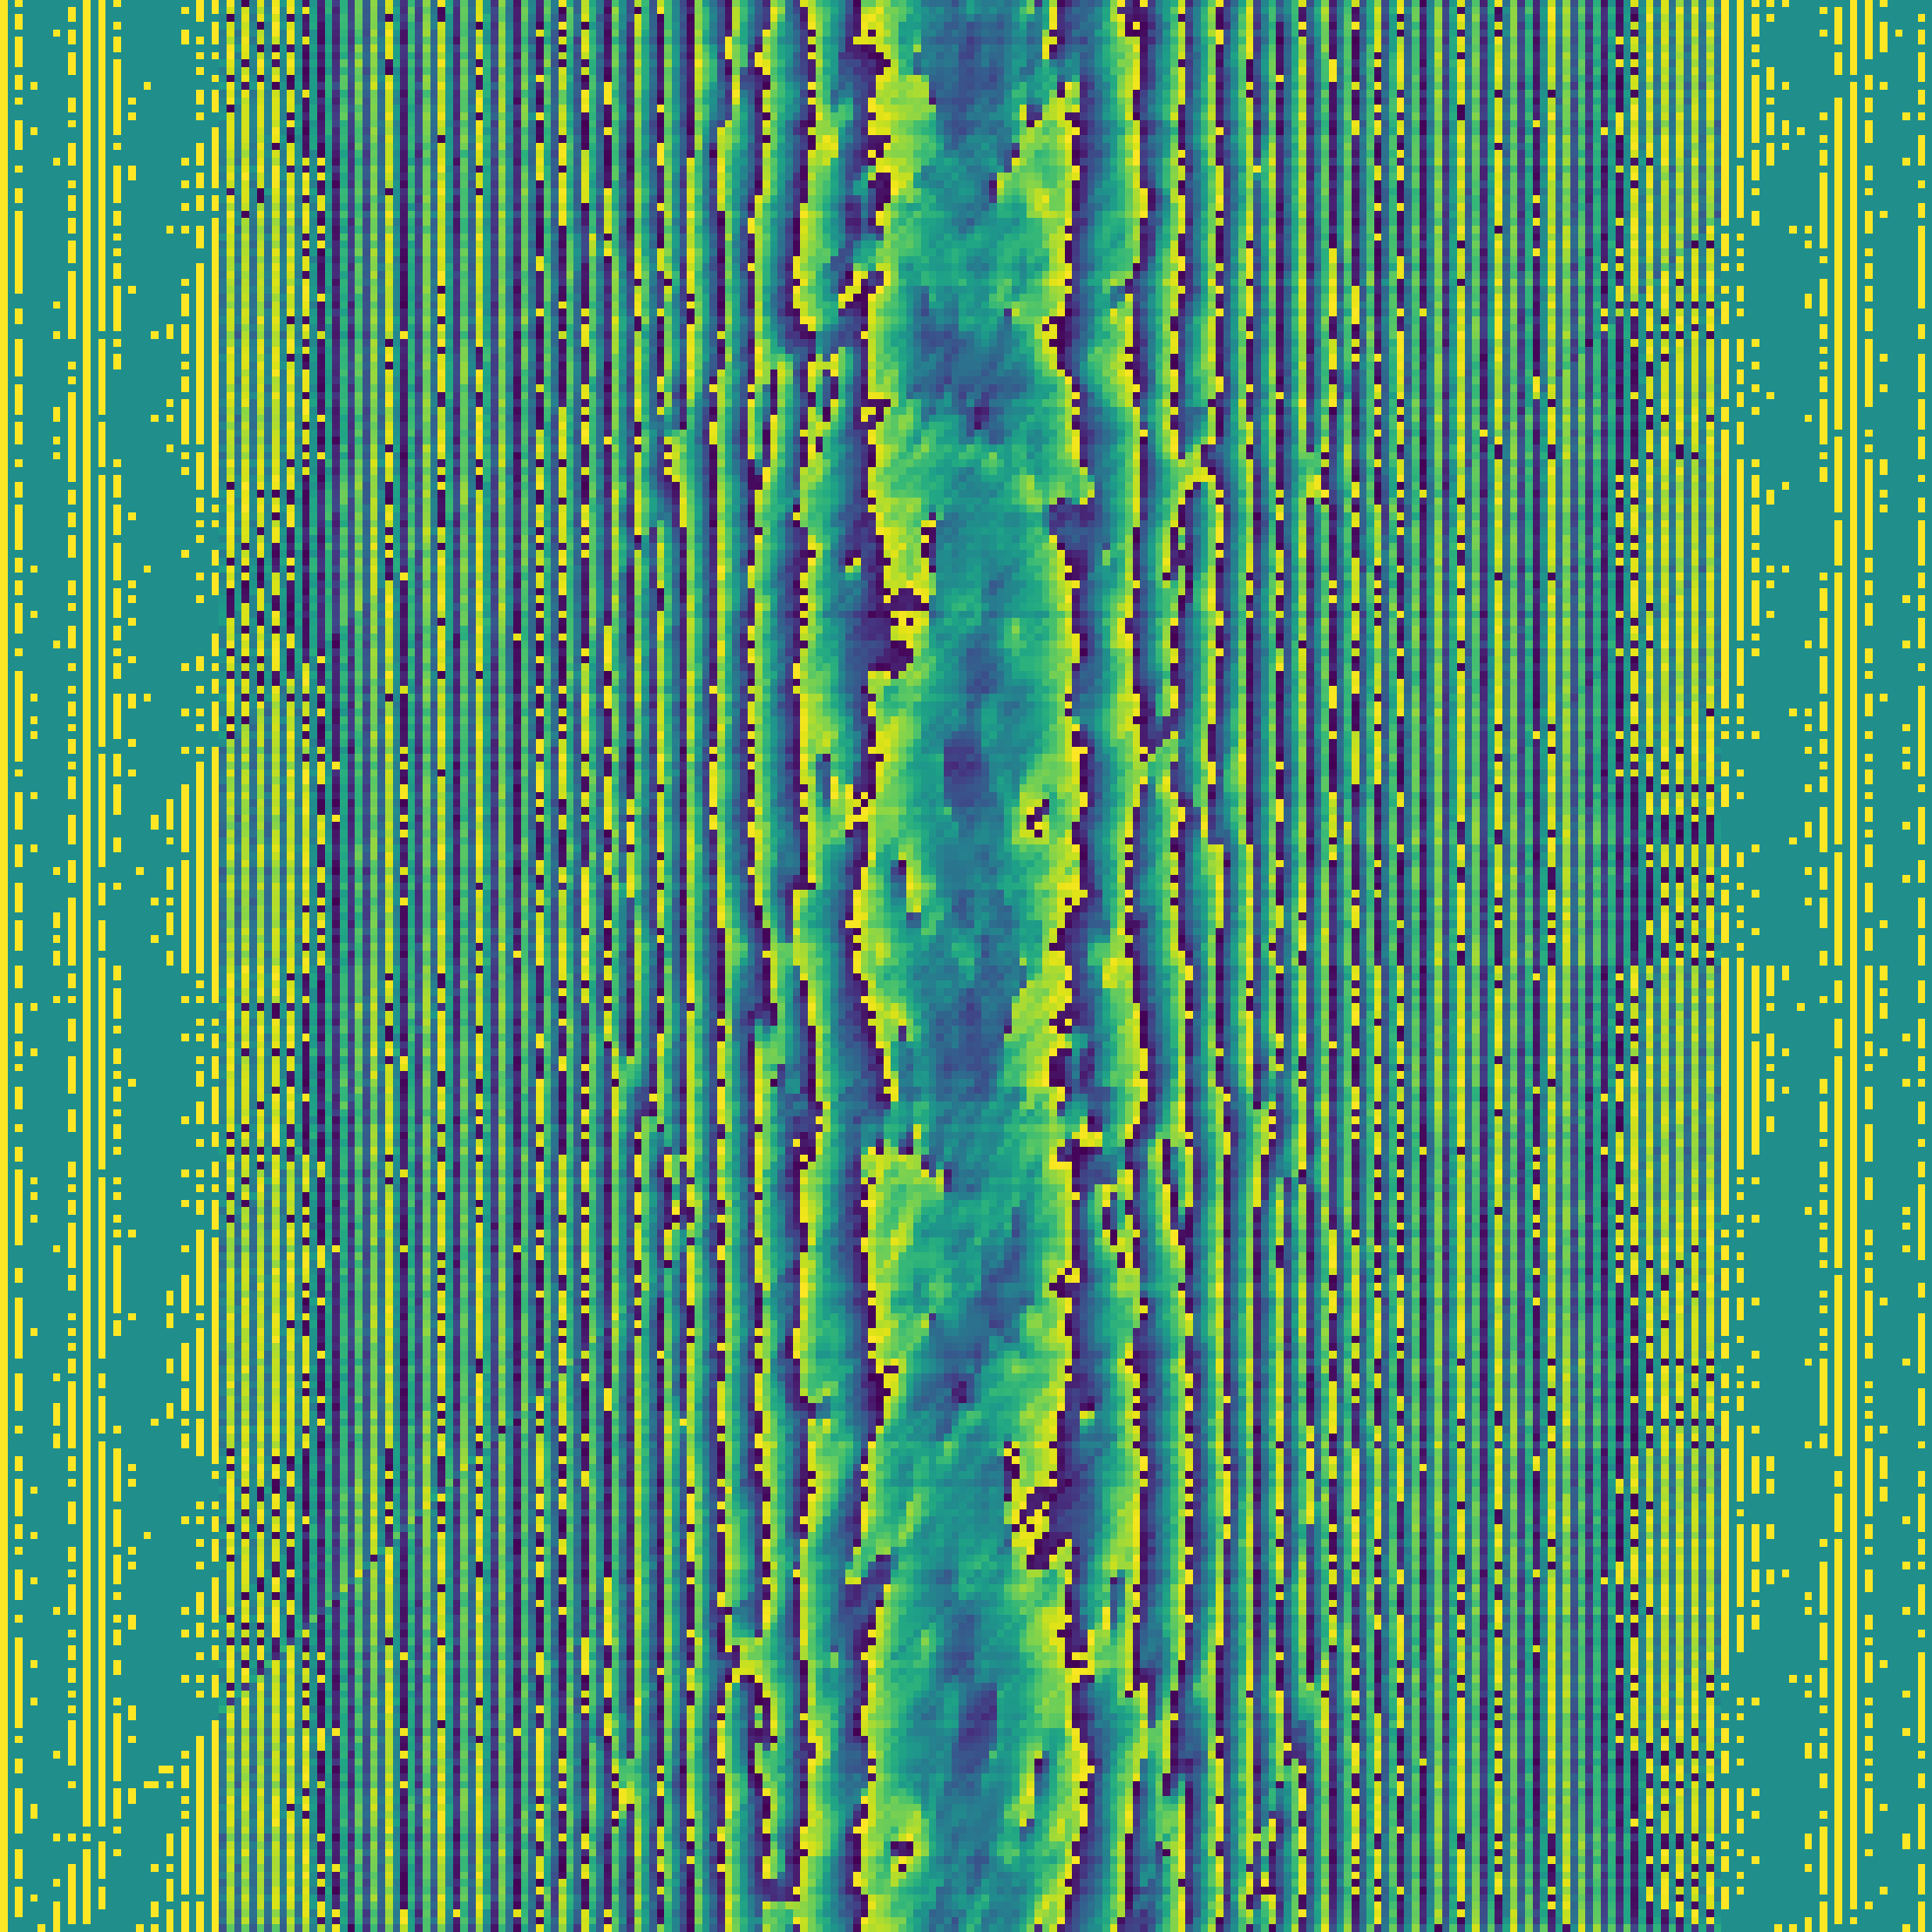
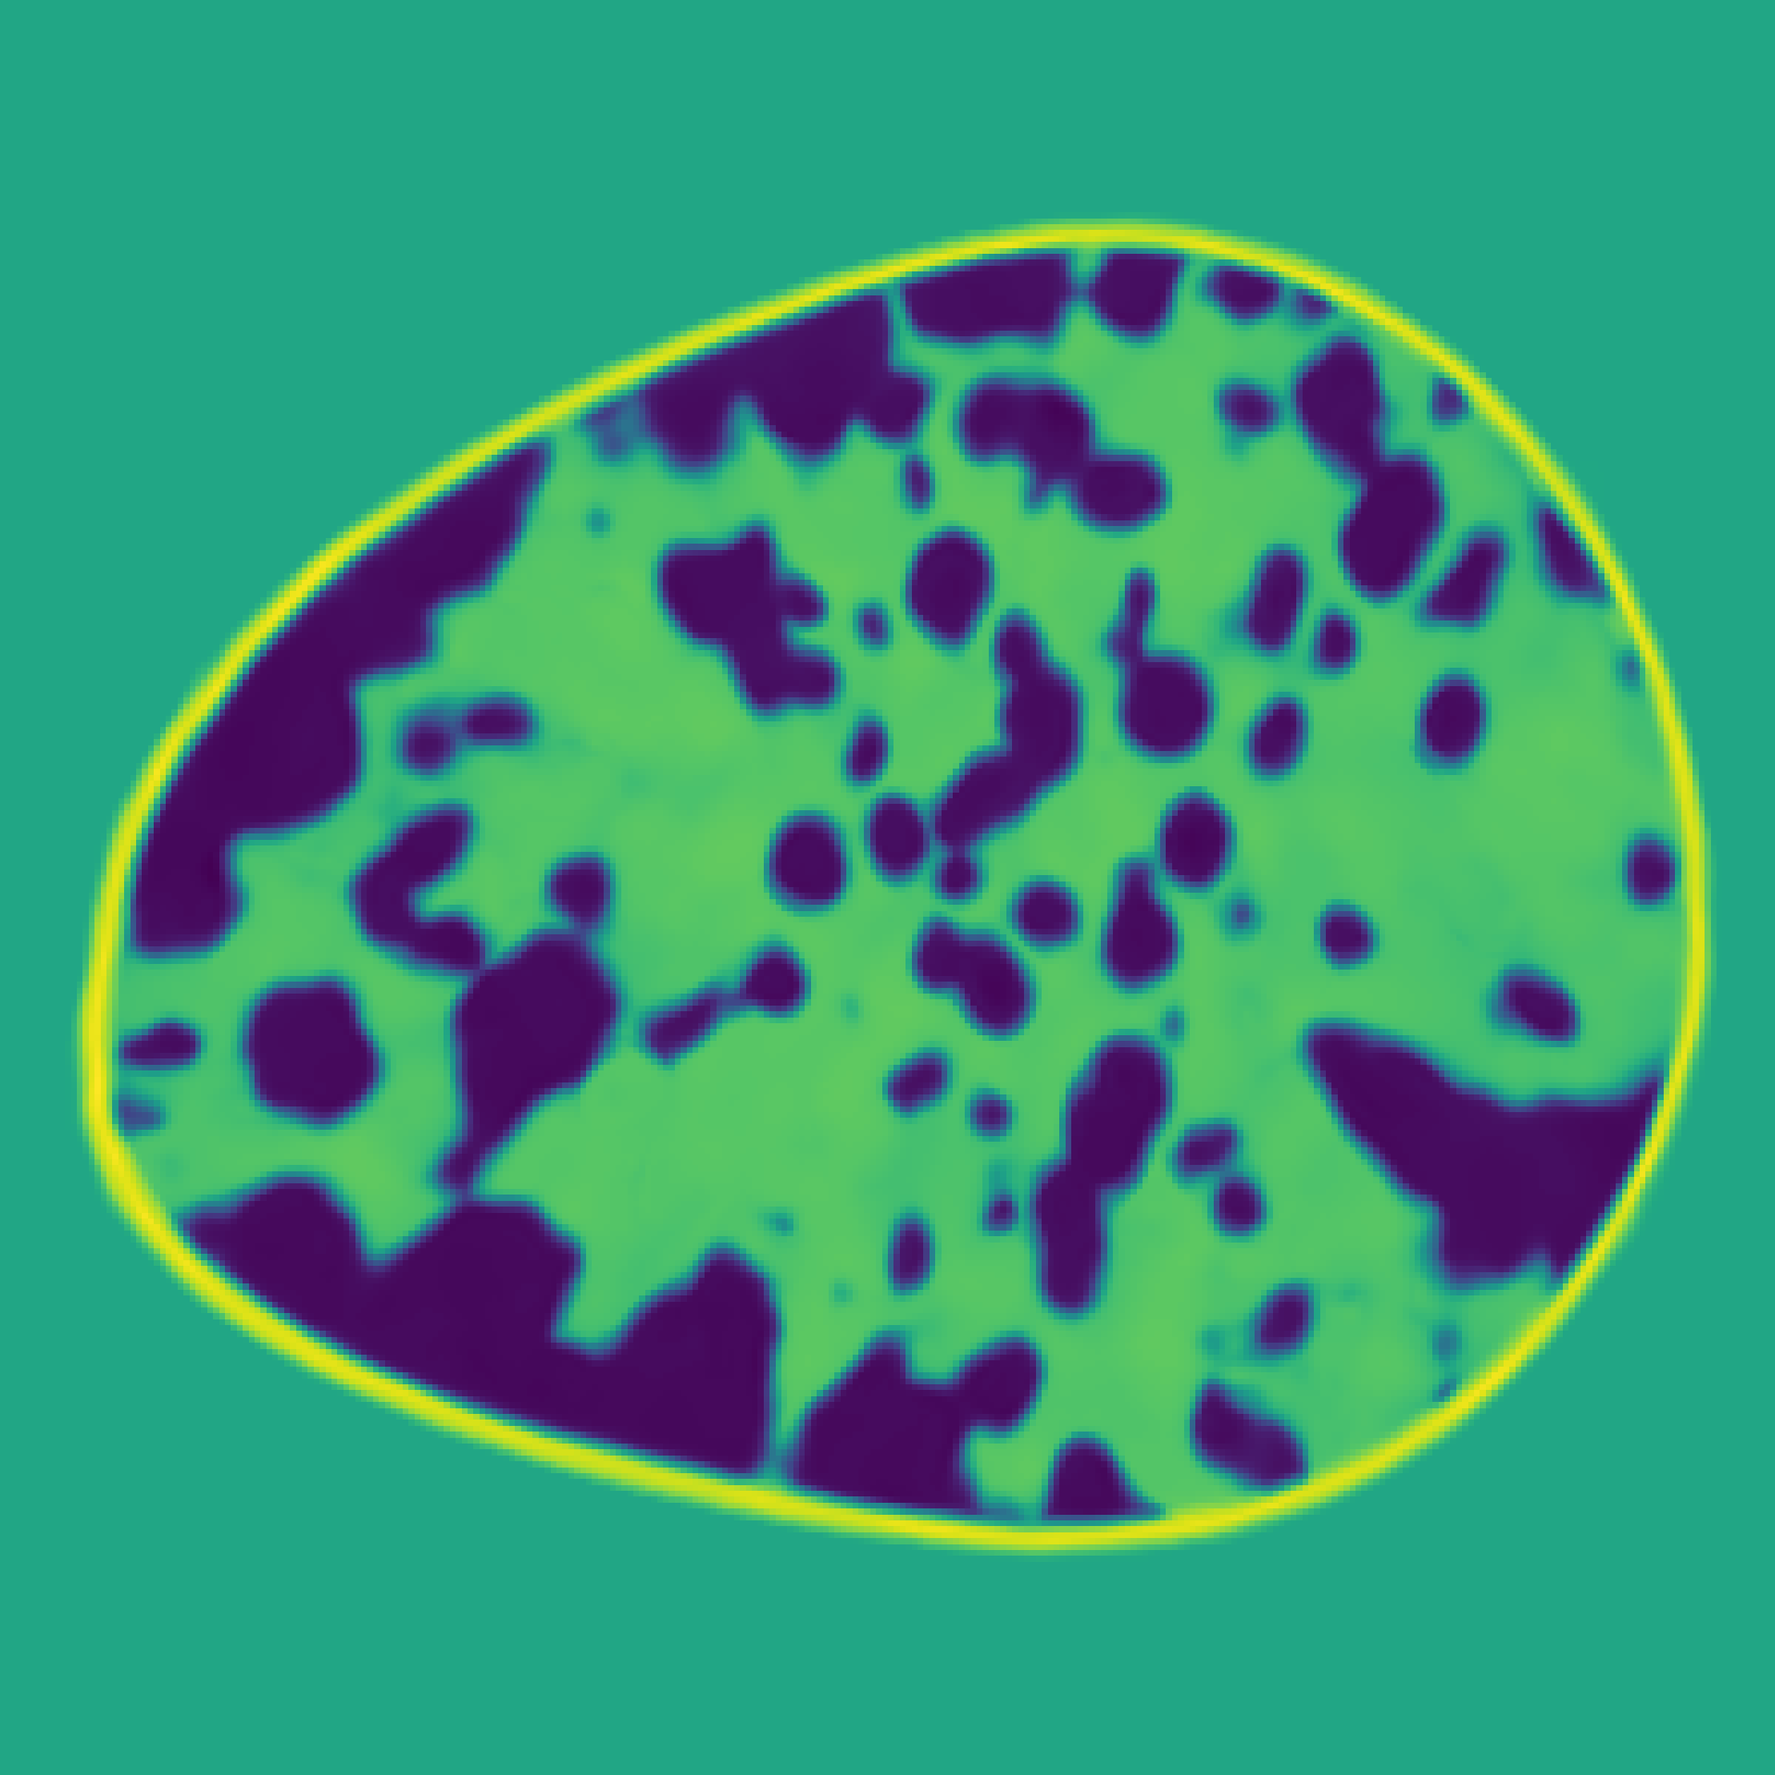
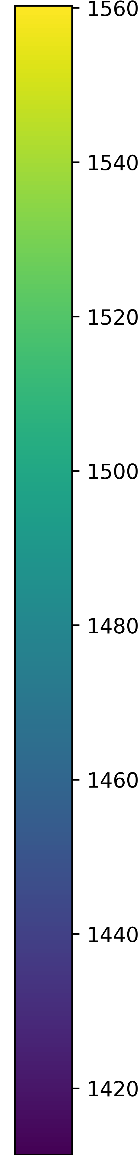
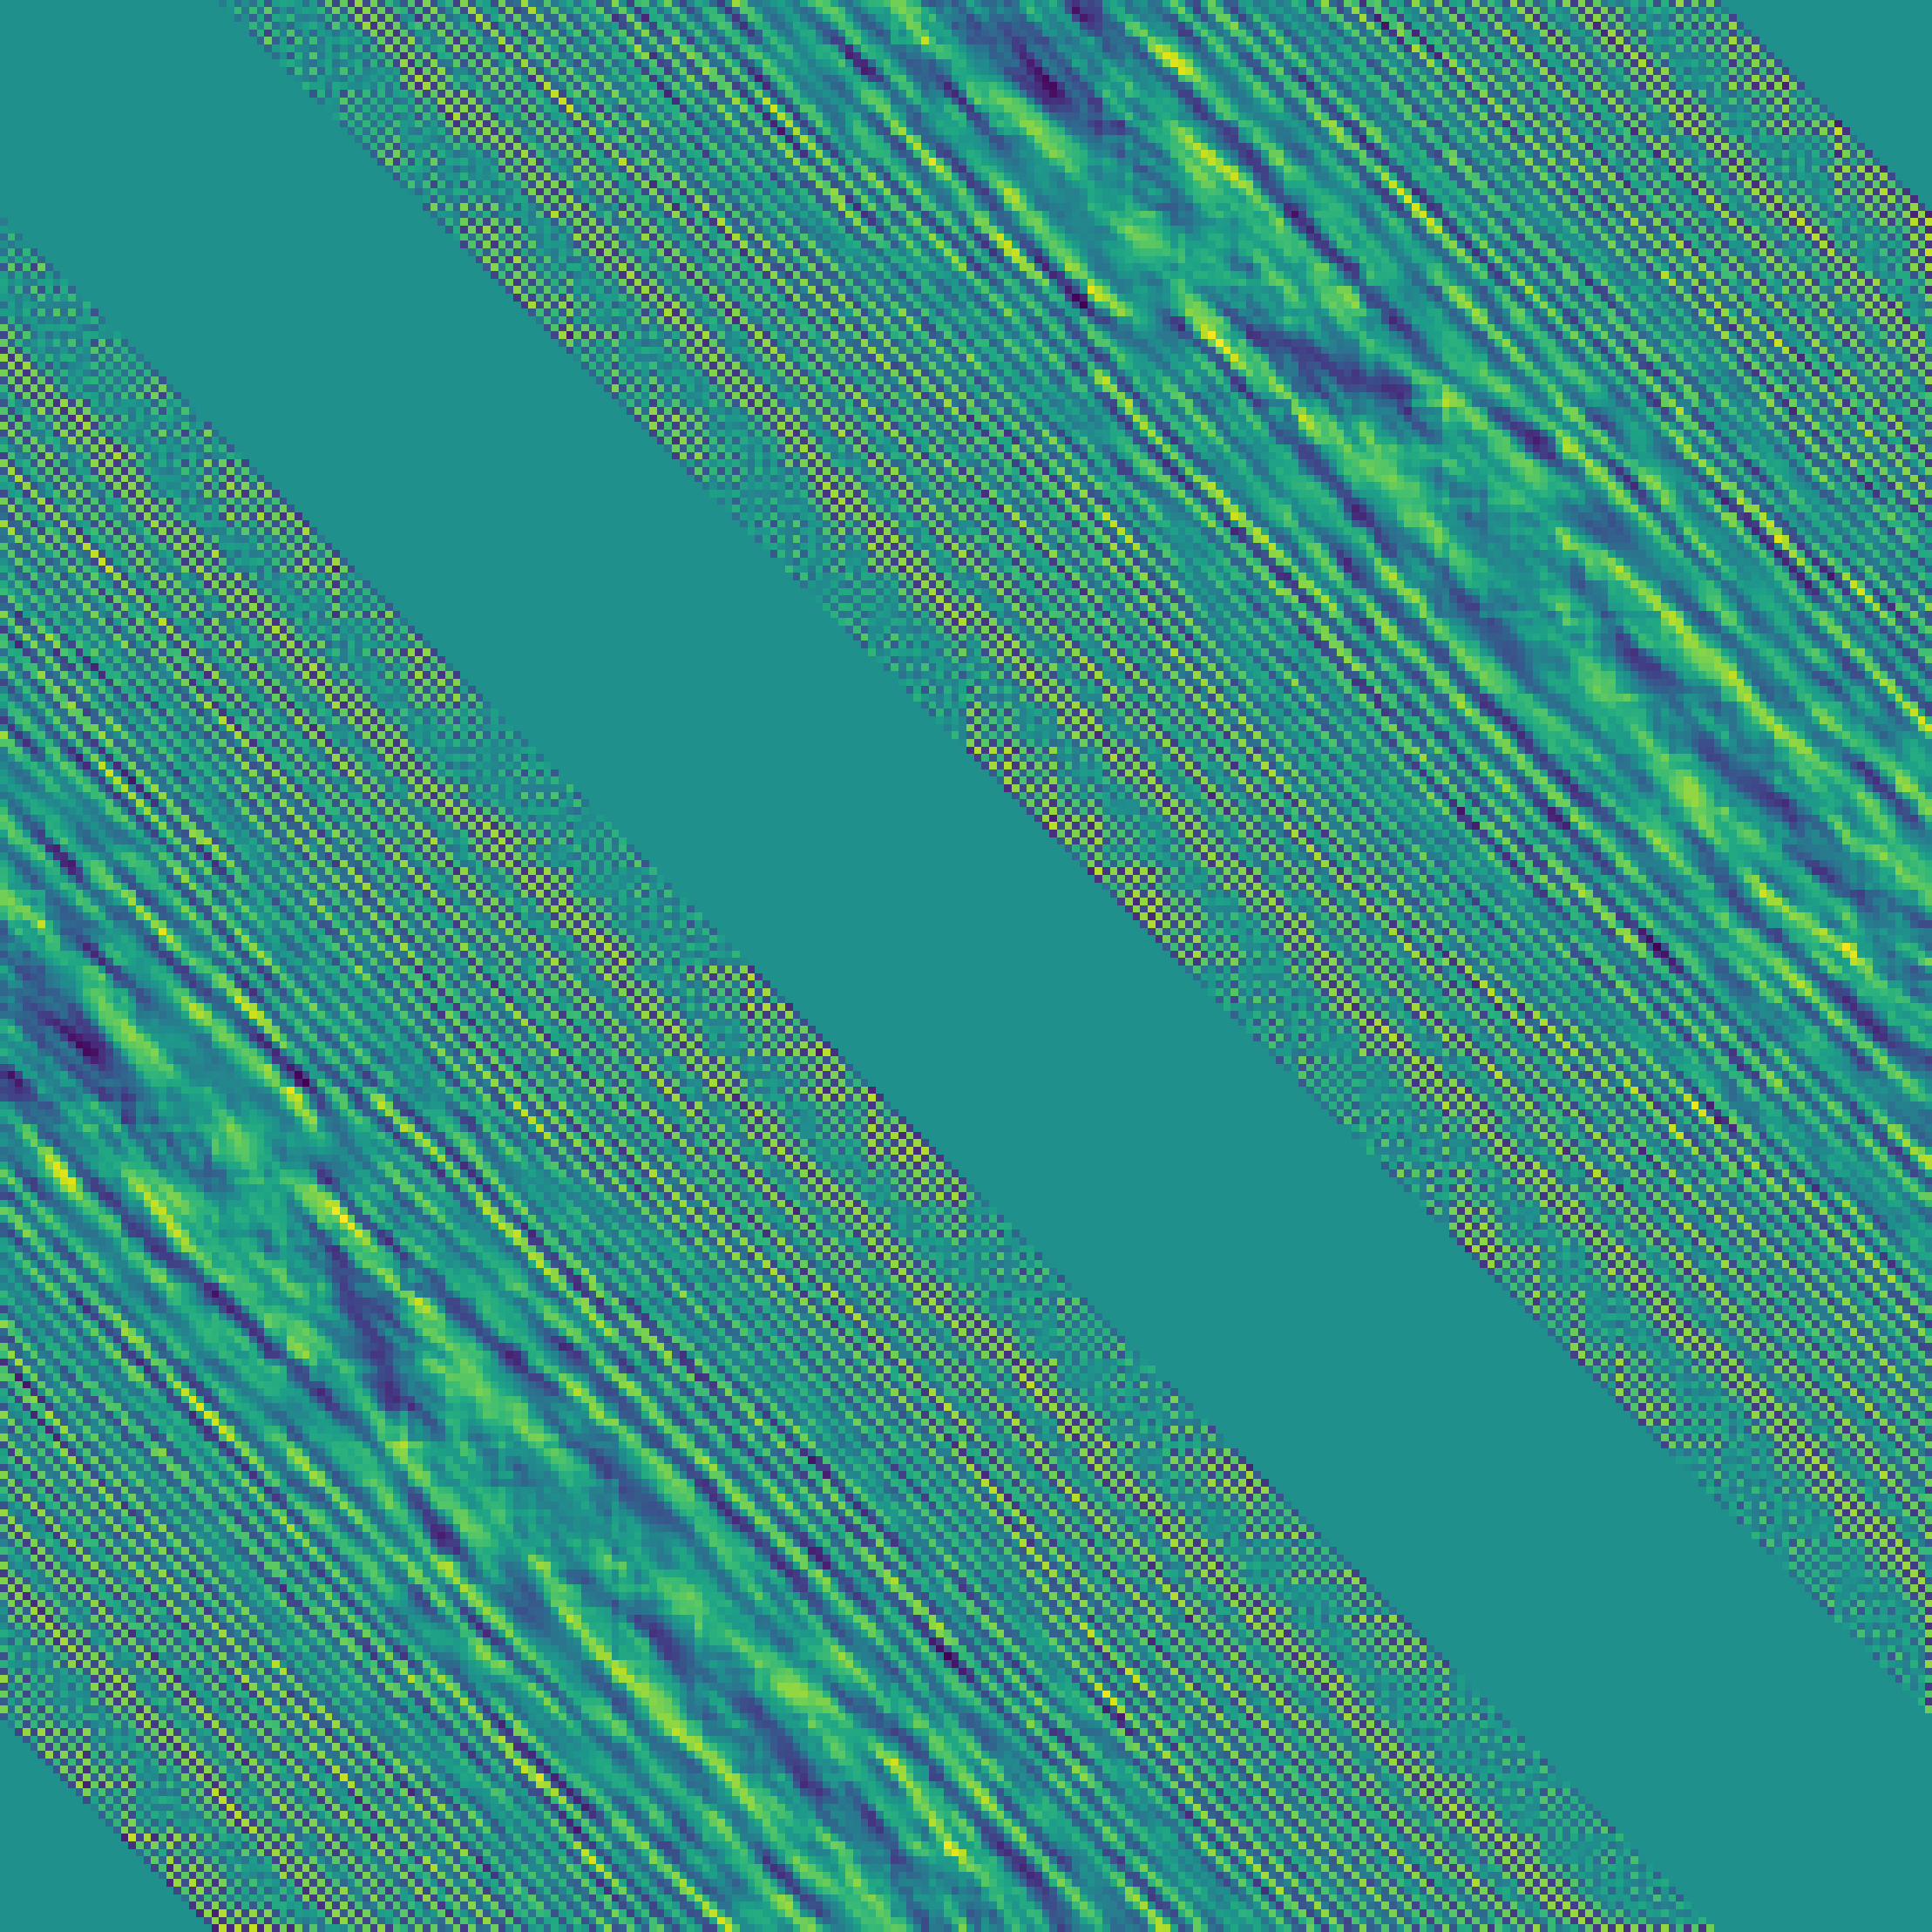
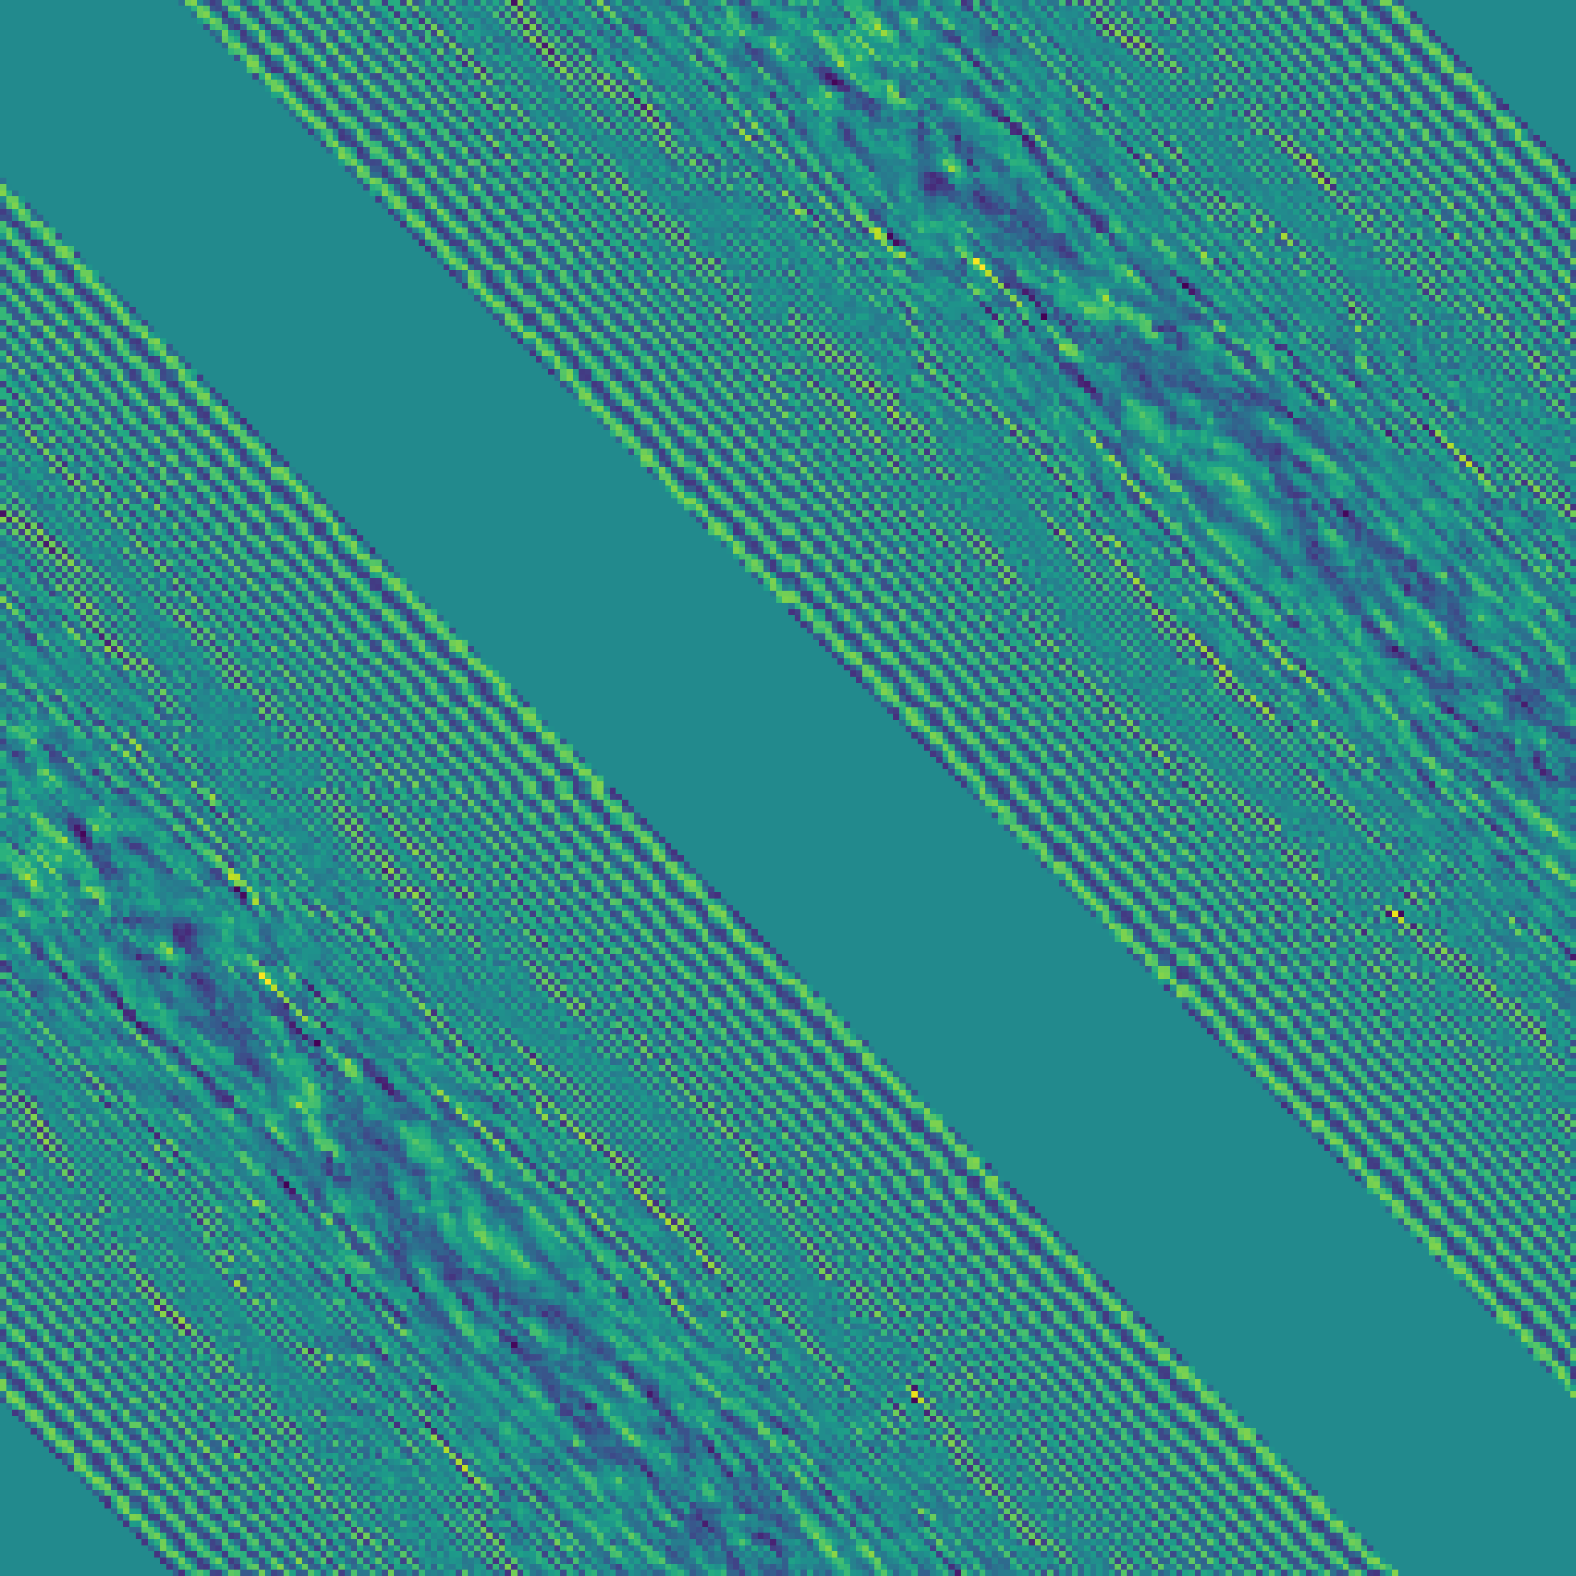
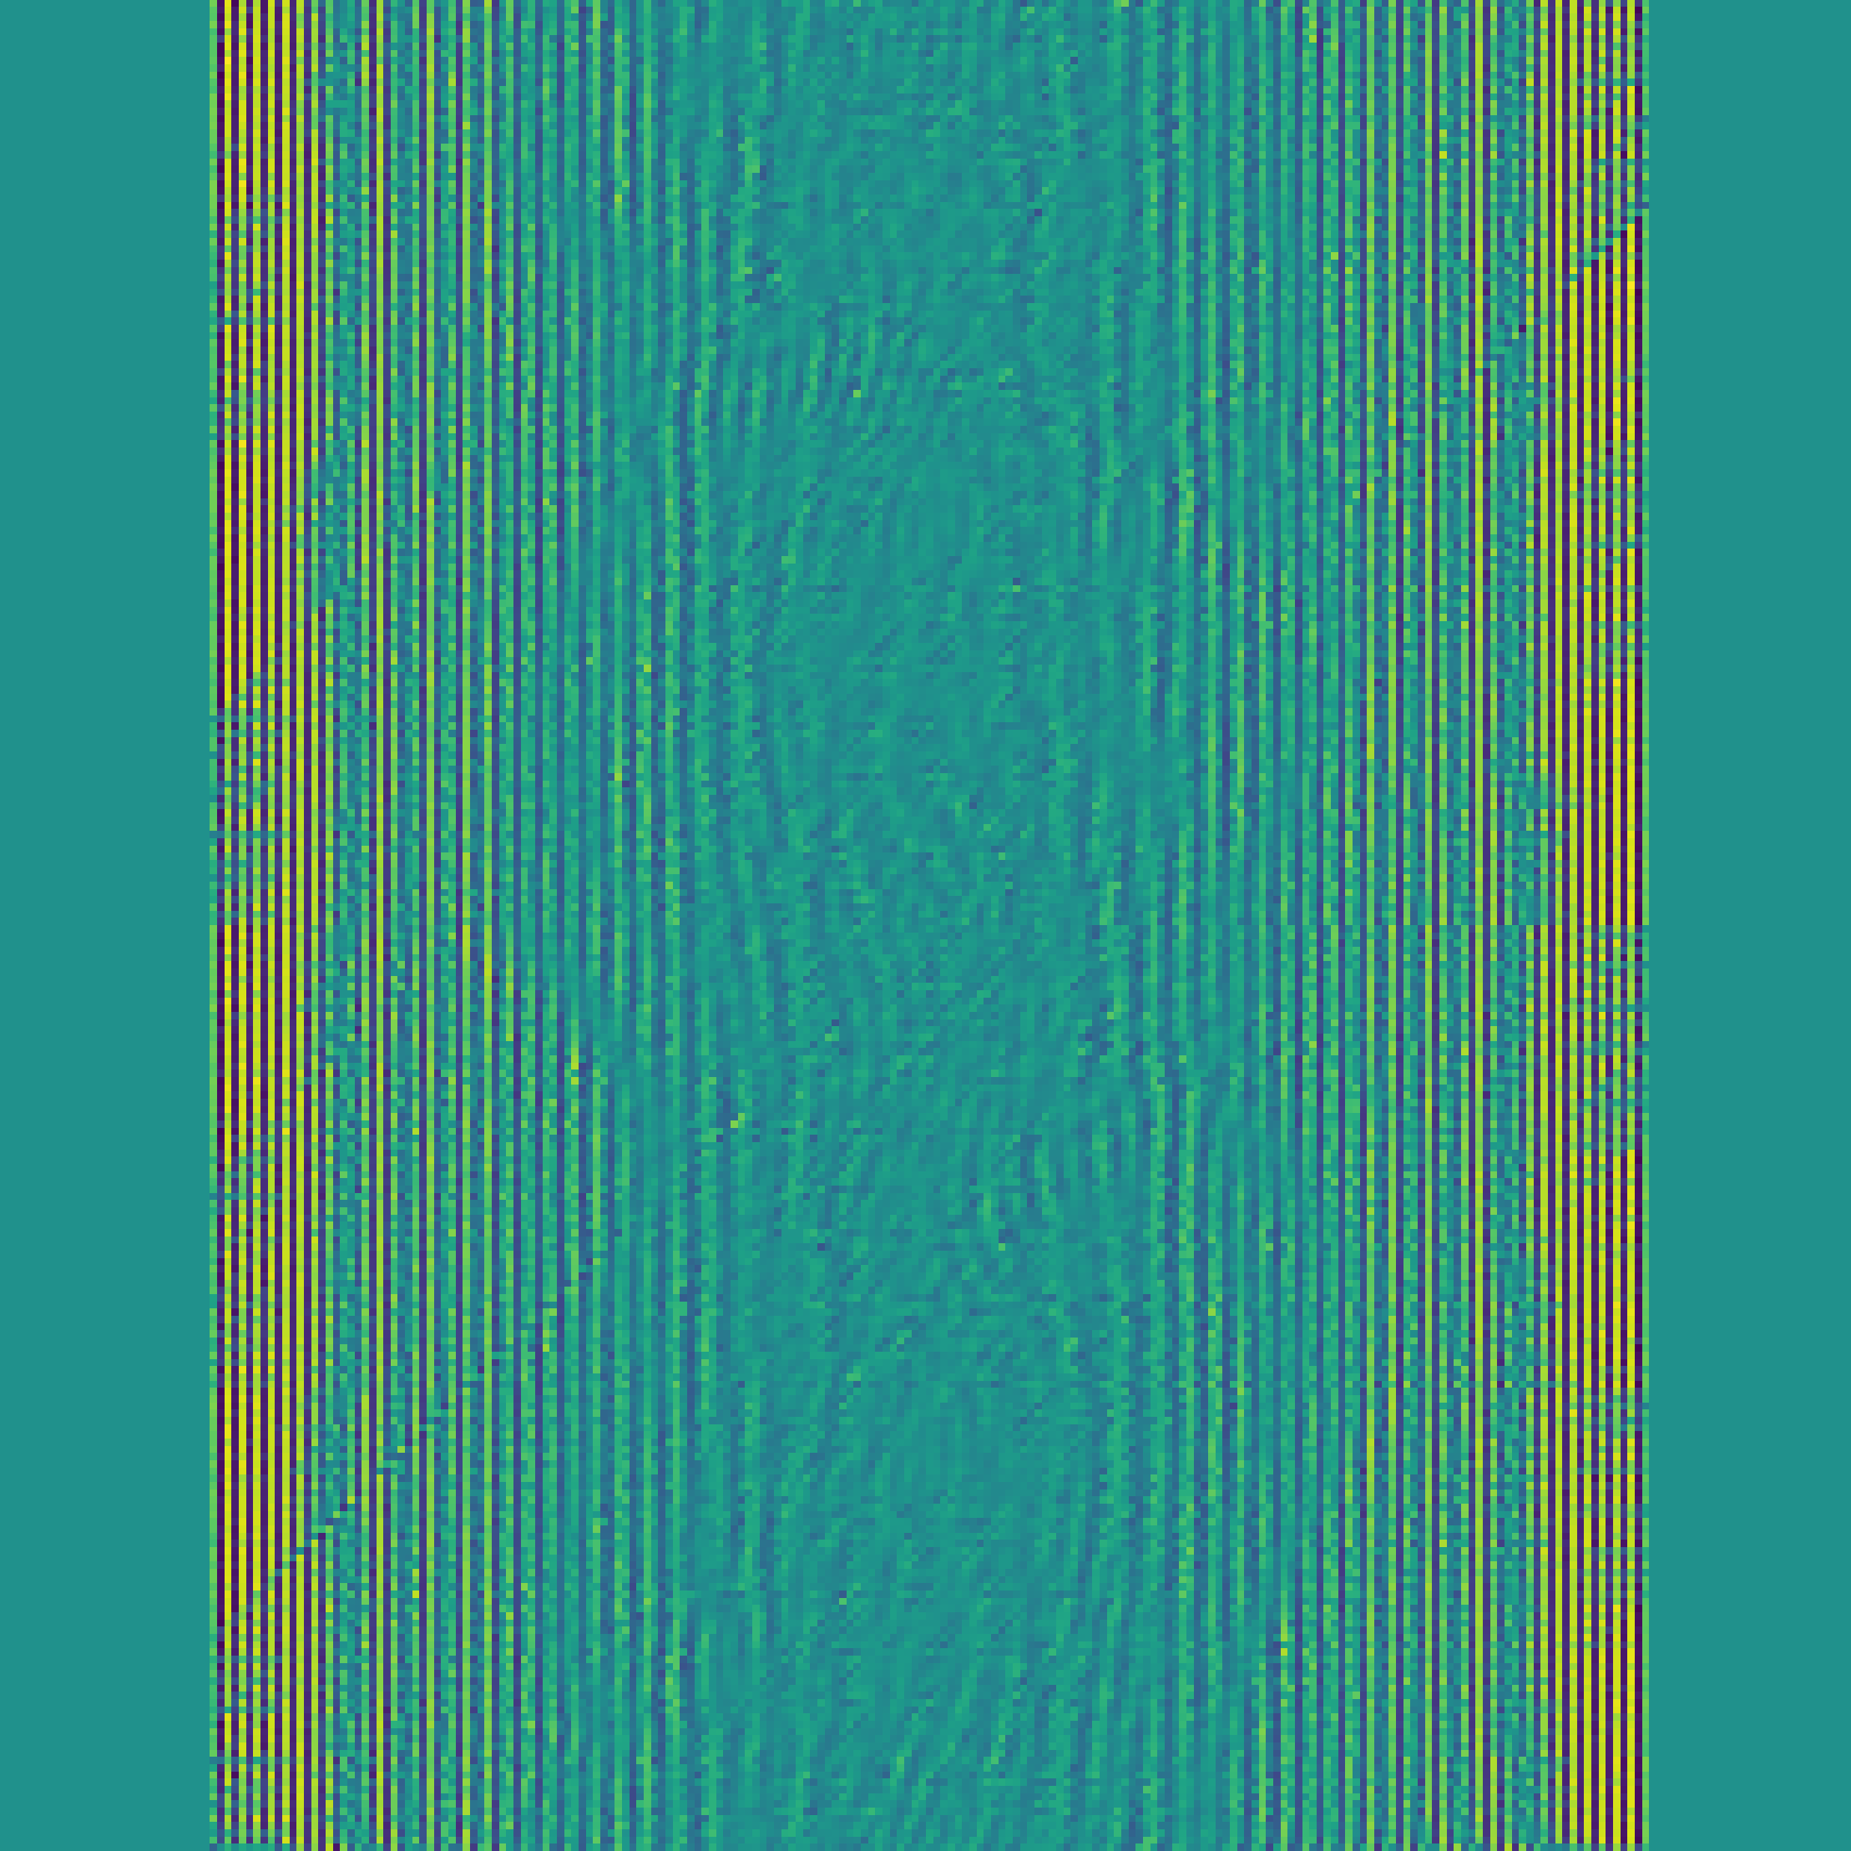
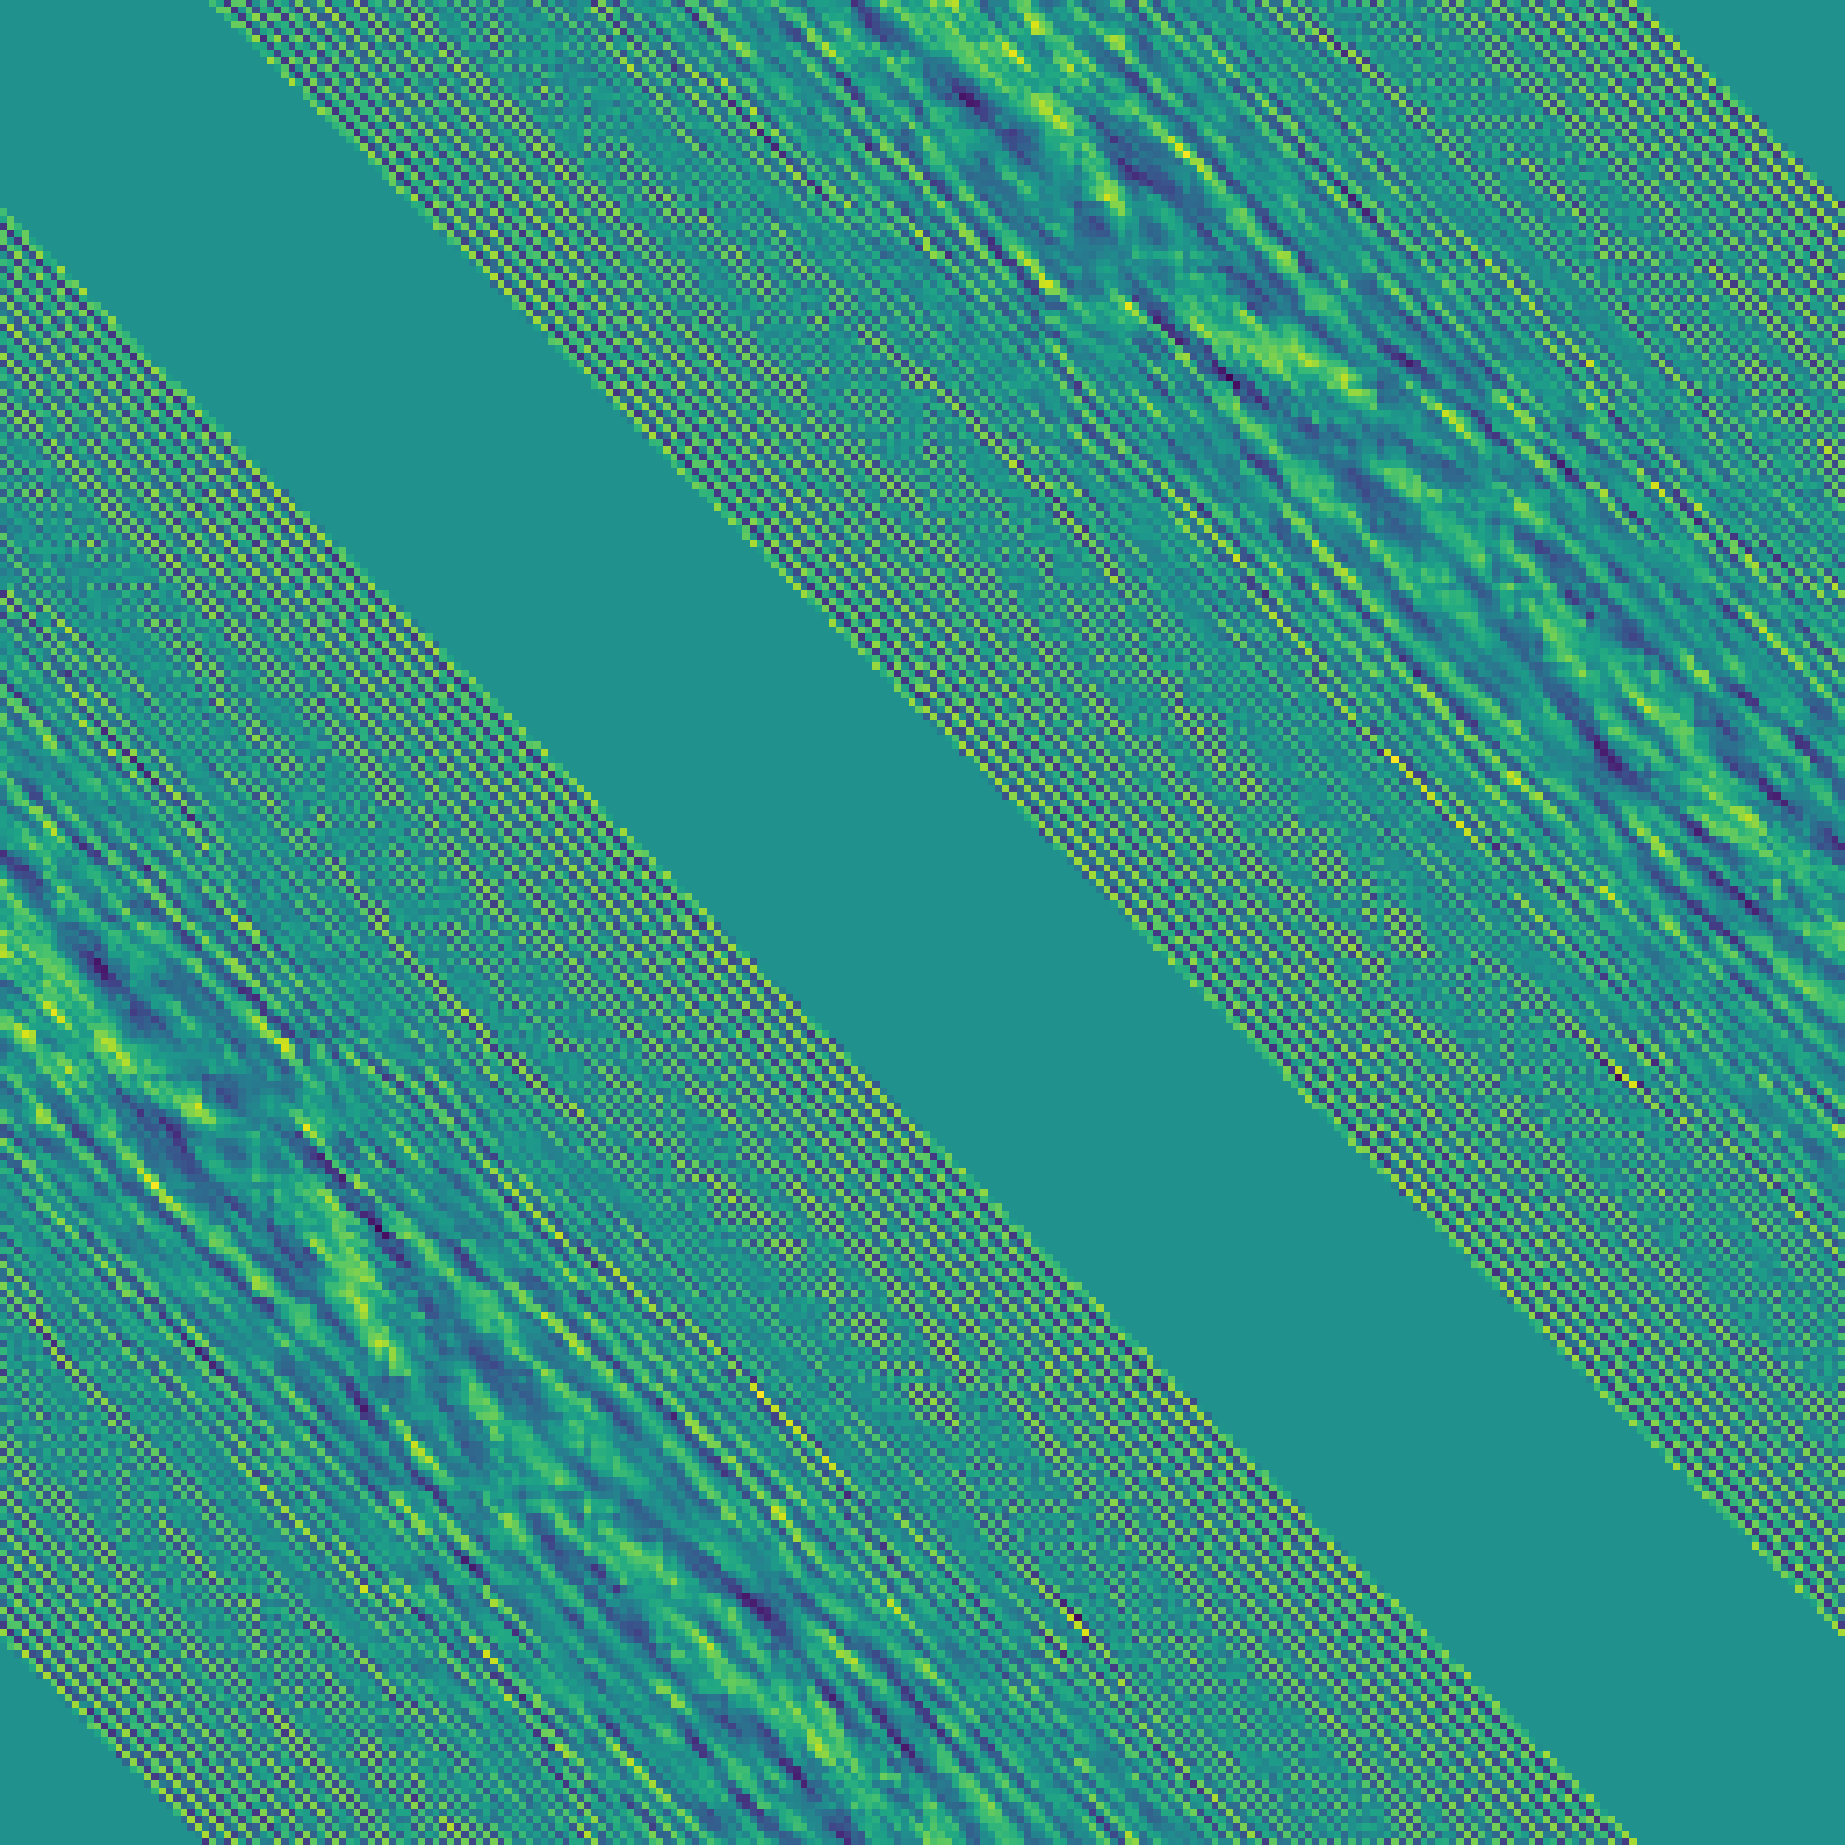

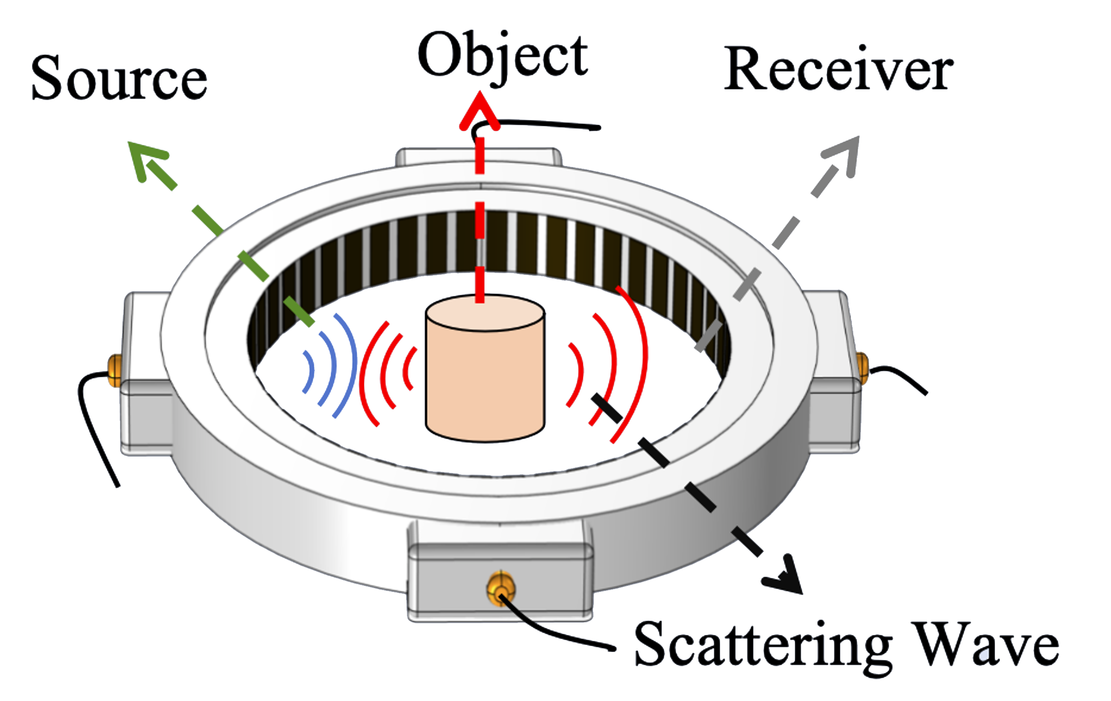
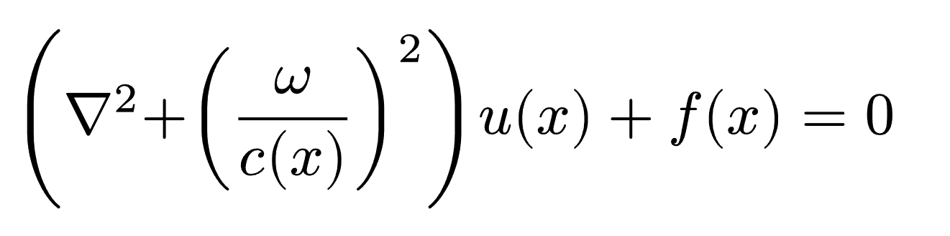

Our Model (Inversion)
Dataset Generation[1] (Forward)
Pred Speed
Extract
Space Embed
Output Layer
… …
Envelope
Phase
FNO Layer
FNO Layer
Mix
Fourier Layer
Ground Truth
Space Embed
High-Frequency Component
Phase
300kHz
400kHz
500kHz
①
Raw Data
Mask
Frequency Band x3
Computer simulation

