Slide 1
Are you ready?

Slide 2



Software Tool Time

Slide 3
Lecture : REACT로 TOAST UI Editor 사용하기2
강사
Ji-Eun Han
배울 내용
REACT로 TOAST UI Editor 사용하기
TOAST UI Editor의 플러그인 설치하기
사전 준비
지식 – javascript, react 문법
자신이 좋아하는 IDE
REACT로 TOAST UI Editor 사용하기1 시청
December 2020 - (CC-BY-NC) Ji-Eun Han and Ajou University

Slide 4
CONTENTS
01
Editor 작성 내용 state로 받기
02
TOAST UI Editor 플러그인 설치하기
CONTENTS

Slide 5
01
Editor 작성 내용 state로 받기
React의 state와 props에 대한 이해가 필요
실습코드: https://github.com/Daily-Jin/OSS_toast-ui-editor-react.git

Slide 6
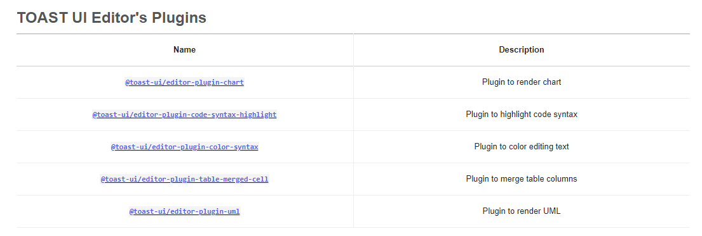
02
TOAST UI Editor 플러그인 설치하기
https://ui.toast.com/tui-editor#toast-ui-editors-plugins

Slide 7
02
TOAST UI Editor 플러그인 설치하기
이 외의 플러그인은 TOAST UI Editor Github의 issue를 참고하세요!

Slide 8
Lecture : REACT로 TOAST UI Editor 사용하기2
Reference / 참고자료
TOAST UI Editor 공식 문서 – https://github.com/nhn/tui.editor
https://github.com/yunyong/tui-editor-react-example.git
December 2020 – (CC-BY-NC) Ji-Eun Han and Ajou University

Slide 9
Software Tool Time (소프트웨어 툴 타임)
(CC-BY-NC) Ajou University
Visit “Software Tool Time” channel in YouTube : http://goo.gl/remxrw Visit “Ajou SW Tool Time” channel in YouTube. It is only for ajou.ac.kr members : https://www.youtube.com/channel/UC-Un-7jmeP-1OaHkS7awO0Q
This video was supported by the MIST (Ministry of Science and ICT), Korea, under the National Program for Excellence in SW supervised by the IITP (2015-0-00908)
All product names, trademarks, and/or company names are used solely for identification and belong to their respective owners.
“Software Tool Time” video is licensed to the public under a Creative Commons Attribution 4.0 License (https://creativecommons.org/license/by/4.0/)
Audionautix’s “Your Intro” is licensed to the public under a Creative Commons Attribution 4.0 License (Artist: http://audionautix.com)
Twin Musicom’s “Puppy Love (Sting)” is licensed to the public under a Creative Commons Attribution 4.0 License (Artist: http://www.twinmusicom.org/)

