Slide 1
Transform from verification & validation…. …towards Quality Engineering
Test Early, Fail Fast…
DevOps based operating model where Business, Dev, QA & Operations collaborate to ensure First Time Right
Deploy, Test & Release on Demand
Leveraging automation tools across the lifecycle, including Advanced Automation to establish Continuous Testing & Release pipelines
TestOps
Understanding the actual operating environment & the challenges to have a continuous feedback to the engineering organization
Best-practices including Lean
Leveraging industry best practices DevOps, DevSecOps, Lean principles & TMMi
© IGT Solutions Pvt. Ltd. | Confidential: Not for Distribution | www.igtsolutions.com
Compliance & Security
Leveraging DevSecOps best practices to ensure end-to-end focus

Slide 2
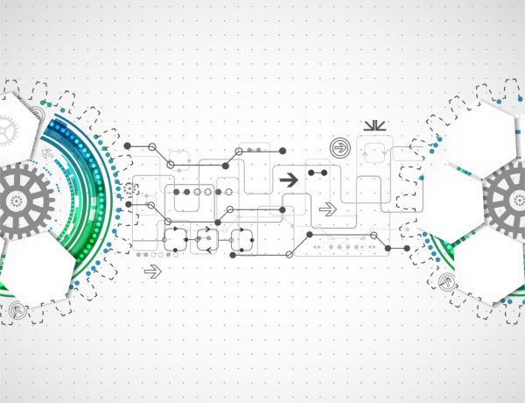



From Automation Scripts to Advanced Automation
… the power of human insight leveraging technology advances test automation
Create Tests Case in plain English
Translated automatically using Natural Language processing & AI algorithms
Go to www.amazon.com
Click on button Search
4X
faster to market
80%
Reduced cost
10X
productivity increase
Rule based scripts validation
Scripts executed based on ETL logic
Execute parallel tests at scale
Detailed Insights for analysis
perform Intelligent Validation
Scalable runtime system in cloud
Cross-Browser
Integrations
Test Warnings
Root cause analysis
focus on business function of target application to be tested rather than traditional automation framework tooling technology focus
integrate with DevOps pipelines

