Slide 1
MCF Quick Reference
Key Institutional Architecture Visualizations

Slide 2
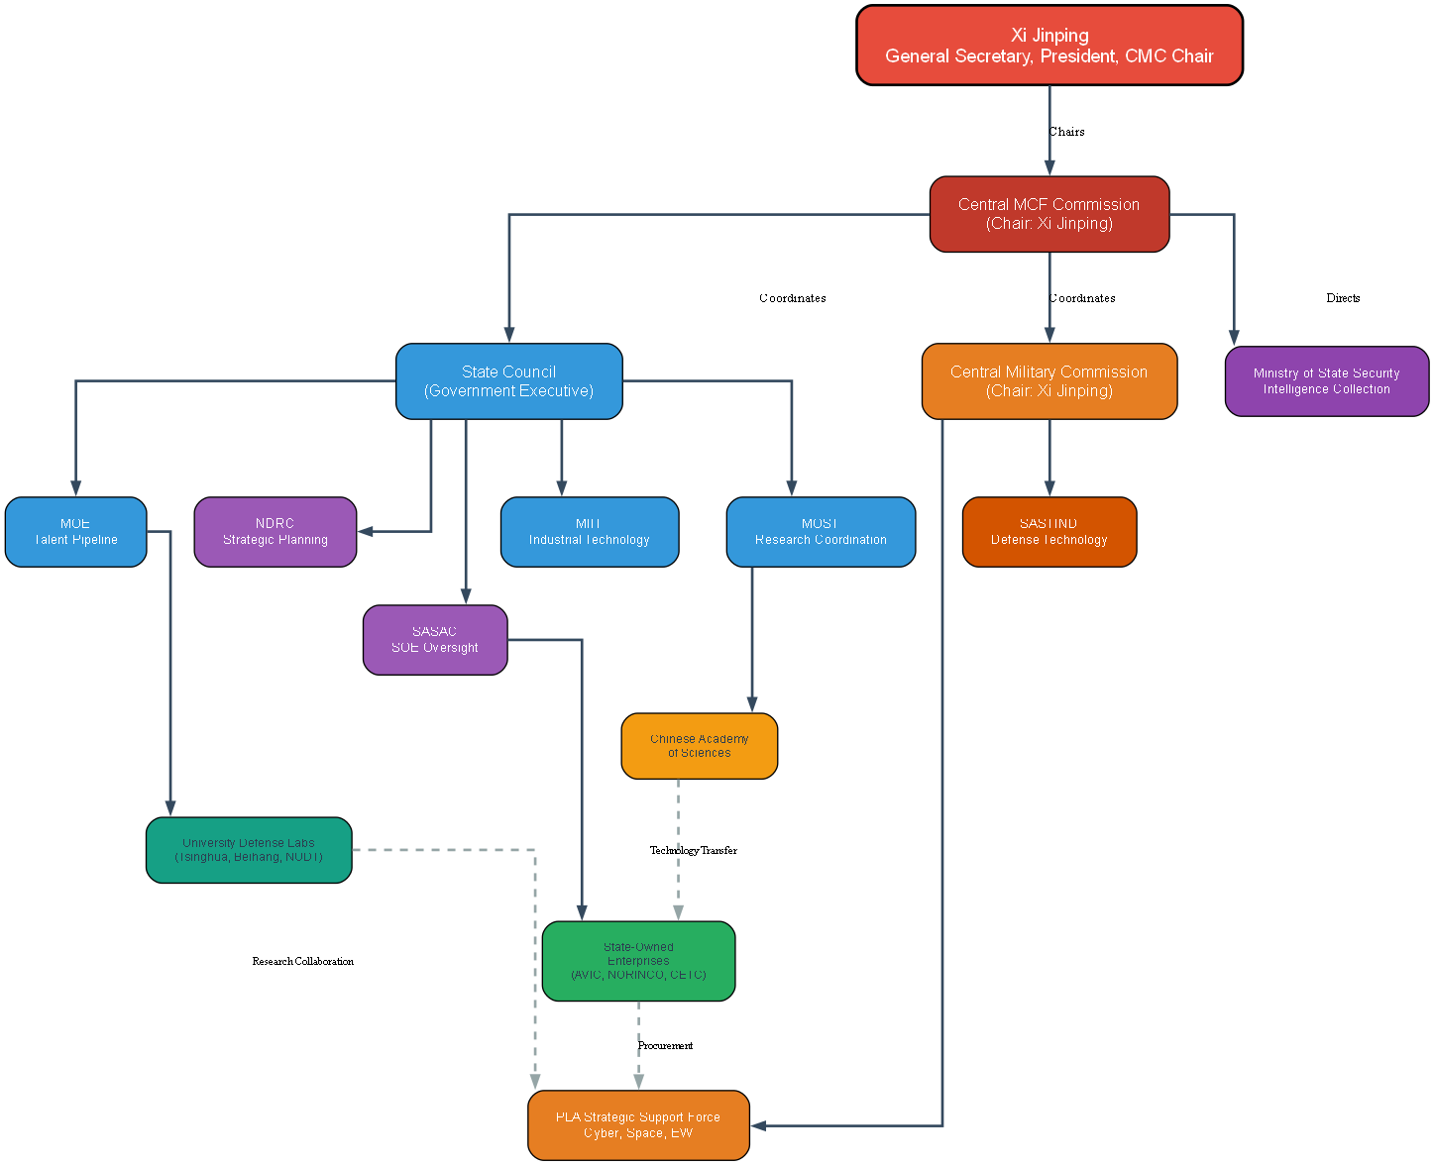
MCF Governance Hierarchy

Slide 3
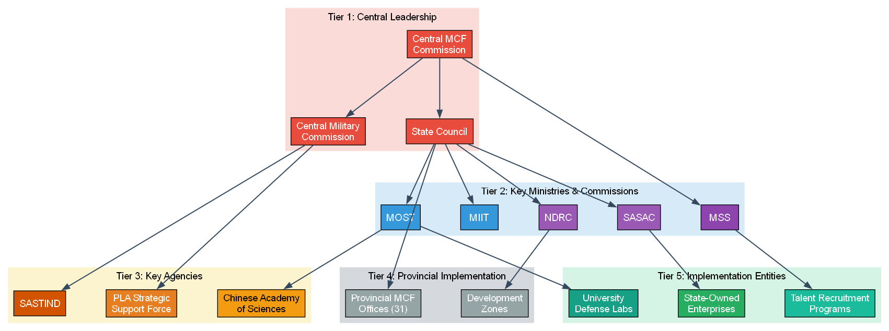
MCF Institutional Layers

Slide 4
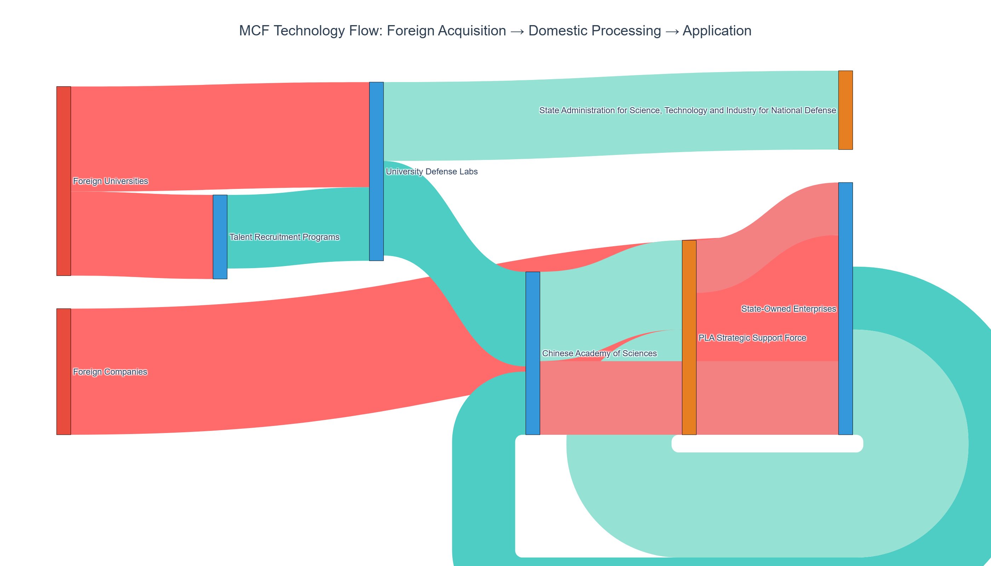
Technology Flow

Slide 5
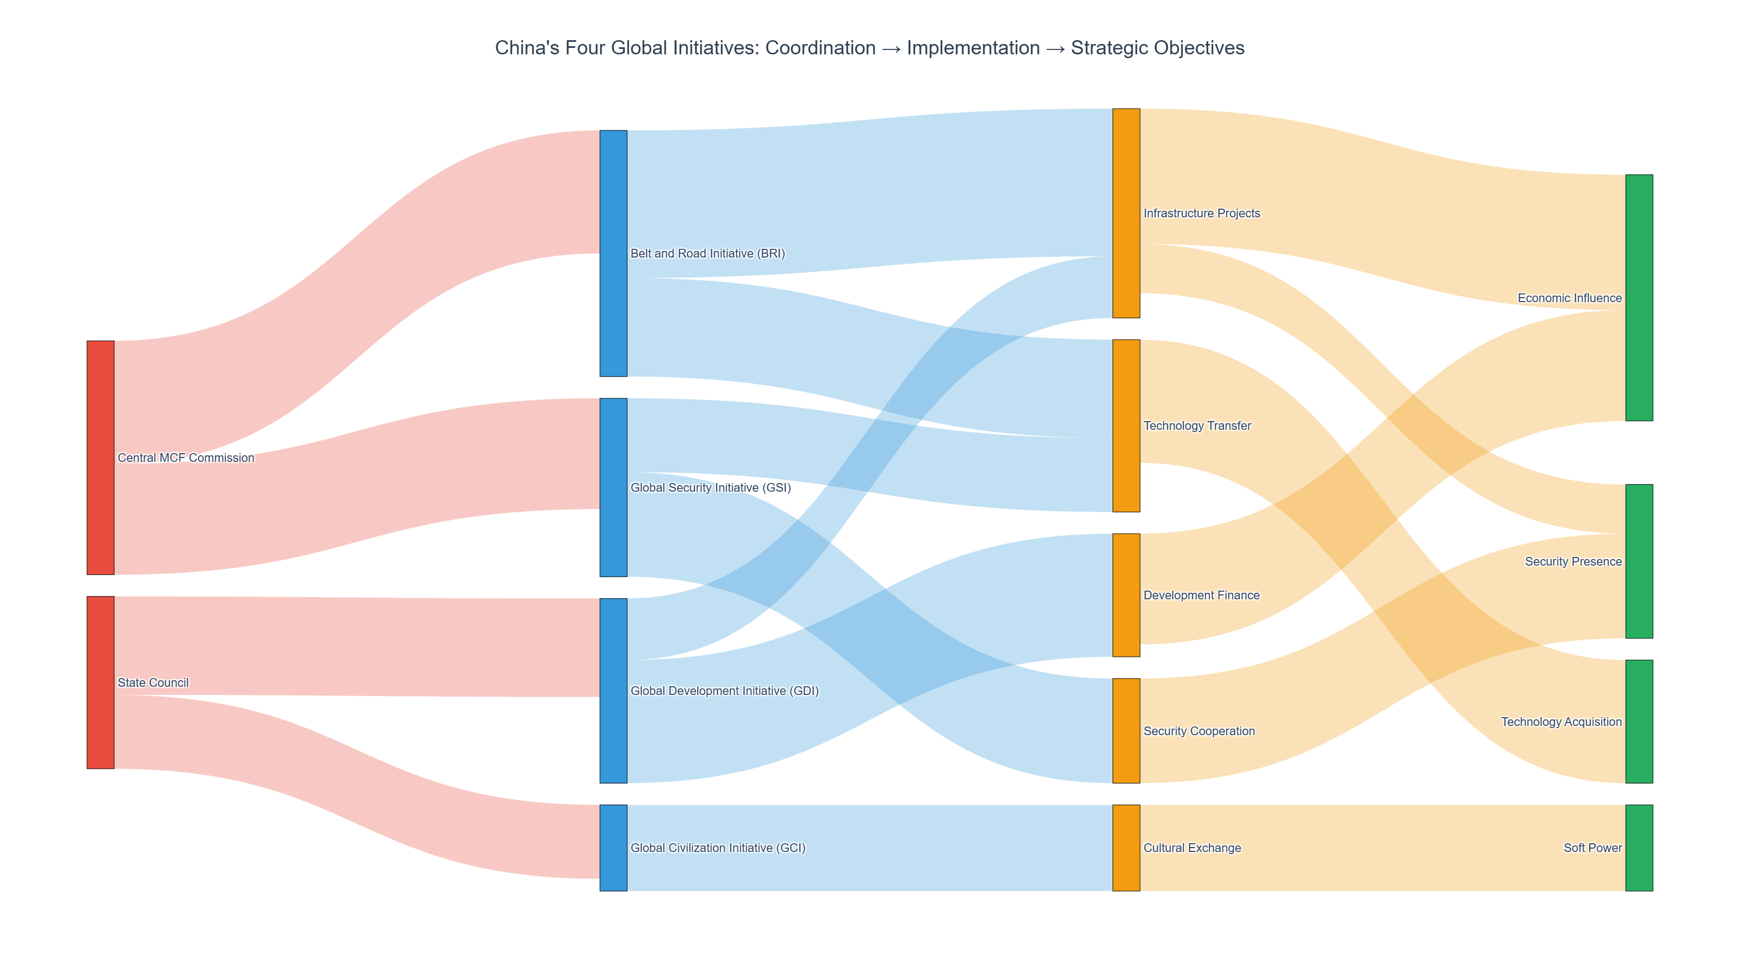
Four Global Initiatives

